Slide 1
The Temporal Behavior of Numerically Simulated Multicell-Type Storms. Part II: The Convective Life Cycle and Cell Regeneration
RobertG. Fovell and Pei-Hua Tan
Summarized by Adam Frumkin

Slide 2
Outline
Introduction and Objectives
Model Description and Initialization
Description of the 2D and 3D Simulations
Detailed Analysis of the Convective Cell Life Cycle
Synthesis and Conclusions

Slide 3
1. Introduction
Squall lines: Appear as a narrow, quasi-linear band of intense convection trailed by a wider zone of light precipitation
Prominent Features:
  Front to rear (FTR) jet
  FTR consists of warm moist low level inflow air
  FTR resides above a subcloud cold pool
  Leading edge of coldpool (i.e., gust front) creates a forced updraft which provides initial lift for parcels to reach LFC

Slide 4
1. Introduction
New cells form at the gust front boundary and propagate backwards over time
  Cell life cycle ~ 1hr
  Do not form until previous cell has been cutoff from the forced updraft
  Previous studies hypothesized that the cells were vertically trapped, rearward propagating gravity waves

Slide 5
1. Objectives
To provide a more clear picture of the convective cell lifecycle and the cutoff processes
  Investigate factors impacting new cell generation
Findings
  Cells do not behave as gravity waves until late in their life cycle
  Cell sows the seeds of its own demise

Slide 6
2. Model Description and Initialization
Fully compressible ARPS model (2D and 3D)
Initial conditions adapted from 22 May 1976 Oklahoma squall line event
1km horizontal resolution (2D and 3D)
2D run for 8h
3D run for 3h

Slide 7
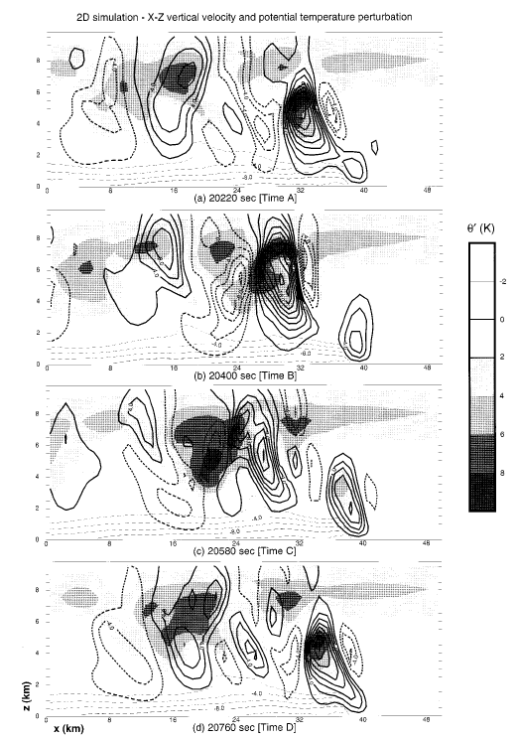
3. Description of the 2D Simulation
Propagation speed ~15.3 m/s
New cells generated after ~11 minutes
Cells propagated from front to back
Initially w and θ’ are in phase
By Time C, w and θ’ take on more of a gravity wave feature
θ’ most likely caused by saturated ascent

Slide 8
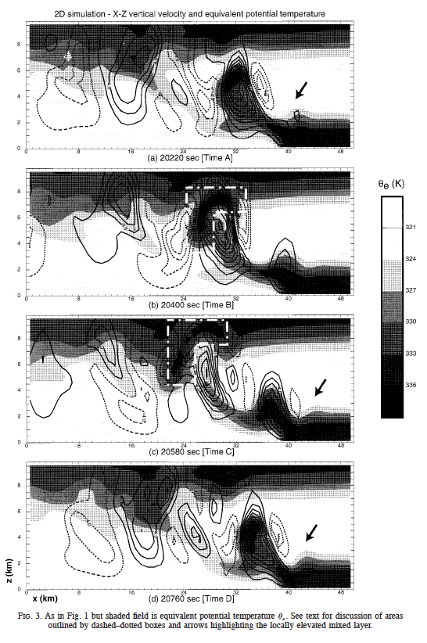
3. Description of the 2D Simulation
High θ_{e} ribbon flows into storm
Ribbon is eventually cutoff from inflow

Slide 9
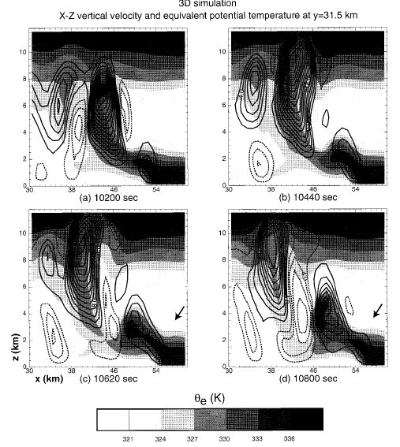
3. Description of the 3D Simulation
Initial conditions were different than 2D case so as to produce dynamically splitting updrafts
Dynamical splitting did not produce significantly different results
  Explanations will primarily use 2D results

Slide 10
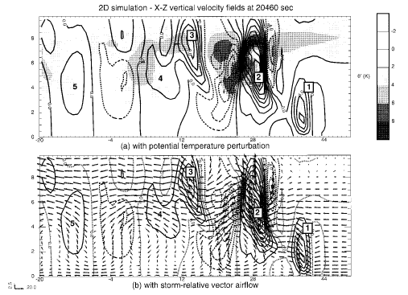
4. Analysis of the Cell Life Cycle

Slide 11
4. Analysis of the Cell Life Cycle
After analyzing tendency equations for w and θ’:
Features 4 and 5 are in quadrature, a gravity wave feature, where heating leads rising motion
  They also propagate quicker (~50m/s) than embedding flow (0-15m/s)
Features 2 and 3 move slower (~14m/s)
Warming that maintains buoyancy is strongest on front facing flank in feature 2
In feature 3 this warming is being advected rearward faster than it can be generated: A mark of a weakening cell

Slide 12
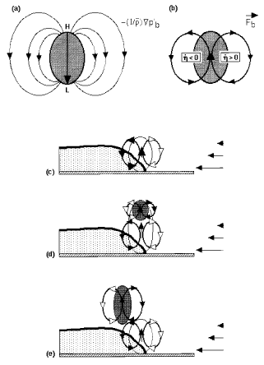
4. Variation of the forced updraft
Shows the buoyancy pressure gradient acceleration
Air is being pushed out of the way at the top of a rising parcel
  This creates high perturbation buoyancy pressure at top and low at bottom
BPGA is directed downward
  Merely acts to slow rate of ascent
(b) When BPGA is combined with F_{b}: represents airflow resulting from buoyant parcel
Forced Updraft
Incipient Cell
Cell opposes forced updraft

Slide 13
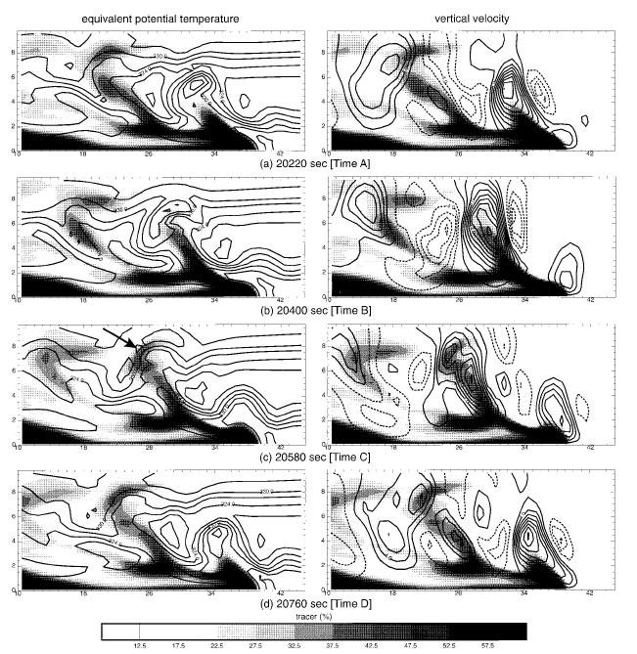
4. Dilution of inflow air
Dilution can come from cold pool or from midlevels ahead of storm
High θ_{e} bubble becomes contaminated over time
Tracers placed in cold pool and in midlevel show that both act to contaminate the inflow air
Dilution process will be shown to be a result of the cell’s circulation

Slide 14
4. Timing of New Cell Establishment
New cell establishment is based on advective timescale and reestablishment timescale
Reestablishment timescale based on generation of convective trigger
  Region where θ_{e} ahead of storm is deepened
Elevated mixed layer forms daughter cloud which later becomes positively buoyant
New updraft is then swept backward by embedded flow

Slide 15
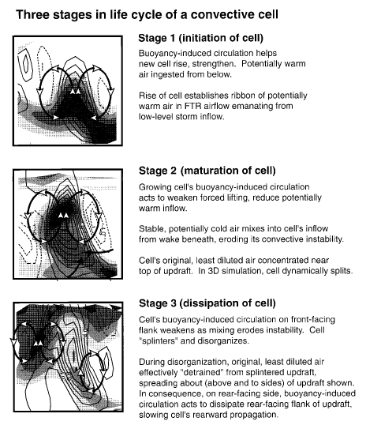
Synthesis and Conclusions
Buoyancy induced circulation helps new cell rise and ingests warm moist air
Rising air establishes ribbon of potentially warm air in the FTR airflow
Buoyancy induced circulation acts to weaken forced lifting
Stable, potentially cold air mixes into cell’s inflow eroding convective instability
Buoyancy induced circulation on the front flank weakens as mixing erodes instability
Cell separates from warm moist ribbon
Least diluted air becomes detrained and spreads out at the top and on the sides of the updraft
Buoyancy circulation acts to dissipate rear-facing flank of updraft and slow rearward progression

Slide 16
Other considerations
Daughter cloud merely provides a visual signature for the elevated layer
  Forced updraft could produce a new cell on its own
Convective cells do not turn into gravity waves until late in their life cycle contradictory to previous studies
Results apply only to multicellular squall lines with deep intense cold pools
Authors now suggest taking into account advective timescales and reestablishment timescales

Slide 17
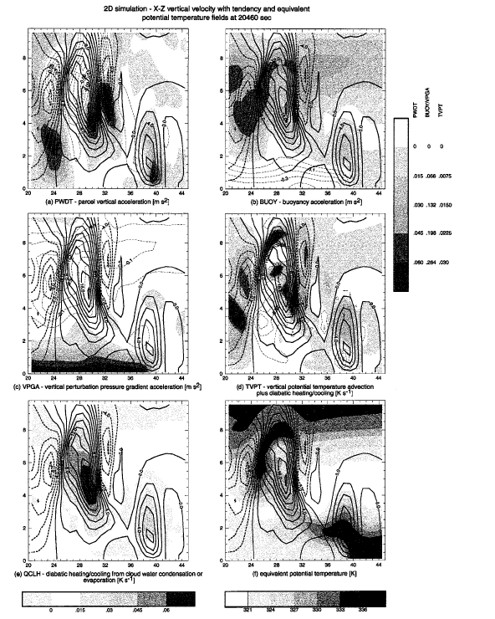
4. Analysis of the Cell Life Cycle
Features 2 and 3 move slower than features 4 and 5 (14m/s vs 50m/s)
Warming that maintains buoyancy is strongest on front facing flank in feature 2
In feature 3 this warming is being advected rearward faster than it can be generated: A mark of a weakening cell

Slide 18
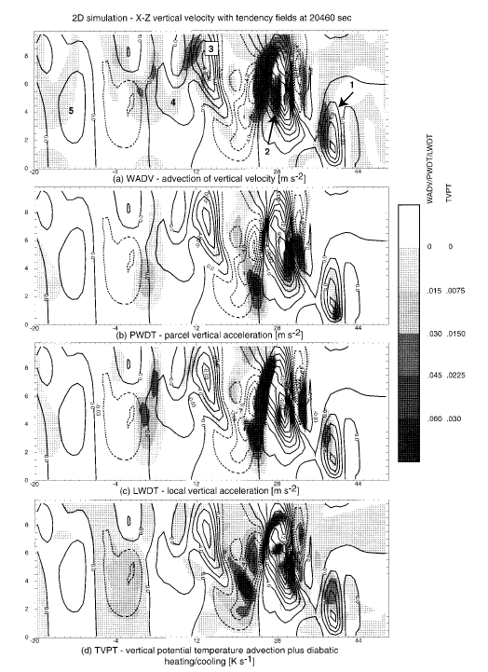
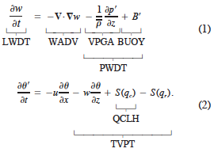
4. Analysis of the Cell Life Cycle
WADV and PWDT act together in features 4 and 5
Features 4 and 5 propagate rearward quickly and θ’ is in quadrature with w

Slide 19

4. Variation of the forced updraft
Can combine the equations to form vector fields
F stands for force per unit mass

Slide 20

4. Variation of the forced updraft
Unsteadiness of the forced updraft may be a reason why we see multiple unevenly spaced cells in the system
Perturbation pressure is broken into dynamic and buoyancy parts

