Slide 1
Investigating Mesoscale Precipitation Banding in Two East Coast Snowstorms
Adam Frumkin

Slide 2
Outline
Motivation
Introduction and Background
Objectives/Methods
Introduction to the Two Cases
Results
Conclusions

Slide 3
Motivation
Snowfall rates in mesoscale snowbands can exceed 4in/h
Due to their small scale, mesoscale snowbands can result in large gradients in snow accumulation
They are a challenge to diagnose and predict
Few operational models use a high enough resolution to resolve individual bands
Bands are the result of many factors (e.g. CSI)
The conditions in midlatitude cyclones are often ideal for the generation and release of CSI
Operational models can resolve the conditions known to produce bands

Slide 4
Introduction/Background
CSI is a form of Moist Symmetric Instability (MSI) and is released through moist slantwise convection
The ingredients for MSI are moisture, instability, and lift.
MSI is released when a parcel is lifted slantwise past the LCL to the level of free slantwise convection

Slide 5
Introduction/Background
Frontogenetical forcing is an efficient way to lift a parcel and to release MSI
Topographic forcing is another way
Frontogenesis and CSI can coexist
Difficult to distinguish CSI vs. frontogenesis bands
Heavy bands can also be due to:
Conditional Instability (CI), a type of gravitational instability
CI will dominate over CSI
CSI can induce CI

Slide 6
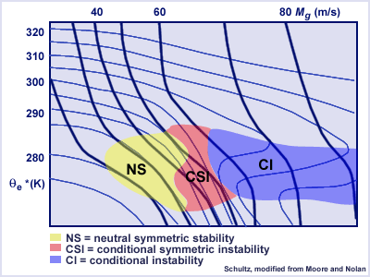
Introduction/Background
Schultz and Schumacher (1999) suggest using MPV_{g}* instead of MG (more versatile)
Novak et al., (2005)

Slide 7
Objective/Methods
Objective: Investigate the instabilities and forcing mechanisms in two significant mesoscale snowband events on the East Coast
Methods: Following the suggestions of Schultz and Schumacher (1999)
Identify the location of mesoscale snowbands in the two events on radar
Using RUC 0hr forecasts
Plot spatial maps of:
MSLP -> Track low pressure center
800hPa frontogenesis -> diagnose regions of enhanced lifting
Plot cross sections of
MPVg* -> Where do Θ_{e}* lines slope more steeply than Mg lines
Θ_{e}* -> diagnose CI vs CSI
RH -> saturation is necessary for the release of the instability
Frontogenesis -> do frontogenesis and instability overlap?

Slide 8
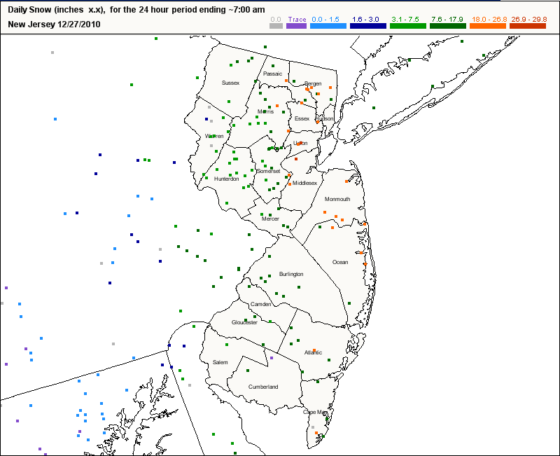
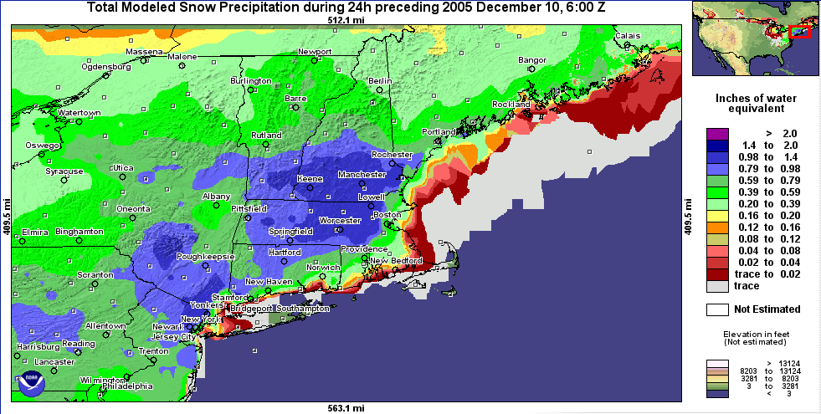
Two Case Studies
NJ 26 Dec 2010
MA 09 Dec 2005
Low pressure deepened as it tracked northward along the eastern seaboard
Hurricane force winds
Thunder and lightning
Low pressure rapidly deepened over Cape Cod
Hurricane force winds
Thunder and lightning
http://www.nohrsc.nws.gov/
http://www.cocorahs.org/

Slide 9
KDIX Radar (21Z)

Slide 10
KDIX Radar (00Z)

Slide 11
KDIX Radar (03Z)

Slide 12
KDIX Radar (08Z)

Slide 13
MSLP and 800mb Frontogenesis (18Z)

Slide 14
MSLP and 800mb Frontogenesis (21Z)

Slide 15
MSLP and 800mb Frontogenesis (00Z)

Slide 16
MSLP and 800mb Frontogenesis (03Z)

Slide 17
CSI Cross Section (18Z)

Slide 18
CSI Cross Section (21Z)

Slide 19
CSI Cross Section (00Z)

Slide 20
CSI Cross Section (03Z)

Slide 21
KBOX Radar (18Z)

Slide 22
KBOX Radar (1830Z)

Slide 23
KBOX Radar (19Z)

Slide 24
KBOX Radar (1930)

Slide 25
MSLP and 800mb Frontogenesis (15Z)

Slide 26
MSLP and 800mb Frontogenesis (18Z)

Slide 27
MSLP and 800mb Frontogenesis (21Z)

Slide 28
MSLP and 800mb Frontogenesis (00Z)

Slide 29
CSI Cross Section (15Z)

Slide 30
CSI Cross Section (18Z)

Slide 31
CSI Cross Section (21Z)

Slide 32
CSI Cross Section (00Z)

Slide 33
Summary
2 strong midlatitude cyclones developed
Well-defined frontogenesis regions in the NW quadrant
Banding is present in both cases
In MA case, banding appears around the time the CSI is evident
Occurs later in NJ case
CSI and CI are present at the same time at nearly every time step
CSI (also CI) and frontogenesis nearly always overlap

Slide 34
Questions/References
Novak. R. D., J. S. Waldstreicher, D. Keyser, and L. F. Bosart, 2006: A forecast strategy for anticipating cold season mesoscale band formation within eastern U.S. cyclones. Wea. Forecasting, 21, 3–23.
Nicosia, D. J., and R. H. Grumm, 1999: Mesoscale band formation in three major northeastern United States snowstorms. Wea. Forecasting, 14, 346–368.
Schultz, D. M., and P. N. Schumacher, 1999: The use and misuse of conditional symmetric instability. Mon. Wea. Rev., 127, 2709–2732.
COMET Module, http://www.meted.ucar.edu/export/csi/
The Conditional Symmetric Instability (CSI) Homepage, David Schultz and Phil Schumacher

