Slide 1
Predictability of Dry Season Downscaled Reforecasts Over the Tropical South American Region
Masters Thesis Defense
17th March 2011
Adam Frumkin

Slide 2
Outline
Introduction
Objectives
Data
Methods and Results
Conclusions

Slide 3
INTRODUCTION

Slide 4
South American Climate
The South American monsoon is arguably the most important feature of the South American climate
South America was only recently recognized as having a monsoon climate by Zhou and Lau (1998).
There is still debate as to whether or not the SAM meets the classic definition of the word.

Slide 5
South American Climate
Characteristics of a monsoon climate:
Shift in overturning circulations
Change in precipitation rate
Seasonal reversal in wind direction
The South American Monsoon exhibits all but the third characteristic.

Slide 6
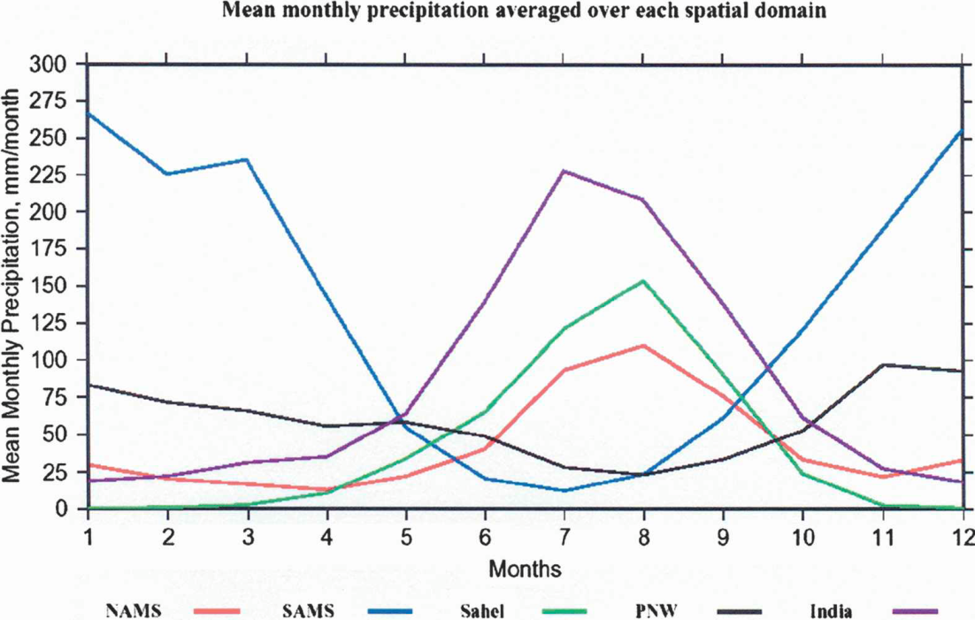
South American Climate
Vera et al. (2006)

Slide 7
Why focus on the dry season?
The Amazon rainforest acts as a massive carbon sink (Phillips et al. 2009)
Modulates atmospheric CO₂ through photosynthesis and respiration
Droughts in South America may become more common in the next century (IPCC)
Phillips et al. (2009) found the greatest impacts to the Amazon to occur during the intense dry season

Slide 8
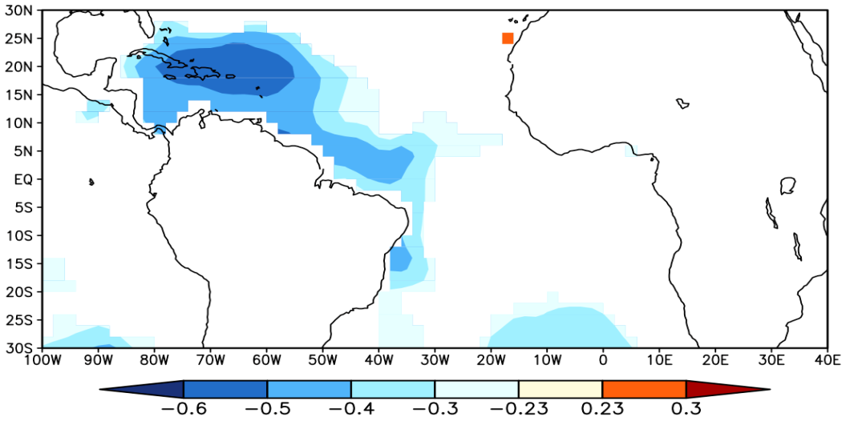
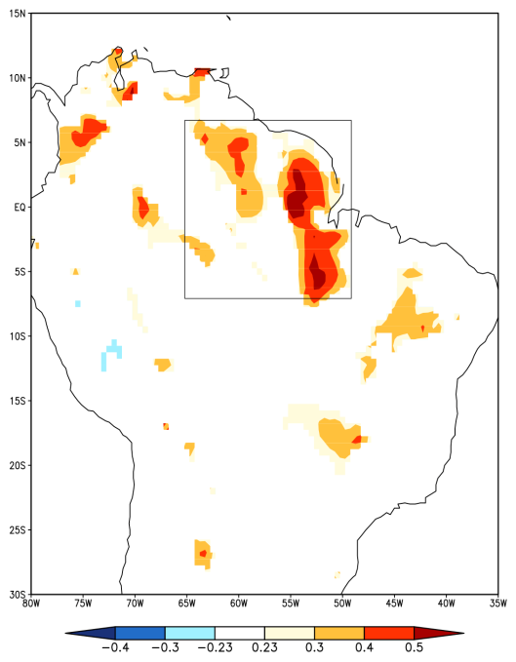
Why focus on the dry season?
Correlation of JJA ERSST v3 w/ DJF CRU Rainfall
Correlation of JJA Rainfall w/ DJF Rainfall

Slide 9
Why should we care about predicting and modeling the monsoon?
The ability to accurately forecast seasonal anomalies associated with monsoon systems is critical
Above normal, normal, and below normal conditions
Fluctuations of the monsoon are often associated with drought, flood, increased risk of fire, etc.
Improvements in forecasting the monsoon anomalies can lead to a reduction in loss of life and property.
We can only efficiently forecast seasonal anomalies using climate models (global climate models or regional climate models)

Slide 10
Objectives

Slide 11
Objectives
We investigate the feasibility of using climate models for routine seasonal prediction of the South American dry season (June-July-August)?
1 Global Climate Model (GCM) Integration
2 Regional Climate Model (RCM) Integrations
Do the models have any skill at predicting anomalous dry season conditions?
Two meter air temperature
Precipitation
Is there any benefit to using a downscaled RCM over a GCM?
Is there any added benefit to bias correction?
We compare model output with reanalysis data

Slide 12
DATA

Slide 13
NCEP Climate Forecast System (CFS)
Fully coupled land-ocean atmosphere
64 vertical levels
Six ensemble members
The CFS was the first model in the U.S. to achieve a level of skill comparable to statistical models.

Slide 14
NCEP Scripps Regional Spectral Model (RSM)
28 vertical sigma levels
60km horizontal resolution
We use the RSM to downscale from the CFS
The RSM domain covers most of North America and South America
This is a large area hence the lower (60km) resolution
6 ensemble members

Slide 15
Downscaling
Multiple methods
This study: lateral boundary conditions of the RSM are forced by the CFS
Allows for seasonal ensemble forecasting on regional to local scales (200km vs 60km)
GCMs are unable to resolve coastlines and steep topography (Misra and Chan 2009)
Misra et al. (2003): RCM improves forecasts of summertime precip and low level jets over South America

Slide 16
Anomaly Nesting
Bias correction: remove the bias in the global climate model
Replace GCM climatology with a reanalysis product climatology (Misra and Kanamitsu 2004).
This is done because the RCM can inherit the bias of the GCM when the downscaling process is performed (Pan et al. 2001).
In this study we replace the GCM climatology with NCEP NCAR Reanalysis I and ERSSTv2
RSM-AN

Slide 17
Model Output
The models are integrated from 2001-2007 beginning 00Z May 23rd.
We include all seven years, but only use data from June-July-August which comprises the dry season.
Data was in a six hourly format.

Slide 18
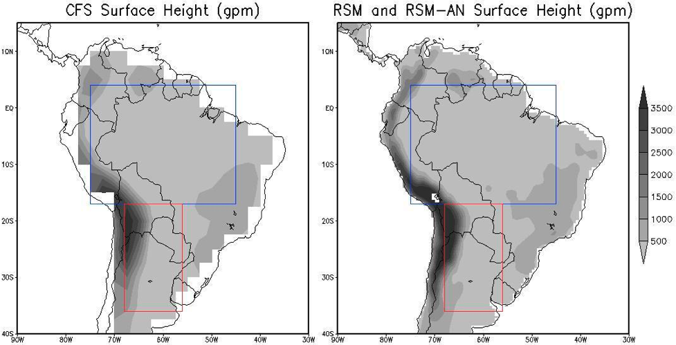
Domain
ARB
ARB
ST
ST

Slide 19
NCEP Climate Forecast System Reanalysis (CFSR)
Use CFSR (reanalysis) to analyze the three model (CFS, RSM, RSM-AN) integrations (bias, model skill, physical processes)
Variables
Two-meter air temperature
Precipitation Rate
Evaporation
Downwelling shortwave flux
Resolution: 0.5°x0.5°
Notes:
This is a reanalysis product which means that it assimilates data from many sources and then feeds it into coupled models to produce many different output variables. Sometimes these models interact with one another.

Slide 20
METHODS AND RESULTS

Slide 21
Methods
Model Bias
Potential Predictability
Area Under the Relative Operative Characteristic Curve
Land-Atmosphere Feedbacks

Slide 22
Model Bias

Slide 23
Model Bias
Model – CFSR= Bias

Slide 24
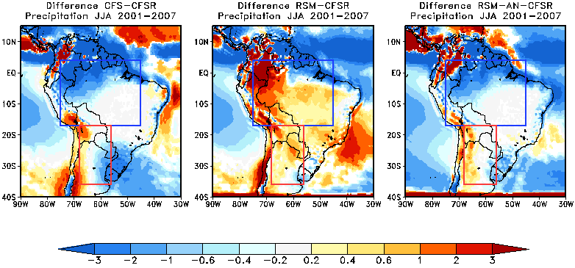
Precipitation Bias
mm/day
 | ARB | ST
1 | RSM-AN (0.7) | RSM-AN (-0.1)
2 | RSM (0.8) | RSM (0.2)
3 | CFS (-1.1) | CFS (-0.4)

Slide 25
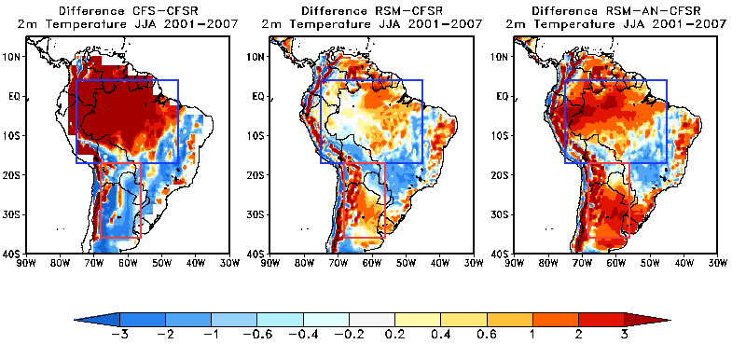
2m Air Temperature Bias
°C
 | ARB | ST
1 | RSM (0.01) | RSM (0.6)
2 | RSM-AN (0.9) | CFS (-1.4)
3 | CFS (>3) | RSM-AN (2.1)

Slide 26
Model Bias: Summary
Precipitation biases were lowest in the RSM-AN for both regions
RSM had the lowest temperature biases in both regions
CFS had the largest bias most often
Notes:
However, just because a model has a low bias does not necessarily mean that it is the most skillful. This is because for the type of forecasting we are doing we do not care about an exact value. If it is heavily biased it can still be skillful if it is consistently biased with the same sign. That’s because for climate forecasting we only care about anomalies relative to the model climatology not anomalies relative to a reanalysis product or observations.

Slide 27
Potential Predictability

Slide 28
Potential Predictability
We calculate the ratio of the external variance (signal) to the total variance following Kumar and Hoerling (1995) for precipitation and temperature.
Total variance = External Variance + Internal Variance
External Variance
Signal
The degree to which the difference between ensemble mean forecasts for different years is due to boundary conditions rather than “chance”
Internal Variance
Noise
Spread of the ensemble members about the ensemble mean
Ratios near 1 mean the boundary conditions are overwhelming the effect of noise.
Ratios near 0 mean the model is not “seeing” the boundary conditions.
Stefanova et al. (2010)
Notes:
External variance - slowly varying boundary conditions (SSTs)
Internal Variance – noise/uncertain initial conditions/noise is basically the spread of the ensembles around the mean

Slide 29
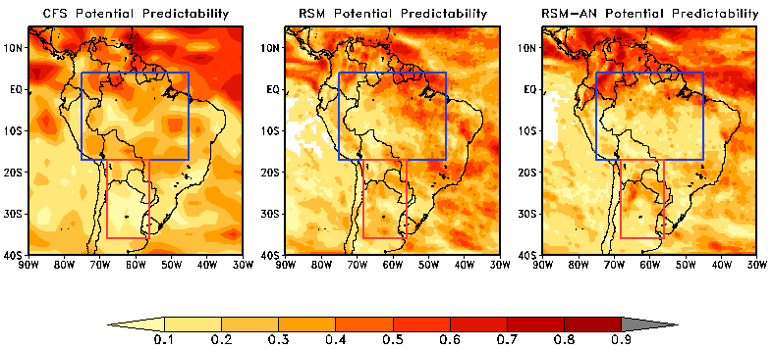
Precipitation
Signal / Total Variance
 | ARB | ST
1 | CFS (0.29) | RSM (0.22)
2 | RSM (0.28) | RSM-AN (0.2)
3 | RSM-AN (0.23) | CFS (0.12)
Notes:
There is very few regions where the ratio is greater than 0.5
The ARB was always higher than the ST

Slide 30
2m Air Temperature
Signal / Total Variance
 | ARB | ST
1 | RSM-AN (0.5) | RSM-AN (0.28)
2 | RSM (0.4) | RSM (0.24)
3 | CFS (0.28) | CFS (0.23)
Notes:
There are many more regions where the ratio was greater than 0.5 compare with precipitation
The ARB was always higher than the ST
Only the CFS ARB precipitation had a ratio greater than its temperature counterpart

Slide 31
Potential Predictability: Summary
Ratios were rarely >0.5.
The ARB region has higher ratios for both variables in all models.
Temperature has higher ratios for both regions
except for the CFS in the ARB region.

Slide 32
Potential Predictability: Summary
We cannot necessarily say that one model will have more skill simply because it has a higher ratio. If we could however:
CFS would have the most skill for precipitation in the ARB region.
RSM would have the most skill for precipitation in the ST region.
RSM-AN would have the most skill for temperature in both regions

Slide 33
Ensemble Forecast Skill

Slide 34
ROC Curves
ROC curves are an efficient way of calculating the skill of a binary forecast system.
Binary implies that an event is either forecast to occur or not occur for a particular threshold.
The ROC curve is actually a plot of hit rate vs false alarm rate for all thresholds
Calculating the area under the ROC curve is the easiest way to interpret the performance of a model.

Slide 35
ROC Curves
2001 | 23.9021 | normal
2002 | 24.3013 | above
2003 | 23.6313 | below
2004 | 23.618 | below
2005 | 24.1368 | above
2006 | 24.0316 | normal
2007 | 23.8736 | normal
2004
2005
2005
2005
2004
2002
2002
2002
2001
2004
2005
2002
2001
2002
2001
2001
2007
2001
2005
2004
2006
2005
2007
2004
2004
2006
2007
2007
2006
2001
2006
2002
2003
2007
2003
2003
2006
2003
2007
2003
2003
2006
25.2675
25.263
25.1643
25.143
25.1422
25.081
25.072
25.0586
25.012
25.0077
24.98
24.9759
24.9413
24.9314
24.9209
24.915
24.9131
24.908
24.9045
24.9004
24.8976
24.8882
24.8619
24.8517
24.8321
24.7963
24.7784
24.7781
24.7733
24.7698
24.7511
24.728
24.7151
24.6006
24.5789
24.5124
24.4943
24.4745
24.4432
24.3832
24.3787
24.3396
Above
Year | CFSR | B | N | A
2001 | N | 0 | 5 | 1
2002 | A | 1 | 1 | 4
2003 | B | 6 | 0 | 0
2004 | B | 0 | 3 | 3
2005 | A | 0 | 2 | 4
2006 | N | 3 | 3 | 0
2007 | N | 2 | 4 | 0
Normal
Below

Slide 36
ROC Curves
6
Table Modified From Mason and Graham (1999)
Year | CFSR | B | N | A
2001 | N | 0 | 5 | 1
2002 | A | 1 | 1 | 4
2003 | B | 6 | 0 | 0
2004 | B | 0 | 3 | 3
2005 | A | 0 | 2 | 4
2006 | N | 3 | 3 | 0
2007 | N | 2 | 4 | 0
Mason and Graham (1999)

Slide 37
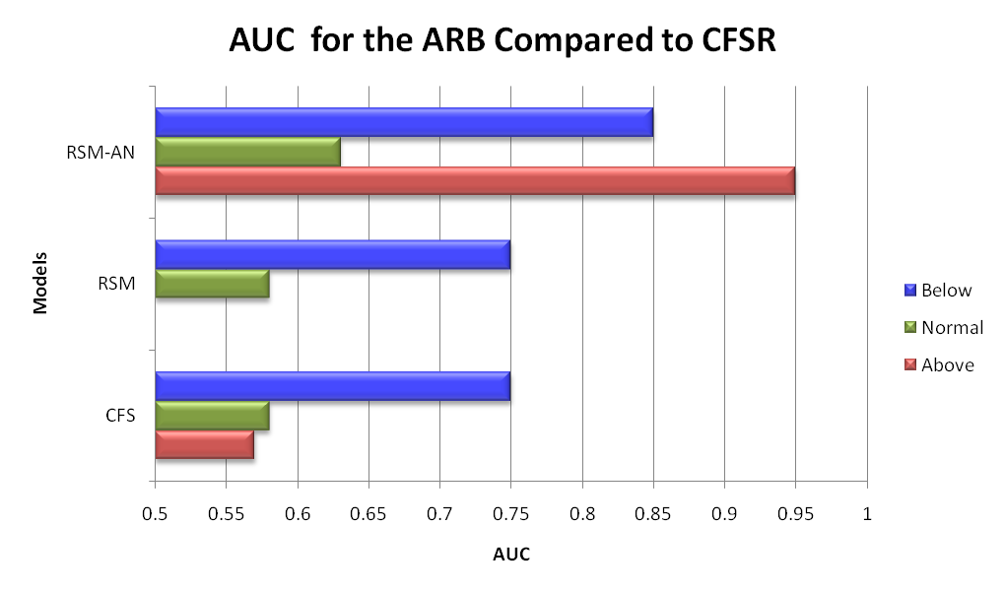
Skill for Precipitation in the ARB Region
 | Above | Normal | Below
1 | RSM-AN | RSM-AN | RSM-AN
2 | CFS | CFS | CFS
3 | RSM | RSM | RSM

Slide 38
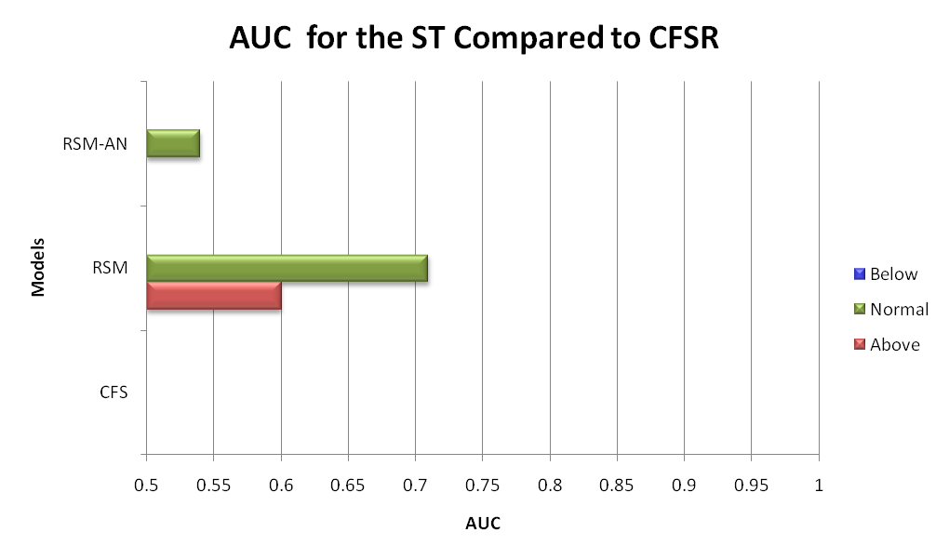
Skill for Precipitation in the ST Region
 | Above | Normal | Below
1 | RSM | RSM
2 |  | RSM-AN
3

Slide 39
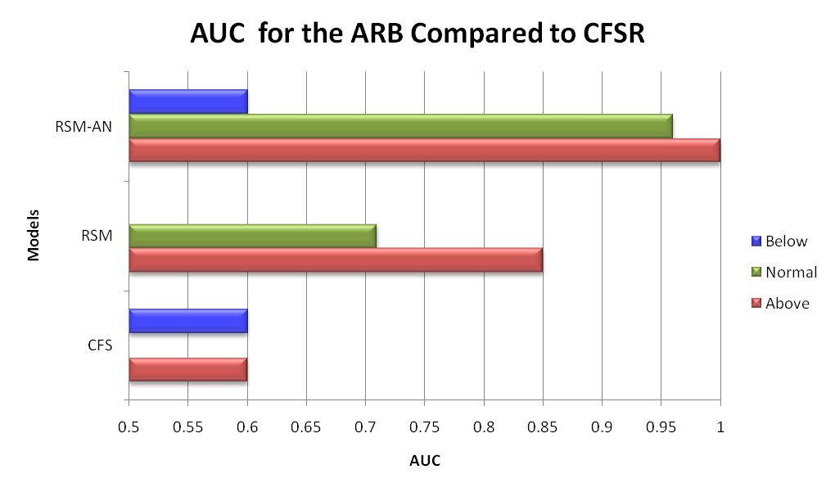
Skill for Temperature in the ARB Region
 | Above | Normal | Below
1 | RSM-AN | RSM-AN | RSM-AN
2 | RSM | RSM | CFS
3 | CFS

Slide 40
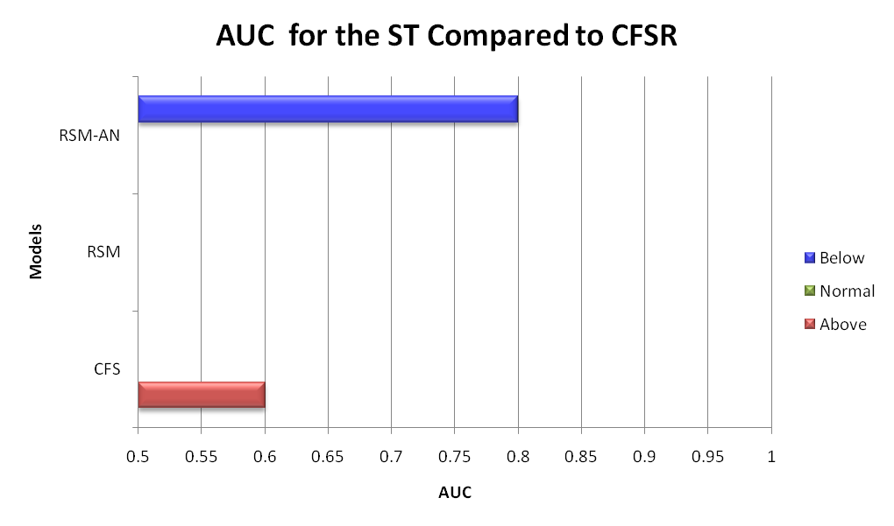
Skill for Temperature in the ST Region
 | Above | Normal | Below
1 | CFS |  | RSM-AN
2
3

Slide 41
ROC Curves: Summary
Precipitation
ARB: Downscaling does not improve upon CFS but anomaly nesting does
ST: Downscaling only provides most skill
2m Air Temperature
ARB: Anomaly nesting usually provides the best results. Downscaling usually helps.
ST: Inconclusive. Very little skill in all models for all events
Obvious that the ARB region has more skill than ST region
Not obvious if temperature has more skill than precipitation

Slide 42
Land-Atmosphere Interactions

Slide 43
Land-Atmosphere Feedbacks
Temperature and precipitation can be greatly affected by land-atmosphere feedback mechanisms in the model.
Koster et al. (2003) splits the land-atmosphere feedback into three parts:
Wetting of soil by precipitation
Enhancement of evaporation by the wet soil
Enhancement of precipitation by evaporation

Slide 44
Land-Atmosphere Feedbacks
Part two can be explained through contemporaneous correlations of daily averaged values of temperature and precipitation (Koster et al. 2003)
Part three can be explained through correlations of daily averaged values of (Misra and Dirmeyer, 2009):
Downwelling shortwave flux with evaporation
Precipitation with evaporation

Slide 45
Land-Atmosphere Feedbacks
Temperature and Precipitation
Positive Correlations: surface evaporation is not contributing to precipitation
Negative Correlations: increased evaporation is occurring at the expense of sensible heat influx into the earth

Slide 46
Land-Atmosphere Feedbacks
Downwelling Shortwave Flux with Evaporation:
Positive: evaporation is energy limited
Negative: evaporation is moisture limited

Slide 47
Land-Atmosphere Feedbacks
Evaporation with Precipitation
Positive: A non-arid regime where evaporation and precipitation are in phase
Negative: Arid regime. Local evaporation is less significant to producing precipitation

Slide 48
Temperature and Precipitation
CFS RSM RSM-AN CFSR

Slide 49
Downwelling Shortwave Flux and Temperature
CFS RSM RSM-AN CFSR

Slide 50
Downwelling Shortwave Flux and Evaporation
CFS RSM RSM-AN CFSR

Slide 51
Evaporation and Precipitation
CFS RSM RSM-AN CFSR

Slide 52
Land-Atmosphere Feedbacks: Summary
Temperature and Precipitation
Strongest values in northeastern Brazil (or ARB)
Weak everywhere else
CFSR has very weak correlations everywhere
Shortwave Flux and Temperature
Almost always positive
Shortwave Flux and Evaporation
Mostly positive
CFSR has some neg. values in ST
Evaporation and Precipitation
Models are mostly negative in both regions
CFSR differs significantly (mostly positive in both regions)

Slide 53
Conclusions

Slide 54
Conclusions
In terms of bias the RSM had the lowest bias for temperature and the RSM-AN had the lowest for precipitation
RSM also did well with precipitation
Based on ROC scores and potential predictability plots the models are more accurate in the ARB than in the ST region
Temperature
ROC and potential predictability agree that RSM-AN is the best in the ARB (possibly also in the ST)
Precipitation
ROC and potential predictability disagree on which model is the best
ROC scores indicate that the RSM-AN is most skillful in both regions
Differences between models and CFSR could be caused by incorrect in the land-atmosphere feedbacks
Downscaling with anomaly nesting appears to provide the most accurate model

Slide 55
Limitations and Future Work
Use a longer dataset to ensure significance
Also use a different skill score and compare to ROC curves
Conduct a moisture budget to fully analyze land-atmosphere interaction

