Slide 1


Predictability of Dry Season Downscaled Reforecasts Over the Tropical South American Region
Masters Thesis Defense
17th March 2011
Adam Frumkin

Slide 2
Outline
Introduction
Objectives
Data
Methods and Results
Conclusions

Slide 3
INTRODUCTION

Slide 4
South American Climate
The South American monsoon is arguably the most important feature of the South American climate
South America was only recently recognized as having a monsoon climate by Zhou and Lau (1998).
Previous scholars thought that South America was too narrow to support long lived stationary circulations
Also, persistent upwelling along the west coast keeps ocean temps lower than air temps year round

Slide 5
South American Climate
Characteristics of a monsoon climate:
  Shift in overturning circulations
  Change in precipitation rate
  Seasonal reversal in wind direction
The South American Monsoon exhibits all but the third characteristic.

Slide 6
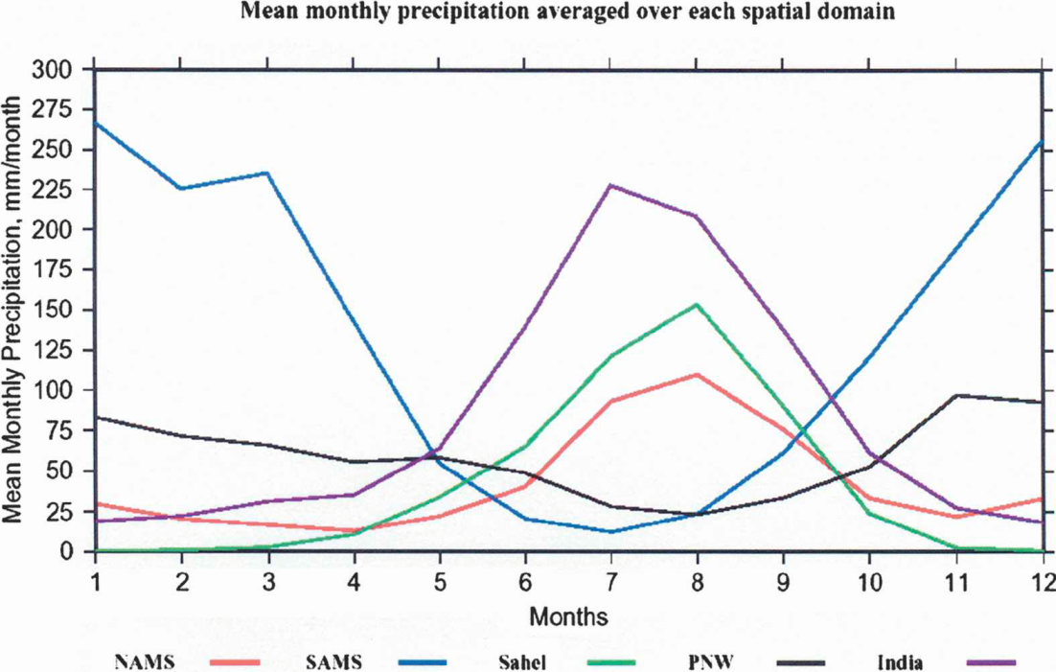
South American Climate
Vera et al. (2006)

Slide 7
Why focus on the dry season?
The Amazon rainforest acts as a massive carbon sink (Phillips et al. 2009)
  Modulates atmospheric CO₂ through photosynthesis and respiration
  Amazonia is a large source of peatlands which globally store 70 billion tons of carbon (Li et al. 2007)
Droughts in South America may become more common in the next century (IPCC)
  Could seriously impact the Amazon when coupled with anthropogenic destruction
Phillips et al. (2009) found the greatest impacts to the Amazon to occur during the intense dry season

Slide 8
Why focus on the dry season?
Myneni et al. (2007) found that leaf growth in the Amazon was greatest during the dry season
Increased leaf production and evapotranspiration during the dry season may aid in the transition from the wet to the dry season
  Destabilization of the lower troposphere and enhancement of convection
Gan et al. 2004 found that convection over the Amazon can release enough latent heat to act as a heat source for the monsoon (in addition to the Andes Mountains)

Slide 9
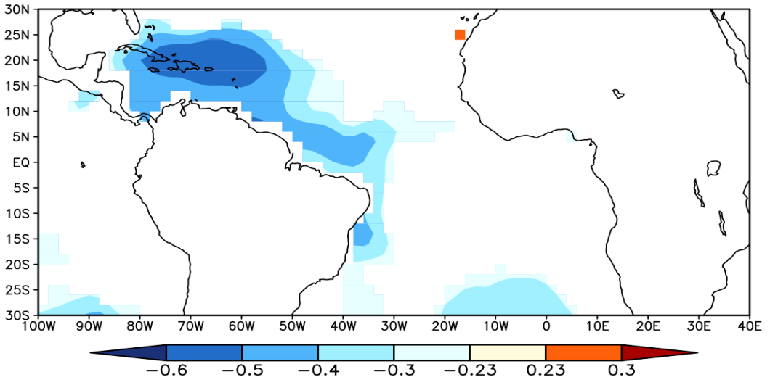
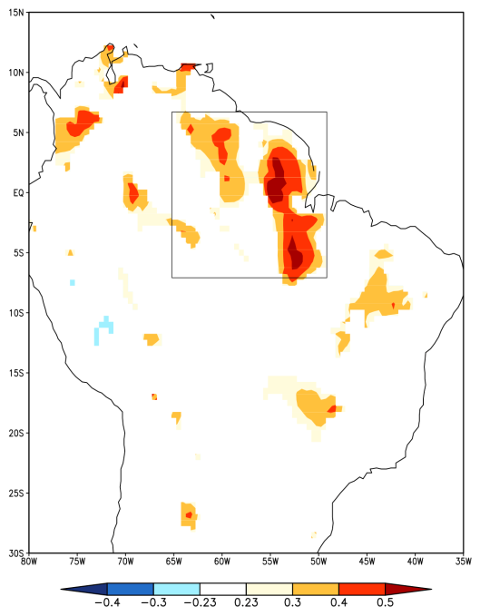
Why focus on the dry season?
Correlation of JJA ERSST v3
w/ DJF CRU Rainfall
Correlation of JJA Rainfall
w/ DJF Rainfall

Slide 10
Why should we care about predicting and modeling the monsoon?
The ability to accurately forecast seasonal anomalies associated with monsoon systems is critical
  Above normal, normal, and below normal conditions
Fluctuations of the monsoon are often associated with drought, flood, increased risk of fire, etc.
Improvements in forecasting the monsoon anomalies can lead to a reduction in loss of life and property.
We can only efficiently forecast seasonal anomalies using climate models (global climate models or regional climate models)

Slide 11
Objectives

Slide 12
Objectives
We investigate the feasibility of using climate models for routine seasonal prediction of the South American dry season (June-July-August)?
  1 Global Climate Model (GCM) Integration
  2 Regional Climate Model (RCM) Integrations
Do the models have any skill at predicting anomalous dry season conditions?
  Two meter air temperature
  Precipitation
Is there any benefit to using a downscaled RCM over a GCM?
  Is there any added benefit to bias correction?
We compare model output with reanalysis data

Slide 13
DATA

Slide 14
NCEP Climate Forecast System (CFS)
Fully coupled land-ocean atmosphere
64 vertical levels
Six ensemble members
The CFS was the first model in the U.S. to achieve a level of skill comparable to statistical models.

Slide 15
NCEP Scripps Regional Spectral Model (RSM)
28 vertical sigma levels
60km horizontal resolution
We use the RSM to downscale from the CFS
The RSM domain covers most of North America and South America
  This is a large area hence the lower (60km) resolution
6 ensemble members

Slide 16
Downscaling
Multiple methods
This study: lateral boundary conditions of the RSM are forced by the CFS
Allows for seasonal ensemble forecasting on regional to local scales (200km vs 60km)
GCMs are unable to resolve coastlines and steep topography (Misra and Chan 2009)
Misra et al. (2003): RCM improves forecasts of summertime precip and low level jets over South America

Slide 17
Anomaly Nesting
Bias correction: remove the bias in the global climate model
Replace GCM climatology with a reanalysis product climatology (Misra and Kanamitsu 2004).
This is done because the RCM can inherit the bias of the GCM when the downscaling process is performed (Pan et al. 2001).
In this study we replace the GCM climatology with NCEP NCAR Reanalysis I and ERSSTv2
RSM-AN

Slide 18
Model Output
The models are integrated from 2001-2007 beginning 00Z May 23rd.
We include all seven years, but only use data from June-July-August which comprises the dry season.
Data was in a six hourly format.

Slide 19
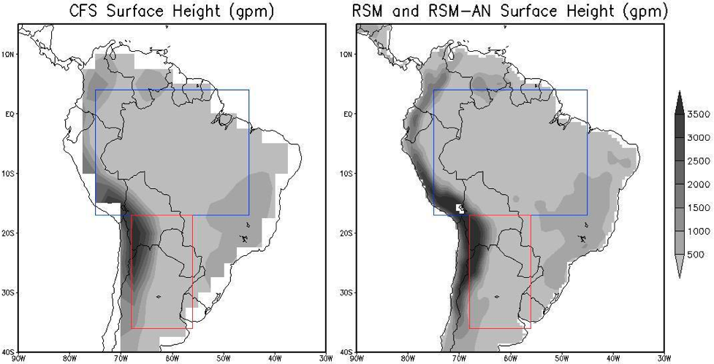
Domain
ARB
ARB
ST
ST

Slide 20
NCEP Climate Forecast System Reanalysis (CFSR)
Use CFSR (reanalysis) to analyze the three model (CFS, RSM, RSM-AN) integrations (bias, model skill, physical processes)
Variables
  Two-meter air temperature
  Precipitation Rate
  Evaporation
  Downwelling shortwave flux
Resolution: 0.5°x0.5°
Notes:
This is a reanalysis product which means that it assimilates data from many sources and then feeds it into coupled models to produce many different output variables. Sometimes these models interact with one another.

Slide 21
METHODS AND RESULTS

Slide 22
Methods
Model Bias
Potential Predictability
Area Under the Relative Operative
Characteristic Curve
Land-Atmosphere Feedbacks

Slide 23
Model Bias

Slide 24
Model Bias
Model – CFSR= Bias

Slide 25
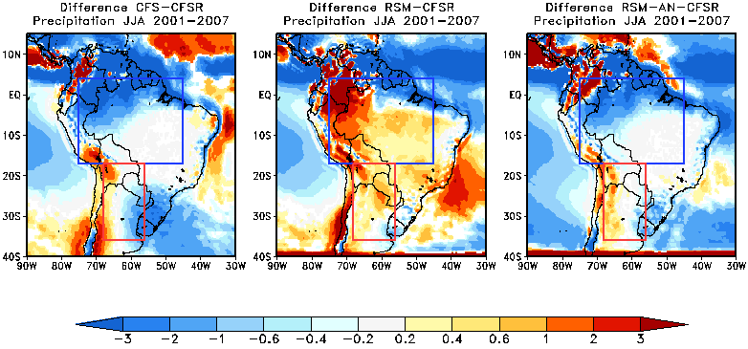
Precipitation Bias
mm/day
 | ARB | ST
1 | RSM-AN (0.7) | RSM-AN (-0.1)
2 | RSM (0.8) | RSM (0.2)
3 | CFS (-1.1) | CFS (-0.4)

Slide 26
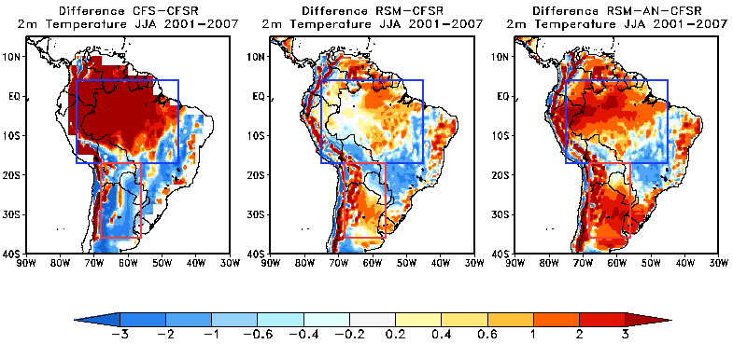
2m Air Temperature Bias
°C
 | ARB | ST
1 | RSM (0.01) | RSM (0.6)
2 | RSM-AN (0.9) | CFS (-1.4)
3 | CFS (>3) | RSM-AN (2.1)

Slide 27
Model Bias: Summary
Precipitation biases were lowest in the RSM-AN for both regions
RSM had the lowest temperature biases in both regions
CFS had the largest bias most often
Notes:
However, just because a model has a low bias does not necessarily mean that it is the most skillful. This is because for the type of forecasting we are doing we do not care about an exact value. If it is heavily biased it can still be skillful if it is consistently biased with the same sign. That’s because for climate forecasting we only care about anomalies relative to the model climatology not anomalies relative to a reanalysis product or observations.

Slide 28
Potential Predictability

Slide 29
Potential Predictability
We calculate the ratio of the external variance (signal) to the total variance following Kumar and Hoerling (1995) for precipitation and temperature.
Total variance = External Variance + Internal Variance
External Variance
  Signal
  The degree to which the difference between ensemble mean forecasts for different years is due to boundary conditions rather than “chance”
Internal Variance
  Noise
  Spread of the ensemble members about the ensemble mean
Ratios near 1 mean the boundary conditions are overwhelming the effect of noise.
Ratios near 0 mean the model is not “seeing” the boundary conditions.
Stefanova et al. (2010)
Notes:
External variance - slowly varying boundary conditions (SSTs)
Internal Variance – noise/uncertain initial conditions/noise is basically the spread of the ensembles around the mean

Slide 30
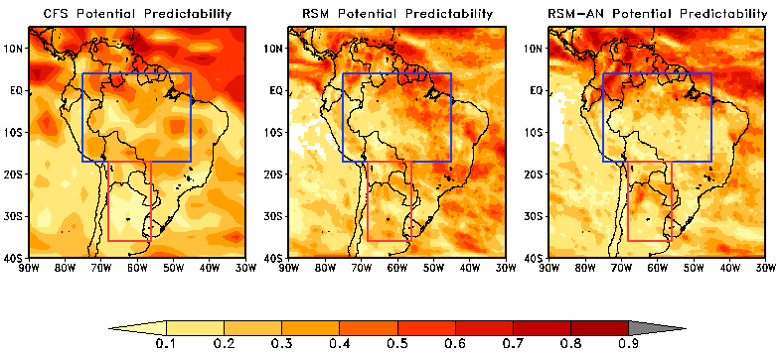
Precipitation
Signal / Total Variance
 | ARB | ST
1 | CFS (0.29) | RSM (0.22)
2 | RSM (0.28) | RSM-AN (0.2)
3 | RSM-AN (0.23) | CFS (0.12)
Notes:
There is very few regions where the ratio is greater than 0.5
The ARB was always higher than the ST

Slide 31
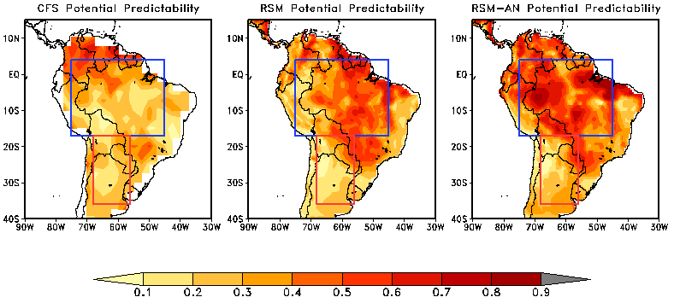
2m Air Temperature
Signal / Total Variance
 | ARB | ST
1 | RSM-AN (0.5) | RSM-AN (0.28)
2 | RSM (0.4) | RSM (0.24)
3 | CFS (0.28) | CFS (0.23)
Notes:
There are many more regions where the ratio was greater than 0.5 compare with precipitation
The ARB was always higher than the ST
Only the CFS ARB precipitation had a ratio greater than its temperature counterpart

Slide 32
Potential Predictability: Summary
Ratios were rarely >0.5.
The ARB region has higher ratios for both variables in all models.
Temperature has higher ratios for both regions
  except for the CFS in the ARB region.

Slide 33
Potential Predictability: Summary
We cannot necessarily say that one model will have more skill simply because it has a higher ratio. If we could however:
  CFS would have the most skill for precipitation in the ARB region.
  RSM would have the most skill for precipitation in the ST region.
  RSM-AN would have the most skill for temperature in both regions

Slide 34
Ensemble Forecast Skill

Slide 35
ROC Curves
ROC curves are an efficient way of calculating the skill of a binary forecast system.
Binary implies that an event is either forecast to occur or not occur for a particular threshold.
The ROC curve is actually a plot of hit rate vs false alarm rate for all thresholds
Calculating the area under the ROC curve is the easiest way to interpret the performance of a model.

Slide 36
ROC Curves
2001 | 23.9021 | normal
2002 | 24.3013 | above
2003 | 23.6313 | below
2004 | 23.618 | below
2005 | 24.1368 | above
2006 | 24.0316 | normal
2007 | 23.8736 | normal
2004
2005
2005
2005
2004
2002
2002
2002
2001
2004
2005
2002
2001
2002
2001
2001
2007
2001
2005
2004
2006
2005
2007
2004
2004
2006
2007
2007
2006
2001
2006
2002
2003
2007
2003
2003
2006
2003
2007
2003
2003
2006
25.2675
25.263
25.1643
25.143
25.1422
25.081
25.072
25.0586
25.012
25.0077
24.98
24.9759
24.9413
24.9314
24.9209
24.915
24.9131
24.908
24.9045
24.9004
24.8976
24.8882
24.8619
24.8517
24.8321
24.7963
24.7784
24.7781
24.7733
24.7698
24.7511
24.728
24.7151
24.6006
24.5789
24.5124
24.4943
24.4745
24.4432
24.3832
24.3787
24.3396
Above
Year | CFSR | B | N | A
2001 | N | 0 | 5 | 1
2002 | A | 1 | 1 | 4
2003 | B | 6 | 0 | 0
2004 | B | 0 | 3 | 3
2005 | A | 0 | 2 | 4
2006 | N | 3 | 3 | 0
2007 | N | 2 | 4 | 0
Normal
Below

Slide 37
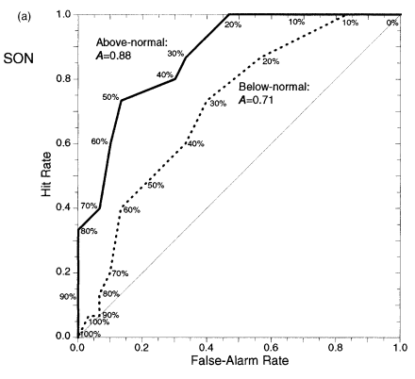
ROC Curves
6
Table Modified From Mason and Graham (1999)
Year | CFSR | B | N | A
2001 | N | 0 | 5 | 1
2002 | A | 1 | 1 | 4
2003 | B | 6 | 0 | 0
2004 | B | 0 | 3 | 3
2005 | A | 0 | 2 | 4
2006 | N | 3 | 3 | 0
2007 | N | 2 | 4 | 0
Mason and Graham (1999)

Slide 38
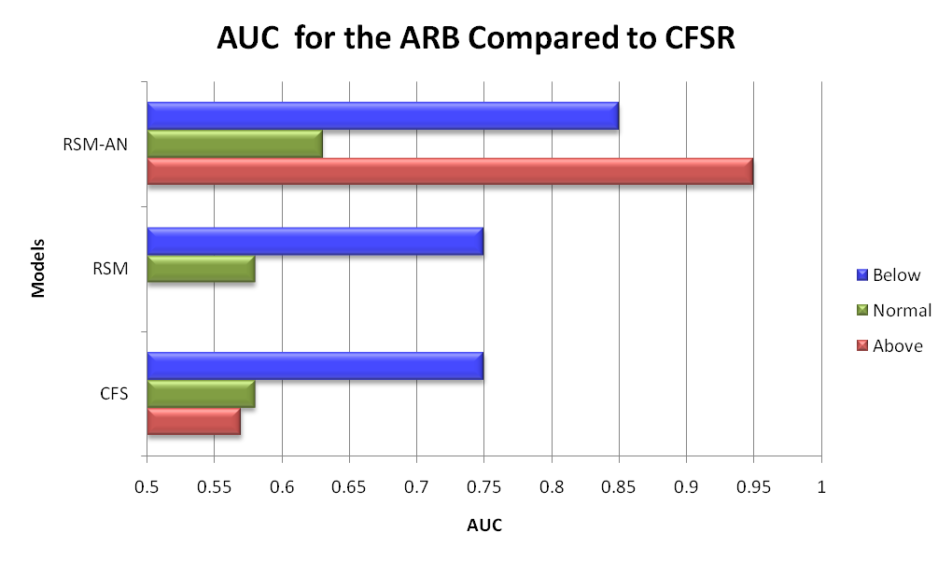
Skill for Precipitation in the ARB Region
 | Above | Normal | Below
1 | RSM-AN | RSM-AN | RSM-AN
2 | CFS | CFS | CFS
3 | RSM | RSM | RSM

Slide 39
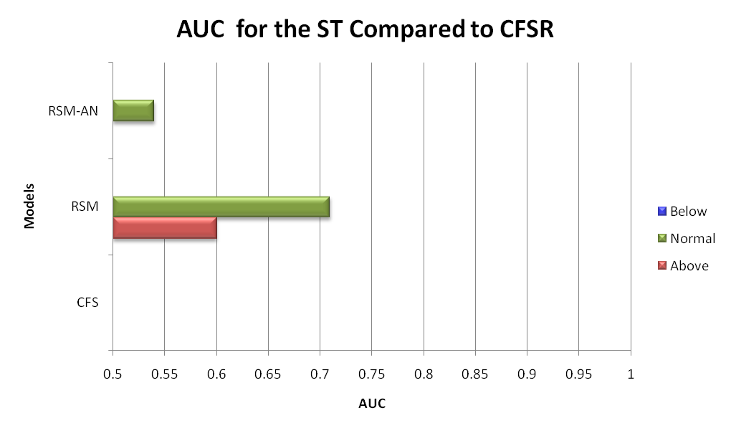
Skill for Precipitation in the ST Region
 | Above | Normal | Below
1 | RSM | RSM
2 |  | RSM-AN
3

Slide 40
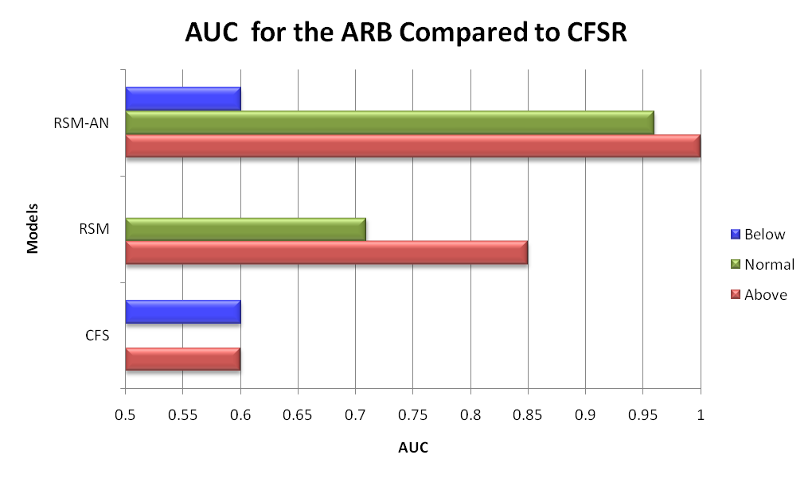
Skill for Temperature in the ARB Region
 | Above | Normal | Below
1 | RSM-AN | RSM-AN | RSM-AN
2 | RSM | RSM | CFS
3 | CFS

Slide 41
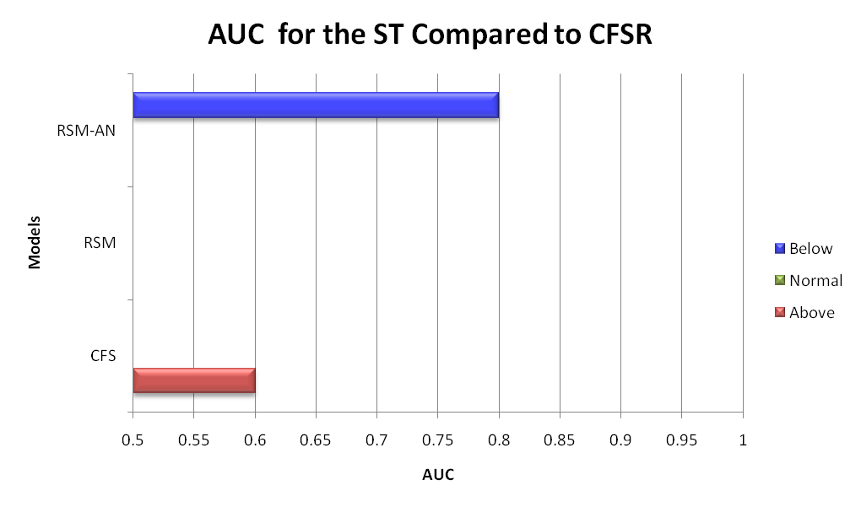
Skill for Temperature in the ST Region
 | Above | Normal | Below
1 | CFS |  | RSM-AN
2
3

Slide 42
ROC Curves: Summary
Precipitation
  ARB: Downscaling does not improve upon CFS but anomaly nesting does
  ST: Downscaling only provides most skill
2m Air Temperature
  ARB: Anomaly nesting usually provides the best results. Downscaling usually helps.
  ST: Inconclusive. Very little skill in all models for all events
Obvious that the ARB region has more skill than ST region
Not obvious if temperature has more skill than precipitation

Slide 43
Land-Atmosphere Interactions

Slide 44
Land-Atmosphere Feedbacks
Temperature and precipitation can be greatly affected by land-atmosphere feedback mechanisms in the model.
Koster et al. (2003) splits the land-atmosphere feedback into three parts:
  Wetting of soil by precipitation
  Enhancement of evaporation by the wet soil
  Enhancement of precipitation by evaporation

Slide 45
Land-Atmosphere Feedbacks
Part two can be explained through contemporaneous correlations of daily averaged values of temperature and precipitation (Koster et al. 2003)
Part three can be explained through correlations of daily averaged values of (Misra and Dirmeyer, 2009):
  Downwelling shortwave flux with evaporation
  Precipitation with evaporation

Slide 46
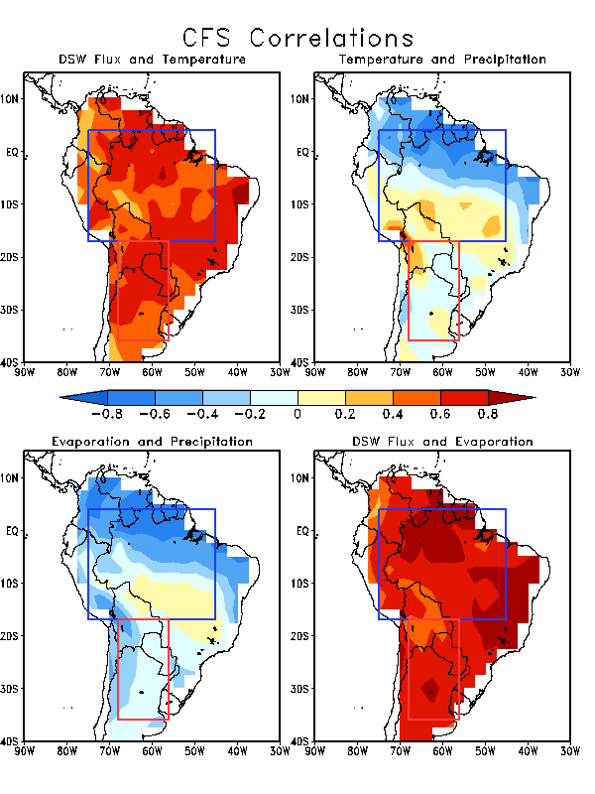
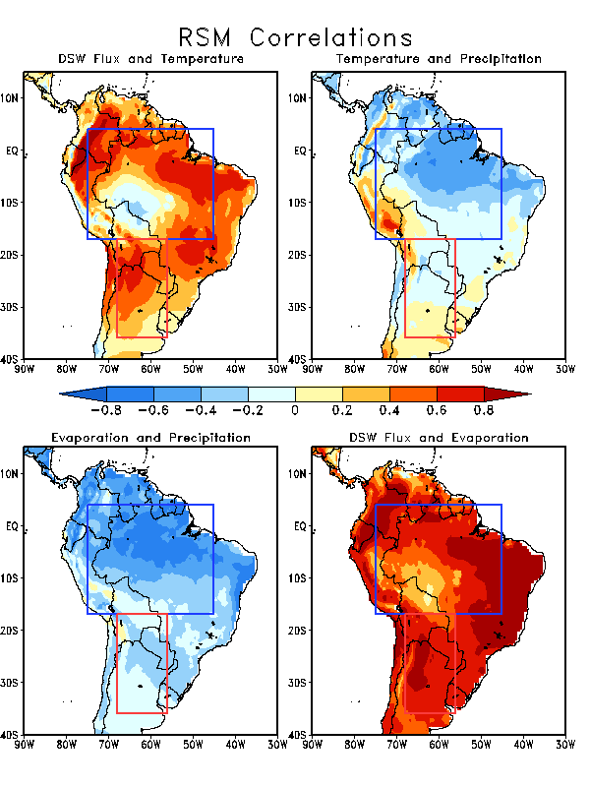
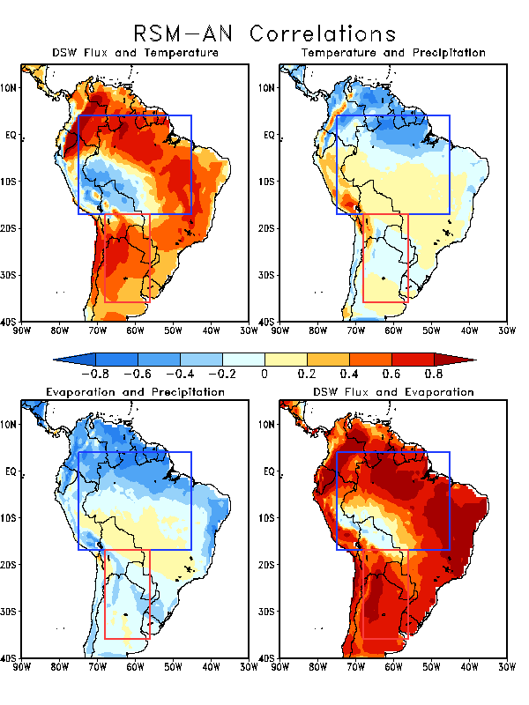
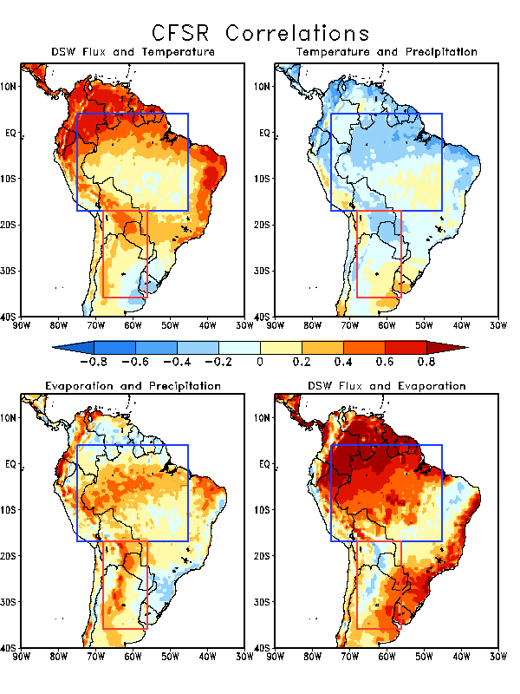
Temperature and Precipitation
CFS RSM RSM-AN CFSR

Slide 47
Downwelling Shortwave Flux and Evaporation
CFS RSM RSM-AN CFSR

Slide 48
Evaporation and Precipitation
CFS RSM RSM-AN CFSR

Slide 49
Land-Atmosphere Feedbacks: Summary
Temperature and Precipitation
  Strongest values in northeastern Brazil (or ARB)
  Weak everywhere else
  CFSR has very weak correlations everywhere
Shortwave Flux and Evaporation
  Mostly positive
  CFSR has some neg. values in ST
Evaporation and Precipitation
  Models are mostly negative in both regions
  CFSR differs significantly (mostly positive in both regions)

Slide 50
Summary

Slide 51
Summary
In terms of bias the RSM had the lowest bias for temperature and the RSM-AN had the lowest for precipitation
  RSM also did well with precipitation
CFS almost always had the largest bias
Based on ROC scores and potential predictability plots the models are more accurate in the ARB than in the ST region
Temperature
  ROC and potential predictability agree that RSM-AN is the best in the ARB (possibly also in the ST)
Precipitation
  ROC and potential predictability disagree on which model is the best
  ROC scores indicate that the RSM-AN is most skillful in both regions
There were differences between how the models and CFSR handle local evaporation
Notes:
Potential predictability: precipitation: alternate between CFS in the ARB and RSM in the ST as the best

Slide 52
Conclusions

Slide 53
Conclusions
We recommend using the RSM with anomaly nesting in the ARB for both precipitation and temperature
More work needs to done in the ST as ROC curve analyses were inconclusive
More effort needs to be exerted to understand why the models produce different land-atmosphere interactions than CFSR
Notes:
Potential predictability: precipitation: alternate between CFS in the ARB and RSM in the ST as the best

Slide 54
Limitations and Future Work
Use a longer dataset to ensure significance
Also use a different skill score and compare to ROC curves
Conduct a moisture budget to fully analyze land-atmosphere interaction

Slide 55
Downwelling Shortwave Flux and Temperature
CFS RSM RSM-AN CFSR

Slide 56
Land-Atmosphere Feedbacks
Temperature and Precipitation
  Positive Correlations: surface evaporation is not contributing to precipitation
  Negative Correlations: increased evaporation is occurring at the expense of sensible heat influx into the earth

Slide 57
Land-Atmosphere Feedbacks
Downwelling Shortwave Flux with Evaporation:
  Positive: evaporation is energy limited
  Negative: evaporation is moisture limited

Slide 58
Land-Atmosphere Feedbacks
Evaporation with Precipitation
  Positive: A non-arid regime where evaporation and precipitation are in phase
  Negative: Arid regime. Local evaporation is less significant to producing precipitation

Slide 59
Land-Atmosphere Feedbacks: Summary
Temperature and Precipitation
  Strongest values in northeastern Brazil (or ARB)
  Weak everywhere else
  CFSR has very weak correlations everywhere
Shortwave Flux and Temperature
  Almost always positive
Shortwave Flux and Evaporation
  Mostly positive
  CFSR has some neg. values in ST
Evaporation and Precipitation
  Models are mostly negative in both regions
  CFSR differs significantly (mostly positive in both regions)

Slide 60
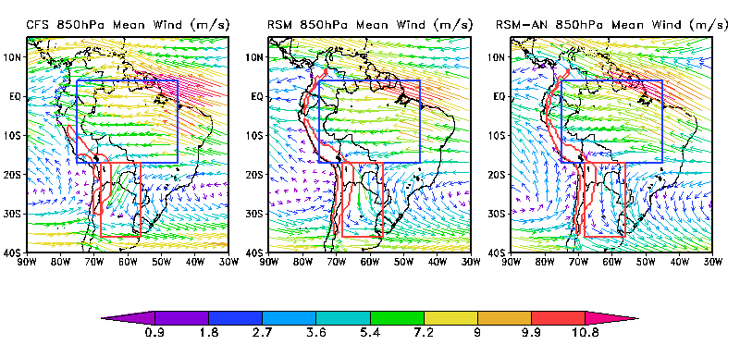

Slide 61
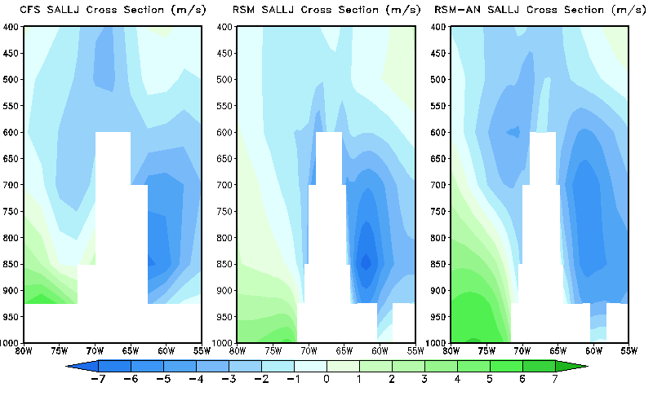

Slide 62
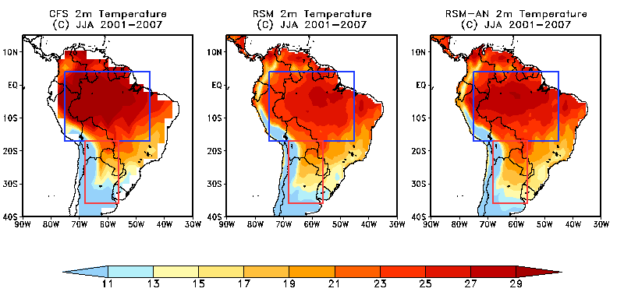

Slide 63
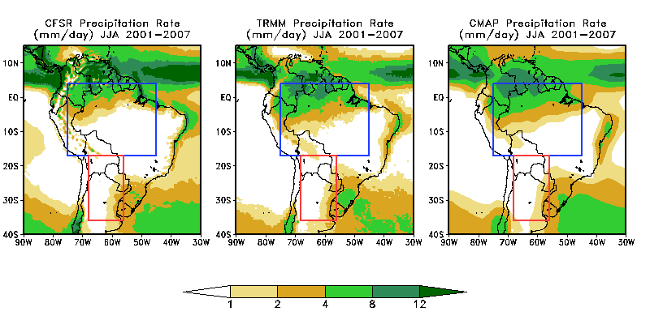

Slide 64
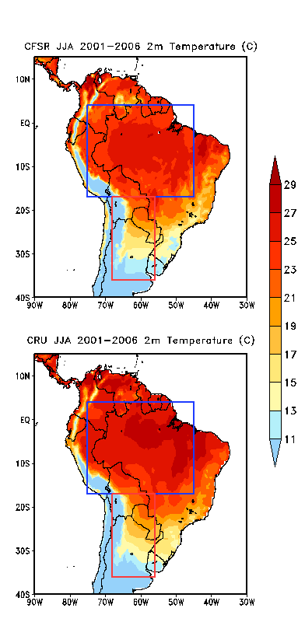

Slide 65
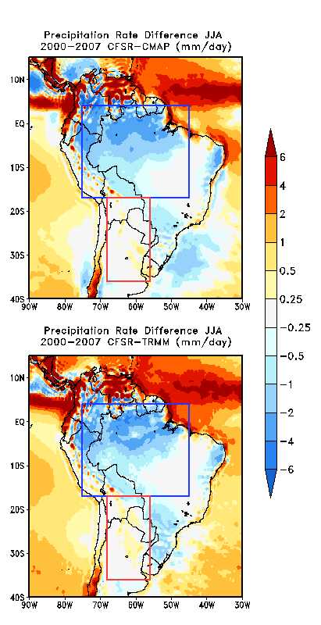

Slide 66
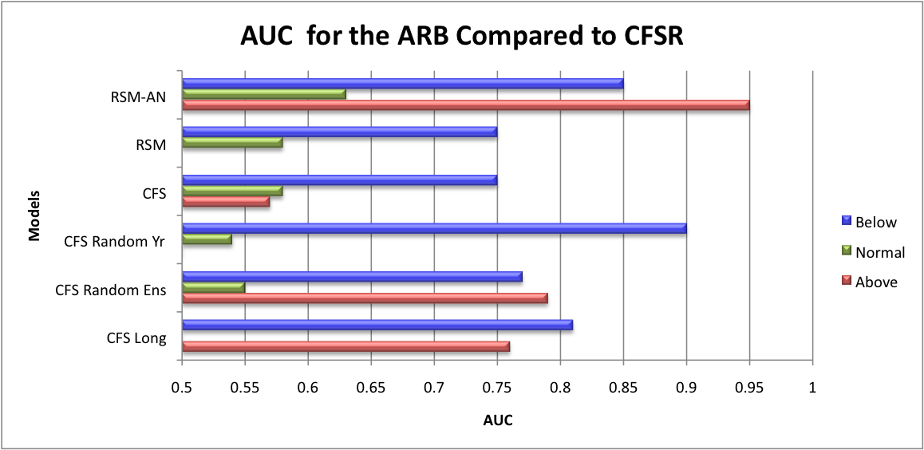
Extra Figures

Slide 71
Precipitation
RSM | ARB | 0.284957
RSM | ST | 0.221454
AN | ARB | 0.238857
AN | ST | 0.201998
CFS | ARB | 0.295158
CFS | ST | 0.125914
Temperature
RSM | ARB | 0.423523
RSM | ST | 0.241186
AN | ARB | 0.52827
AN | ST | 0.287035
CFS | ARB | 0.281875
CFS | ST | 0.23095

Slide 72
ARB Precip | RSM | AN | CFS
CFSR | 0.873358262 | -0.749822976 | -1.133152629
CMAP | -1.688243167 | -3.311424405 | -3.694754057
TRMM | -0.573443167 | -2.196624405 | -2.579954057
ST Precip | RSM | AN | CFS
CFSR | 0.214093167 | -0.097624095 | -0.426929619
CMAP | -0.347700262 | -0.659417524 | -0.988723048
TRMM | 0.363488452 | 0.05177119 | -0.277534333
ARB Temps | RSM | AN | CFS
CFSR | 0.010361905 | 0.911411429 | 3.450090476
ST Temps | RSM | AN | CFS
CFSR | 0.566916667 | 2.10339619 | -1.447493333

