Slide 1
DopplerScatt Simultaneous Surface Wind and Currrents
Jet Propulsion Laboratory, CalTech

Slide 2
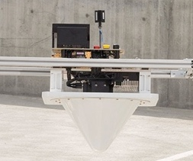
DopplerScatt Overview
DopplerScatt Overview
Scanning Doppler radar developed under NASA’s IIP program
Becoming operational under NASA AIST program
Data Products:
Vector ocean surface currents
Vector ocean surface winds
Radar brightness maps (sensitive to surfactants such as oil films)
Mapping capabilities: 25 km swath; maps 200km x 100km area in about 4 hrs; 200m data product resolution; 5-10cm/s radial velocity precision.
Current status:
Instrument hardware completed
Instrument currently undergoing final calibration and validation
Upcoming CalVal campaigns: SPLASH in Mississippi Delta (CARTHE) & Taylor Oil Platform Plume (NOAA), , April 18-28; KISS (NASA) in Monterey Bay May 1-4.
DopplerScatt instrument. It has been deployed on a DOE King Air and will transition to an operational instrument in the NASA King Air B200.
DopplerScatt radial surface currents and biological surfactants (white) at Columbia River mouth.
Potential Uses for Scientific Use
Observation of mesoscale to submesoscale transition in surface current circulation with associated wind drivers.
Observation of internal waves and evolution over synoptic scales
Improved understanding of air-sea interaction by simultaneous measurements of surface currents, wind stress, and SST (separate sensor that can be accommodated in NASA King Air platform).
Improved understanding of mechanisms leading to upwelling
Understanding of interactions of river plumes and ocean circulation, including mixing
Potential for Operational Use
High resolution characterization of circulation in coastal shipping areas
Tracking of surface surfactants (e.g., oil) with simultaneous measurements of surface currents and winds to aid models in prediction of dispersal
Understanding beach erosion
Planning for oil platform siting and safety

Slide 3
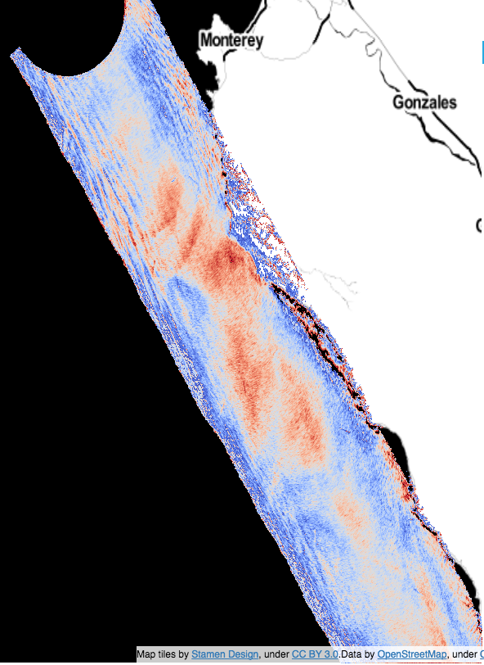
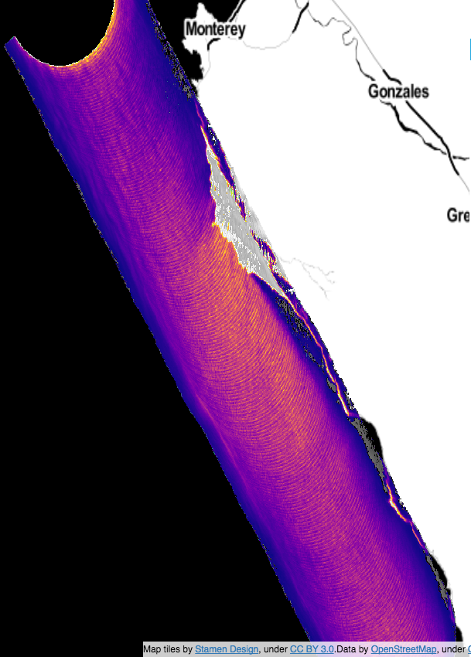
DopplerScatt physical measurements– Engineering Flight June 22nd 2016
Fore-looking Surface radial velocity from Doppler, after subtracting platform motion and rough Bragg contribution.
Notice tidally induced internal waves at the continental shelf.
Fore-looking backscatter cross section corresponding to radial velocity. Notice increased brightness due to wind strengthening off Point Sur.
Aft-looking residual radial velocities
Velocity (m/s)

Slide 4
Preliminary Retrievals with Wind Correction Internal Wave Changes
T = 0
T ~ 30 min
T ~ 90 min
T ~ 120 min
Speed
Speed & Direction
Notes:
Inclusion of this depends on Tom’s assessment. These plots show a zoom of the region on slide 13 retrieved from four different flight lines off the Monterey coast. The currents and vectors are retrieved every 200m. A wind correction based on a wind direction estimate from the sigma0 modulation (e.g., slide 11) has been applied. Only regions in the low-error western swath are shown. Swath width is a little larger than 10 km.

Slide 5
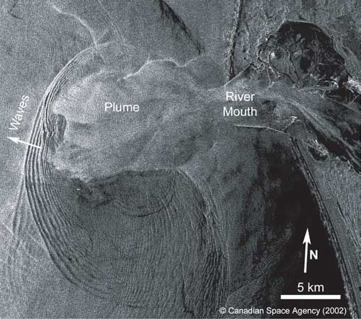
Columbia River Internal Wave Tidal Bore
Clockwise from top left:
1. Satellite SAR image of the Columbia river plume from Aug 9th 2002, Nash & Moum, Nature, 2005 showing internal waves generated by the plume. Another feature has been conjectured to be a submesoscale front (Akan et al, JGR submitted. J. McWilliams, personal communication)
2. DopplerScatt September 13th Track 1 fore-looking radial velocity
3. DopplerScatt September 13th Plume track fore-looking radial velocity
4. DopplerScatt September 13th Plume track aft-looking radial velocity
Submesoscale
front

Slide 6
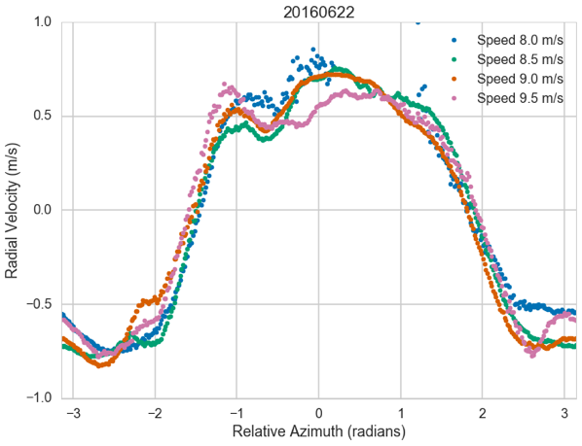
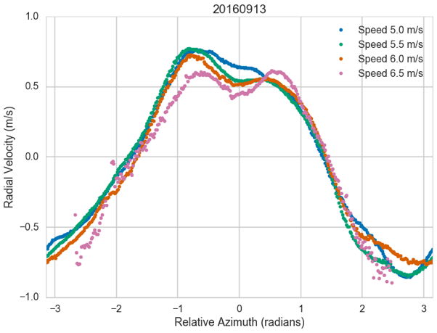
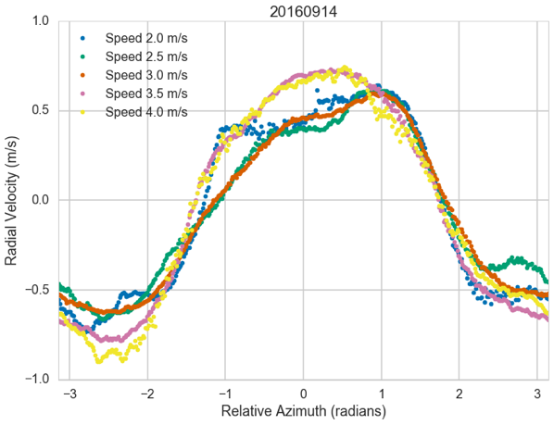
Correction for Wind-Driven Component
A wind driven component is estimated by binning Doppler velocities relative to wind direction to make a wind driven current GMF. The current estimates of the GMF are still being refined but preliminary estimates over a large range of wind speeds shows near universal behavior independent of waves and wind speed.
Notes:
Binning the observed radial velocities by azimuth relative to the wind direction for the data collected in Oregon and California shows the same general behavior (modulo real currents on the surface) independent of wind speed. These curves can be subtracted from the radial velocities prior to estimating the vector currents.

Slide 7
U/V Component Retrieval Errors
Notes:
This slide shows the random U,V surface velocity component errors estimated from pulse to pulse correlations. Due to geometry, there are large errors in the far-swath and along the nadir track. However, the swaths show good retrievals with a precision between 5cm/s to 10cm/s on a large part of the swath. The bite taken out of the data is land contamination from Point Sur.

Slide 8
Winds Retrieved from DopplerScatt

