Slide 1


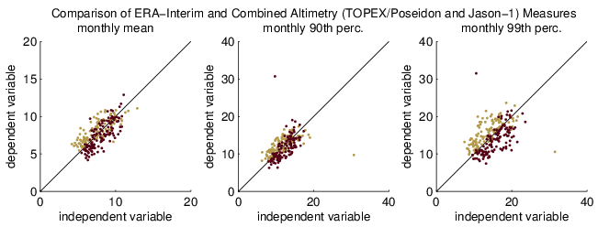
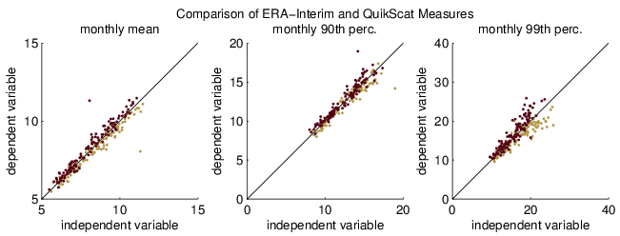
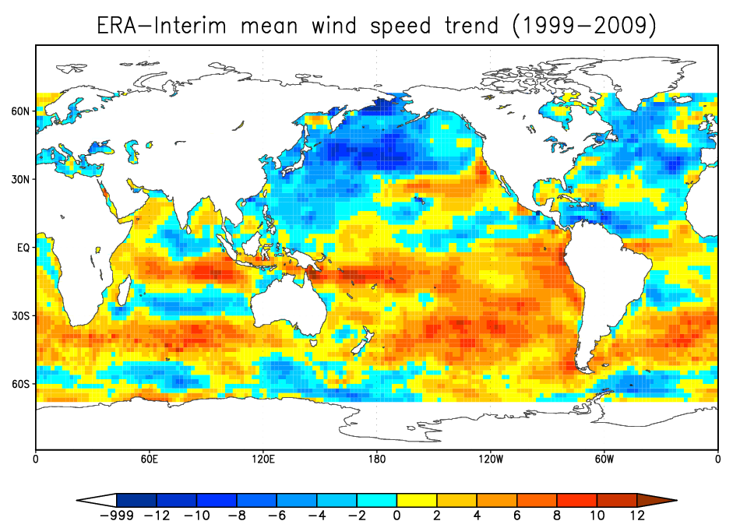
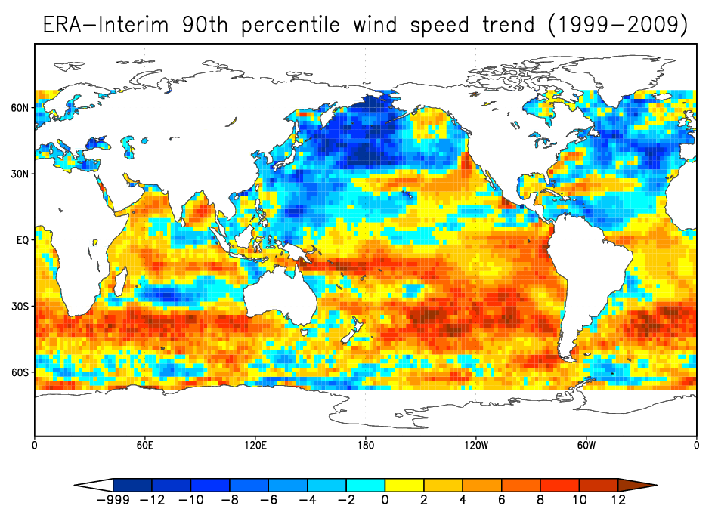
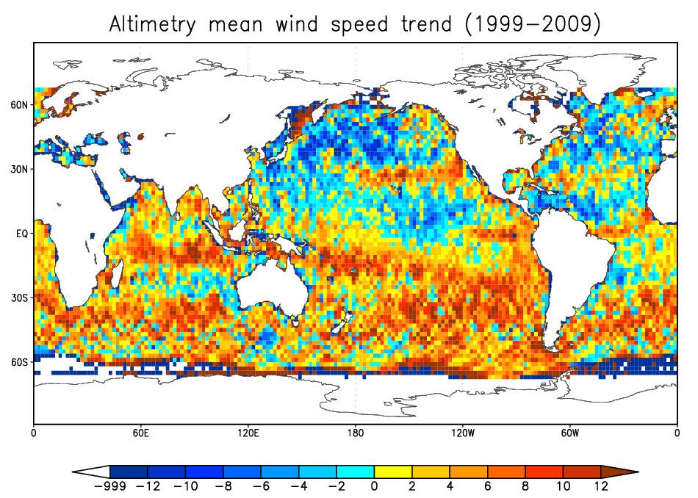
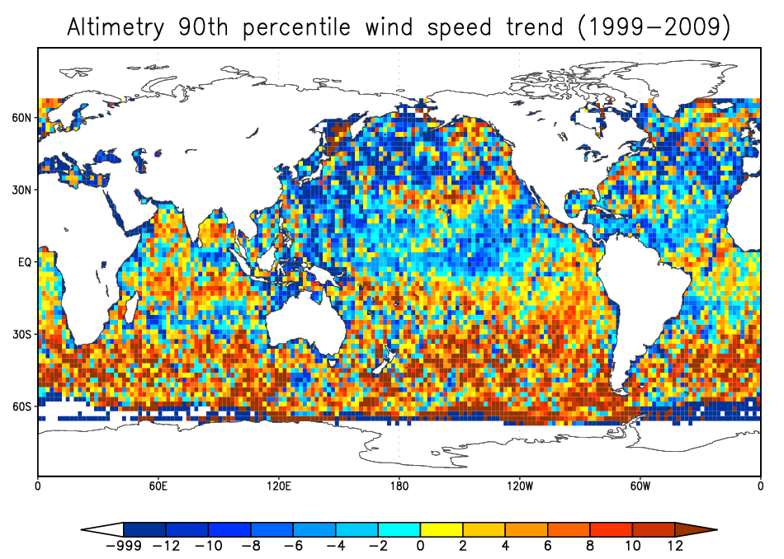
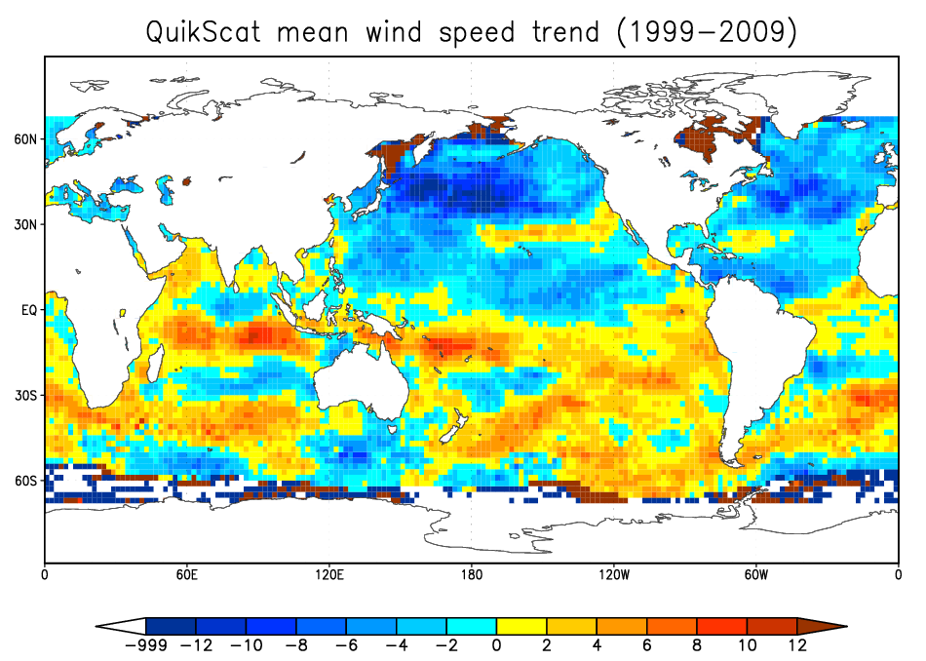
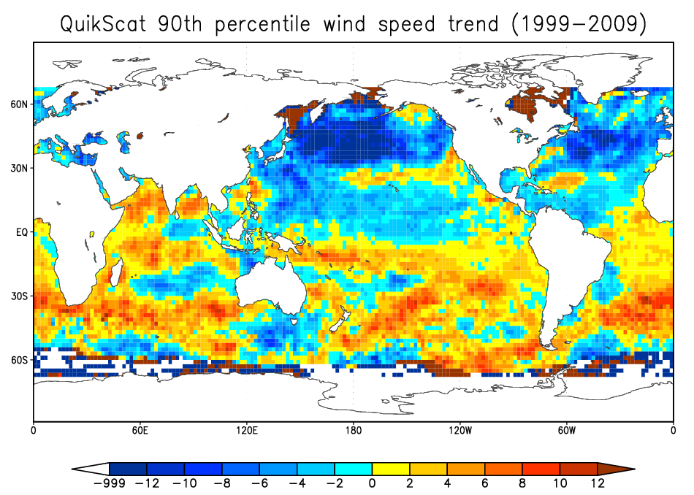
Assessing the Controversy between Altimetry, Radiometry, and Scatterometry: Satellite Observation Requirements for
Trends in Extreme Winds and Waves
Jason H. Keefer and Mark A. Bourassa
Center for Ocean—Atmospheric Prediction Studies, Florida State University, Tallahassee, Florida, USA
Introduction
Results
Young et al. (2011) studied global trends in mean, 90th percentile, and 99th percentile wind speed and wave height using a series of altimeters. The authors validated their findings against trends derived from buoy data and NCAR/NCEP reanalysis data.
Wentz and Ricciardulli (2011) raised concerns over the results of Young et al. (2011), stressing a potential lack of sampling from altimetry, inadequate verification, and greatly higher wind speed trends compared to earlier studies (e.g. Wentz et al. 2007).
This study aims to answer:
How do wind speed and wave height trends differ when trends derived from altimetry data compared to those derived from other sources, like scatterometry and microwave radiometry?
How do these trends compare with those from a reanalysis dataset?
What kind of sampling is needed for determining these trends?
Above: Scatter plots of monthly mean, 90th and 99th percentile values of wind speed. Exchanging the axis highlights biases and slope errors, as well differences in random errors, which do not appear to be important in these cases. These plots suggest differences in slope, consistent with images below.
Data and Methodology
This study uses the following data:
Reanalysis: ERA-Interim
Altimetry: TOPEX/Poseidon, Jason-1 missions
Scatterometry: QuikSCAT mission
Like Young et al. (2011), trends for mean, 90th- and 99th-percentile wind speed in 2° × 2° grid regions were calculated. Data from the altimetry missions were combined. Data from October 1999 through November 2009 were used to calculate the trends. This corresponds to a common era of overlap.
Preliminary Conclusions
Wind speed trends derived from the combined altimetry mission data is extremely noisy, and appear to be very sensitive to lack of sampling, and are larger than the other trends.
QuikScat-derived wind speed trends are noisy compared to ERA-Interim-derived trends, but do not suffer the same sampling-related problems as the altimetry-derived trends (except at very high latitudes).
Above: Contour plots of mean (left) and 90th percentile (right) wind speed trend (99th percentile not shown). Units in cm/s/year (except for missing data — value of ‒999).
Future Work
References
Further work in this study will involve data from the SSM/I missions.
Sub-sampling the ERA-Interim dataset to mimic satellite sampling will isolate sampling-related errors.
This study also aims to quantify the sampling necessary to determine extreme wind speed and wave height trends.
Wentz, F. J., and L. Ricciardulli, 2011: Comment on “Global trends in wind speed and wave height.” Science, 334, 905-b, www.sciencemag.org/cgi/content/full/334/6058/905-b.
Wentz, F. J., L. Ricciardulli, K. Hilburn, and C. Mears, 2007: How much more rain will global warming bring? Science, 317, 233—235.
Young, I. R., S. Zieger, and A. V. Babanin, 2011: Global trends in wind speed and wave height. Science, 332, 451–455.

