Slide 1
Impact of horizontal resolution (1/12° to 1/50°) on Gulf Stream separation and penetration
Eric Chassignet and Xiaobiao Xu
Florida State University

Slide 2
Questions
When do we have convergence?
How well do the simulations compare to observations?
When is the solution “good enough”?
Are the mesoscale and sub-mesoscale eddy activity representative of quasigeostrophic (QG) or surface quasigeostrophic (SQG) turbulence?

Slide 3
Approach
Identical North Atlantic configurations with the horizontal resolution varying from 1/12° to 1/50°
Analysis
Comparison to observations
Ratio of ageostrophy to geostrophy
Ability of altimetry to represent eddy activity
Power spectra

Slide 4
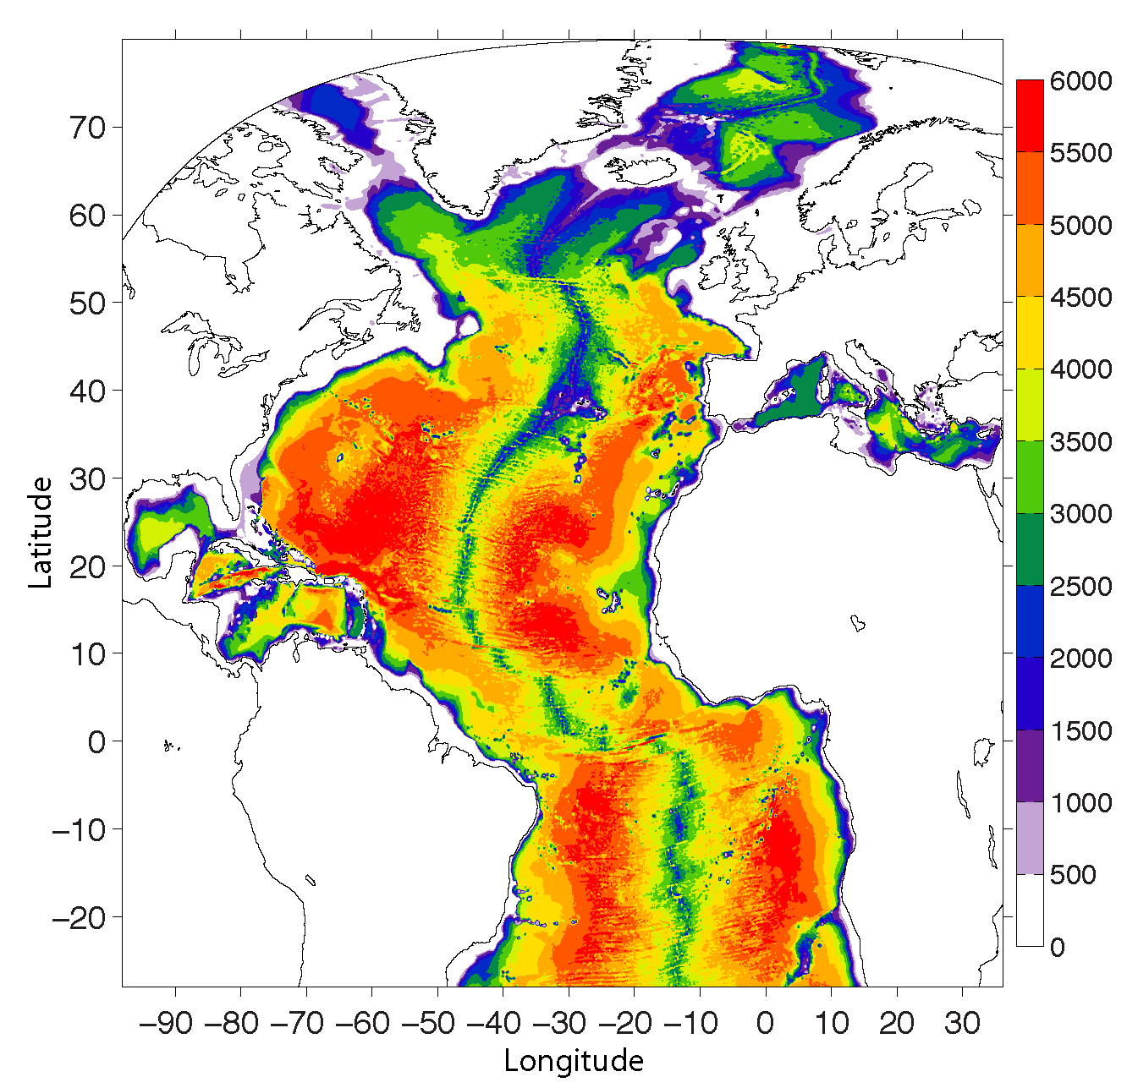
Identical 32 layers HYCOM configuration including topography.
Climatological forcing with daily variability
Viscosity as a function of grid spacing (1/12° and 1/25°)
Same viscosity for 1/25° and 1/50°
500k CPU-hours per model year for the 1/50°

Slide 5
MKE Atlantic simulation spinup
Domain averaged kinetic energy of monthly mean flow (thin) and 12-month averages (thick)

Slide 6
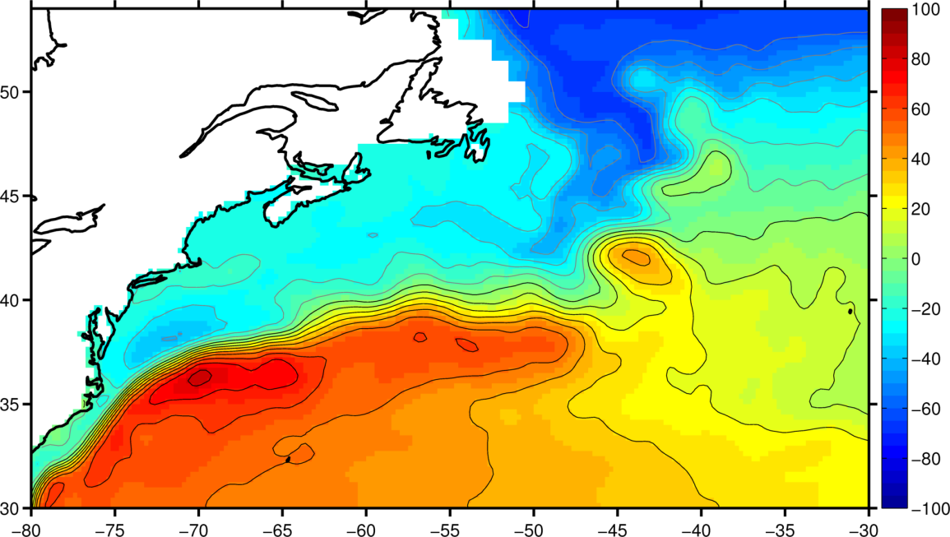
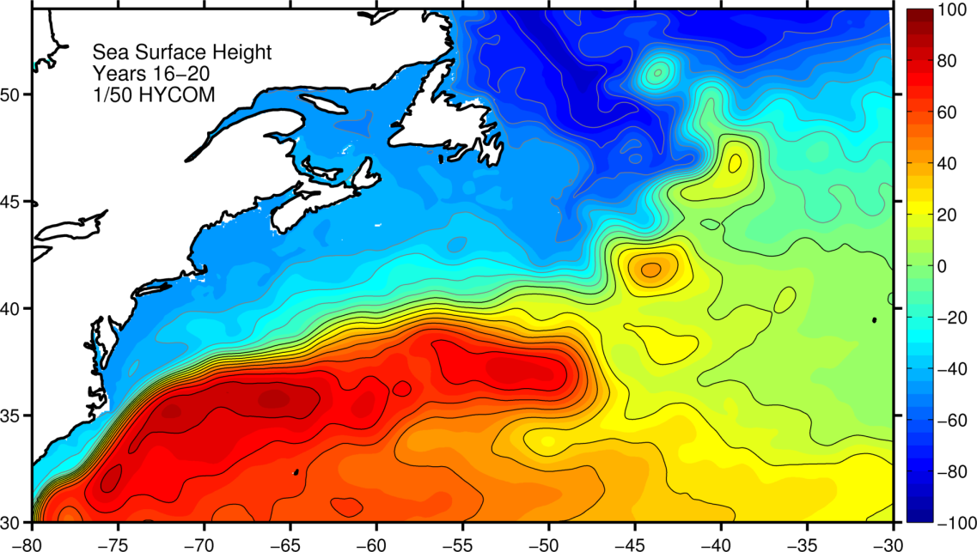
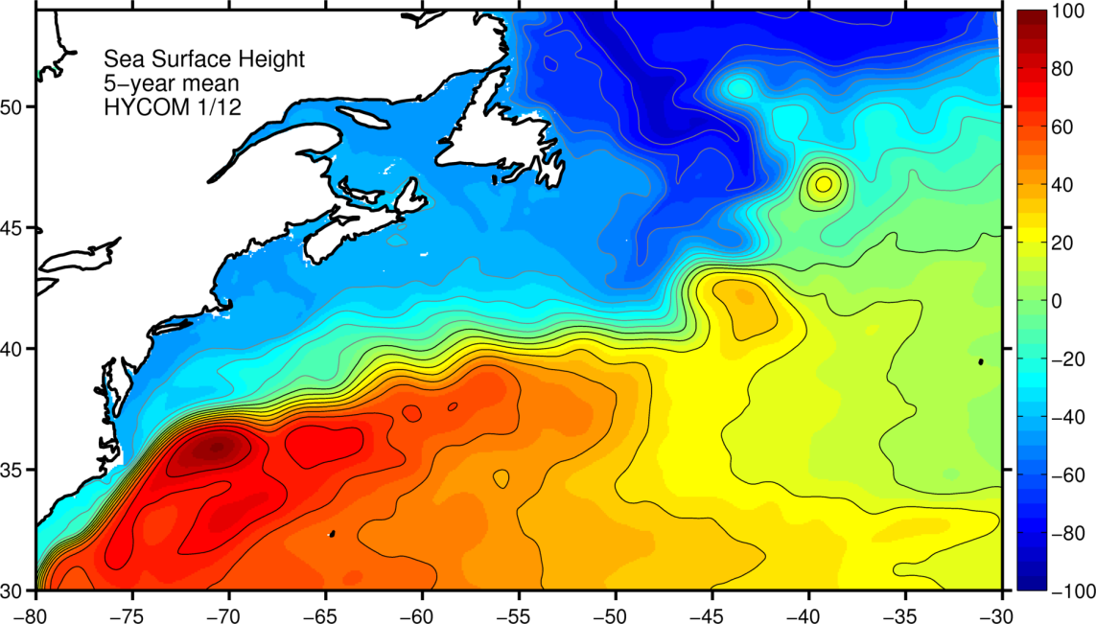
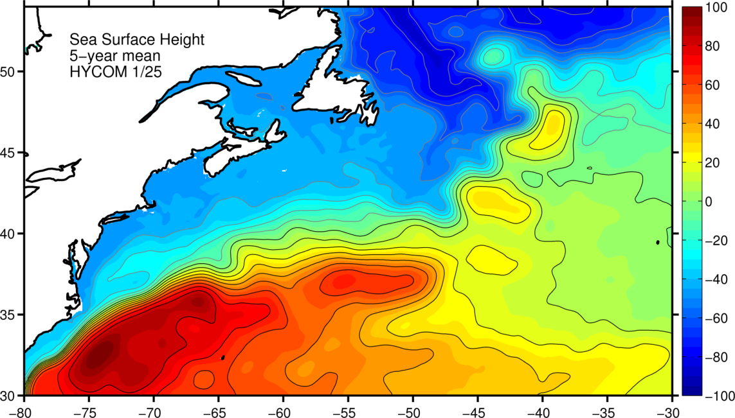
Mean SSH (Years 16-20)
CNES-CLS
2013
1/50°
1/12°
1/25°

Slide 7
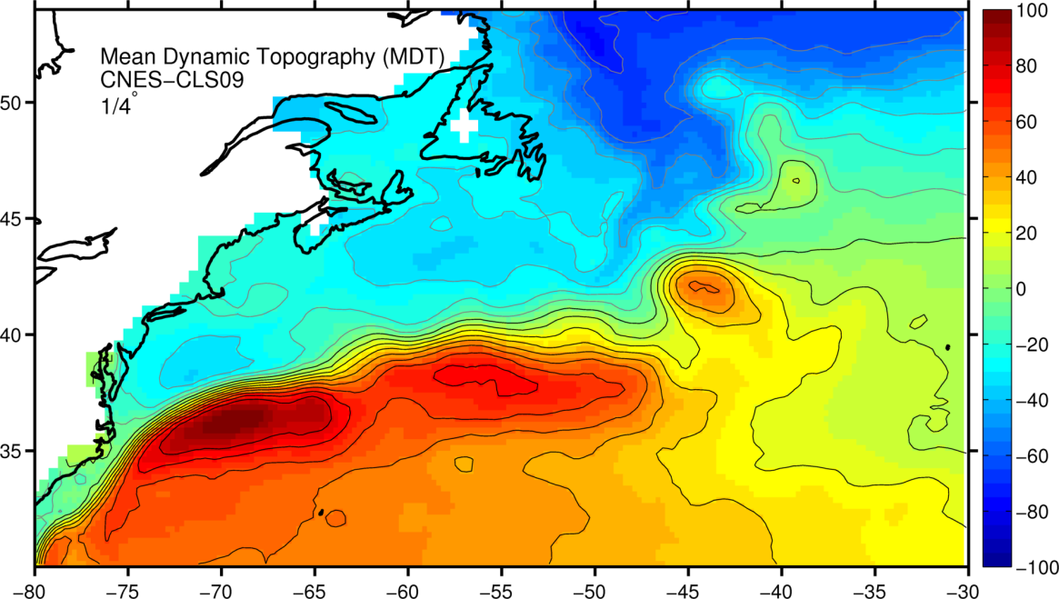
Mean SSH (Years 16-20)
CNES-CLS
2009
1/50°
1/12°
1/25°

Slide 8
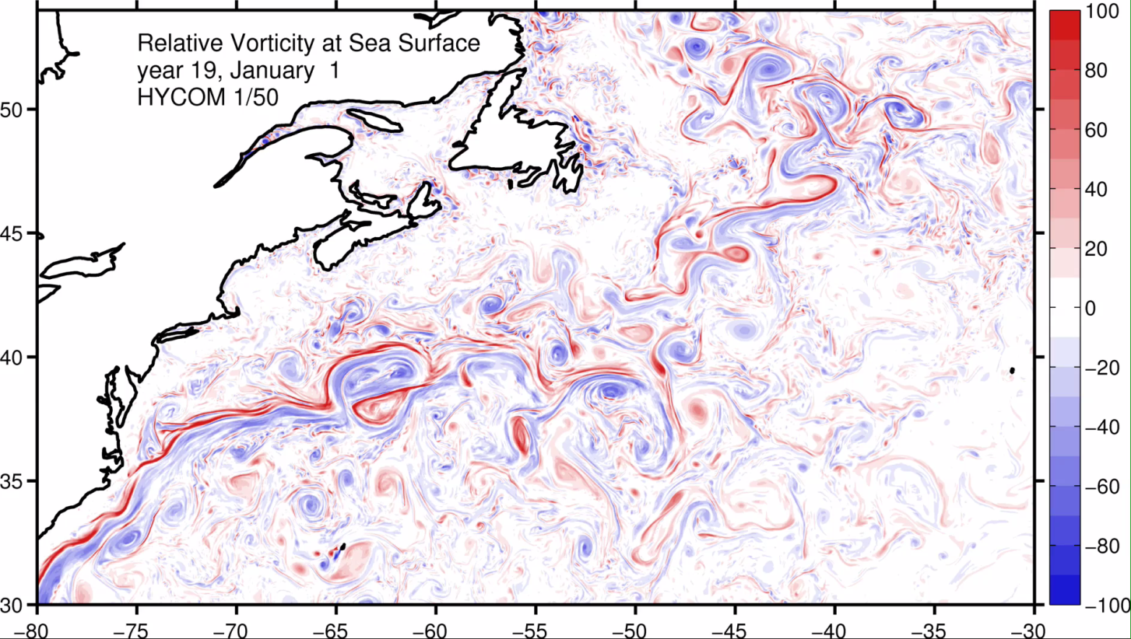
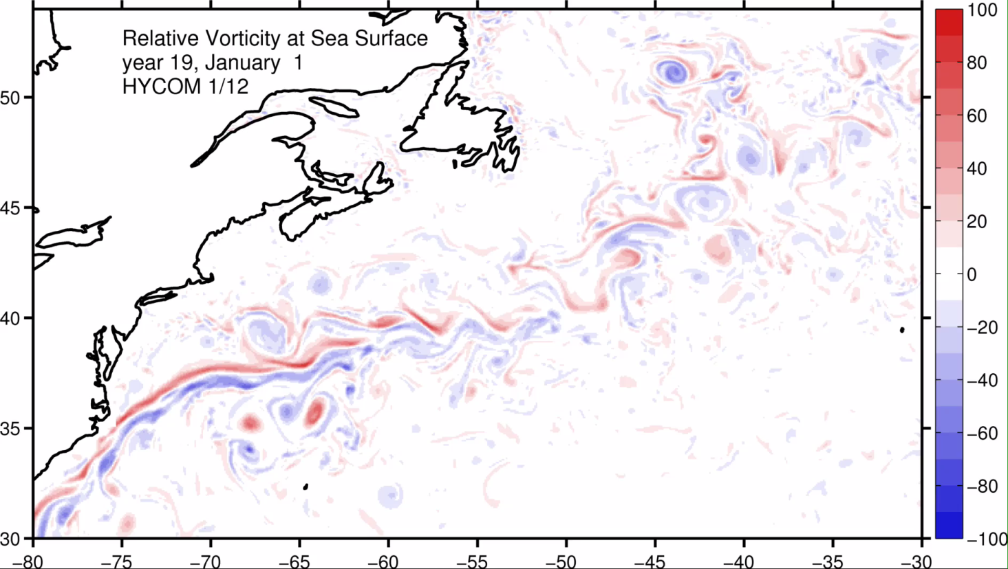

Slide 9
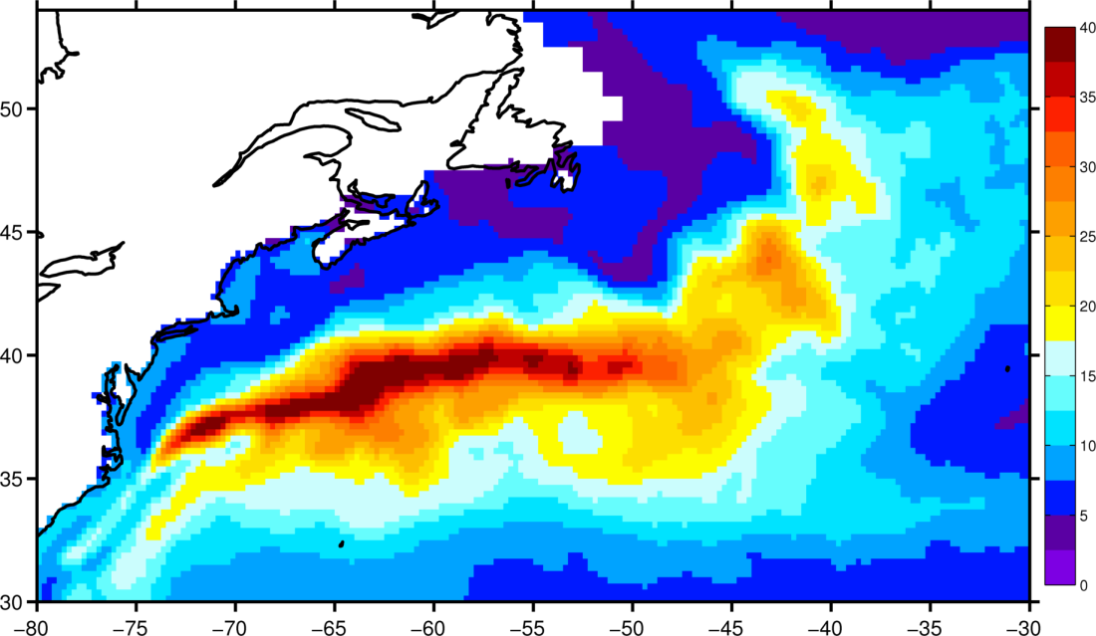
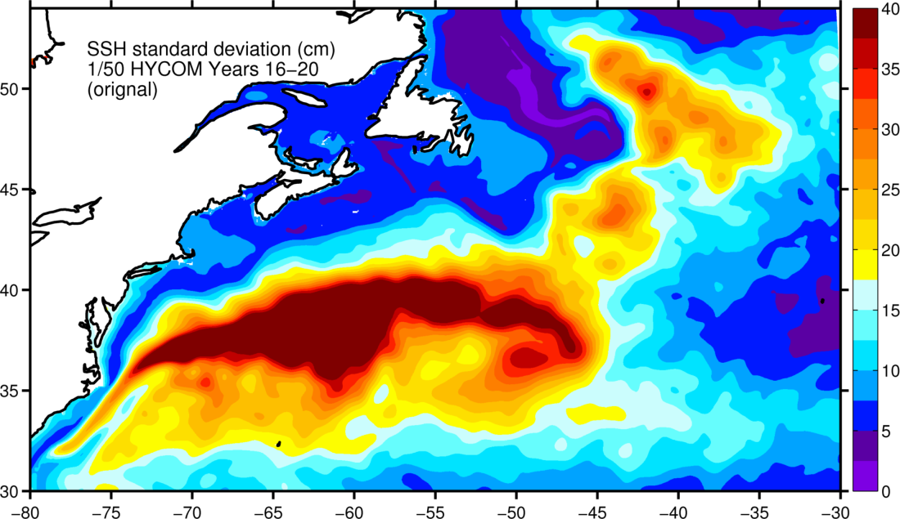
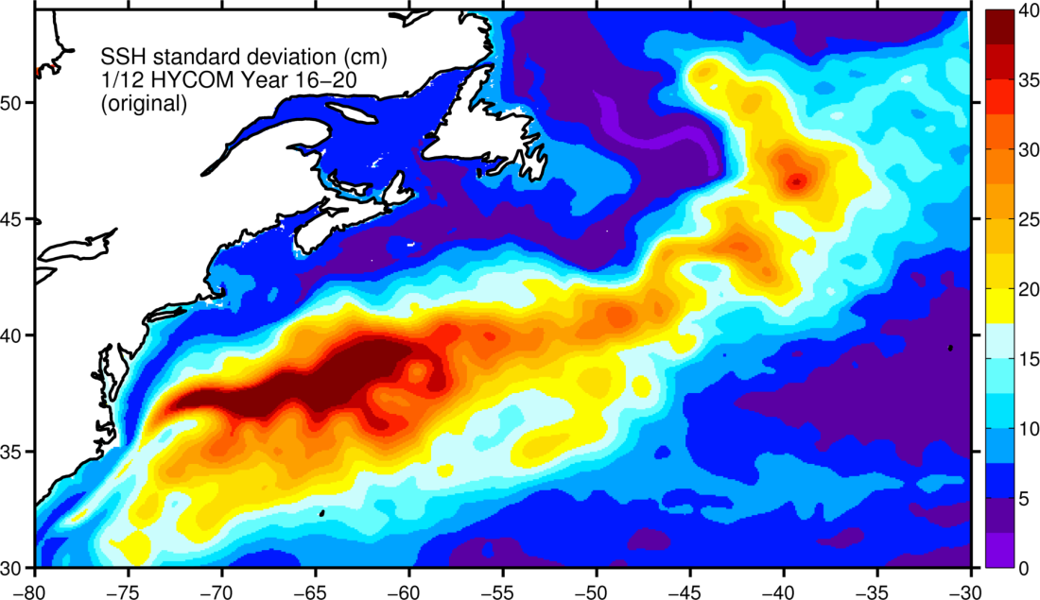
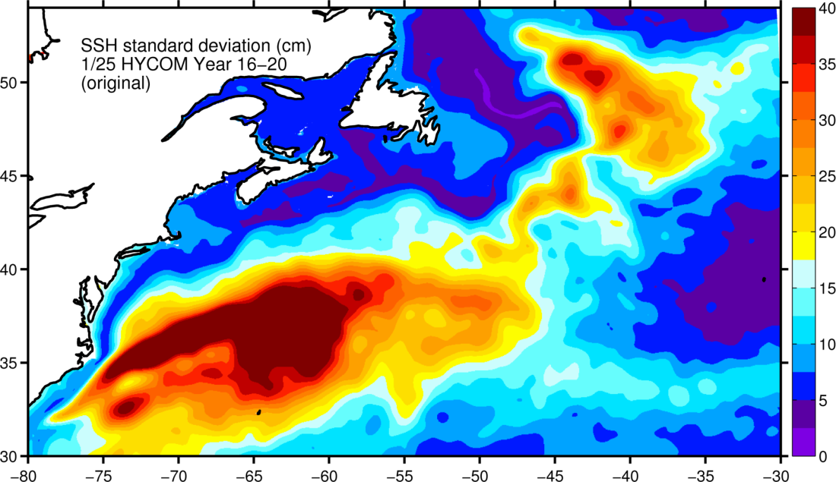
SSH variability (Years 16-20)
AVISO
1/50°
1/12°
1/25°

Slide 10
Mean zonal velocity at 55°W
(Richardson, 1985)
Years 16-20

Slide 11
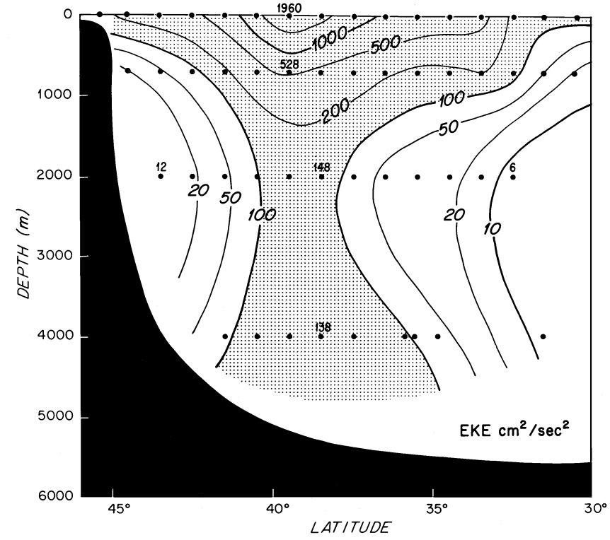
Mean Eddy Kinetic Energy at 55°W
(Richardson, 1985)
Years 16-20

Slide 12
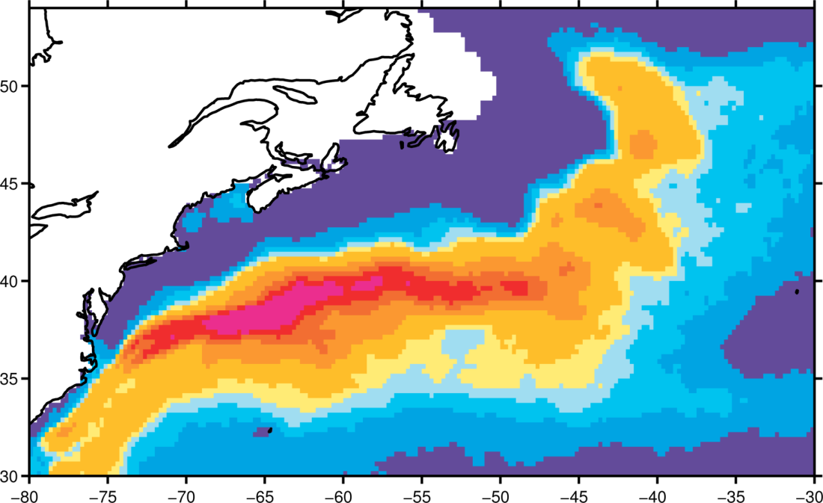
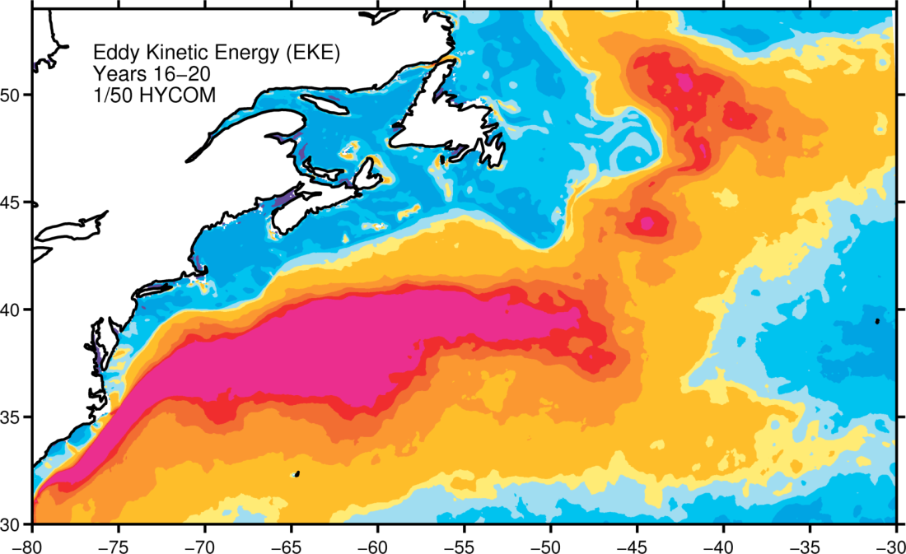
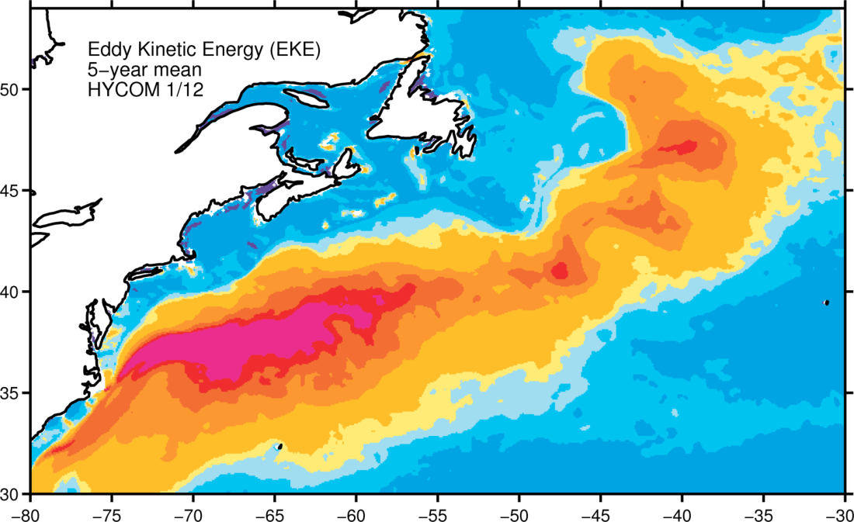
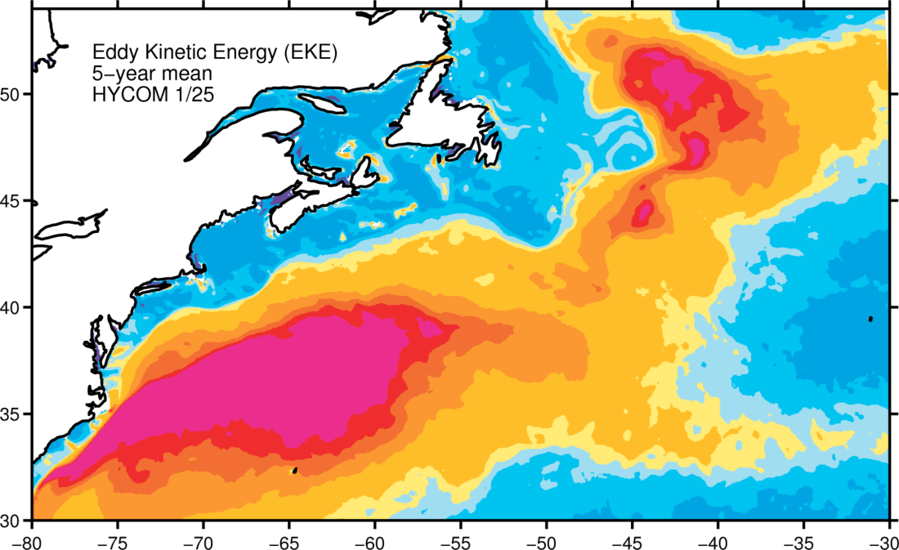
Surface EKE (Years 16-20)
AVISO
1/50°
1/12°
1/25°

Slide 13
Why is the modeled EKE in the Gulf Stream is higher than altimetry (AVISO)?
Ageostrophic contribution?
Spatial and temporal averaging in the observations?
Smaller viscosity in model than in reality?

Slide 14
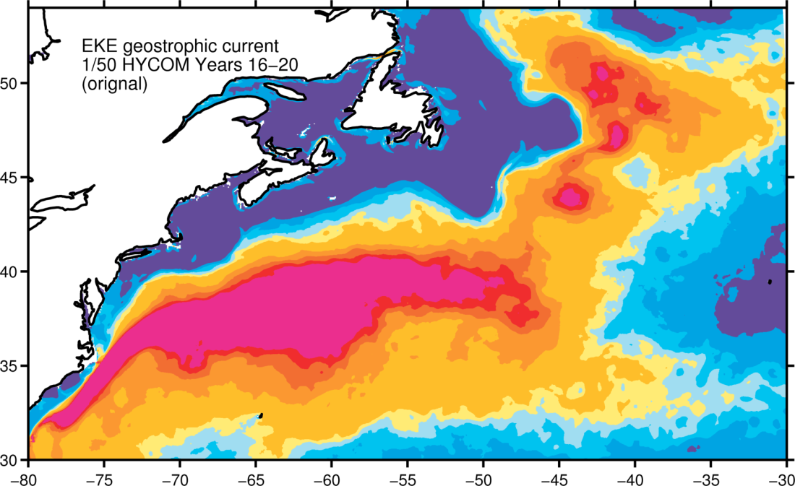
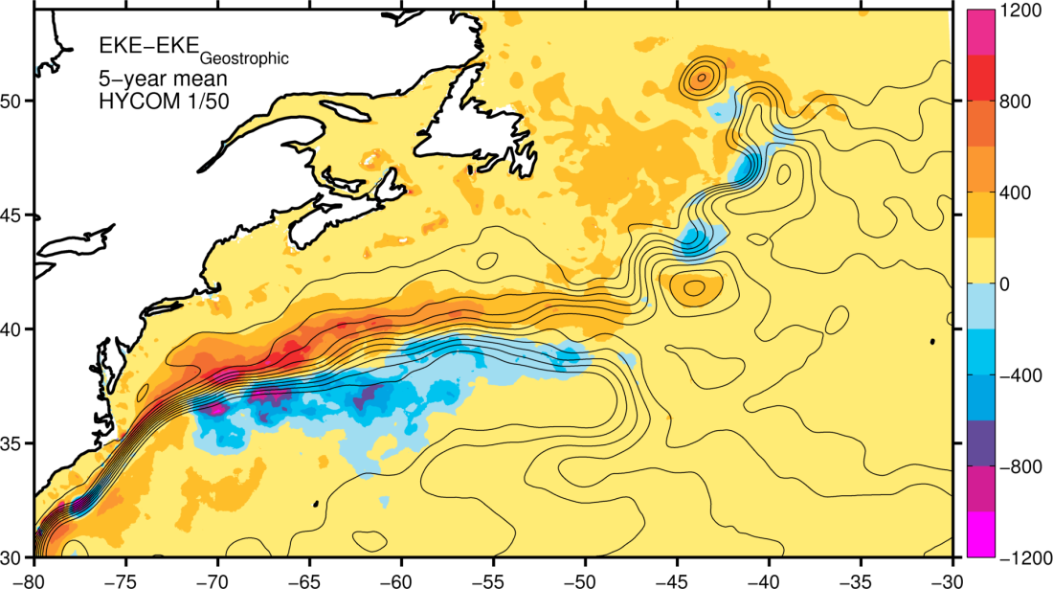
EKE geostrophic difference (1/50°)
TOTAL
GEOSTROPHIC

Slide 15
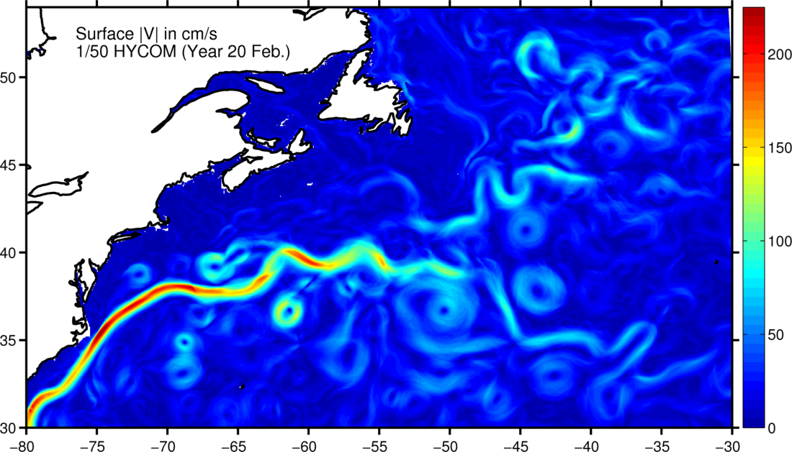
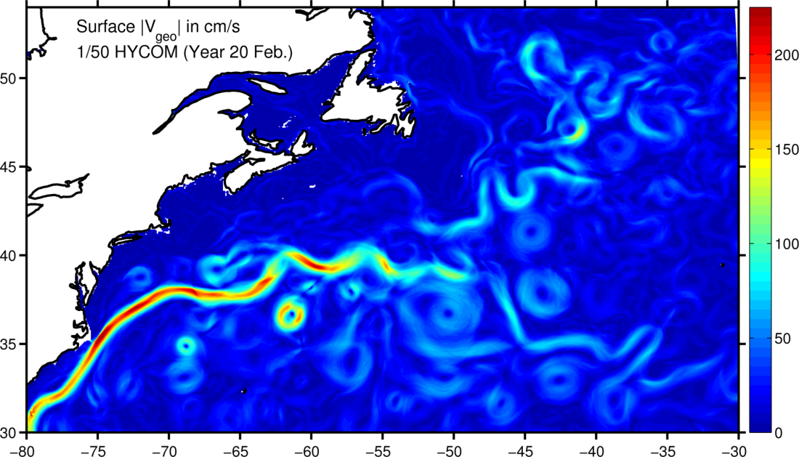
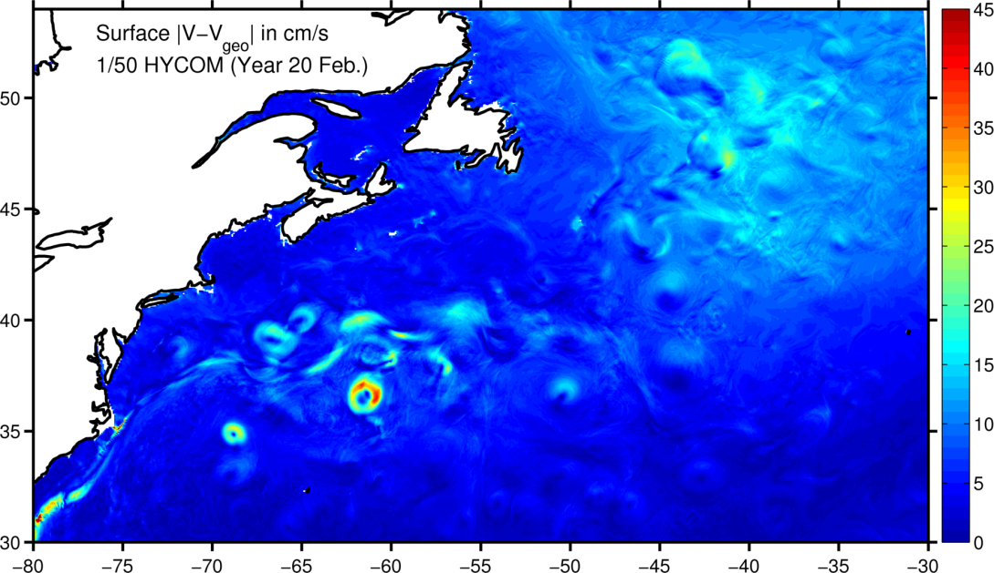
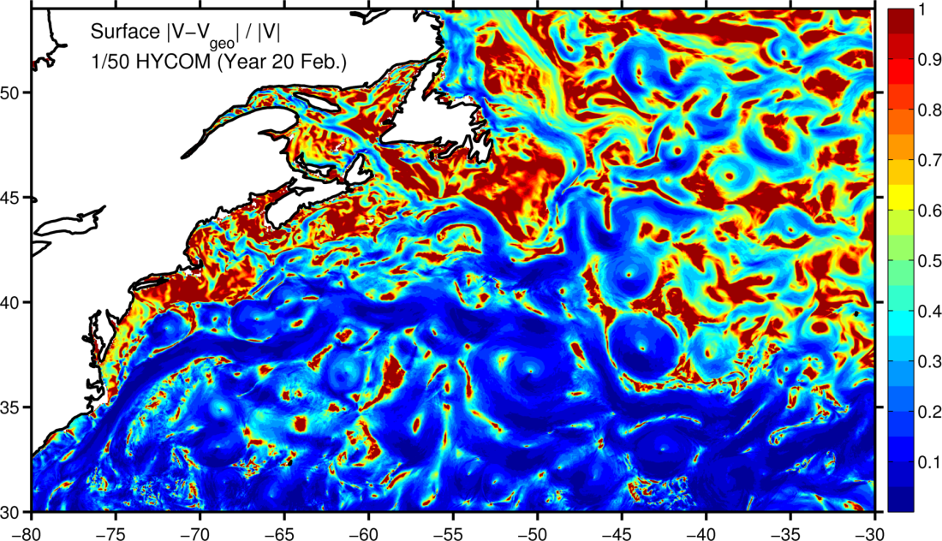
For a typical month

Slide 16
Zoom
Warm ring
Cold ring
Ekman drift

Slide 17
SSH spectra in the North Atlantic
1000
km
250
km
70
km
10
km
1/12°
1/25°
1/50°
Winter
Summer
k⁻⁵
-5.124 (-5.223, -5.025)
-4.905 (-4.983, -4.828)
-4.962 (-5.038, -4.886)
Linear fit coefficients (with 95% confidence bounds) for horizontal scale of 70-250 km
Notes:
Linear

Slide 18
SSH wavenumber Spectrum
The results, which are independent of resolution, suggest that the SSH spectra slope is k⁻⁵, in agreement with QG turbulence theory. This is in agreement with shipboard ADCP observations (Wang et al., 2010) and the latest spectra calculated from along-track satellite altimetry data with high-frequency noise corrections (Zhou et al., 2015). Seasonal dependence is most significant below 70 km.
SSH spectral slope is k⁻⁴ in quiescent regions.

Slide 19
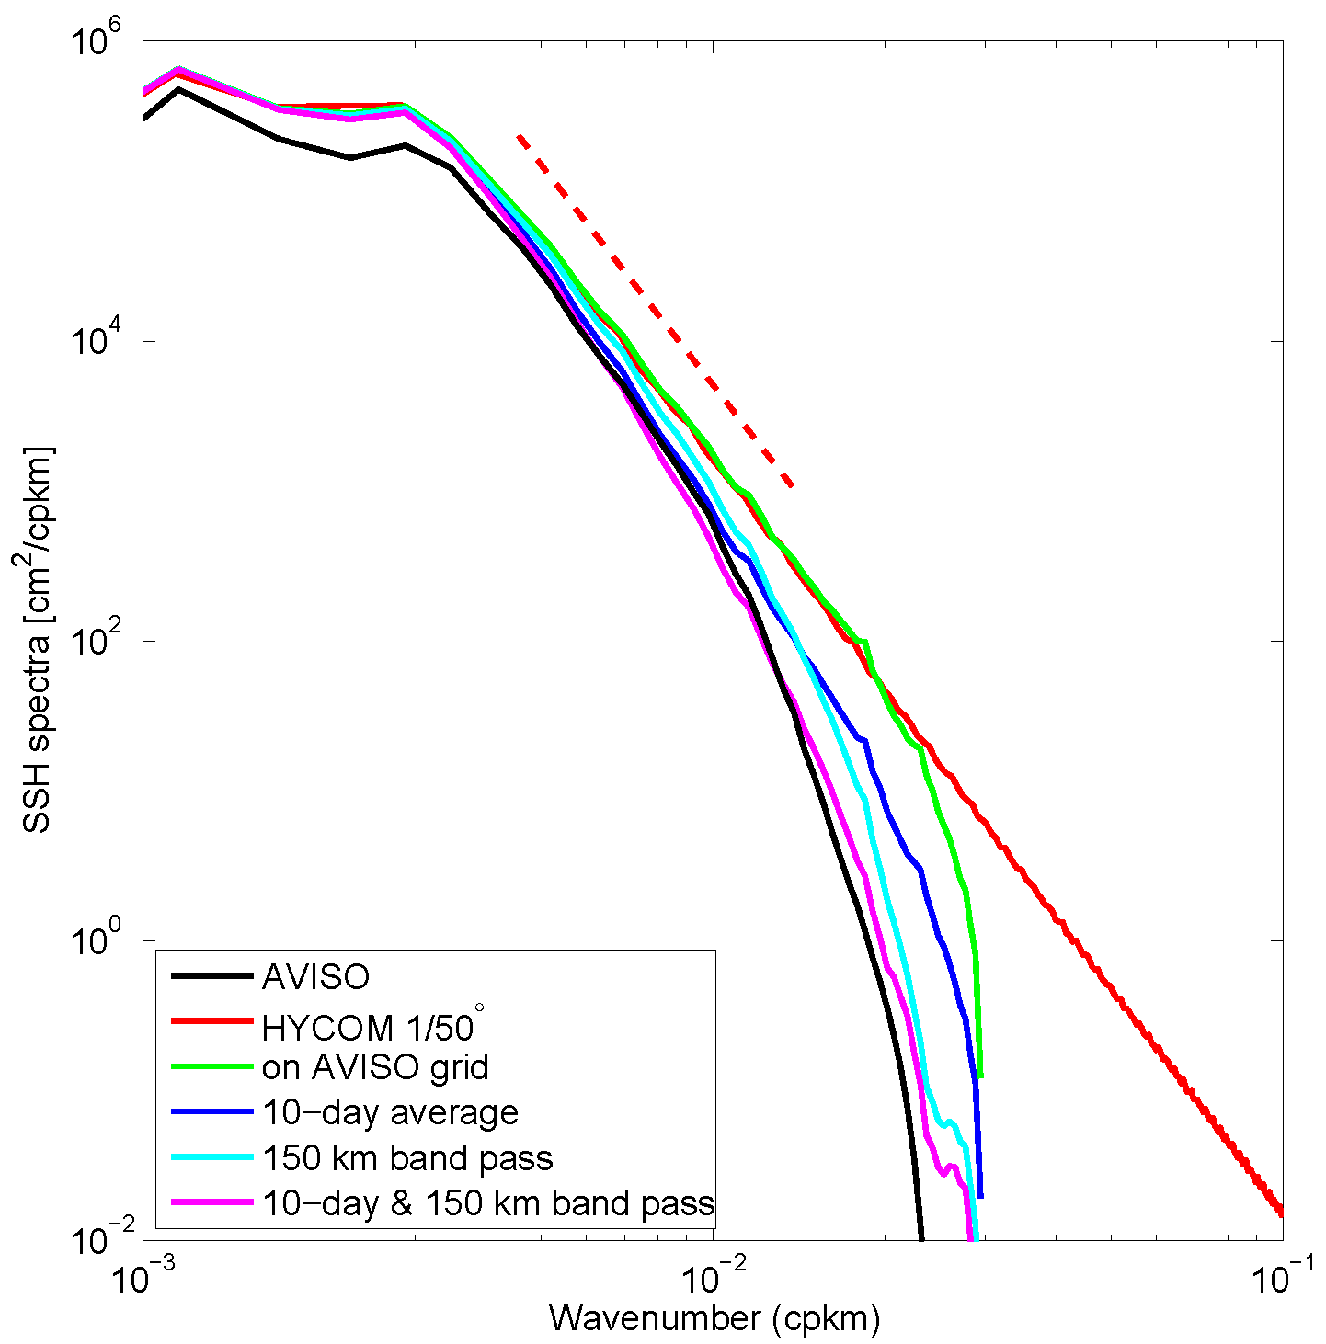
Altimetry resolves eddy scales greater than 150km
k⁻⁵

Slide 20
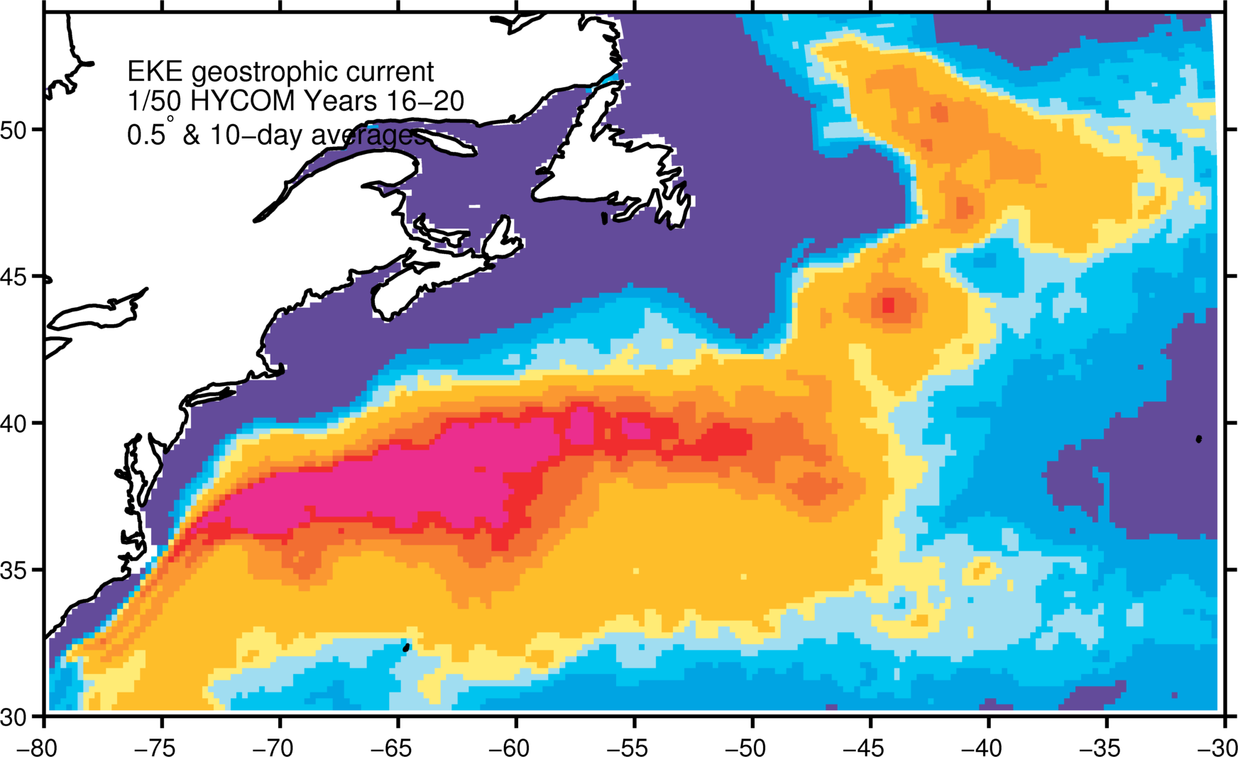
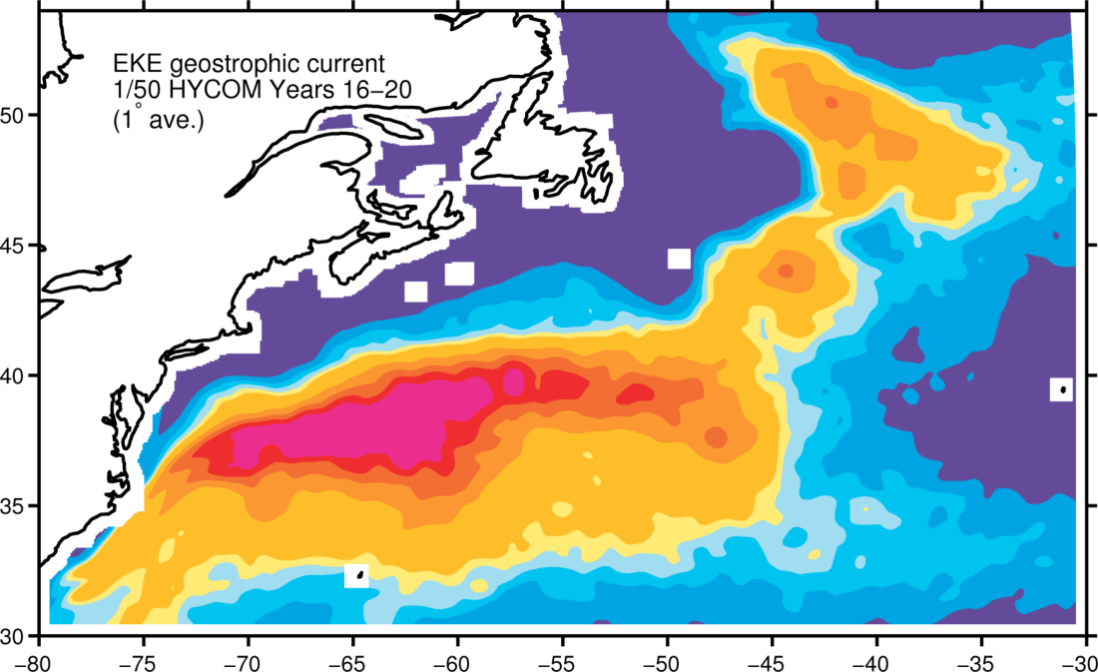

Impact of averaging on EKE
AVISO
1/50°
150 km
band pass
+
10-day
average
150 km
band pass
1°

Slide 21
Summary
Significant improvement in Gulf Stream model representation at 1/50°.
Time and spatial averaging are responsible for the observed difference between altimetry and model EKE.
The ageostrophic component in eddies is always cyclonic and increases/decreases the EKE on the north/south side of the Gulf Stream.
Power spectra agree with QG turbulence.

Slide 22
Questions?

