Slide 1
Impact of horizontal resolution (1/12° to 1/50°) on Gulf Stream separation and penetration
Eric Chassignet and Xiaobiao Xu
Florida State University

Slide 2
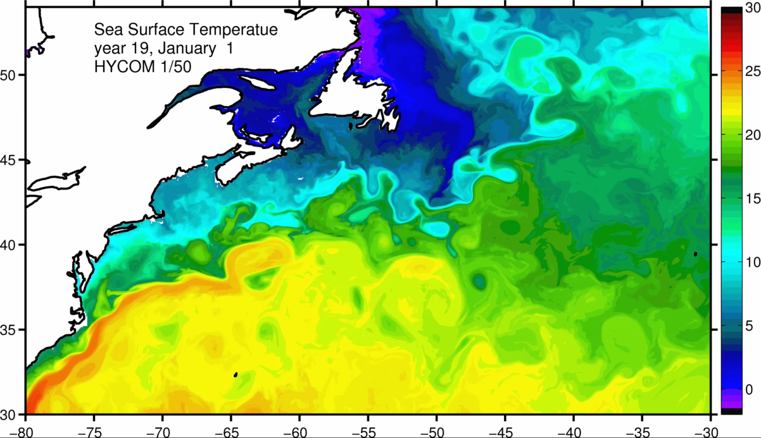

Slide 3
Questions
How well do the simulations compare to observations?
When is the solution “good enough”? Convergent?
Are the mesoscale and sub-mesoscale eddy activity representative of quasigeostrophic (QG) or surface quasigeostrophic (SQG) turbulence?
Current status: Most high resolution ocean models are still very sensitive to numerical choices. While ~1/10 degree grid spacing is now routine, very few simulations use higher resolution, often with mixed success.

Slide 4
Approach
Identical North Atlantic configurations with the horizontal resolution varying from 1/12° to 1/50°
Analysis
Comparison to observations
Ratio of ageostrophy to geostrophy
Ability of altimetry to represent eddy activity
Power spectra

Slide 5
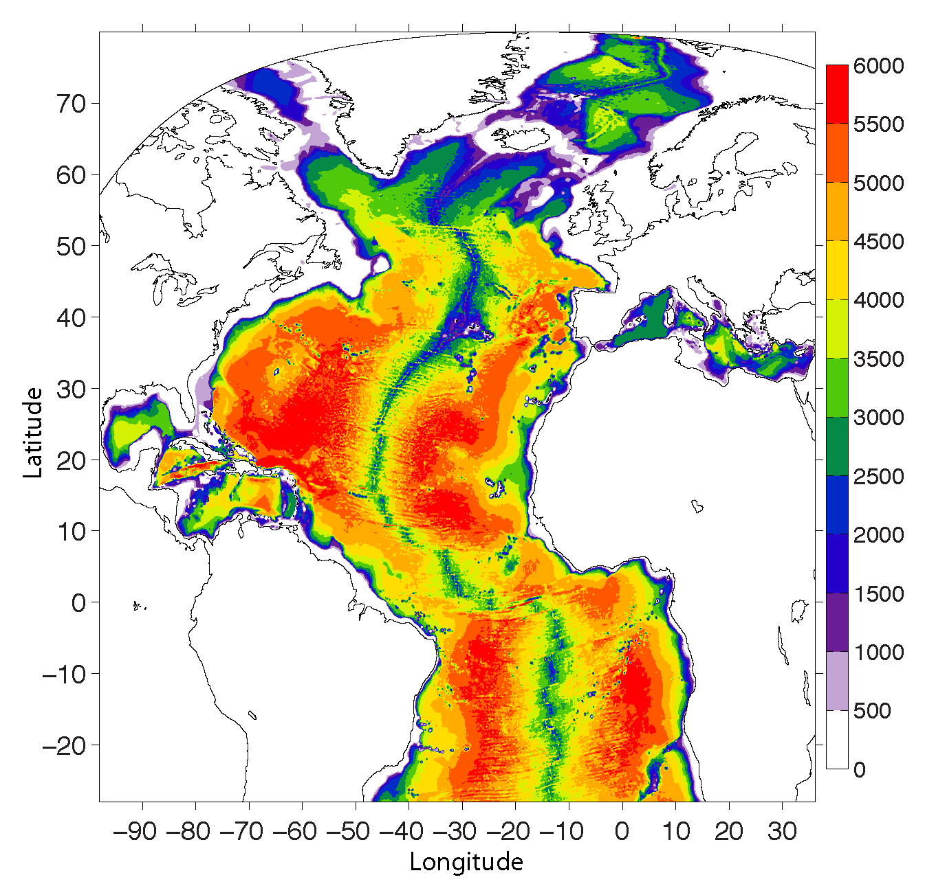
Identical 32 layers HYCOM configuration including topography.
Closed boundaries
Climatological forcing with daily variability
Viscosity as a function of grid spacing (1/12° and 1/25°)
Same viscosity for 1/25° and 1/50°
500k CPU-hours per model year for the 1/50°

Slide 6
MKE Atlantic simulation spinup
Domain averaged kinetic energy - monthly (thin) and yearly (thick)

Slide 7
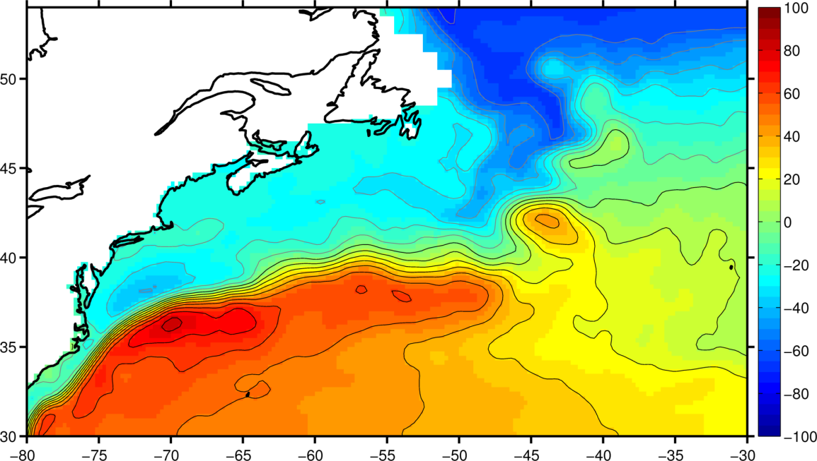
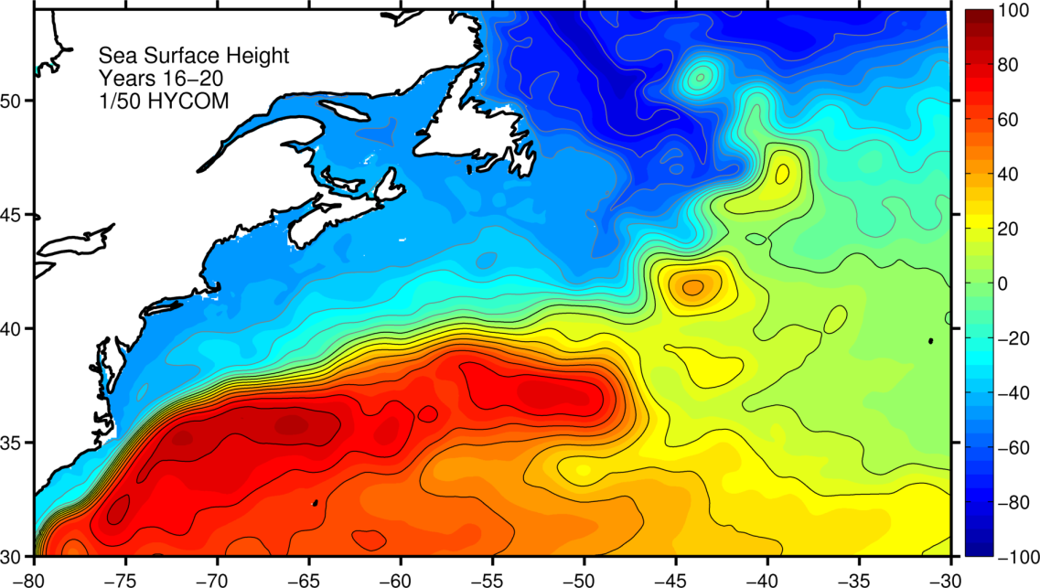
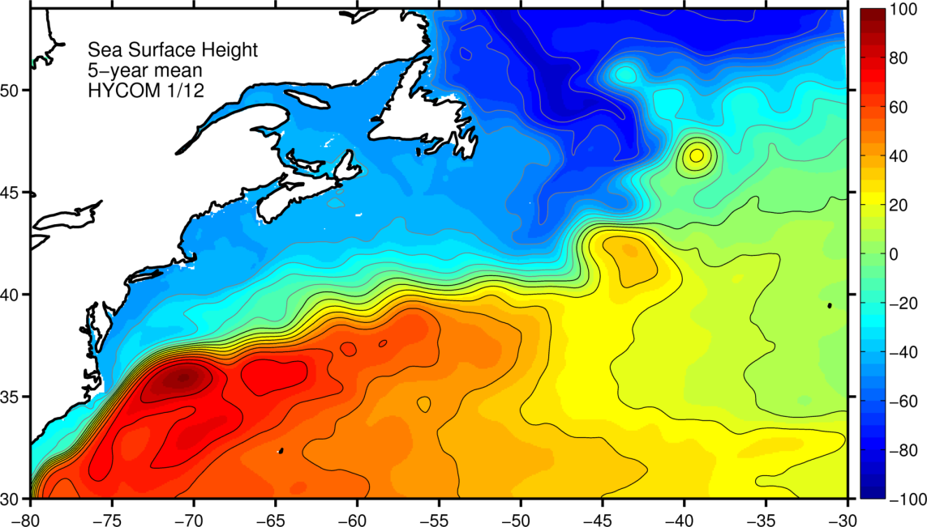
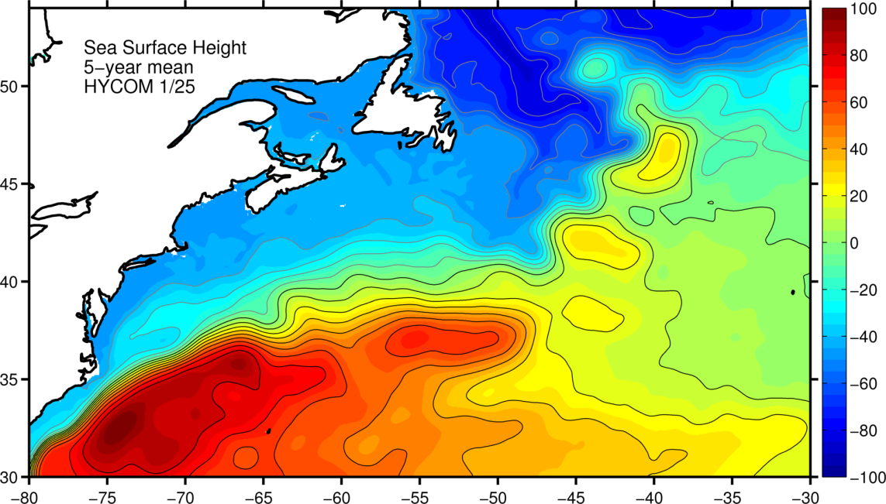
Mean SSH (Years 16-20)
CNES-CLS
2013
1/50°
1/12°
1/25°

Slide 8
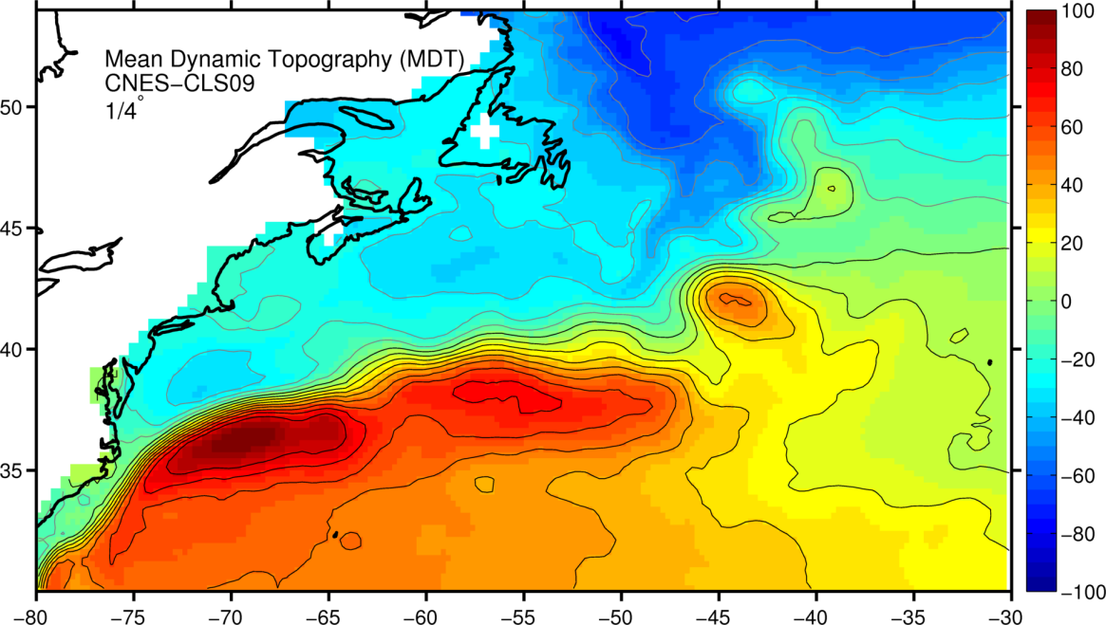
Mean SSH (Years 16-20)
CNES-CLS
2009
1/50°
1/12°
1/25°

Slide 9
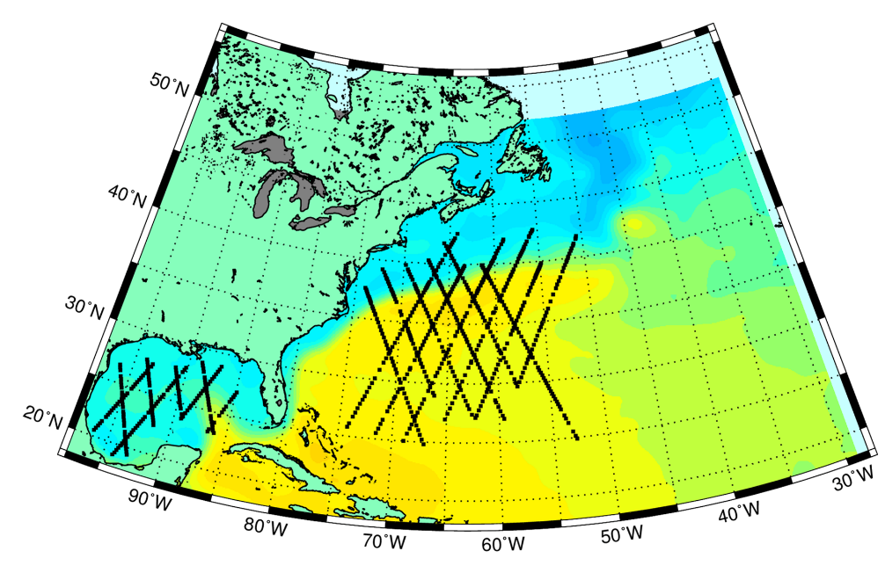
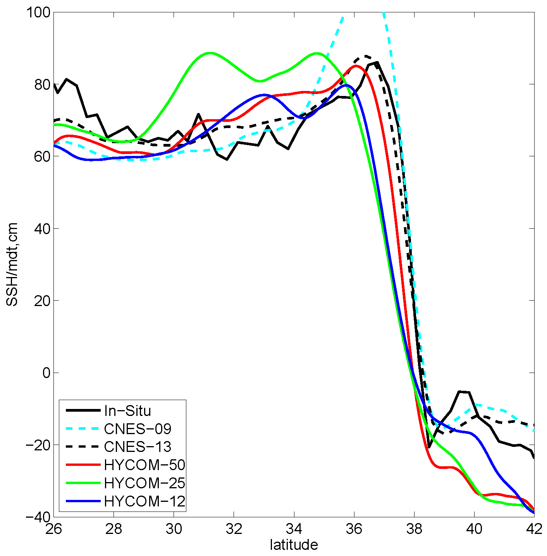
SSH across Gulf Stream

Slide 10
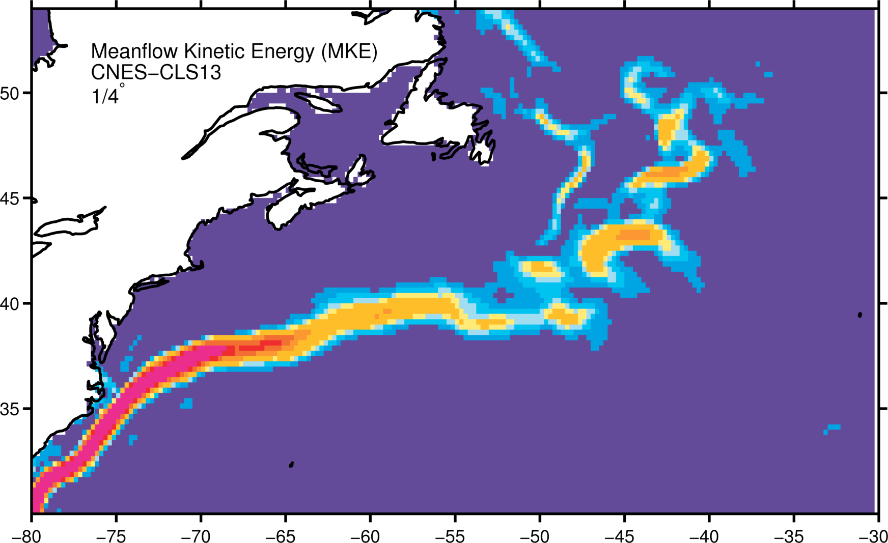
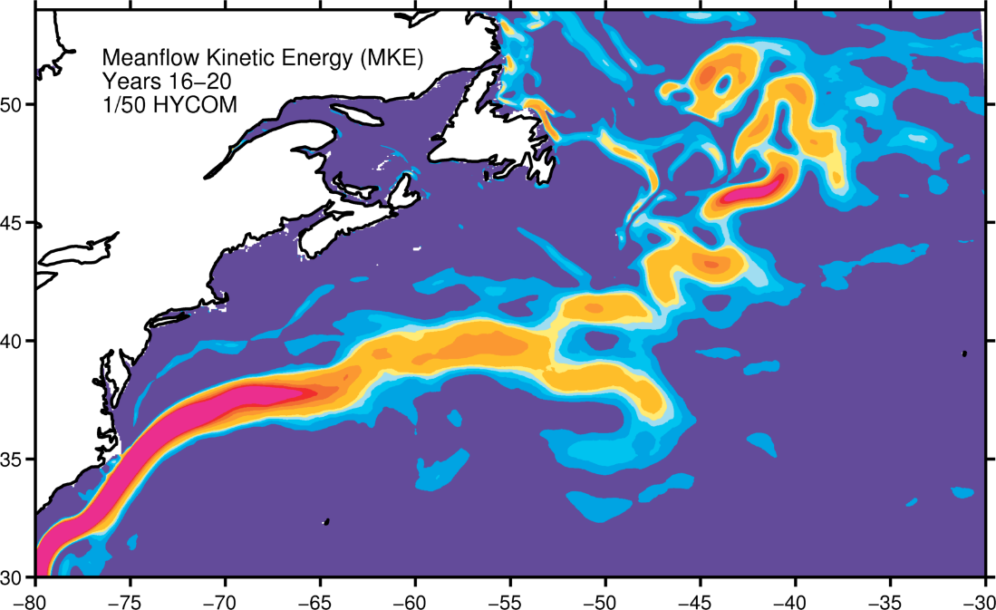
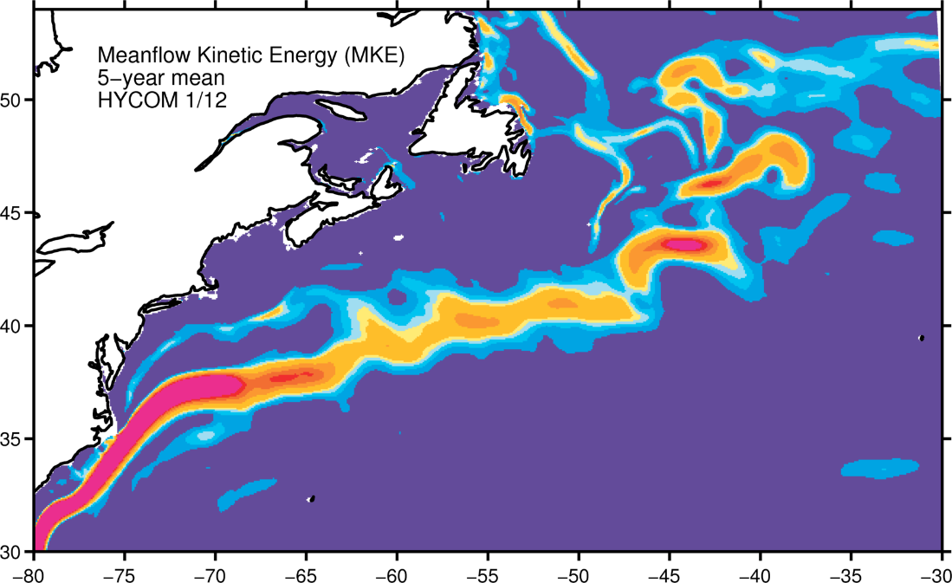
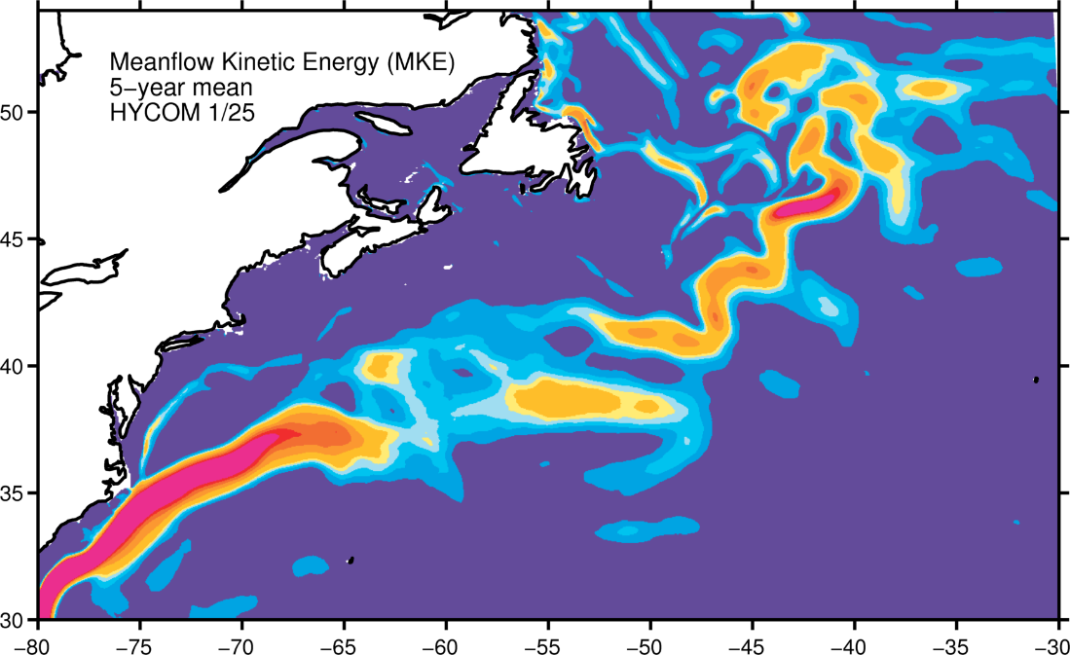
Surface MKE (mean flow)
AVISO 1993-2013
AVISO 1993-2013
CNES-CLS
2013
1/50°
1/12°
1/25°

Slide 11
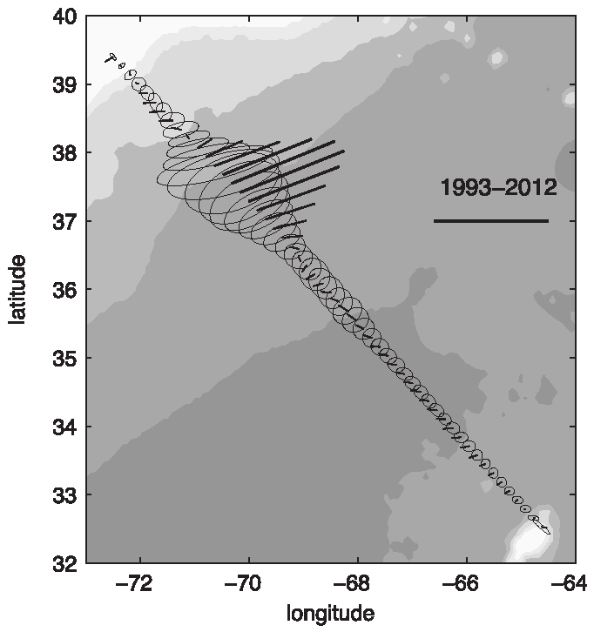
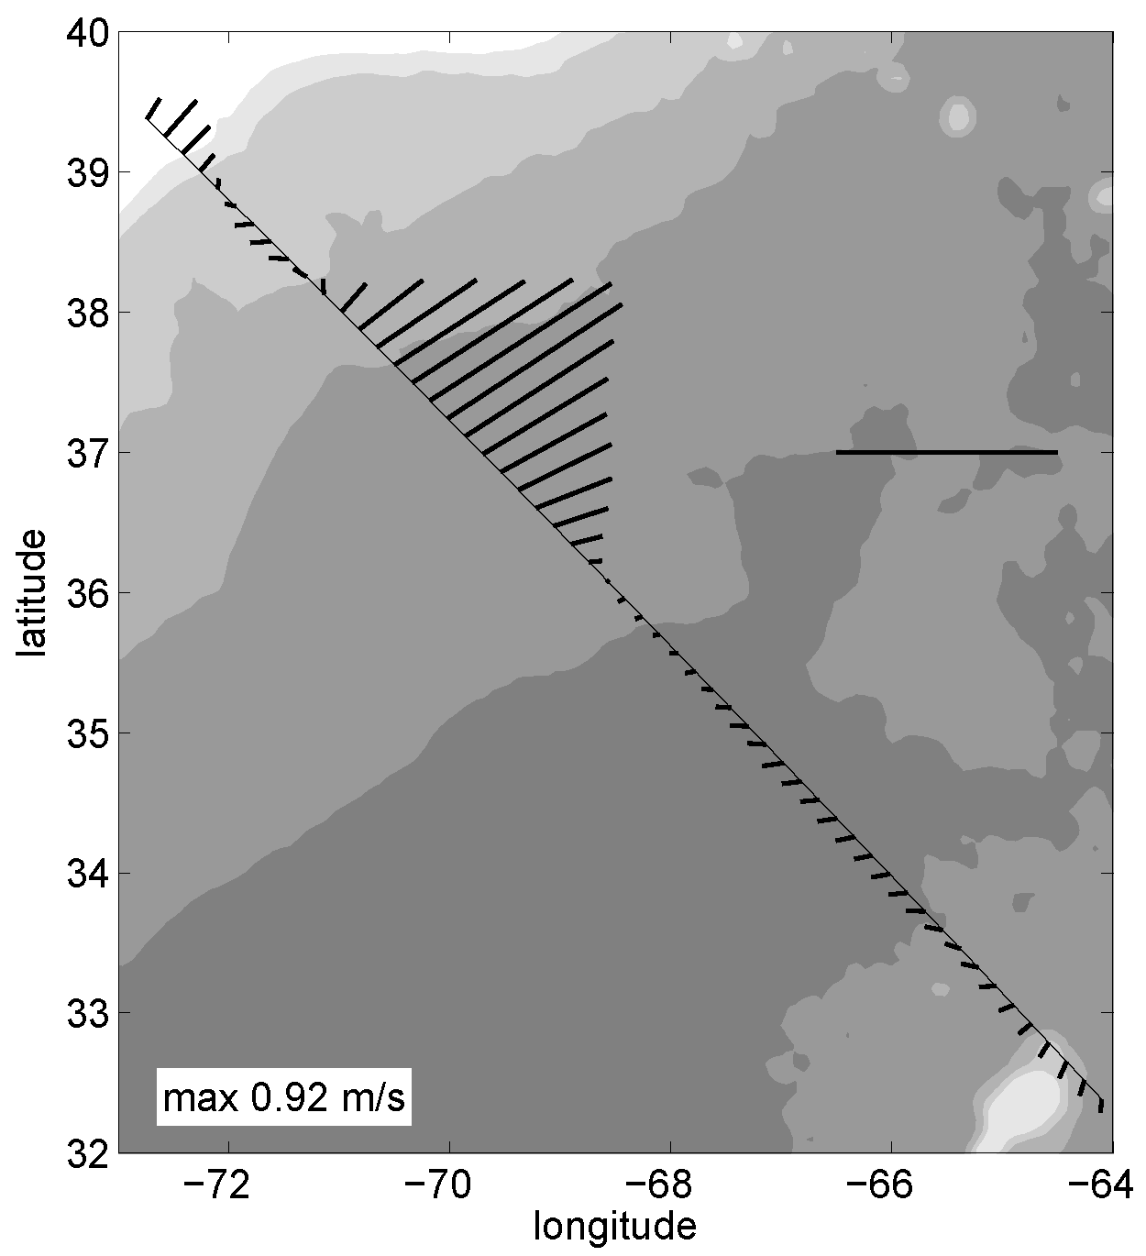
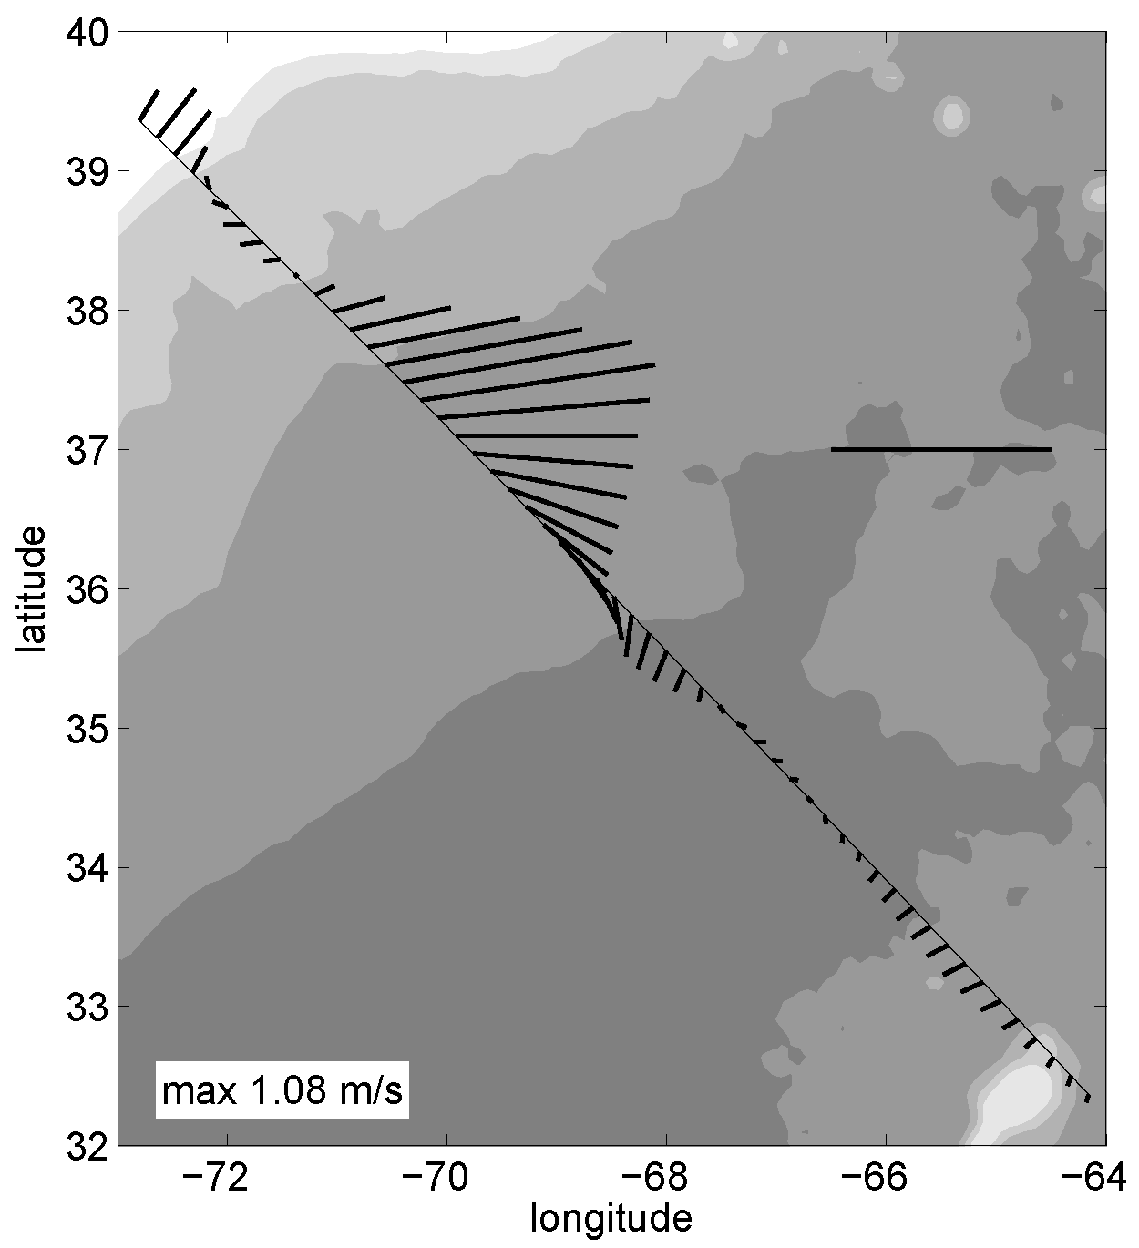
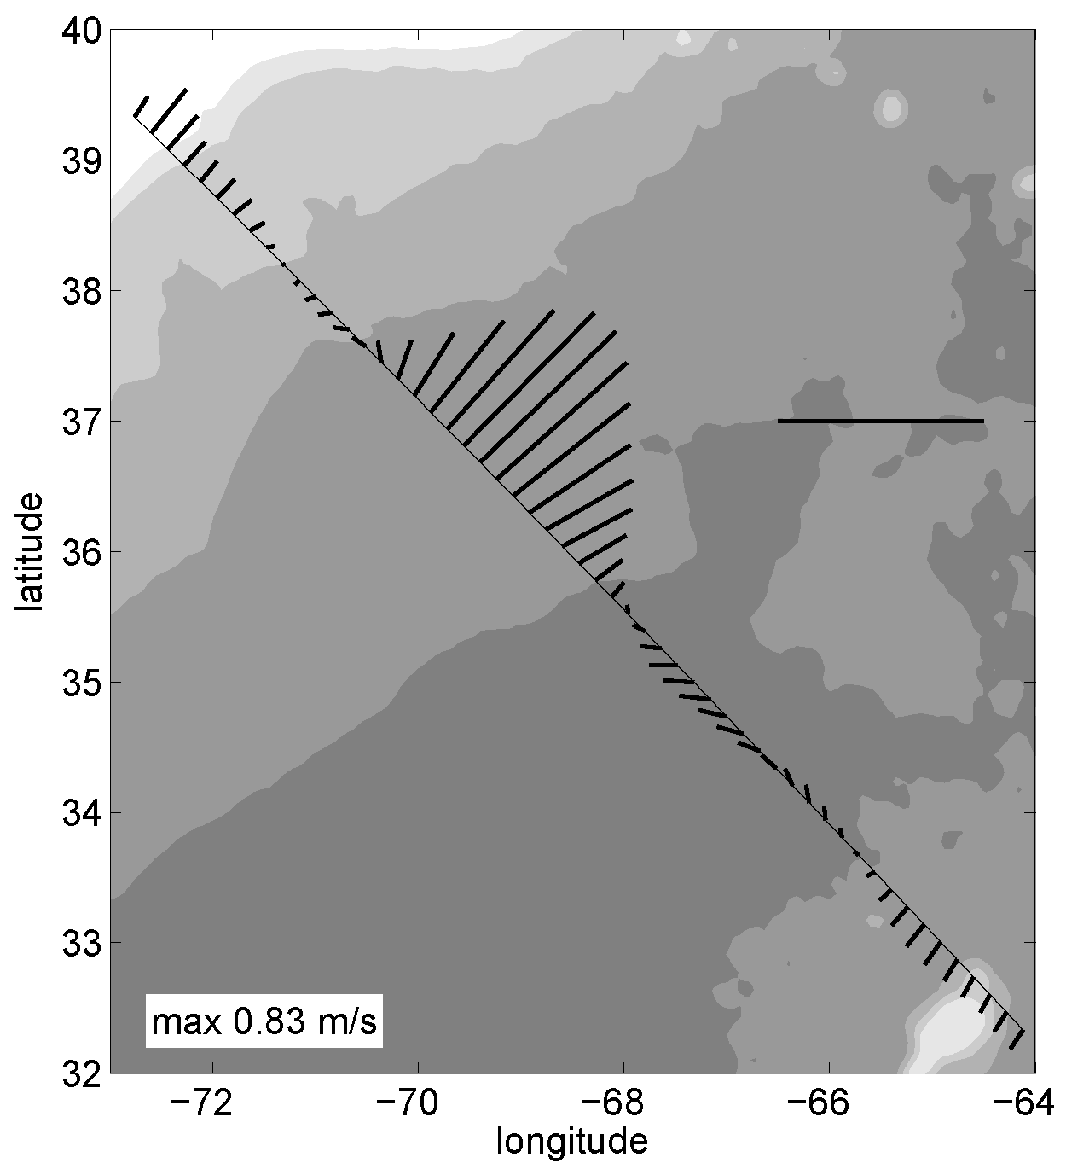
Mean velocity Oleander section
Oleander
1/50°
max 0.98 m/s
1/12°
1/25°

Slide 12
Florida Current (~32 Sv observed)
  1/12°: 30.8 Sv
  1/25°: 34.8 Sv
  1/50°: 34.9 Sv
Maximum meridional overturning transport (~17 Sv observed)
  1/12°: 17.7 Sv
  1/25°: 17.8 Sv
  1/50°: 17.5 Sv

Slide 13
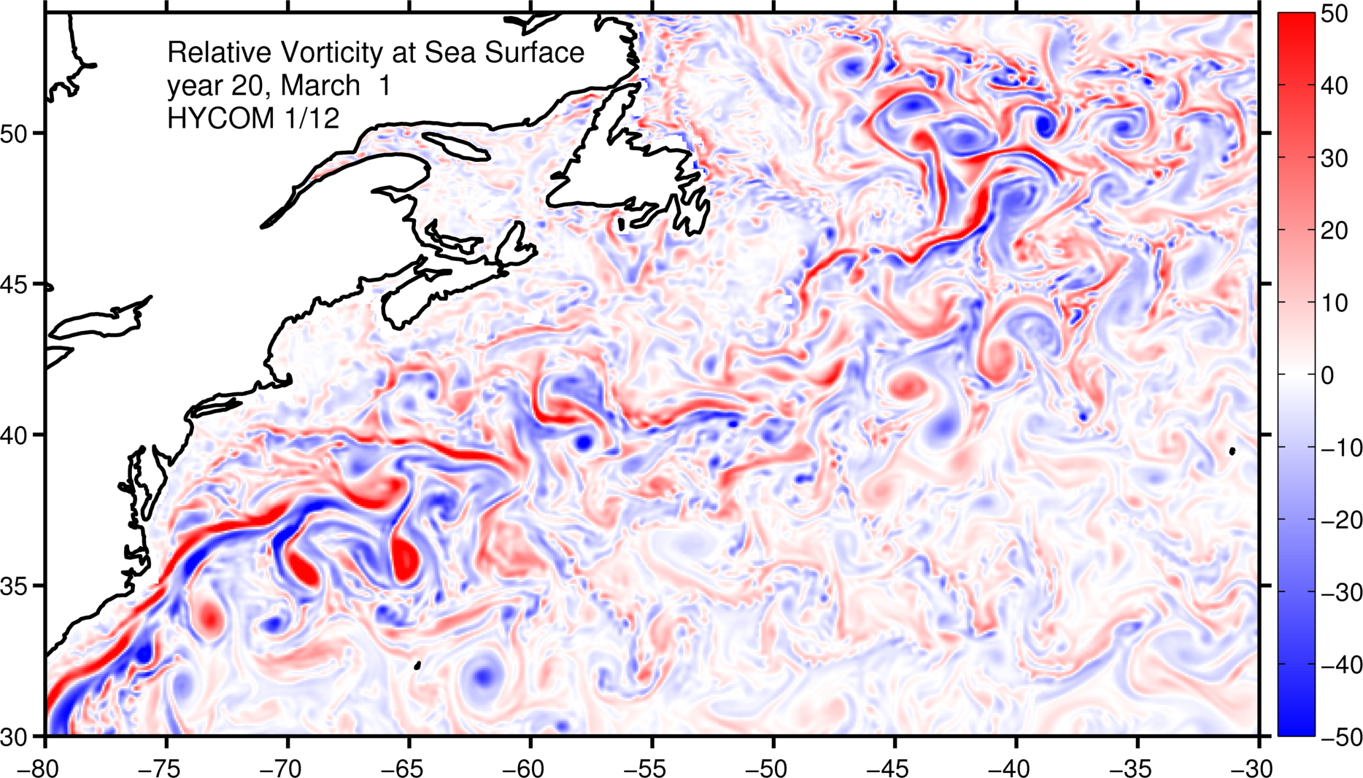
Relative vorticity in winter
1/12°

Slide 14
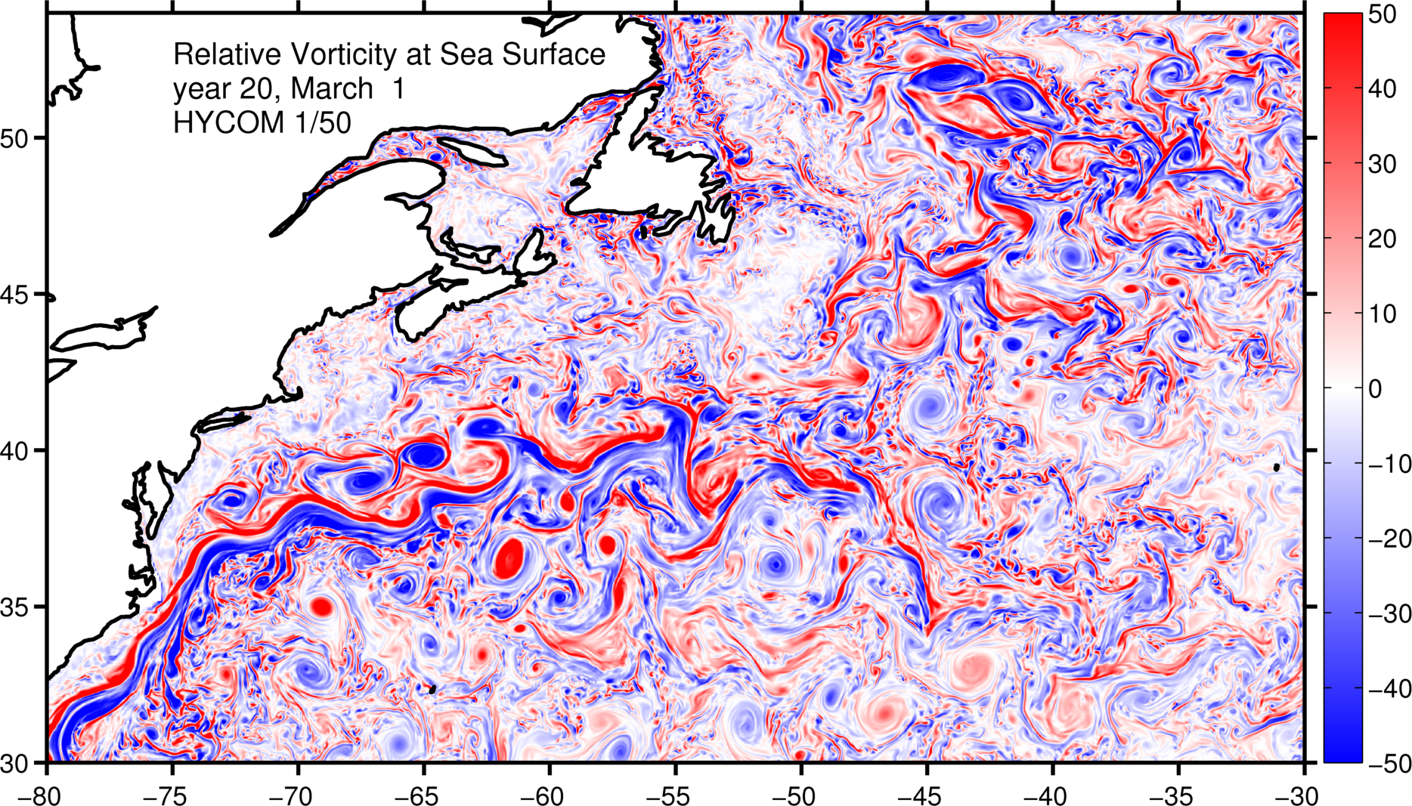
Relative vorticity in winter
1/50°

Slide 15
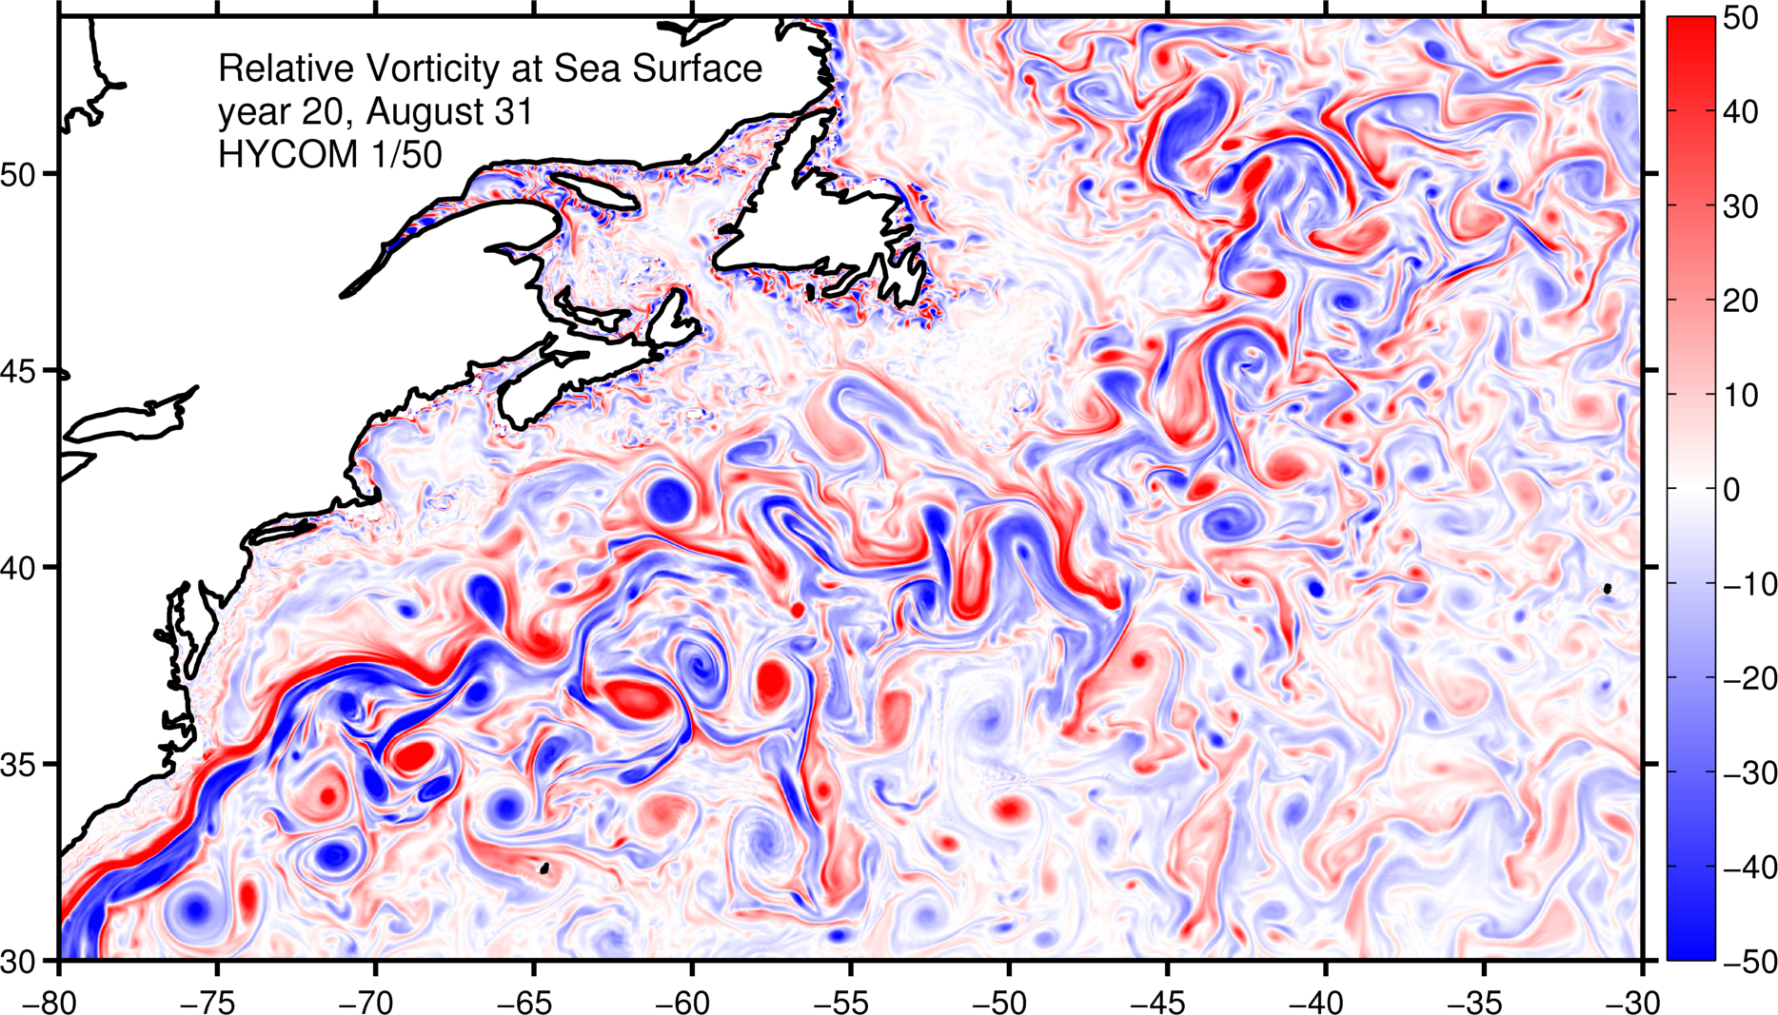
Relative vorticity in summer
1/50°

Slide 16
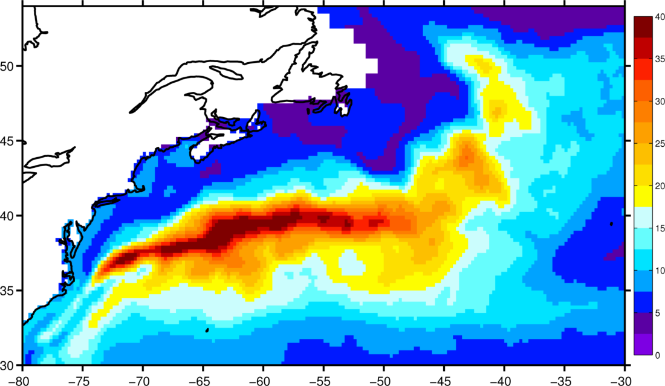
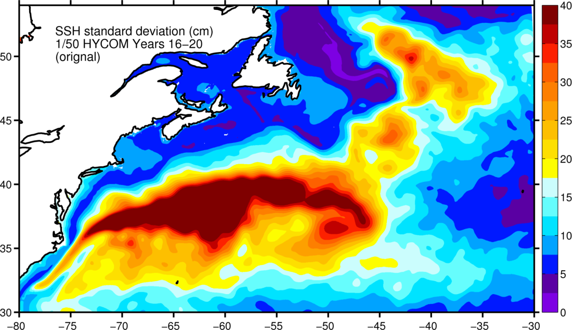
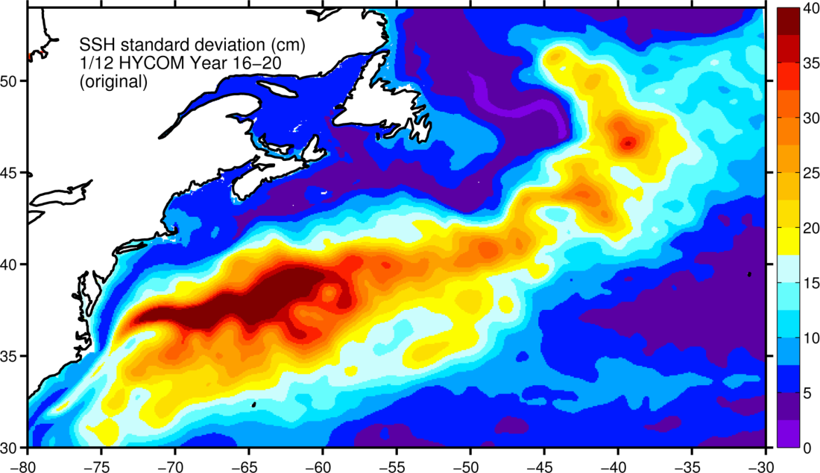
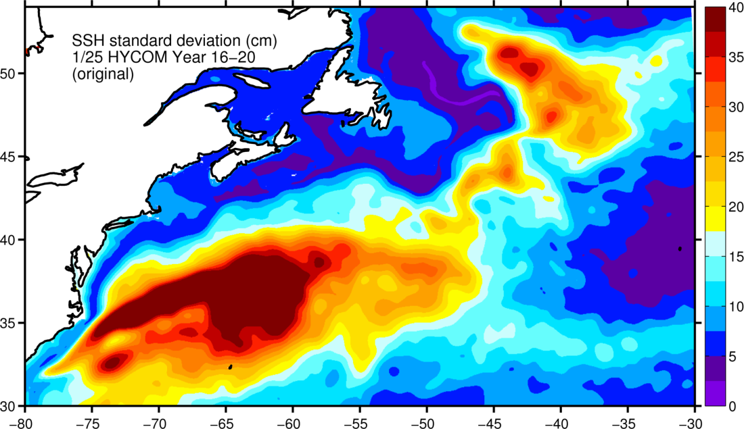
SSH variability (Years 16-20)
AVISO
1/50°
1/12°
1/25°

Slide 17

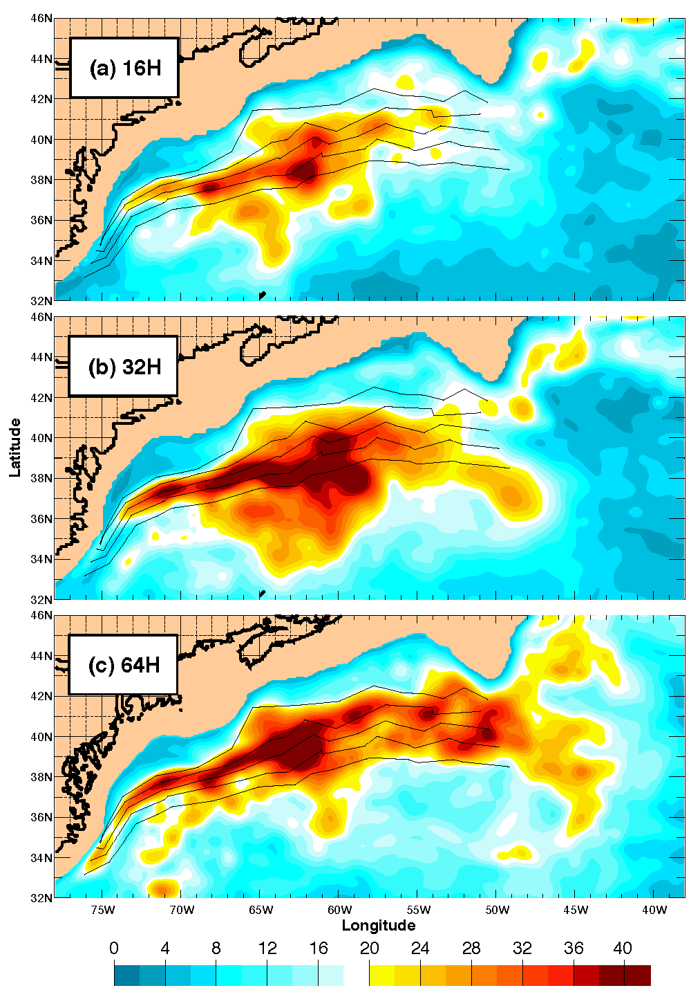
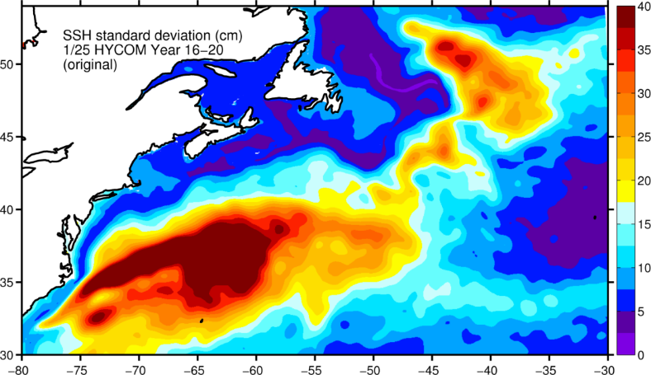

Hurlburt and Hogan (2000)

Slide 18
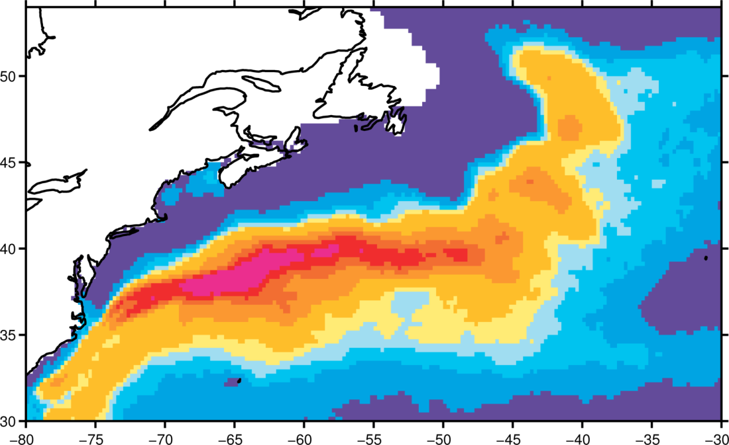
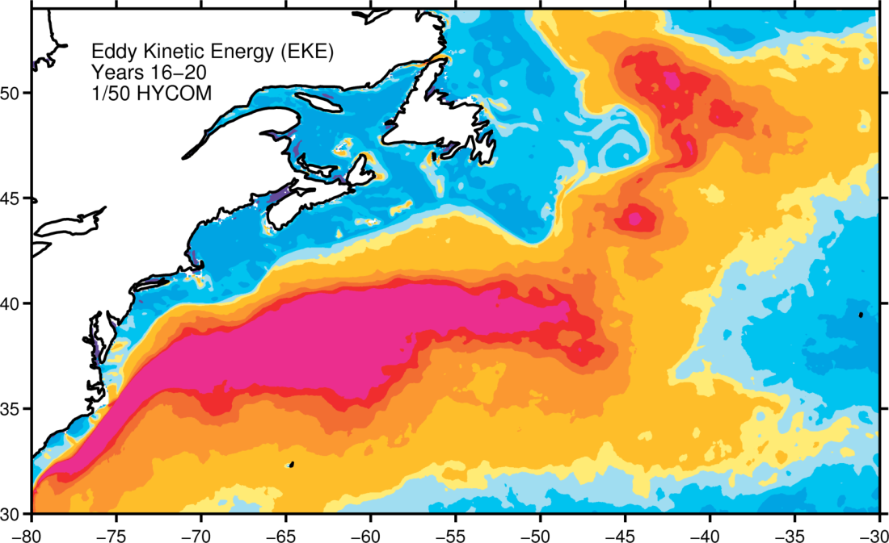
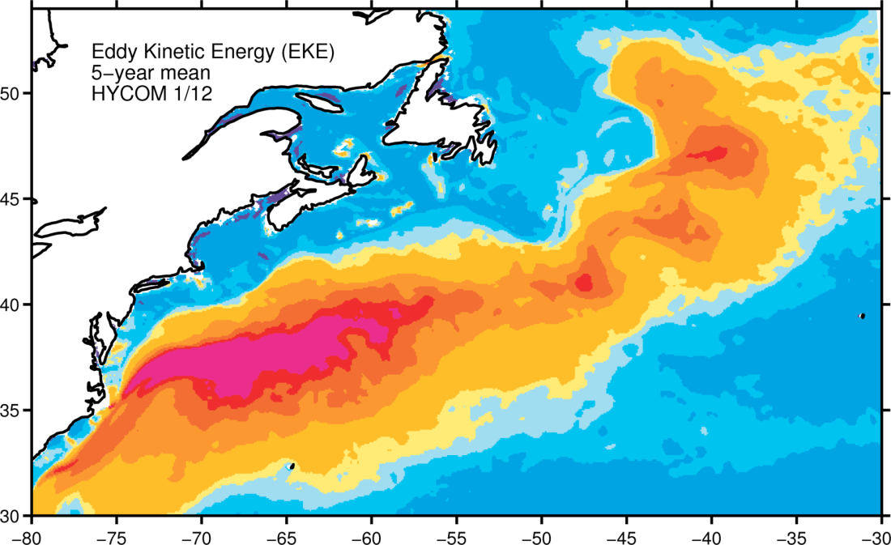
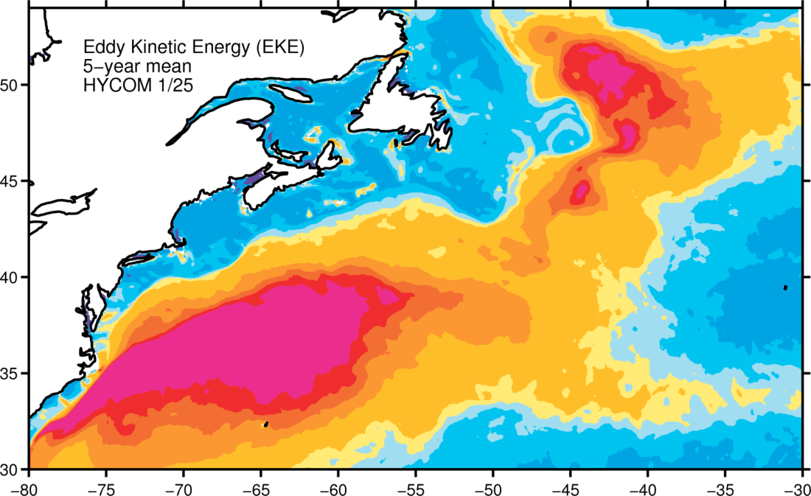
Surface EKE (Years 16-20)
AVISO
1/50°
1/12°
1/25°

Slide 19
Mean zonal velocity at 55°W
(Richardson, 1985)
Years 16-20

Slide 20
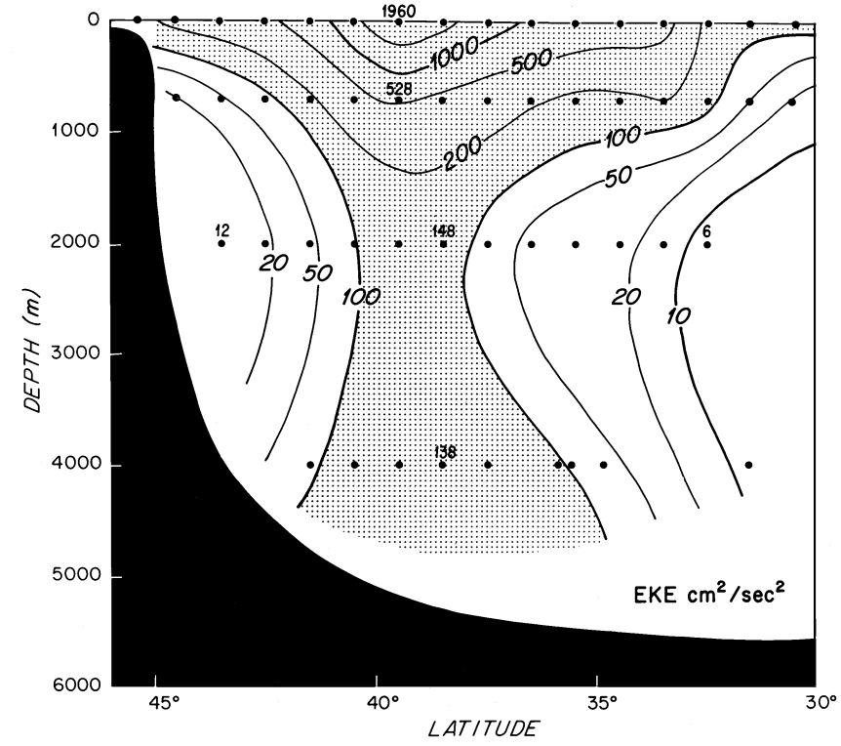
Mean Eddy Kinetic Energy at 55°W
(Richardson, 1985)
Years 16-20

Slide 21
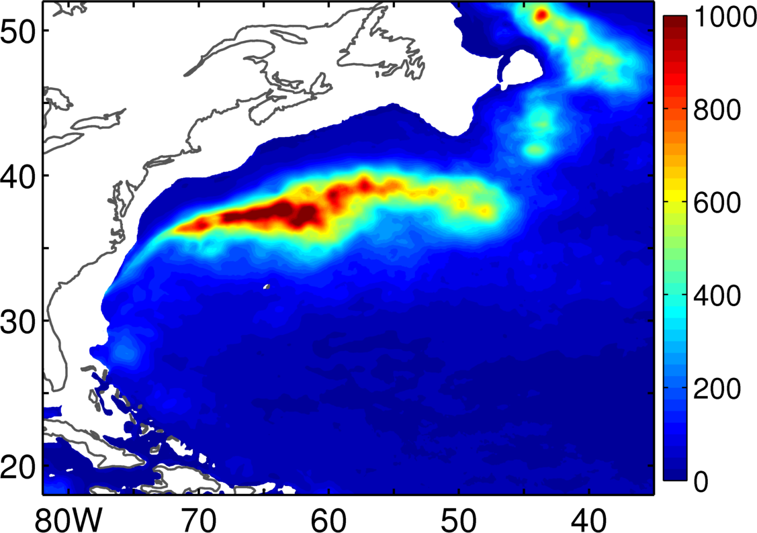
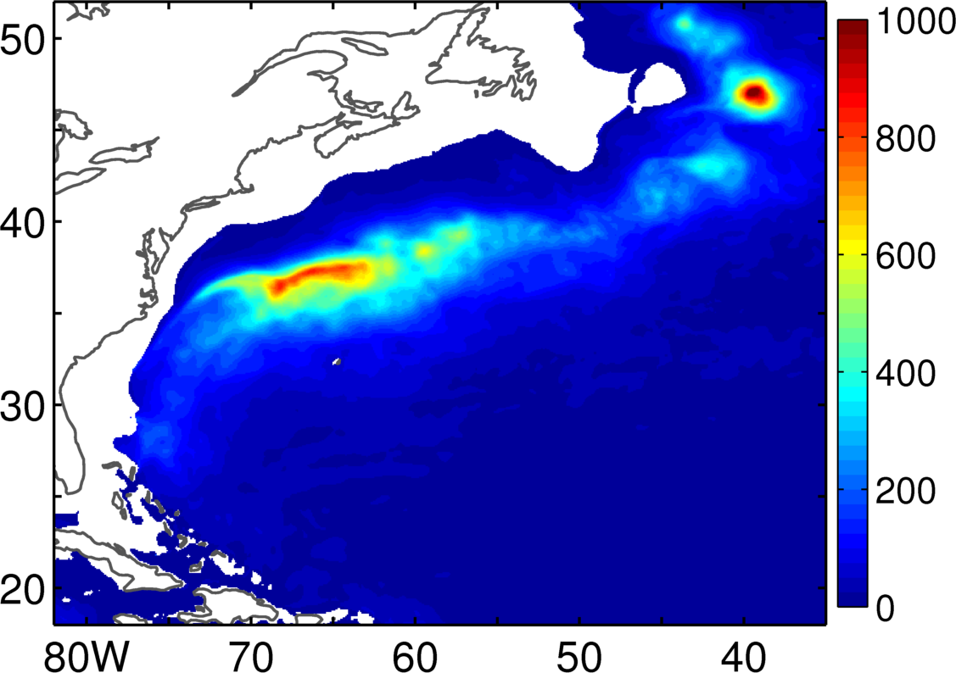
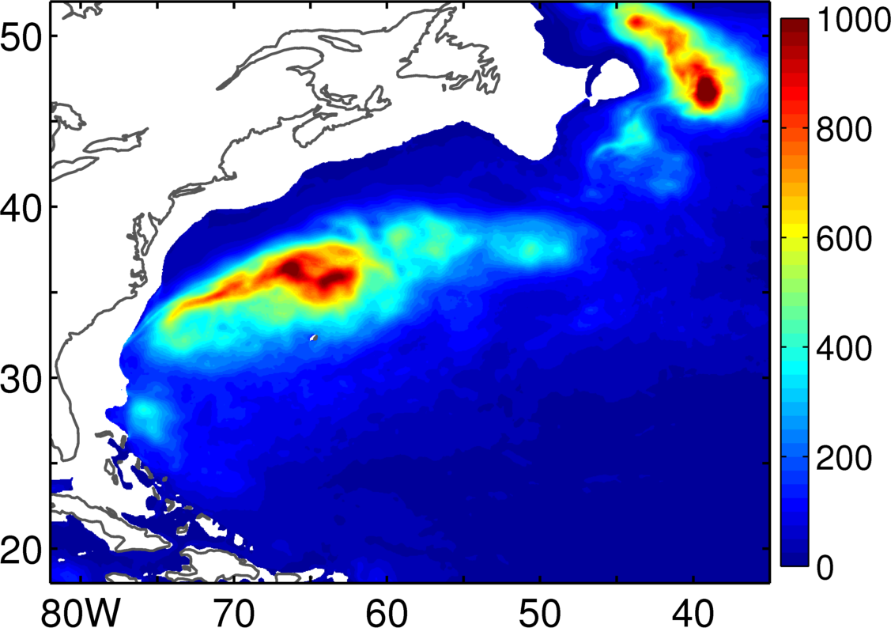
EKE@700m
1/50
1/12
1/25

Slide 22
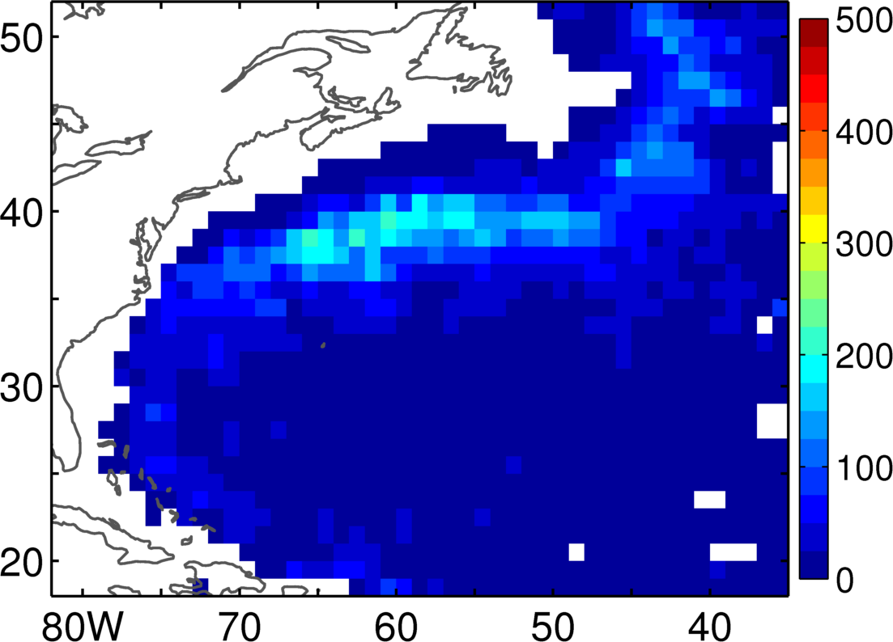
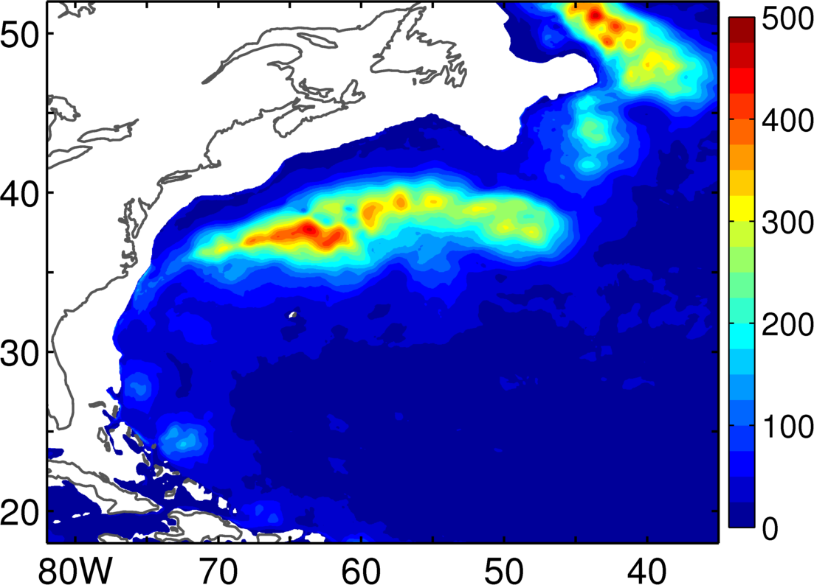
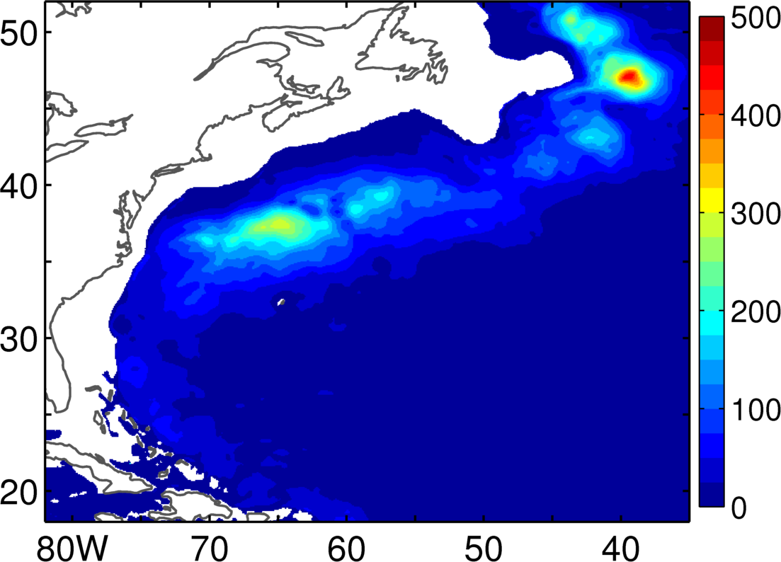
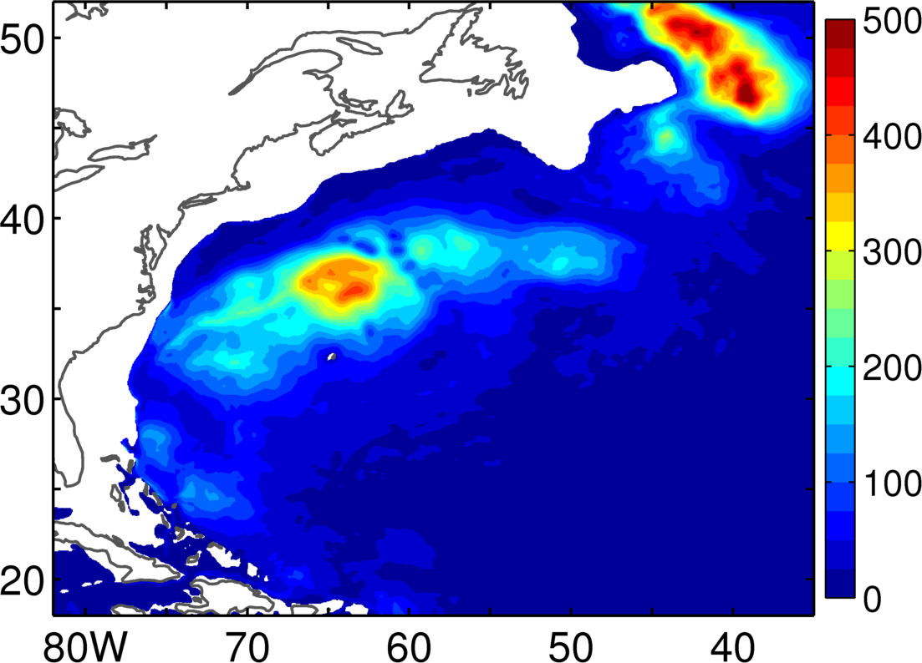
EKE@1000m
Argo
1/50
1/12
1/25

Slide 23
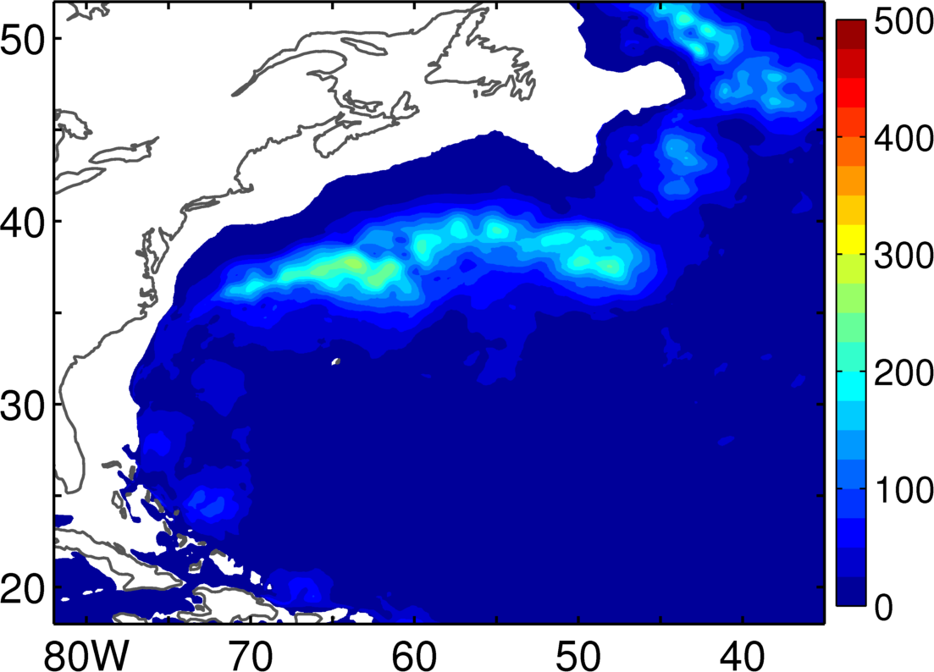
EKE@1000m
Argo
1/50
1/50
30-day average

Slide 24
Why is the modeled surface EKE in the Gulf Stream is higher than altimetry (AVISO)?
Ageostrophic contribution?
Spatial and temporal averaging in the observations?

Slide 25
Surface EKE (Years 16-20)
AVISO
1/50°
1/12°
1/25°

Slide 26
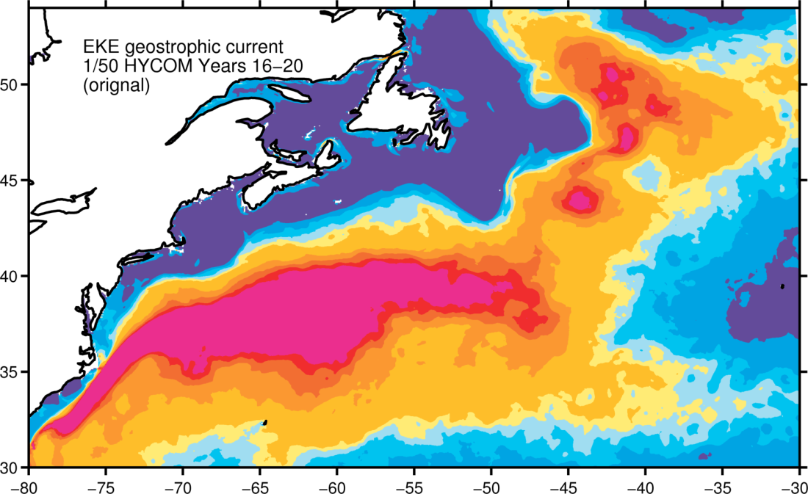
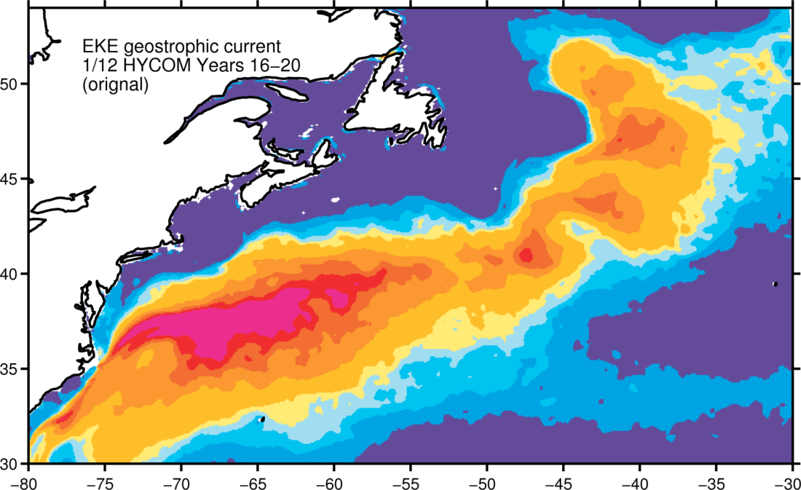
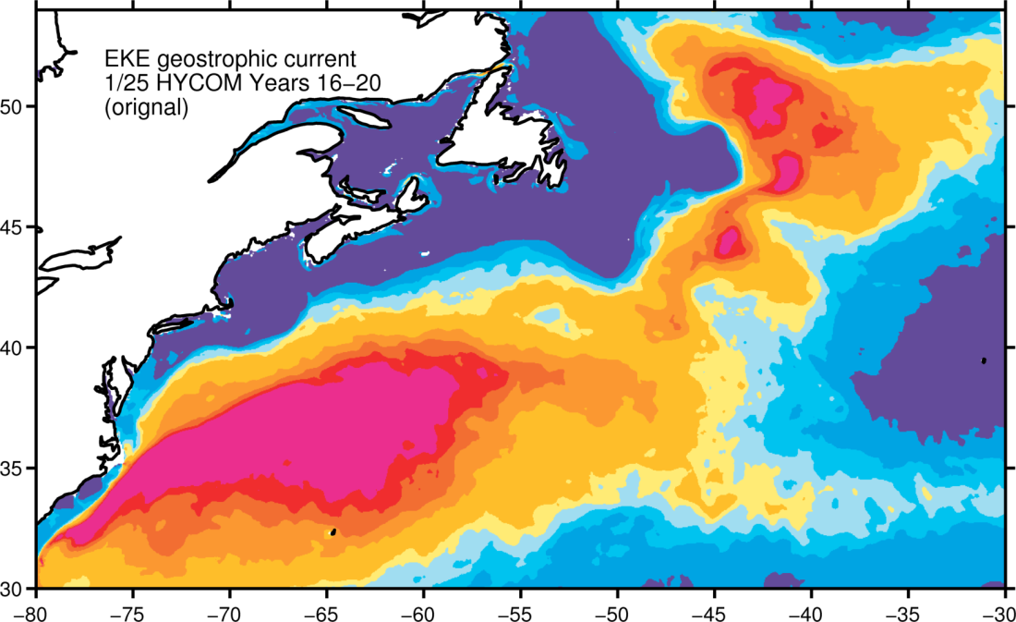
Surface EKE (geostrophic)
AVISO
1/50°
1/12°
1/25°

Slide 27
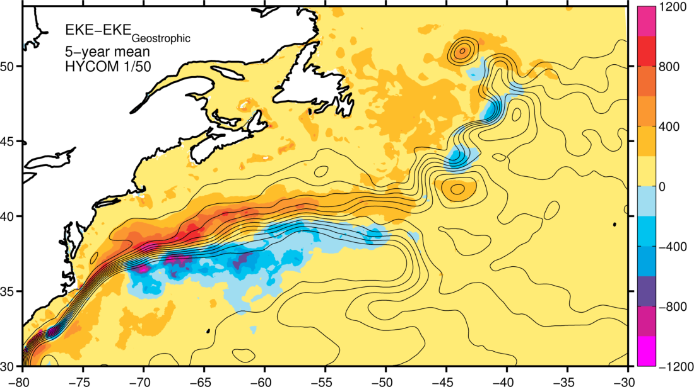
EKE geostrophic difference (1/50°)
TOTAL
GEOSTROPHIC

Slide 28
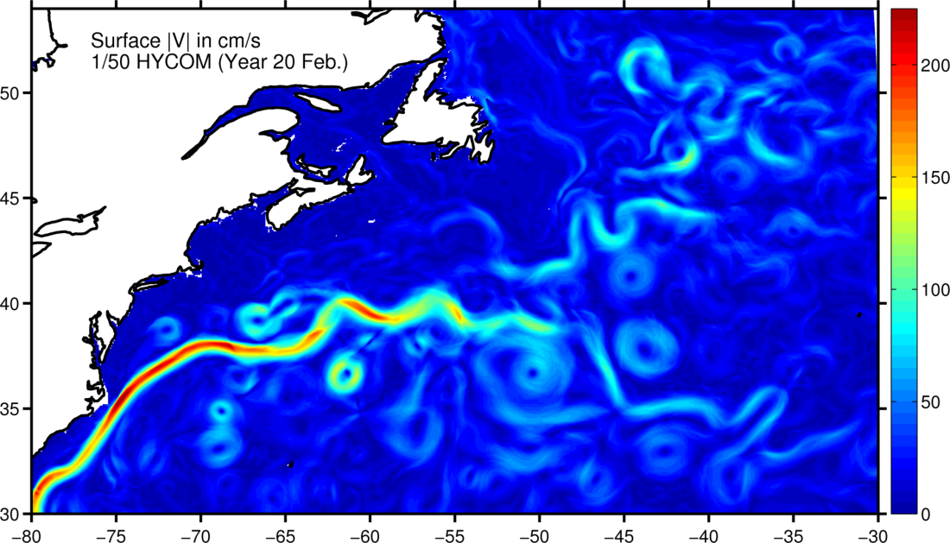
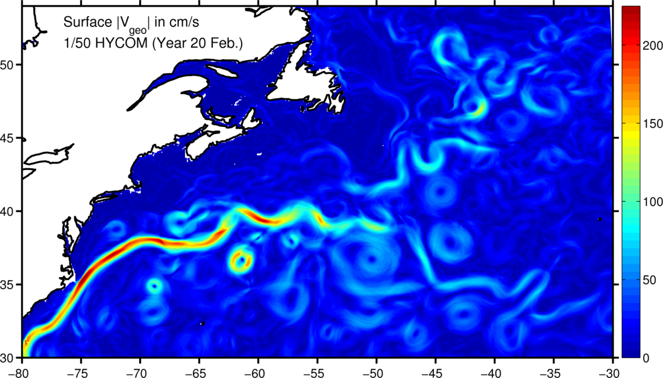
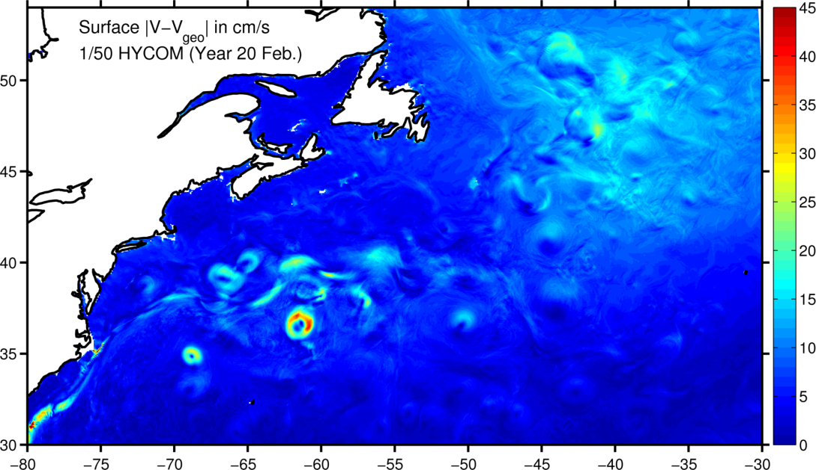
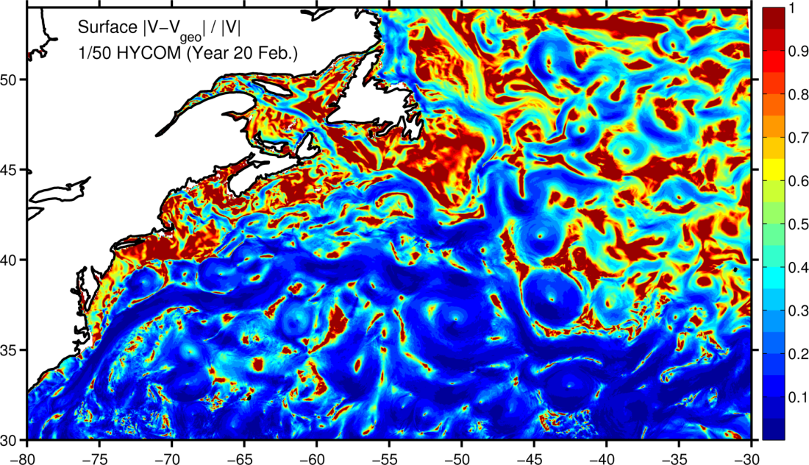
For a typical month

Slide 29
Asymmetry due to gradient wind balance in eddies
Warm ring
Cold ring
Ekman drift

Slide 30
SSH spectra in the North Atlantic
1000
km
250
km
70
km
10
km
1/12°
1/25°
1/50°
Winter
Summer
k⁻⁵
-5.124 (-5.223, -5.025)
-4.905 (-4.983, -4.828)
-4.962 (-5.038, -4.886)
Linear fit coefficients (with 95% confidence bounds) for horizontal scale of 70-250 km
Notes:
Linear

Slide 31
SSH wavenumber Spectrum
The results, which are independent of resolution, suggest that the SSH spectra slope is k⁻⁵, in agreement with QG turbulence theory. This is in agreement with shipboard ADCP observations (Wang et al., 2010) and the latest spectra calculated from along-track satellite altimetry data with high-frequency noise corrections (Zhou et al., 2015). Seasonal dependence is most significant below 70 km.

Slide 32
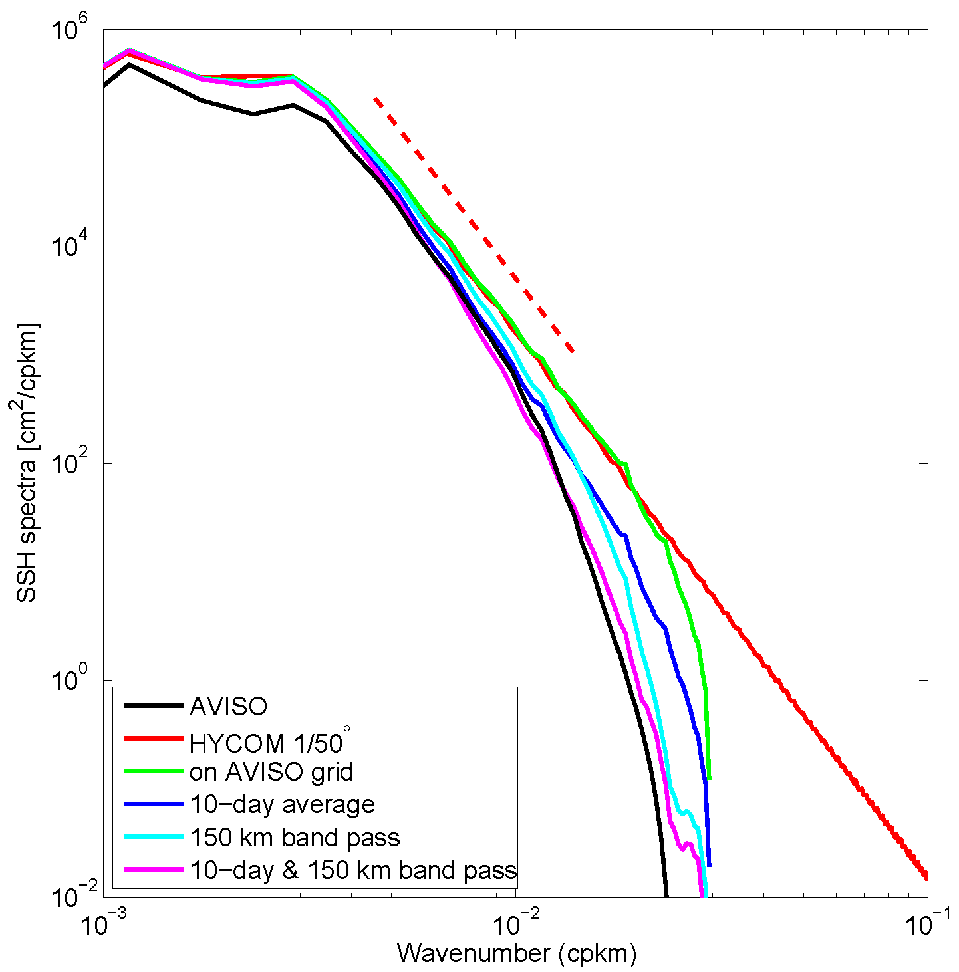
Altimetry resolves eddy scales greater than 150km
k⁻⁵

Slide 33
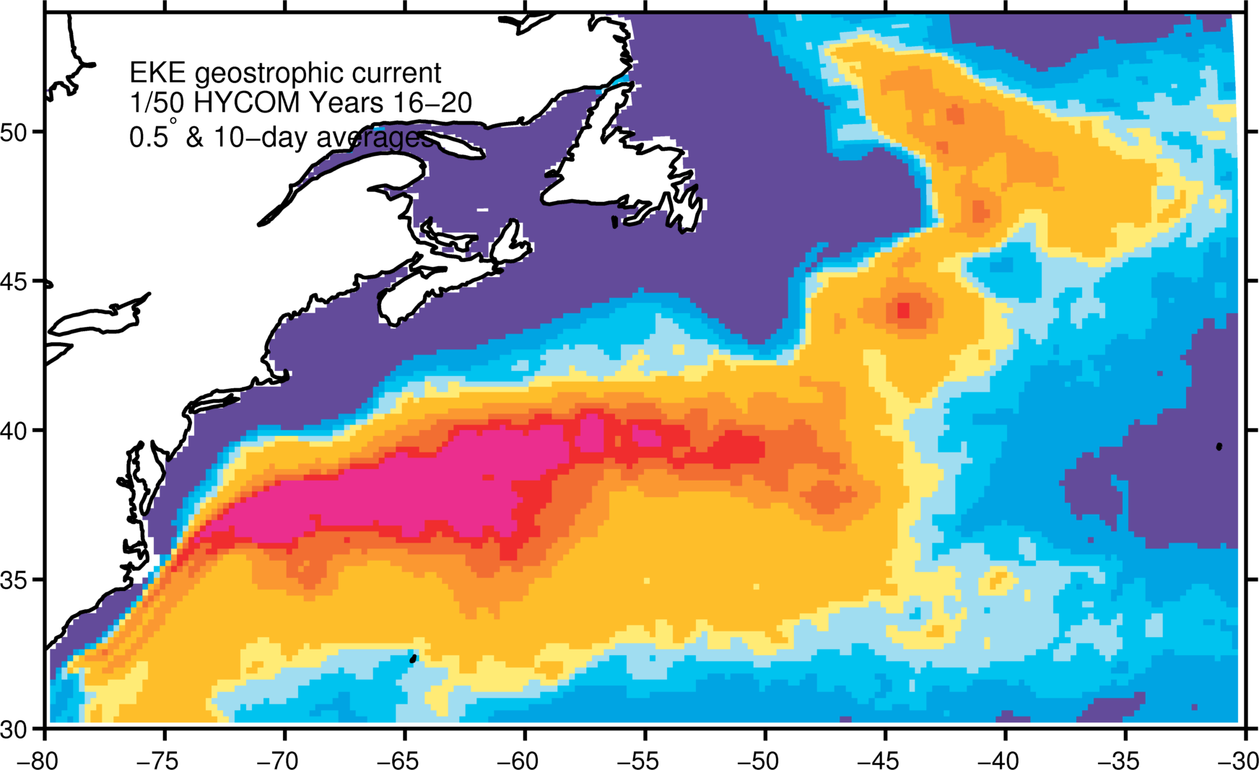
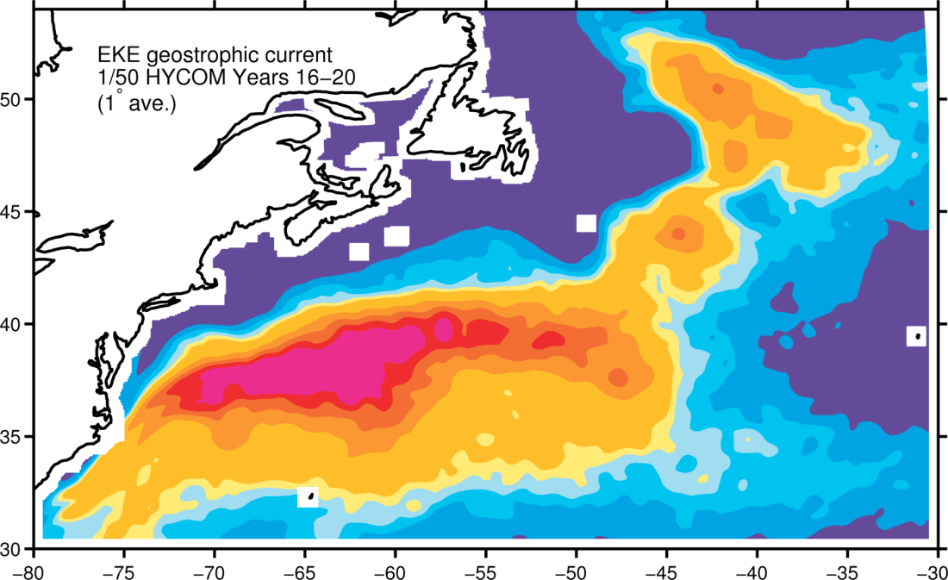

Impact of averaging on EKE
AVISO
1/50°
150 km
band pass
+
10-day
average
150 km
band pass
1°

Slide 34

“Observed” spatial distribution
Global distribution of spectral slopes of SSH from Zhou et al. (2015, JPO). Very low slope in tropical region (<-2), in contrast with the high slope in GS/NAC (-5)

Slide 35

Modeled spatial distribution

Slide 36

Daily versus hourly spectra

Slide 37

40-50N
4.8
4.6
4.5
4.1
December
Year 20

Slide 38
Summary
Significant improvement in Gulf Stream model representation at 1/50°.
Time and spatial averaging are responsible for the observed difference between altimetry and model EKE.
The ageostrophic component in eddies is always cyclonic and increases/decreases the EKE on the north/south side of the Gulf Stream.
Power spectra agree with QG turbulence in energetic regions.
Hourly spectra differ from daily spectra at equator.

