Slide 1
North Atlantic circulation in three simulations of 1/12°, 1/25°, and 1/50°
Xiaobiao Xu and Eric Chassignet
Center for ocean-atmospheric prediction studies
Florida State University

Slide 2
Motivation
Numerical models with different goals vary widely on horizontal resolutions, from 1° long-term climate simulations (no eddy), to 1/10° ocean simulations (resolve most of mesoscale eddies) and, more recently, to 1/60° simulations (resolve some sub-mesoscale physics).
Will (or when) the ocean model results converge? Specifically, how sensitive is large-scale circulation to the horizontal resolution in eddying regime?

Slide 3
Experiments
3 nearly identical experiments with 1/12°, 1/25°, 1/50°.
Same 32 layers in the vertical. Bathymetry in 1/25° and 1/50° is linearly interpolated from 1/12°.
All initialized from climatological T/S and zero velocity.
Same climatological forcing from monthly ECMWF Reanalysis (ERA40) and high-frequent wind from NOGAPS for 2003 (no interannual variability).
Diffusion Parameters | 1/12° | 1/25° | 1/50°
Laplacian deformation-dependent viscosity coefficient | 0.05 | 0.05 | 0.05
Laplacian (background) viscosity for momentum | 20 m²/s | 10 m²/s | 10 m²/s
Biharmonic diffusion velocity for momentum | 1 cm/s | 1 cm/s | 4 cm/s
Biharmonic diffusion velocity for layer thickness | 1 cm/s | 1 cm/s | 4 cm/s
Laplacian diffusion velocity for temperature/salinity | 0.5 cm/s | 0.5 cm/s | 1 cm/s

Slide 4
Kinetic Energy
½ Biharmonic diffusivity (for momentum and layer thickness)
1/2 Laplacian diffusivity 1/8 Bihamonic diffusivity
Time evolution of the 3-d domain averaged kinetic energy in three simulations

Slide 5
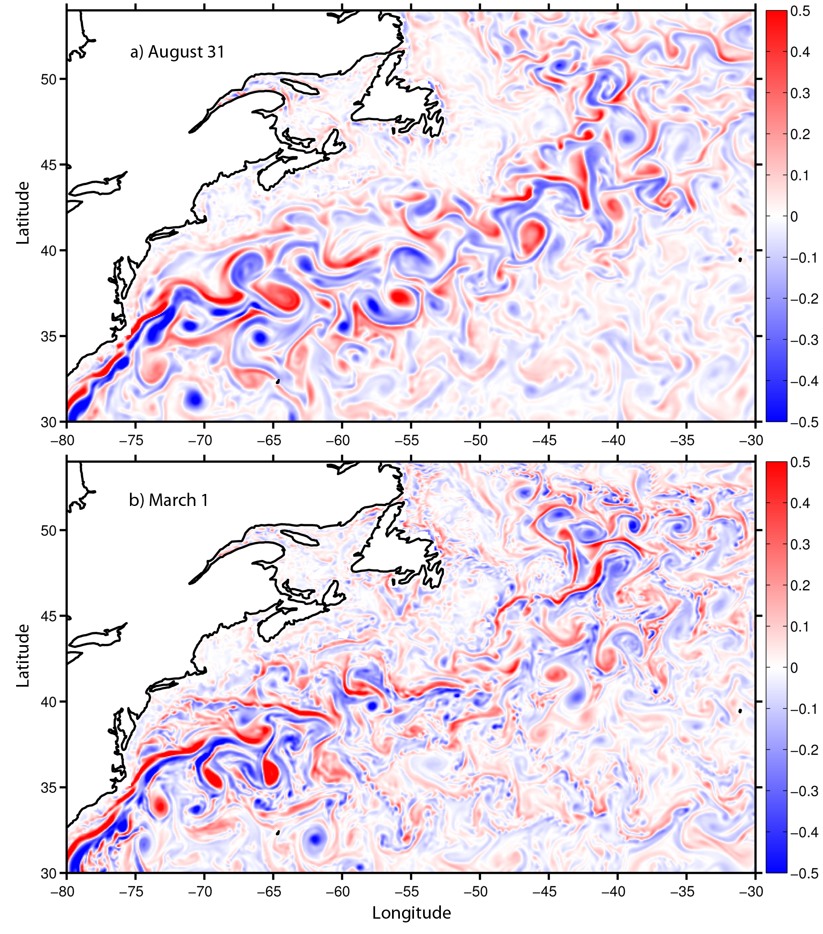
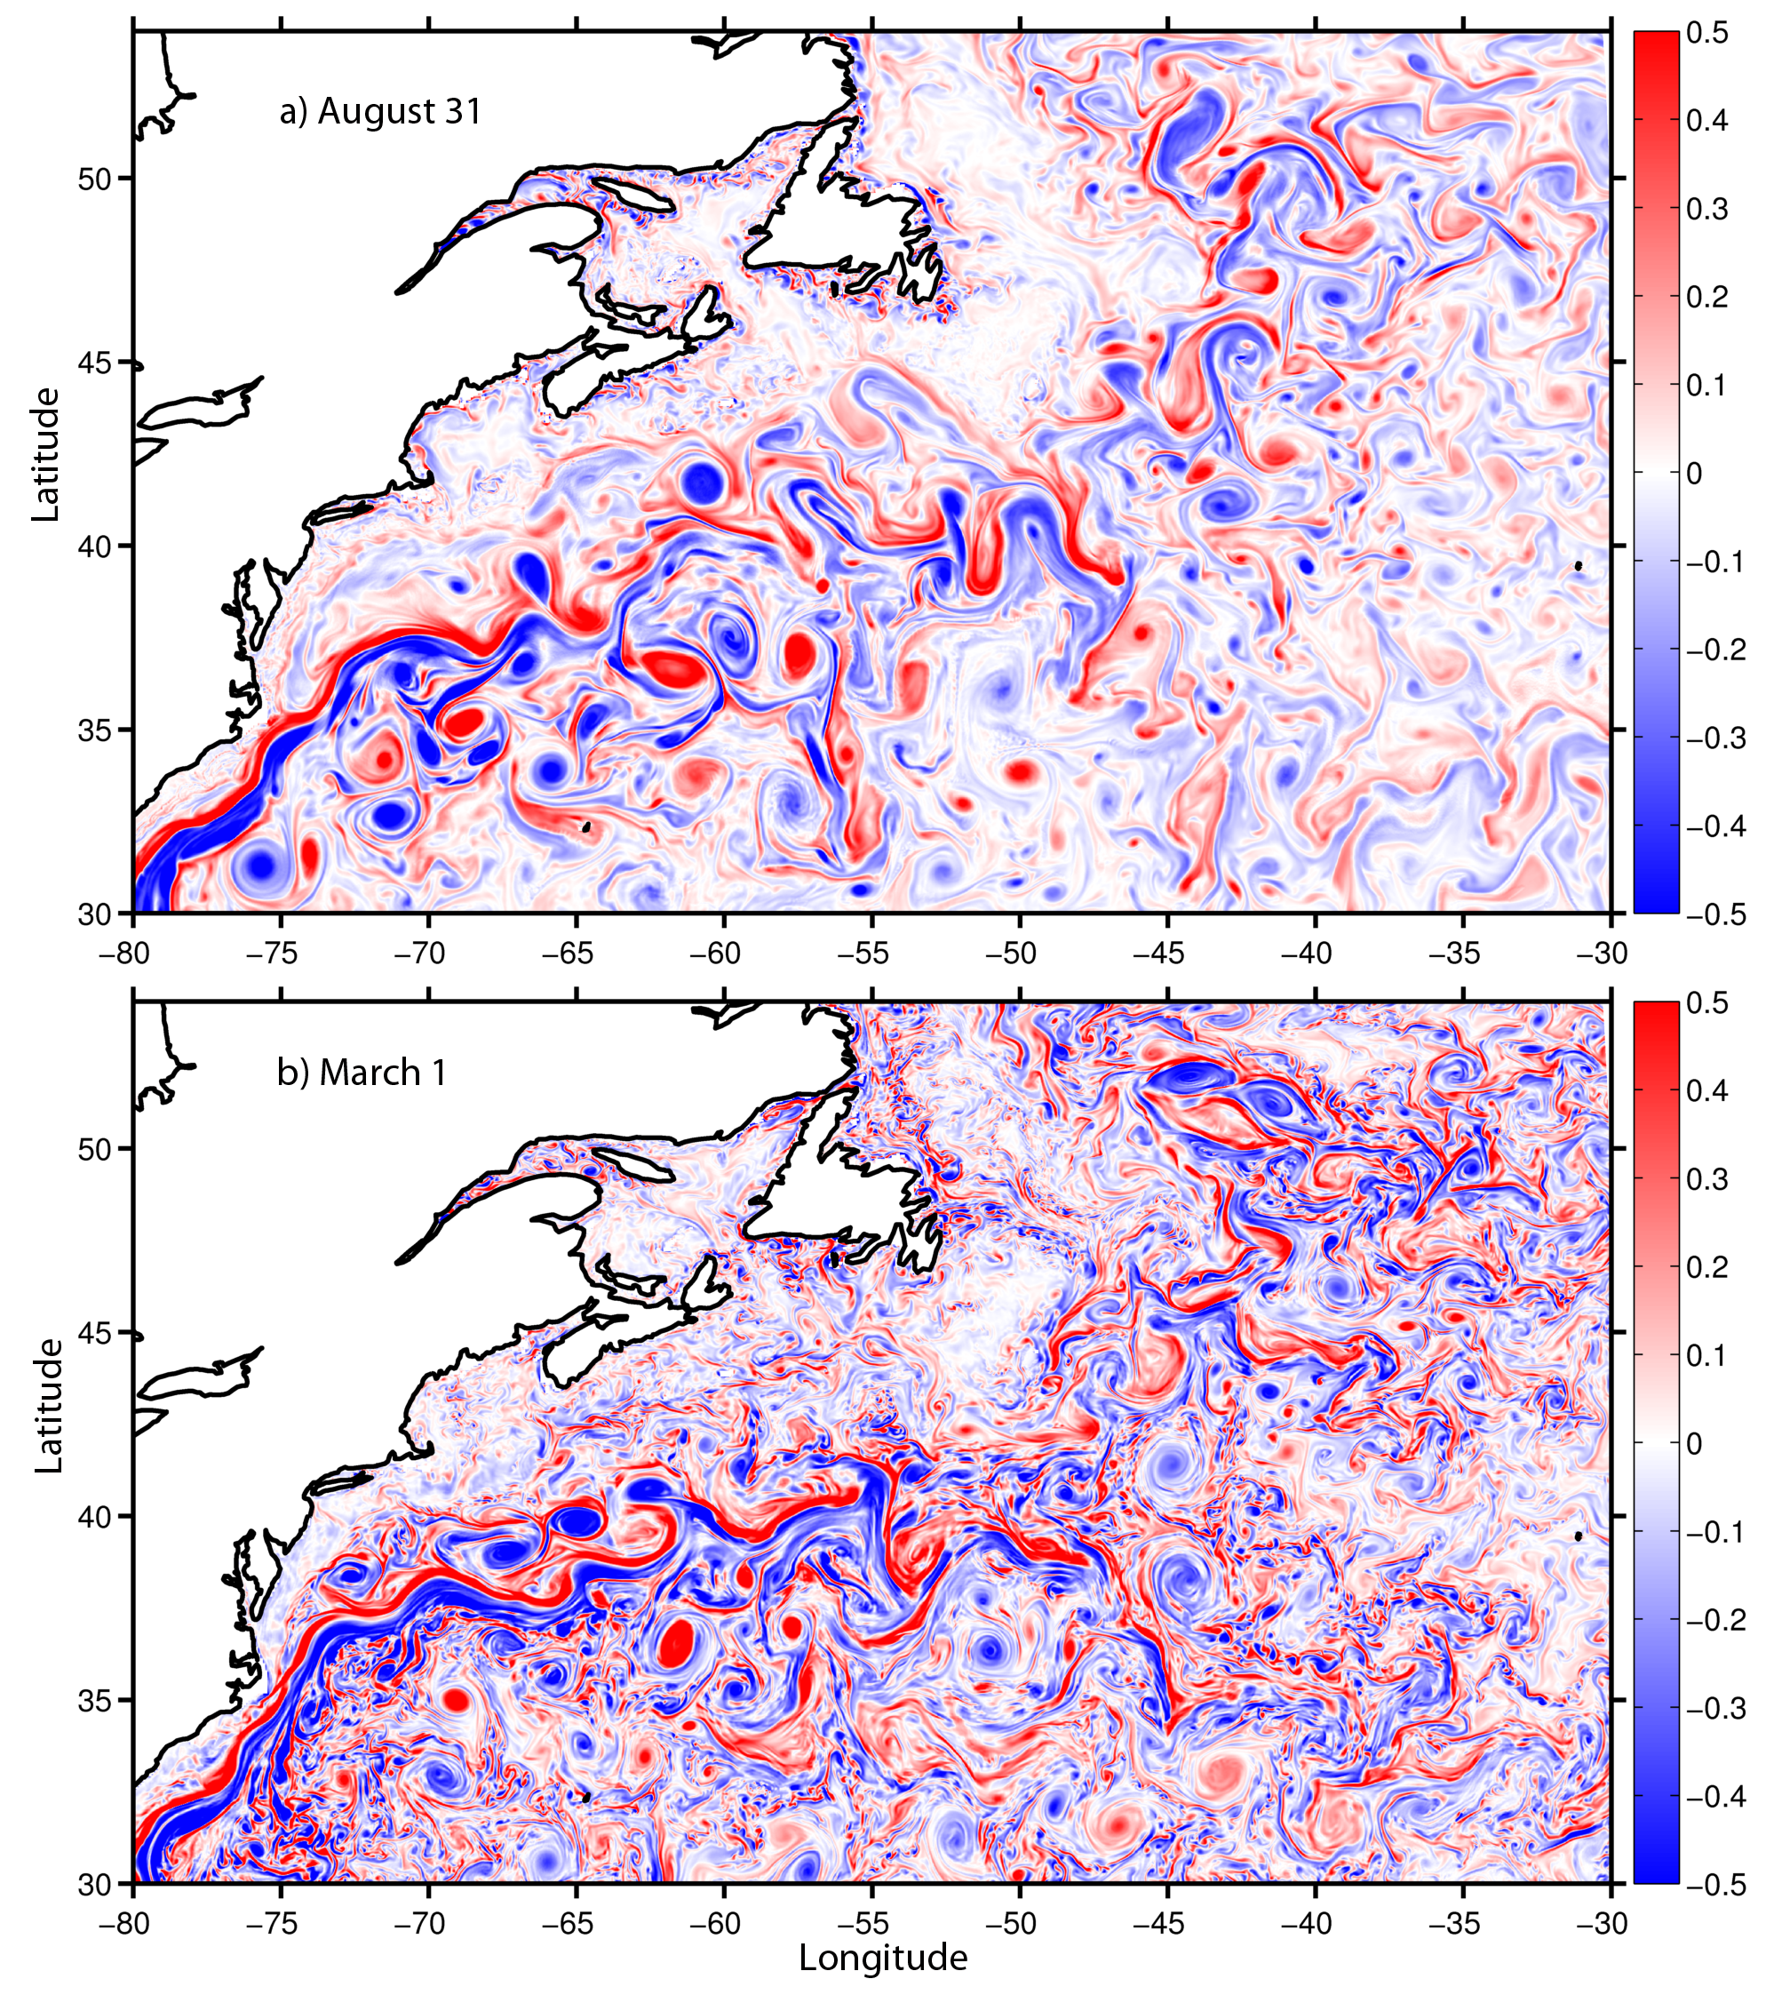
Surface eddy activity
1/12°
1/50°
Ratio of relative vorticity to Coriolis parameter f

Slide 6
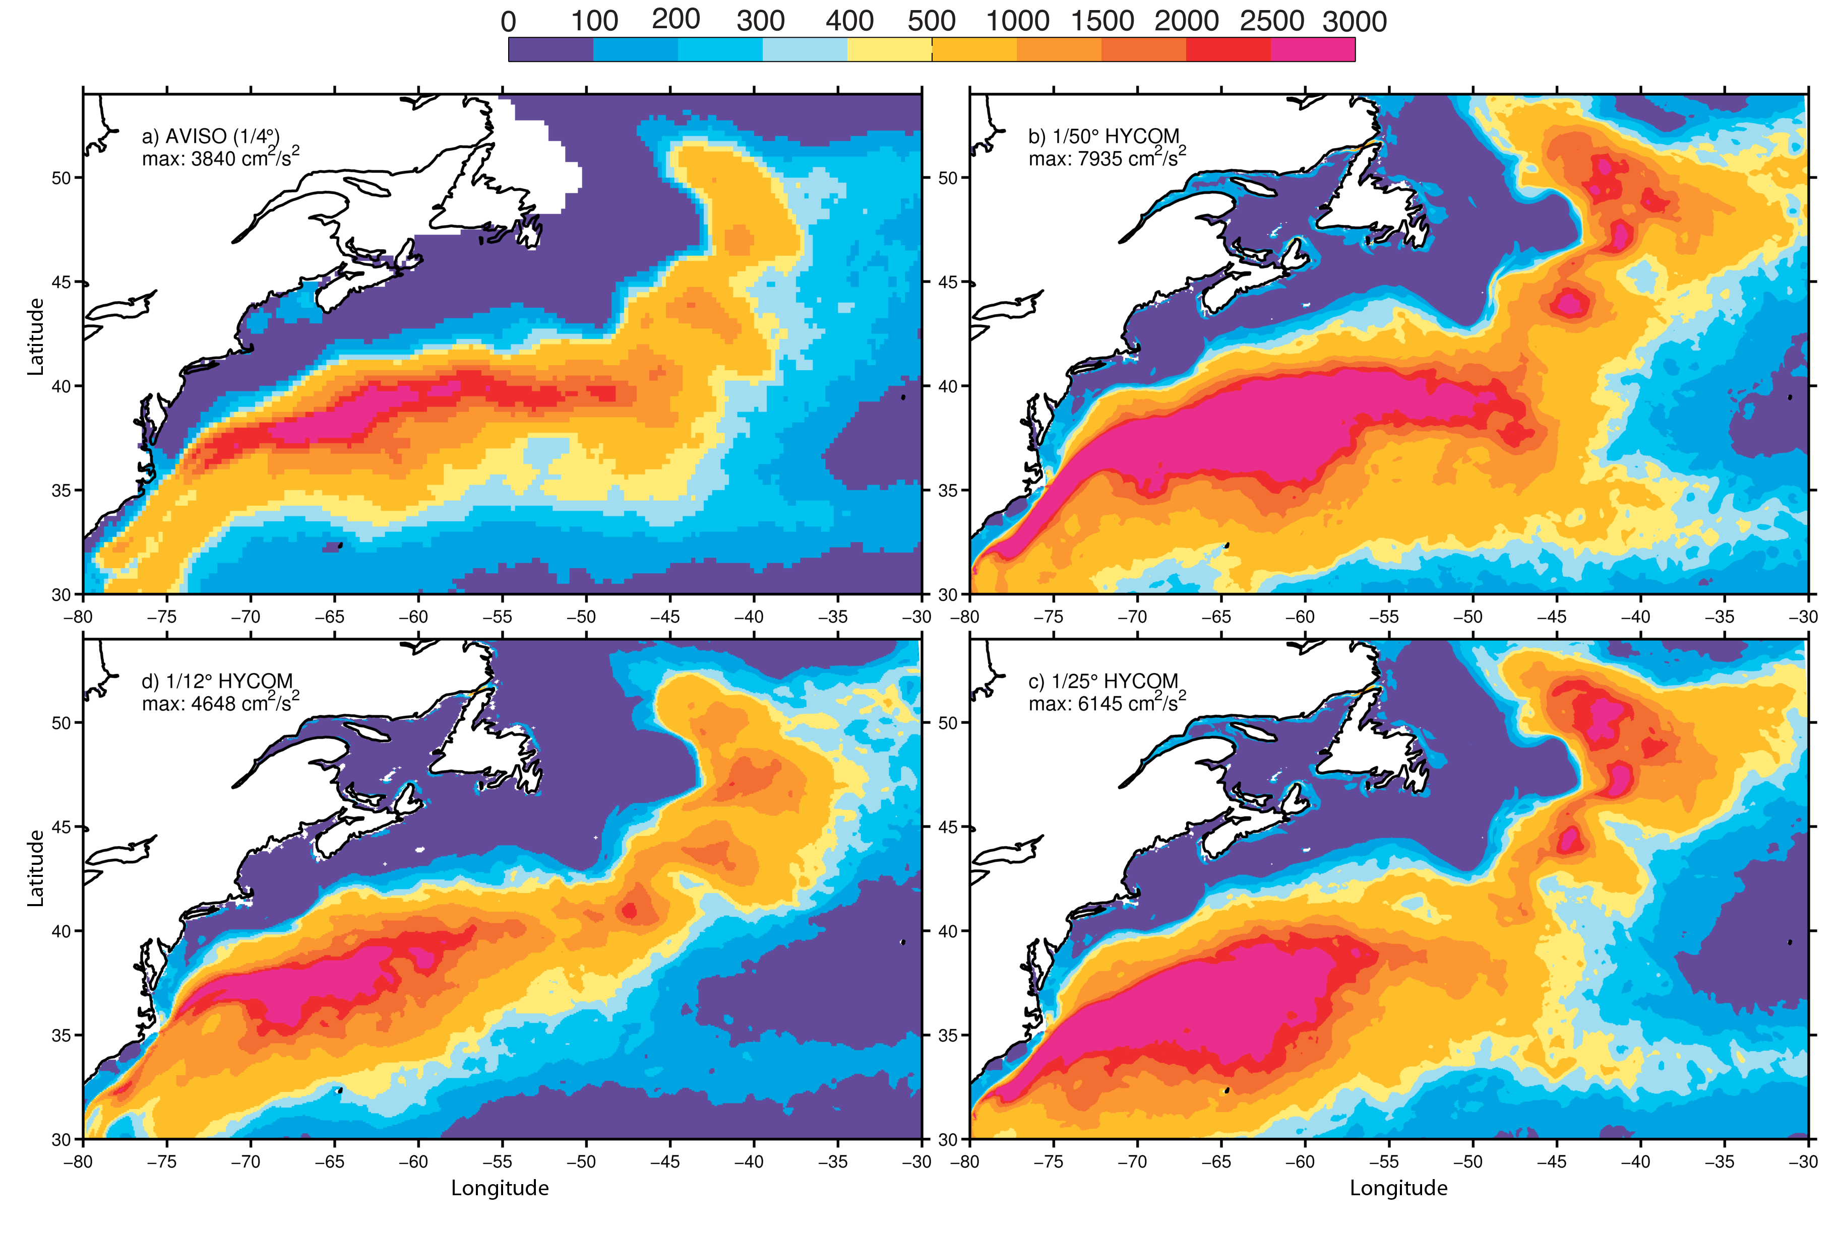
Eddy Kinetic Energy (EKE)

Slide 7
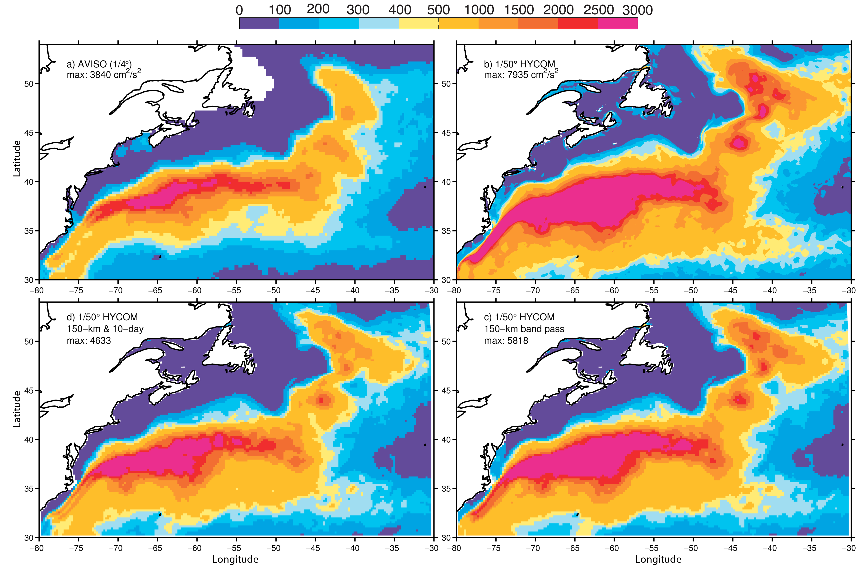
Impact of filtering to EKE

Slide 8
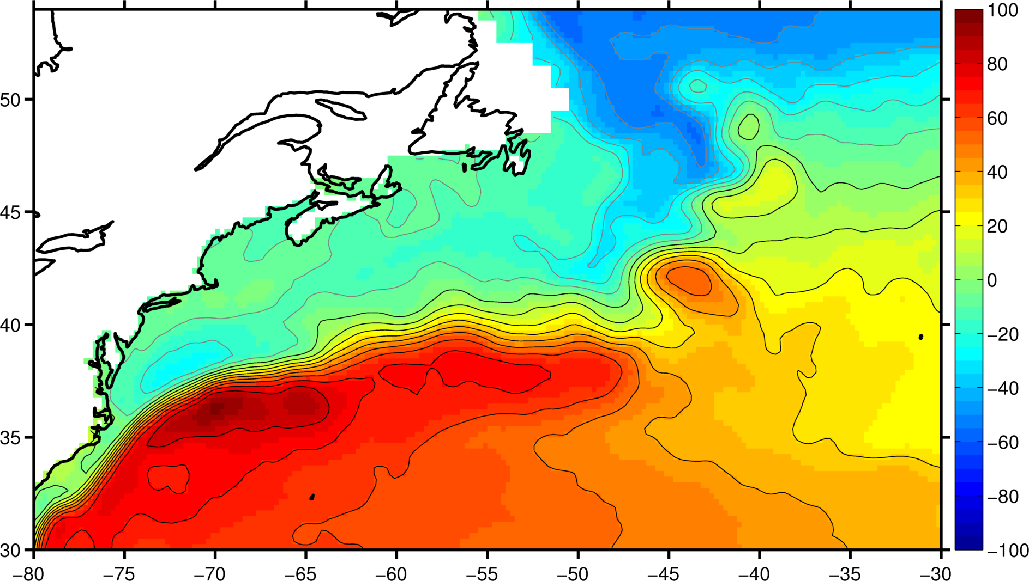
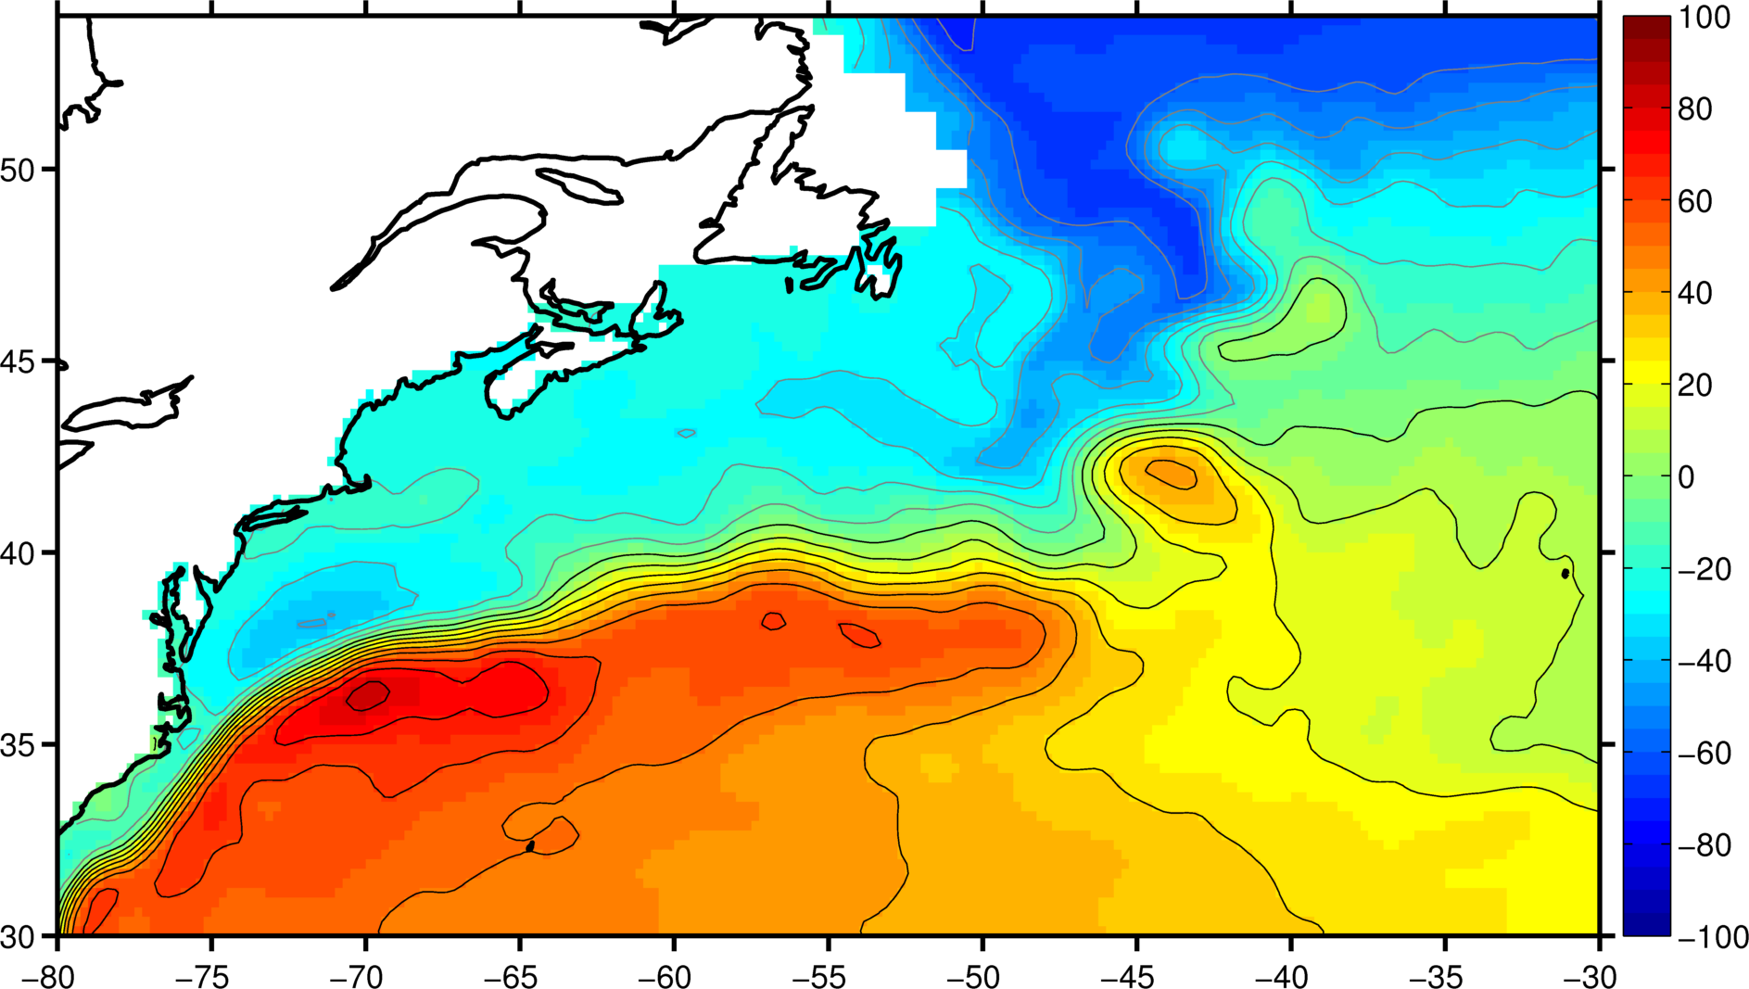
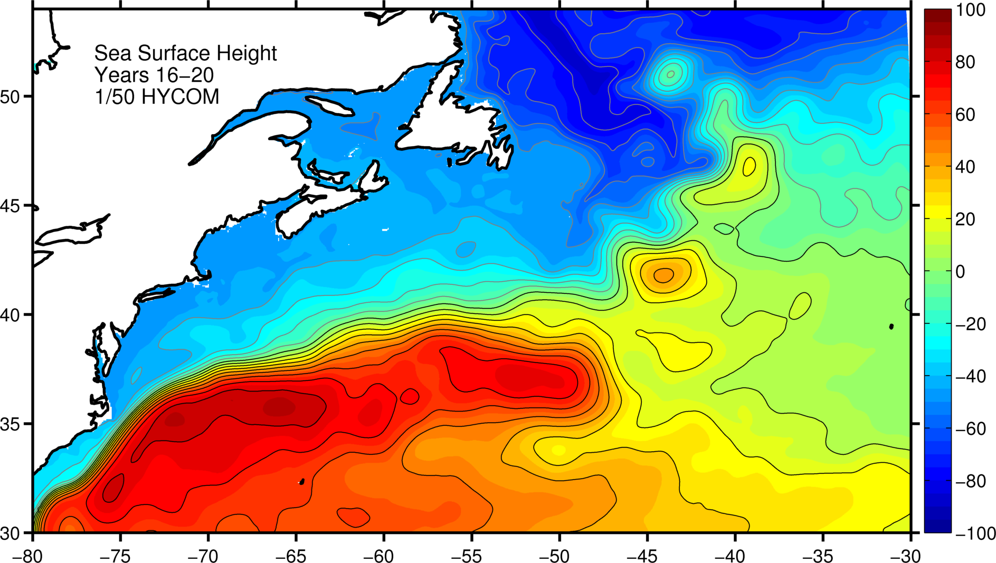
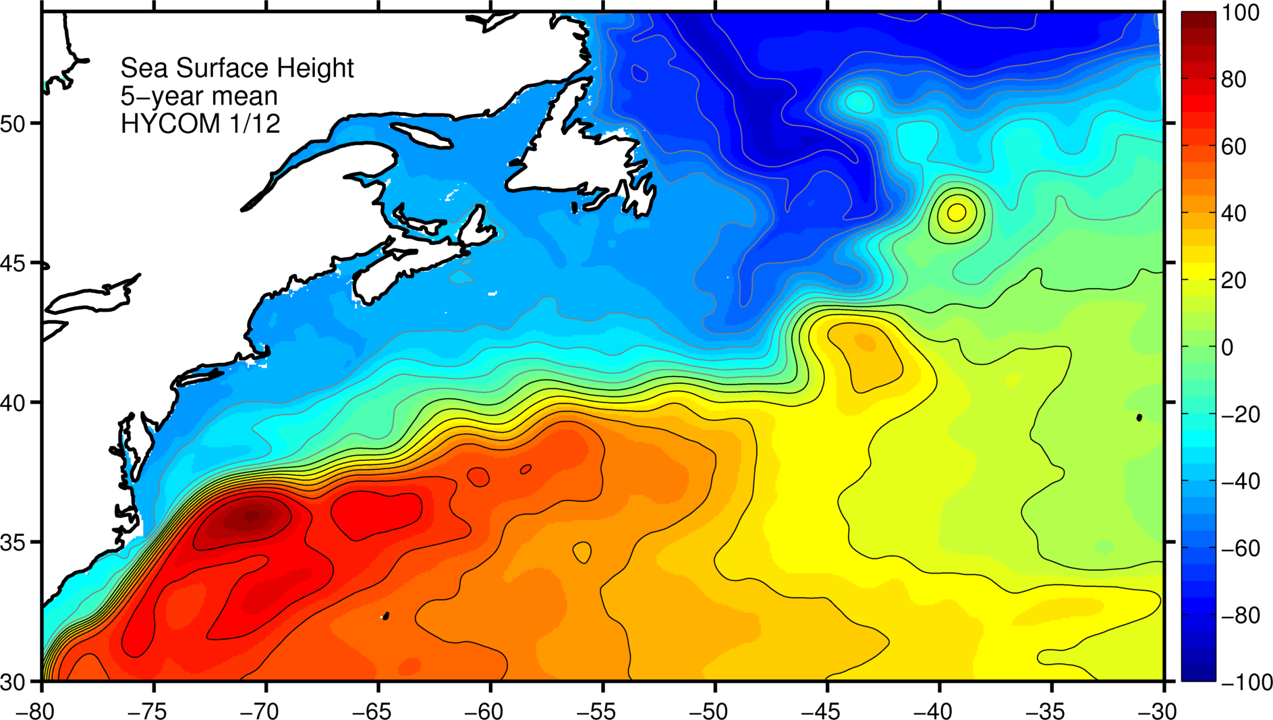
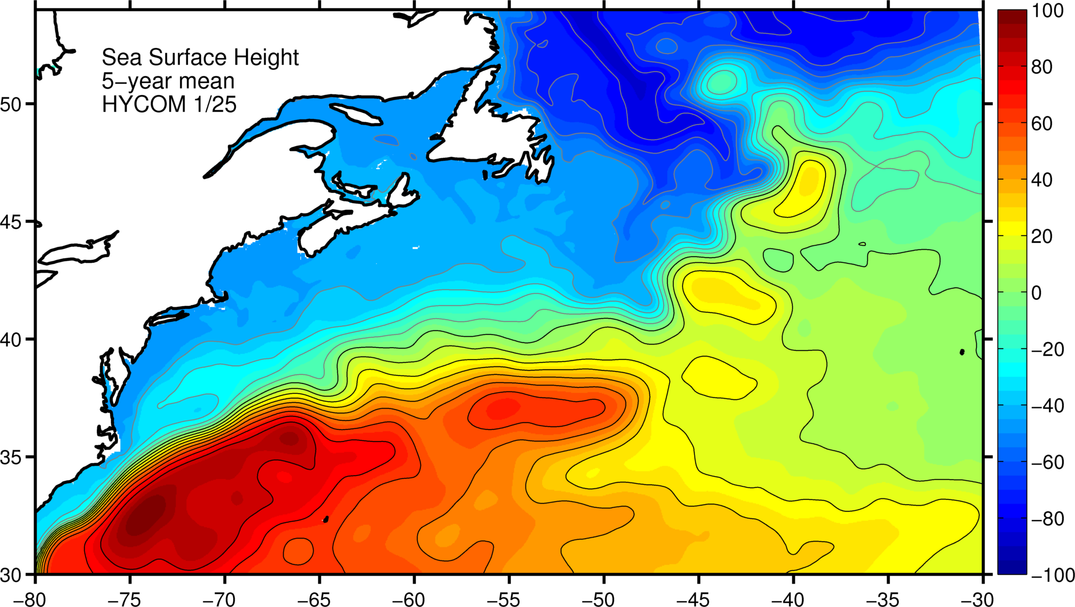
Mean SSH
AVISO (1993-2012)
1/50 (years 16-20)
1/12 (years 16-20)
1/25 (years 16-20)

Slide 9
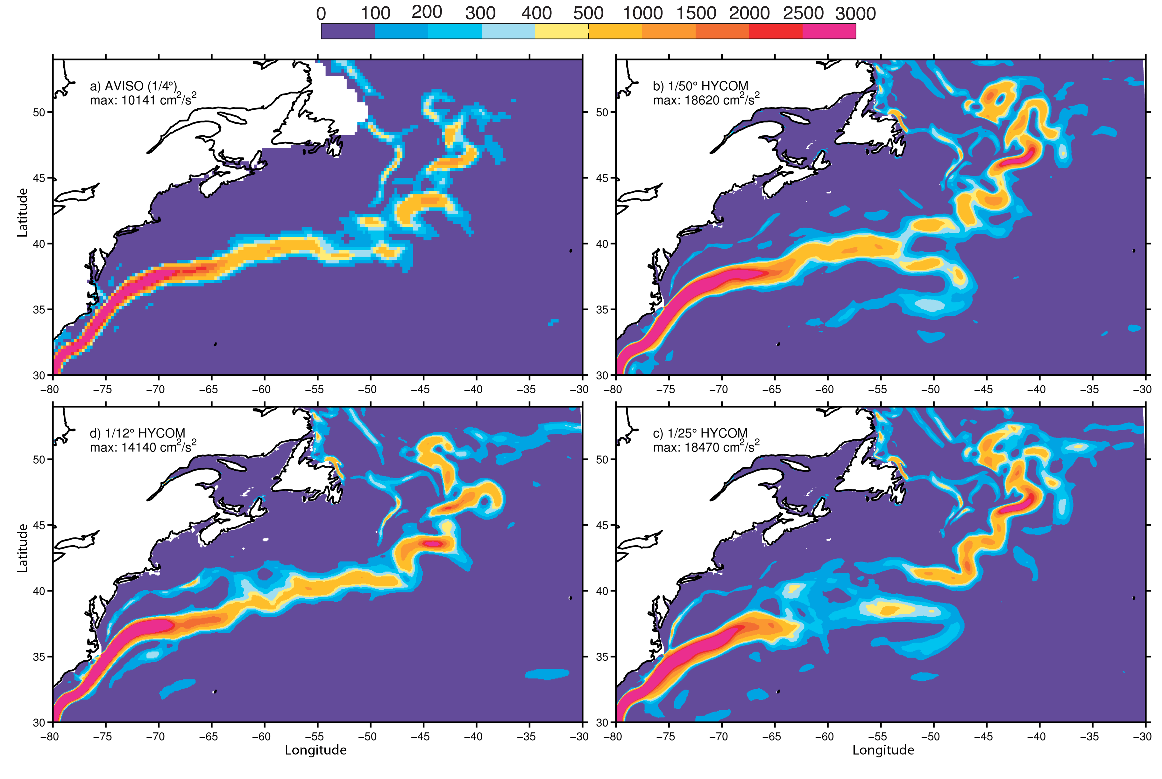
Mean flow Kinetic Energy (MKE)

Slide 10
Mean flow and EKE at 55°W
Observations
Model
Zonal velocity, u
from Richardson (1985)
Eddy Kinetic Energy (EKE)
Notes:
SLJ (Slop Water Jet); DWBC (deep western Boundary current); GS (Gulf Stream); NRG/SRG (Northern/Southern Recirculation Gyre)

Slide 11
Summary I
Increasing the horizontal resolution to 1/50° leads to a significant improvement on the representation of the Gulf Stream penetration and the associated recirculation gyres, not seen in simulations at 1/12° or 1/25°.
This is consistent with earlier results obtained by Hurburt and Hogan (2000) using a 6-layer hydrodynamic model NLOM in the subtropical North Atlantic configuration and by Levy et al. (2010) using NEMO model in an idealized configuration.
More details, including spectra analysis, in Chassignet and Xu (2017, JPO)

Slide 12
How about even larger scale circulation patterns
AMOC
Subtropical gyre
Subpolar gyre

Slide 13
AMOC streamfunction (z)
°
°
°

Slide 14
AMOC streamfunction (σ₂)
°
°
°

Slide 15
Basin-scale barotropic streamfunction
OVIDE
RAPID

Slide 16
Subtropical North Atlantic (26°N)
Zonal Integration
Zonal Structure
1/12°
1/25°
1/50°
Sverdrup flow
Northward limb
Southward limb
Northward limb
Southward limb

Slide 17
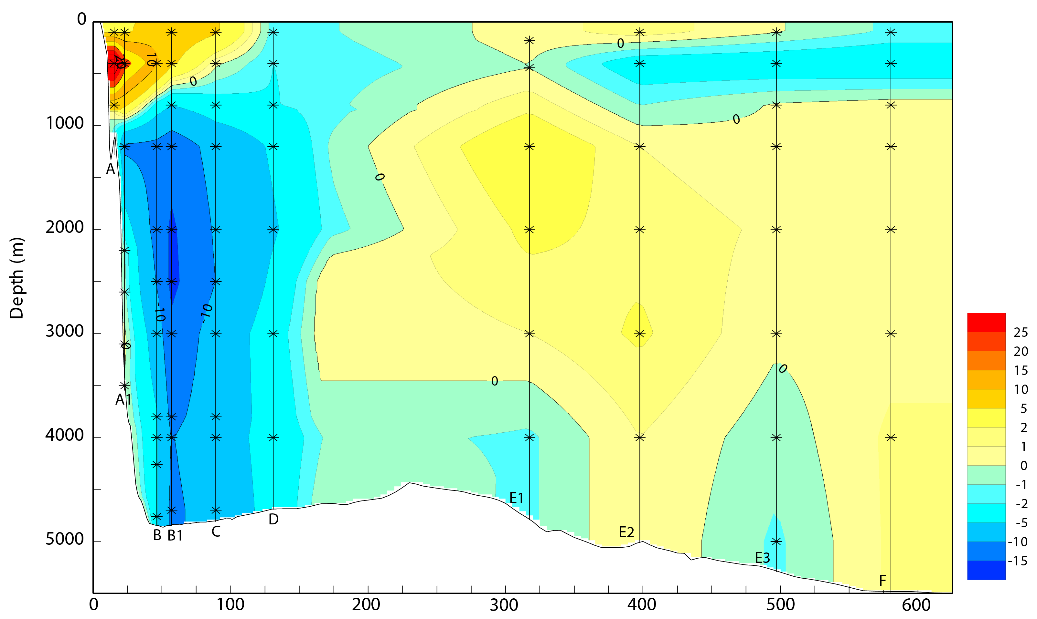
WBC east of Abaco at 26°N
(Bryden et al., 2005)
Observations
1/50°
1/12°
1/25°
Distance (km)
Distance (km)

Slide 18
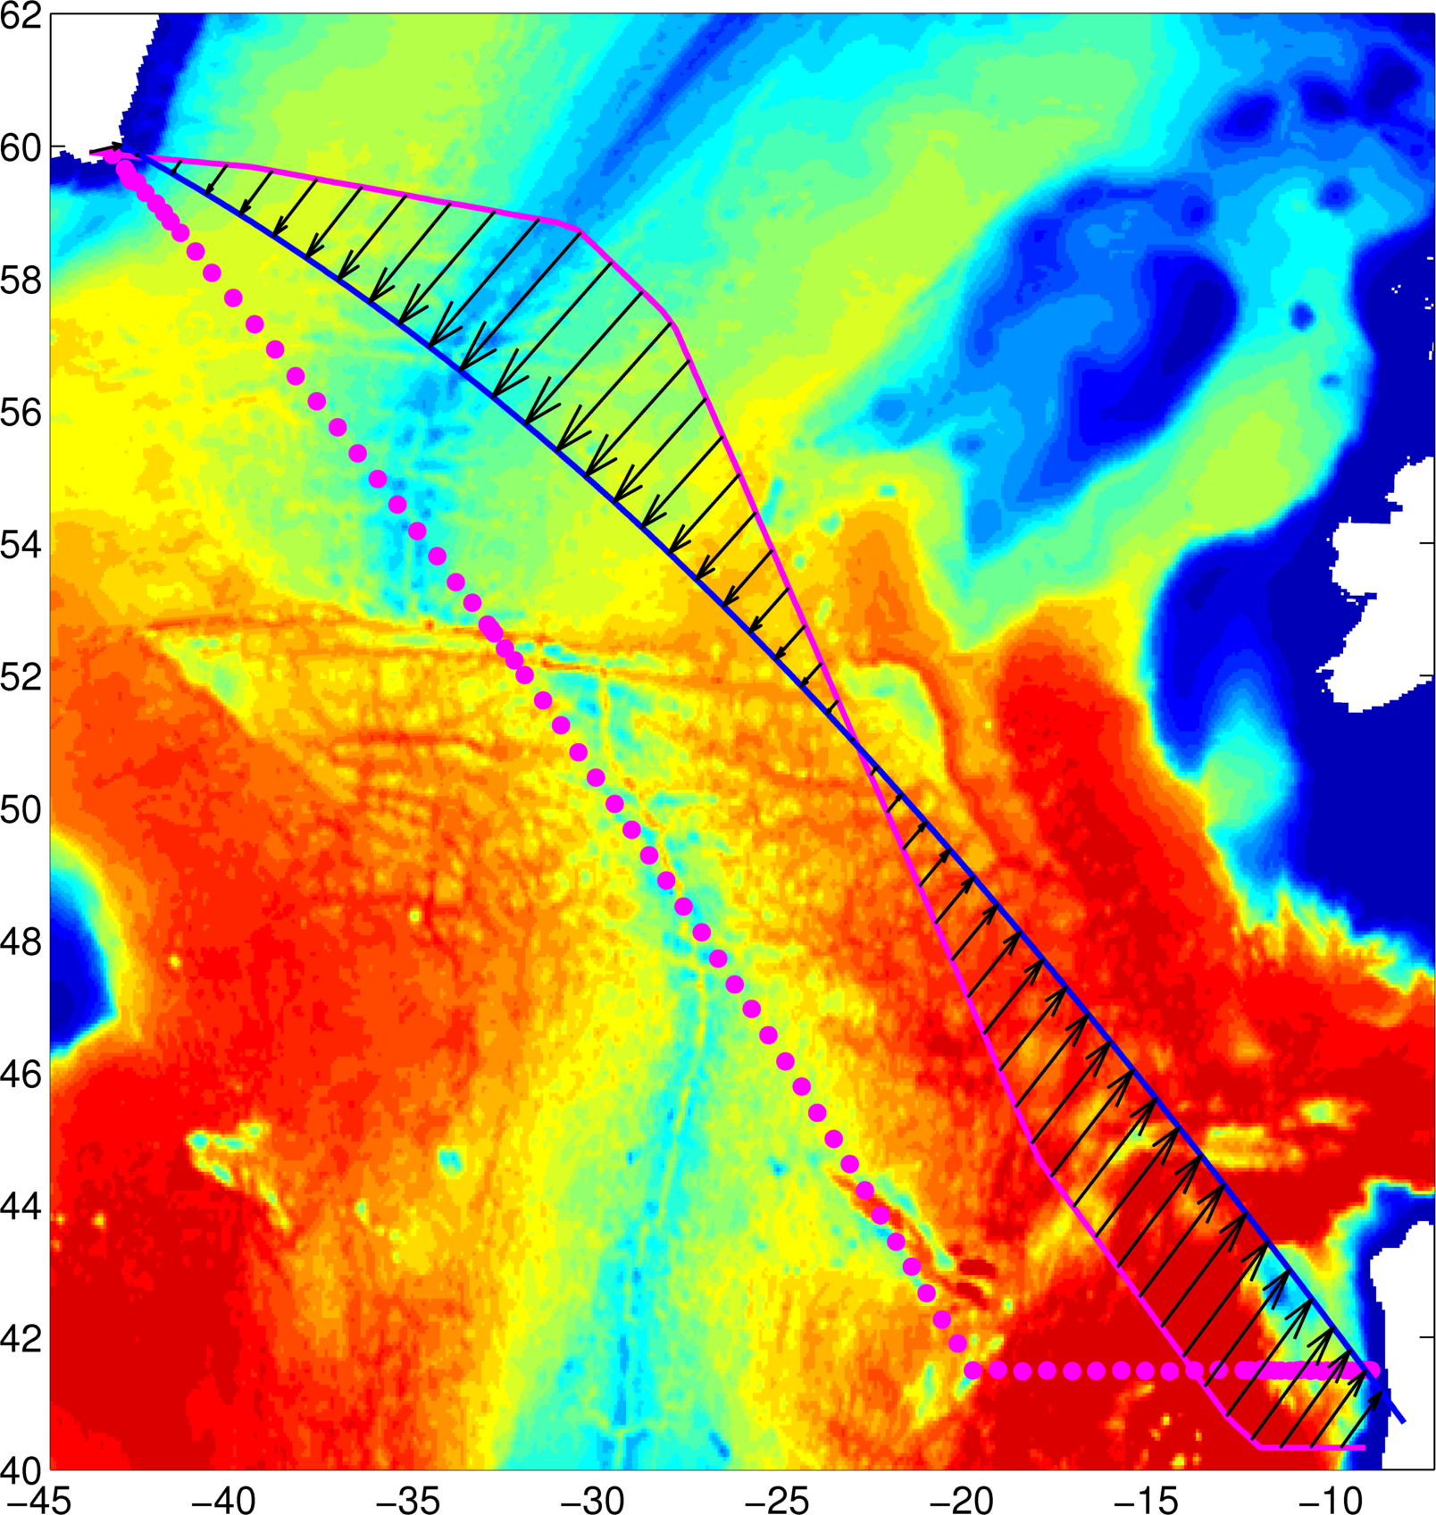
Subpolar (OVIDE section)
Section map
Overturning streamfunction
2002-2010
1997
1/12°
1/25°
1/50°
Observations from Daniault et al. (2016)-PO

Slide 19
Spatial distribution
Full water column transport
Two-layer transport
1/12°
1/25°
1/50°
1/12°
1/25°
1/50°
Sverdrup flow
bathymetry
Observation from Daniault et al (2016)-PO

Slide 20
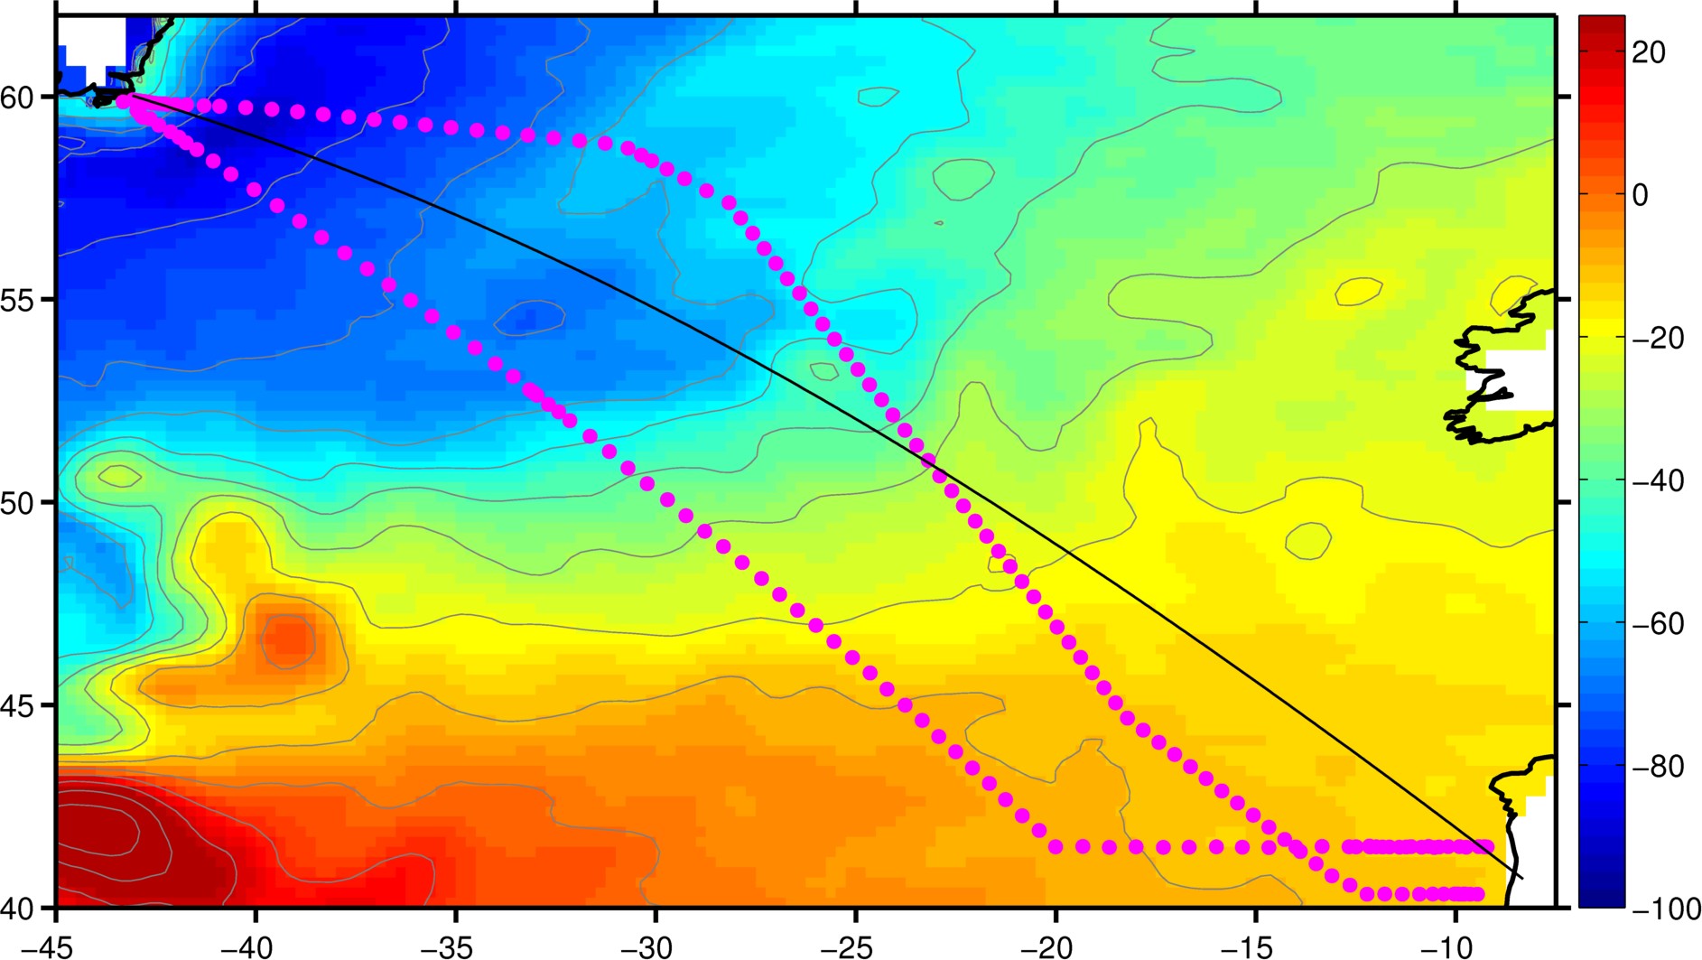
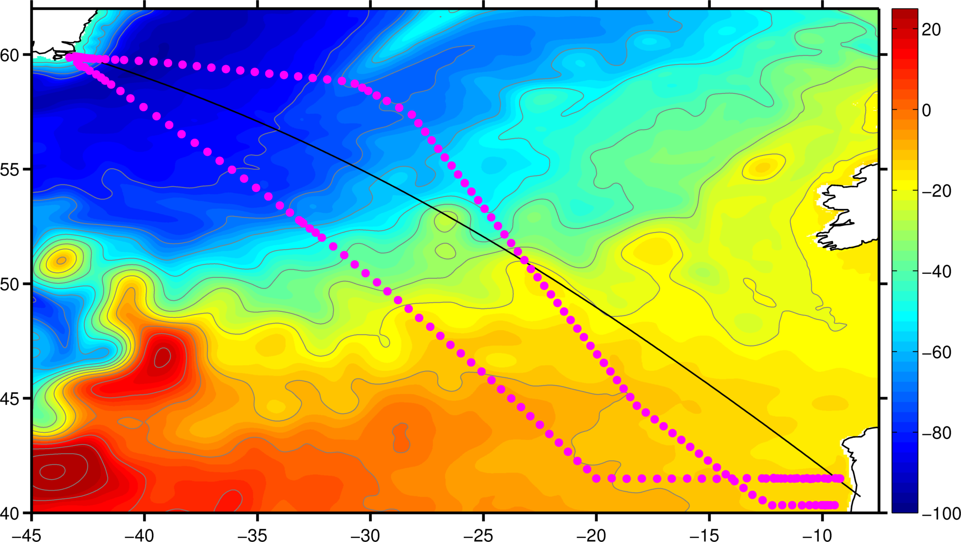
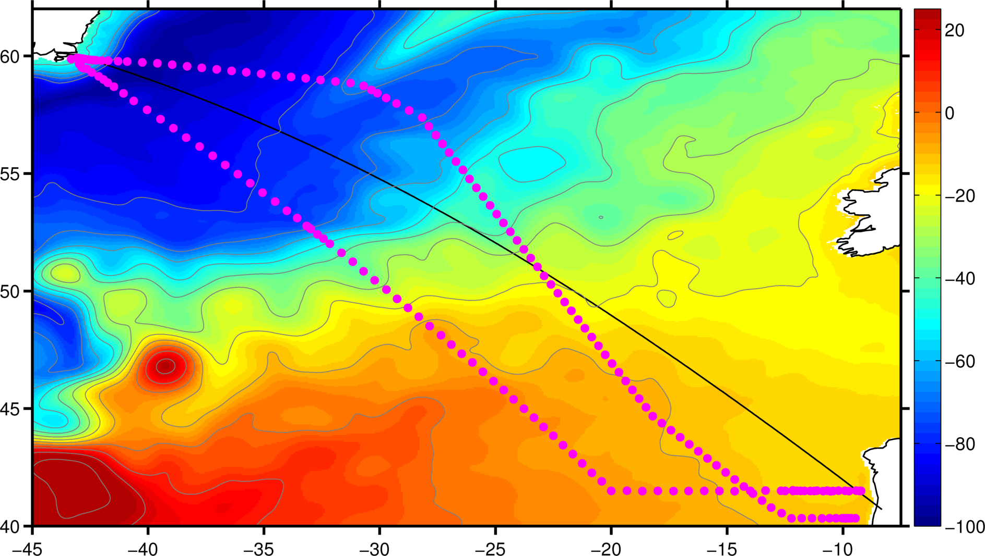
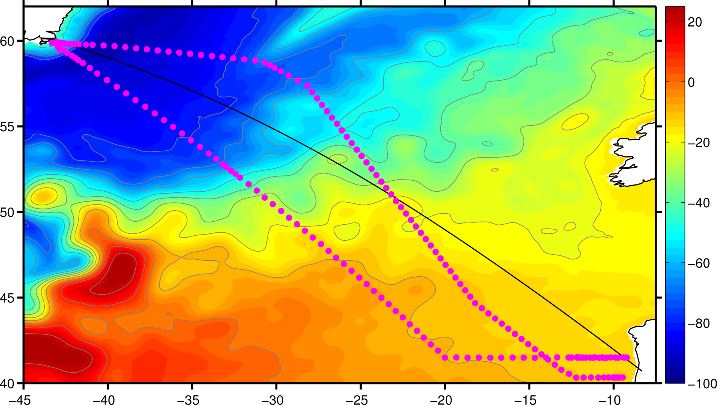
SSH in the subpolar North Atlantic
CNES-CLS-2013
1/50 HYCOM
1/12 HYCOM
1/25 HYCOM

Slide 21
Summary II
The transport structure of the large-scale AMOC and the subtropical/subpolar gyres is consistent among the 1/12°, 1/25°, and 1/50° simulations.

