Slide 1
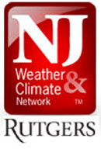
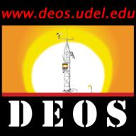
Mid-Atlantic Mesonet Consortium
Founded through the State Climate Offices at:
the University of Delaware
and Rutgers, The State University of New Jersey

Slide 2
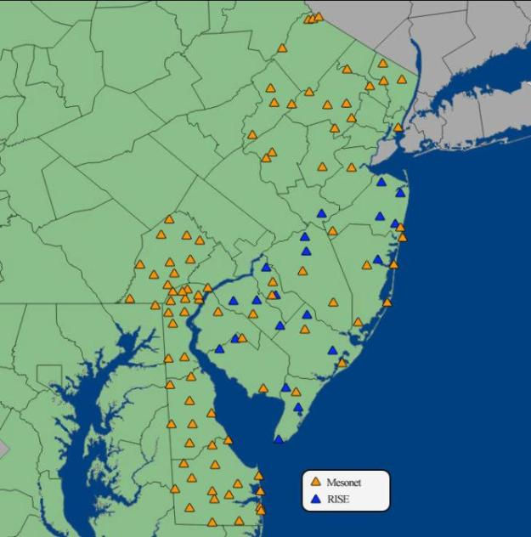


Locations of DEOS*, NJ Mesonet and RISE* stations…
PA & MD stations are part of DEOS.
RISE becoming part of the NJ Mesonet with the assistance of resources from the Meso US project.

Slide 3
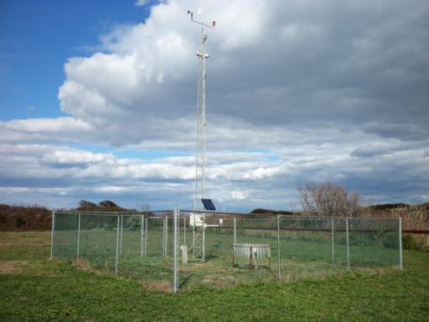
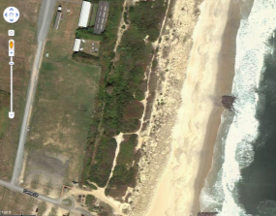
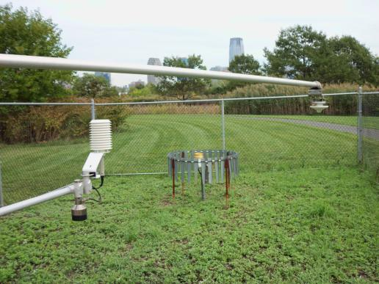
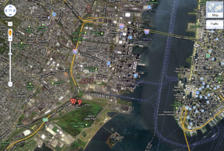
Sea Girt, NJ Mesonet
Coastal
Jersey City, NJ Mesonet
Urban

Slide 4
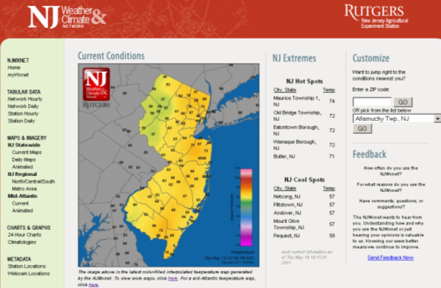
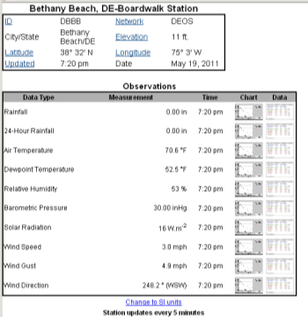
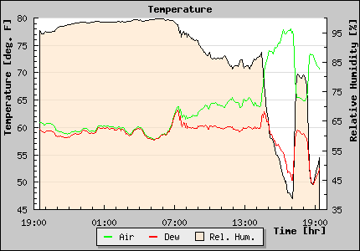
Sample displays:
DEOS &
NJWxNet

Slide 5


Mid-Atlantic Mesonet
Consortium Contributions to
FY11-12 Meso US Initiative
Upgrade & maintain DEOS and NJ Mesonet stations.
Generate detailed metadata.
Standardize data ingest across multi-state networks.
Develop quality control procedures with urban and coastal foci.
Explore expansion of Mid-Atlantic Mesonet to nearby states.

Slide 6
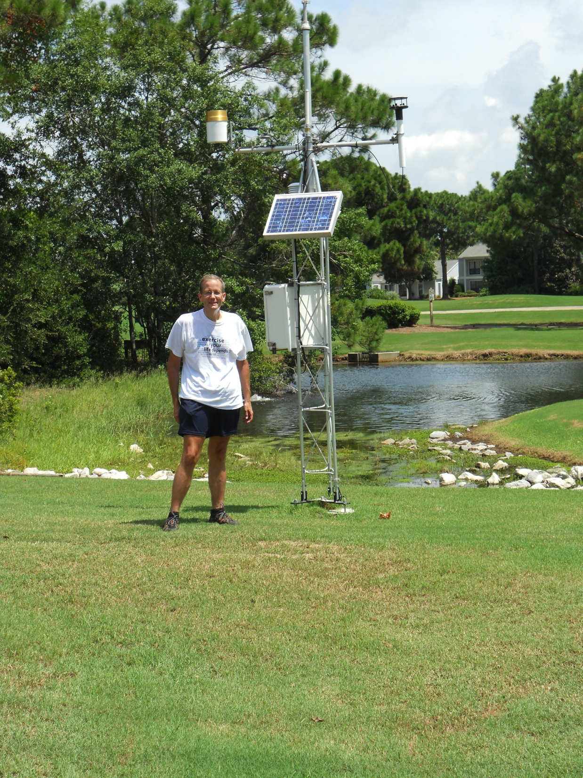

Slide 7

University of Delaware (DEOS)
UDEL operates the Delaware Environmental Observing System (DEOS), which encompasses coastal, urban, and rural locations in Delaware. DEOS provides state agencies and the citizens of the Delmarva area with immediate information about environmental conditions in and around the region with a network of 50 stations that report data in real time every five minutes
www.deos.udel.edu

Slide 8
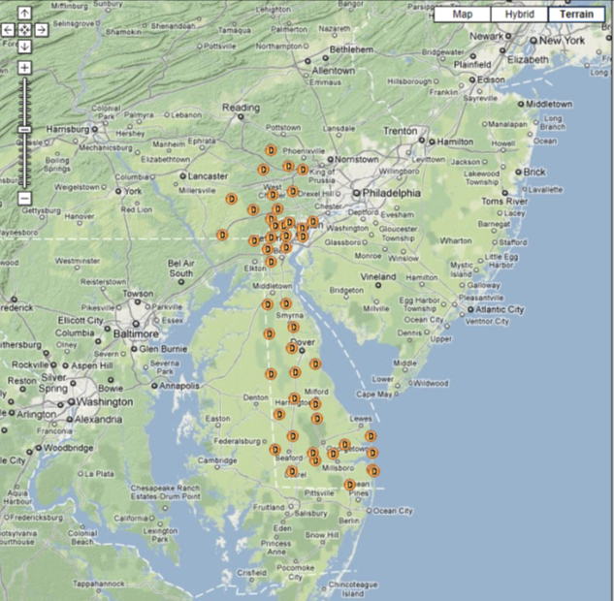
50 Core DEOS Mesonet Stations

Slide 9
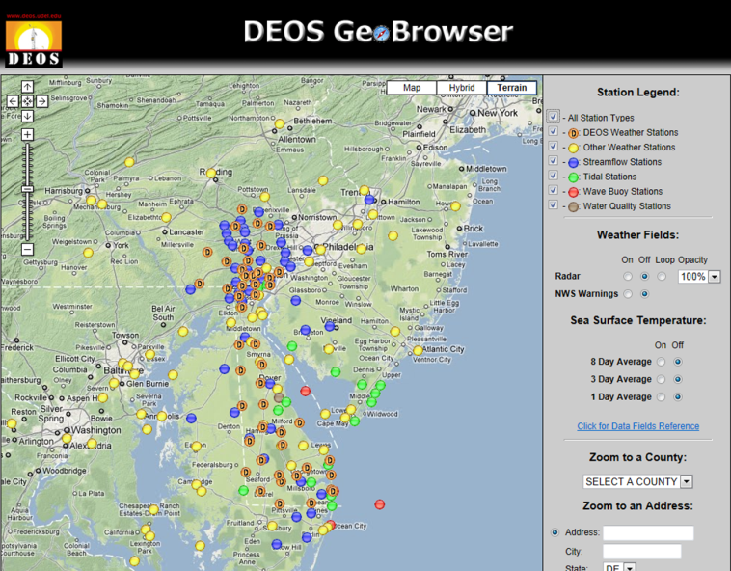
DEOS Receives Real-time Data from approximately 250 Environmental Sensing Platforms across the Delmarva Region

Slide 10
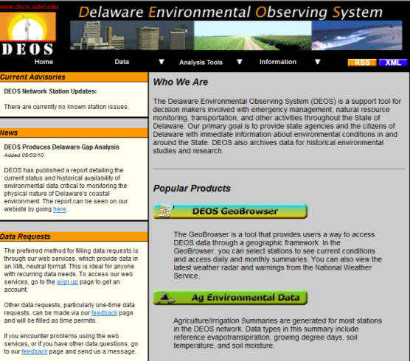
The data received from these 250 observing platforms is made immediately accessible in real-time on the web. In addition, the data is archived in an Oracle Data Base for later retrieval, and for various analysis and research applications.

Slide 11
DEOS Monitors the Following Environmental Variables
Meteorological variables (temp, precip, wind, atmospheric pressure, humidity, solar radiation, soil temp, soil moisture)… DEOS/NWS/DSWA
Stream Flow (gage height and discharge)… USGS/DGS
Tidal Data (tide level)… USGS/DGS
Ocean Buoy Data (wave height, wave period, water temp)… NOAA/NERR
Well Levels... DGS
Water Quality… DNREC/USGS
Snow Depth… DEOS

Slide 12
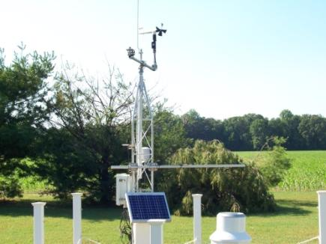
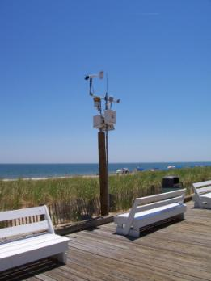
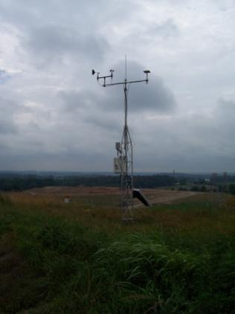
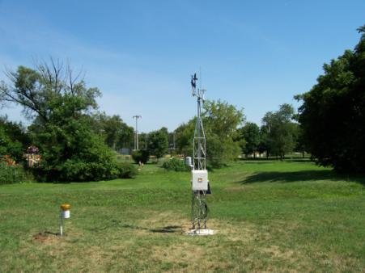

Slide 13
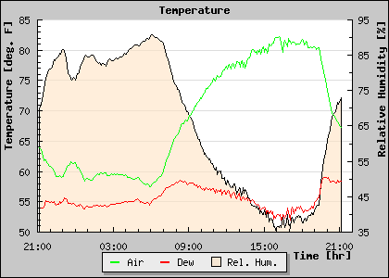
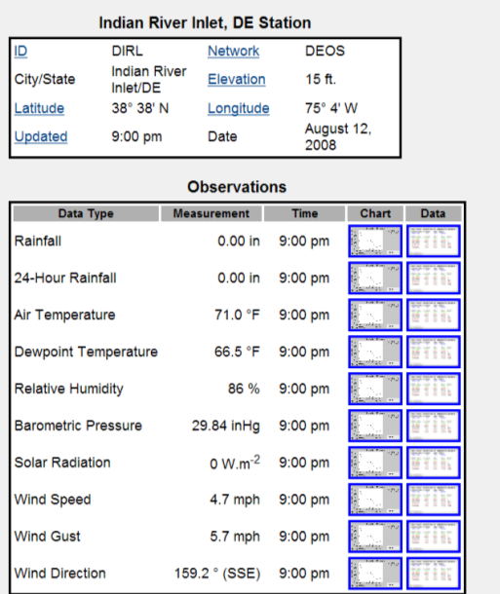
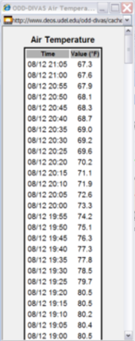
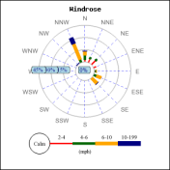
Some DEOS Visual Products…

Slide 14
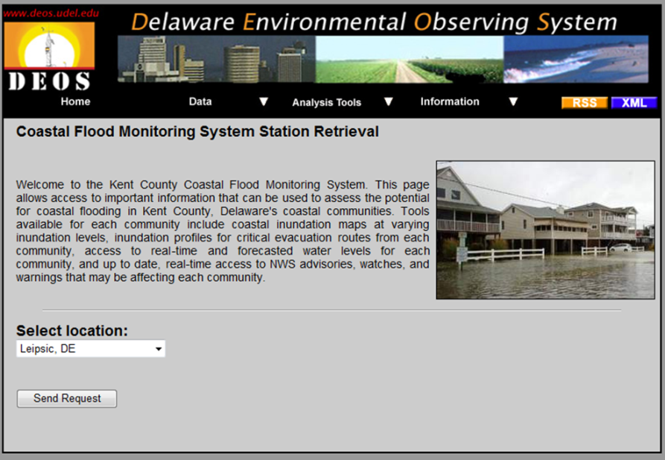
Delaware Coastal Flood Monitoring System

Slide 15
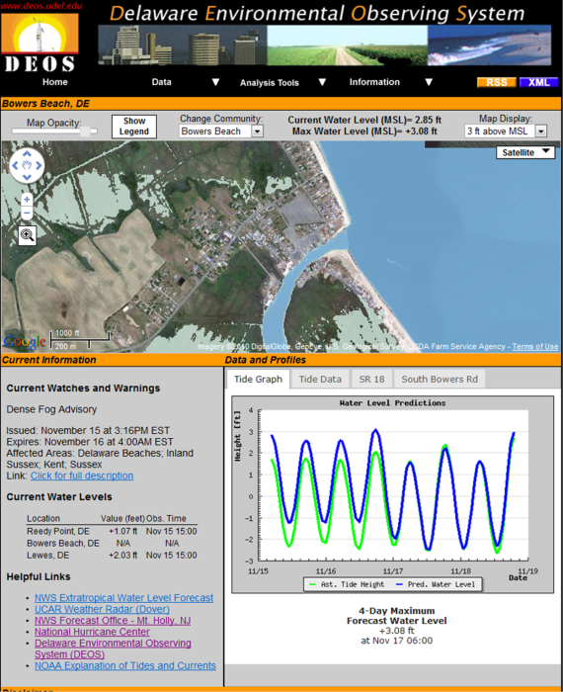
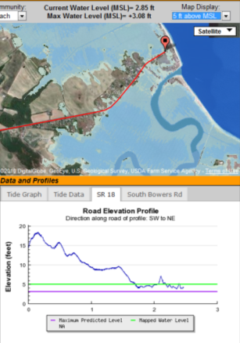

Slide 16
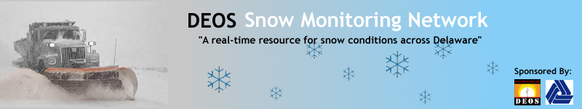
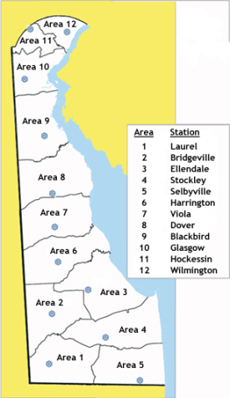
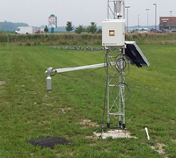

Slide 17
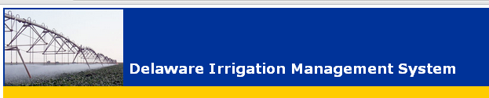

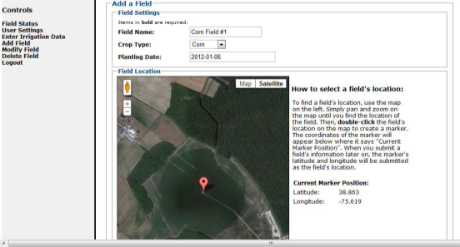
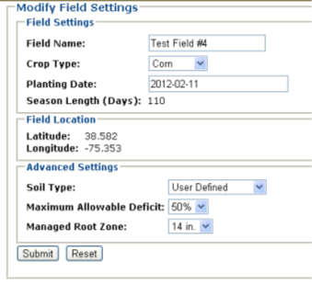
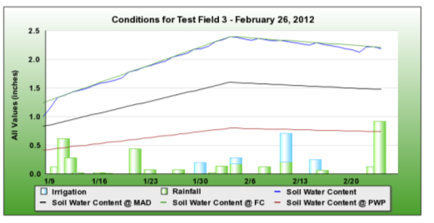

Slide 18
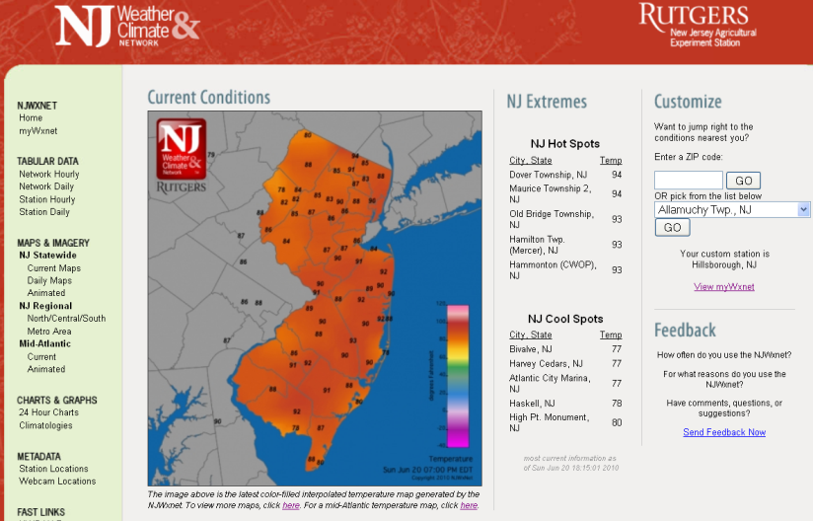
New Jersey
Weather & Climate Network
http://climate.rutgers.edu/njwxnet

Slide 19
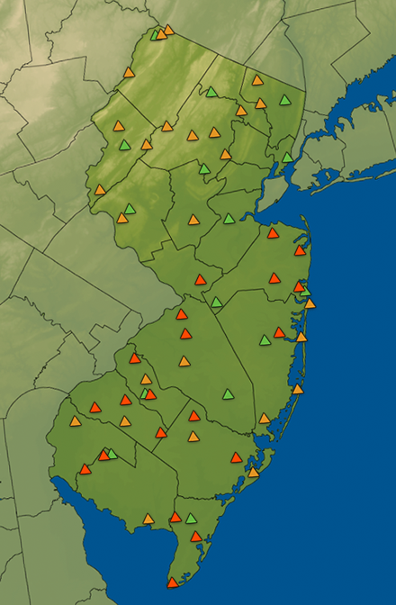
Stations maintained by the Office of the
NJ State Climatologist
(ONJSC)

Slide 20
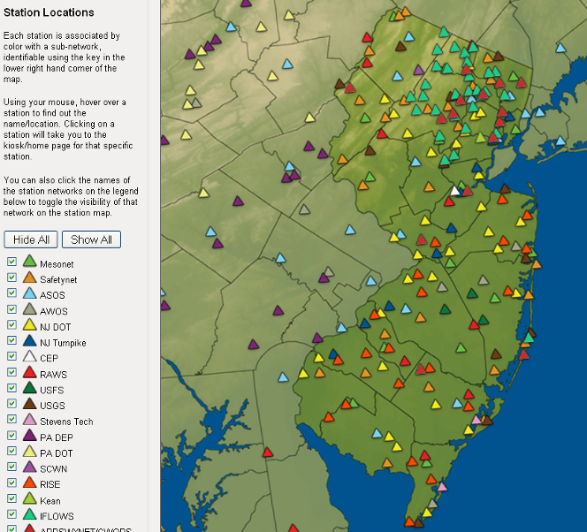
A multitude of stations
ONJSC stations
and those of
various other
real-time
networks

Slide 21
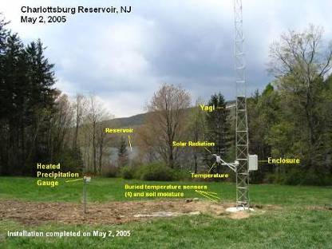
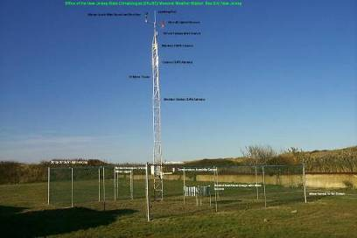
ONJSC New Jersey Mesonet
15 Mesonet sites measure:
Air temperature
Wind speed and direction
Dew point/Relative Humidity
Precipitation
Air pressure
Solar radiation
Soil temperature
Soil Moisture
Cellular communications
every 5 minutes
Ability for expansion built into station design

Slide 22
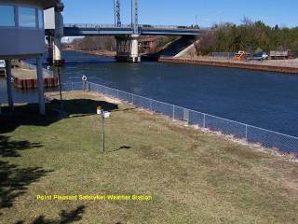
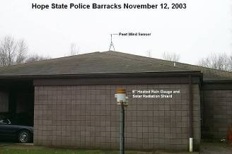
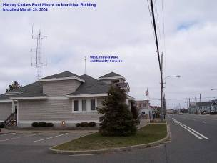
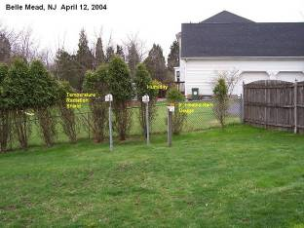
ONJSC New Jersey SafetyNet
SafetyNet sites measure:
Air temperature
Wind speed and direction
Dew point/Relative Humidity
Precipitation
Air pressure
via Cellular communications

Slide 23
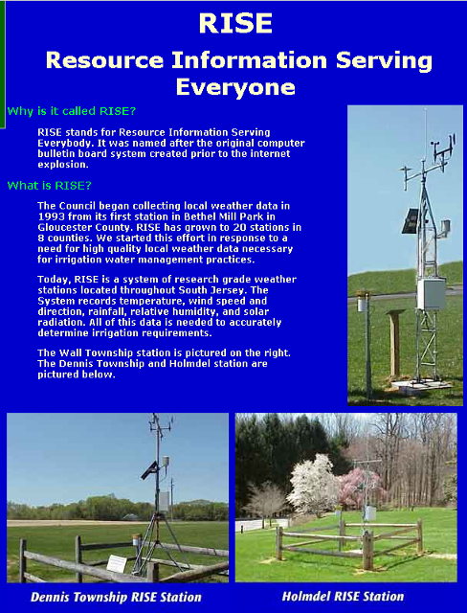
RISE
stations are
now part
of the
ONJSC
Program: conversions in progress to Mesonet stations with 5 minute observations via cellular modem

Slide 24
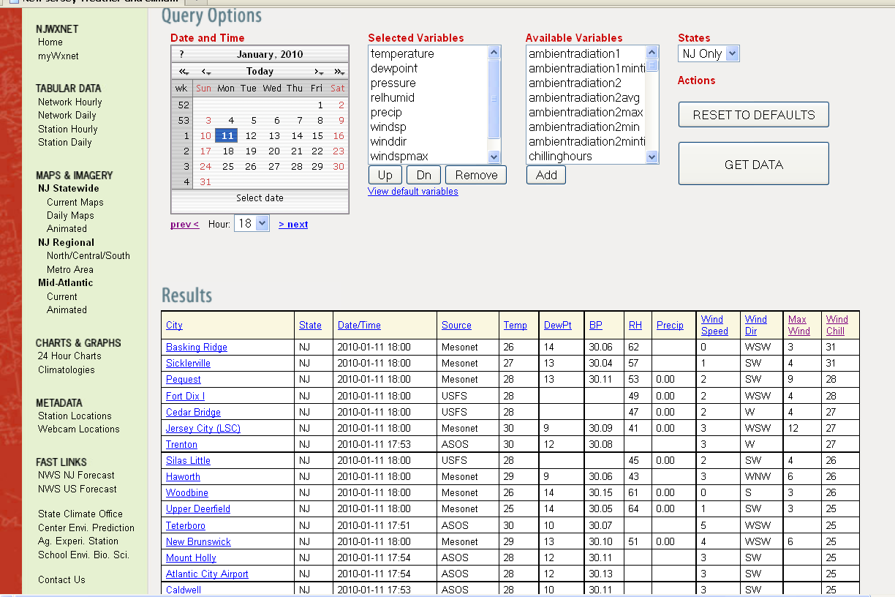

Slide 25
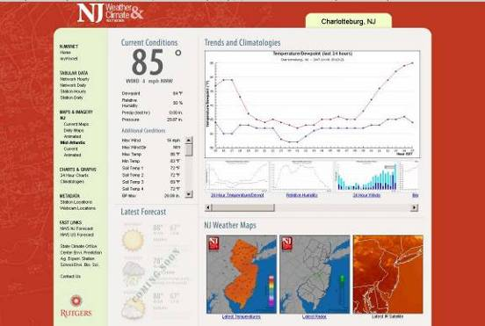
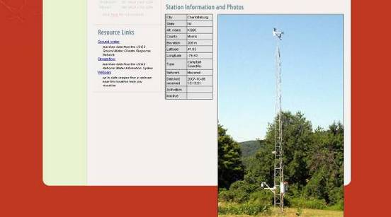
Station
specific
page

Slide 26
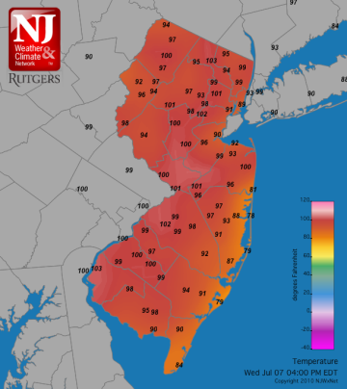
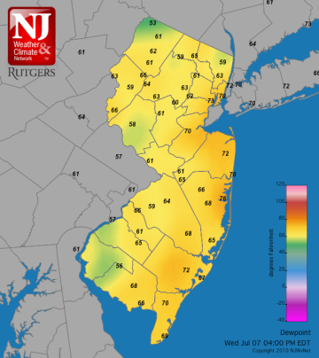
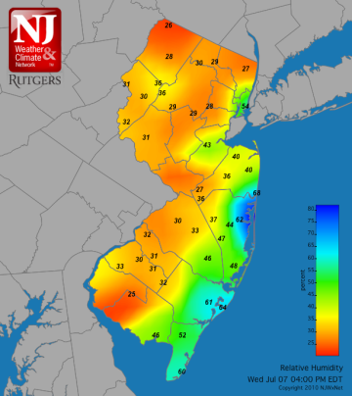
July 7, 2010
4:00PM
Temperature
Dewpoint
Relative humidity

Slide 27
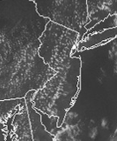
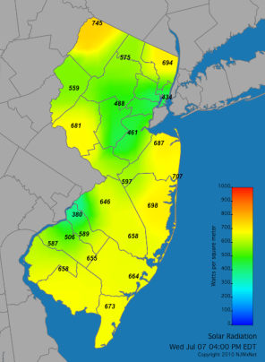



Sky conditions via
satellite
Radar
Solar radiation
July 7, 2010
4:00PM
Wind speed & direction
Wind gusts

Slide 28


Evapotranspiration
Precipitation
July 13, 2011 9:00 PM

Slide 29


Soil water content
Soil temperature
Each at 10 cm depth under grass Nov. 11, 2011 noon

Slide 30

Sea Breeze
Temperatures
4PM, April 11, 2011

