Slide 1
AASC State Report: Oklahoma
Renee A. McPherson
State Climatologist
Oklahoma Climatological Survey

Slide 2
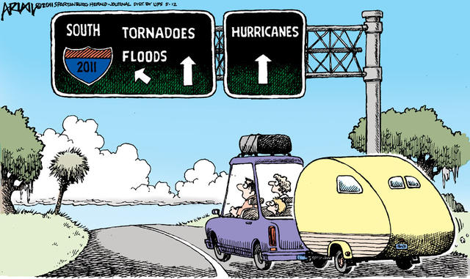
SNOW
FRIGID COLD
DROUGHT
WILDFIRES
(modified from original source)

Slide 3
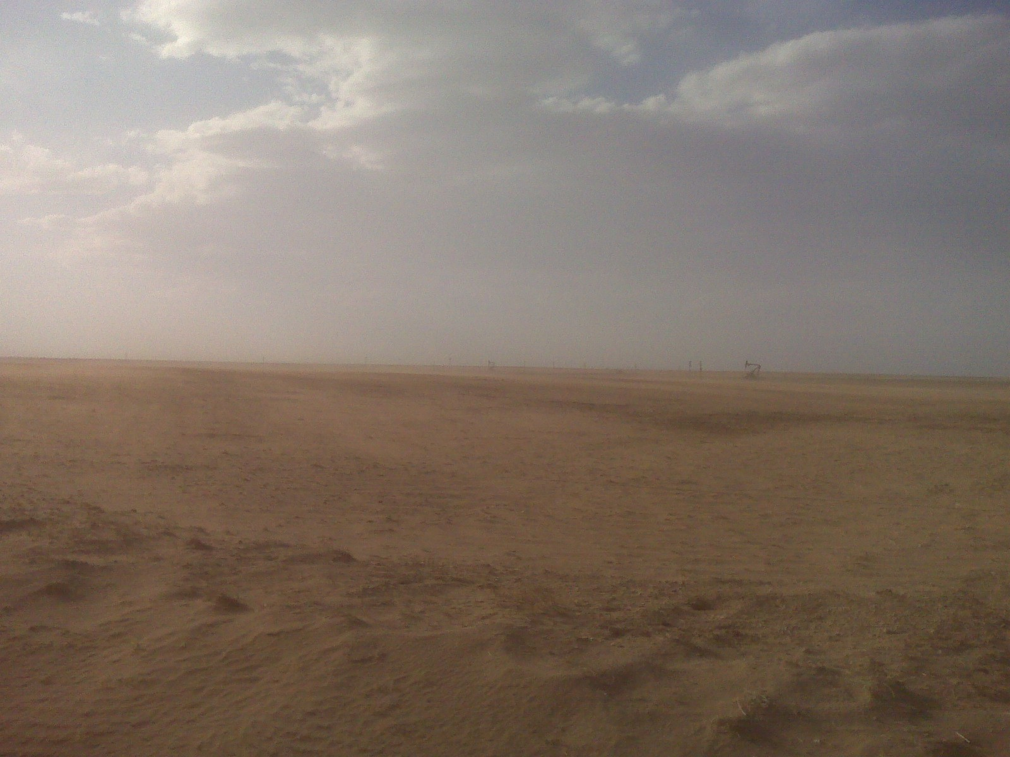
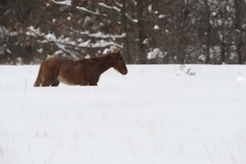
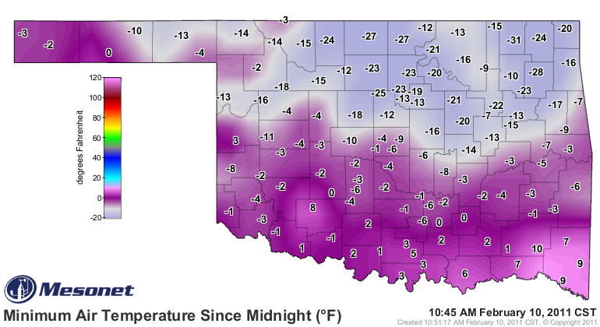
New Records in 2011
24-hour snowfall: 27 inches of snow; Spavinaw over Feb. 8-9
Low temperature: –31˚F; Nowata Mesonet site on Feb. 10
Summer heat: hottest summer of any state since records began in 1895 (statewide average of 86.9˚F); July’s average temperature was 89.3˚F (hottest month for any state on record); Grandfield Mesonet site recorded 101 days above 100˚F (previous record was 86 days at Hollis in 1956)
Photo: Von Castor & Fox23 Tulsa

Slide 4
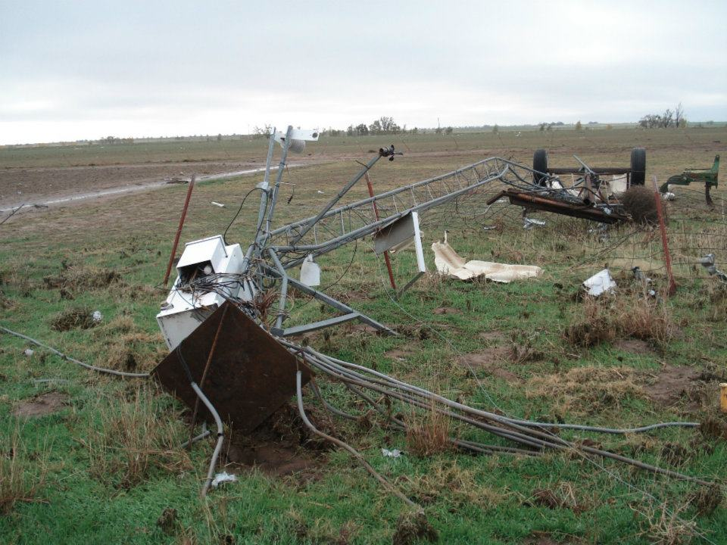
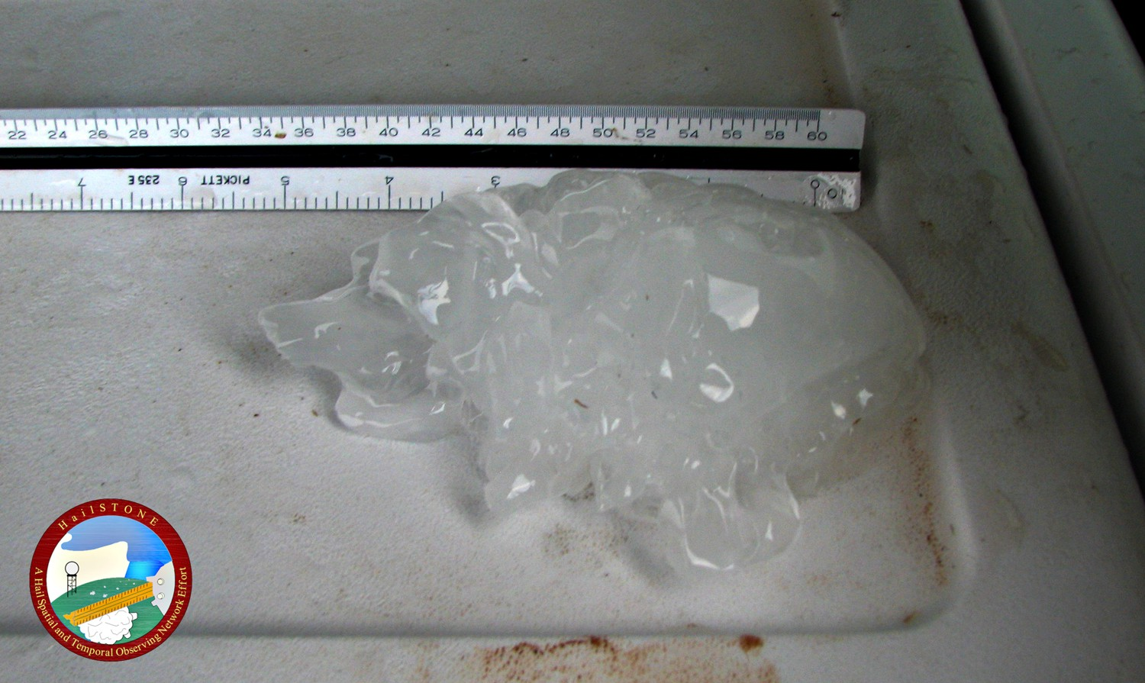
New Records in 2011
Tornadoes: 50 tornadoes for April; 2011 tornado count was 119 (2nd highest)
Maximum surface wind: 151 mph on May 24 at El Reno Mesonet site
Hailstone: 6 inches near Gotebo on May 23

Slide 5
Stats Summary for 2011
Issued 22 press releases, >80 “Ticker” emails, and provided interviews to hundreds media entities (Gary)
On average, 76 people attended bi-weekly drought webinar that started in the fall (Mark)
Customers requested 36.3 Terabytes of information from 2 billion hits to our web pages
Taught 256 public safety officials through 17 workshops
At the end of 2011, OCS employed 32 professional staff, 6 graduate students, and 10 undergraduates; just hired Monica Deming as a new service climatologist

Slide 6
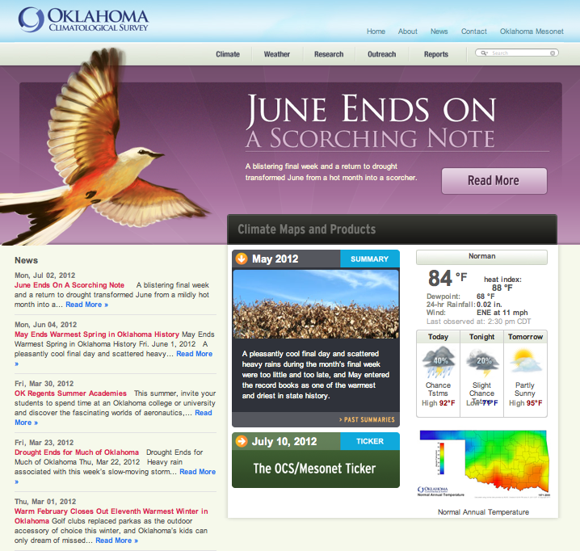
Web Page Update

Slide 7
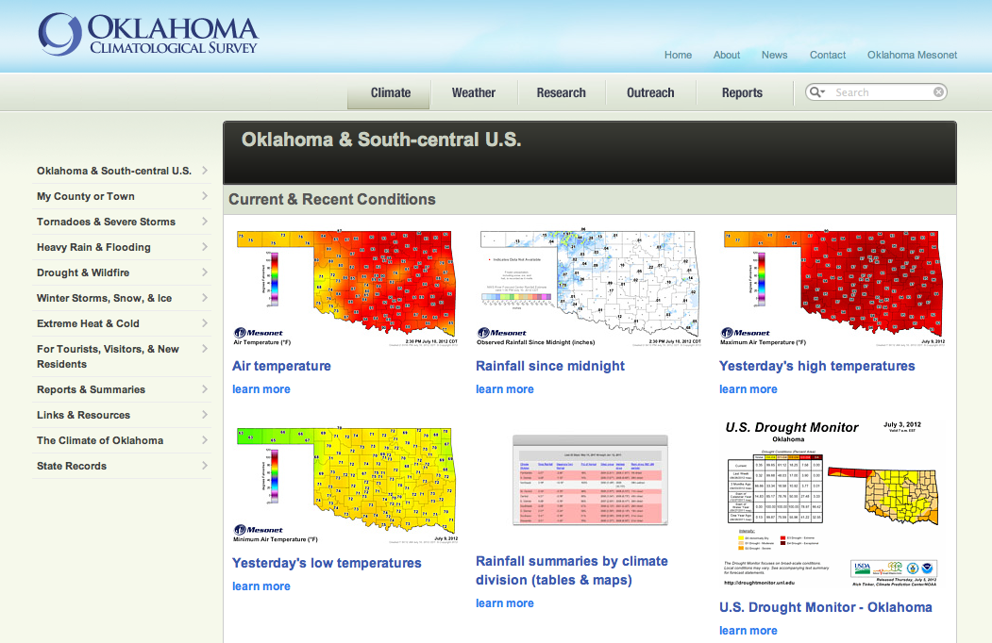

Slide 8
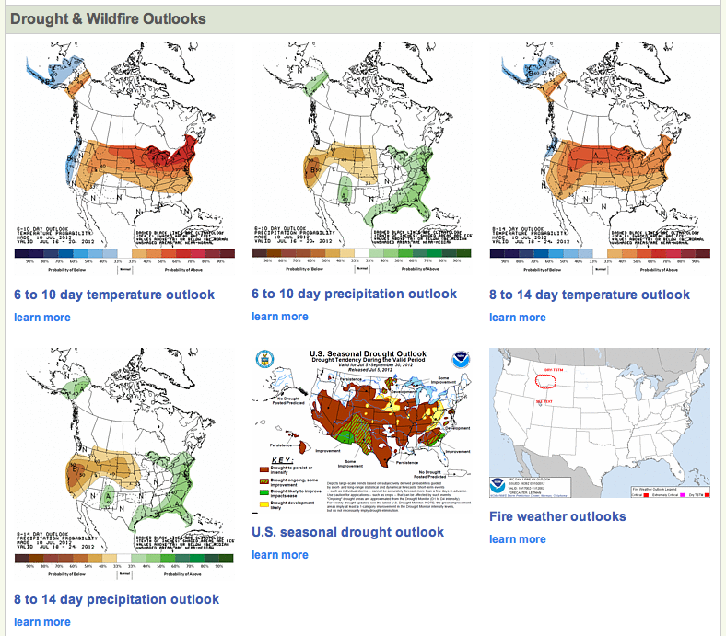

Slide 9
Recent Reports
National Climate Assessment chapter work (forthcoming)
Riley, R., K. Monroe, J. Hocker, M. Boone, and M. Shafer, 2012: An Assessment of the Climate-Related Needs of Oklahoma Decision Makers. Southern Climate Impacts Planning Program, Norman, OK, 48 pp.
Riley, R., P. Blanchard, B. Bennett, R. Peppler, and D. Wildcat, 2012: An Assessment of the Climate-Related Needs of Oklahoma Decision Makers. Southern Climate Impacts Planning Program, Norman, OK, 22 pp.
AMS, 2011: Final report of the AMS ad hoc Committee on a Nationwide Network of Networks. American Meteorological Society, Boston, MA, 94 pp.

Slide 10
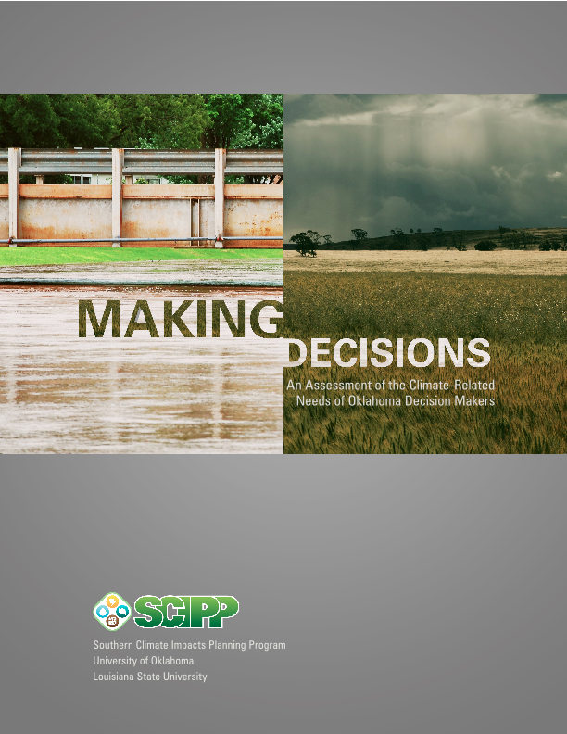
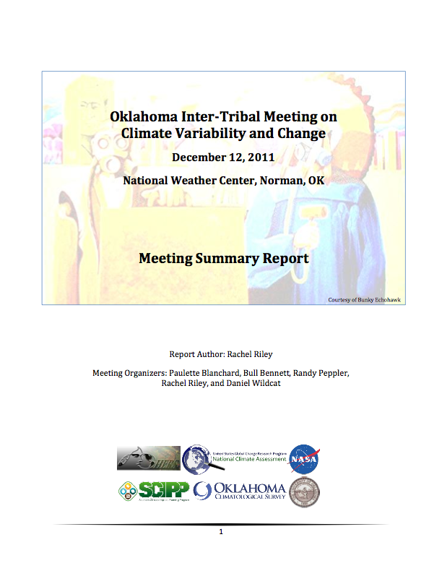
Oklahoma Climate Needs Assessment
Intertribal Climate Workshop
U.S. Fish & Wildlife
Needs Assessment

Slide 11
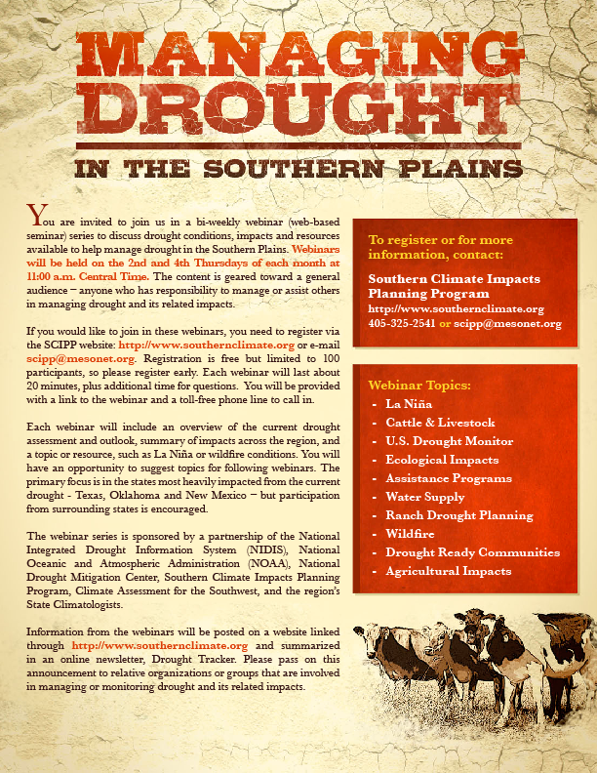
Webinar Series
Bi-weekly
Overview of regional drought conditions and outlook
led by the Drought Monitor authors
Discussion Topic
Mix of technical and sector-specific information
Presenters from multiple states, organizations
Comments & Updates from State Climatologists

Slide 12
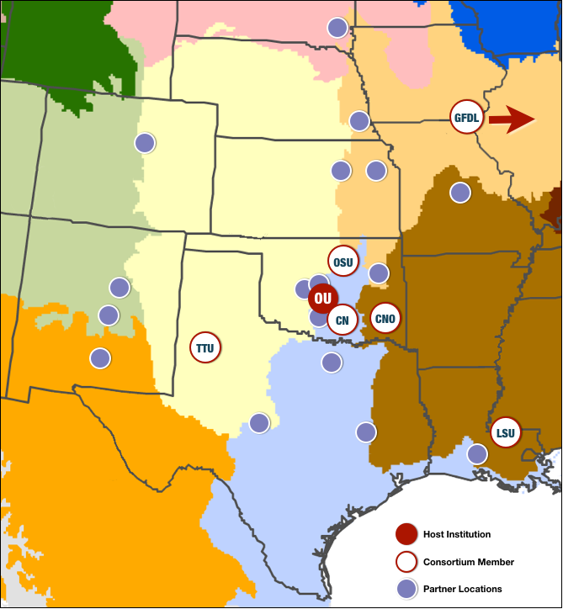
New DoI Climate Science Center
The University of Oklahoma (OU)
Texas Tech University (TTU)
Louisiana State University (LSU)
The Chickasaw Nation (CN)
The Choctaw Nation of Oklahoma (CNO)
Oklahoma State University (OSU)
NOAA’s Geophysical Fluid Dynamics Laboratory (GFDL)
SOUTH CENTRAL CLIMATE SCIENCE CENTER

Slide 13
Some Recent Research
Boone, K. M., R. A. McPherson, M. B. Richman, and D. J. Karoly, 2012: Spatial coherence of rainfall variations using the Oklahoma Mesonet. Intl J. Clim., 32, 843-853.
Hoekstra, S., K. Klockow, R. Riley, J. Brotzge, H. Brooks, S. Erickson, 2011: A preliminary look at the social perspective of Warn-on-Forecast: Preferred tornado warning lead time and the general public’s perceptions of weather risks. Wea. Climate Soc., 3, 128–140.
McPherson, R. A., J. D. Lane, K. C. Crawford, and W. G. McPherson Jr., 2011: A climatological analysis of heatbursts in Oklahoma (1994 – 2009). Intl J. Clim., 31, 531-544.
Klockow, K. E., R. A. McPherson, and D. Sutter, 2010: On the economic nature of crop production decisions using the Oklahoma Mesonet. Weather, Climate, and Society, 2, 224–236.

Slide 14
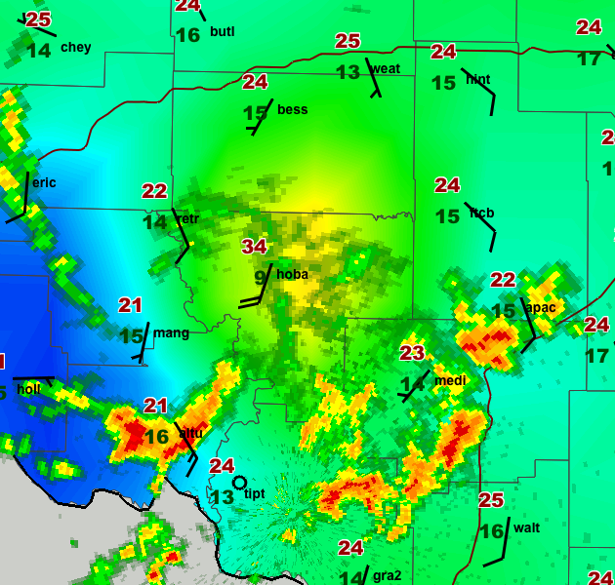
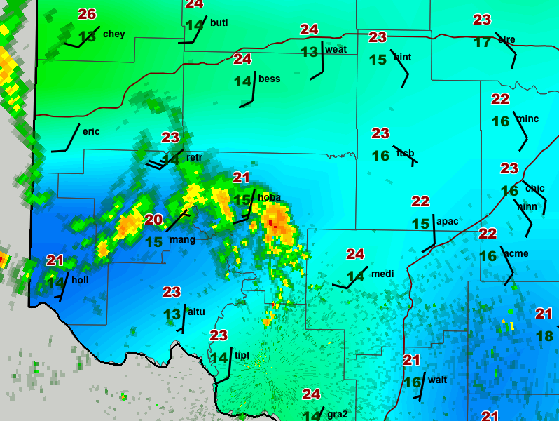
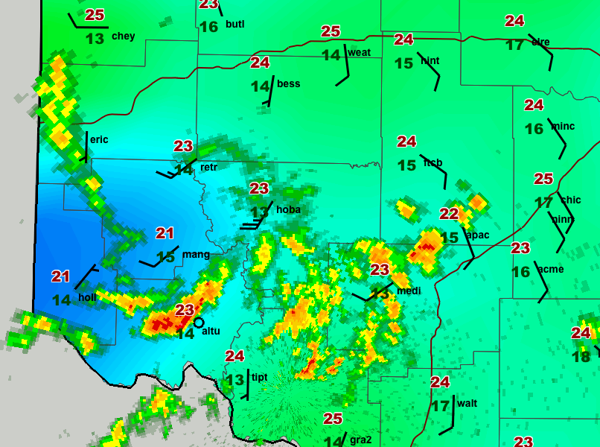
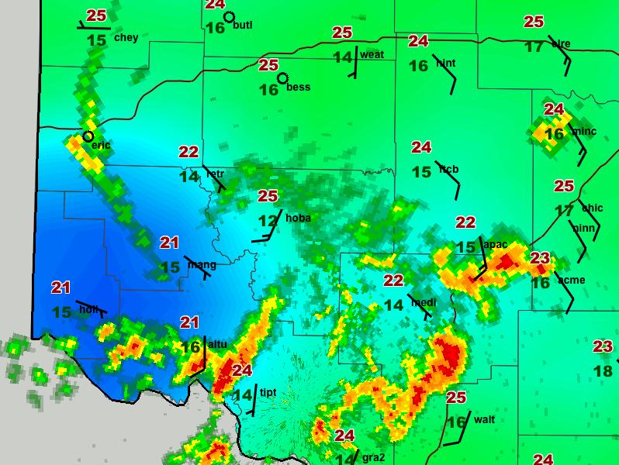
1255 UTC
1345 UTC
1335 UTC
1355 UTC
Single-Site Measurement
23 May 2005 heatburst

Slide 15
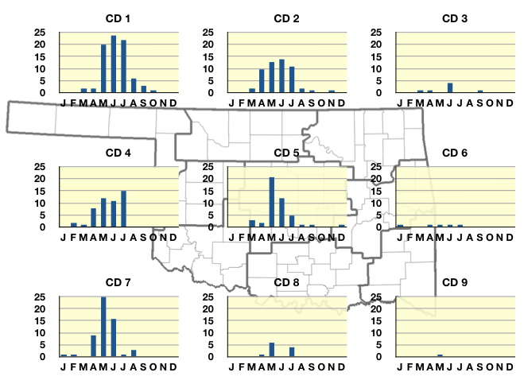
Spatial Distribution
Heatburst detections

Slide 16
AASC Meeting 2014?
SNOW
FRIGID COLD
DROUGHT
WILDFIRES

