Slide 1
NWS Climate Services Division
Developing the Partnership with LCAT
Fiona Horsfall
AASC Annual Meeting
July 2012

Slide 2
Local Climate Analysis Tool (LCAT)
Developed to support NWS field offices
Online interactive tool
For regional and local climate studies
State-of-the-art station data
Best practices for climate analysis
Variables beyond average temp and total precip, including extreme events
Reduce field office time spent on responding to customers’ climate questions
Provides critical links for forecasters on climate drivers for weather and water events

Slide 3
LCAT Essentials
Requirements
Training
Integrated
Working
Team
Drought Analysis and
Impacts
Climate Change
Impacts
SMEs
NCDC, CPC,
NCMC, ESRL,
CBRFC, WWA
Science
Advisory
Teams
Climate Variability
Impacts
Water Resources
Applications
CSD, OST,
Contractors
LCAT
Development
Team
Attribution of
Extreme Events
* Livezey et al, 2007; J. Appl. Meteor. Climatol.
** NIST/SEMATECH e-­‐Handbook of Statistical Methods. 2012
*** Huang et al, 1996; J. Climate

Slide 4
How does LCAT work?
LCAT uses principles of Artificial Intelligence to connect humans with computing capability to apply data and scientific techniques
How is the temperature in my town changing?
Data: Homogenized station maximum temperature
Analysis: best practices for trend; rate of change
Output: statistics, plots, metadata
NWS Forecasters
LCAT
Should we expect floods during La Nina events?
Data: Homogenized precipitation and river flow
Analysis: composites, risk assessment
Output: statistics, plots, metadata
How severe is the drought in my region this year?
Data: Drought indices
Analysis: time series analysis
Output: statistics, plots, metadata
Temp, precip, 30 years…………………………………..
Which climate model performs best in my region?
Data: Reanalysis and GCM fields
Analysis: downscaling, sensitivity tests
Output: statistics, plots, metadata
What are the projections for climate in my region?
Data: GCM outputs
Analysis: downscaling
Output: statistics, plots, metadata
Notes:
Ears, mouth, arms, brain – we train the brain.

Slide 5
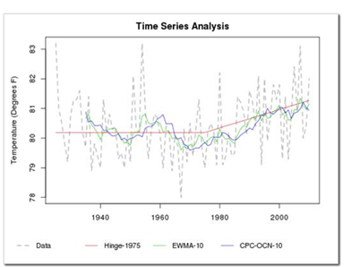
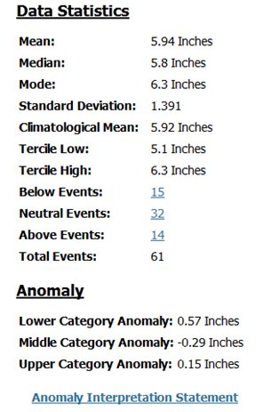
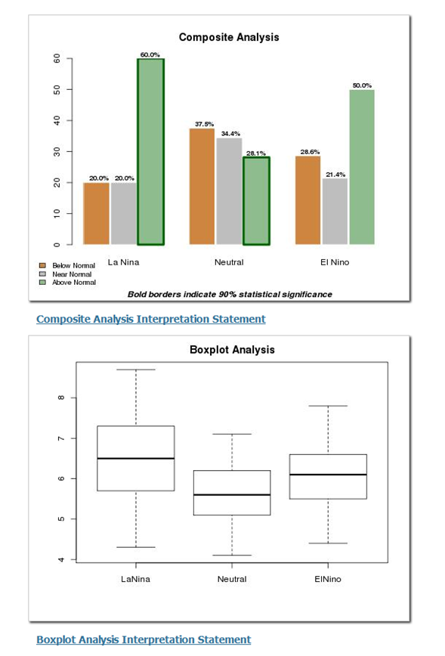
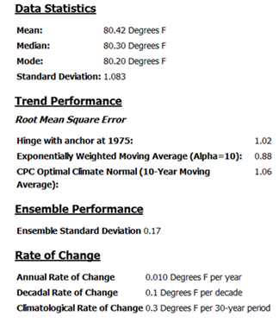
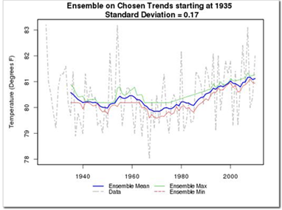
LCAT Output
ENSO Composite Analysis performed at 90% confidence (10% error) level for Florida Panhandle (Climate Division ID# 69), suggests that
During LaNina events (when ONI* is less than or equal to -0.5):
There is a statistically significant chance (60.0%) that the 3-Month Total Precipitation (inches) for the July-August-September period will be Above Normal. A chance (20.0%) for Total Precipitation (inches) to occur in the Below Normal category is not statistically significant. A chance (20.0%) for Total Precipitation (inches) to occur in the Near Normal category is not statistically significant.
During Neutral events (when ONI* is between -0.5 and +0.5):
There is a statistically significant chance (28.1%) that the 3-Month Total Precipitation (inches) for the July-August-September period will be Above Normal. A chance (37.5%) for Total Precipitation (inches) to occur in the Below Normal category is not statistically significant. A chance (34.4%) for Total Precipitation (inches) to occur in the Near Normal category is not statistically significant.
During ElNino events (when ONI* is greater than or equal to +0.5):
A chance (28.6%) for 3-Month Total Precipitation (inches) for the July-August-September period to occur in below normal, (21.4%) in near normal and (50.0%) in above normal category is not statistically significant.
*ONI episodes based on a threshold of +/- 0.5 Degrees C for the Oceanic Nino Index (ONI) [3 month running mean of ERSST.v3b SST anomalies in the Nino 3.4 region (5N-5S, 120W-170W)], based on centered 30-year base periods updated every 5 years. For historical purposes cold and warm episodes are defined when the threshold is met for a minimum of 5 consecutive over-lapping seasons. Please refer to http://www.cpc.ncep.noaa.gov/products/analysis_monitoring/ensostuff/ONI_change.shtml for more information.
Climate Change Impacts
Climate Variability Impacts
COOP Data: TALLAHASSEE WSO AP, FL
Variable: Average Temperature (degrees F)
Climate Division Data: Florida Panhandle
Variable: Total Precipitation (inches)

Slide 6
Currently Under Development
By September 2012
Add trend due to climate change to analysis of climate variability
Additional output statistics displayed
Enhancements to help buttons and references
Personalized report labeling for easier reference
Reference maps for Climate Divisions, County Warning Areas, and station locations
Additional output formats available (comma-, space- or tab- delimited, XML, PDF and Excel)
Analog signal years displayed (e.g., years that were La Niña or El Niño)
Additional data sets:
Alaska and Hawaii stations
NCDC Climate Division Data
LCAT FY13 plans
Tuning ONI index capability
Addition of Climate Variability Indices (NAO/AO, SOI, MEI )
Functional link between xmACIS data and LCAT
Additional statistical analysis options (e.g., Multiple linear regression, logistic regression, PCA, etc.)
User defined variable seasons (e.g. 2- , 4-month or 6-month periods)
Increase of spatial options (e.g. county or state wide)
Additional options for definition of climate variable (e.g., critical value)
Multiple signal option combinations (e.g., Negative ONI with Positive AO)
Drought studies (incorporation of drought data)
Trouble Ticketing system implemented
Functionality improvements
Publication process available
Additional data sets:
Pacific Island Data sets
Reanalysis data
Unique data sets

Slide 7
LCAT in the Future
Reanalysis data – CFSR
Grid point data
Averaging over a region
Model data at grid points and regions
CFSv2, FIM
7 models of the NMME – individual model output and ensemble average
CMIP / IPCC models – AR5
Uses
Validation/evaluation of climate model output/performance by region
Analysis of regional trends in climate models
Spatial correlations to climate phenomena
Etc.

Slide 8
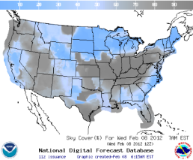
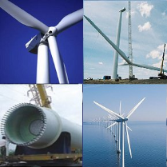
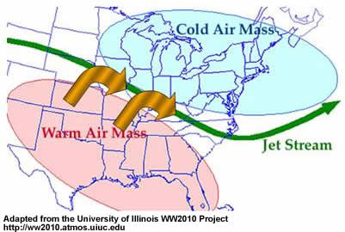
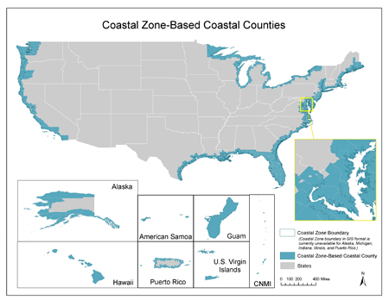
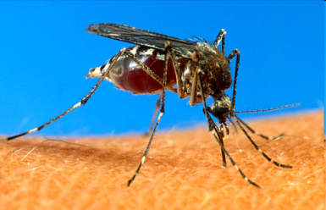
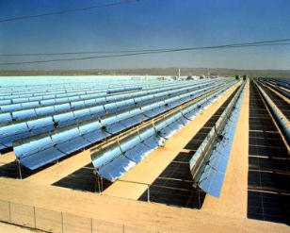
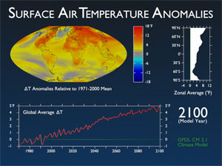
LCAT Future
Relative humidity, upper air, storminess, lightning, tornadoes, hurricanes, snow, radiation, tornadoes, large hail, high winds, lightning, winter storms, blizzards, tropical storms and hurricanes, flooding, dust storms, radiation
What is the trend in snowfall in the Pacific NW?
What is the average speed of the midlatitude jet over Kansas during ENSO neutral years?
What is the probability of a greater than average number of hurricanes during a La Niña year?
Is the local climatology favorable for spreading the Dengue Fever vector?
Will a spring drought increase the chance for spread of West Nile virus?
Water level (tides, etc.) and climate signals for coastal regions
What are water level extremes during El Niño or La Niña events?
Are there seasonal extremes?
Data and analyses for energy industry support
What has been the maximum wind speed over the past 30 years?
What is the projection for the next 20-50 years?
What is the average daily cloud cover in a region during an El Niño winter?
What is the average radiation in the North East when the AO is in the negative phase?

Slide 9
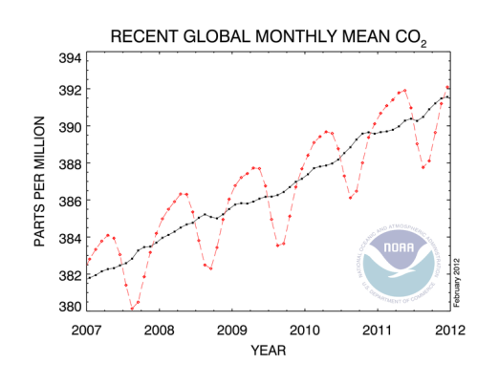
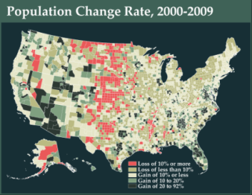
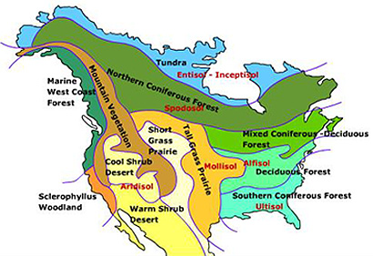
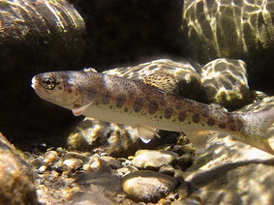
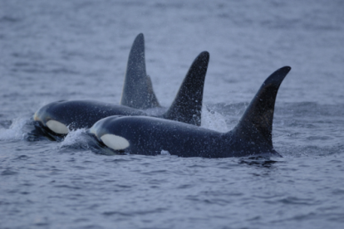
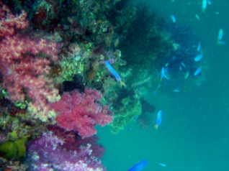
Other Potential Parameters
CO₂ emissions/trends
Satellite data
Biological/physical ocean data
Ecological data for deriving relationships to climate signals (coastal, soil, demographics, vegetation)
NOAA Habitat Blueprint: A framework to improve habitat for fisheries, marine life, and coastal communities
Relating climate variables with relevant data sets
Fisheries
Habitats
Iconic species
Climate change impacts to the oceans
Sea level
Acidification
Warming

Slide 10
Final Thoughts
LCAT is a unique, revolutionary tool for data analysis
Relieves user of burden of
Identifying which data is the most relevant and reliable
Identifying which analysis technique to use that is most appropriate and scientifically sound
Developing codes for data access and analysis techniques
LCAT has potential for broad application for comprehensive environmental study of climate impacts at regional and local levels
Nationally and globally
Historical data out to climate projections
Partnerships are growing
Vermont SC; NOS; Fisheries; DOE; USGCRP; private sector

Slide 11
LCAT Link
https://apps.weather.gov/lcat/_dev/index.php?lcatArea=lcat

Slide 12
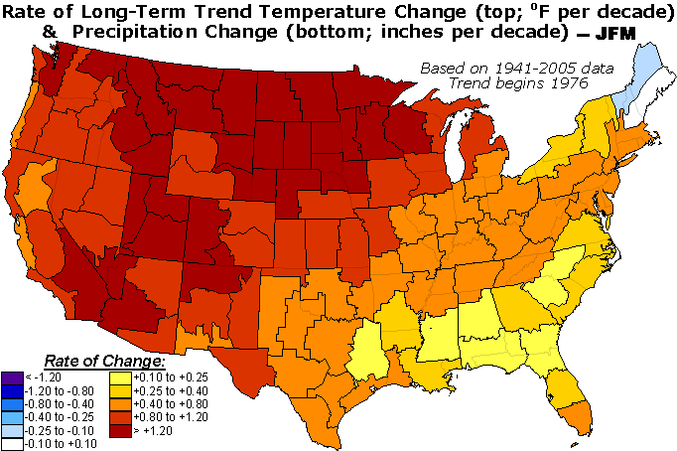
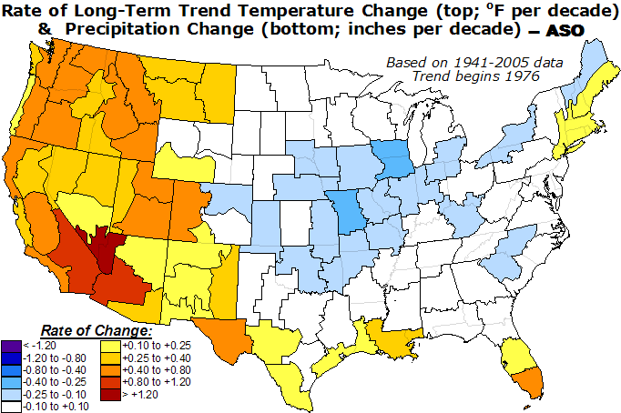
Testing LCAT Best Practices
Climate Division
Stations
(Inches per decade)
http://www.cpc.noaa.gov/trndtext.shtml

