Slide 1
A Footnote to Florida’s
Observational History
Glen Conner
Kentucky State Climatologist Emeritus
Notes:
Old folks like to talk about olden times.
Old climatologists like to talk about old climate.
My talk is about, what I think should become, a significant footnote to Florida’s Climate history

Slide 2
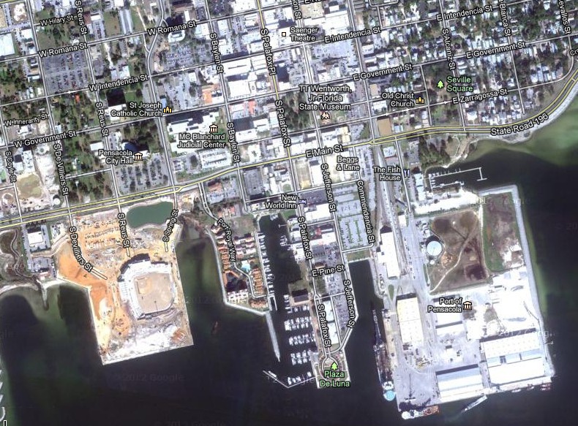
Signal Service
Pensacola Observations July 1885
Signal Service Office
Notes:
The story begins here with the Army’s Signal Service
Part of the Signal Corps
The nation’s weather network beginning in 1870
Opened a station at Pensacola
First obs on 27 October 1879
By July 1885, they were in a tall downtown building
At Palafox and Zarragossa Streets

Slide 3
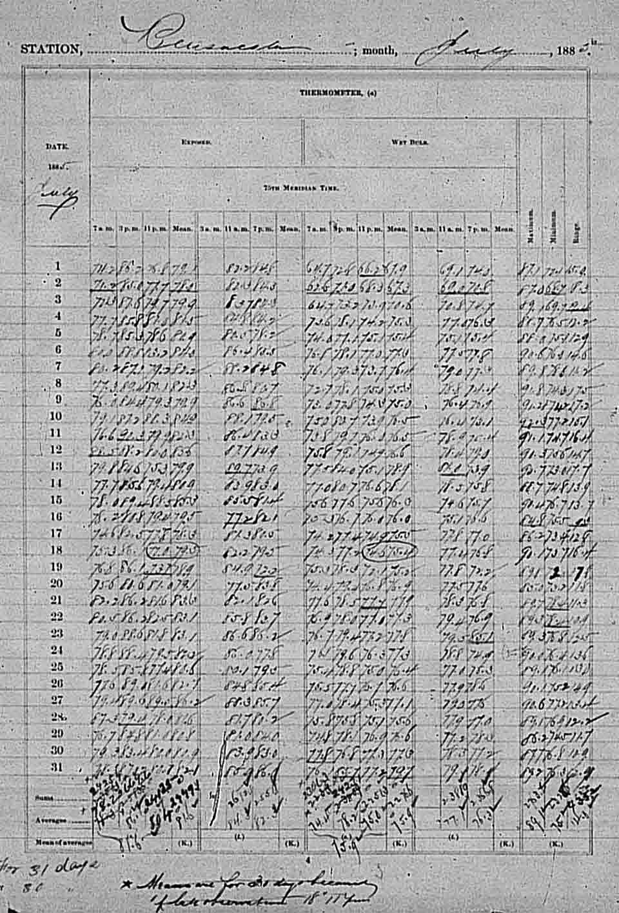
Pensacola Observations
3 p.m. EST 10 July 1885
Dry Bulb 87.2
  Wet Bulb 78.2
  RH 75%
Wind S 15
  Max Wind Last 8 Hrs S 20
  Last 8 Hours 69 miles total
High Cirrostratus 1/10 cover
  Low Cumulus 3/10 from SW
Temperature of the water 88.2
Pressure 29.982
Notes:
At 3 p.m. EST 10 July1885, 127 years ago, the observer made the readings on the right.
Observer recorded data eight times per day: at sunrise, 3 a.m, 7 a.m., 11 a.m.,3 p.m., 7 p.m. 11 p.m. and sunset
They exempted him from doing the 3 a.m., so that he would sleep
Plus water temperature at 2 p.m.
And beginning and ending times of precipitation
By the end of the month, he had 14 pages of data
The image on the right is just the wet and dry bulb page

Slide 4
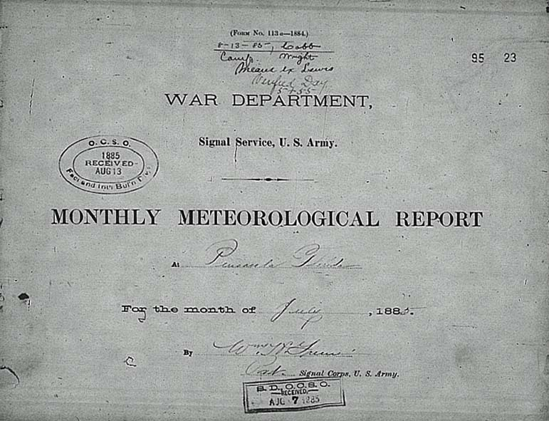
Pensacola July 1885
Notes:
This sheet covered the 14 pages that were sent to the
Signal Service in Washington
It is signed by Private William H. Greene
AND, HE is my Footnote to Florida’s Observational History
Let me tell you about him

Slide 5
William Hallett Greene
Graduation Day
City College of New York
  Was Secretary of his Class
  Graduated 26 June 1884
  Age 19
New York Times reported
  Audience applauded liberally
Notes:
Private Greene had graduated from CCNY
about a year earlier
The New York Times recognized his success there
As did the audience

Slide 6
William Hallett Greene
Graduation Day
City College of New York
  Was Secretary of his Class
  Graduated 26 June 1884
  Age 19
New York Times reported
  Audience applauded liberally
  First “colored boy” to graduate
  from CCNY
Notes:
He had succeeded where several other African Americans
previously failed to graduate
He was interested in meteorology
Wanted to attend the Signal Service Meteorology School
Fort Whipple Virginia (Ft Myer bear where the Pentagon is now)
He applied to enlist for the Army’s Signal Service

Slide 7
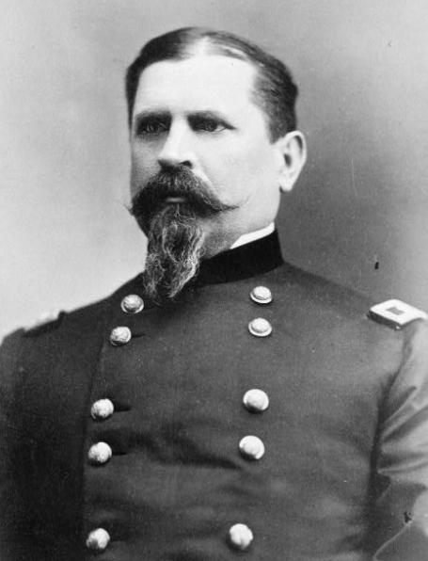
Letter from General Hazen
8 May 1884
“I have taken time to very carefully consider your application for enlistment. The legislation ….provides for the enlistment of men of color only in two regiments of infantry and two of cavalry.
….I am not at liberty to violate
….feel obliged to dismiss the case without further action.”
Notes:
The Chief Signal Officer of the Army was General Hazen
Served in several Civil War battles with distinction
Conducted meteorological research
Published many papers on results
Congress limited black soldiers to two infantry and two cavalry regiments
Viewed Greene’s enlistment into the white Signal Corps as illegal

Slide 8
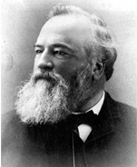
Alexander Stuart Webb’s letter to Secretary of War
The President of CCNY wrote
  “….General Hazen is in error in his interpretation of the action of the members of Congress.”
Asked protection of Greene “against such a decision by the Chief Signal Officer of the Army”
Notes:
President of CCNY was another Civil War general
Had a different view
Was offended by the refusal to enlist Greene
He knew that you don’t ever write to your adversary
You write to his boss — to his BIG boss
The Secretary of War

Slide 9
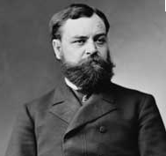
Robert Todd Lincoln's letter to General Hazen
“Colored men have been have been Senators and Representatives in
  Congress”
No distinction “should be made in admitting them to the Signal Corps in any capacity which they are qualified to fill.”
Sent a copy to CCNY President Webb
Asked Greene to reapply
Notes:
The Secretary of War just happened to be
the great emancipator’s son
Abraham had taught him well

Slide 10
Exchange between
Hazen and Lincoln
Hazen objected having Signal Service singled out for integration
  Would not act unless ordered to
Lincoln wrote
  “The Chief Signal Officer of the Army is ordered ….to prohibit rejection as a recruit ….on account or the African descent of such applicant”
    Specifically included Greene by name
Notes:
Hazen argued with his boss
Made a “cover your ass” assertion
Unless ordered to
That apparently aroused Lincoln’s competitive spirit
He issued the order and mentioned Greene by name

Slide 11
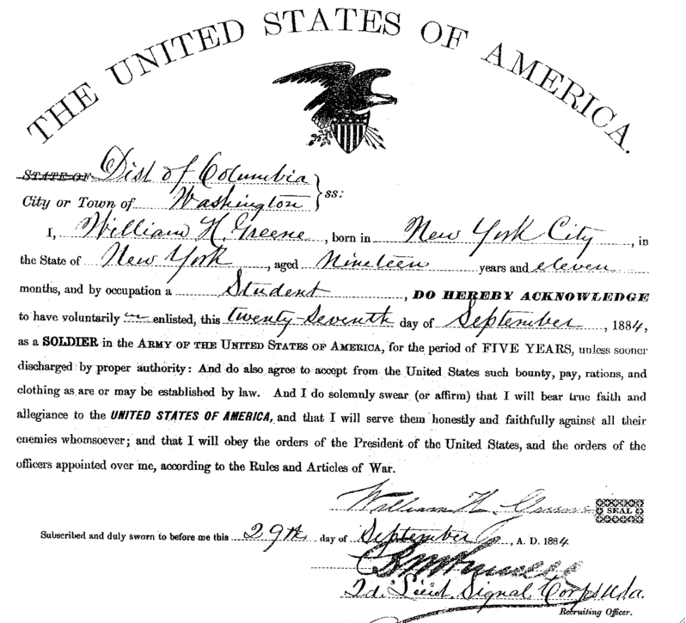
Greene’ Enlistment
Notes:
Hazen wrote to Greene asking him to apply again
Greene enlisted in September 1884

Slide 12
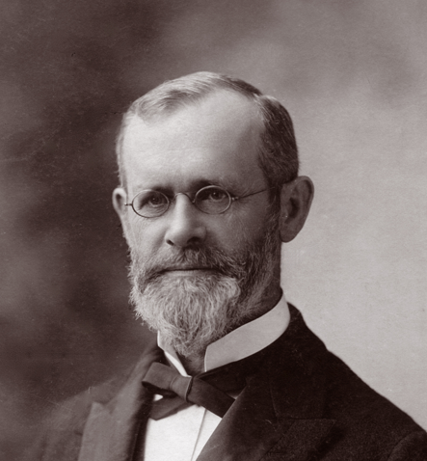
Cleveland Abbe’s
Signal Service Meteorology School
Signal Service required passage of a written examination to qualify for the Signal Service
  Greene scored high on it
Hazen reported to Lincoln that Greene had qualified and was accepted
Greene stayed the course
  Ranked second in a class of eight
Notes:
Greene passed the entrance exam with flying colors
Began training in Meteorology
Coursework designed and supervised by Cleveland Abbe, father of NWB
Greene’s class began with 13 students
One deserted
Two were dismissed
One completed the course but failed the exams at the end
Of the eight left, Greene ranked scored second highest

Slide 13
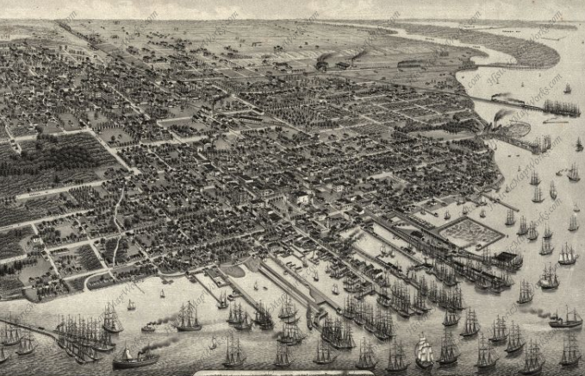
Greene Assigned to
Signal Service at Pensacola
Signal Service Office
Notes:
This is Pensacola in 1880
The Board of Trade was advisor to the Signal Service Office
Forecasts were vital to shipping interests
Signal Service Office was in a tall building
Where forecast flags could be seen by the most people
After graduation, Private Greene was assigned there
Sgt McGowan was in charge of that office

Slide 14
Greene’s Tour at Pensacola
Sergeant McGowan refused to accept Private Greene
General Hazen ordered Sgt McGowan back to Washington
  Demoted him to Private
Assigned Private Greene as the station chief
  First monthly report was in July 1885
  He remained as the chief until late 1885
Notes:
Greene was not welcomed when he arrived
Sgt McGowan had arranged a place for the new guy to live
Greene was not exactly who he and the landlord had expected
Sgt McGowan advised Washington that Greene was not acceptable
Pensacola would not accept him either
For disobedience, Sgt McGowan was reassigned to Washington and
demoted
Private Greene became the new Station Chief by default
His first observations were in July 1885, the report you saw earlier
In December, Greene was reassigned to Rochester NY

Slide 15
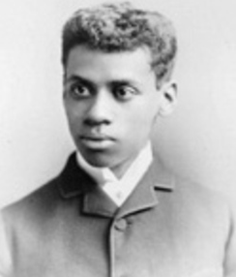
The First Black Meteorologist
127 years ago
William Hullett Greene
Private, U.S. Army
First Black Observer
First Black Forecaster
First Black Station Chief
Notes:
May I introduce you to my footnote to Florida’s climate history
William H Greene

