Slide 1
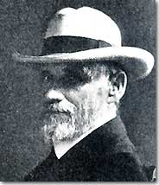
State ClimaTOLOGISTS
A HISTORICAL LIST
“Preserving our collective history”
Henry W. Reges, Colorado State University

Slide 2
Brief history
Pre-1880 - US Army Signal Service, established in 1870. By the late 1870s, most of the weather networks, including the Smithsonian and the US Army's Medical Service, were combined into the US Army Signal Service.
1880’s - During the 1880s, state weather services were developed.
1890’s – National weather program transferred to US Department of Agriculture. As part of the establishment of the civilian U.S. Weather Bureau, one office in each state was designated the "section center.”
1890s -1950’s – “Section Directors” similar to modern state climatologists
1930’s & 40’s – Many climatology programs on the decline.
1954 – Weather Bureau Climatological Service Division headed up by Helmut Landsberg. Discontinues section sectors and creates state climatologist program.
1956 - State climatologist program established on a national basis and federal state climatologists appointed.
1973 - Federal funding of the national state climatologist program was terminated on April 16, 1973 due to budget considerations and the state climatologists were assigned to other positions in NOAA.
– NOAA Administrator Robert M. White sends letter to all state governors asking that they establish their own state climate programs.
1976 – The American Association of State Climatologists organized.
1980’s – Several States without state climate offices. Regional Climate Offices begin.
2012– 48 states + Puerto Rico/Virgin Islands with state climate programs
History List References - Wisconsin State Climatology Office,
P. Waite, United States Climatological Chronology

Slide 3
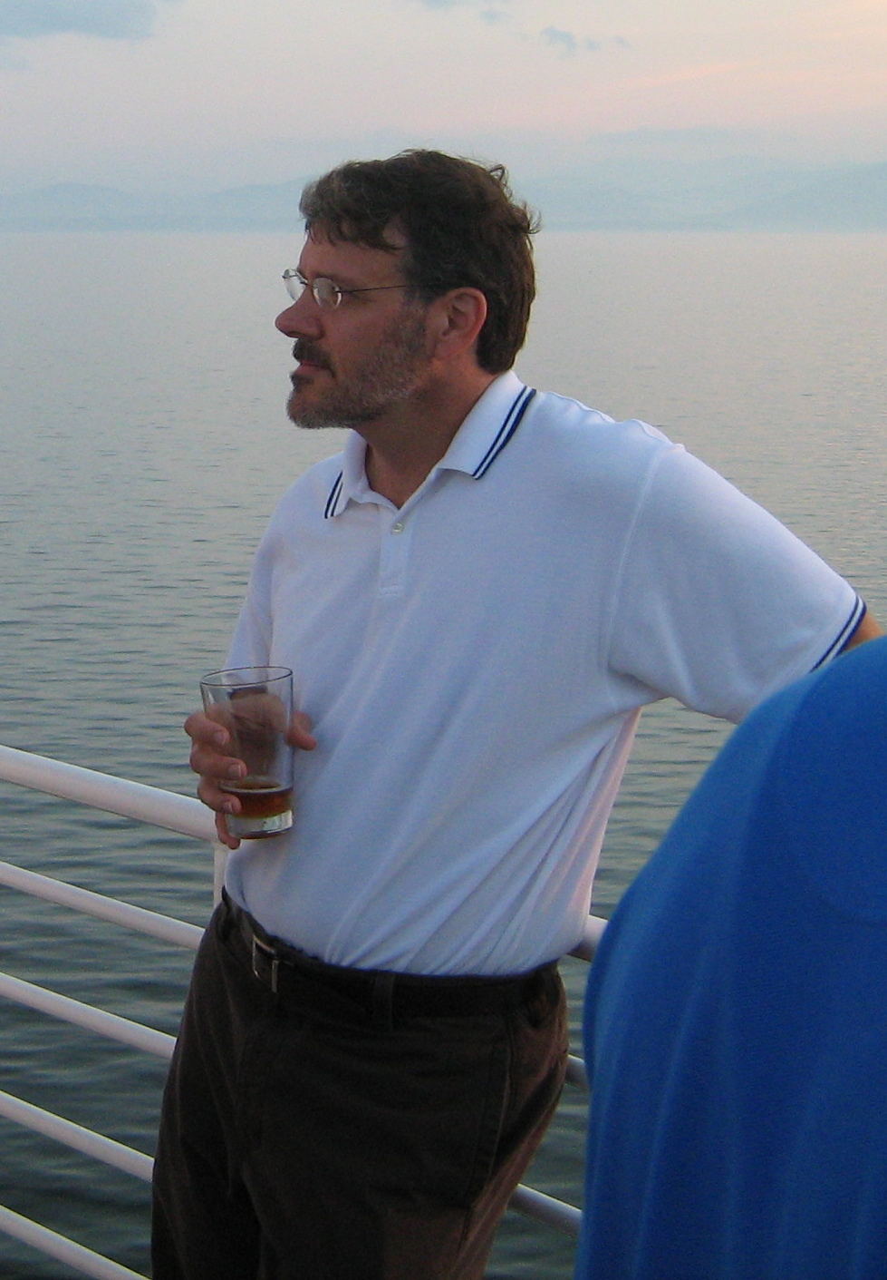
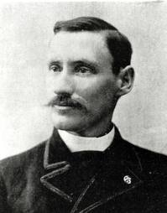
GOAL: compile a list of state climatologists (all in one place) back to the 1880’s for all 50 states
Louisiana
Isaac M. Cline
Barry D. Keim

Slide 4
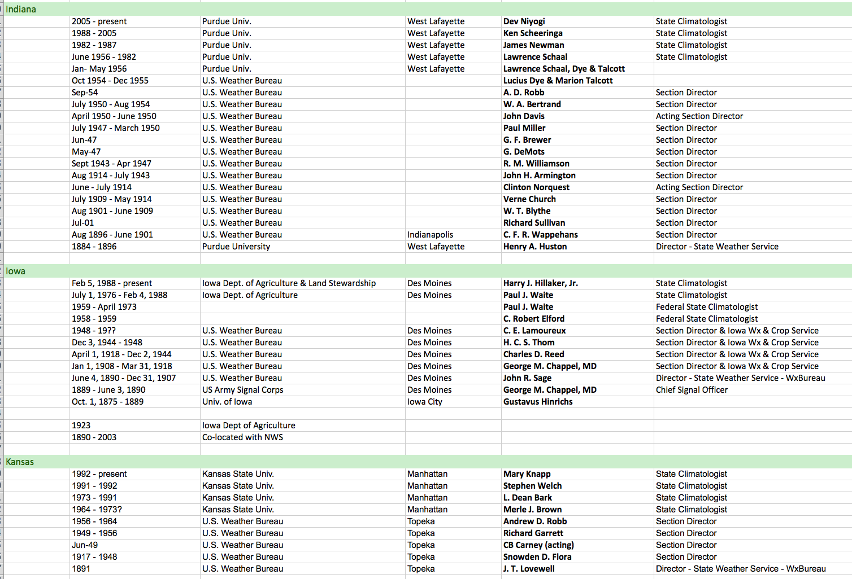
“In progress” - State Climatologist History Spreadsheet

Slide 5
US Weather Bureau Climatological Data Publications
Where are the Clues ?
Ag Experiment Station regional project reports
State Climate office archives
Collective Climatologist memories
Past AASC Programs
Climatological Services Memorandum 1956 -1973

Slide 6
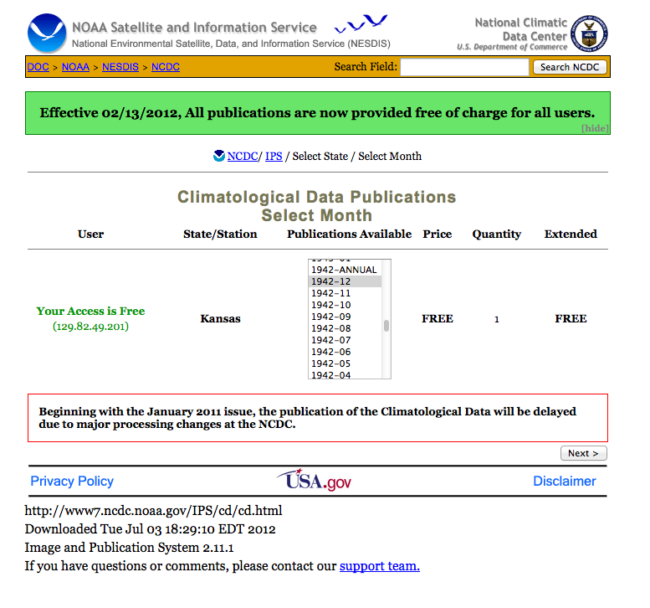
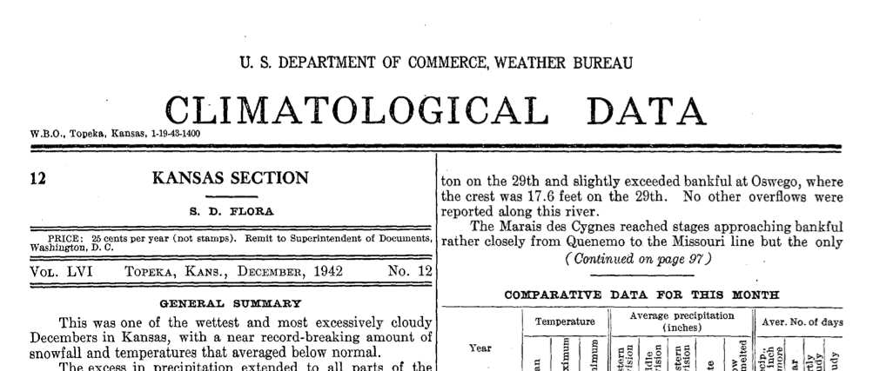
Climatological data
Kansas State Section Director
Snowden D. Flora, 1942

Slide 7
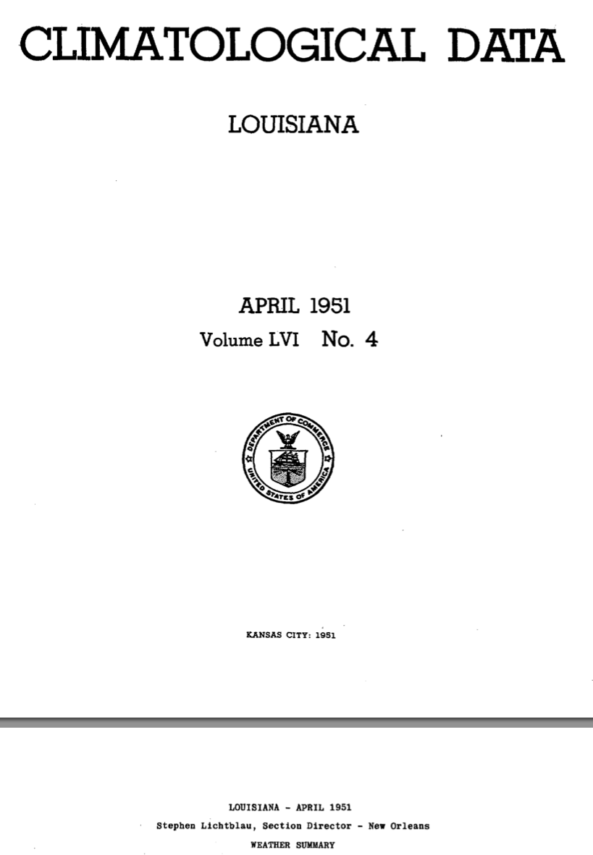
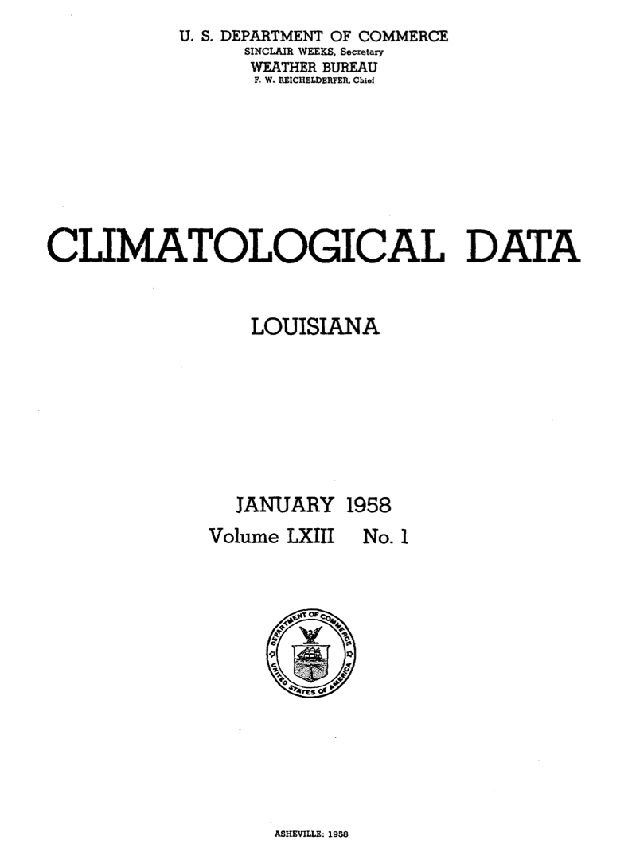

Slide 8
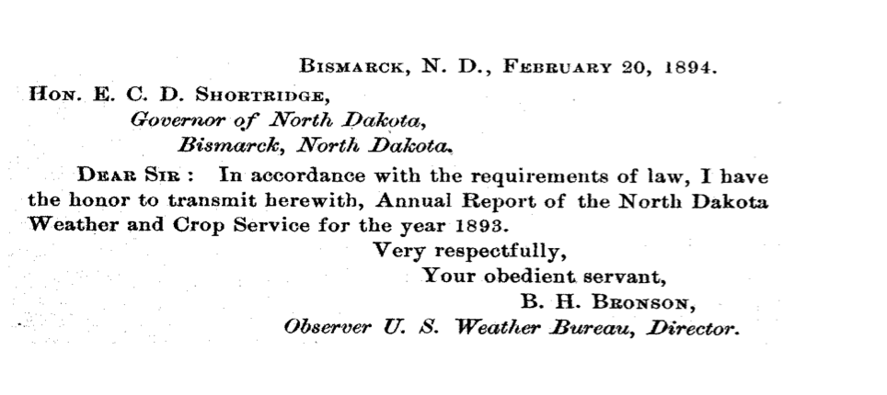
February 1894

Slide 9
STATES WE Really NEED HELP WITH
Alaska
Arkansas
California
Connecticut
Delaware
Florida
Guam
Hawaii
Illinois
Maine
Maryland
Massachusetts
Montana
Nebraska
Nevada
New Mexico
New York
Ohio
Puerto Rico
Rhode Island
South Dakota
Vermont
Virginia
West Virginia
1956 - present

Slide 10
STATES ALMOST COMPLETE
1880’s - 2012
Colorado
Indiana
Iowa
Kentucky
Louisiana
Minnesota
Missouri
North Dakota
Pennsylvania
Wisconsin
Wyoming

Slide 11
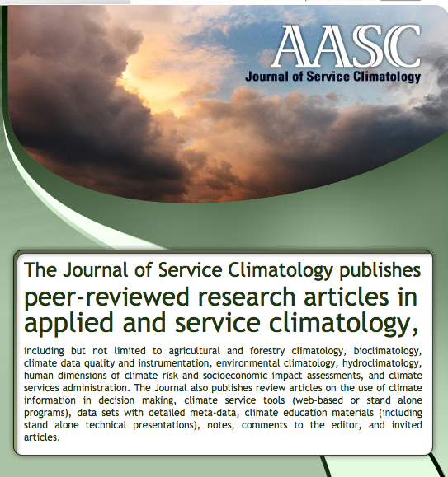

Slide 12
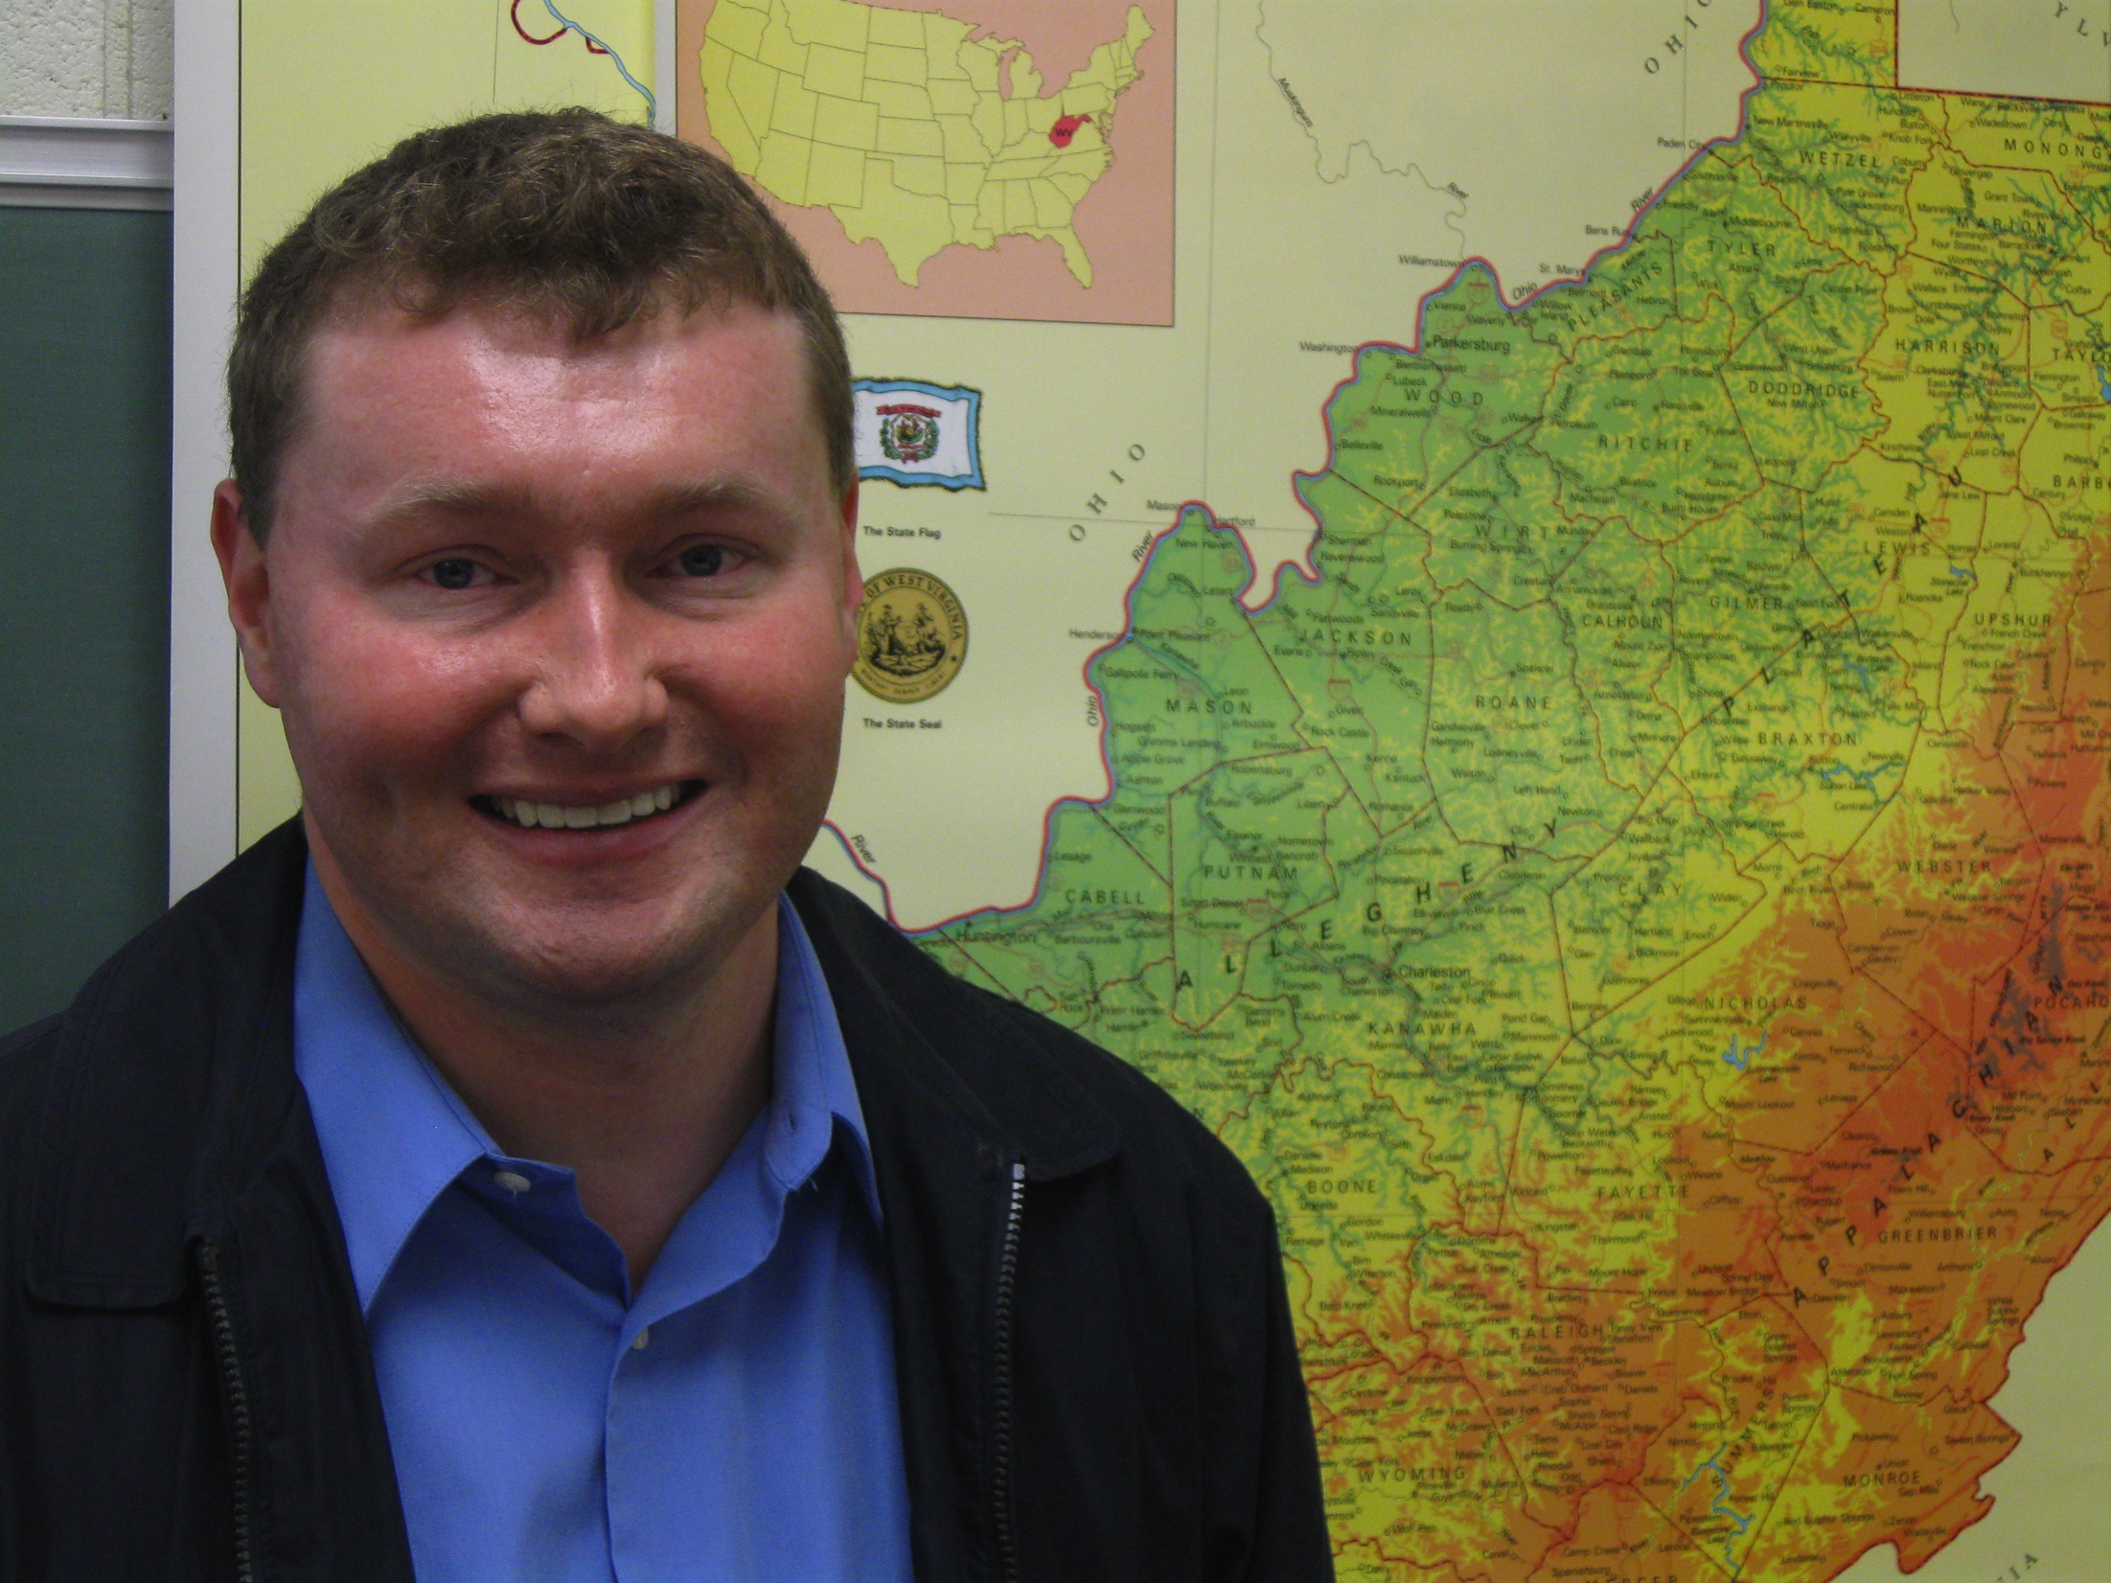
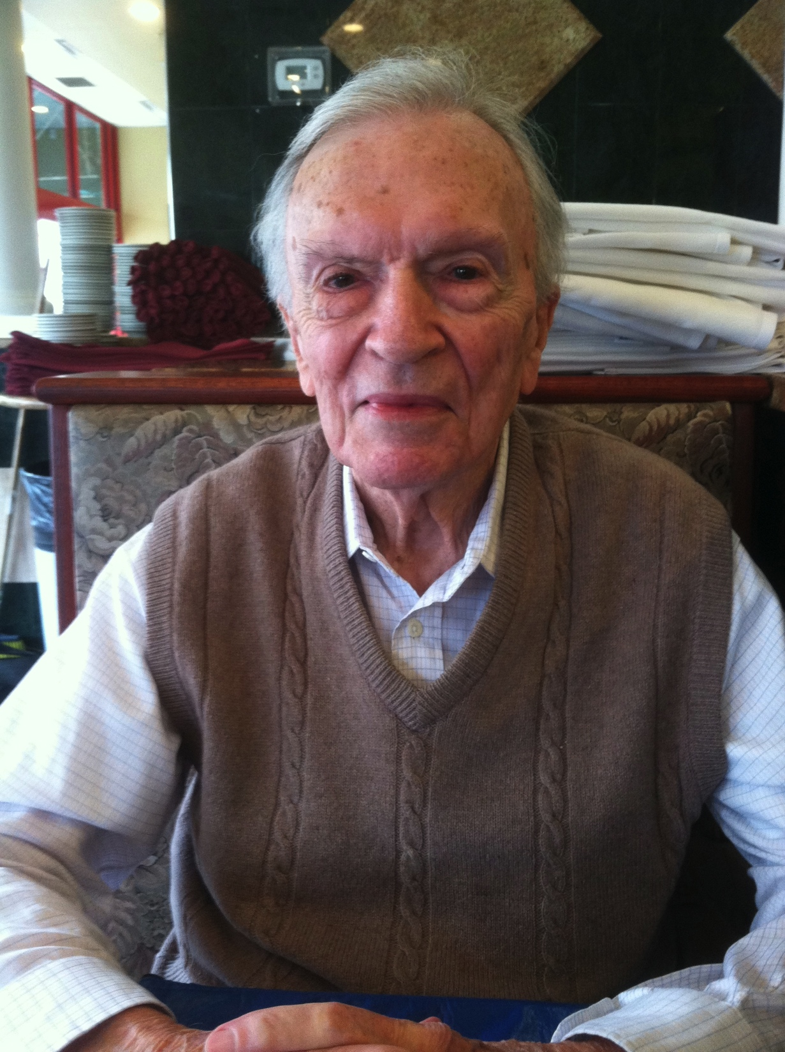
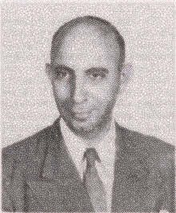
American Association of State Weather Services
1955
Robert M. White
ARSCO
Environmental Data Service
Jerry Davis
AASC
Section Director
April 1973
Nelson Kaufman
Donald Dunlap
DAVID ROBINSON
435 Stewart Ave
Robert Lautzenheiser
WRPC
helmut landsberg

