Slide 1
2012 AASC Annual Meeting
President’s Report
2012 Meeting
AASC
Destin, FL
10-12 July 2012

Slide 2

Welcome to Destin!
  Very different venue for our meeting
  There will be roll calls and beach checks for attendees…….
  Fully understandable to step aside with multiple climate/weather issues ongoing.

Slide 3
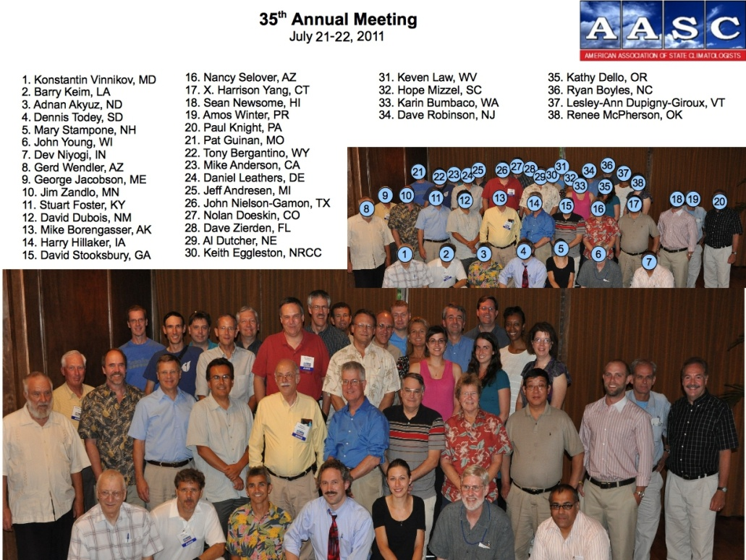
37th Annual Meeting
First time in Florida
Over 90 registered
About 40 SC offices in attendance
Many associates

Slide 4
Executive Council
President – Dennis Todey (SD) (Term-limited)
President –elect – Stuart Foster (KY) assumes presidency
Secretary – Nancy Selover (AZ) Year 1
Treasurer – Mike Anderson (CA) Year 2
Treasurer-elect (TBA)
ARSCO Coordinator - David Robinson (NJ)
  More about this later

Slide 5
Changes
Some good
  New SCs named or in process
Some very bad
  Process, not people
Retirements (luncheon)
Passing

Slide 6
Activities
Meetings
  Fewer meetings - federal budget -NCS
  Various membership discussions
  Working on developing climate services partnerships

Slide 7
Business Meeting Preview
Executive Director discussion
ARSCO coordinator
Web site hosting
Treasurer’s report
Meeting location 2014 (2013 St. Louis)
Associate Members – get paperwork now
Nomination of officer (treasurer)
Other minor/Anything else?

Slide 8
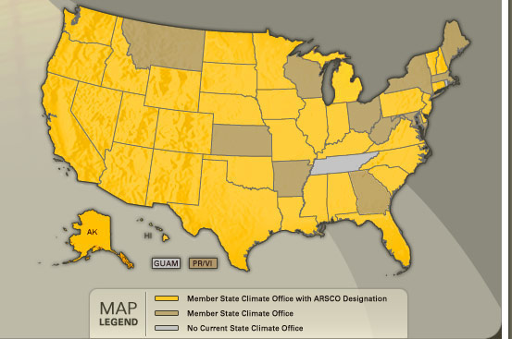
ARSCO Report

Slide 9
Journal of Service Climatology
New co-editors
  Nolan Doesken
  Jim Angel

Slide 10
Introductions
Introductions – new SCs
  MS
  GA
  MN
  NV
  MT – in process
  A couple still percolating
Notes:
Intros for all if time….

Slide 11
Remembrances
Scott Archer
  Long-time associate
  First (short-lived) executive director
Stan Changnon
  Early associate
  Long-time applied climatologist

