Slide 1

State Climatologist Report
Alabama – Water Water Everywhere (Most of the Time)
John R. Christy
University of Alabama in Huntsville

Slide 2
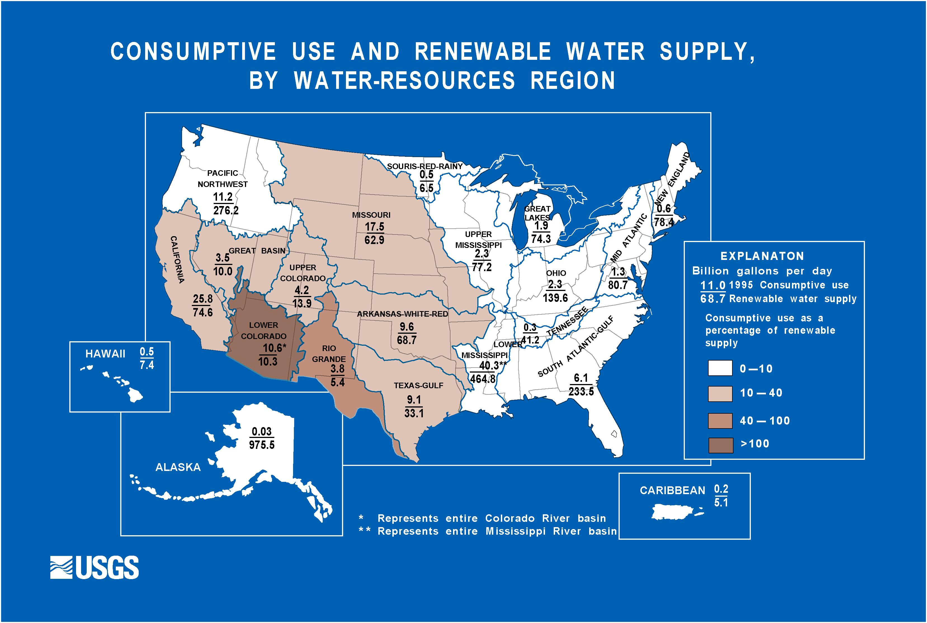
Net Consumption of Water
102%
2.5%
27%

Slide 3
Summer Drought and Moistness Index No. Alabama., 900-2011
2009 .
2011 .
2010 .
2008 .
1839 .
2007 .

Slide 4
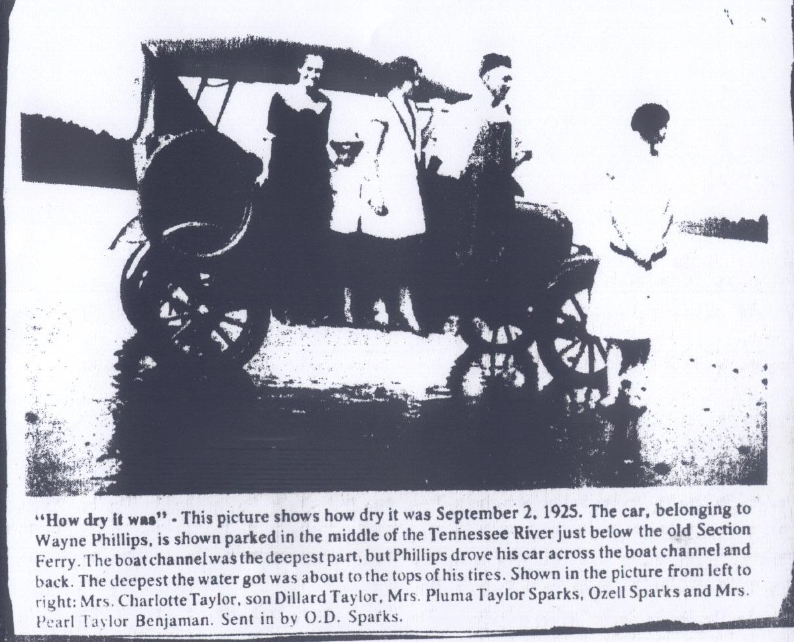

Slide 5
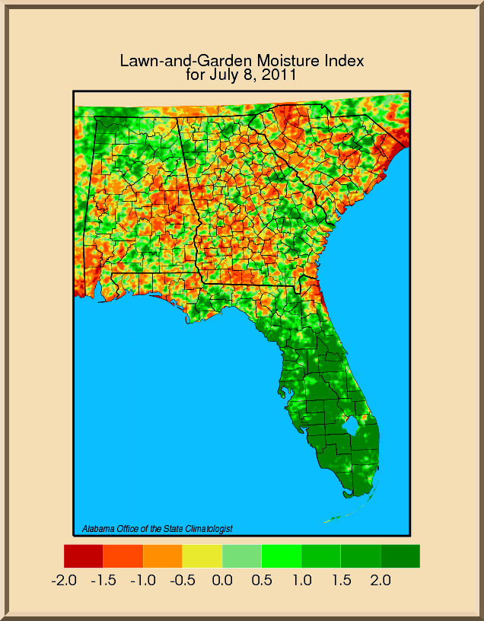
Shallow-rooted index
3-week time scale
Note scale of variation
Impossible to forecast
http://vortex.nsstc.uah.edu/aosc
http://vortex.nsstc.uah.edu/aosc

Slide 6
Climate Change Issues

Slide 8
1883-2011 Interior AL JJA TMax

Slide 9
Water Policy and Resources
Alabama has abundant water resources so our policy should be based on managing this abundance for the good of the State
Management plan looks to store water when abundant so as not to further stress streams when Mother Nature sends a drought
Largest storage – ground water
Next largest storage – surface water
Requires accurate information on these resources and their variability and trends

Slide 10
Water Policy and Resources
Alabama has abundant water resources so our policy should be based on managing this abundance for the good of the State
Management plan looks to store water when abundant so as not to further stress streams when Mother Nature sends a drought
Largest storage – ground water
Next largest storage – surface water
Requires accurate information on these resources and their variability and trends

Slide 11
Water Policy and Resources
Alabama has abundant water resources so our policy should be based on managing this abundance for the good of the State
Management plan looks to store water when abundant so as not to further stress streams when Mother Nature sends a drought
Largest storage – ground water
Next largest storage – surface water
Requires accurate information on these resources and their variability and trends

Slide 12
Water Policy and Resources
Alabama has abundant water resources so our policy should be based on managing this abundance for the good of the State
Management plan looks to store water when abundant so as not to further stress streams when Mother Nature sends a drought
Largest storage – ground water
Next largest storage – surface water
Requires accurate information on these resources and their variability and trends

Slide 13
Water Policy and Resources
Alabama has abundant water resources so our policy should be based on managing this abundance for the good of the State
Management plan looks to store water when abundant so as not to further stress streams when Mother Nature sends a drought
Largest storage – ground water
Next largest storage – surface water
Requires accurate information on these resources and their variability and trends

Slide 14
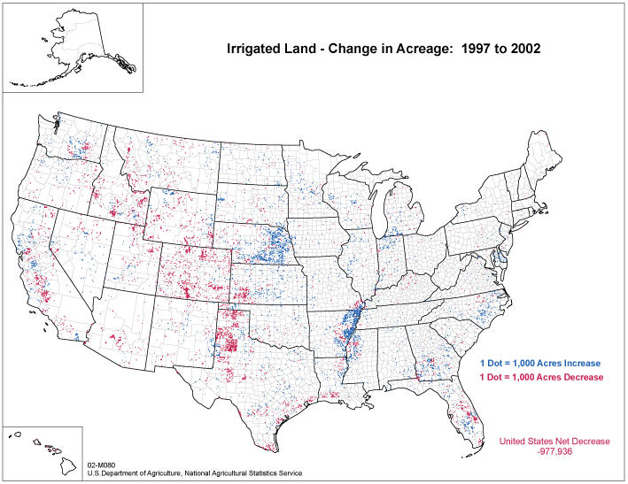
Jim’s Change in Irrigation Slide
Notes:
14
John
John

Slide 15
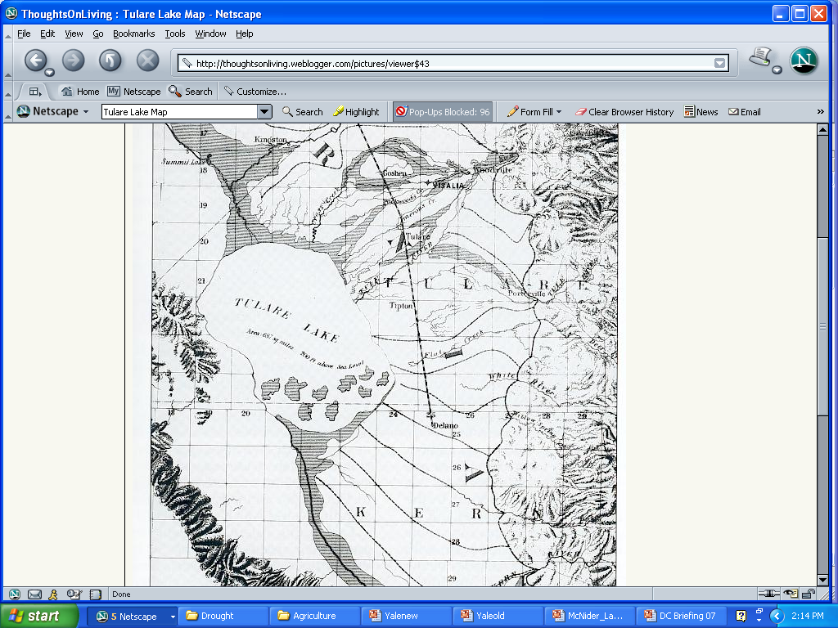
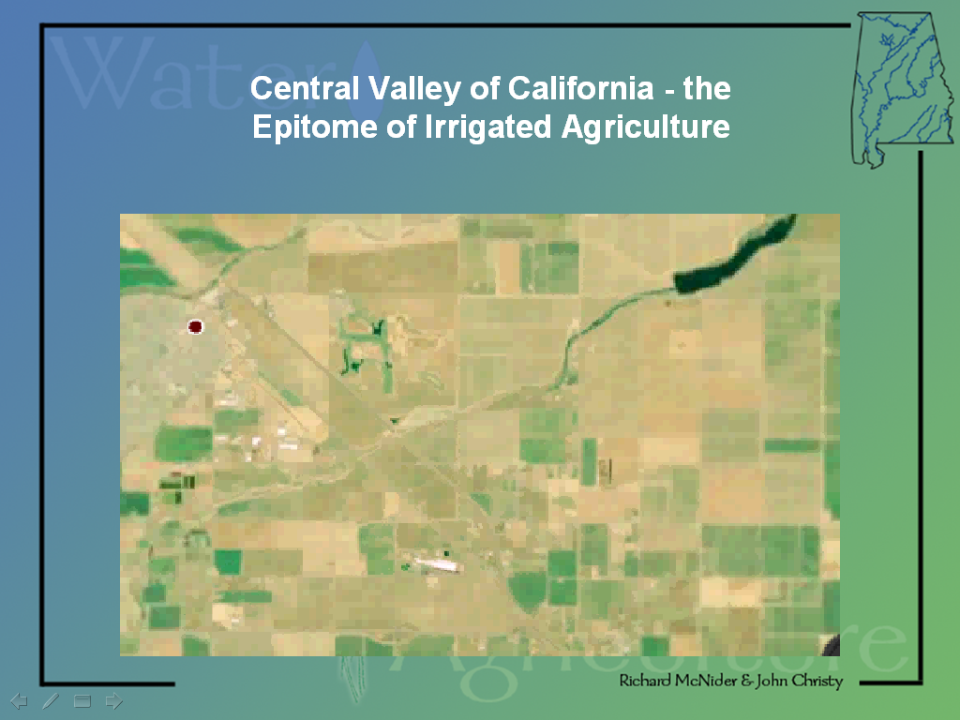
The tremendous increase in western agriculture due to irrigation came with additional costs beyond what the federal government paid.
For example in California tremendous environmental damage was done as rivers were totally depleted destroying salmon runs and wetlands.
Lakes were drained for farm land.
Tulare Lake
River is gone
See King of California
See Cadillac Desert

Slide 16
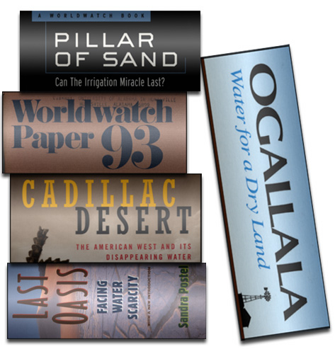
The next 50 years in the West may be much different than the last 50 years.
Not Environmentally Sustainable
New pressures are now forcing a cost-accounting for Western irrigated-agriculture. In the long-term many observers feel this desert agriculture is not sustainable.
Ground water overdrafts from pumping
Water demand from rapid urban growth
• Crops take 3 – 15 ft per year of water
Farmers vs municipalities ($15 farmer cost vs $200-600 municipal water cost per acre-foot)
Silting of reservoirs
Salt and selenium surface poisoning
New air, water, and soil pollution regulations
River restoration and endangered species initiatives

Slide 17
What about Alabama?
Is it possible to have economically and environmentally sustainable agriculture?

Slide 18
Law of Sustainability
If it’s not economically sustainable, it’s not sustainable.

Slide 19
Law of Sustainability
If it’s not economically sustainable, it’s not sustainable.

Slide 20
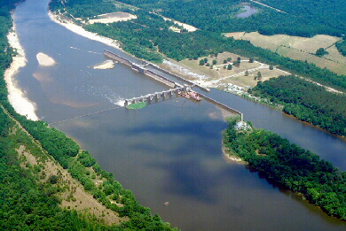
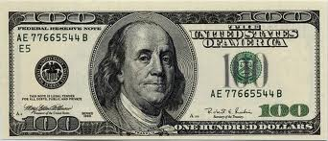

Coffeeville Lock and Dam - unused water is like watching bales of $100 bills float out to sea

Slide 21
For corn the average difference can be $300 per acre!
Irrigated
250
Bushels per Acre
Mid-west
Rainfed

Slide 22
WE NEED TO STOP GAMBLING IN ALABAMA
The number one gambler in our state is the rain-fed farmer who each spring borrows money to place a bet that rain will come at the right time and in the right amount.
If it doesn’t rain, he loses the bet.
This is not economically sustainable

Slide 23
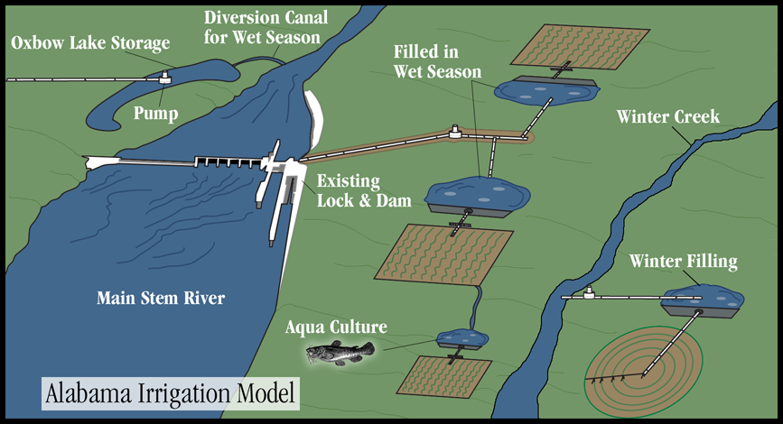
Sustainable Southeastern Model - Storage of Winter Surface Water
Even in dry years crops need less than a foot of water. Irrigation can be supported with a tiny fraction of the winter river flow removed.

Slide 24
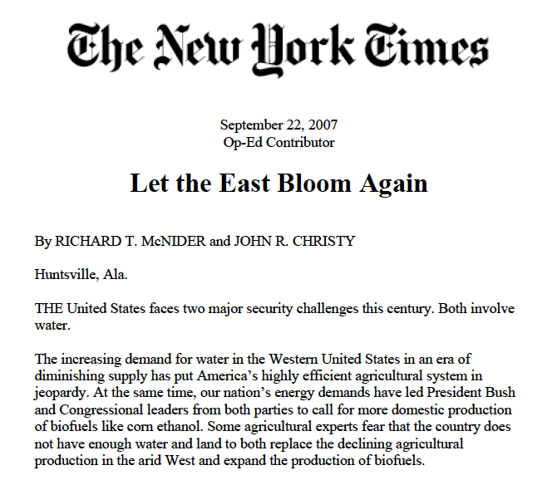

Slide 25
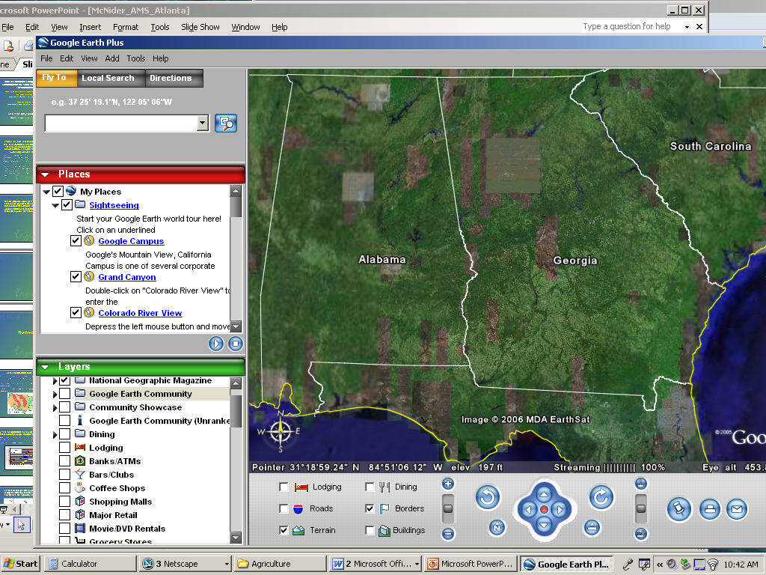
River Flows Are Huge in SE
Colorado River – Glen Canyon 10 million acre-ft/yr
Tennessee
Tennessee –Huntsville 30 million acre-ft/yr
Tombigbee
Tombigbee River - Coffeeville
19 million acre-ft/yr
Alabama River -Monroeville
24 million acre-ft/yr
Alabama
Apalachicola – Blountstown 16 million acre-ft/yr
Apalachicola
Alabama consumes less than 1%
of its surface water

Slide 26
Irrigated farming in Alabama is economically sustainable
But is it environmentally sustainable?

Slide 27
Irrigated farming in Alabama is economically sustainable
But is it environmentally sustainable?

Slide 28
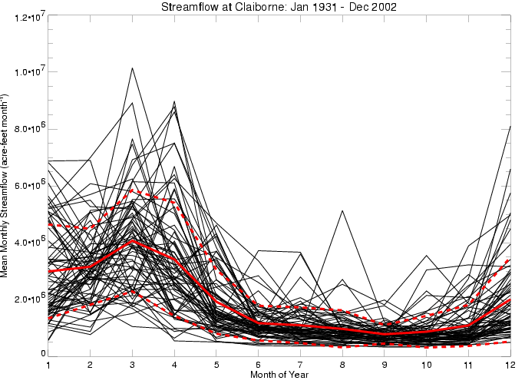
Add Water Withdrawal
Withdrawing small amounts of water during high winter flows is sustainable – about the width of the solid red line can support 1 million acres

Slide 29
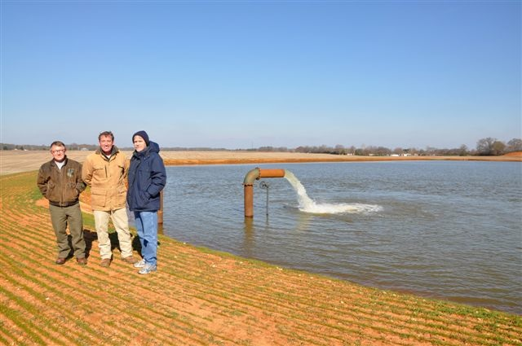
East needs help for investment in storage infrastructure
Wringing the final drops of water out of the western system will be incredibly expensive. Catching and storing water in the east is easy and inexpensive.
In many areas a 10 acre pond ten feet deep (enough to irrigate nearly 500 acres) can be constructed for less than $300,000.
We had a $300 million program AWEP in the 2008 Farm Bill – But Western interests changed bill in Conference so that 85% of money went west of Mississippi .
Bragg Farms
Feb 2011
Notes:
29

Slide 30

Don’t bet the farm on a climate forecast –
secure your own climate

Slide 31
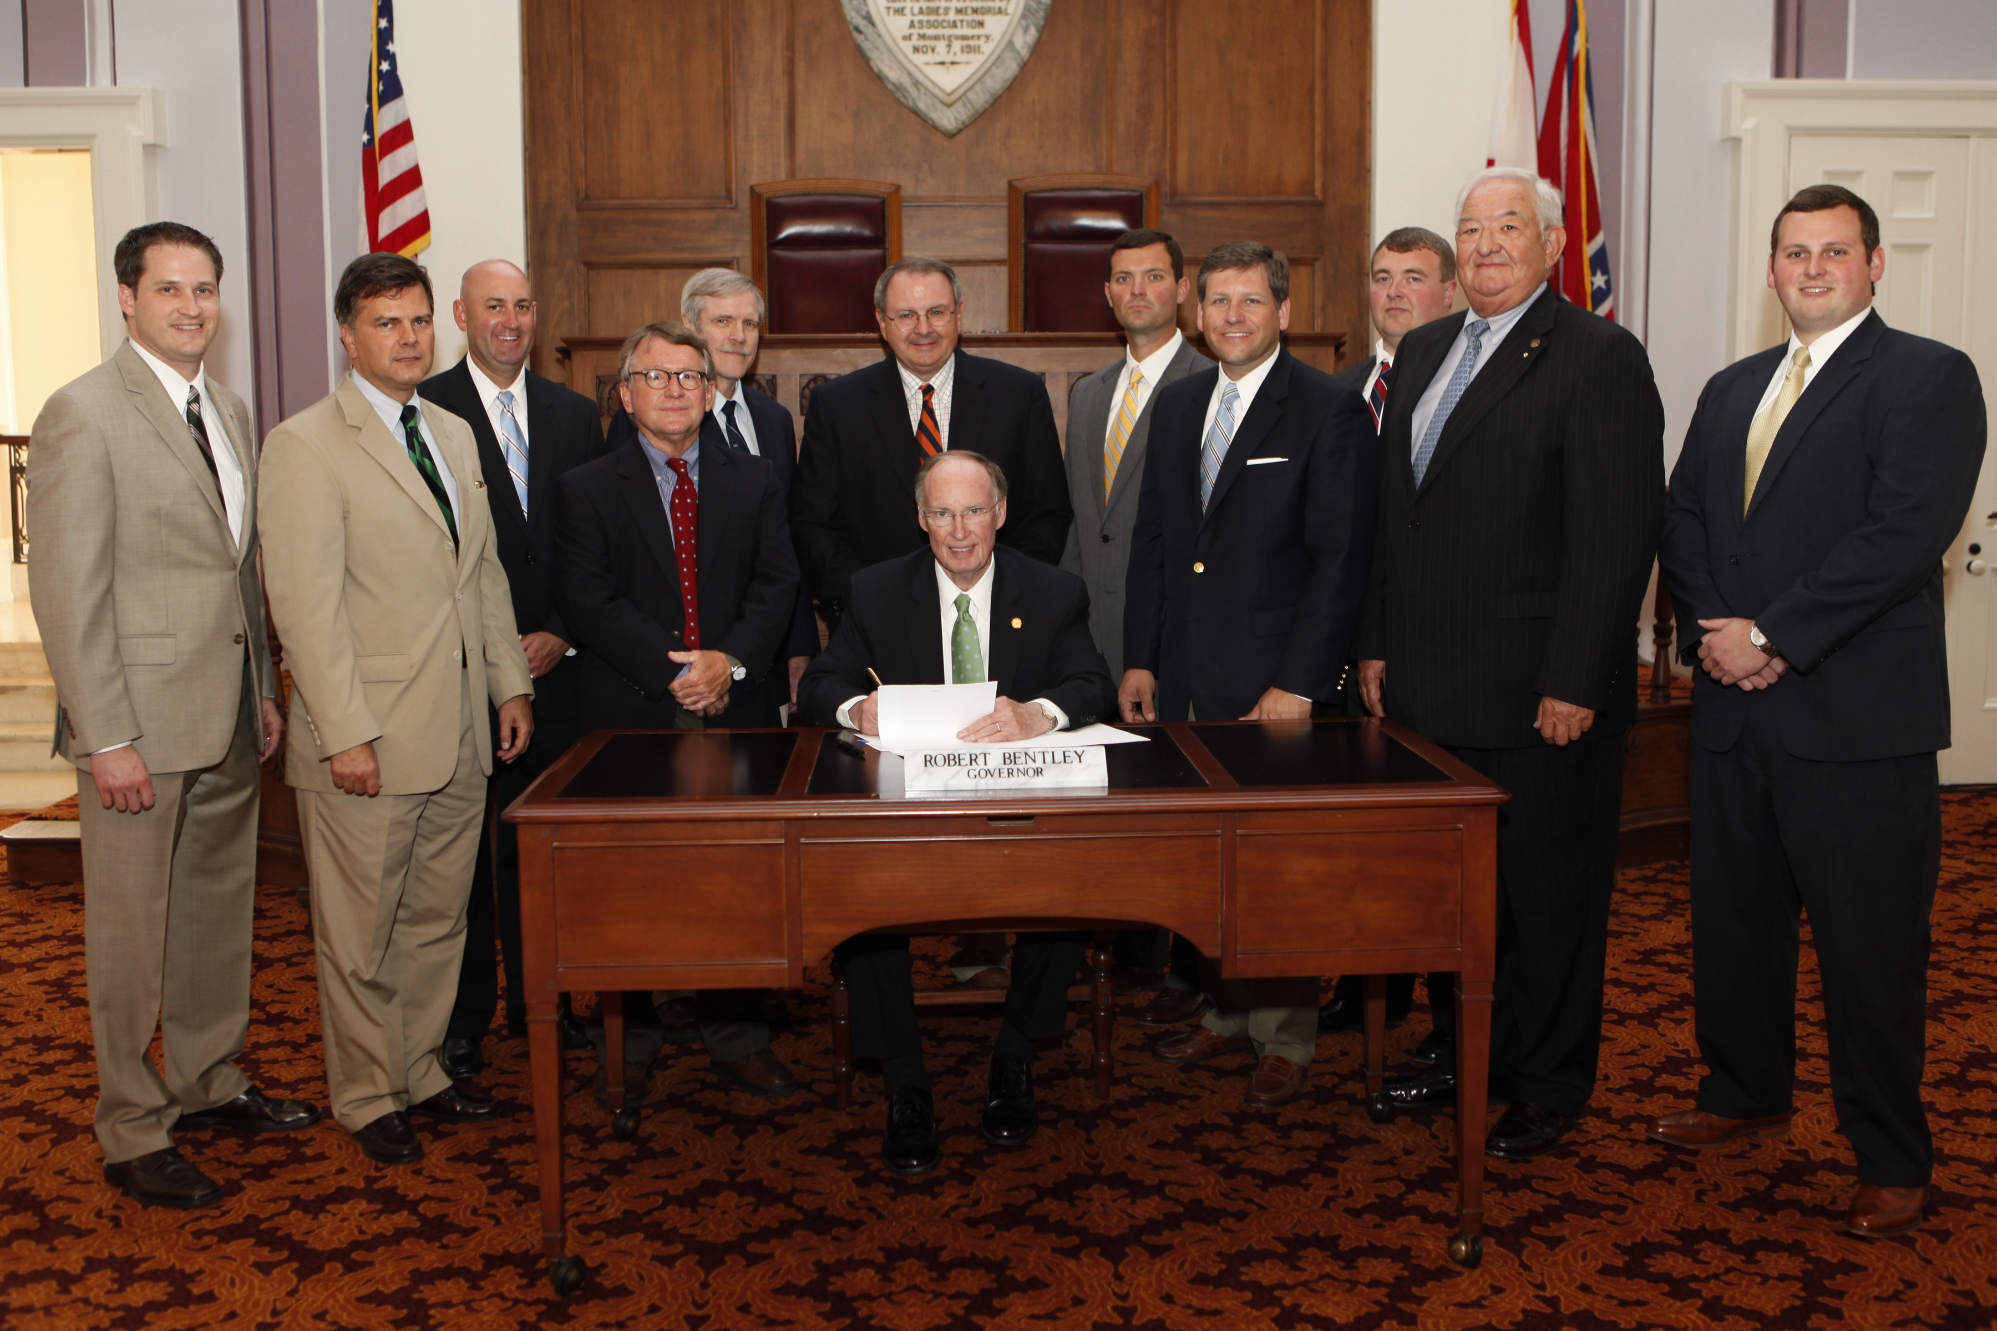
18 June 2012 Bill Signing

Slide 32
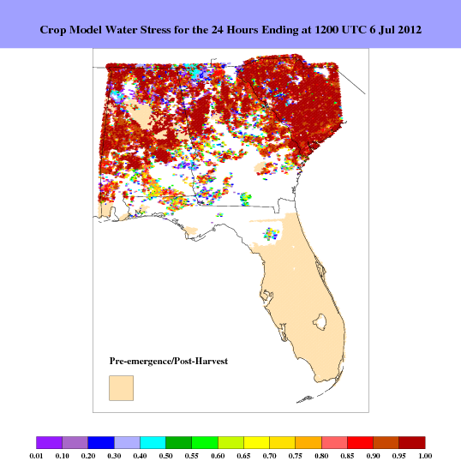
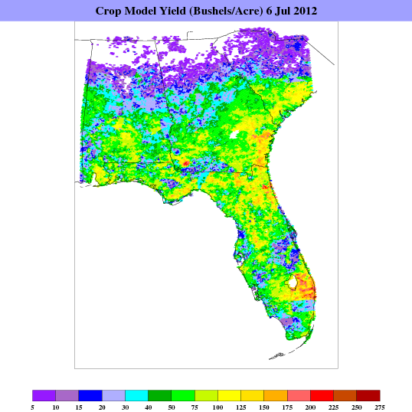
GRIDSSAT
5km Resolution
Daily Crop Model

Slide 33
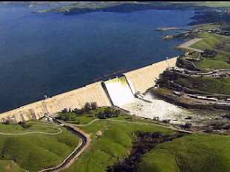
20th Century: Move Water to Agriculture
The western belief that it was a crime to let water flow into the sea lead to the financing of colossal projects to divert water onto deserts. Moving water is expensive and long term problems are now apparent.
Friant Dam near Fresno CA
0.5 to 3 million ac-ft/year
21st Century: Move Agriculture to Water
In wet climates, only inches per year of irrigation are needed to supplement natural rainfall. The most cost effective and sustainable solution for U.S agriculture is to bring it back to water.
This will enable food security and allow expansion of agriculture for bioenergy needs. This is economically and environmentally sustainable.
Coffeeville Lock and Dam in Alabama
11 to 35 million ac-ft /year

Slide 34
Climate Change Issues
What is the impact on climate of emissions of greenhouse gases?
Alabama’s economy is closely tied to affordable energy and accessible water
Regulations must be tested for environmental impact (benefit?) and economic consequences (cost?)
Virtually all proposals to date have no benefit and high cost

Slide 35
Climate Change Issues
What is the impact on climate of emissions of greenhouse gases?
Alabama’s economy is closely tied to affordable energy and accessible water
Regulations must be tested for environmental impact (benefit?) and economic consequences (cost?)
Virtually all proposals to date have no benefit and high cost

Slide 36
Climate Change Issues
What is the impact on climate of emissions of greenhouse gases?
Alabama’s economy is closely tied to affordable energy and accessible water
Regulations must be tested for environmental impact (benefit?) and economic consequences (cost?)
Virtually all proposals to date have no benefit and high cost

Slide 37
Climate Change Issues
What is the impact on climate of emissions of greenhouse gases?
Alabama’s economy is closely tied to affordable energy and accessible water
Regulations must be tested for environmental impact (benefit?) and economic consequences (cost?)
Virtually all proposals to date have no benefit and high cost

Slide 38
Climate Change Issues

Slide 39
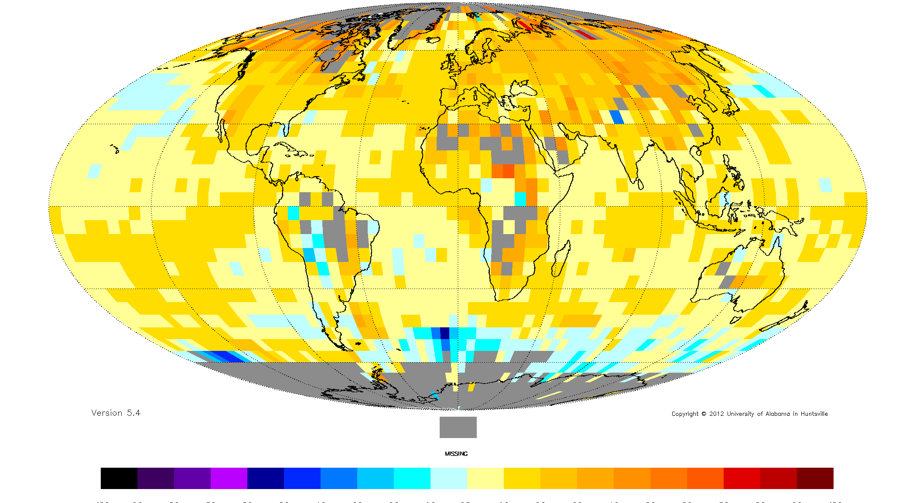
1979-2010 Temp Trend Difference
Sfc (HadCRUT4) minus Lower Troposphere (UAH)

Slide 40
What Does the AOSC Do?
Provide historical climate data and specialized analyses including a monthly climate report
Lead the weekly U.S. Drought Monitor discussion for Alabama
Generate products requested for industrial recruitment
Assure climate monitoring stations are adequate
Host the archive of original climate observations
Provide web-site of general climate and surface-water resource information
Provide leadership for economic development utilizing the climate resources of the state
Provide foundational research for policy issues related to climate variability and change

Slide 41
What Does the AOSC Do?
Provide historical climate data and specialized analyses including a monthly climate report
Lead the weekly U.S. Drought Monitor discussion for Alabama
Generate products requested for industrial recruitment
Assure climate monitoring stations are adequate
Host the archive of original climate observations
Provide web-site of general climate and surface-water resource information
Provide leadership for economic development utilizing the climate resources of the state
Provide foundational research for policy issues related to climate variability and change
Help Alabama realize its potential in climate resources

