Slide 1
North Dakota Report
AASC 2012
July 9-12
Destin, FL

Slide 2
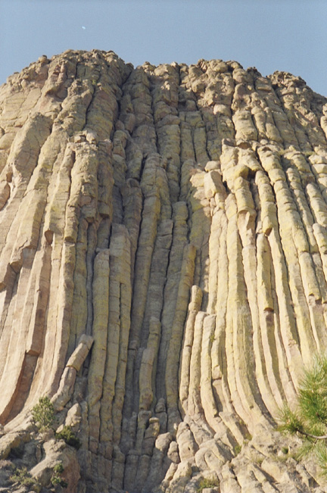


Since Last Time
9/11/2011
CLIMBIT
Notes:
Home Improvement: Wilson

Slide 3

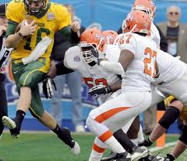
Since Last Time
NDSU Wins FCS National Championship
NDSU-Sam Houston State
FCS Championship. Jan. 7, 2012, Frisco, TX
Notes:
North Dakota State wide receiver Ryan Smith (4) is grabbed by Sam Houston State defensive back Darnell Taylor (38) after catching a pass during the first half of the FCS championship NCAA college football game Saturday, Jan. 7, 2012, in Frisco, Texas.

Slide 4
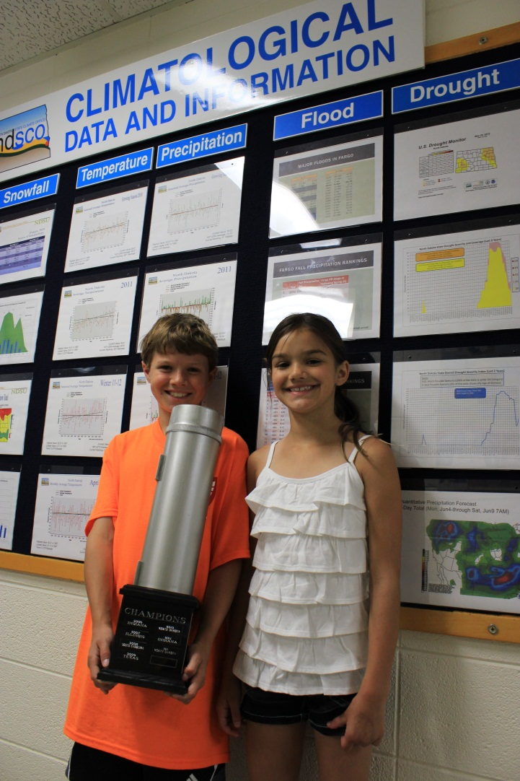
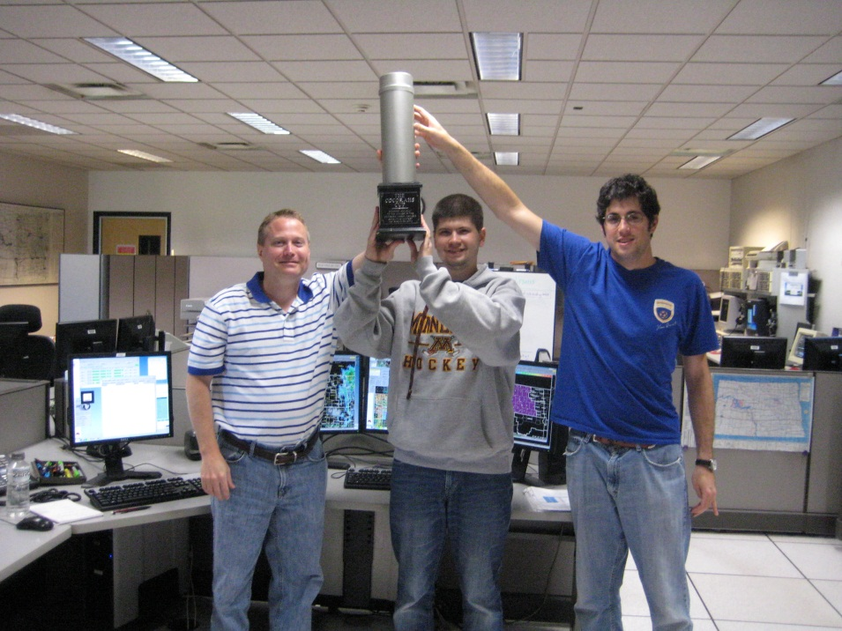
Since Last Time
ND Wins the CoCoRaHS Cup
Again

Slide 5


Since Last Time
Helmet use for tornado safety is finally catching on.
CDC Statement on Helmets and Tornadoes
“…helmets should be considered just one part of their overall home tornado preparedness kit…”

Slide 6
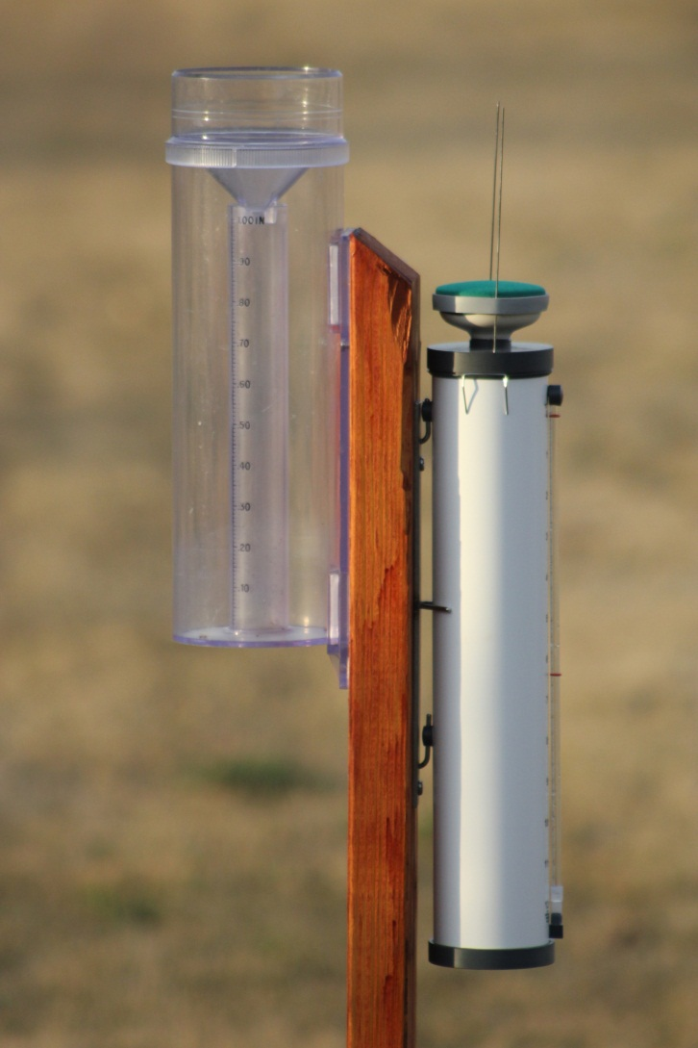
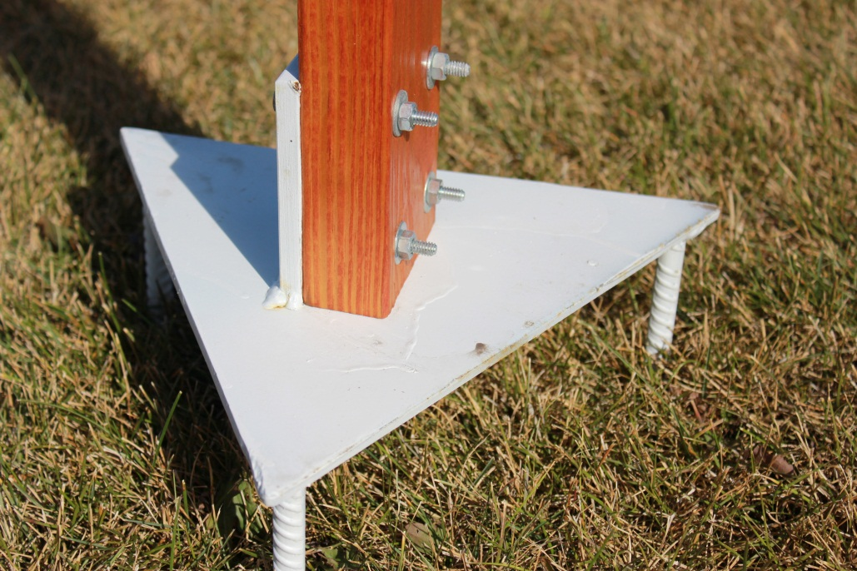
Since Last Time
ND Participating in Reference ET Observations.

Slide 7
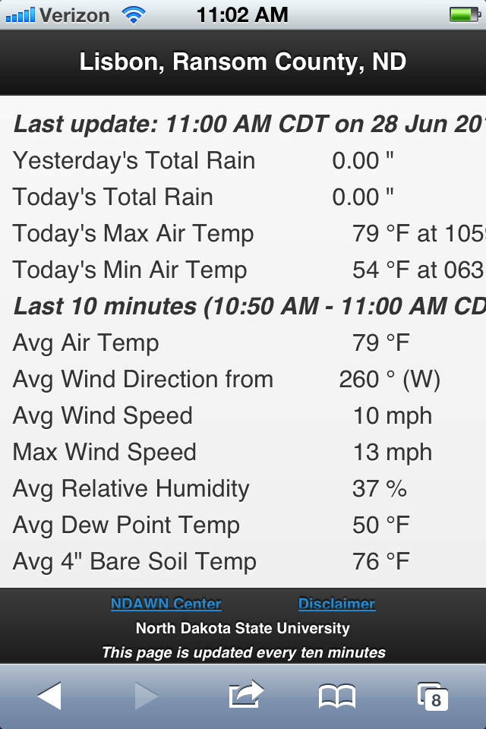
North Dakota Agricultural Weather Network (NDAWN) Mobile
NDAWN Mobile
Verizon wireless
25MB/$15 Plan (Includes $5 per station to be in the shared plan)
  Average Monthly Usage per Station = 5MB @ 10-min frequency

Slide 8
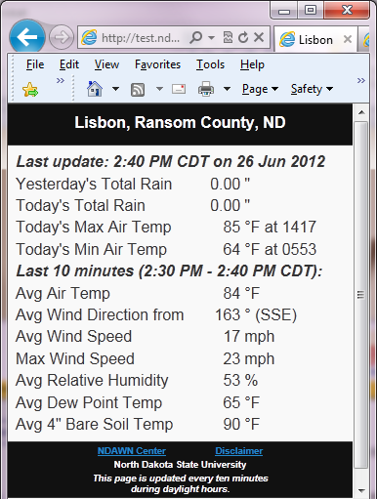
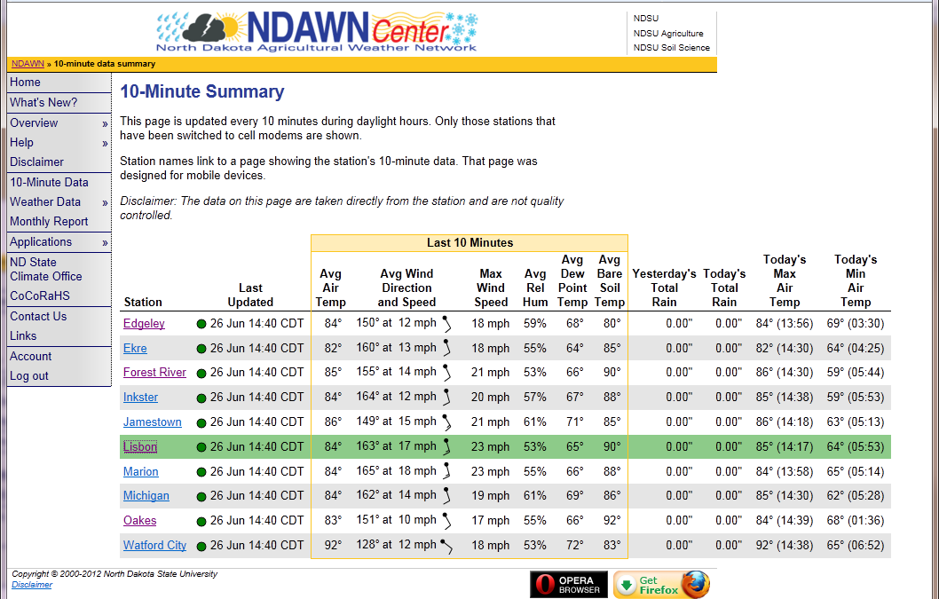
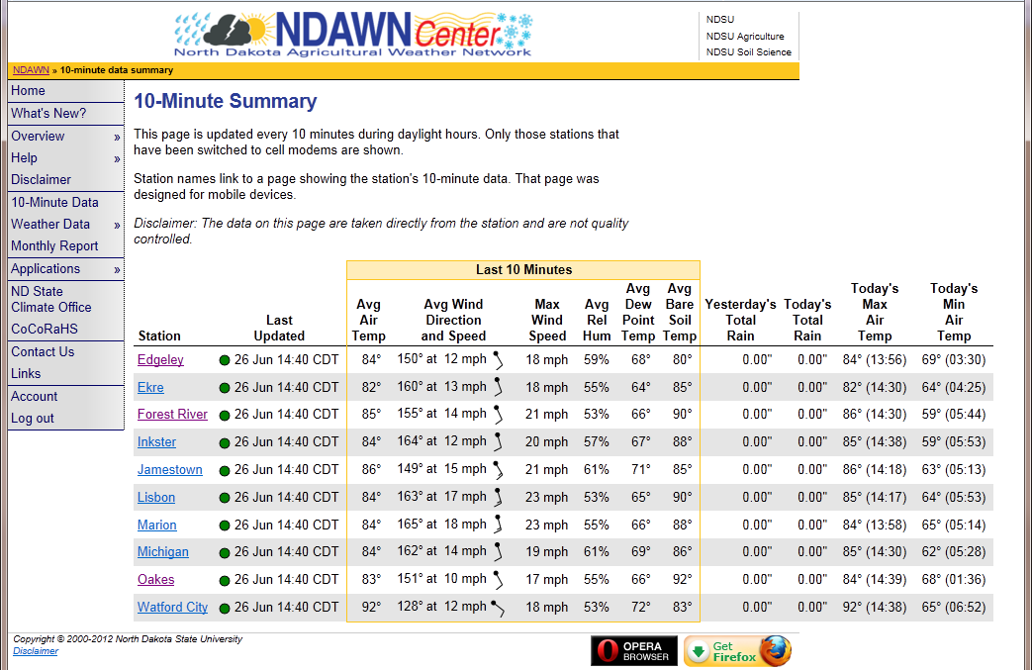
NDAWN Mobile

Slide 9
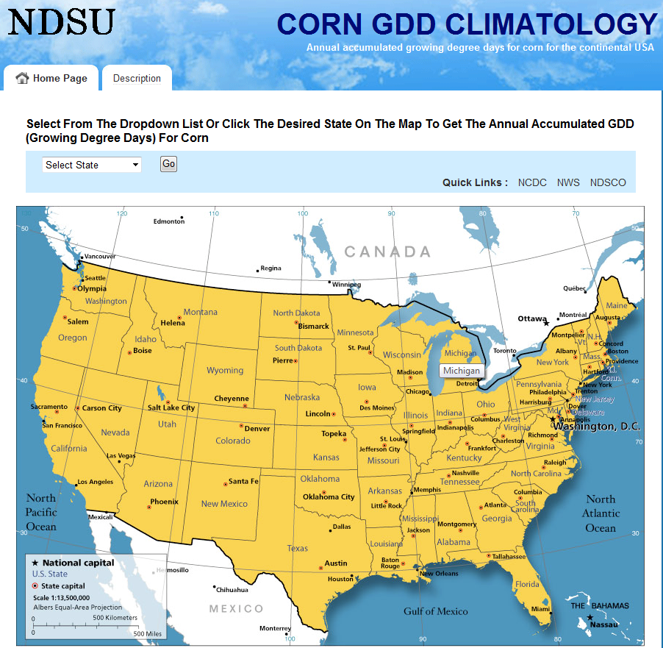
Corn GDD Climatology
http://www.ndsu.edu/pubweb/GDD/

Slide 10
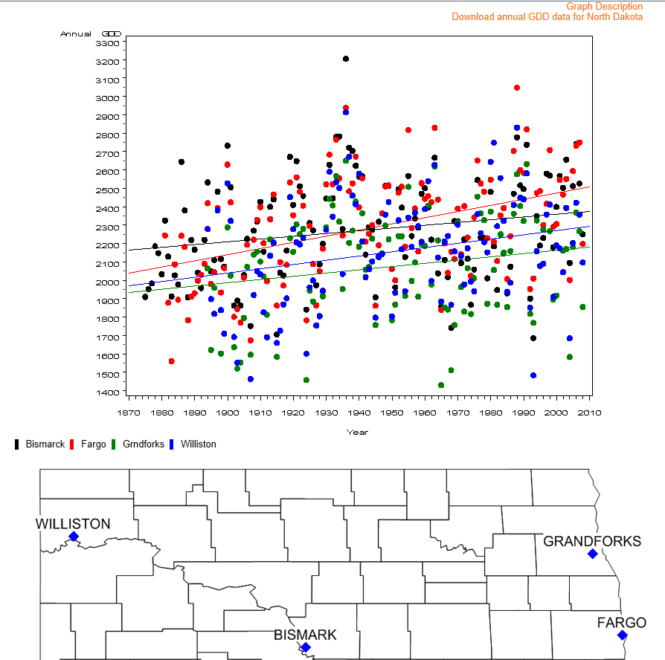

Slide 11
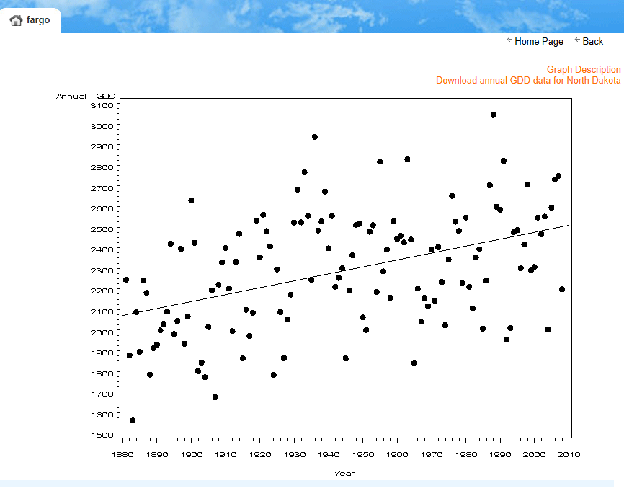
Notes:
Trend: 3.35 GDD per year
Largest + Trend=18.8/year (Las Vegas, CA)
Largest – Trend=-5.97/year (Youngstown, OH)

Slide 12
Corn GDD in Fargo, ND increased 33.5 heat units per decade since 1890
There are 335 additional heat units available today for corn development compared to 100 years ago.
That is 16% of total heat units necessary to mature a corn plant in Fargo.

Slide 13
Publications on GDD
Badh, A., F. A. Akyüz, 2010: Evaluating Trend Changes in Annual Accumulated Growing Degree Days for Corn Grown in the Northern Plains, United States of America. International Journal of Climate Change: Impacts and Responses, Volume 2, Issue 2, pp.127-136.
Badh, A., and Akyüz, 2010: A. Studying Climate Change and Precipitation Trends for North Dakota, United States. International Journal of Climate Change: Impacts and Responses, 2010, Volume 2, Issue 2, pp.97-108.
Badh, A., F. A. Akyüz, G. Vocke, B. Mullins, 2009: Impact of Climate Change on the Growing Seasons in Select Cities of North Dakota, United States of America. International Journal of Climate Change: Impacts and Responses. V.1, Number 1, 105-117.

Slide 14
How to use “Trace” in tie-breaking procedure in Precipitation
Extreme Lowest Monthly Total Snowfall Ranking for March in Fargo, ND
(Records from 1881 through 2011 from ACIS)
Rank | March Snowfall Value (in) | Year
1 | 0.0 | 2010, 1961, 1905
4 | 0.1 | 1910

Slide 15
March 1905, Fargo, ND
March 1905
Day | Precipitation | Snowfall
1 | 0 | 0
2 | 0 | 0
3 | 0 | 0
4 | 0 | 0
5 | 0 | 0
6 | T | T
7 | T | T
8 | 0.02 | 0
9 | T | T
10 | T | T
11 | 0 | 0
12 | 0 | 0
13 | 0 | 0
14 | 0 | 0
15 | T | 0
16 | 0 | 0
17 | 0.04 | 0
18 | 0.04 | 0
19 | 0 | 0
20 | 0.02 | T
21 | T | T
22 | 0.06 | 0
23 | T | 0
24 | T | 0
25 | 0 | 0
26 | 0 | 0
27 | 0.3 | 0
28 | 0.02 | 0
29 | 0 | 0
30 | 0 | 0
31 | 0 | 0
Sum | 0.50 | 0
5 Trace Events in 1905

Slide 16
March 1961, Fargo, ND
March 1961
Day | Precipitation | Snowfall
1 | T | 0
2 | 0.01 | 0
3 | 0 | 0
4 | T | T
5 | T | T
6 | 0 | 0
7 | 0 | 0
8 | T | T
9 | 0 | 0
10 | 0 | 0
11 | 0 | 0
12 | 0 | 0
13 | 0 | 0
14 | 0 | 0
15 | 0 | 0
16 | 0 | 0
17 | T | 0
18 | 0 | 0
19 | 0 | 0
20 | 0 | 0
21 | 0.01 | T
22 | T | T
23 | 0 | 0
24 | 0 | 0
25 | 0.02 | 0
26 | 0.34 | T
27 | T | T
28 | T | T
29 | T | T
30 | 0 | 0
31 | T | T
Sum | 0.38 | 0
10 Trace Events in 1961

Slide 17
March 2010, Fargo, ND
March 2010
Day | Precipitation | Snowfall
1 | 0 | 0
2 | 0 | 0
3 | 0 | 0
4 | 0 | 0
5 | 0 | 0
6 | 0.03 | 0
7 | 0 | 0
8 | 0.01 | 0
9 | 0.04 | 0
10 | 0.65 | 0
11 | 0.51 | 0
12 | 0.07 | 0
13 | 0 | 0
14 | 0.02 | 0
15 | 0.08 | 0
16 | 0 | 0
17 | 0 | 0
18 | 0 | 0
19 | T | T
20 | 0 | 0
21 | 0 | 0
22 | 0 | 0
23 | 0 | 0
24 | T | 0
25 | 0 | 0
26 | 0 | 0
27 | T | T
28 | 0 | 0
29 | 0 | 0
30 | 0 | 0
31 | 0 | 0
Sum | 1.41 | 0
2 Trace Events in 2010

Slide 18
Manual Procedure
Count number of un-measurable snowfall events (Trace) among the months that had no measurable snow events.
Give higher ranking for the months that produced the least number of “Trace” events
Ranking Prior to the Manual
Procedure
Ranking After the Manual
Procedure
Rank | March Snowfall Value (in) | Year
1 | 0.0 | 2010, 1961, 1905
4 | 0.1 | 1910
Rank | March Snowfall Value (in) | Year
1 | 0.0 | 2010
2 | 0.0 | 1905
3 | 0.0 | 1961
4 | 0.1 | 1910

Slide 19
Automated Procedure
We developed a proper tie-breaker procedure:
  to minimize climatic ties, and
  to properly identify an extreme precipitation event in a dataset where the record event may seem to be hidden among the other events sharing the same magnitude before the traces are properly evaluated.

Slide 20

Method
Assign “T” a numerical value such that it
  Would not change the magnitude of the precipitation
  Would only help automate manual procedure to incorporate “T” events into ranking calculations
$$T={10}^{−5}$$

Slide 21
Method
Row # | Date | Precipitation (in) | Precipitation (in) | Accumulated Precipitation
1 | Jan 1 | T | 0.00001 | 0.00001
2 | Jan 2 | T | 0.00001 | 0.00002
. | . | . | . | .
365 | December 31 | T | 0.00001 | 0.00365
Annual Total |  | 0.00 | 0.00 | 0.00

Slide 22
Recommendation
Climate Data Management Systems such as ACIS may be programmed to retain the “T” for display but treat it as a numerical value of 0.00001 for calculation purposes.

Slide 23
Output
A publication submission to JSC (4/12/2012) by a sub-group within NDST
  Adnan Akyüz, SC
  Karsten Shein, NCDC
  Mike Asmus, NWS

