Slide 1
New Mexico 2014 Pitch
Stan Engle
Destin, FL
July 11th, 2012

Slide 2
Santa Fe, NM
June/July – June is not as expensive. July becomes more expensive as the tourist season starts
Avg. Temp is 83 in June
High and Arid – Cools in the evenings

Slide 3
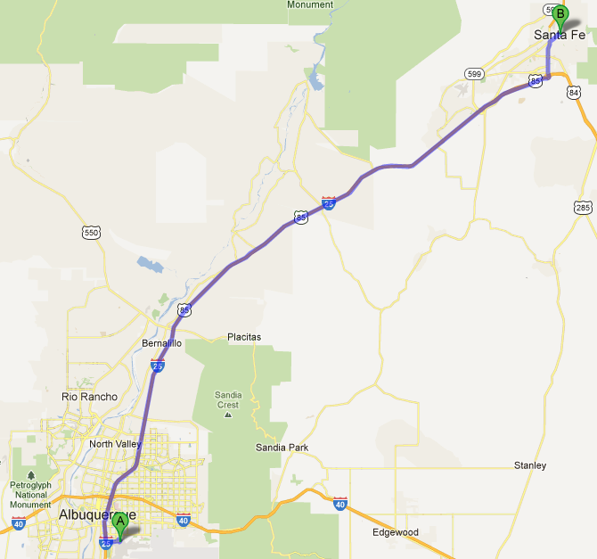
Planes, Trains, and Automobiles
Fly into the Albuquerque Sunport. Santa Fe is about an hour away depending on the choice of travel for the last leg.

Slide 4
Planes, Trains, and Automobiles
Santa Fe Shuttle – Airport to Santa Fe - $47 per person – 70 minutes travel time
Rental Car – Hertz, Enterprise, Thrifty, etc. – Located near Airport – shuttle service to rental lot takes 5 minutes
Railrunner! – Take the train! – ABQ bus service to ABQ train depot – Railrunner goes to within walking distance of Santa Fe Plaza

Slide 5
La Fonda on the Plaza
$130 for rooms in June. July ??
Meeting rooms that can accommodate up to 300.
Right on the Plaza. Walking distance to historic buildings and local restaurants.

Slide 6
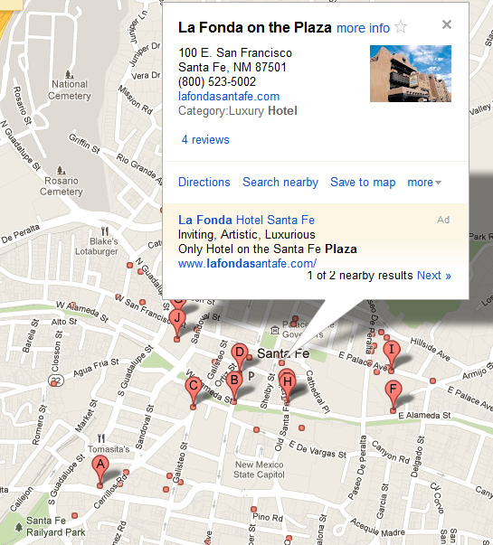
Other Choices

Slide 7
Other Choices
El Dorado Hotel & Spa - $210
Hilton Santa Fe Historic Plaza - $160
Old Santa Fe Inn - $160
Santa Fe Sage Inn – Around $100
Santa Fe Motel & Inn – Under $100
Motel 6 - $70

Slide 8
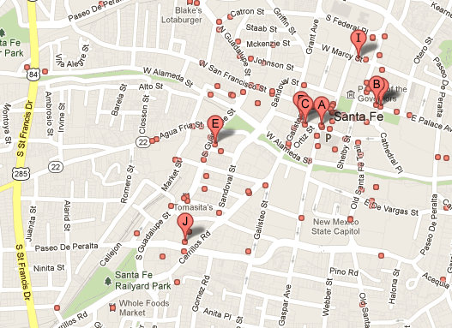
Restaurants

Slide 9
Restaurants
Blue Corn Café and Brewery
Marble Brewery
Rooftop Pizzeria
The Shed Creative Cooking
Second Street Brewery
Etc.

Slide 10
Things We Can Do
Visit Bandelier National Monument.
Hike Santa Fe Ski Area
Visit Bradbury Science Museum at LANL
Bowling

Slide 11
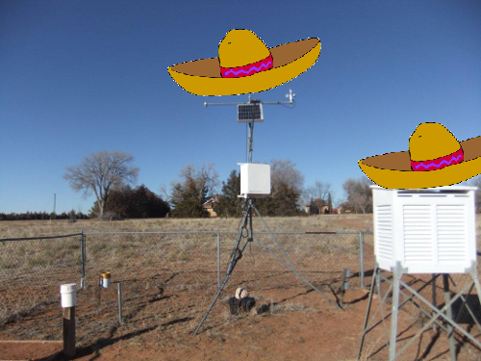
Finally, Sombreros.

Slide 12


