Slide 1
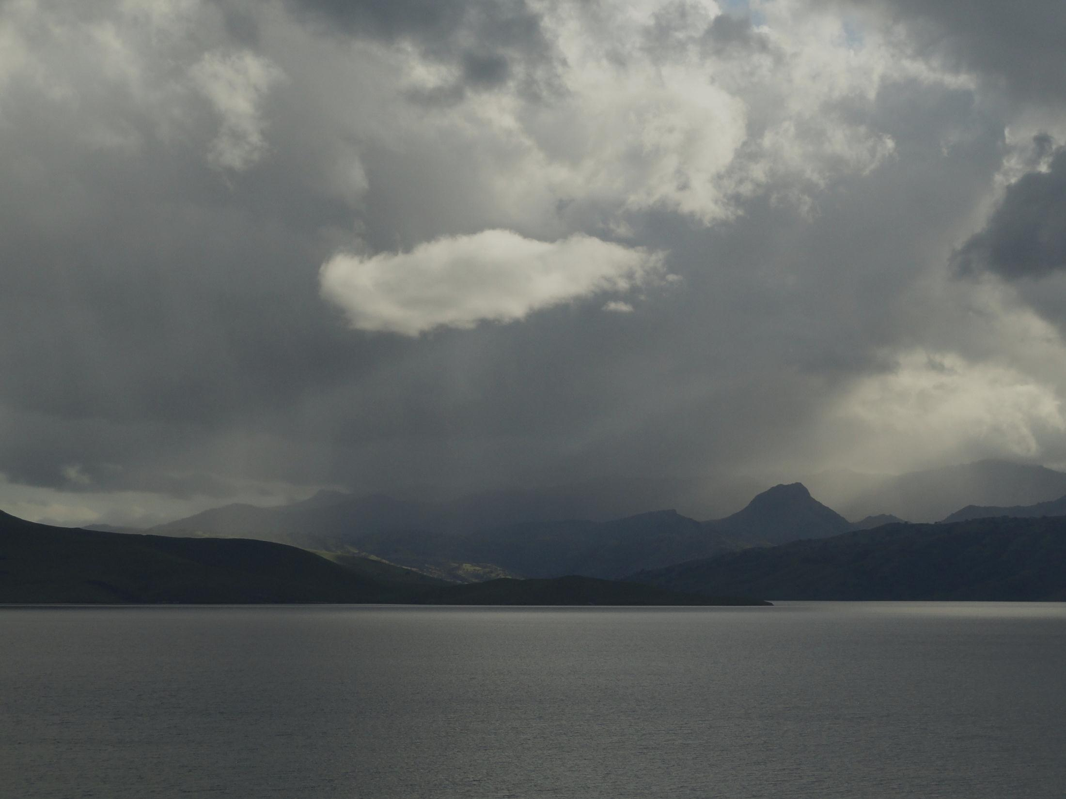
Estimating Future Floods to Manage Flood Risk
Michael Anderson
California State Climatologist
Extreme Precipitation Symposium 2012

Slide 2
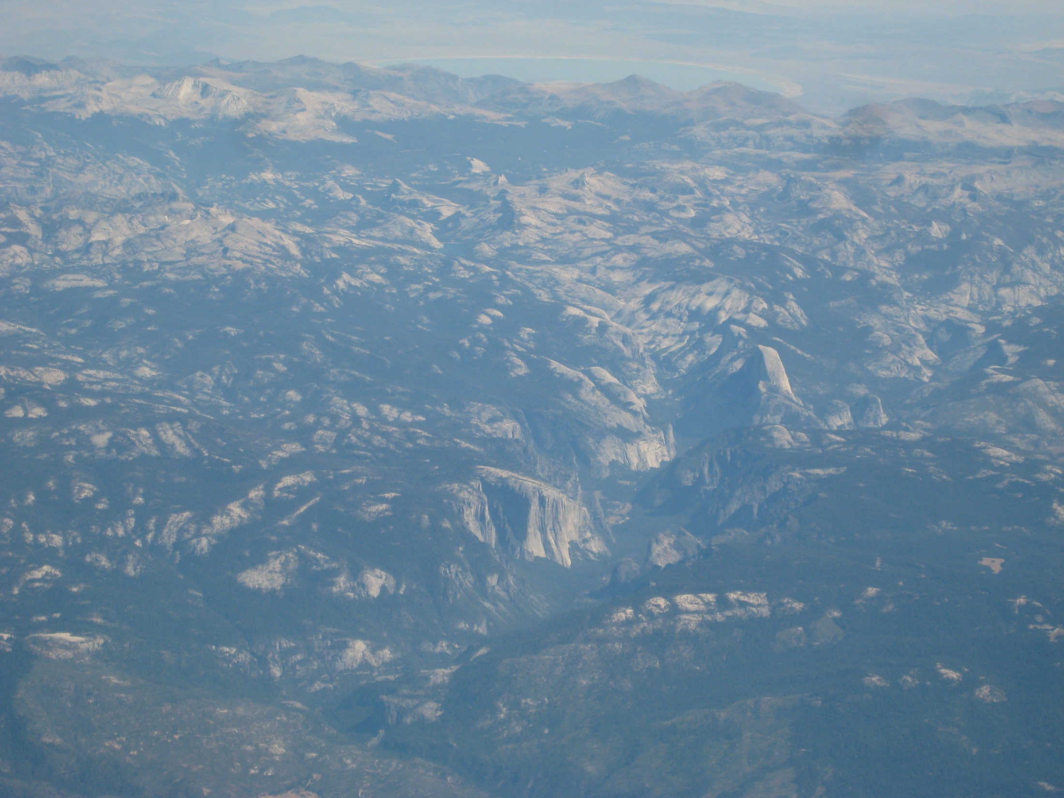
Talk Overview
Statistics
Physics
Climate Change
Flood Management and the 200-year Event
Panel Discussion Set-Up
Notes:
Here is an overview of the material I will present over the next 20 minutes or so. We’ll start with statistics, move on to physics, and look at climate change issues. Then we will move onto discussion of building a flood management strategy for the State-mandated 200-year event.

Slide 3
The 200-Year Event
A State mandated target threshold for flood peak and volume for a critical duration to use for flood management planning for current and future climate conditions
Notes:
A good starting point is to understand that the State-mandated 200-year event is a target threshold of flood peak and volume for a critical duration that will be used for flood management planning for current and future conditions. A successful flood management strategy for the 200-year event will be needed for continued local development in floodplains. A framework is needed to help define what a successful strategy will be for a given urban area.

Slide 4
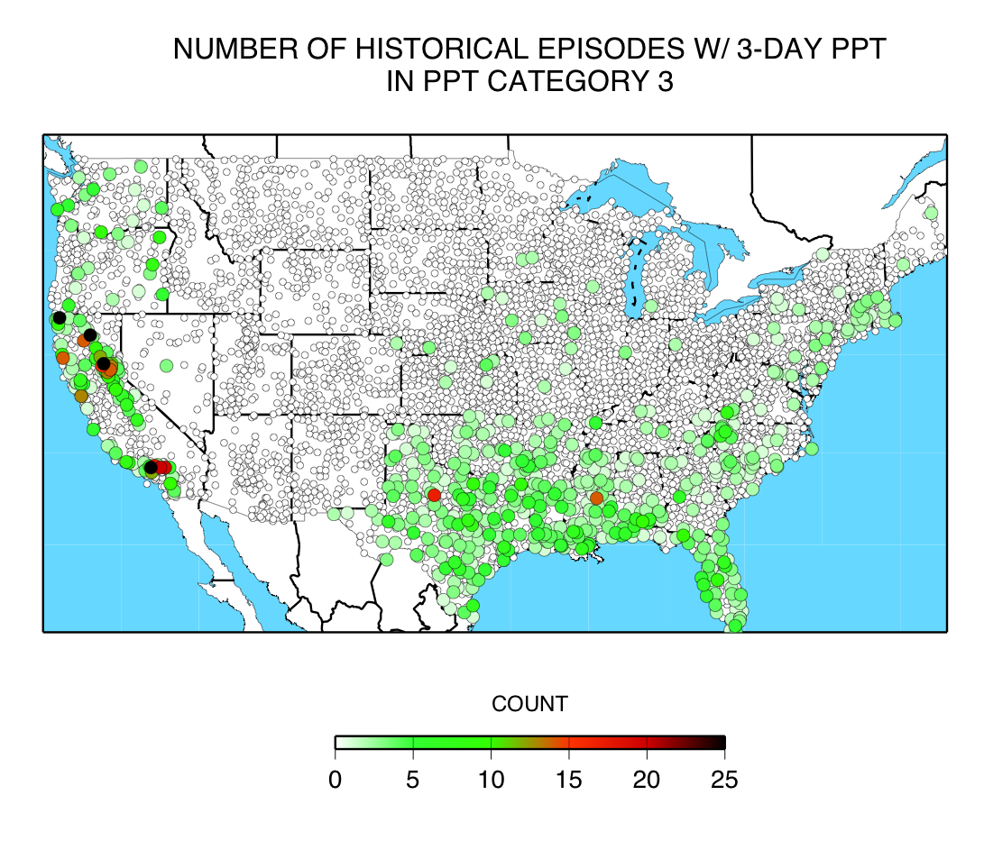
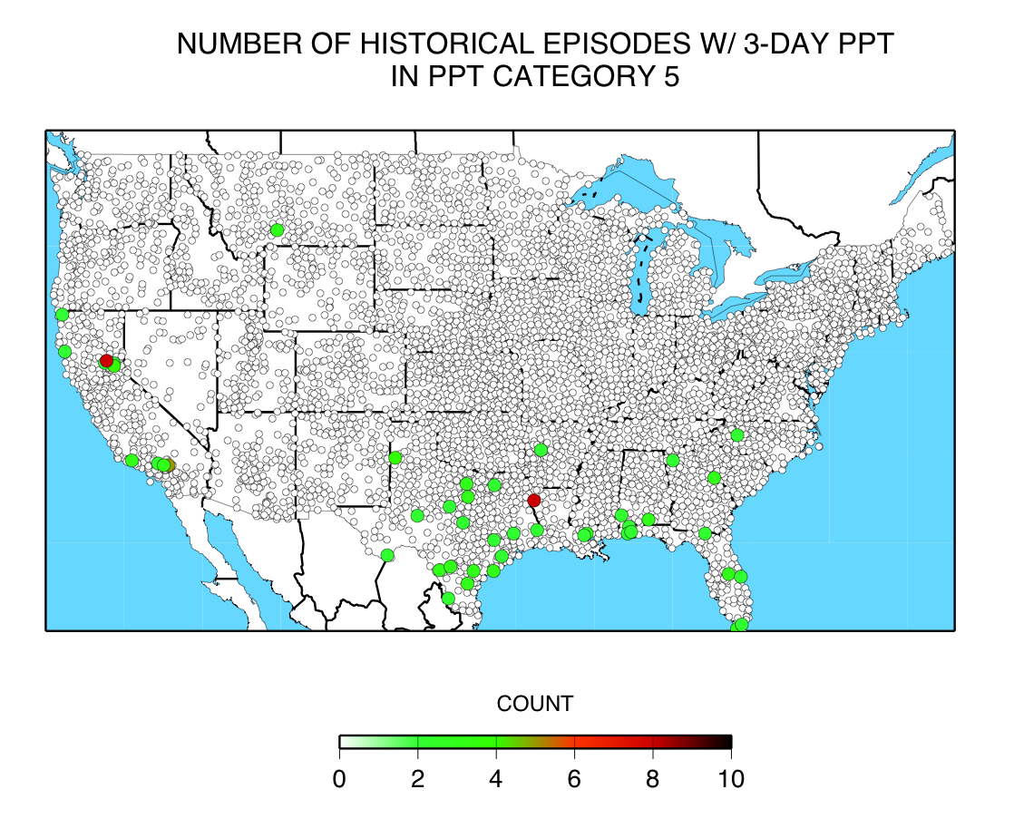
What does a 200-year Event Look Like?
Buck’s Creek NOAA Atlas 14
200-Year 3-Day Estimate 23.5 inches
(18.4-30.6 inch 90% confidence interval
CAT 3 is > 30 cm (12 in)
in 3 days
Blue Canyon NOAA Atlas 14
200-Year 3-Day Estimate: 24.4 inches
(19.1-31.9 inch 90% confidence interval)
HMR 58/59 3-Day PMP Estimate : 37.8 inches
CAT 5 is > 50 cm (20 in.) in 3 days
Notes:
So let’s start to look at what a 200-year event might look like. Here are two plots taken from work by Mike Dettinger at Scripps Institute of Oceanography. He evaluated 3-day precipitation totals for the National Weather Service Cooperative Observer sites and categorized them by different 3-day totals. The Category 3 and 5 totals are shown here which show that California sees as many big events as anywhere else in the contiguous United States. Also shown on this slide are 2 different 200-year 3-day precipitation estimates from NOAA’s Atlas 14 which is the updated depth-duration-frequency atlas for California. Buck’s Creek is in the Feather River watershed and Blue Canyon is in the American River watershed. Note the estimates are similar and both have large ranges for the 90% confidence interval. For the American River watershed note that the upper bound of the confidence interval starts to approach the mean areal precipitation for the probable maximum precipitation for the American River watershed. A question to keep in mind as these values are considered is do you use the estimate for the mandated threshold or do you try to incorporate the uncertainty and aim for a percentage of the upper confidence bound? What is appropriate and what is realistic?

Slide 5
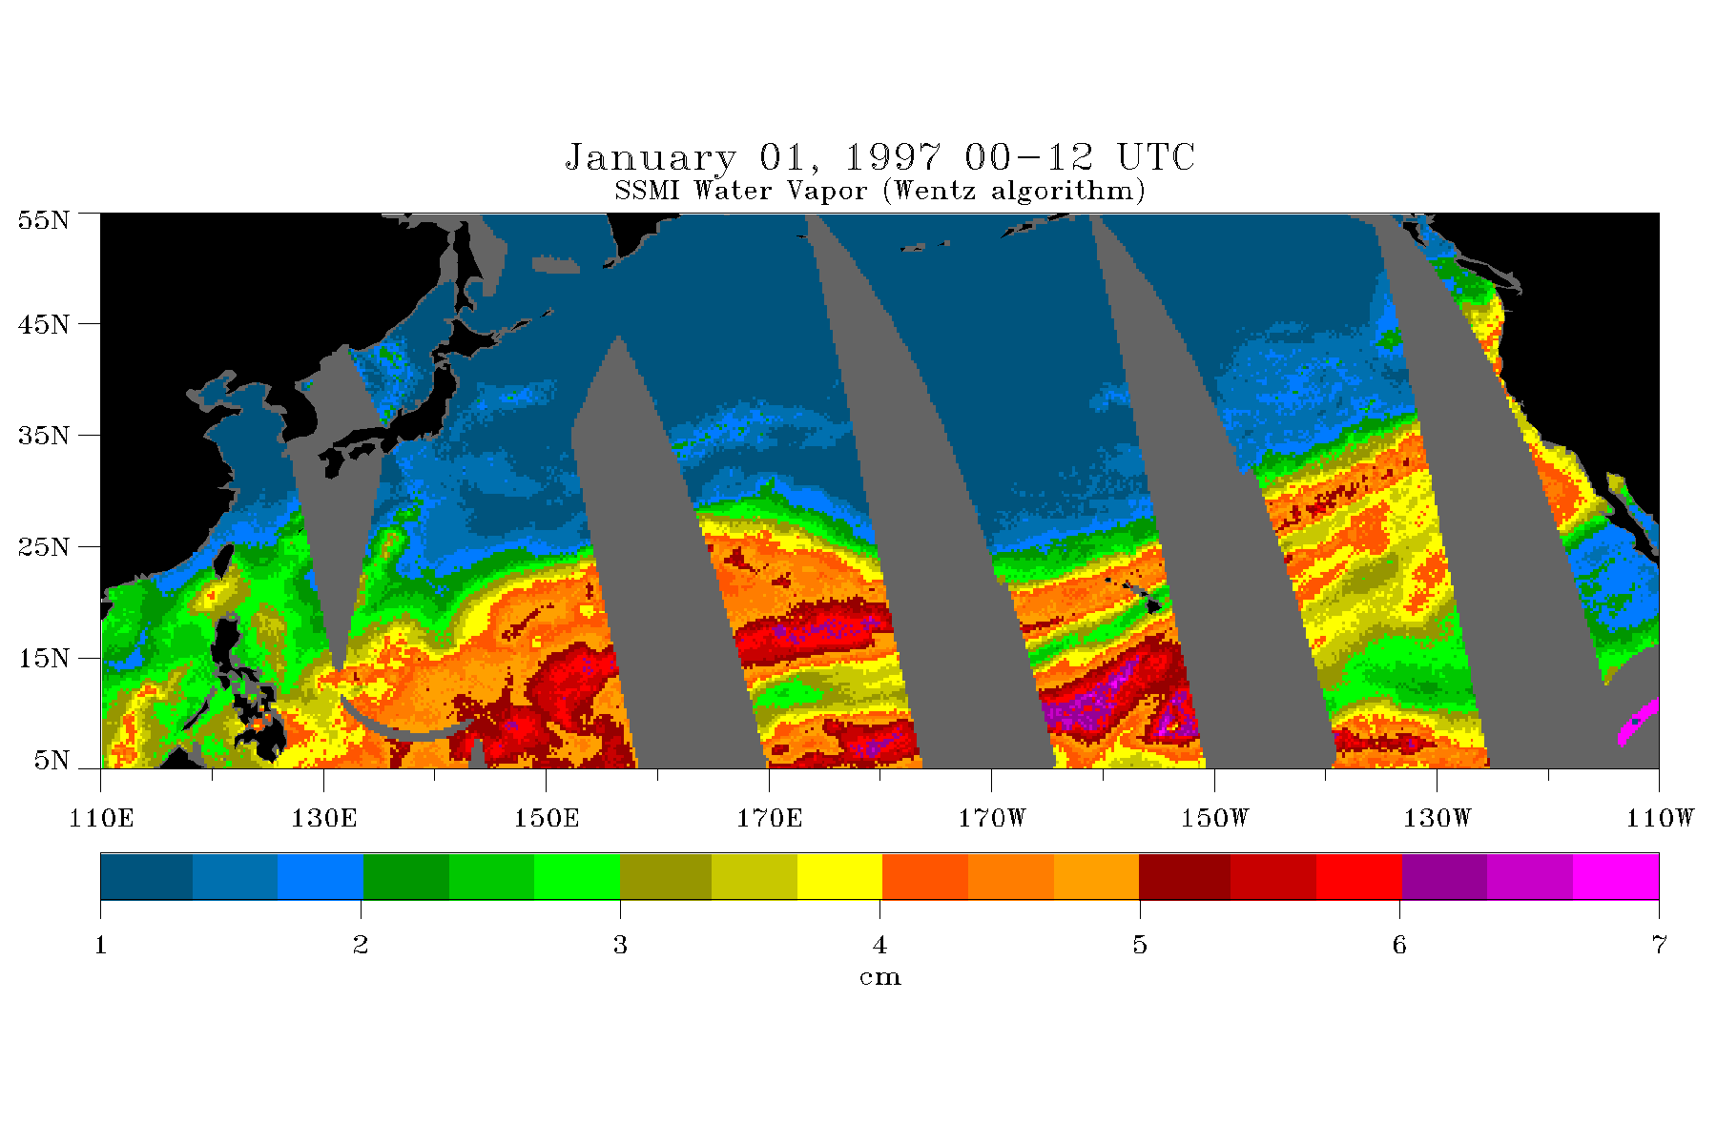
What does a 200-year Event Look Like?
Notes:
Here we have a water vapor image during the peak of the 1997 flood. Nine inches of rain fell in 24 hours at Blue Canyon on this day. Note that there are two plumes of atmospheric moisture coming from the tropics for this event. These two plumes are the primary routes for atmospheric rivers that impact California. Some questions to ponder are how long can this set-up be sustained in terms of water vapor delivery, can the magnitude be larger, and how does this flux of atmospheric moisture get processed by a watershed into runoff for a flood peak and volume over a given duration. If we understand how this process works, we can look at how this may change in the future and gain insight into how to plan for a suitably extreme event.

Slide 6
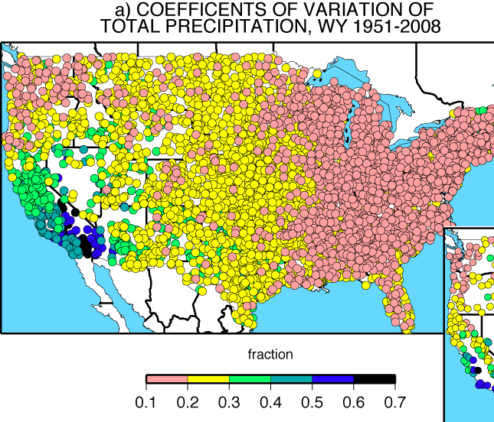
California’s Wild Precipitation Regime
California precipitation is uniquely variable
Std Dev of Annual Precipitation
Mean Annual Precipitation
Dettinger et al, 2011
Notes:
This slide courtesy of Mike Dettinger at Scripps points out a unique condition for California that has an important influence on how flood peaks and volumes are characterized. For most of the country the standard deviation of precipitation is a small fraction of the mean. One year looks a lot like other years which lends itself to the assumption of independent and identically distributed annual peaks for event runoff. However in California the standard deviation is larger relative to the mean than anywhere else in the country. We have years where nothing happens and years when something major happens. The challenge with annual totals is that the major event can be in a single event like 1997 or built up of several more moderate events like 1983. Then we have years like 1995 when multiple events occur of which only one will be considered in an annual maximum analysis. This can make working with the statistics a challenge as we will soon see.

Slide 7
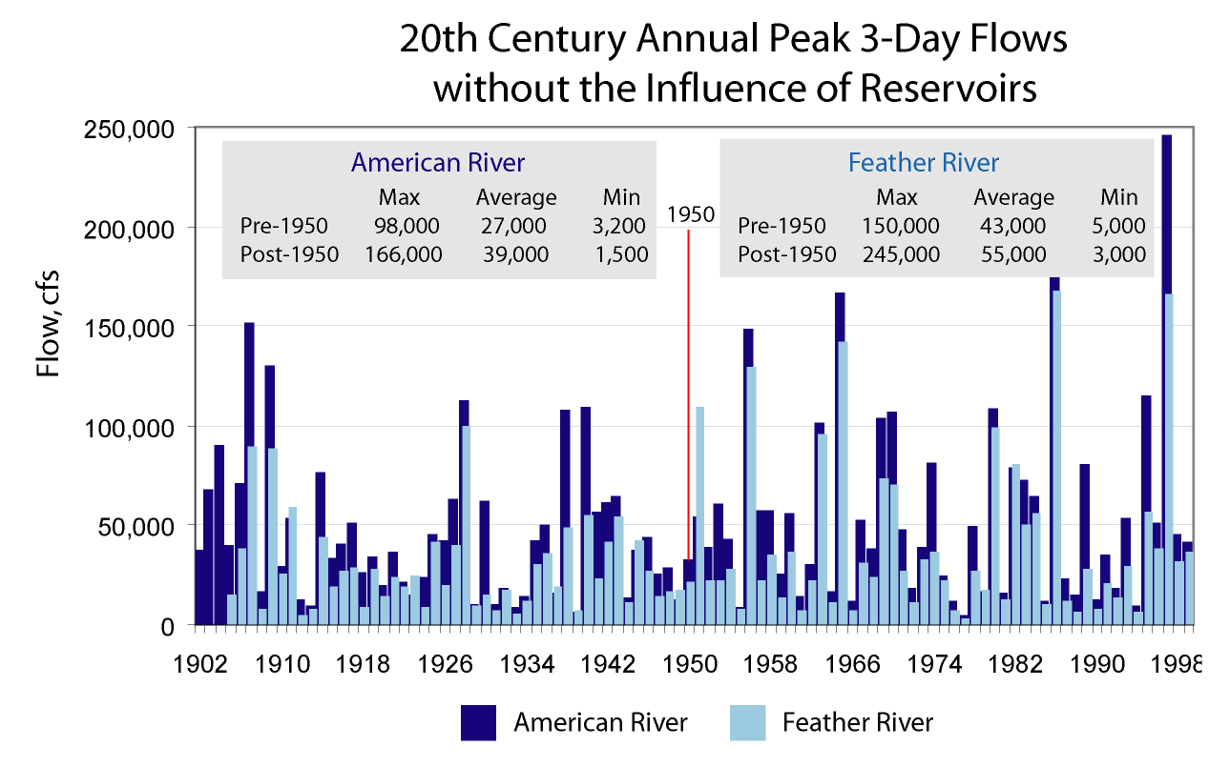
American River
Feather River
How to
anticipate, plan
and operate to
this
Given this
history
Feather River
American River
Notes:
Here we have the 20th century annual maximum flows for the American River near Folsom and the Feather River at Oroville. Consider that the structures used to manage floods were built primarily using data from the first half of the 20th century and operated to the events of the second half of the 20th century. We are now asked to consider a potentially similar situation where given one set of hydrologic data we are being asked to anticipate, plan and operate to a future hydrology that may not look much like the observed set. In this wildly fluctuating world, we have to extrapolate to the 200-year event both for current conditions as well as for some future condition incorporating climate change.

Slide 8
More Statistics –
3-Day Peak Flows
 | Pre-1955 |  |  | Total Period
 | Q10 | Q50 | Q100 | Q10 | Q50 | Q100
American | 58,002 | 103,569 | 126,185 | 71,937 | 149,980 | 194,349
Feather | 88,380 | 148,413 | 176,040 | 100,752 | 178,094 | 215,266
 | Extrapolation – 50 years out
 | Q10 | Q50 | Q100
American | 89,219 | 217,189 | 299,334
Feather | 114,857 | 213,710 | 263,232
Notes:
I made this slide several years ago looking at how extrapolating statistics can cause some problems when looking at the American and Feather River watersheds. Note this effort only goes out to the 100 year event. The problems will only magnify as the extrapolation is extrapolated to the 200-year event. For the time extrapolation I took the change in statistical parameters between the first half of the 20th century and the total 20th century record and made an equivalent jump to represent a change 50 years from now. Changes were made to both the mean and the variance. Unfortunately you can see that this has resulted in the 50 and 100 year events on the American River out-producing the Feather River watershed which is significantly bigger. That doesn’t seem plausible and motivates consideration of some of the physics occurring during extreme events in California.
8

Slide 9
Flood Frequency Curve
Rain to top of
watershed
Snow Level Varies
Dry Years
Notes:
Here is a flood frequency curve for a river in California with different regions identified conceptually. The bottom of the frequency curve is made up of annual peaks during dry years when the biggest event of the year was not likely to be an event anything like the other end of the frequency curve. In between the two extremes are events where the snow level or freezing level of the atmosphere varied somewhere within the watershed boundaries and antecedent conditions played a role in how large the event registered. At the top of the curve we have events where rain reached the top of the watershed and now consideration of the event duration relative to the watershed size and magnitude of the atmospheric river play a role in how big the flood peak reaches. We need to look at what physical processes go into these events to see just how big an event can be. Extrapolating with a straight line to get to the 200 year event much less considering the uncertainty bounds for such an event may not be the appropriate approach.
9

Slide 10
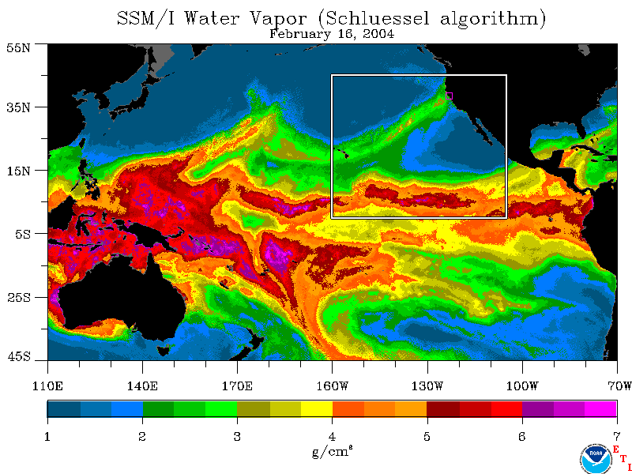
Key Phenomena Affecting California
Water Supply/Flooding:
Flooding &
water supply
Cyclogensis
Storm Track changes
L
Atmospheric
River
MJO/Tropical
Convection
ENSO
Easterly Wave
The most extreme CA storm would result from a rare alignment of key processes
Notes:
There are a lot of moving pieces going on in the ocean-atmosphere-land surface systems for an extreme event in California. This slide taken from Marty Ralph at NOAA’s Earth System’s Research Laboratory shows some of those processes which may play a role. We have the atmospheric rivers which deliver the tropical moisture into the warm-sector of a winter storm leading to heavy orographic precipitation. However, the state of the El Nino Southern Oscillation (ENSO) plays a role in the shape of the storm track and potential entrainment of these atmospheric rivers into winter storms. Easterly disturbances or waves in the tropics can push higher concentrations of atmospheric water vapor northward possibly providing a greater source for entrainment by atmospheric rivers. The Madden Julian Oscillation, MJO, is a large-scale convective structure that moves from the Indian Ocean to the Pacific Ocean with a period of 30 to 60 days. If this activity is in just the right part of the western Pacific, it excites planetary waves that act to amplify the dynamics of storms in the eastern mid-latitude Pacific which can increase event rainfall in California. Polar processes can also influence the ease with which storms can develop in the eastern Pacific which may enable multiple storms to impact California during a given event extending the number of days of heavy rainfall. As it says on the slide, it is a rare alignment of key processes that creates the most extreme California storm. Understanding how many of these processes need to occur to meet the 200-year event is an important consideration.

Slide 11
From AR Flux to Runoff
How much moisture flux generates how much precipitation?
How much precipitation where generates how much runoff?
Are these relationships static? If not, how do they change and why?
Notes:
This slide depicts another important consideration in the physics of extreme events. Atmospheric rives provide a flux of moisture at low elevations. This flux of moisture moves into the Sierra watersheds where the airflow will be modulated by the topography. There will be areas where the moisture flux is brought together in areas of convergence which combined with the uplift accentuates the precipitation. Where that heavy precipitation falls in the watershed relative to the outlet for how long plays a role in the shape of the event runoff hydrograph. Each watershed is shaped differently and will have a different configuration for what is its extreme event. Understanding these processes for each watershed can be used to define a watershed’s 200 year storm event which would be the collection of physical processes that translate the extreme atmospheric moisture into extreme runoff that corresponds to the targeted runoff peak, volume, and duration thresholds.

Slide 12
Physical Boundaries
Watershed Size and Elevation
Atmospheric River Event Duration
Atmospheric River Flux Limits
Limits on Flux to Precipitation Conversion Process
Notes:
With all watersheds and for the atmosphere there are physical boundaries which may limit the amount of runoff that can result from an extreme event. It is important to understand where these boundaries are and how they can inform the extrapolation of statistical methods to identify the appropriate flood peak, volume and duration. Some of these boundaries include the size of the watershed and the elevation pattern. Moisture flux above the highest elevation in the watershed may not impact the watershed directly. The duration of atmospheric river conditions is a critical component to generating large flows. Understanding the limits of atmospheric river flux magnitude and duration are important to understanding what size event can occur in a given watershed. There may also be limits in the flux to precipitation to runoff process that need to be explored. This would help inform if projected changes to atmospheric river flux translate to changes in future flood flows.

Slide 13
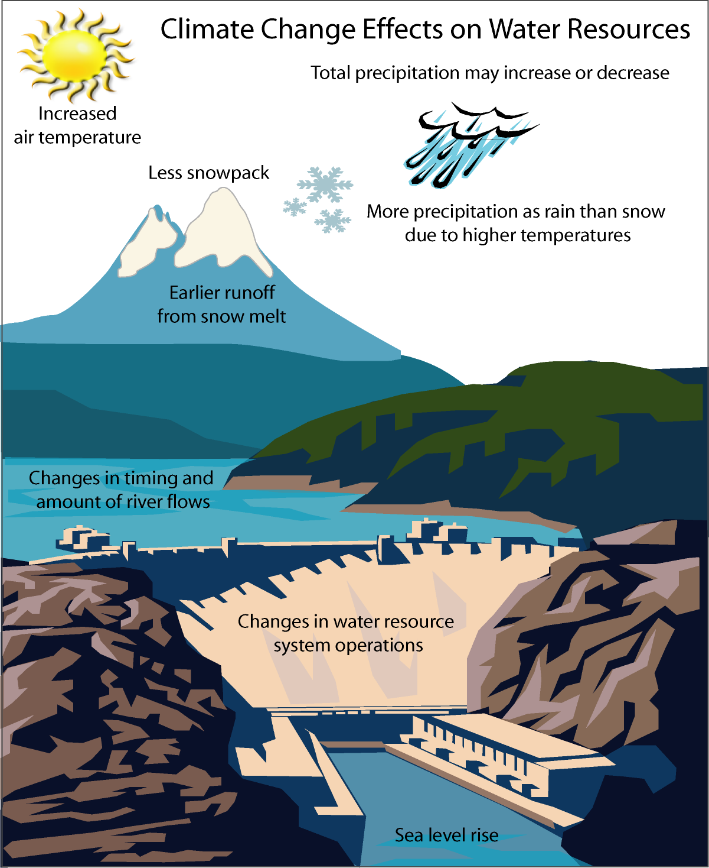
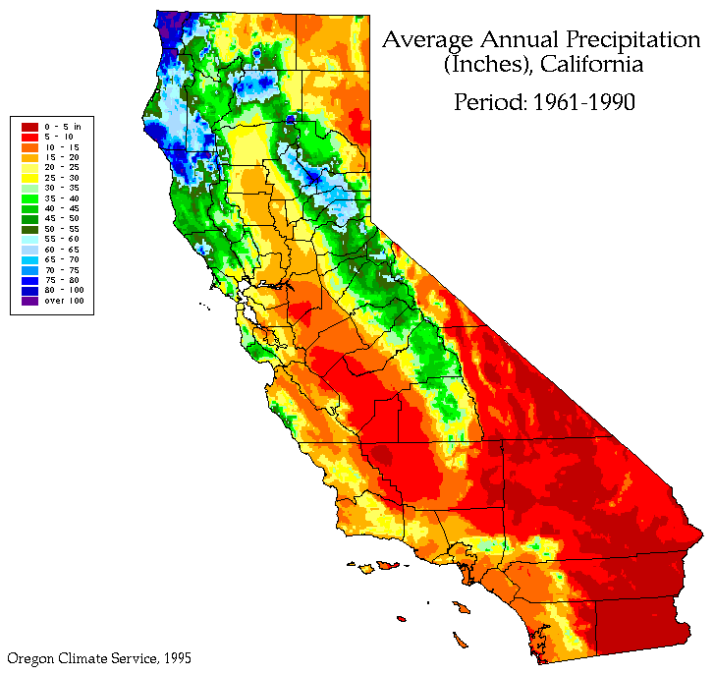
Climate Change and CA Hydrology
Notes:
Speaking of climate change we need to consider how climate change can impact a given winter storm event that produces a major flood. On the left side of the slide is an overview of how climate change may affect water resources courtesy of Jamie Anderson of DWR’s Bay Delta Office. Increased temperatures, higher snow lines, precipitation changes, and sea level rise all can play a role in changing the look and magnitude of a flood event. On the right hand side is a depiction of the 1961-1990 mean climatology for annual precipitation to highlight those areas where precipitation is impacted by California’s topography. Latitude, and elevation both play a role.

Slide 14
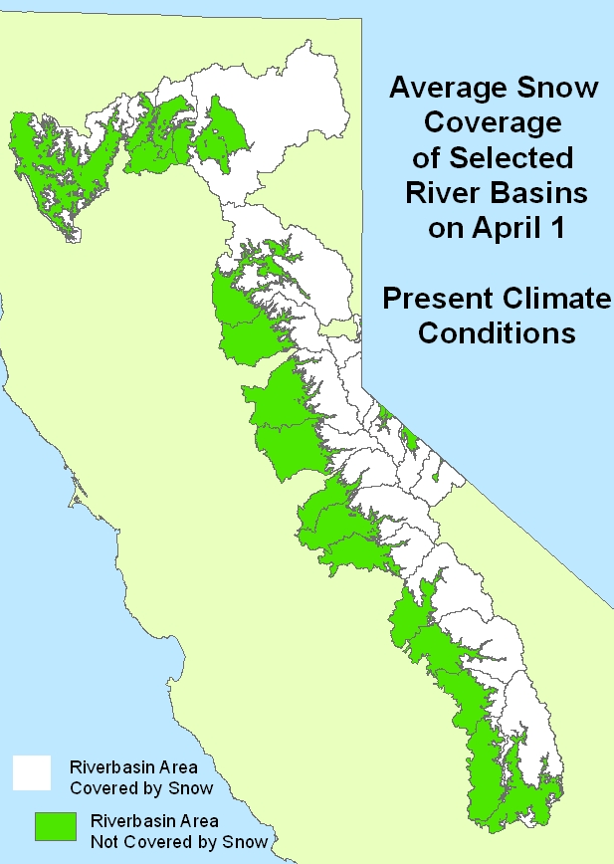
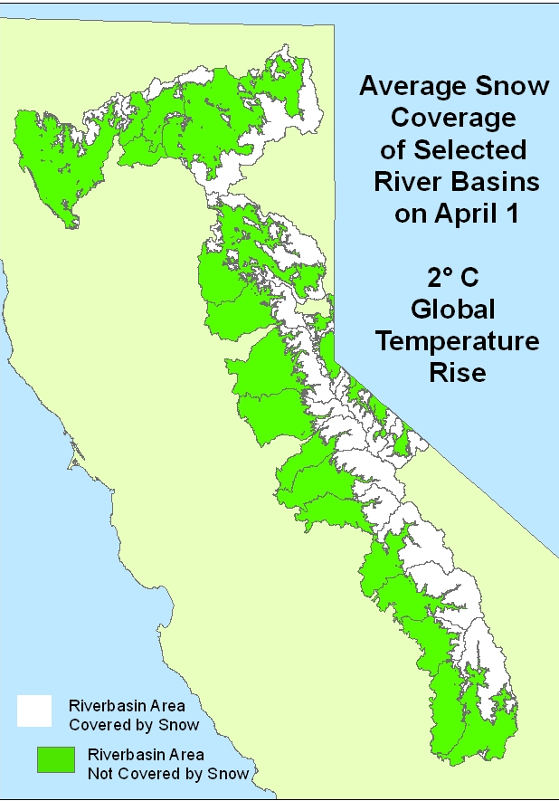
Climate Change and CA Hydrology – Snow Lines
Notes:
Another important consideration is the extent of snow cover for Sierra watersheds. These maps created by Jane Shaffer-Kramer of DWR’s Bay Delta Office show the potential change in average snow cover for current climate conditions and a 2 degree Celsius rise assuming that each degree Celsius rise in temperature corresponds to a 500 foot elevation increase in the elevation of the mean snow coverage. Note that this increase in temperature opens up a lot of watershed area in the northern watersheds for direct runoff contribution. The higher elevation of the southern Sierras is less impacted for this aspect of climate change.

Slide 15
Precipitation/Temperature
Distribution Plot
Hot/Wet
Cold/Wet
As distribution shifts,
new extremes possible
Climate system
plays a role in what
extremes are possible
Some extremes
are unique – need to
diagnose why
Cold/Dry
Hot/Dry
Notes:
Here is a depiction of the 20th Century evolution of climate for California using data from Western Region Climate Center’s California Climate Tracker. Each dot corresponds to an annual total precipitation and average temperature normalized by subtracting the total period mean and dividing by the total period standard deviation. The (zero,zero) coordinate corresponds to the period-of-record mean of this bivariate distribution. Looking at the observations which make up this distribution we see a shift in where the observations are occurring with more recent observations at the warmer edge of the distribution. As climate changes, new extremes in the distribution will be possible. However, some events like the highlighted blue square from 1931-1960 are uniquely extreme. This warrants investigation as the events that aligned to create that extreme may happen again, but from a sampling point further to the right of the distribution. It should be noted that these are annual values and not event values. Floods are events that can occur in the backdrop of a year that can be very different from one major event to another.

Slide 16
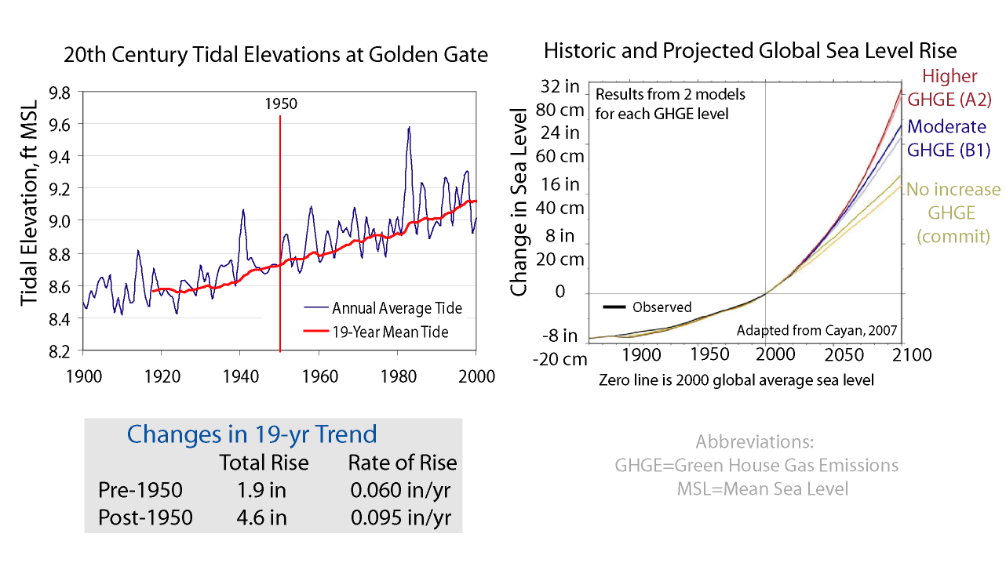
Sea Level Rise
Slide from
Jamie Anderson
DWR- Bay Delta
Notes:
Here is a slide depicting observed and projected sea level rise. This is important from the standpoint that higher sea levels can create backwater conditions preventing the draining of flooded areas such as the conditions during the north coast event in 1964. Note also that an event sea level such as 1983 can be significantly larger than the mean sea level and that during an event considerations like the wintertime astronomical peak tide need consideration. This is one other physical process that can align to create extreme conditions.

Slide 17
Managing Floods and the
200-year Event
Notes:
So given all of the statistics and physics presented so far, we need to come up with a framework for managing floods and being able to say that we can successfully manage floods associated with a 200-year threshold. The next couple of slides will discuss some considerations that will go into the framework document being developed at the Department for the 200 year event.

Slide 18
Components of Managing Floods
Monitoring Networks
Reservoirs – Designated Flood Storage and Incidental Flood Space
Levees
Control Structures/Urban Drainage
O&M Considerations
Critical Event Duration Determination
Notes:
Managing a flood can be done through a variety of methods and structures that vary for each watershed. Monitoring networks can be used to identify what is happening and help to inform forecasts of what might happen over the course of an event. Some reservoirs in a given watershed have designated flood control space identified in the water control manual. However, the year-to-year operations of these reservoirs and upstream reservoirs with no designated flood control space often result in what can be called incidental flood space. This incidental flood space can be used to attenuate and manage the flood peak and volume, but it is not guaranteed to be there. There may be room in the framework to use incidental flood storage as an interim management practice while other improvements specifically for flood management are implemented. These improvements may be to levees or control structures for both river flow and urban drainage that all can play a role in flooding for an urban area. Any framework has to consider the operation and maintenance of flood management structural and nonstructural elements as deferred maintenance could cause problems. As stated earlier, determining the critical event duration is important to understanding how the flood managemenet components work together during an event and when they can be overwhelmed under certain conditions.

Slide 19
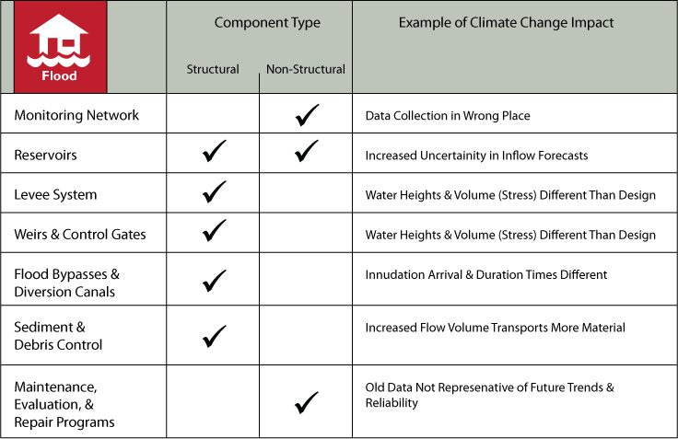
Climate Change and Flood Planning
Notes:
This slide shows how climate change can negatively impact different aspects of flood management and planning. Each of these issues needs to be addressed along with the projected changes in climate that can impact flood peak, volume, and duration.

Slide 20
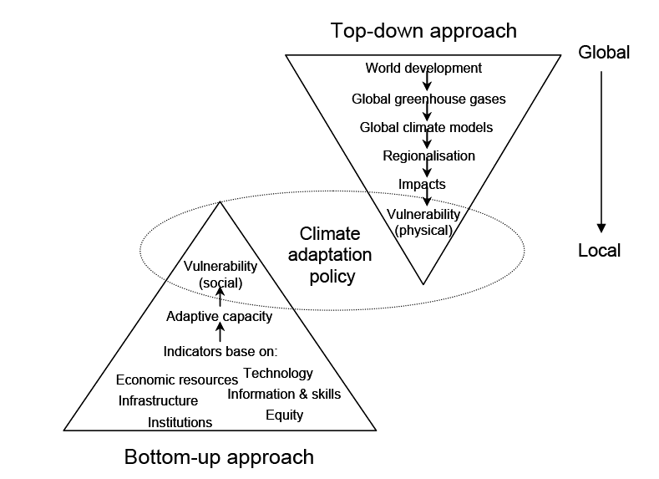
Threshold Analysis Approach
Combination of approaches
Begin with a “Bottom-up” approach – Vulnerability assessment at critical system thresholds
Work at Developing “Top-down” approach to define physical conditions for flood event
Source: Dessai and Hulme, 2003
Notes:
As part of the 2012 Central Valley Flood Protection Plan, a framework for addressing climate change and flood management was introduced. This methodology based on the identification of critical system thresholds and consequences differs from the traditional climate change impacts analysis. This methodology starts with known elements of the flood management system and works from the bottom up to define critical thresholds and identify the hydrology that could cause these thresholds to be exceeded. The methodology also aimed to identify the available information to do a traditional top-down approach of taking climate change projection information data and processing it to develop the necessary hydrologic information to evaluate the identified thresholds. There are still a lot of questions to be answered to be able to fully carry out this top-down approach and work is underway to try to find answers for them for California. Progress will be updated in each subsequent flood plan until a fully executable methodology is available for feasibility and project studies.

Slide 21
Developing a Strategy
Identify target flood peak, volume, and duration
Identify critical thresholds
Identify timing of transition points
Identify adaptive capacity
Identify capital investments needed for present and future conditions
Notes:
Getting back to the topic of coming up with a management strategy for the 200 year level of protection, the following information needs to be included. Some estimate is needed for the target flood peak, volume and duration. In the absence of physical process modeling to generate these estimates, some form of extrapolation of statistics informed by some modeling will be needed. Critical thresholds of management components need to be identified along with the timing of any transitions between components as the flood system is improved. The adaptive capacity of each component is also needed to determine how its use will accommodate climate change modifications to the flood peak, volume, and duration. Finally the capital improvements needed to meet present and future conditions and the timing of their implementation need to be specified.

Slide 22
Adaptive Management for a
Changing Climate
Planning Process and Policy
Monitoring Change
Thresholds, Timing, and Transitions
What About Forecasts?
Notes:
Dealing with climate change includes not only changes to the physical processes but changes to the planning process and policy. It also needs to include a way to monitor change in the watershed to help identify when changes to critical thresholds, timing of improvements or processes, or transitions in the strategy or physical process come into play. Another component not described here, but certainly may play a role in the future is the use of forecasts to assist flood management practices. It is already done on an ad-hoc basis. It may be codified in the future as an element of achieving 200 year level of protection. These forecasts can range from multiple days out to seasons and years in the future.

Slide 23
UNCERTAINTY
Climate Projections
Converting GCM data to watershed scales and event runoff
Water cycle changes
$$$$
Ecosystem response
Future Mandates
Future Watershed Conditions
Adaptation Strategies
Sea level rise
Changes in societal values
Notes:
A huge challenge to this whole process is uncertainty. There is uncertainty in the climate projections and the translation of those projections into water cycle changes and future flood event depictions. There are uncertainties in how the watershed will change and how the ecosystem response will impact flood hydrology. Sea level rise may play a significant role in some locations and will need to be accounted for. A National Research Council study on climate change and sea level rise for the Pacific Coast is due out later this year. This document may help inform the process of incorporating sea level rise into management plans. Changes in societal values, adaptation strategies, and mandates from the State legislature are also possible and contribute a level of uncertainty to the process. There will be work to chip away at these uncertainties as the planning process progresses so stay tuned.

Slide 24
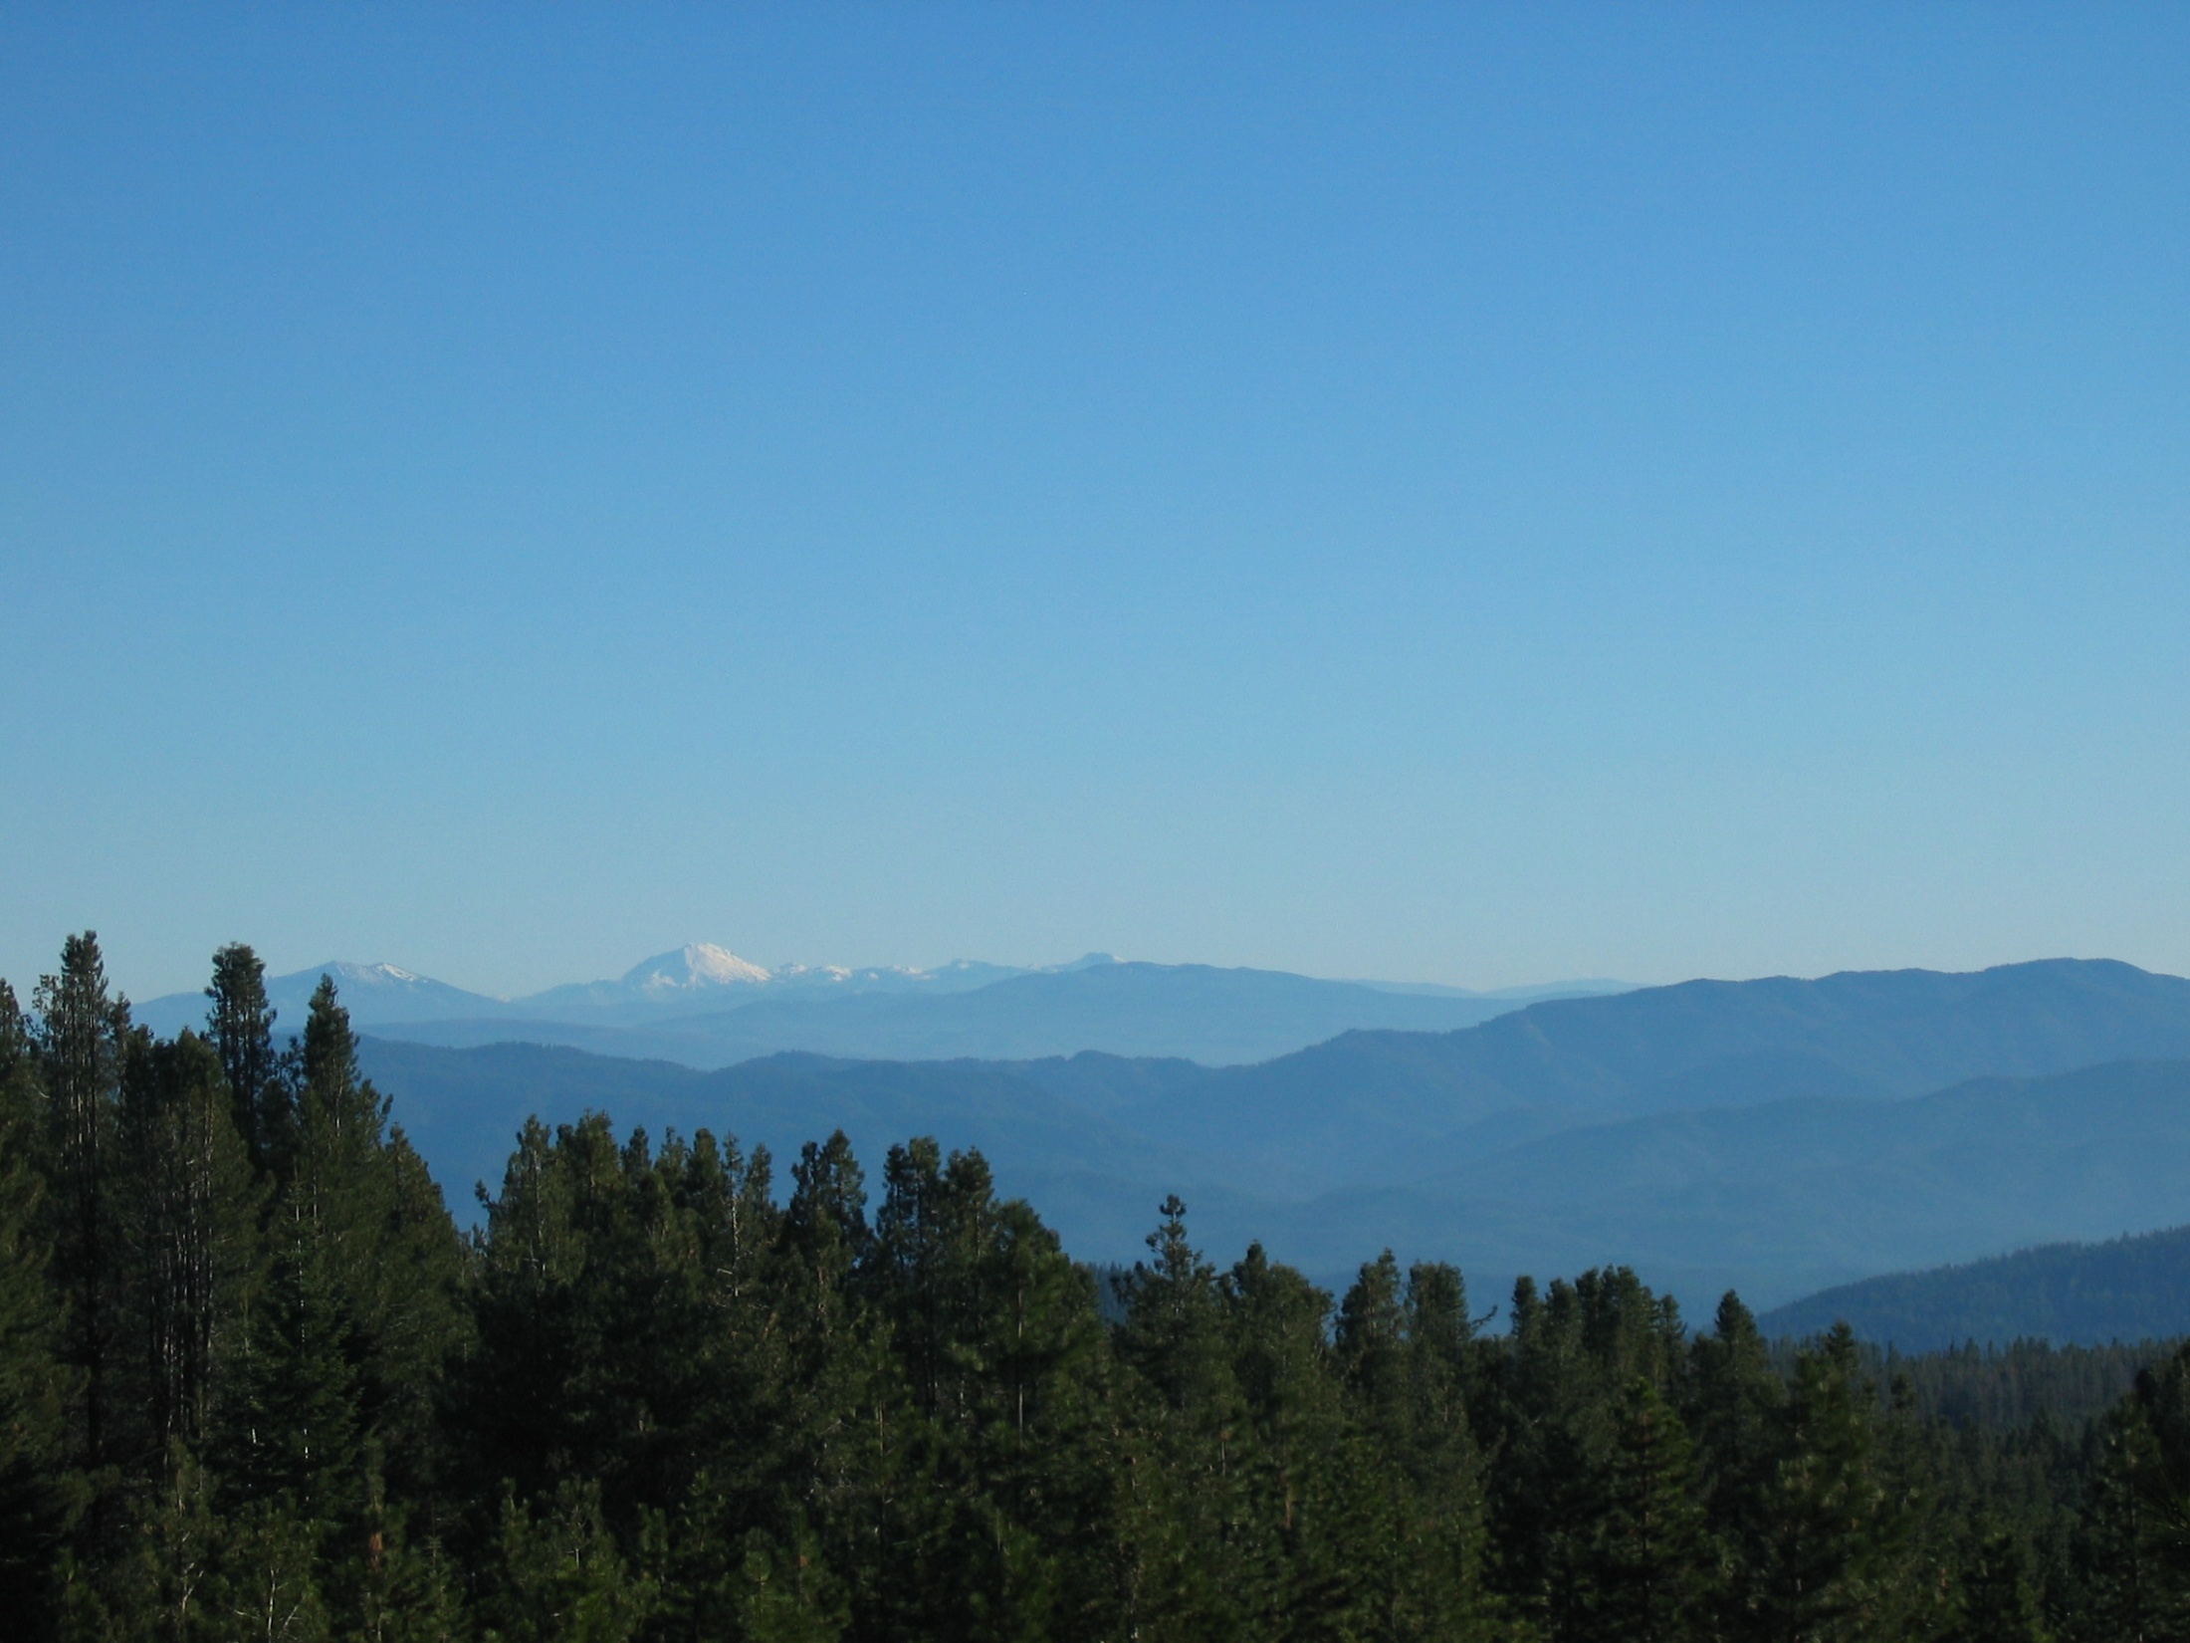
Questions?
Michael Anderson
State Climatologist, California
California Department of Water Resources
manderso@water.ca.gov

