Slide 1
Irene as viewed from the International Space Station on 22 August 2011. Photo credit: Ron Garan
Notes:
http://www.nasa.gov/multimedia/imagegallery/image_feature_2043.html

Slide 2
Tropical Storm Irene - A synoptic view of the new flood of record
Dr. Lesley-Ann Dupigny-Giroux
Associate Professor of Climatology – University of Vermont
VT State Climatologist
AASC Annual Meeting - Destin, FL - 11 July 2012

Slide 4
Direction of motion is important

Slide 5
Irene’s winds and rain
27 August 2011
http://www.nnvl.noaa.gov/MediaDetail.php?MediaID=818&MediaTypeID=1
Notes:
http://www.nnvl.noaa.gov/MediaDetail.php?MediaID=818&MediaTypeID=1
http://www.nnvl.noaa.gov/MediaDetail.php?MediaID=818&MediaTypeID=1

Slide 6
Heavy rainfall from Irene
Credit: Northeast Regional Climate Center

Slide 7
Irene’s storm track & VT rainfall

Slide 8
Why are hurricanes so dangerous? Associated hazards
winds (beach erosion, property damage, large waves)
intense rainfall - rates of metres/day
storm surge
winds & storm surge most intense to right of hurricane
sum of wind speed and storm speed
tornadoes
inland flooding
Photo credit: D. Koopman
Notes:
Intensity (category) has a lot to do with surge height. Cat 5 has highest wind velocity to drive water onland and lowest pressure enabling water to stack higher in front of the hurricane with little resistance from atmospheric pressure.
- Concave shorelines increase surge because water forced to concentrate near centre. Same for bays and river mouths.
- Shallow bathymetry adds to surge height because with less depth, wave height is higher. Shallow waves form steeper slope making them higher and moving more water onshore (Bascom, 1980)

Slide 9
Vermont flooding

Slide 10
General causes of flooding in Vermont
deep snow cover
frozen ground
saturated soil
full reservoirs
existing bankfull conditions
ice-covered rivers
widespread, heavy rain
topography
ground cover

Slide 11
Role of topography

Slide 12
Flooding is enhanced by…
topography
air is funneled
orographic uplift along the Greens
RICHFORD
JAY PEAK

Slide 13
Tropical storm related flooding
consecutive movement of large storms over the same area
antecedent wet soil conditions (additional precipitation runs off since the soil is saturated)
influence of hurricane/tropical storm remnants
November 1927
August 1955 (Connie, Danny)
June 1972 (Agnes)
August 1998 (Bonnie)
September 1999 (Dennis, Floyd)
August 2011 (Irene)

Slide 14
History of major hurricanes in New England – (3-5)

Slide 15
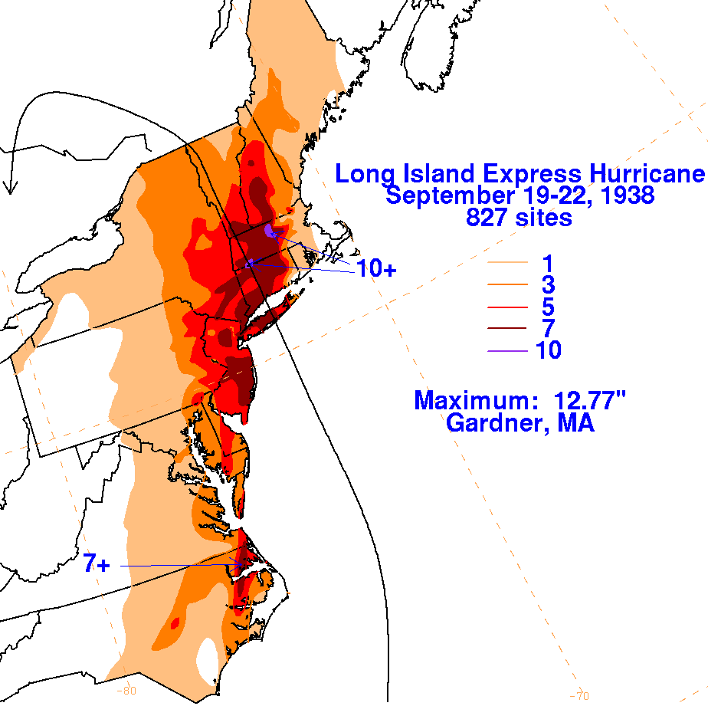
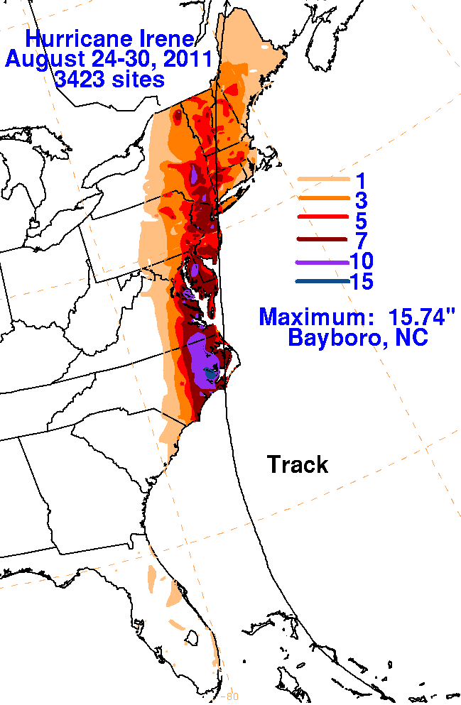
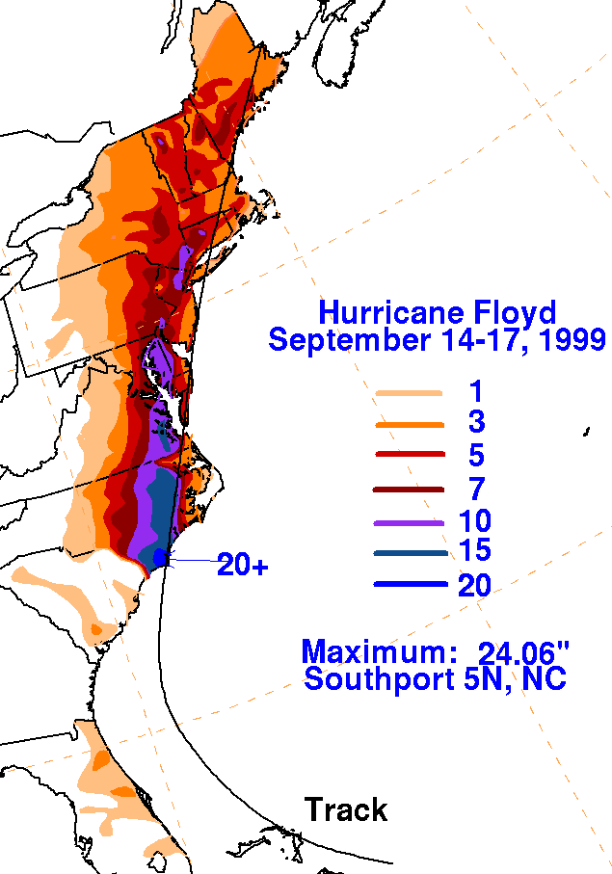
Courtesy: NOAA

Slide 16
Total precipitation in 2011

Slide 18
Departure from 1981-2010 average (aka normal) values

Slide 20
Importance of soil moisture
NOAA

Slide 21
North vs. south Vermont
southern flash flooding
northern riverine flooding

Slide 22
Flash flooding

Slide 23
Riverine flooding
long term event over the course of a week or more

Slide 24
Vermont damage from Digital Globe

Slide 25
Vermont damage from Digital Globe

Slide 26
Vermont damage from Digital Globe

Slide 27
Take-home message
Geography matters
topography matters
storm track influences precipitation, winds, storm surge
beware of the inland flooding potential
antecedent conditions are important

Slide 28
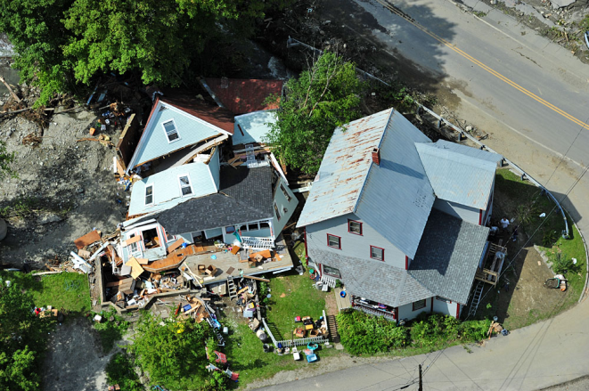
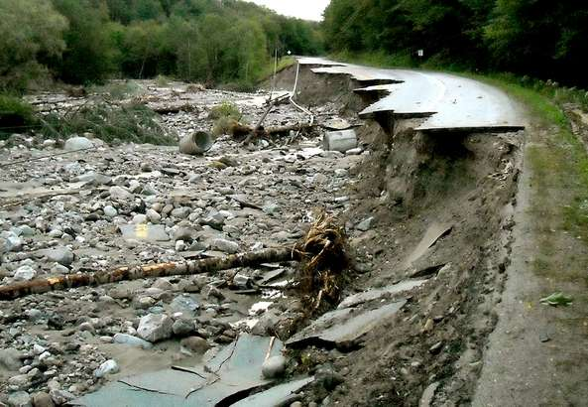
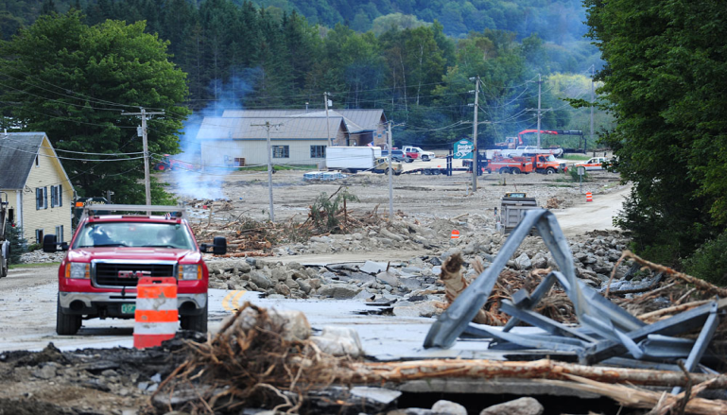
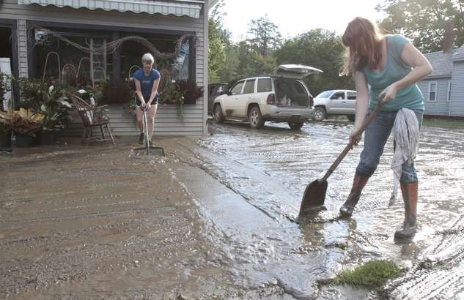
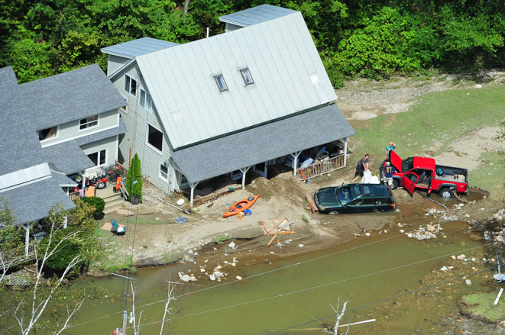
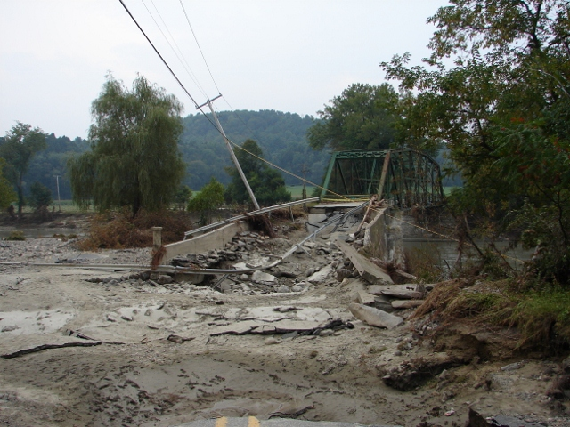
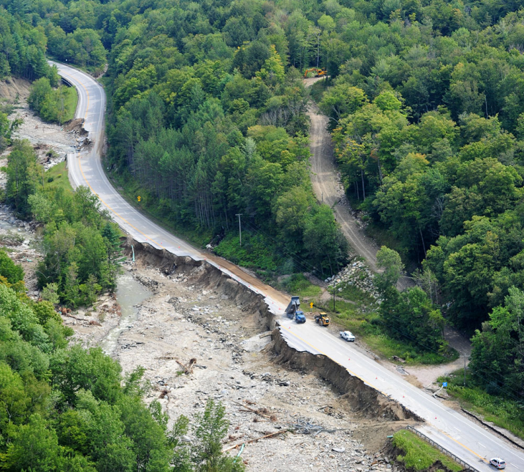
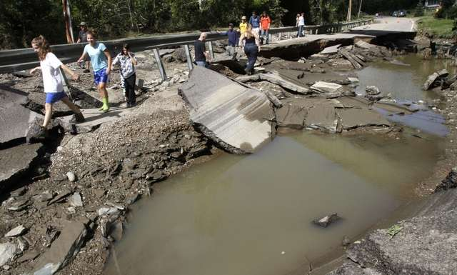
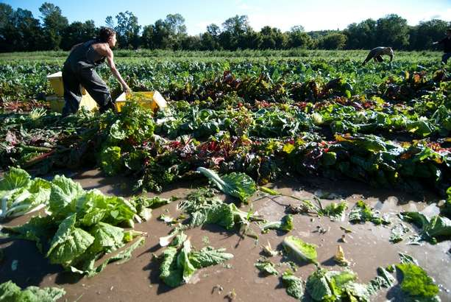
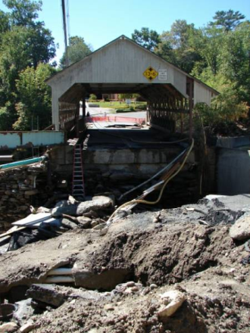
IRENE 2011 Flood Aftermath (Paul Sisson – NWS/BTV)
Photos courtesy of BTV Free Press and Mansfield Heliflight

