Slide 1

Diffusing Scientific Climate Information for Agriculture Management
American Association of State Climatologists
Annual Meeting, Miramar Beach, Florida
July 11, 2012
Adam K. Wilke
Department of Sociology
Iowa State University

Slide 2
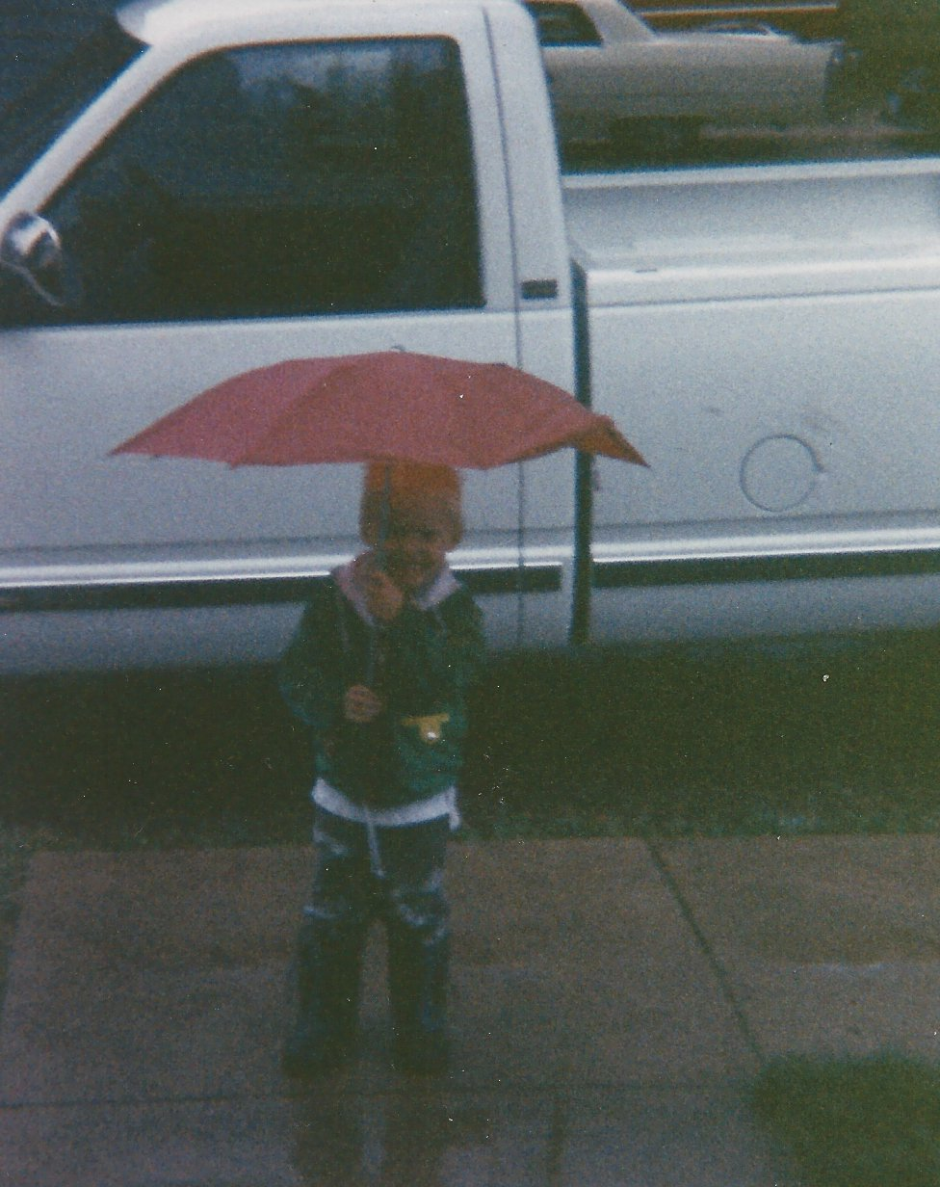

Slide 3
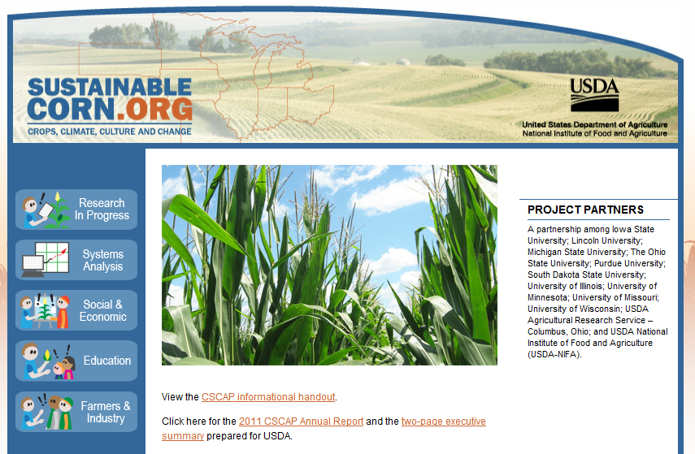
Source: http://www.sustainablecorn.org

Slide 4
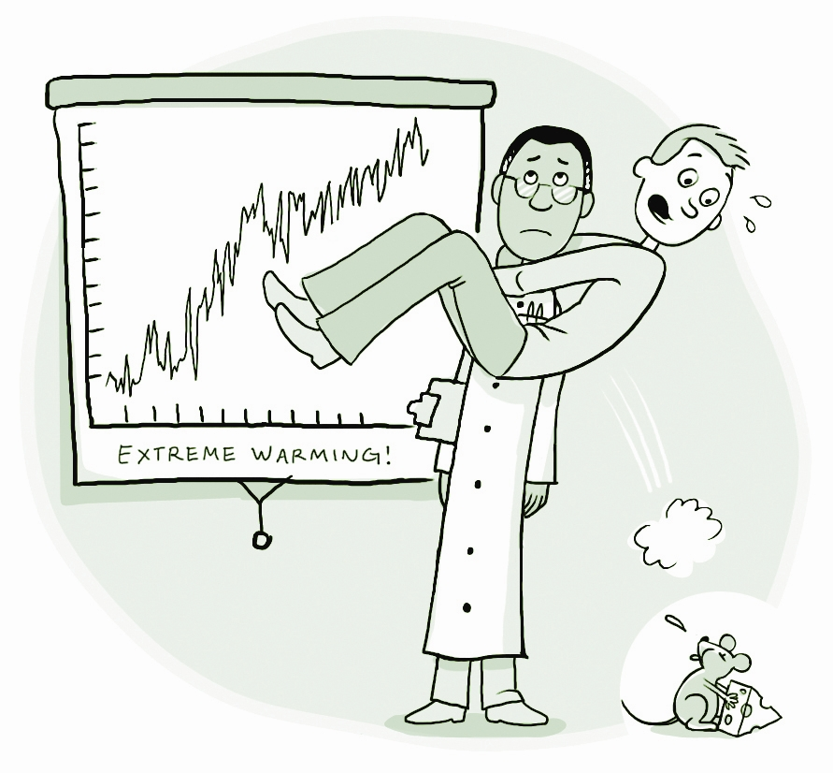
Source: Erich Nagler, Center for Research on Environmental Decisions. http://guide.cred.columbia.edu/

Slide 5
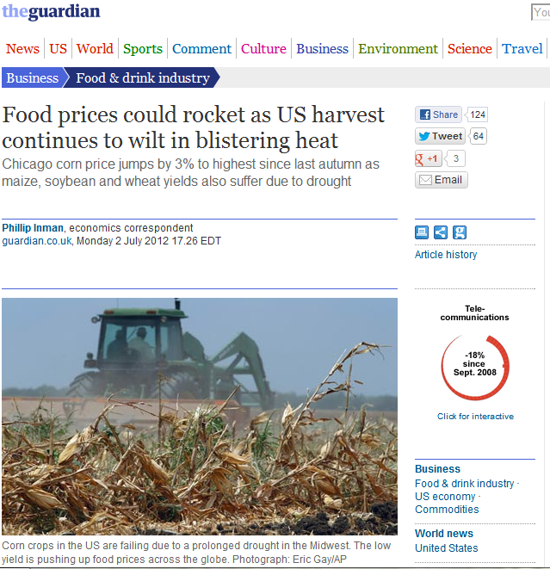
Source: http://www.guardian.co.uk/business/2012/jul/02/food-prices-rocket-us-harvest?newsfeed=true

Slide 6

Advance Science: Advance scientific knowledge of the integrated natural and human components of the Earth system, drawing upon physical, chemical, biological, ecological, and behavioral sciences.
Inform Decisions: Provide the scientific basis to inform and enable timely decisions on adaptation to and mitigation of global change.
Conduct Sustained Assessments: Build a sustained assessment capacity that improves the Nation’s ability to understand, anticipate, and respond to global change impacts and vulnerabilities.
Communicate and Educate: Broaden public understanding of global change and support the development of a scientific workforce skilled in Earth-system sciences.
Source: The National Global Change Research Plan 2012-2021, http://www.usda.gov/oce/climate_change/files/USGCRP/Factsheet_Strat-Plan.pdf

Slide 7
Stages of Scientific Communication
1. All we have to do is get the numbers right
2. All we have to do is tell them the numbers
3. All we have to do is explain what we mean by the numbers
4. All we have to do is show them that they’ve accepted similar risks in the past
5. All we have to do is to show them that it’s a good deal for them
6. All we have to do is treat them nice
7. All we have to do is make them partners
Source: Fischhoff (1995)

Slide 8
Research Question
What is the role of Climatologists in diffusing scientific climate information for use in developing agriculture management decision support tools for grain producers in the North Central Region of the United States?

Slide 9
Methods
Interviews with 22 Climatologists
  11 State Climatologists
  11 Extension and Regional Climatologists
Survey
  19 Responses

Slide 10
Survey
In your opinion, what proportion of farmers in your state believes that climate is changing?

Slide 11
Survey
There is increasing discussion about climate change and its potential impacts. Please select the statement that best reflects your beliefs about climate change.

Slide 12
Survey
Please indicate how influential you think the following groups and individuals are to producers when they make decisions about agricultural practices and strategies.
Notes:
1 – 4 scale, 1 being no influence, 4 being strong influence

Slide 13
Survey
From your experience, how much do the following types of information influence farmers’ decisions?
Notes:
1 – 5 scale, 1 being low, 5 being high

Slide 14
Interview Initial Themes
“A couple of things you need to understand about farmers: First, there aren’t any dumb ones. If there was ever such a thing as the old dumb farmer, they’ve been out of business now for decades….
And they’ll decide if they want to be impressed with what you’ve got to teach. You don’t have to impress them. You’re not dealing with a fourth grader. You’re dealing with a very intelligent person when you deal with farmers.” –EC #3

Slide 15
Initial Themes - Objectivity
“We want to be always seen as an impartial deliverer of climate data, data that people can trust, and know it was not provided by somebody with an agenda.” -SC #4
“I try to make it as apolitical as possible, nonpolitical, apolitical and just show the facts, the data, the information and let folks come up with their own decision or assessment on what they think might be happening.” –SC #5

Slide 16
Initial Themes - Trust
“It seems like farmers will make decisions based off of what other farmers are doing or what like their family members are doing, even if the experts are telling them otherwise. It kind of seems like, oh, well, I saw my neighbor already starting to plant, so maybe I should plant early too.” -SC #2
“I’ve actually had people call in and ask me what the Farmers’ Almanac forecast is....It could be that their parents used it, and their parents’ parents used it. I mean, that thing’s been around a long time.” -SC #9

Slide 17
Initial Themes – Citizen Science
“Typically the citizen of the world does not understand very much about the importance of the stratosphere; they just know it’s a part of our atmospheric structure, and that’s about all you learn in school.” -RC #1
“Likely we as public citizens are going to have to make some really challenging decisions in the future – what, if anything, to do about climate change. We have to be informed. We have to be educated about those. We can’t afford to be ignorant.” -SC #11

Slide 18
Phases of Communication
1. All we have to do is provide objective information (Stages 1-3)
“In a scientific process, we will not simply say ‘yes.’ We will go through the reasoning and say ‘these are the indicators, these are the question, these are the answers we say yes, and therefore we conclude “yes.”’ To assume that common individuals will have that leap of faith, or that synthesis, is expecting too much.” -SC #10

Slide 19
Phases of Communication
2. All we have to do is make the information relevant (Stages 4-5)
“We look at the most relevant models, whether they’re ENSO-based, atmospheric patterns—we try to identify what’s going on and try to project that type of pattern as we move to the growing season to give the producers a risk assessment.” - SC#5

Slide 20
Phases of Communication
3. All we have to do is translate the message through a trusted source (Stages 6-7)
“I think it needs to come from, or have the branding of, somebody that they trust. And I think university extension would probably be a good one. Because they’re local agents, they live in the same communities, they interact with these producers on a regular basis, so that familiarity is important, I would think.” -SC #7

Slide 21
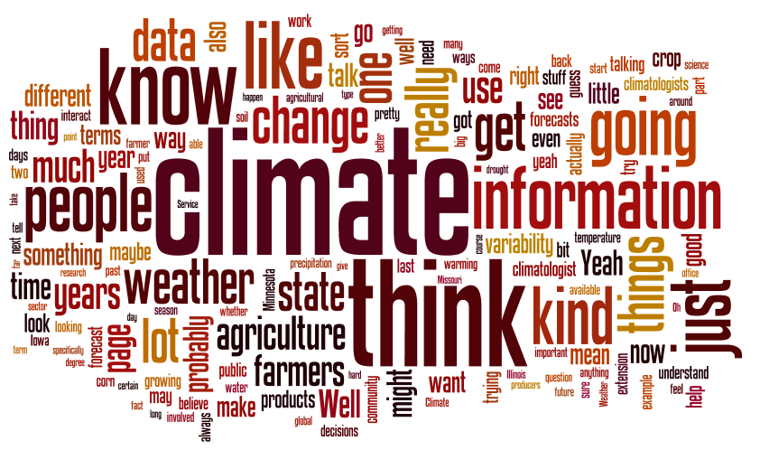
Source: http://www.wordle.net

Slide 22
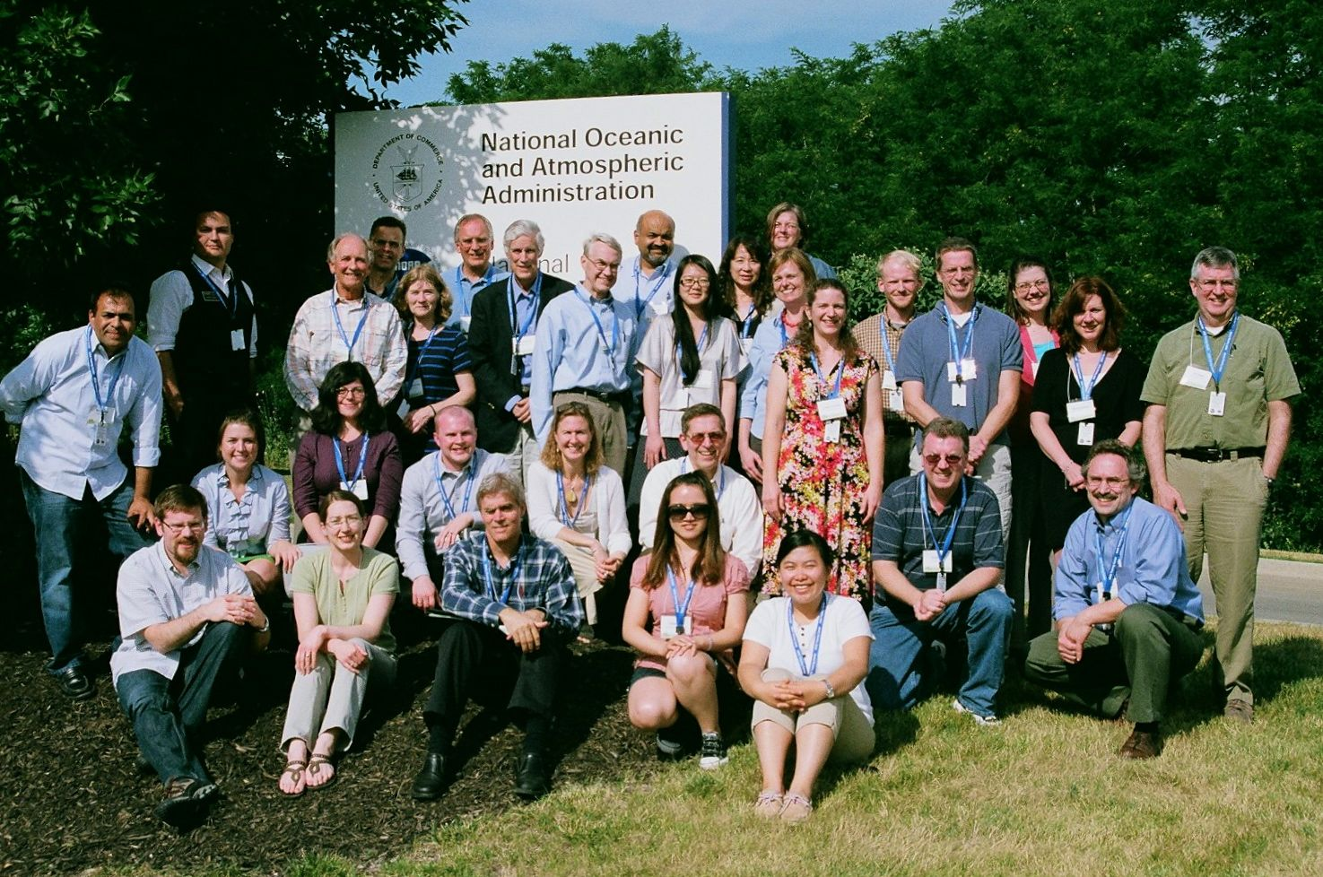
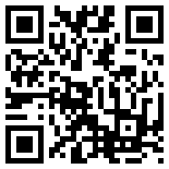
Thank you!
Purdue University: Linda Prokopy (Lead), Corinne Alexander, Larry Biehl, Otto Doering, Bruce Erickson, Ani Elias, Sajeeve E.M., Patrick Freeland, Ben Gramig, Olivia Kellner, Xing Liu, Amber Mase, Dev Niyogi, Paul Preckel, Carol Song, Melissa Widhalm, Lan Zhao
Iowa State University: Roger Elmore, Chad Hart, Jean McGuire, Lois Wright Morton, Gene Takle, Adam Wilke
Michigan State University: Gopal Alagarswamy, Jeff Andresen, Jim Hilker, Mike Holp
South Dakota State University: Dennis Todey
University of Illinois: Jim Angel, Beth Hall, Steve Hilberg, Atul Jain
University of Michigan: Yun-Jia Lo, Maria Lemos, Jennifer Perron
University of Minnesota: Tom Bartholomay, Whitney Meridith
University of Missouri: Pat Guinan, Ray Massey
University of Nebraska-Lincoln: Juliana Dai, Tonya Haigh, Cody Knutson, Tapan Pathak, Martha Shulski
University of Wisconsin: Tom Blewett, Rebecca Power, John Kriva
http://www.AgClimate4U.org
This project is supported by Agriculture and Food Research Initiative Competitive Grant no. 2011-68002-30220 from the USDA National Institute of Food and Agriculture.

Slide 23
Citations
Adger, W.N., Desssai, S., Foulden, M., Hulme, M., Lorenzoni, I., Nelson, D.R., Naess, L.O., Wolf, J., & Wreford, Anita. (2009). Are there social limits to adaptation to climate change? Climatic Change, 93, 335-354.
Field, C.B., L.D. Mortsch,, M. Brklacich, D.L. Forbes, P. Kovacs, J.A. Patz, S.W. Running & M.J. Scott. (2007). North America, Climate Change 2007: Impacts, Adaptation and Vulnerability. Contribution of Working Group II to the Fourth Assessment Report of the Intergovernmental Panel on Climate Change, M.L. Parry, O.F. Canziani, J.P. Palutikof, P.J. van der Linden and C.E. Hanson, Eds., Cambridge University Press, Cambridge, UK, 617-652.
Fischhoff, B. (1995). Risk perception and communication unplugged: Twenty years of progress. Risk Analysis, 15, 137–45.
Pidgeon, N., & Fischhoff, B. (2011). The role of social and decision sciences in communicating uncertain climate risks. Nature Climate Change, 1(1), 35-41.
Weber, E. U., & Stern, P. C. (2011). Public understanding of climate change in the United States. The American Psychologist, 66(4), 315-328.

