Slide 1

Climate change concerns, beliefs, and information needs of agricultural advisors in the Midwestern United States

Slide 2
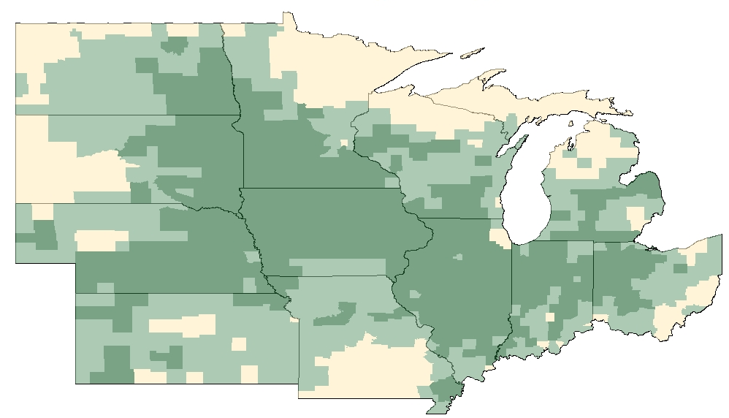

U.S. Corn Belt
One-third of global corn supply
Over $100B to US economy

Slide 3
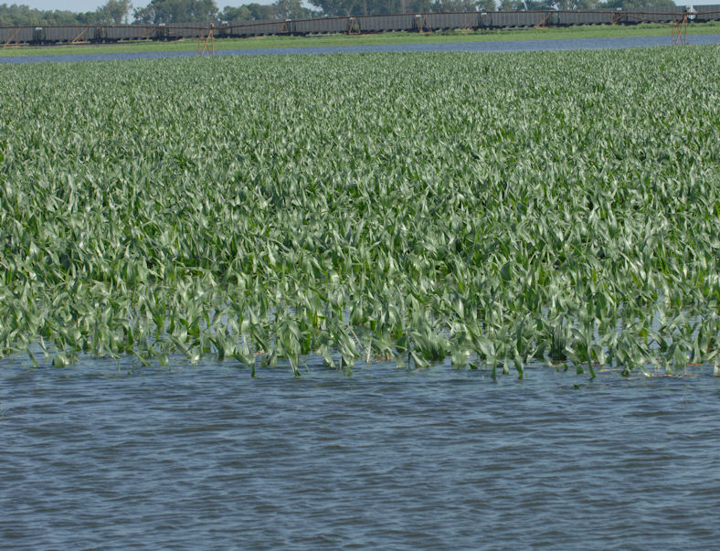
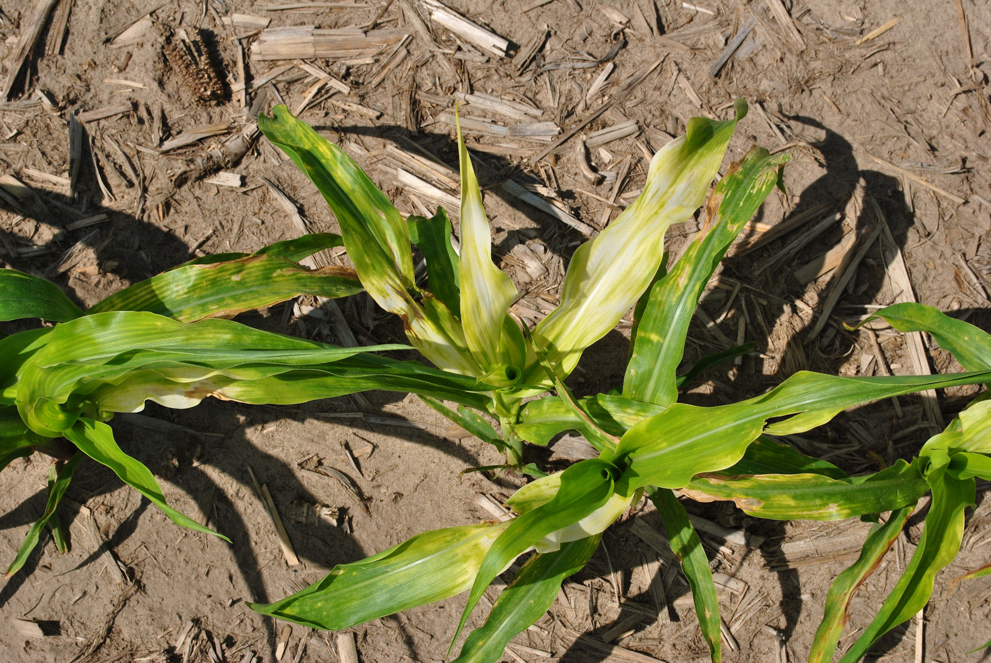
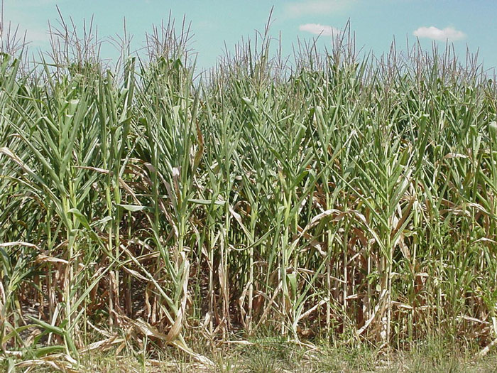
The Problem
Corn Belt crop production highly dependent on favorable temperatures and appropriate precipitation patterns
Climate variability limits season-to-season predictability and lessens ability to maintain viable farm operations
Producers need enhanced information for decision making

Slide 4
Project Vision
Transform existing climate information into usable knowledge
Give farmers and their advisors the resources and training to more effectively manage variable climate conditions
Increase Extension capacity to address agro-climate needs
More resilient and profitable farms in a changing climate!

Slide 5












Collaborators
State climatologists
Crop modelers
Agronomists
Economists
Social scientists
RCC staff

Slide 6
Objectives – Five Year Plan
Examine impacts of past/future climate on crop productivity and implications for farm management
Understand stakeholder needs
Design decision support tools and prepare training materials and delivery approaches
Pilot test tools, methods and outreach
Disseminate across 12 state region
Not clear yet what resources will be needed!

Slide 7
Current Social Science Tasks
Survey producers and advisors about climate change perceptions and information needs
  19,000 farmers in 22 Midwestern watersheds (in conjunction with CS-CAP)
  7,000 advisors in 4 pilot states
  21 climatologists in the north central US
  Native American farmers
Determine how climate information flows through agricultural communities using network analysis
Farmer and advisor focus groups / learning communities

Slide 8
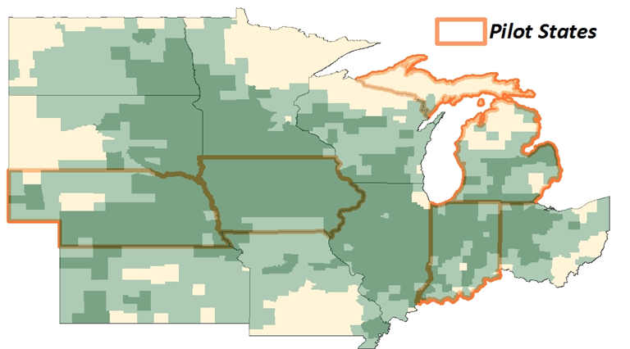
Advisor Survey
Web-based survey distributed to 7,000+ advisors
  All identified advisors in 4 pilot states
  Extension in 12 states
-- Crop consultants
-- Extension
-- Ag bankers and lawyers
-- Agro-business retailers
-- Trade organizations
-- USDA employees
-- State conservation districts
-- State Ag department

Slide 9
Question Topics
  Type and timing of farm management strategies
  Influence/use of weather and climate information in decision making
  Climate change concerns and beliefs
  Influential information sources
Survey Deployed
March 2012

Slide 10
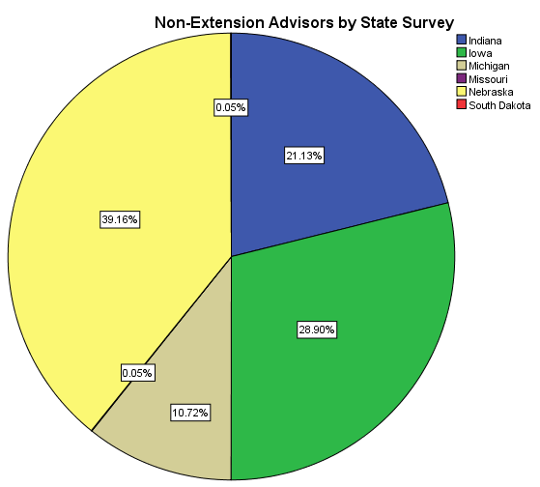
Who Responded?
Number of Responses = 2530
Indiana 508
Iowa 664
Michigan 264
Nebraska 904
Minnesota Ext. 9
Missouri Ext. 43
Kansas Ext. 34
Illinois Ext. 9
North Dakota Ext. 18
Ohio Ext. 35
South Dakota Ext. 16
Wisconsin Ext. 26
28.6% overall response rate
(could not be calculated for IA or SD).

Slide 11
Types of Advice
75.2% of survey takers said they provide advice to corn producers, and went on to complete the survey
Types of advice provided to corn producers?
 | % Checked
Conservation practices | 50.7
Agronomic (seed, crop inputs, crop management services) | 43.9
Financial | 29.2
Daily management (i.e. scouting for disease or insects) | 28.4
Marketing | 19.3
Equipment | 16.8
Full farm management | 8.4
Other* | 18.8

Slide 12
Beliefs about Climate Change
There is increasing discussion about climate change and its potential impacts. Please select the statement that best reflects your beliefs about climate change.
 | Advisors
Climate change is occurring, and it is caused mostly by natural changes in the environment…………………………………………………… | 24.9%
Climate change is occurring, and it is caused mostly by human activities………………. | 12.6%
Climate change is occurring, and it is caused equally by natural changes in the environment and human activities……………………… | 37.0%
Climate change is not occurring………………………………… | 2.3%
There is not sufficient evidence to know with certainty whether climate change is occurring or not………………………………...... | 23.3%

Slide 13
Influence of Weather/Climate Info
In general, how much do the following types of weather information influence the advice you give to corn producers? (no-low-moderate-strong influence)

Slide 14
Use of Decision Support Resources
Do you use any of the following weather-related decision support resources?
Do you pay for any weather information (beyond basic internet, satellite, or cable service fees)? (n=1807)
Yes………… 4.8%
No…………. 95.2%

Slide 15
Potential Uses of Weather/Climate Info
Corn producers can use historical weather and/or trend forecasts to… (Please check all that apply) (n=1731)

Slide 16
Decisions Using Weather/Climate Info
Top Four Advisor Decisions Influenced by Weather/Climate Information
Timing of nitrogen application (n=1040) | 70.6%
Planting or harvest schedule (n=929) | 66.3%
Adoption of conservation practices (not including drainage) (n=1246) | 63.3%
Integrated pest management practices (n=1003) | 61.9%
Top Decision that Could be Influenced with Better Information
Use of cover crops (n=1063) 18.6%

Slide 17
Issues of Concern
How concerned are you about the following potential problems for corn production in your area?
Percent “concerned” + “very concerned” by state
 | Floods | Droughts | Weeds | Insects | Disease | Rain | Ponding | Heat | Nutrient Loss | Erosion
Indiana | 53.2 | 78.6 | 57.2 | 53.4 | 47.1 | 70.7 | 63.9 | 70.8 | 63.1 | 66.9
Iowa | 42.3 | 66.5 | 60.7 | 52.2 | 50.4 | 58.3 | 40.7 | 50.4 | 57.0 | 63.2
Michigan | 32.9 | 66.3 | 59.0 | 58.3 | 57.7 | 54.2 | 45.5 | 53.2 | 61.2 | 56.6
Nebraska | 26.6 | 74.8 | 52.0 | 50.0 | 49.3 | 38.6 | 23.0 | 54.9 | 44.2 | 57.6
All | 37.9 | 71.8 | 57.7 | 52.9 | 49.7 | 53.0 | 40.3 | 56.3 | 53.8 | 61.3
Highlighted numbers = top three concerns in each state

Slide 18
Interest and Ability to Use Climate Forecasts
Please indicate your level of agreement with each of the following statements.
 | Disagree/Strongly Disagree | Uncertain | Agree/Strongly Agree
 | — Percentage —
Changing practices to cope with increasing climate variability is important for the long-term success of the farmers I advise (n=1730) | 8.0 | 27.5 | 64.6
I would like to provide advice based on climate forecasts (n=1696) | 22.6 | 45.1 | 32.3
I am confident in my ability to apply weather forecasts and information in my crop related advice (n=1669) | 22.7 | 40.9 | 36.4

Slide 19
Most/Least Trusted Info Sources
Thinking about the following agencies, organizations, and groups, how much do you trust or distrust them as sources of information about climate change and its potential impacts?
Most Trusted
University Extension 81.1%
Scientists 69.6%
Most Distrusted
Mainstream news media 64.9%
Online social media (blogs, Twitter, etc.) 64.4%
Radio talk show hosts 63.1%

Slide 20
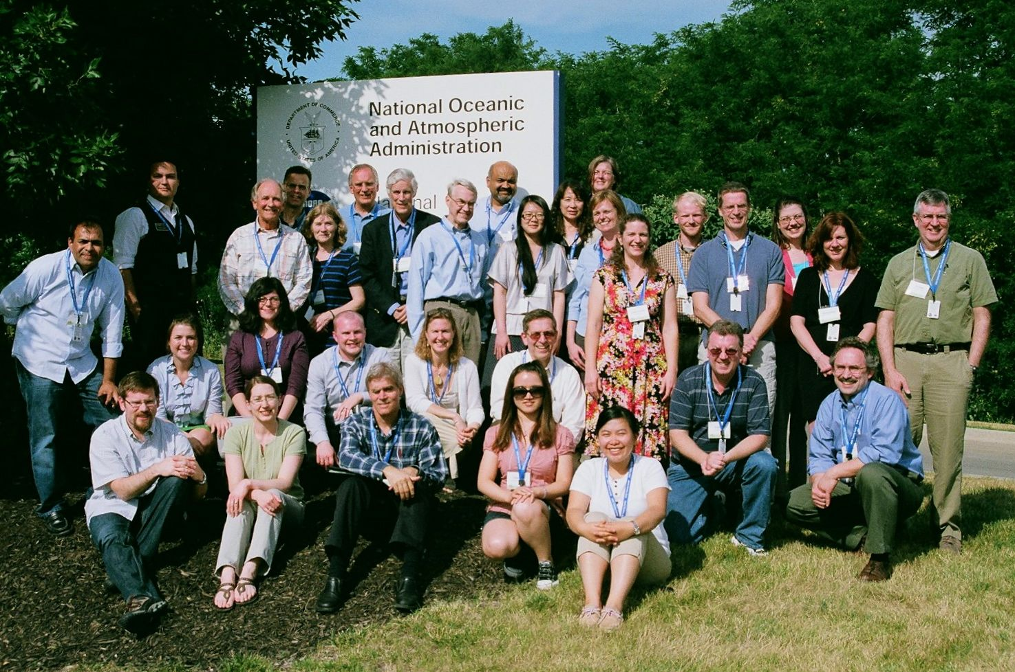
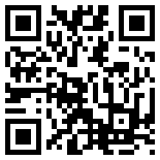
Thank you!
Purdue University: Linda Prokopy (Lead), Corinne Alexander, Larry Biehl, Otto Doering, Bruce Erickson, Ani Elias, Sajeeve E.M., Patrick Freeland, Ben Gramig, Xing Liu, Amber Mase, Dev Niyogi, Paul Preckel, Carol Song, Melissa Widhalm, Lan Zhao
Iowa State University: Roger Elmore, Chad Hart, Jean McGuire, Lois Wright Morton, Gene Takle, Adam Wilke
Michigan State University: Gopal Alagarswamy, Jeff Andresen, Jim Hilker, Mike Holp
South Dakota State University: Dennis Todey
University of Illinois: Jim Angel, Beth Hall, Steve Hilberg, Atul Jain
University of Michigan: Yun-Jia Lo, Maria Lemos, Jennifer Perron
University of Minnesota: Tom Bartholomay, Whitney Meridith
University of Missouri: Pat Guinan, Ray Massey
University of Nebraska-Lincoln: Juliana Dai, Tonya Haigh, Cody Knutson, Tapan Pathak, Martha Shulski
University of Wisconsin: Tom Blewett, Rebecca Power, John Kriva
http://www.AgClimate4U.org
This project is supported by Agriculture and Food Research Initiative Competitive Grant no. 2011-68002-30220 from the USDA National Institute of Food and Agriculture.

