Slide 1
Optimum Big Rain Indicator of Extremes for the Southeast USA
Presented by: Jim O’Brien
Collaborators: Preston Leftwich and David Zierden
COAPS, The Florida State University

Slide 2
Hurricanes and Tornadoes are Categorical
Hurricanes
Saffir-Simpson Scale
Category Wind Speed
Cat 1 74-95 mph
Cat 2 96-110 mph
Cat 3 111-130 mph
Cat 4 131-155 mph
Cat 5 > 155 mph
Tornadoes
Enhanced Fujita Scale
Category Wind Speed
EF0 65-85 mph
EF1 86-110 mph
EF2 111-135 mph
EF3 136-165 mph
EF4 166-200 mph
EF5 > 200 mph
Both scales are based on damage potential.

Slide 3
Gamma Distribution
Alpha > 1.0
Gamma Function
Generalized Gamma
pdf
Alpha < 1.0

Slide 4
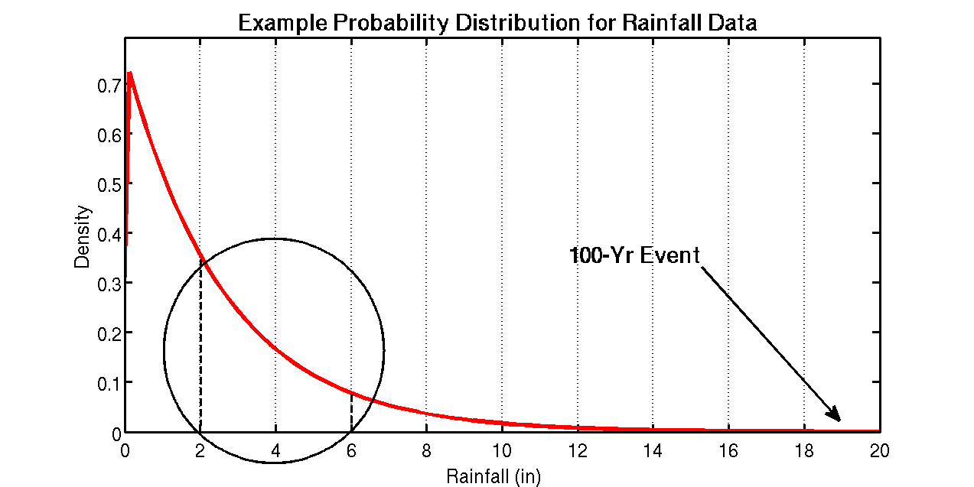

Slide 5
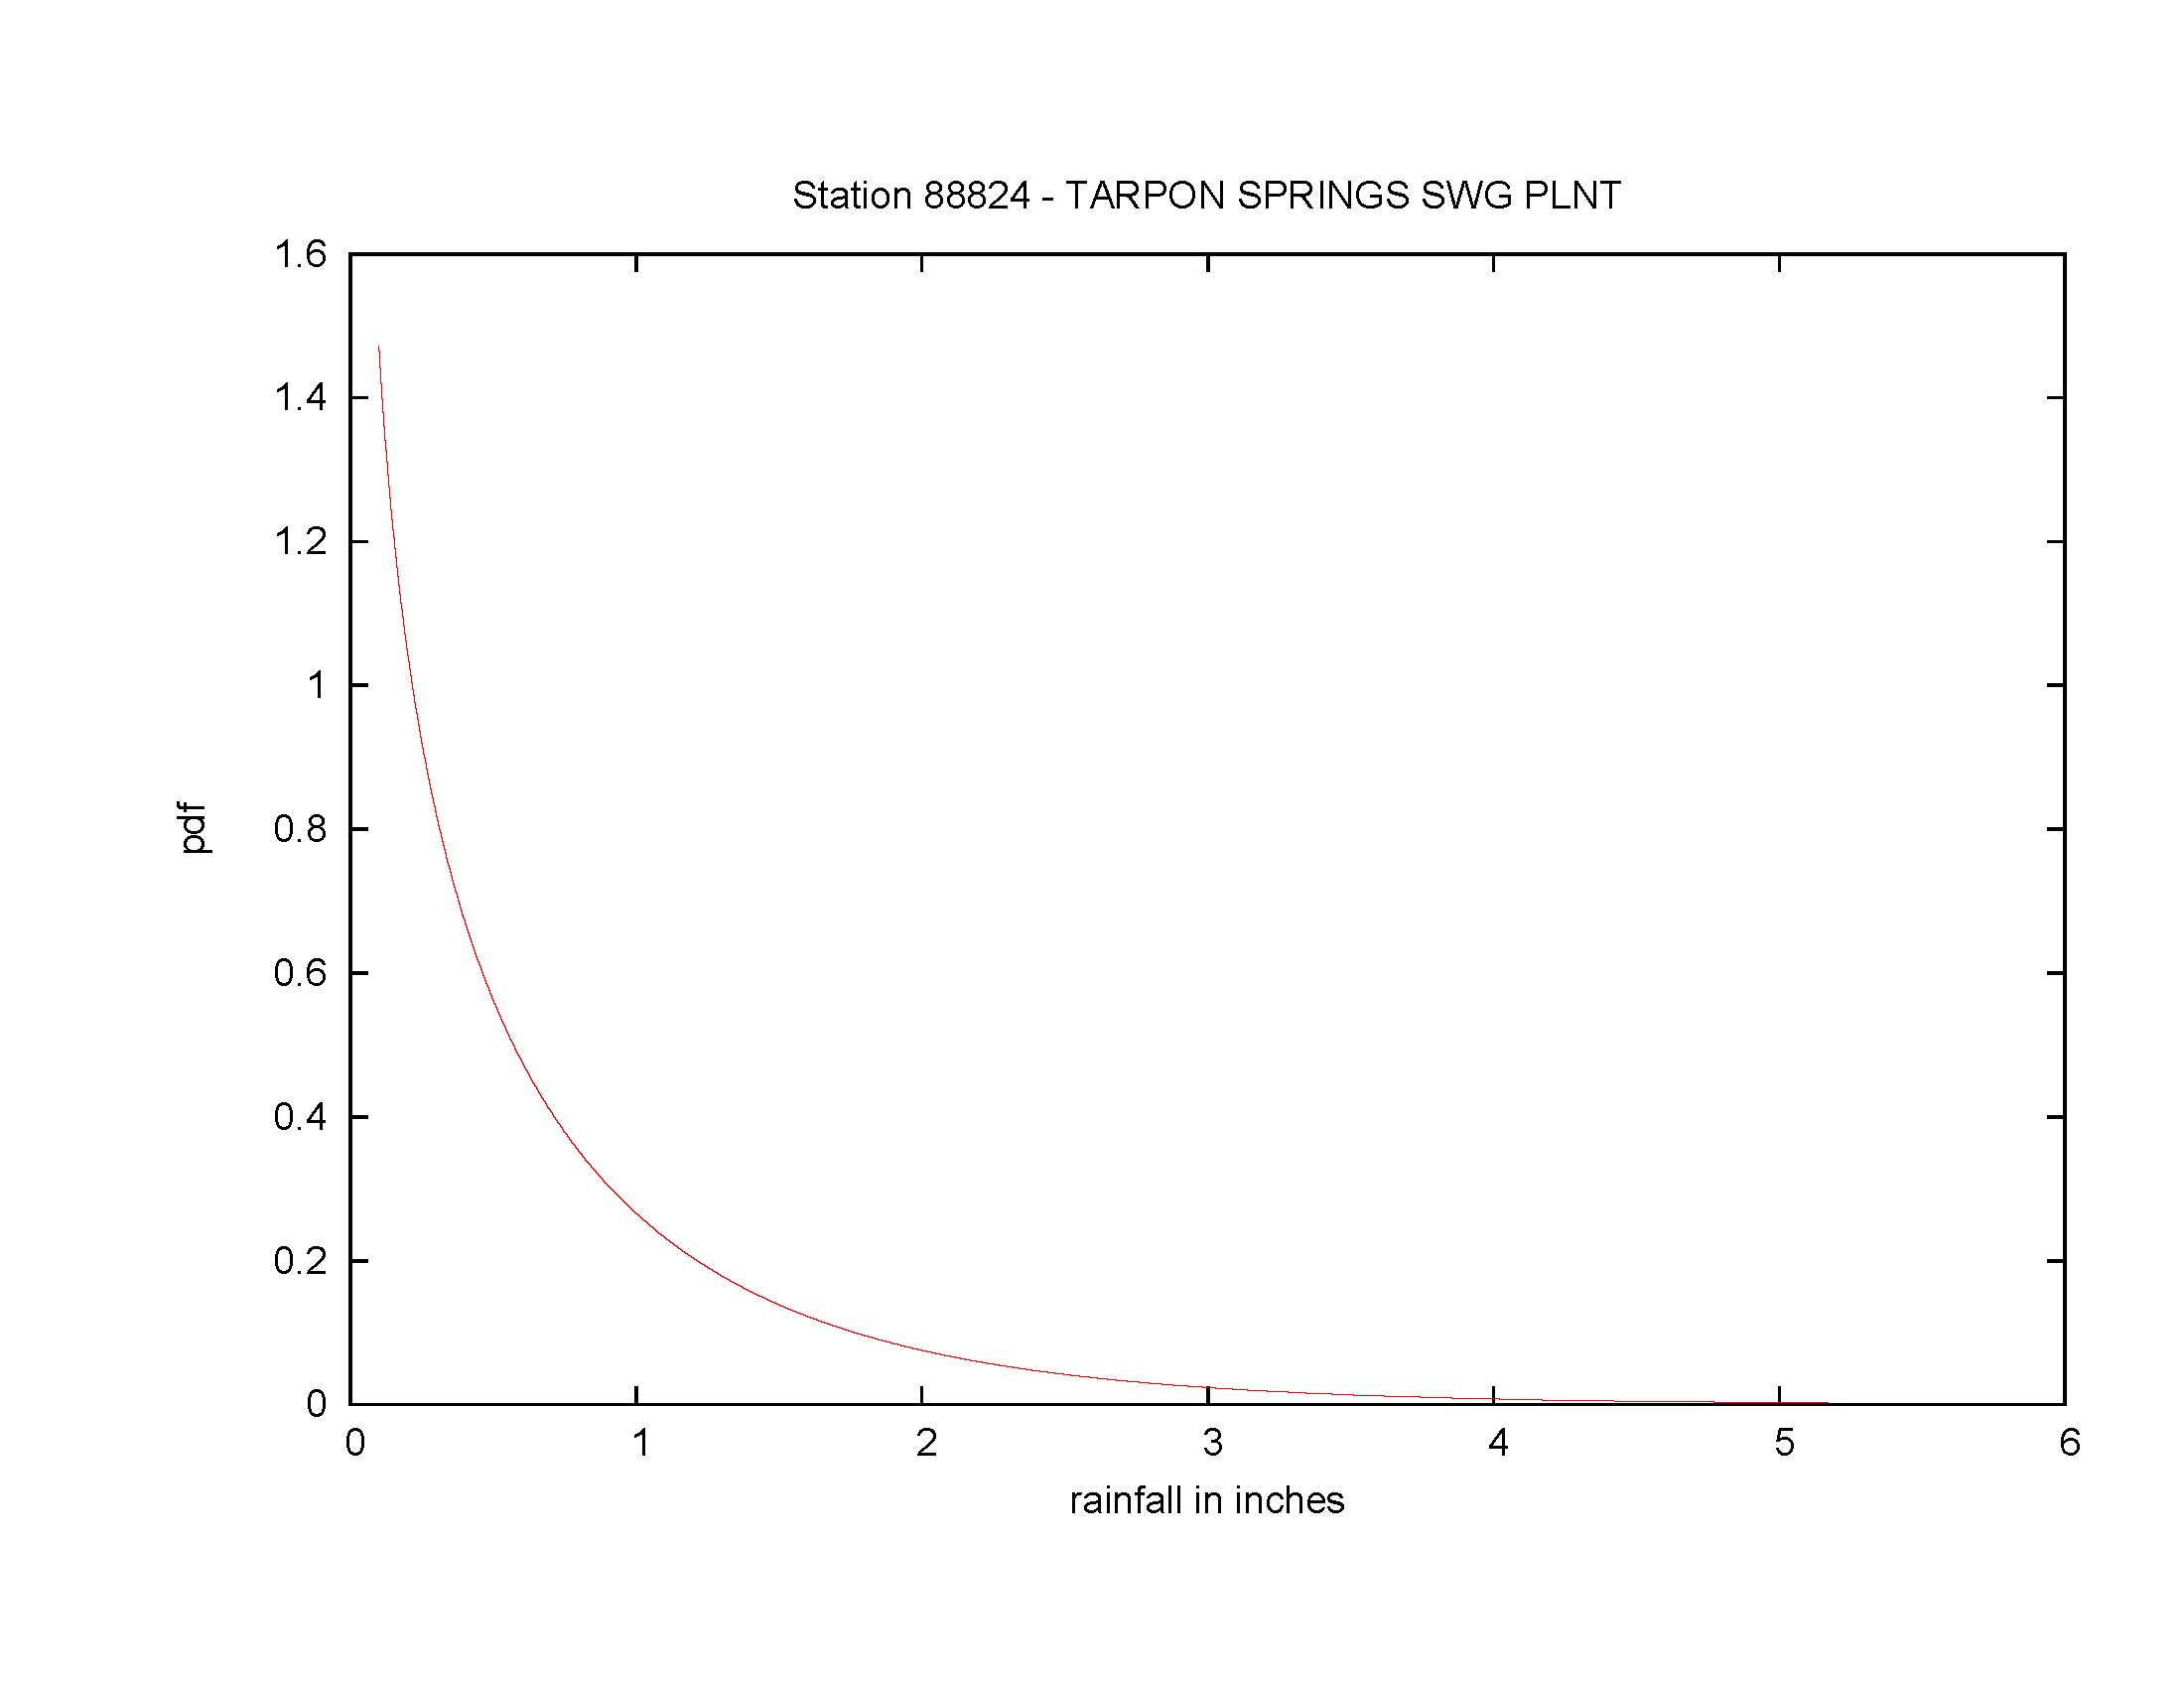
Rainfall Events Fitted to a Gamma Distribution

Slide 6
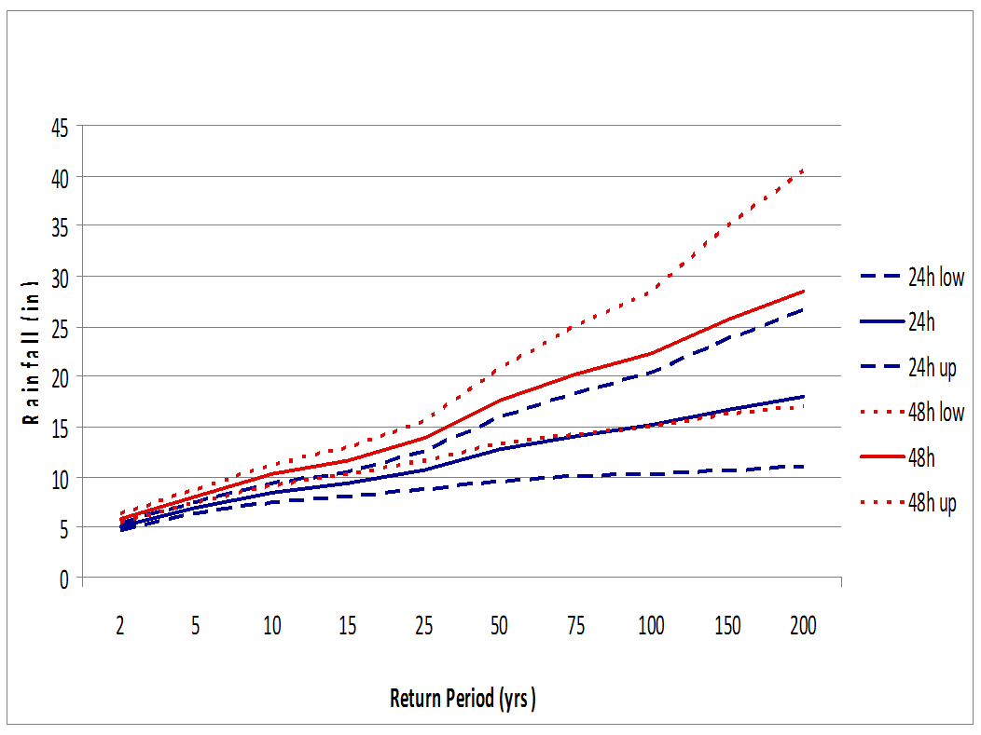
Pensacola, FL

Slide 7
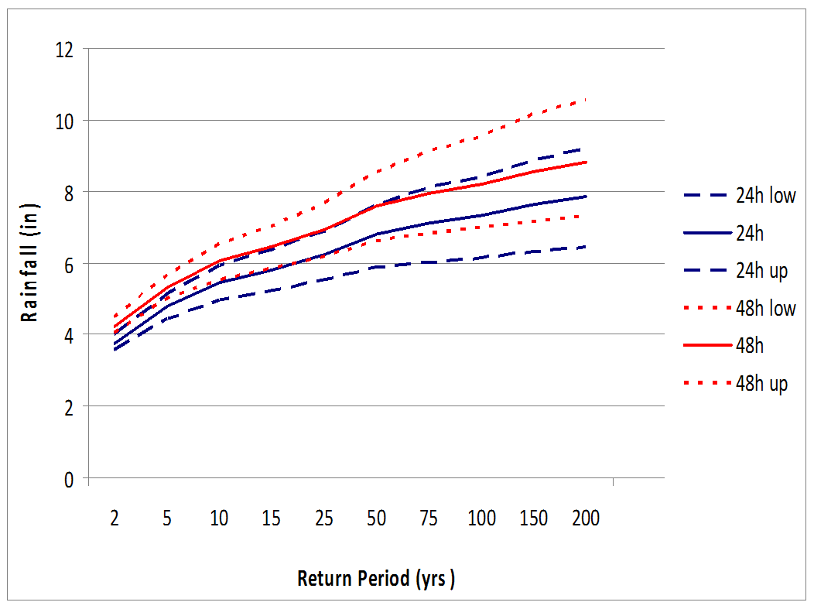
Bartow, FL

Slide 8
Potential Applied Users
Water utility managers
Water management districts
Stormwater design and control
Engineering (retention pond design and maintenance)
Road and other construction
Agricultural specialists
Flooding potential outlooks
Wildcard – human health

Slide 9
Proposed Scale for Heavy Rainfall
Heavy Rainfall Event (2-day)
Category Amount Probability
R1 1-2 inches 80-88%
R2 2-2.5 inches 88-96%
R3 2.5-3 inches 96-99%
R4 > 3 inches > 99%

Slide 10
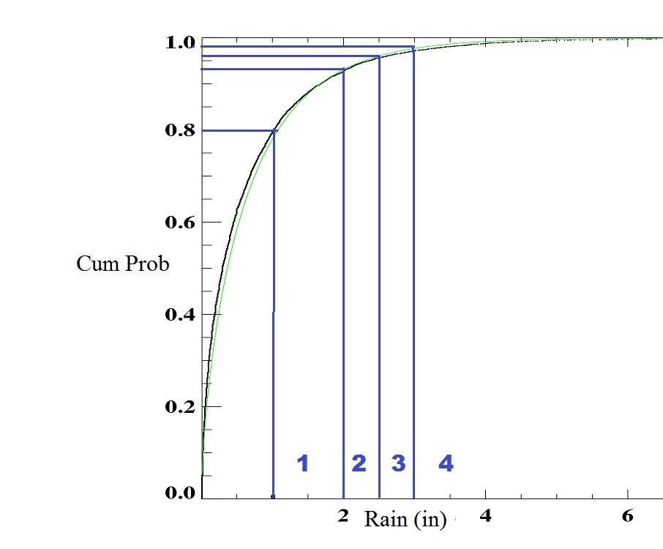

Slide 11
Station Distribution Map
Heavy rain events based on 2-day totals.
NWS Cooperative Observers only report once daily, usually midnight-to-midnight.
Rainfall does not automatically stop at midnight, 2-day totals better describe discrete events.
In some cases, 3-day totals may be applicable

Slide 12
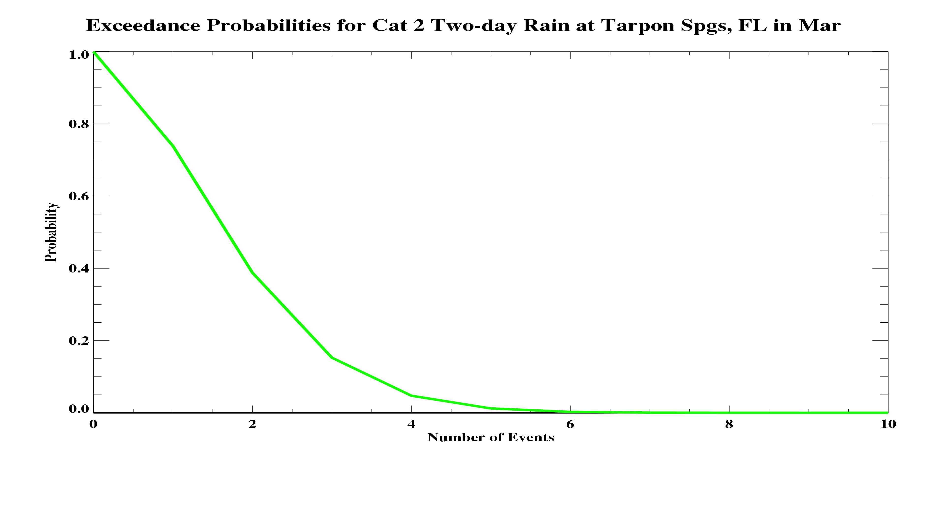
Exceedance Probabilities by Month
Tarpon Springs, FL
March
Category 2 Rainfall Event

Slide 13
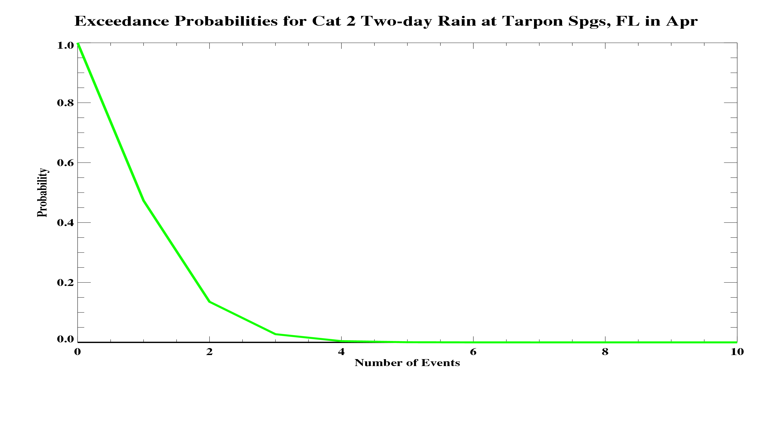
Exceedance Probabilities by Month
Tarpon Springs, FL
April
Category 2 Rainfall Event

Slide 14
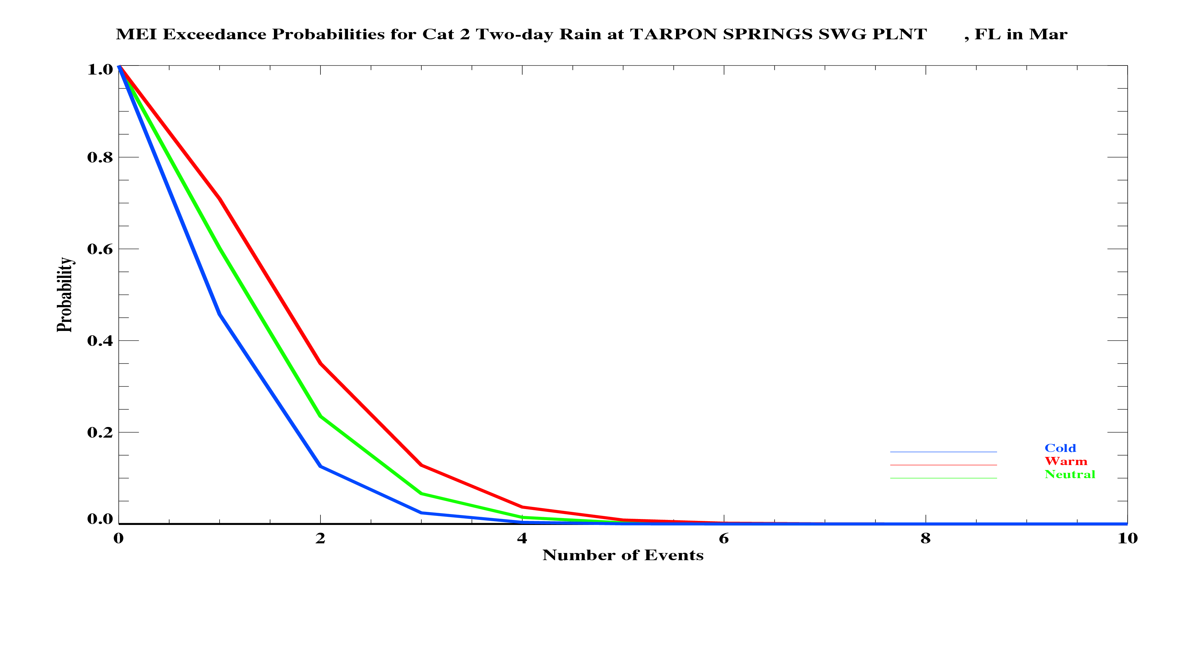
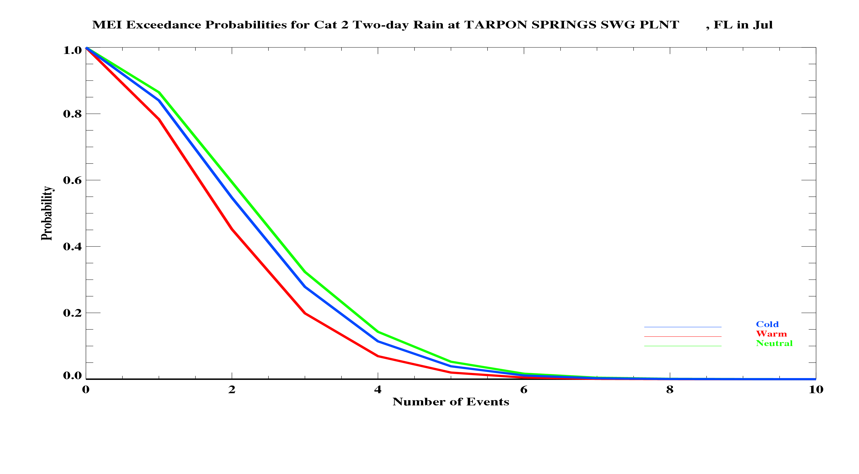
Exceedence Probabilities by ENSO Phase
Tarpon Springs, March
Tarpon Springs, July

Slide 15
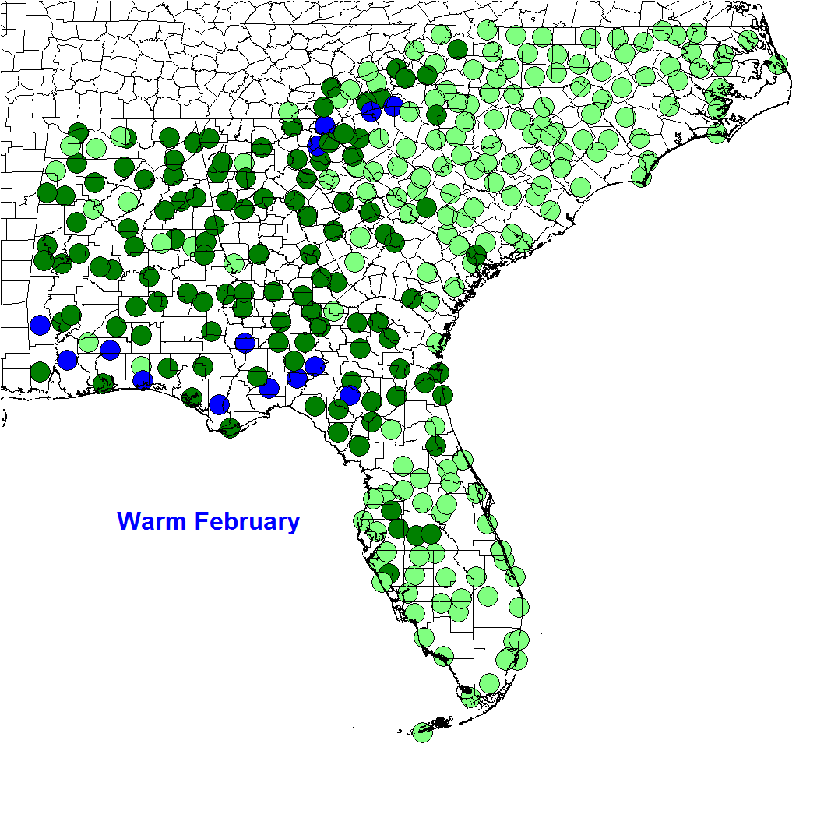
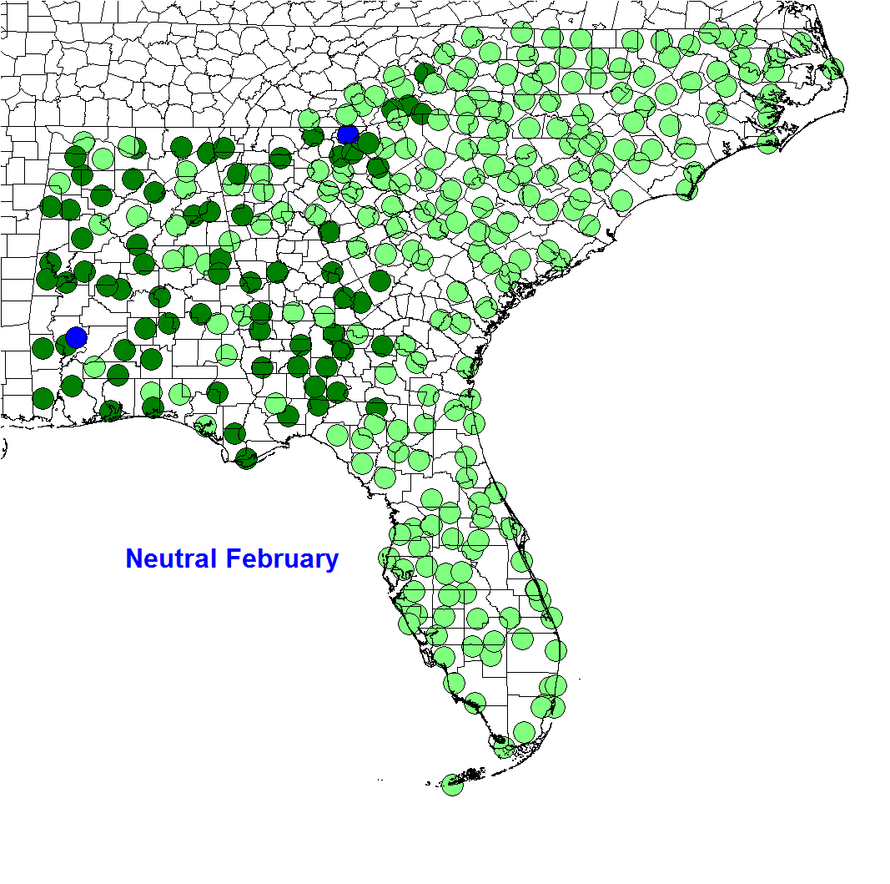
Probability of Two or More Events > Two Inches

Slide 16
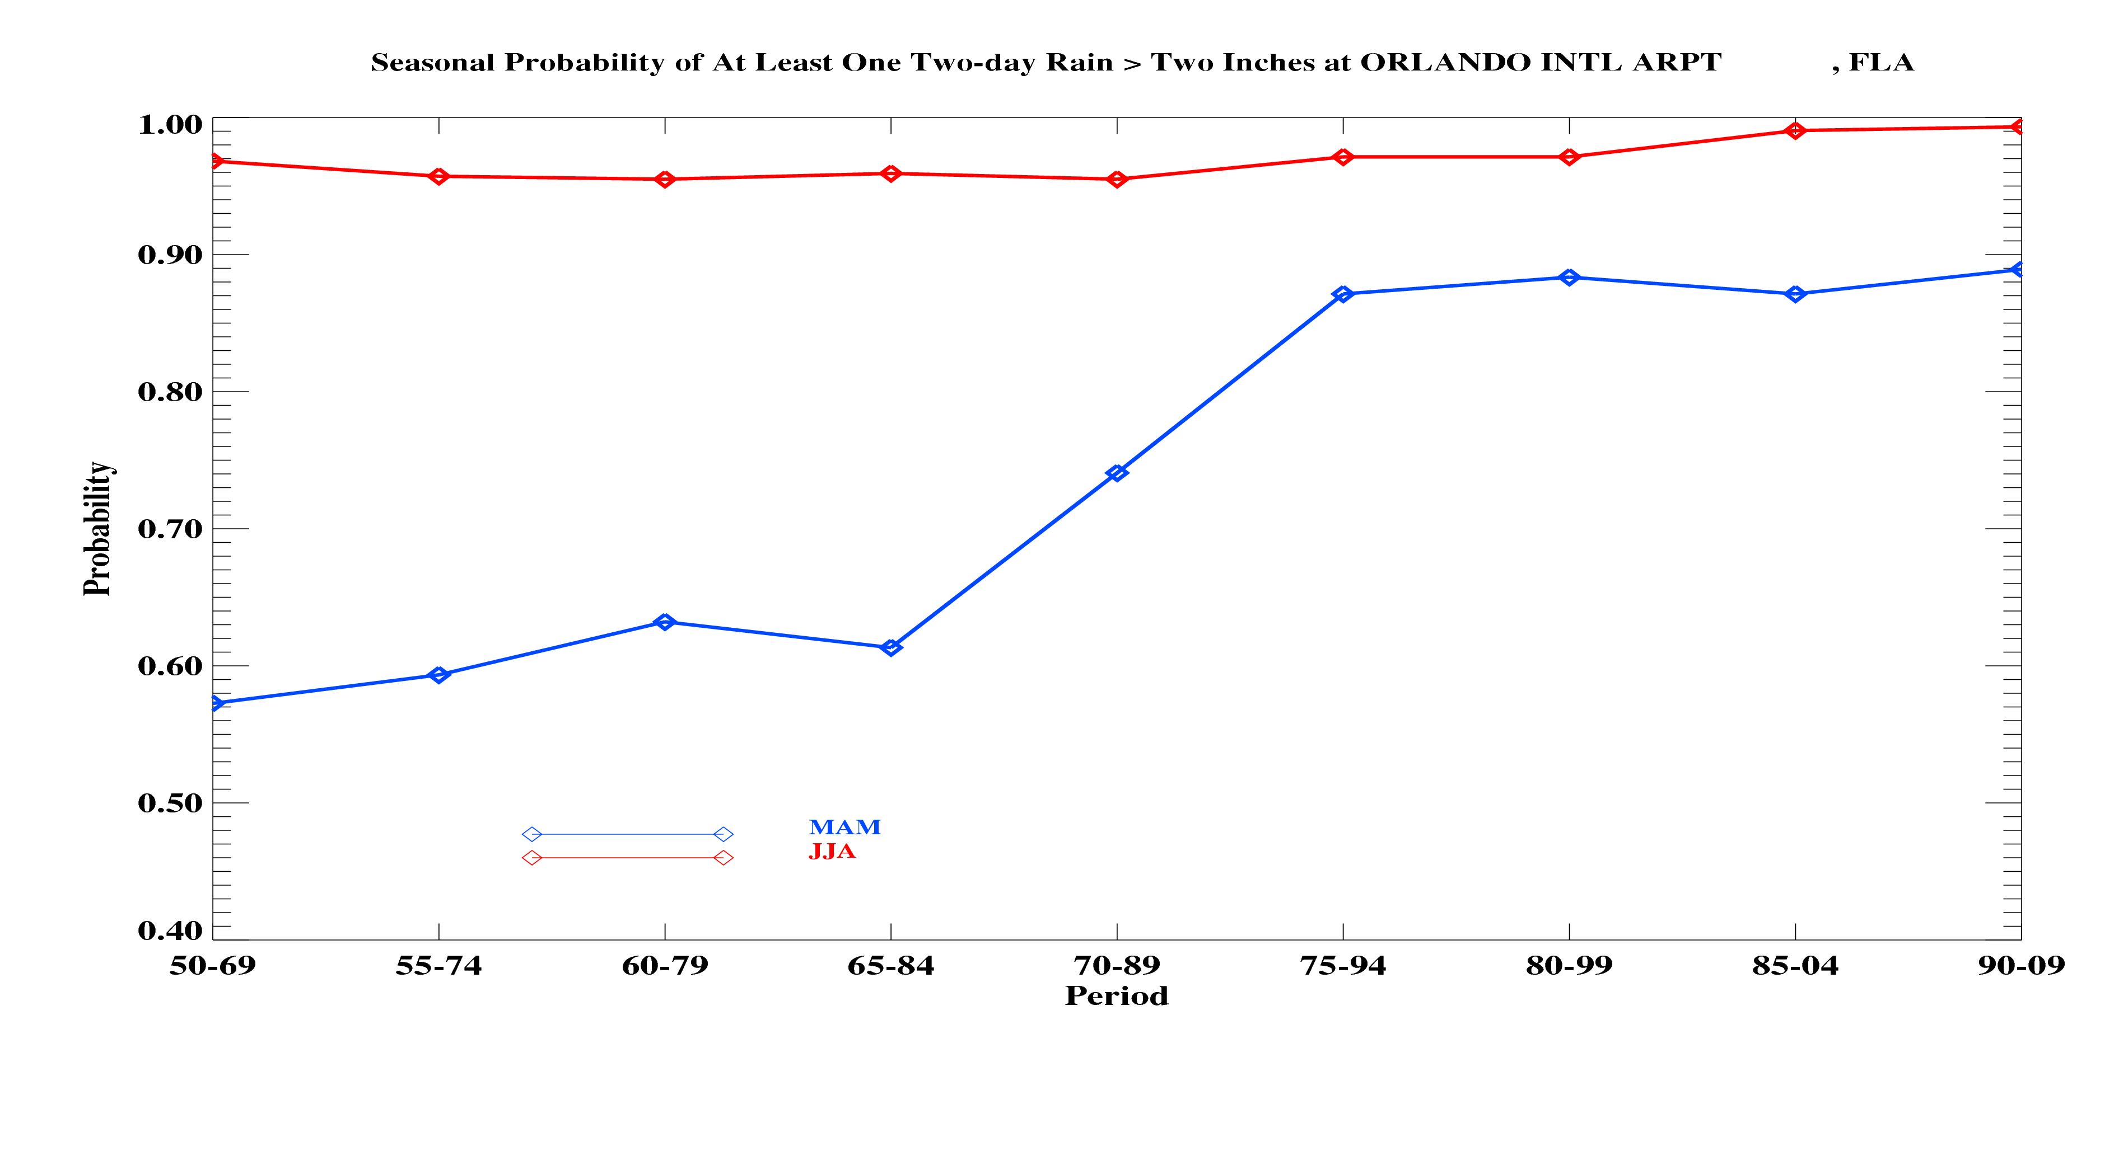
Seasonal Probability by 20-year periods
Orlando, FL
Probability of at least one Cat 2 Rainfall Event (2 inches or greater)

Slide 17
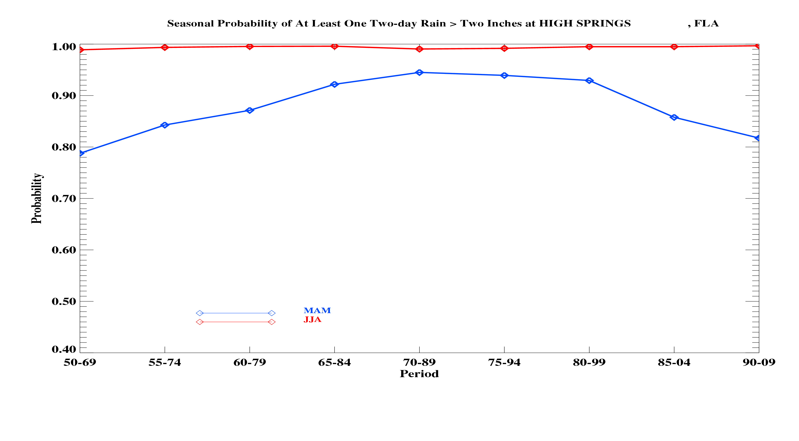
Seasonal Probability by 20-year periods
High Springs, FL
Probability of at least one Cat 2 Rainfall Event (2 inches or greater)

Slide 18
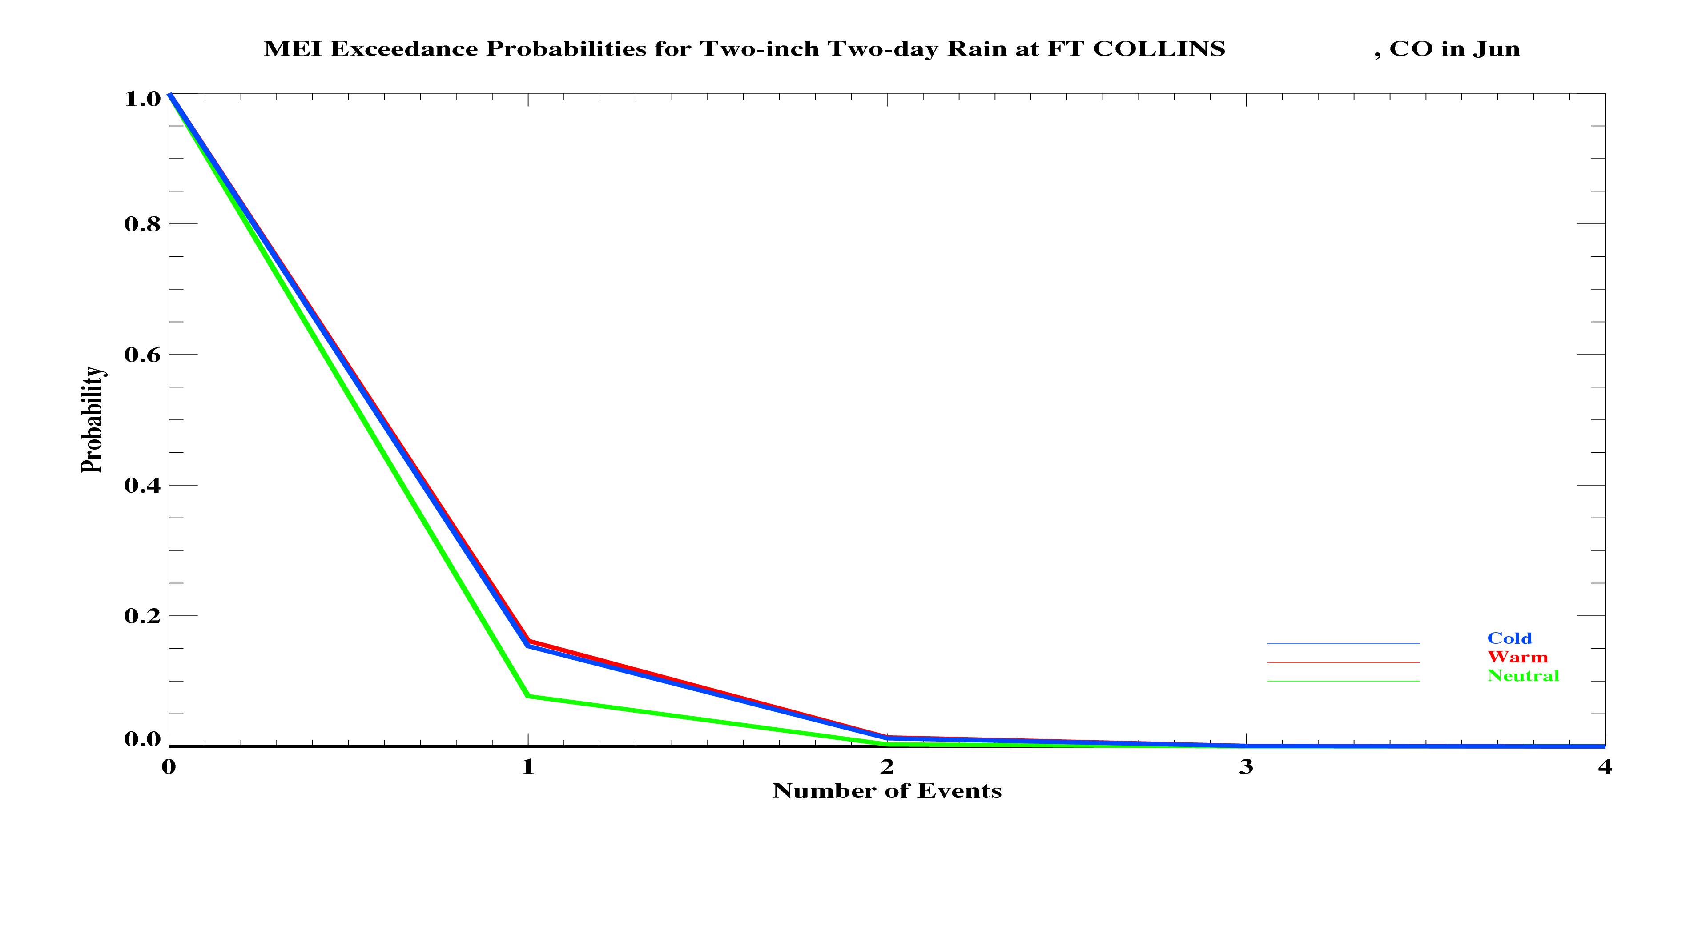

Slide 19
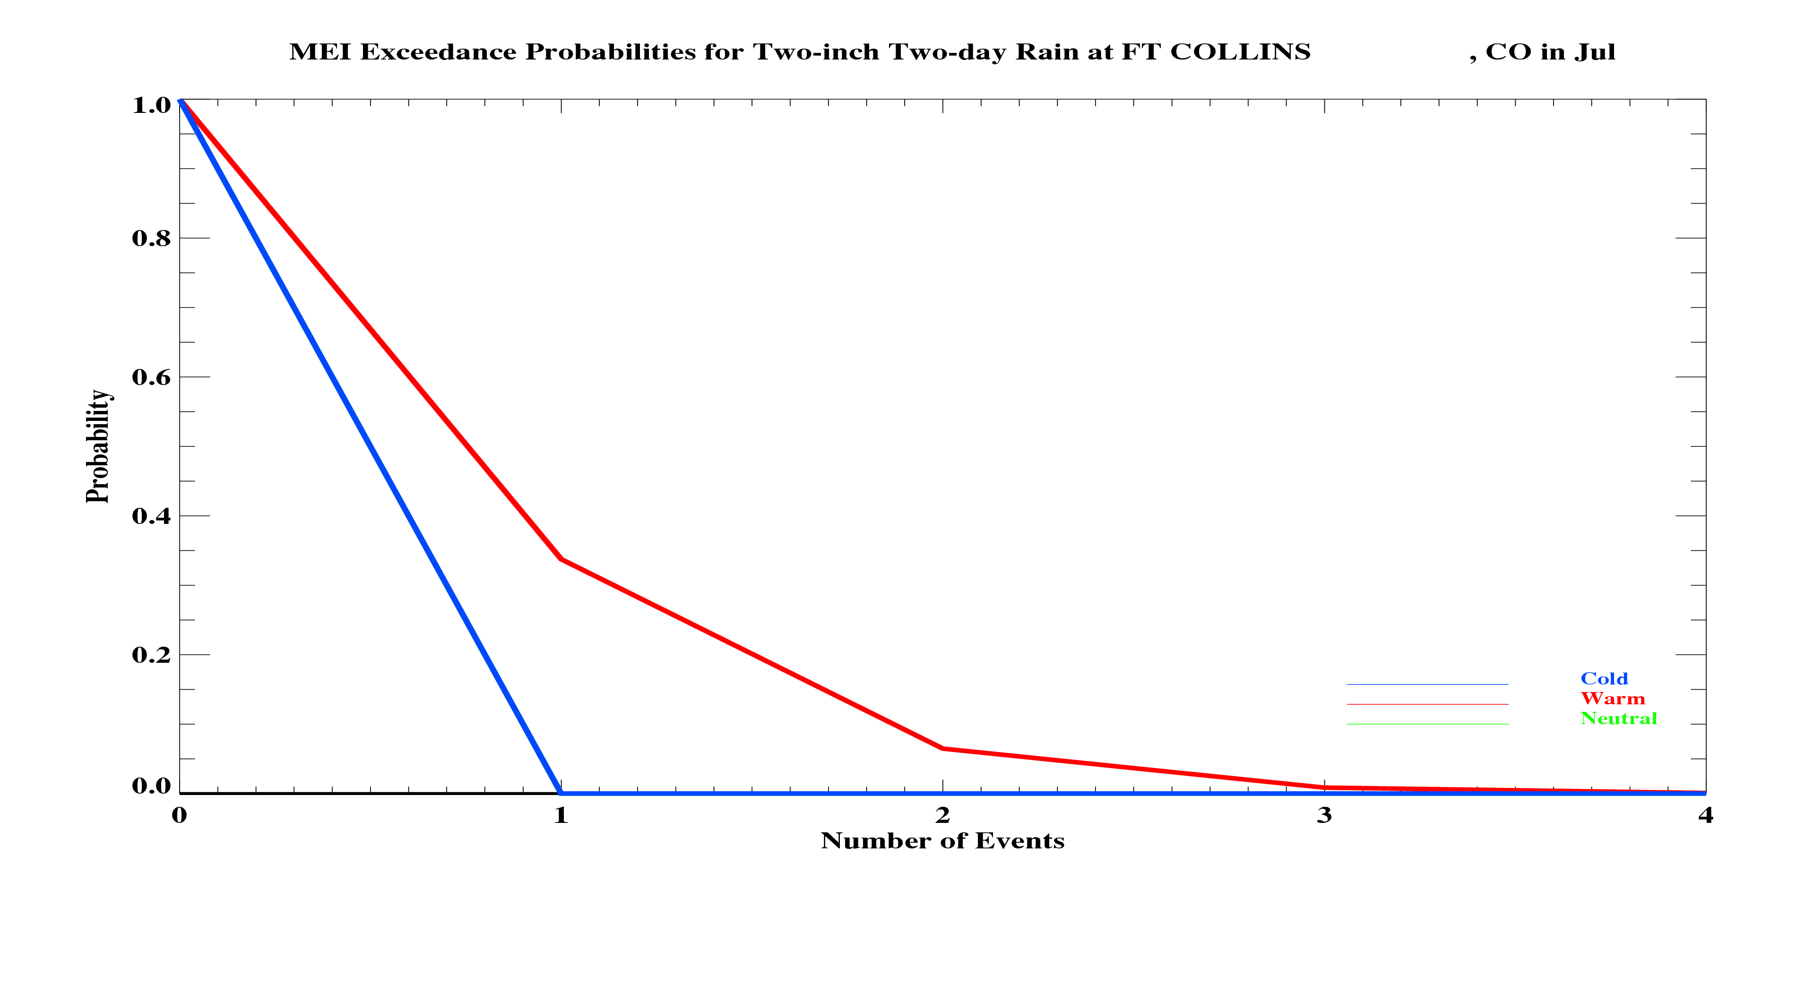

Slide 20
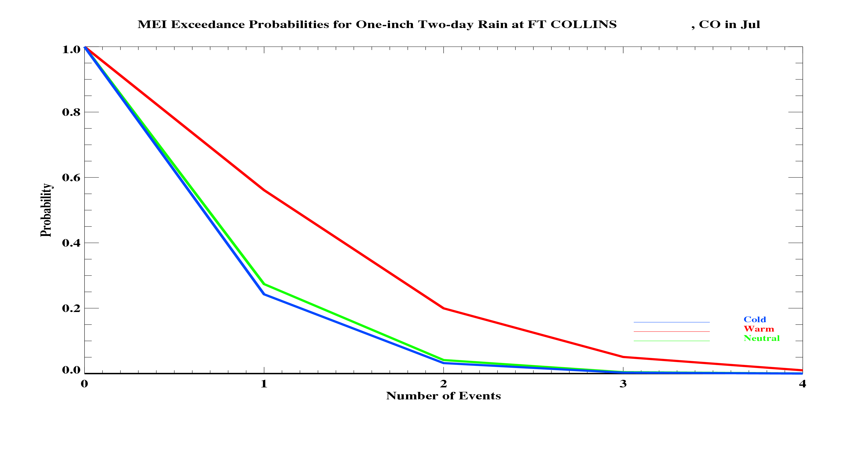

Slide 21
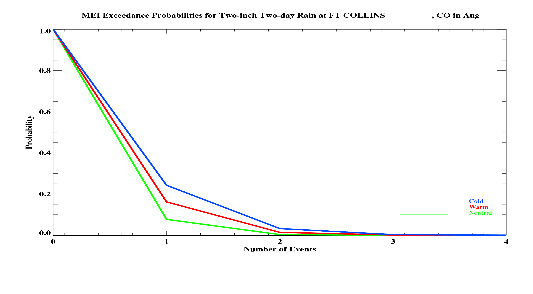

Slide 22
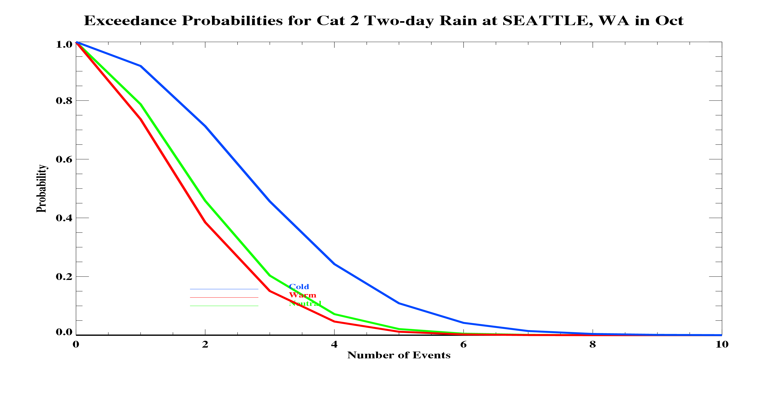

Slide 23
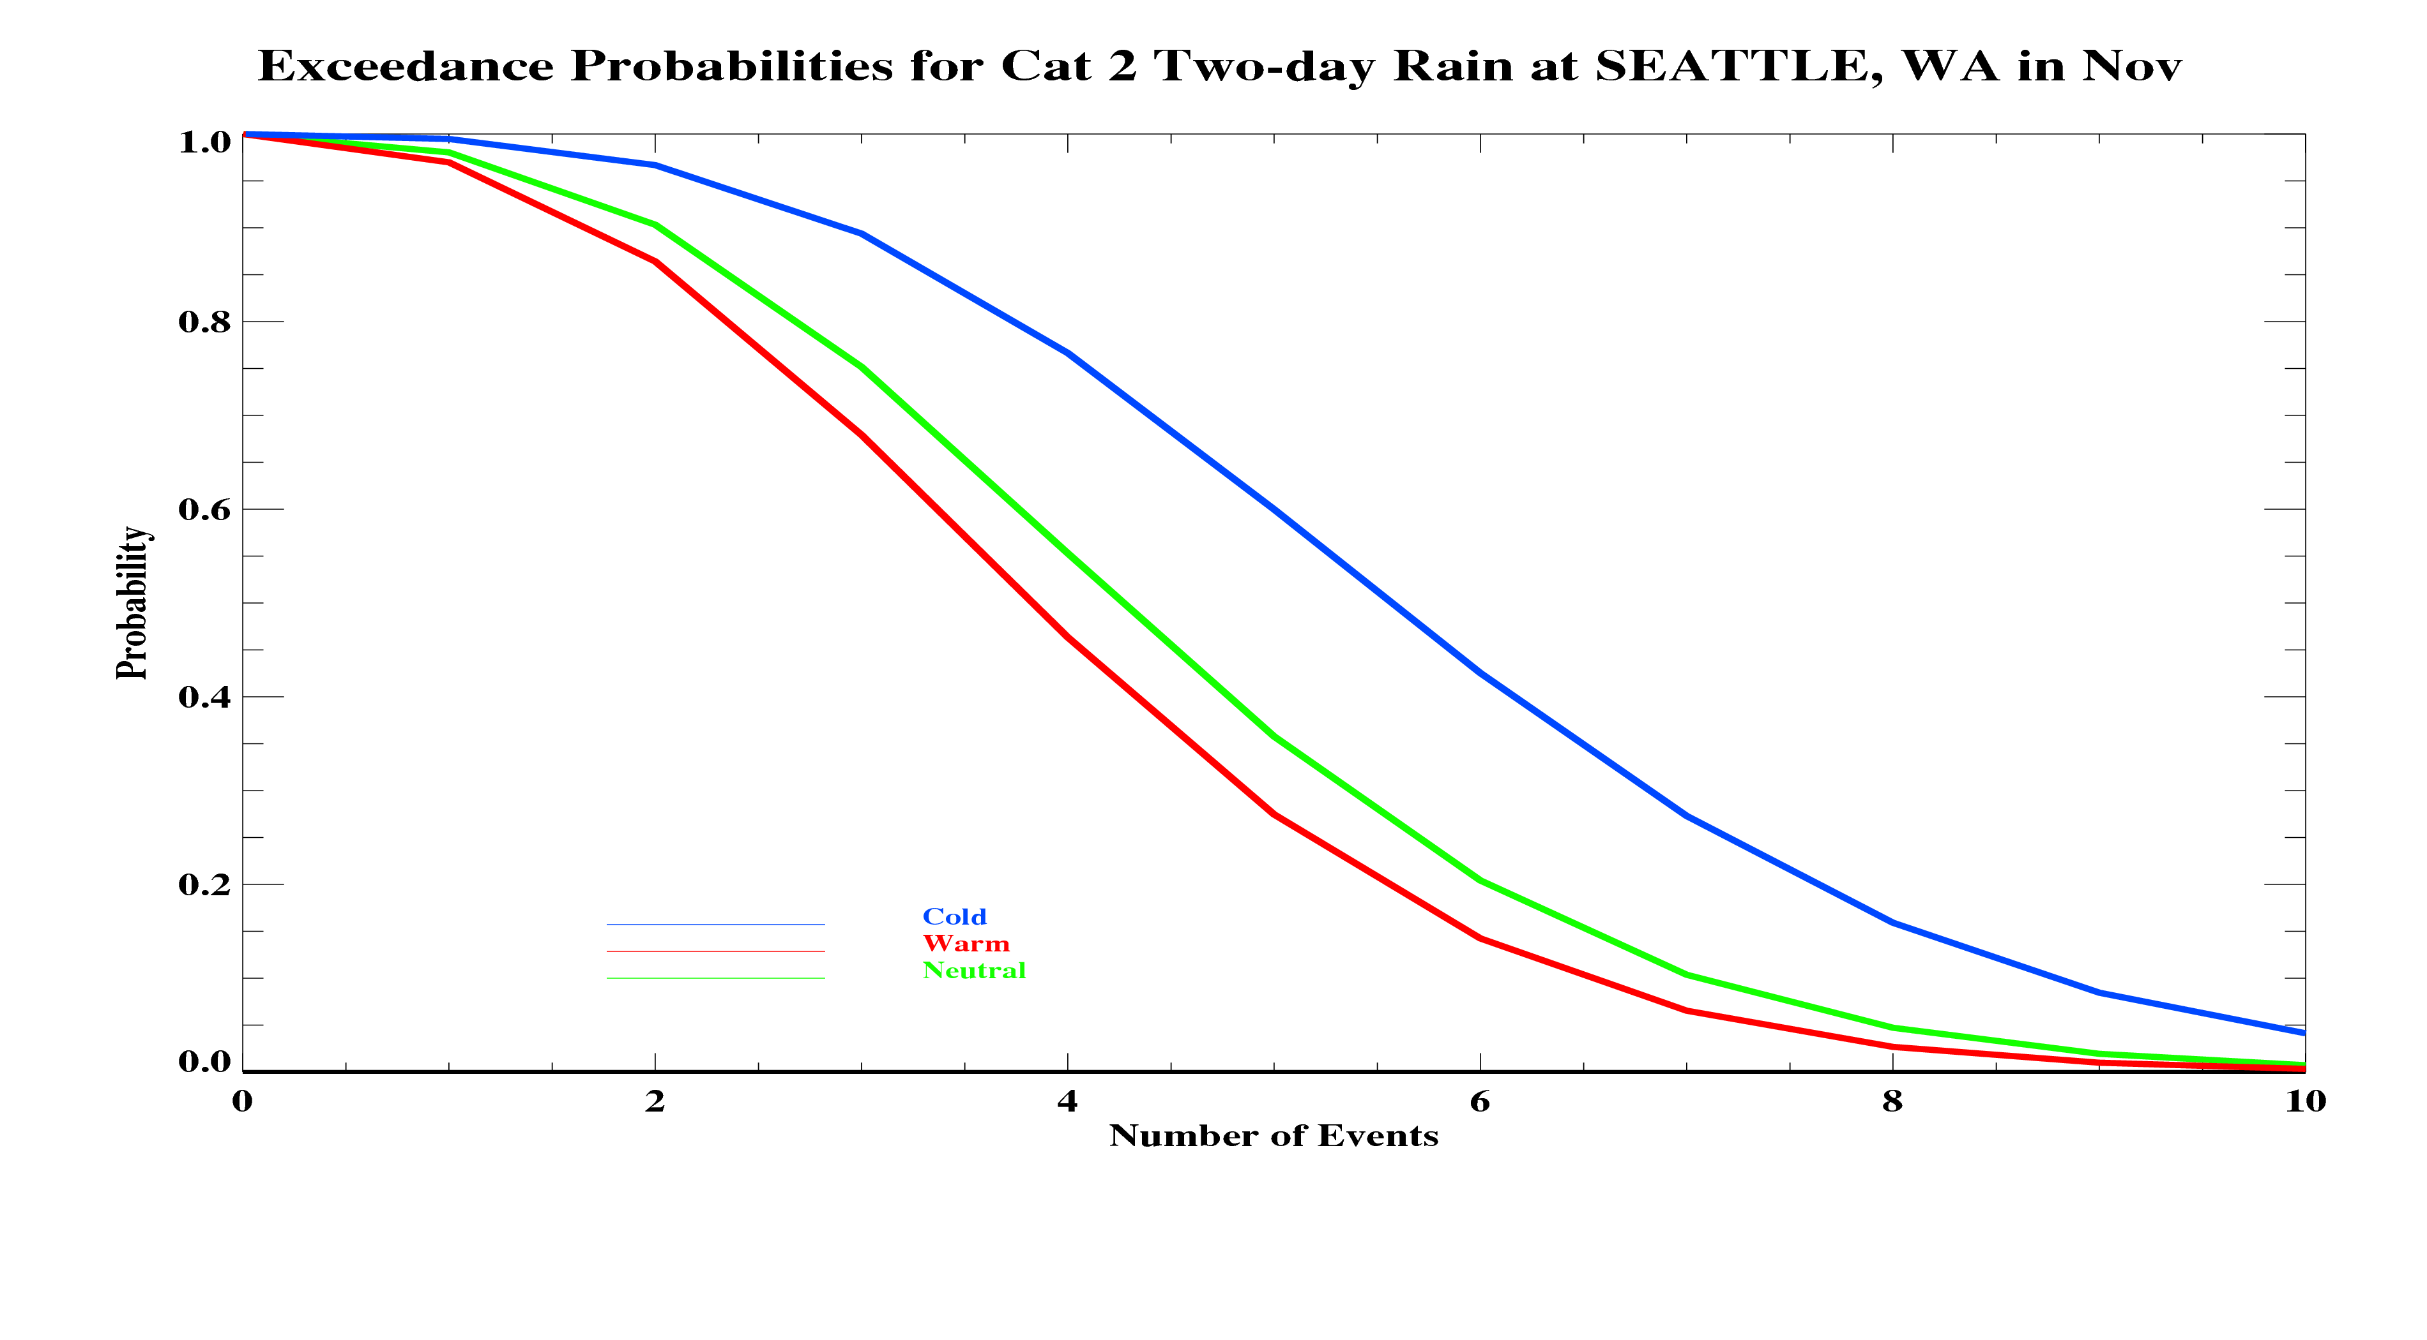

Slide 24
Southeastern Rainfall Extremes
Dr. James J. O’Brien
July 10, 2012
AASC Annual Meeting in Sandestin

Slide 25
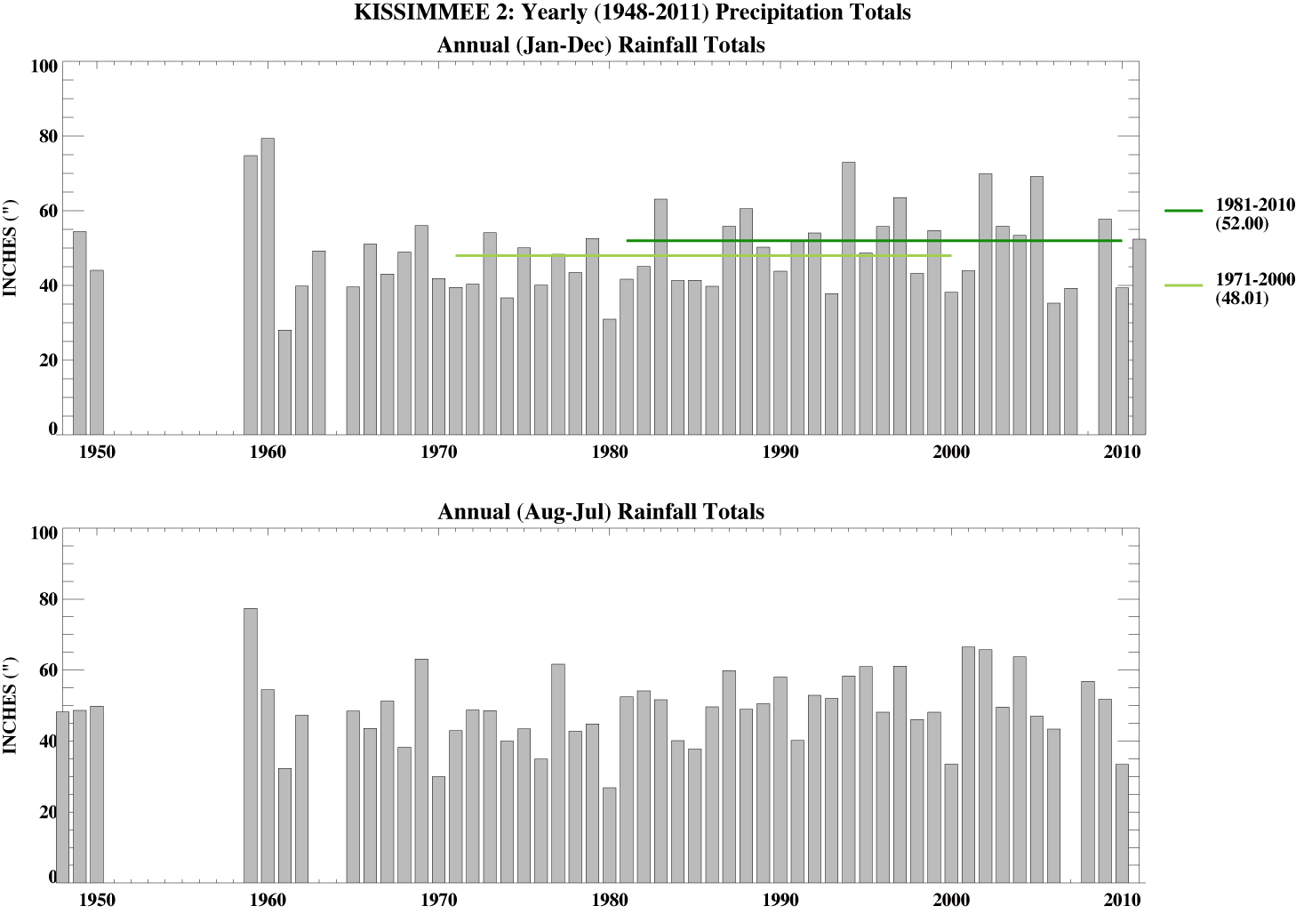
Kissimmee Rainfall

Slide 26
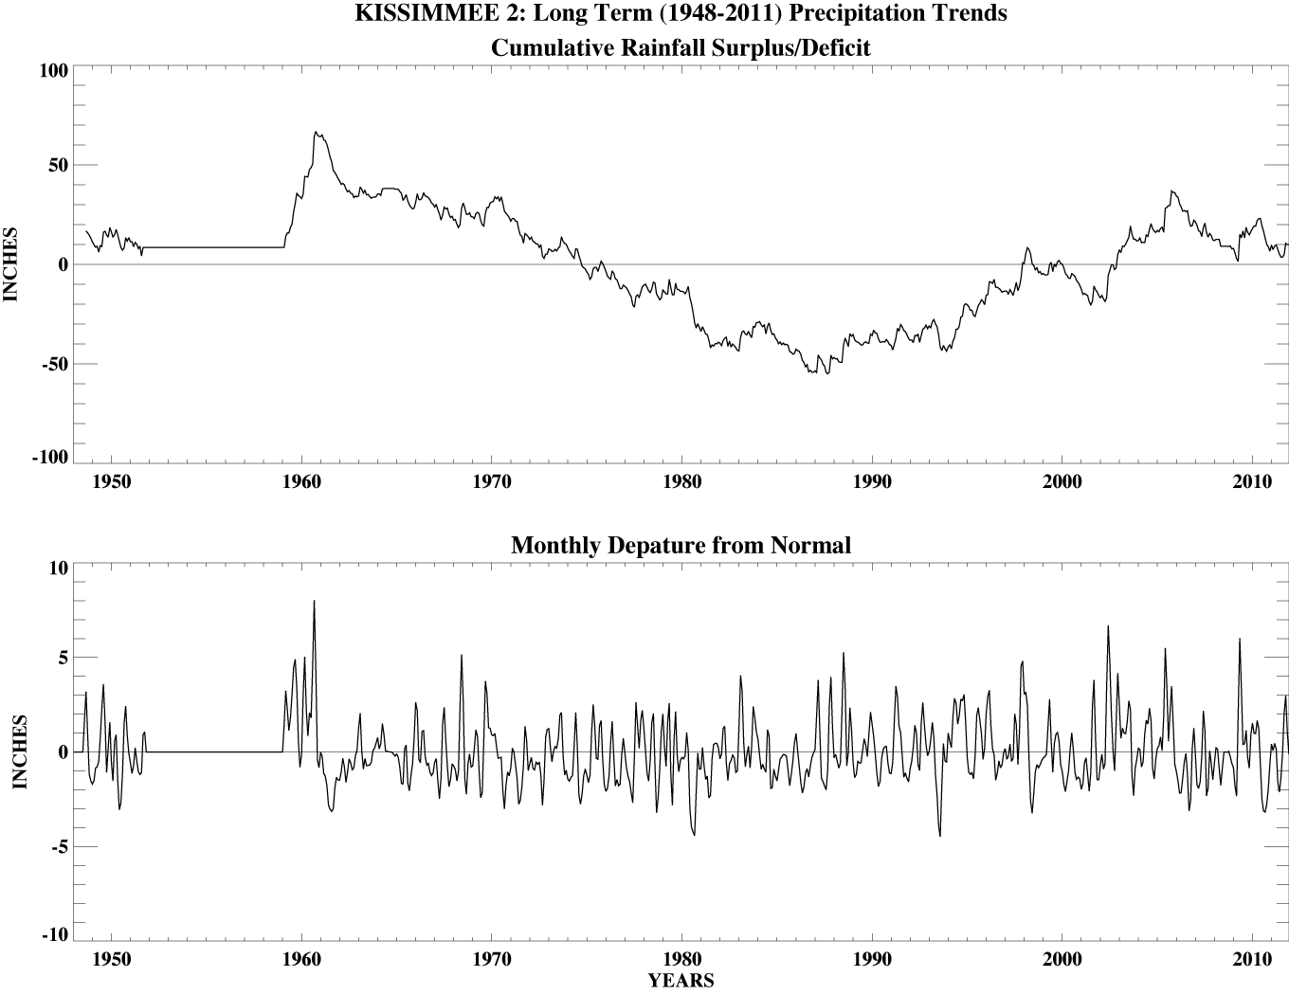
Kissimmee Rainfall

Slide 27
The End
www.coaps.fsu.edu

Slide 28
The End

Slide 29
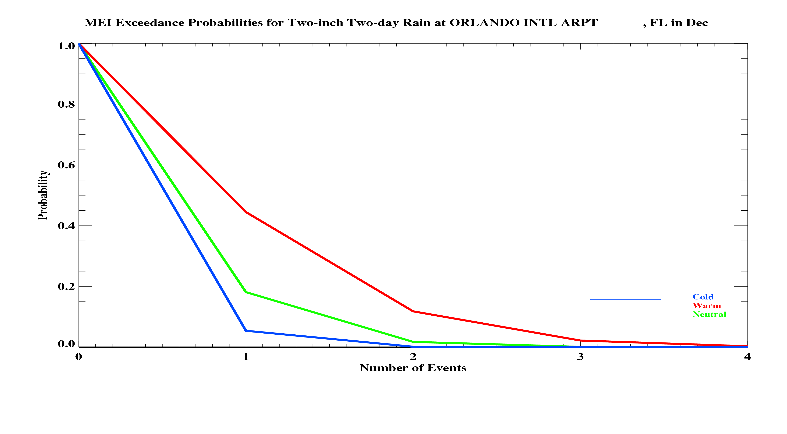
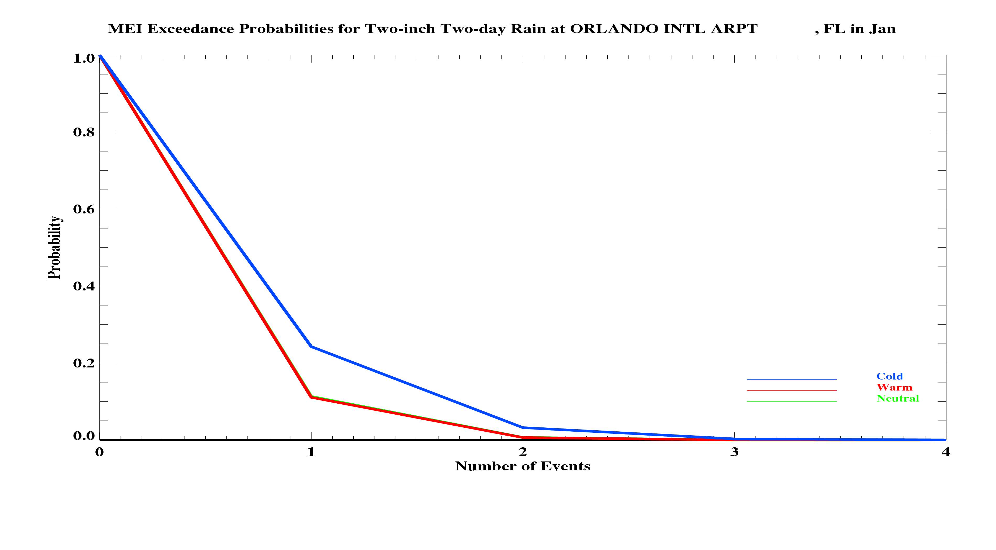
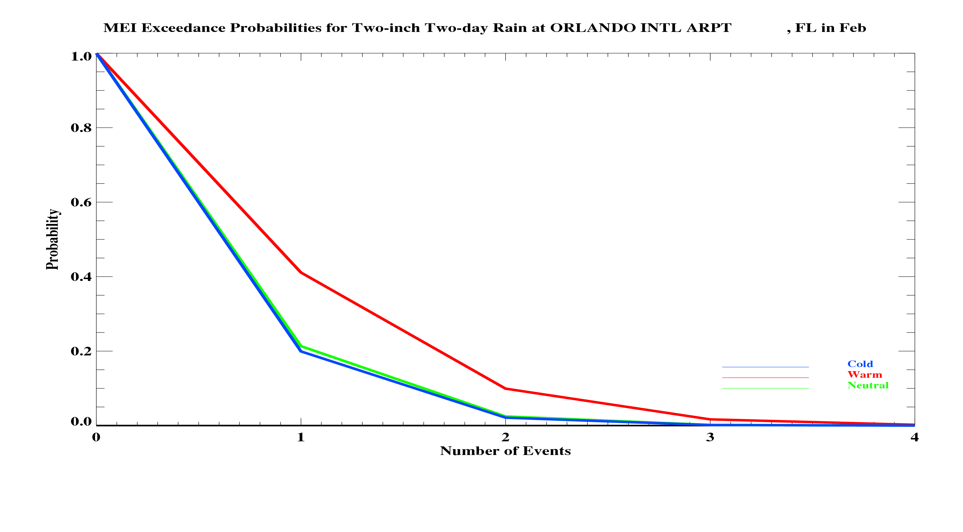
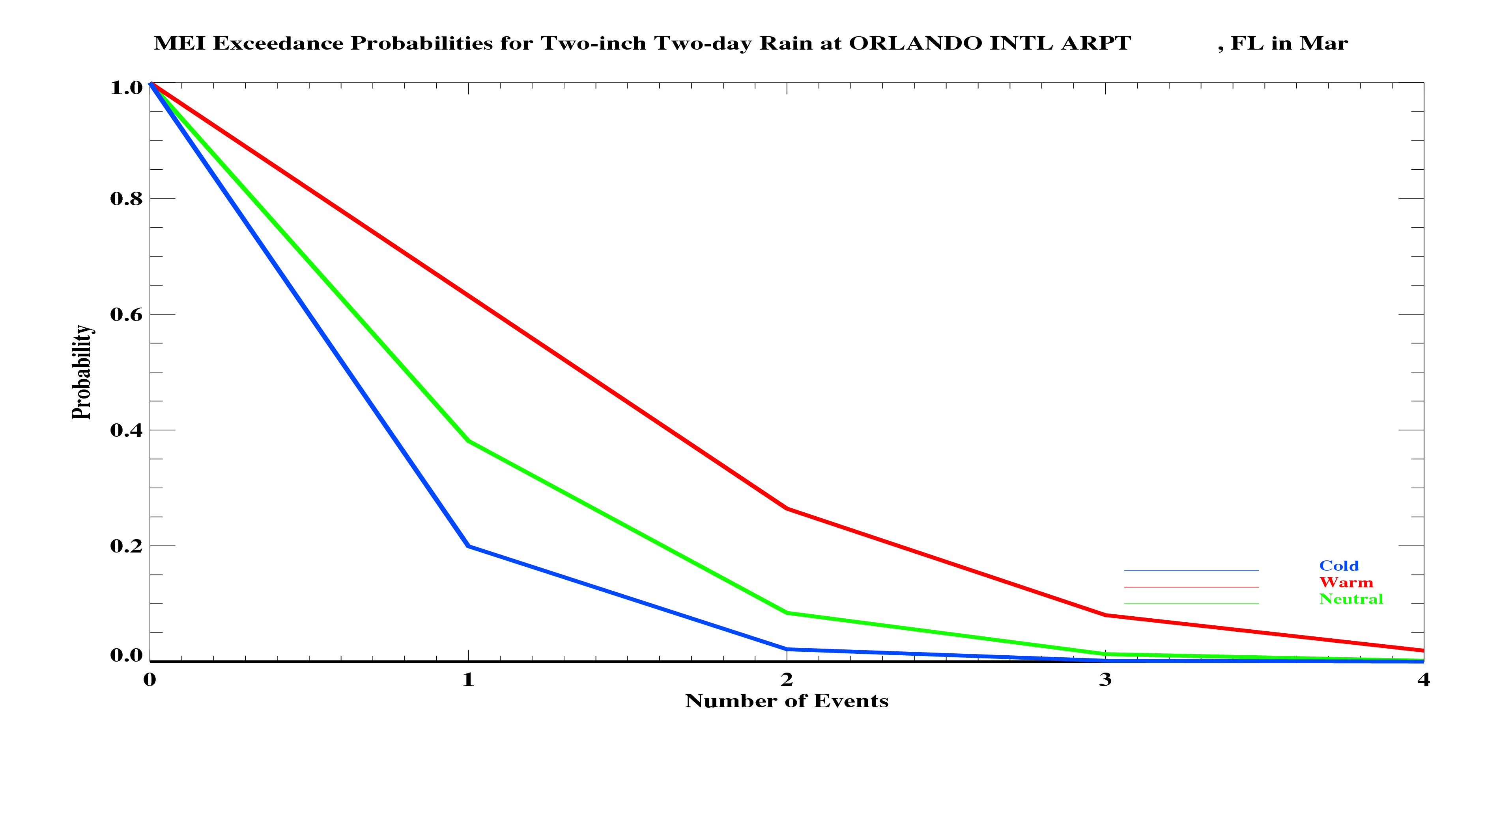
Two-Inch Two-day Events

Slide 30
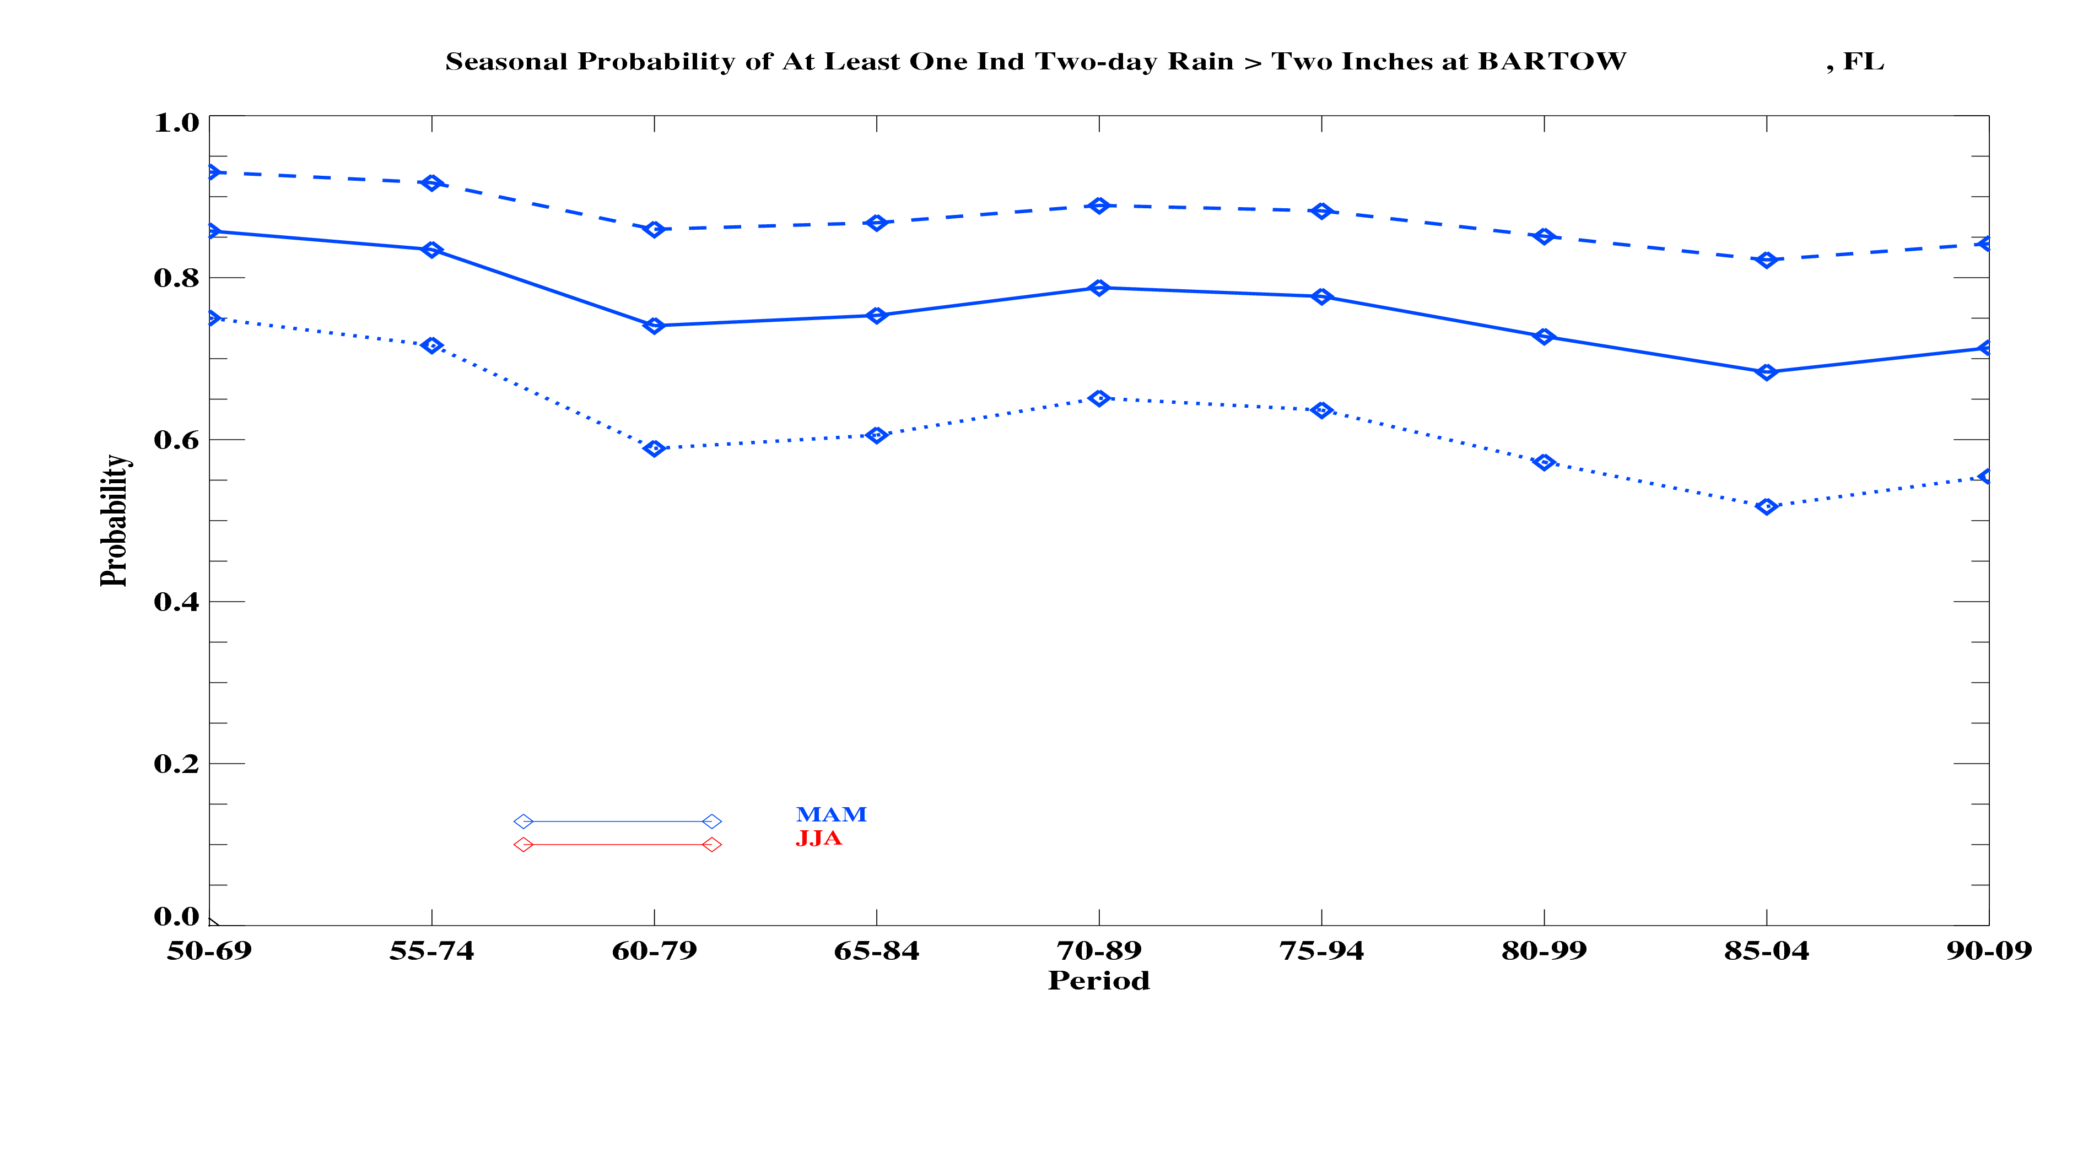

Slide 31
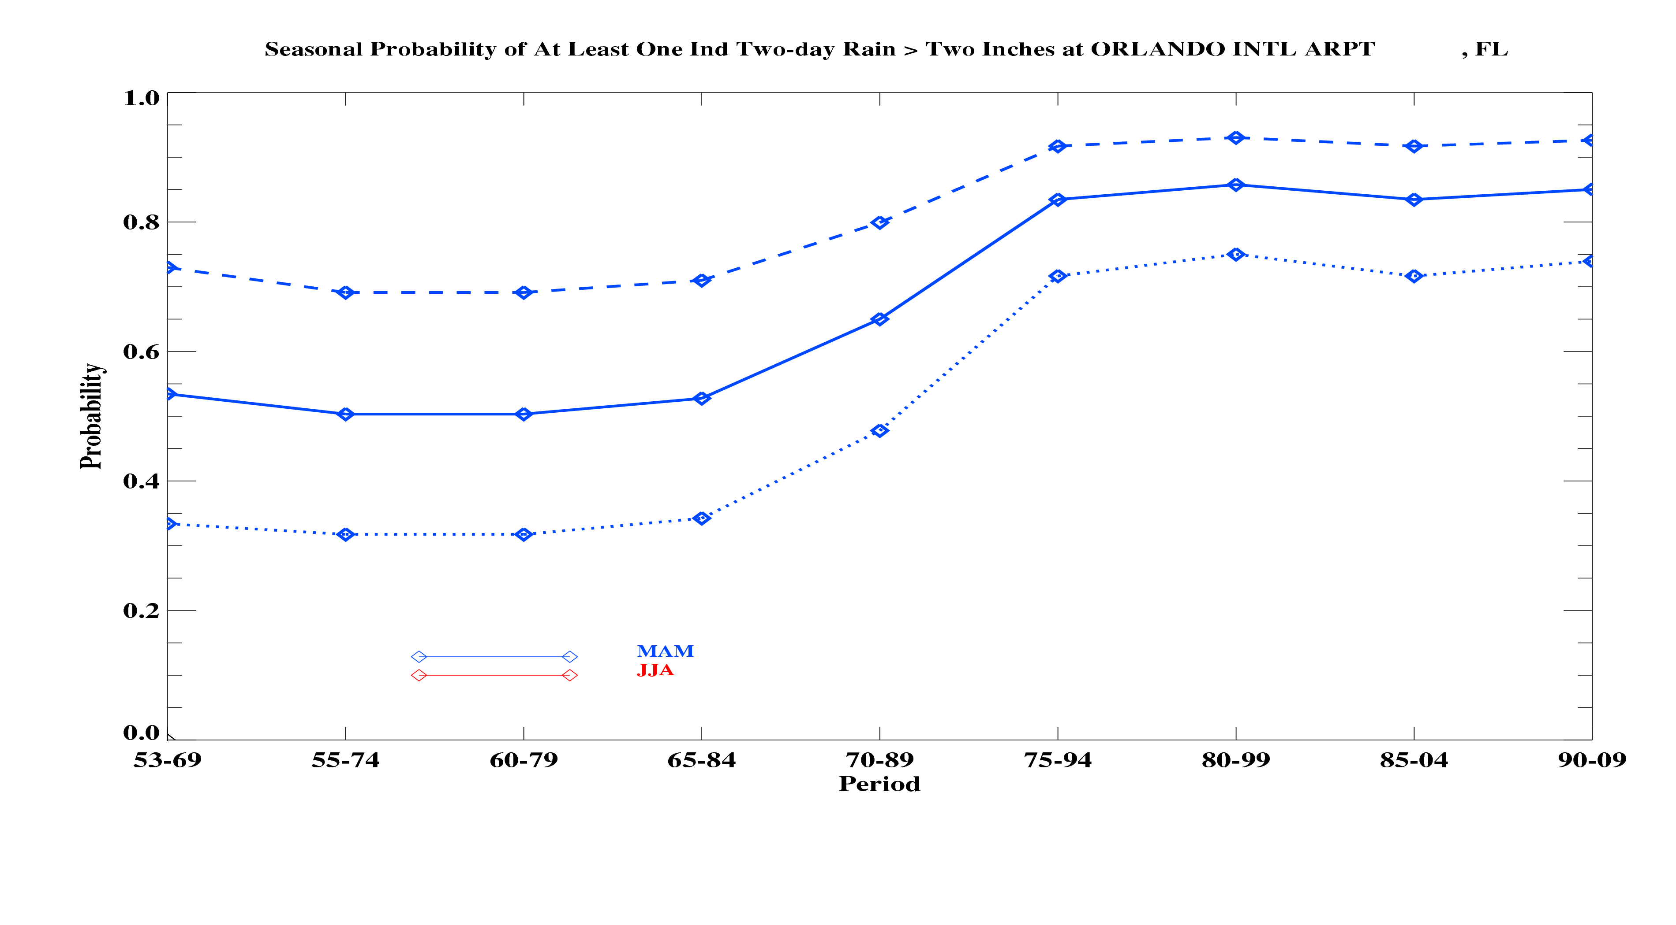

Slide 32
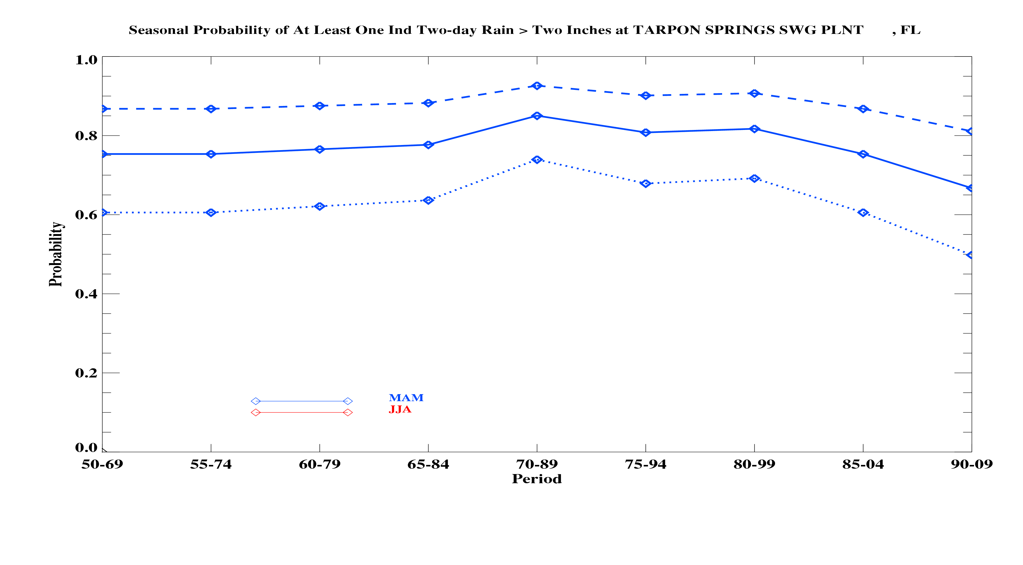

Slide 33
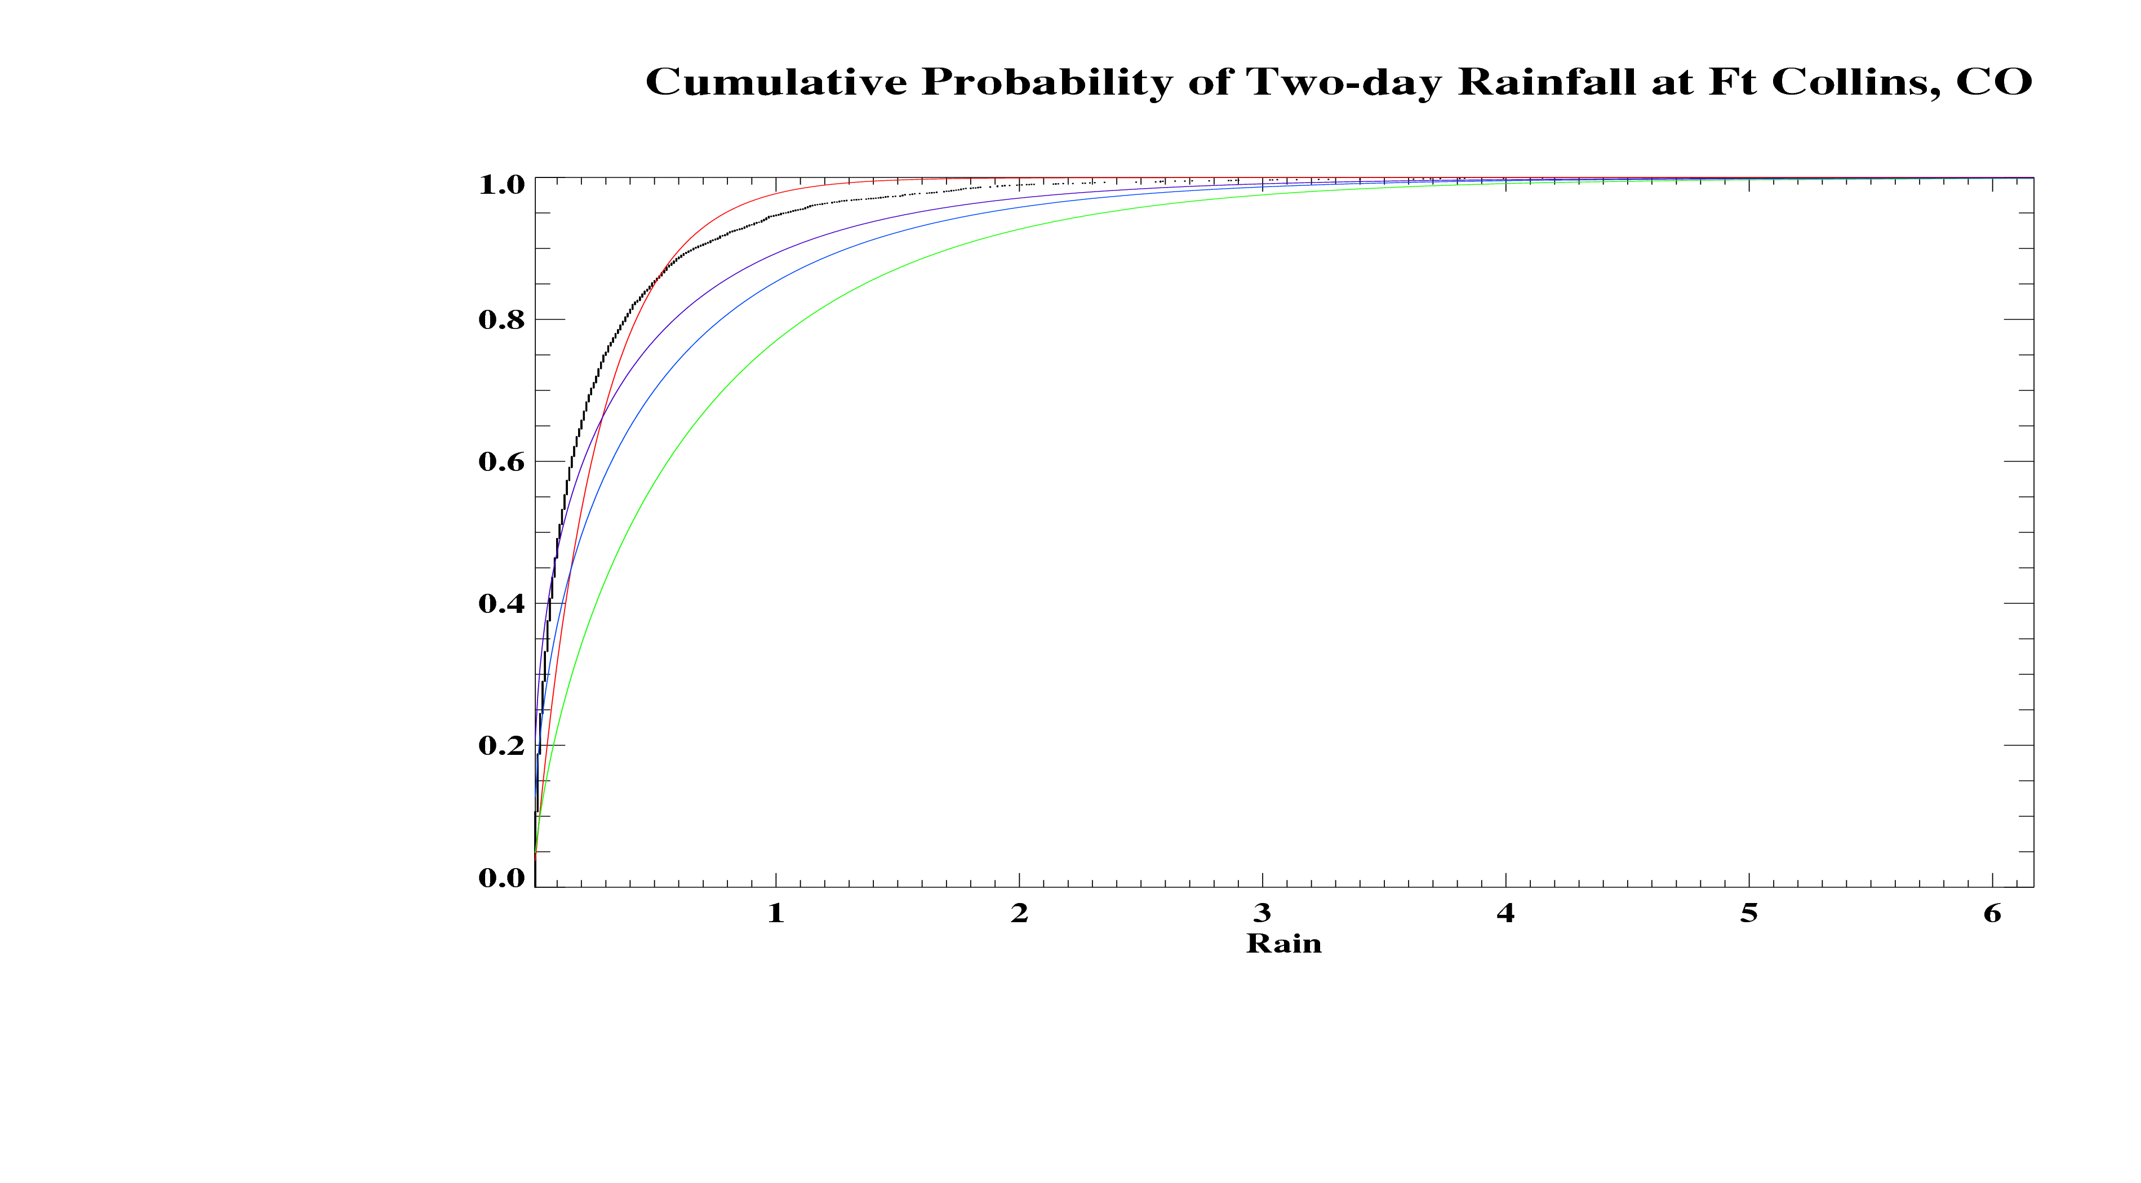
Black: Empirical Red: Exponential Green: Gamma (max liklihood)
Blue: Gamma (Method of Moments) Purple: Gamma (Method of Moments via L-moments)

Slide 34
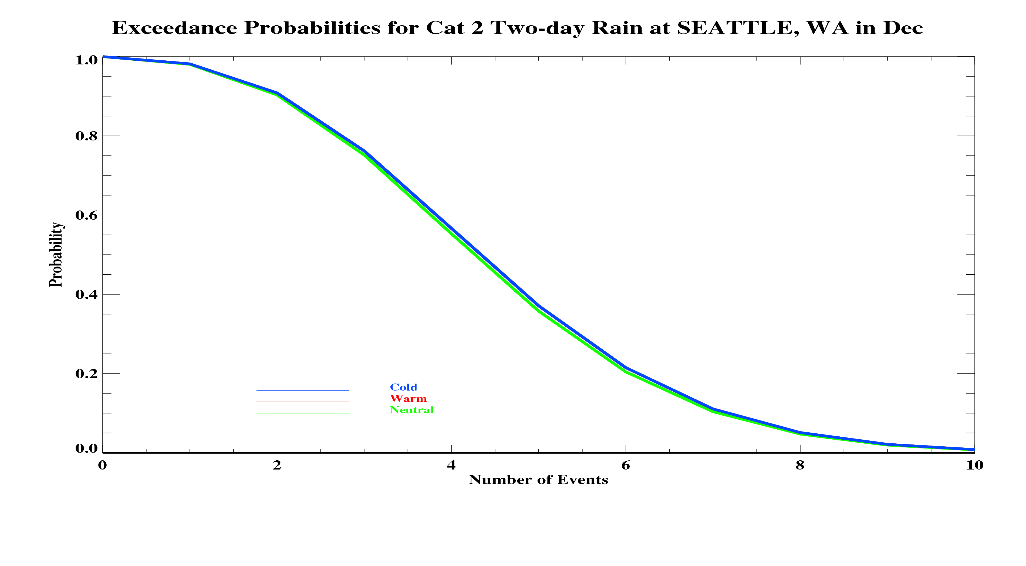

Slide 35
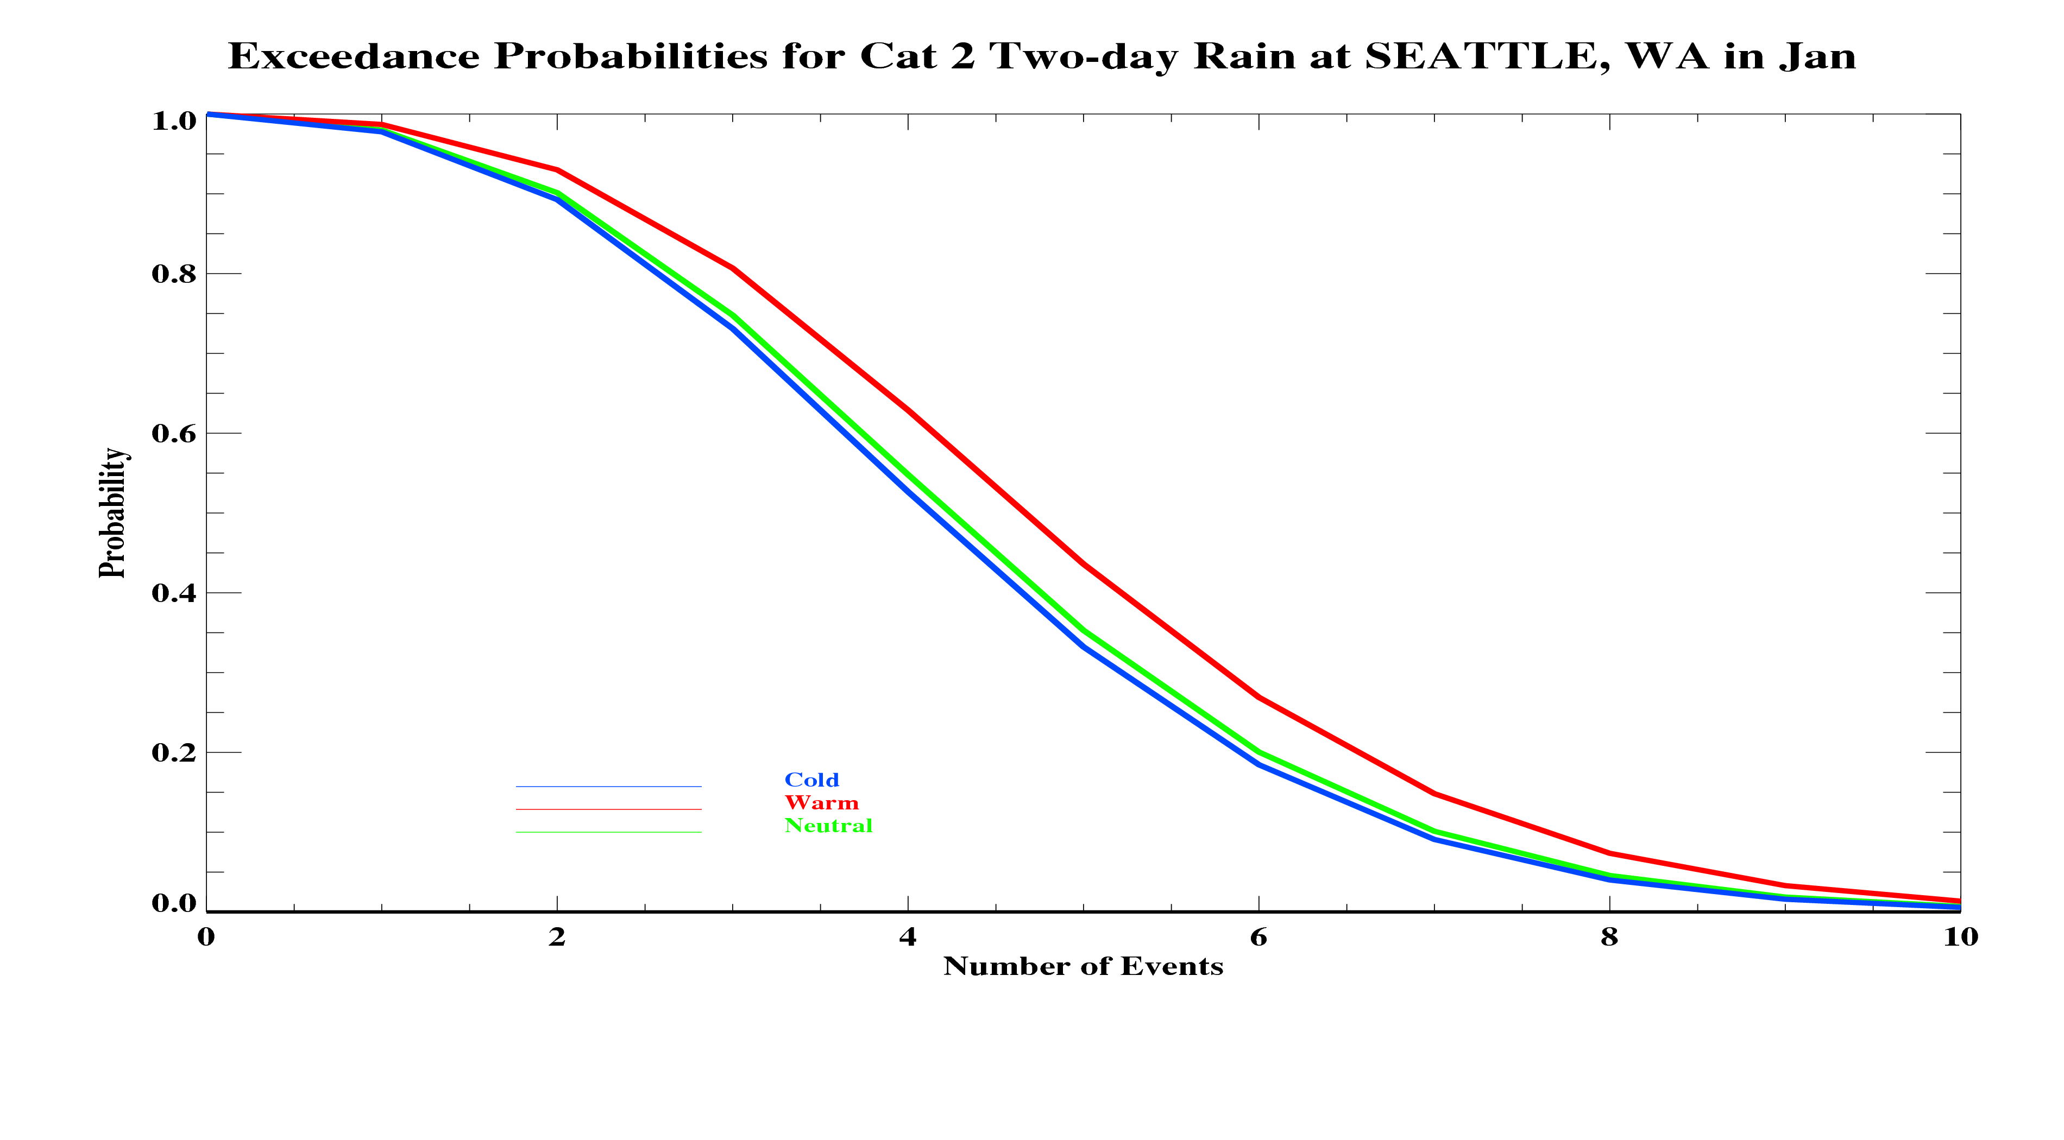

Slide 36
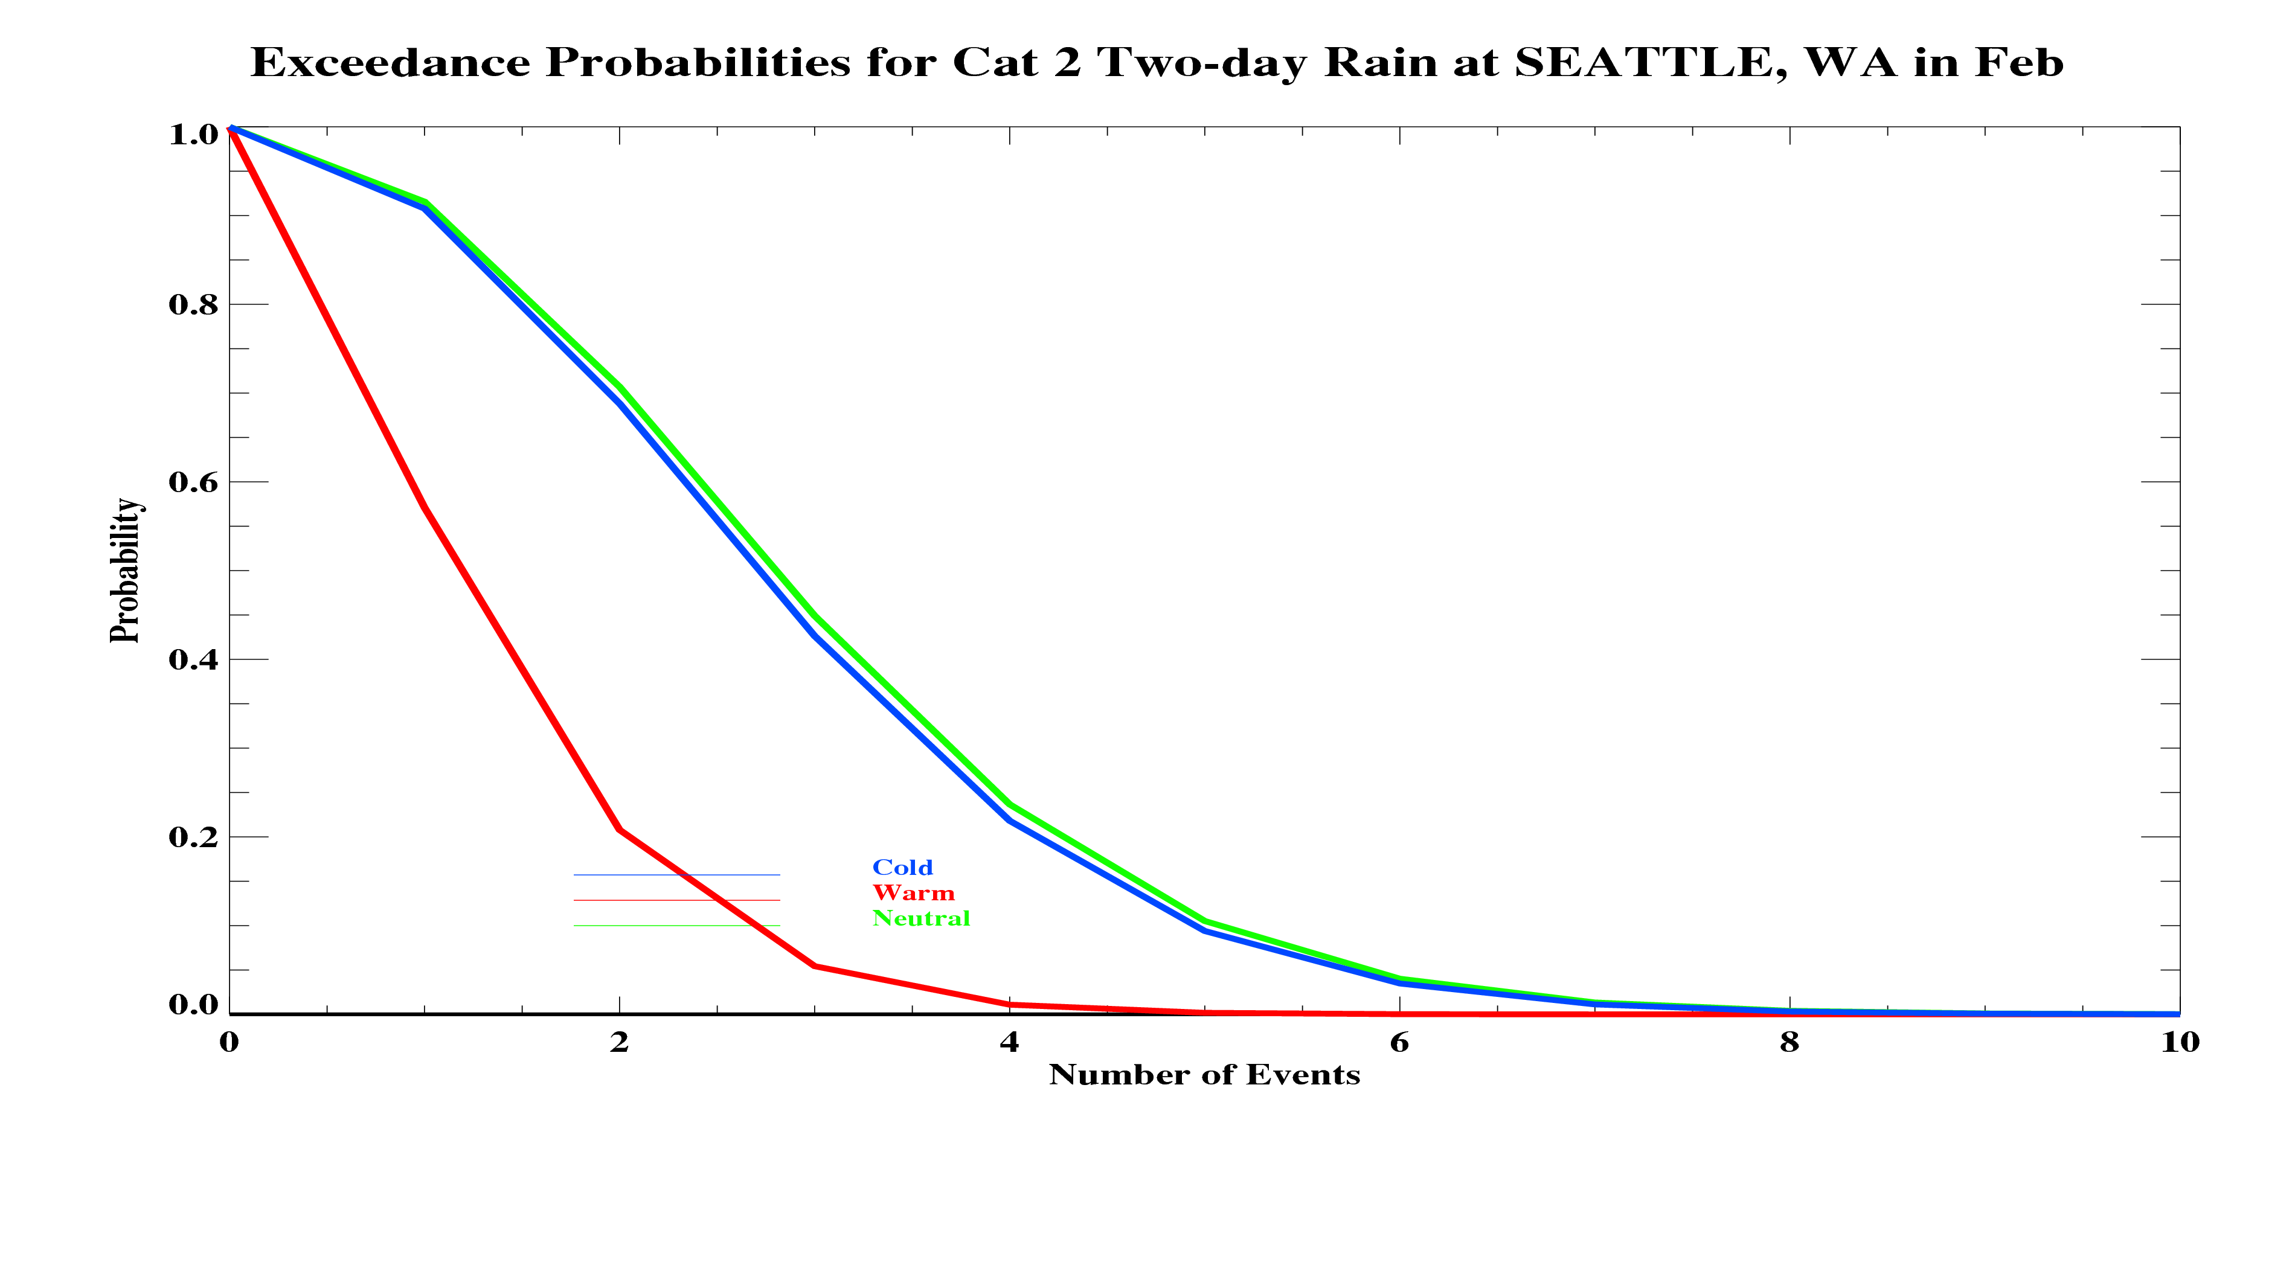

Slide 37
