Slide 1
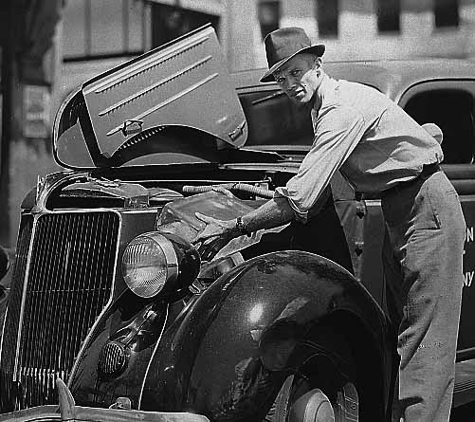
Minnesota Report: 2012
Cooling Car Off in Minnesota Heat
(Minnesota Historical Society Archives)
Pete Boulay: Minnesota State Climatology Office
DNR- Division of Ecological and Water Resources

Slide 2
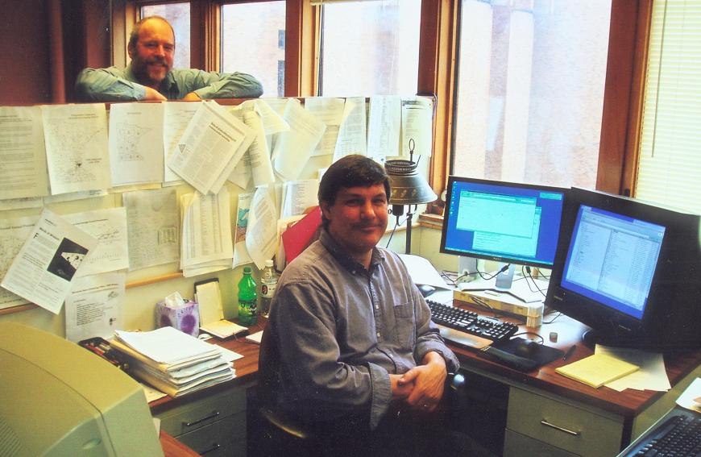
Minnesota SC Office Changes

Slide 3
Minnesota SC Office Changes
Retired
Greg Spoden
New SC

Slide 4
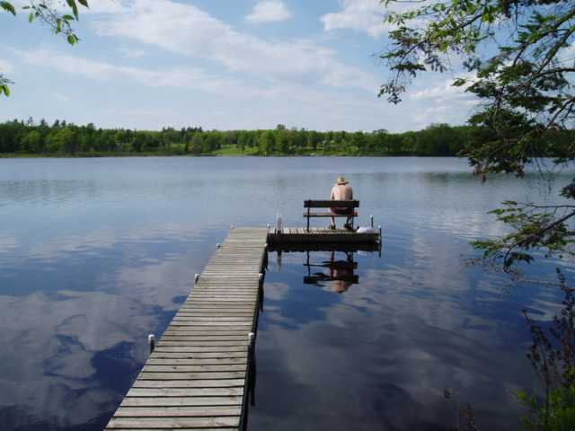
Jim Zandlo’s New Office View

Slide 5
Impact of CoCoRaHS
Joined CoCoRaHS in December 2009
Currently have 150-250 reporting daily
About 325 active in the past month
Approx. 150 are inactive (since May 12)
Impact on High Density Network?

Slide 6
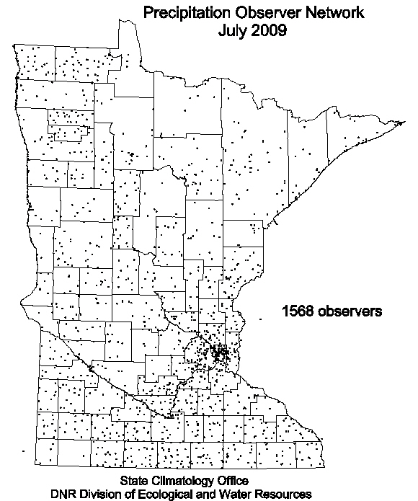

Slide 7
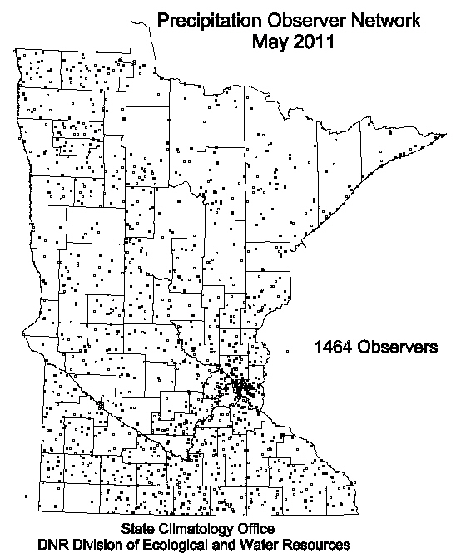

Slide 8
Results of CoCoRaHS in MN
HIDEN down by 104 observers (6.6%)
Only 49 attributed to “network jumping”
150 CoCo’s are inactive (since May)
Overall a net gain of rain gauge readers
CoCoRaHS added to analysis of events

Slide 9
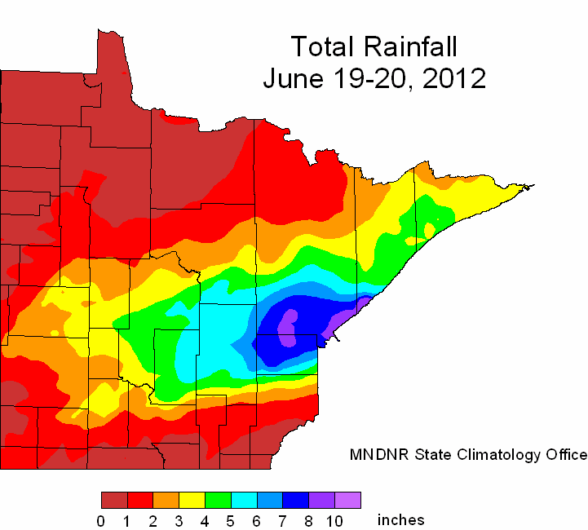
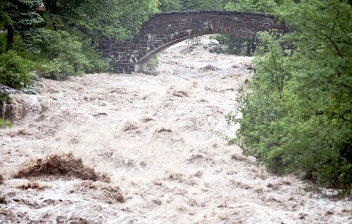
June 19-20 Duluth Area Flood

Slide 10
Future Plans
Continue to adjust to two person office
Minnesota SC Facebook Page
Transfer of web server to new host
Maintain all service and precipitation networks

Slide 11
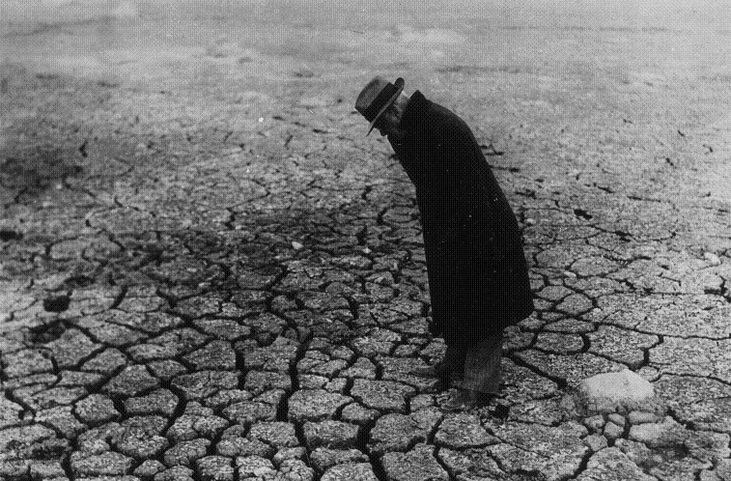
Any Questions?
Lake Traverse: Nov 7, 1934
(MN State Climatology Office Archives)

