Slide 1
South Dakota State Report
2011-12
Laura Edwards, Extension Climate Field Specialist
Dennis Todey, SD State Climatologist
Notes:
UND receiving NDSU trophy.

Slide 2
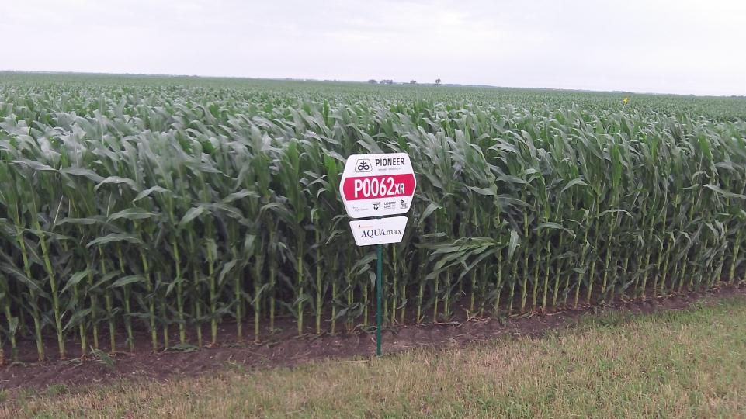
Notes:
A perfect year for a drought resistant corn study! New AquaMax hybrid research plot.

Slide 3
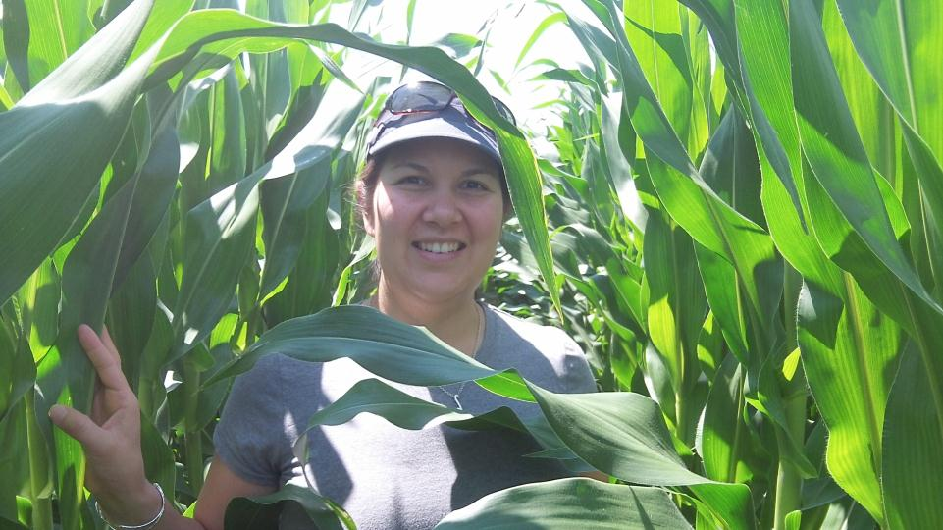
Notes:
What drought resistant corn looks like on Sunday July 8. Near tasseling stage.

Slide 4
Extension Climate Field Specialist
SDSU Extension reorganization led to hiring a Climate Field Specialist (that’s me)
Based in Aberdeen at new regional extension center
Brand new position
Department home = Ag & Biosystems Engineering
Notes:
I get to talk about me first since I’m giving this talk. ☺ Beef up on midwestern Ole and Lena jokes. ND ice. Picking up the accent again. 12% more trusted now that I’m in extension!

Slide 5
Staff in State Climate Office
Dennis Todey as state climatologist
Nathan Edwards as engineer for AWDN
Ryan VanderLeest as data specialist
Ba Nguyen as web programmer (part time)
Assistant State Climatologist to be hired, and also permanent data specialist

Slide 6
Notable Current Funded Projects
(both SCO and Extension)
USDA CSCAP: direct corn farmer interactions and professional development/continuing ed. for teachers
Pioneer: water balance in corn
USDA RMA: web tools for precipitation trends, particularly floods/wet episodes
U2U: climate tools for agriculture

Slide 7
Other activities
AWDN station maintenance
Data acquisition process update (data transmission, hardware and software)
Website redesign for SCO
CoCoRaHS
Women in Science
Weekly climate updates for ag statistics service and extension agronomists
Weekly radio segments year-round
Missouri River Basin flood, coordination and response team
Notes:
Media has been our friend so far. Extension has worked to get info out when we need it.

Slide 8
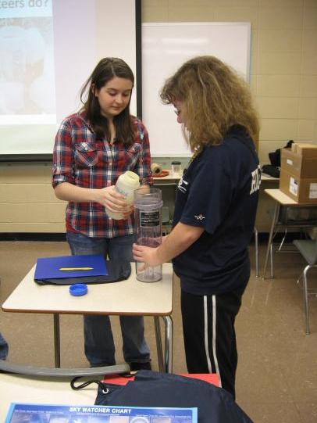
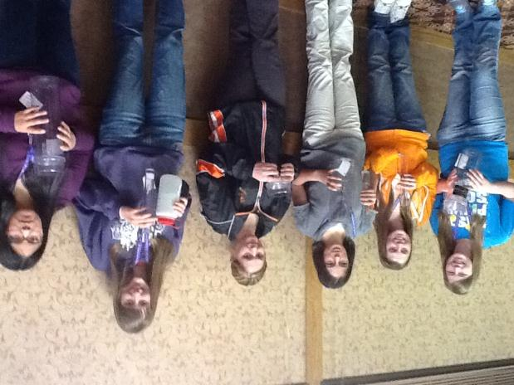
Women in Science

Slide 9
Tech time
For Extension Field Specialists, 20% of time required to create content for online/social media/blog/”tech” activities
Facebook page: SDSU Climate
Twitter feed: @climatechick (unofficial)
Extension website: igrow.org
State Climate Office website: climate.sdstate.edu

Slide 10
Events to keep life interesting
Missouri River flooding and extended period of high water, June 2011-September 2011
Rapid transition to moderate to severe drought conditions within 12 months
Hail
Wildland fires, summer 2012

Slide 11
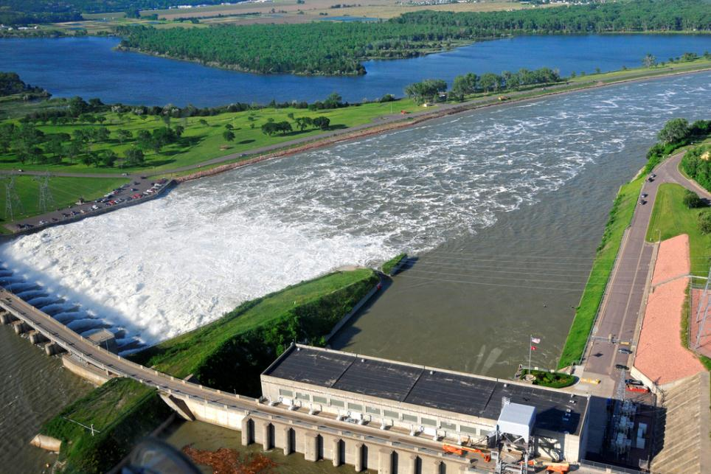
http://www.flickr.com/photos/usdagov/5869968743/sizes/l/in/photostream/

Slide 12
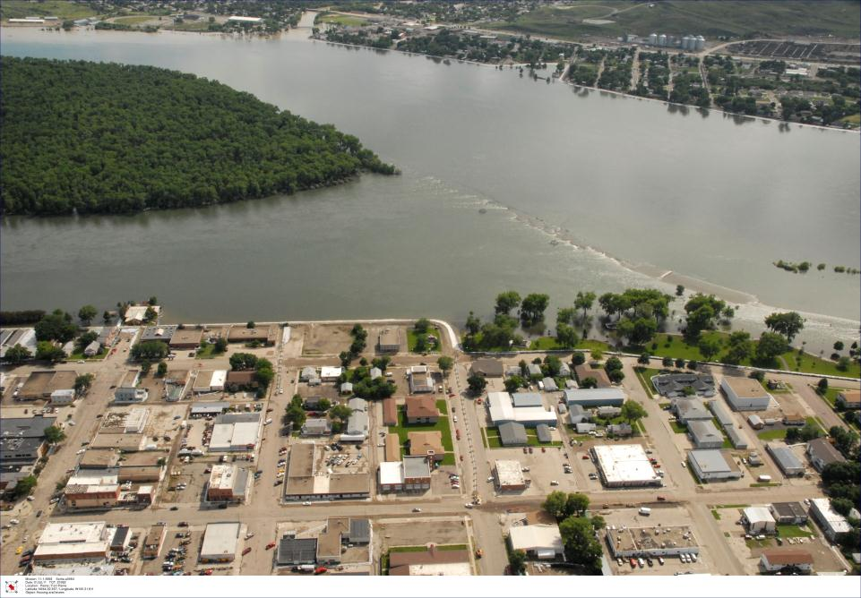
Pierre, SD July 2011

Slide 13
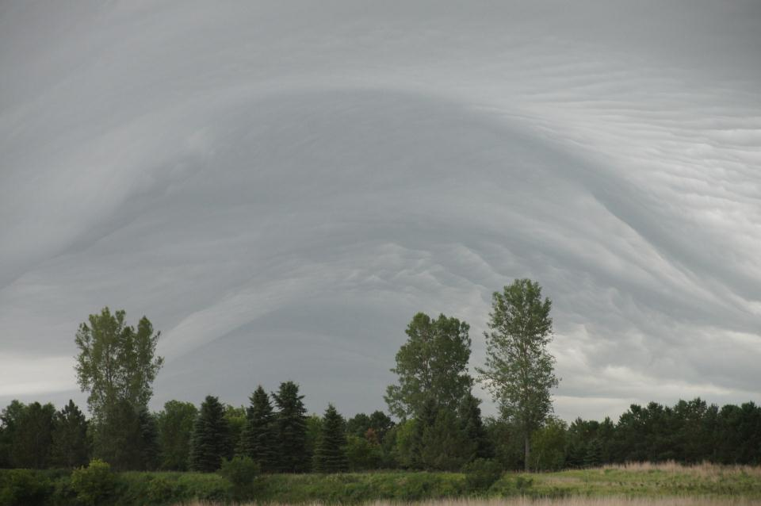
Near Aberdeen, SD June 29, 2012

Slide 14
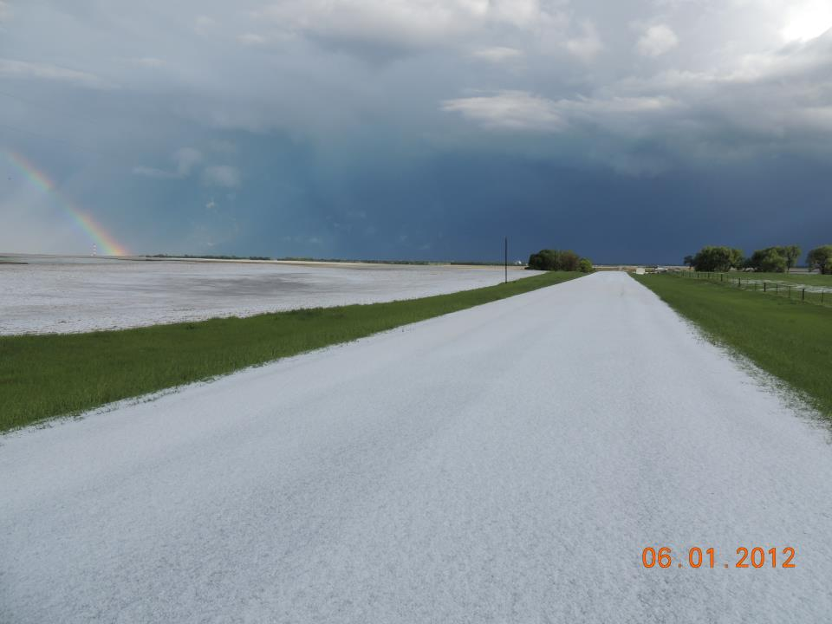
Near Britton, SD

Slide 15
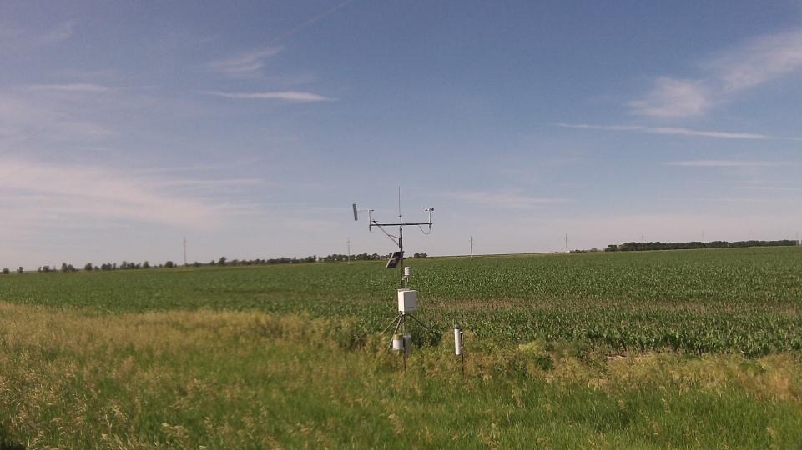
CoCoRaHS ET gauge
CoCoRaHS rain gauge

Slide 16

Contact Information
Laura Edwards, Extension Climate Field Specialist in Aberdeen
laura.edwards@sdstate.edu
(605) 626-2870
Dennis Todey, State Climatologist in Brookings
dennis.todey@sdstate.edu
(605) 688-5141

Slide 17
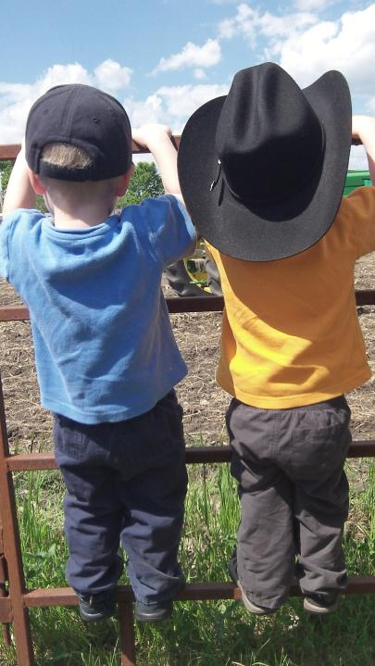
Climatologists in training
Notes:
Might be able to meet two more staff members tomorrow.

