Slide 1
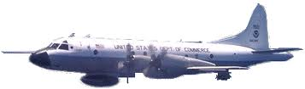
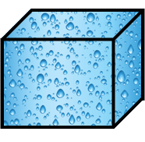
NOAA WP-3D
1 km
2 km
2 km
Saturated
Unsaturated
Release heating/cooling
No heating/cooling

