Slide 1
Earth System Modeling Task Overview
Task Members
FSU: E. Chassignet (Task Lead), M. Bourassa, D. Dukhovskoy, S. Morey, H. Hiester, W. Sturges, P. Velissariou
NRL: S. DeRada, P. Hogan
RSMAS: M. Iskandarani, V. Kourafalou, A. Srinivasan (Tendral)
USF: R. Weisberg
NMI: L. Hole, C. Wettre

Slide 2
Goal
Develop a regional Earth System Model (ESM) to:
Investigate the effects of petroleum hydrocarbons on
  Exchange processes between the ocean, atmosphere and sediments
  Biogeochemical processes
Understand the transport of marine organisms
Conduct hindcasts
Provide estimates and predictions of discharged oil’s fate and measures of confidence
Provide results and data via a web-based interface

Slide 3
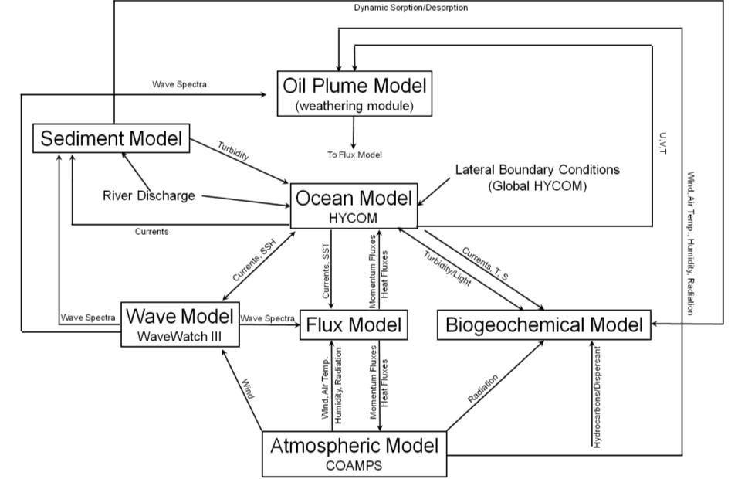
Prediction of the fate of hydrocarbons not only requires detailed knowledge of the Gulf of Mexico 3D circulation (basin-wide and shelf/coastal processes), but also knowledge of the surface winds, waves, sediments, and biogeochemistry. Integration of those modules in a Earth System Model will facilitate retrospective studies, forecasting, and scientific investigations.

Slide 4
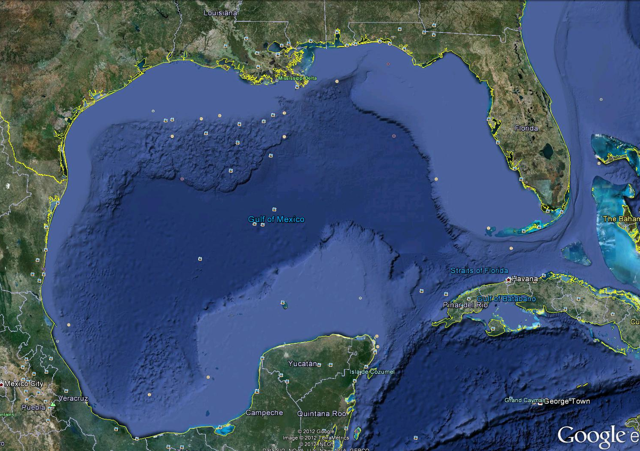
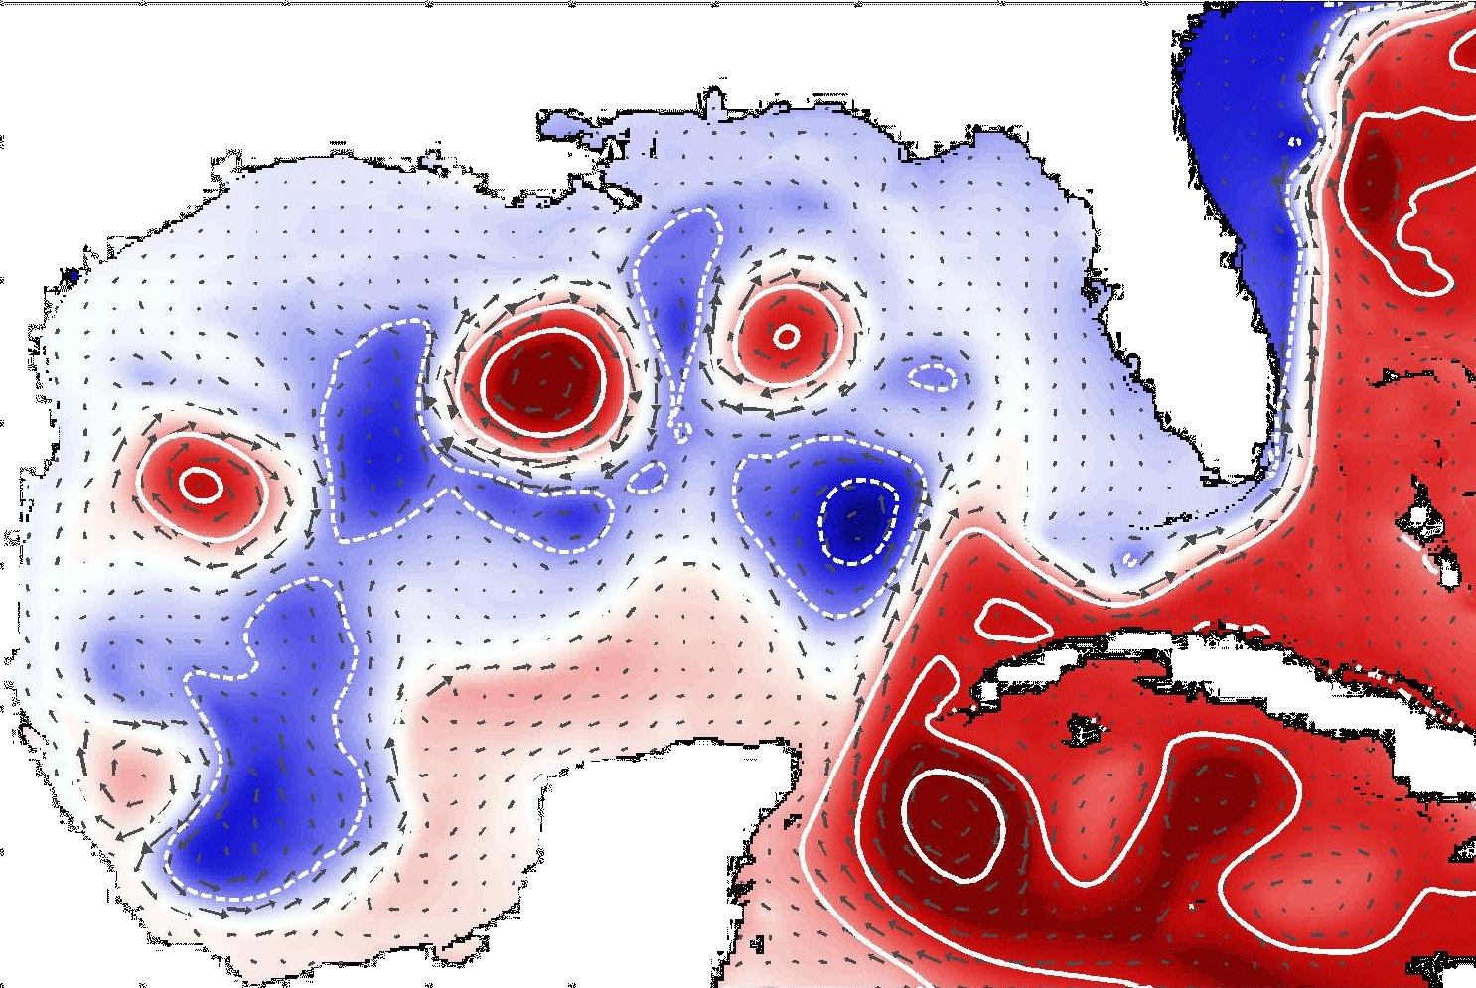
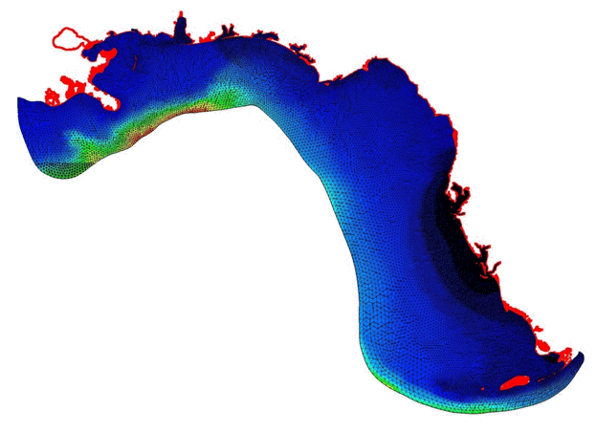
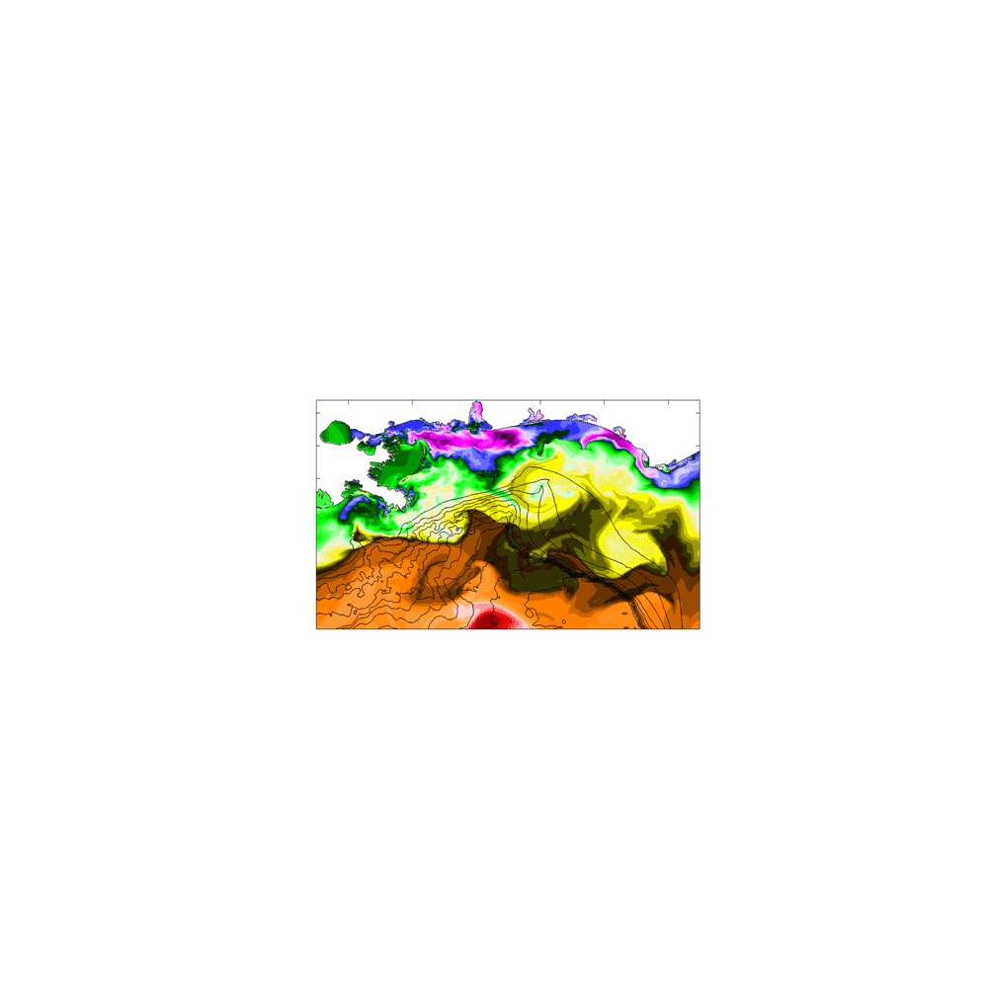
Nested Modeling Approach
Regional simulations of the DeSoto Canyon and coastal estuaries embedded in Gulf of Mexico ESM simulations

Slide 5
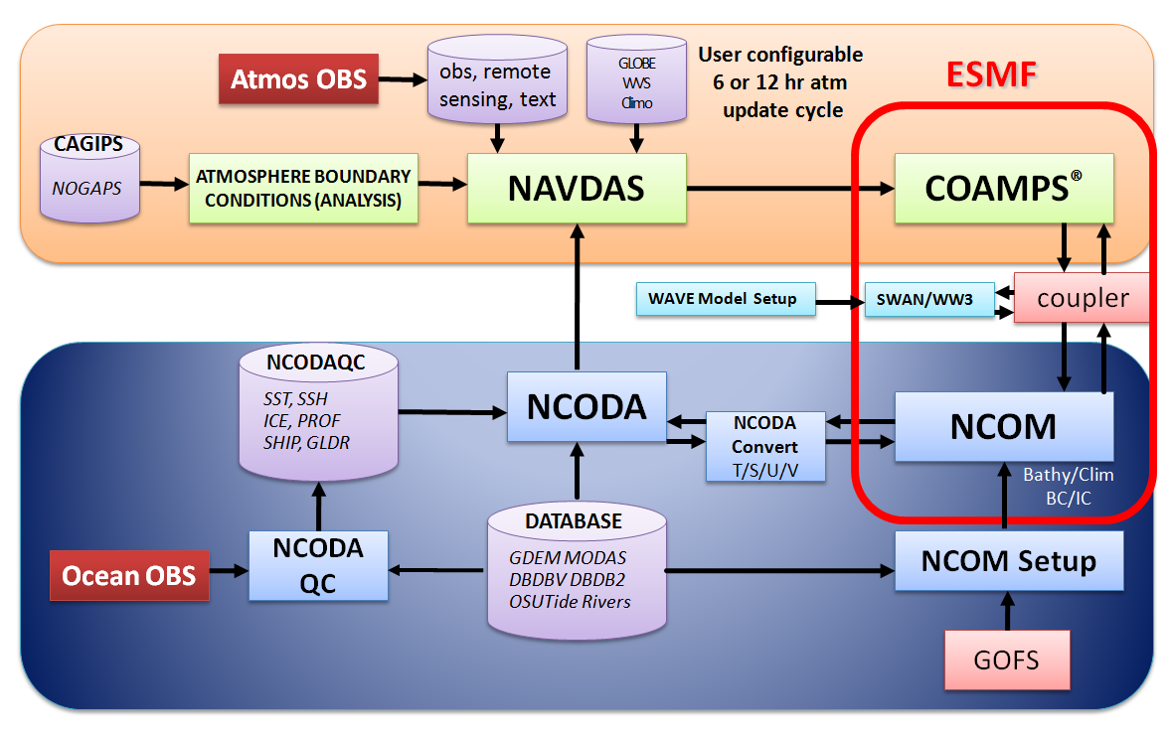
COAMPS Gulf of Mexico Model
(NRL)
Goals:
Develop a coupled Ocean (NCOM) – Atmosphere (COAMPS) – Wave (SWAN) model
Provide data assimilative nowcast/forecasts

Slide 6
COAMPS Gulf of Mexico Model
(NRL)
Tasks Accomplished:
Configured coupled ocean-atmosphere-wave forecast system for the Gulf of Mexico
  3 km resolution ocean and 6 km resolution atmosphere and waves
  Coupling via Earth System Modeling Framework (ESMF)
Performed comparisons between coupled and uncoupled forecast systems
Performed validation and verification studies

Slide 7
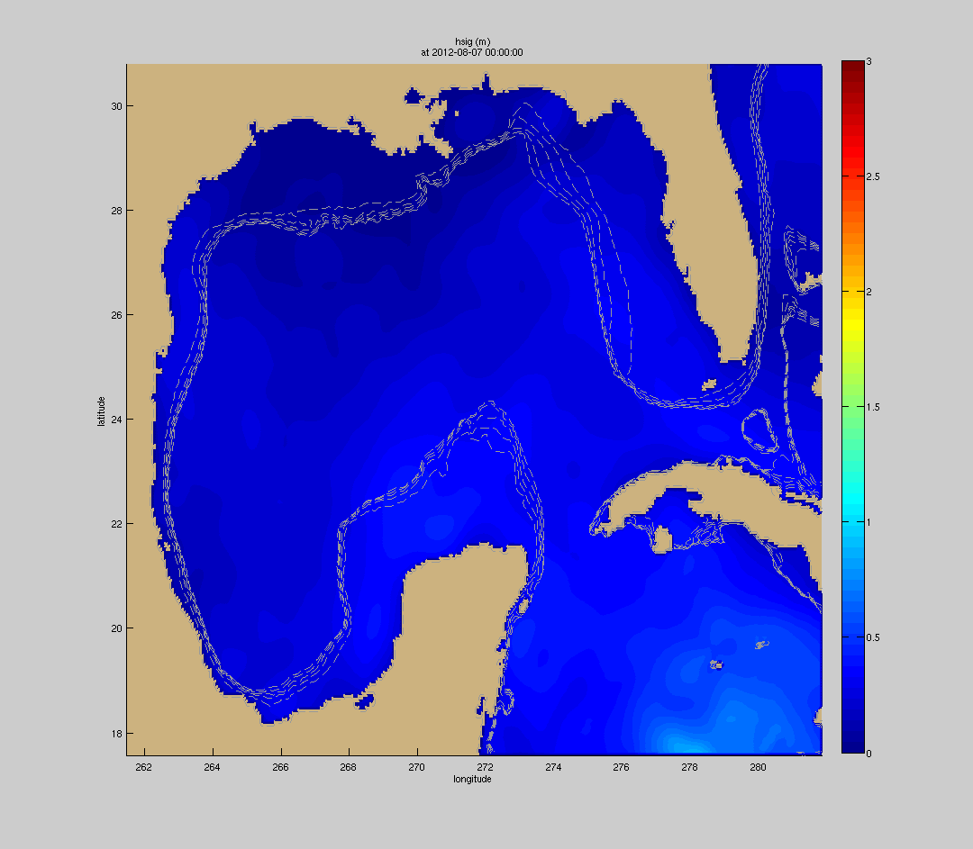
COAMPS Gulf of Mexico Model
(NRL)
Major Findings:
Inclusion of the wave component in the coupled modeling system results in enhanced vertical mixing during high-wind events
Simulated Significant Wave Height - Hurricane Ernesto

Slide 8
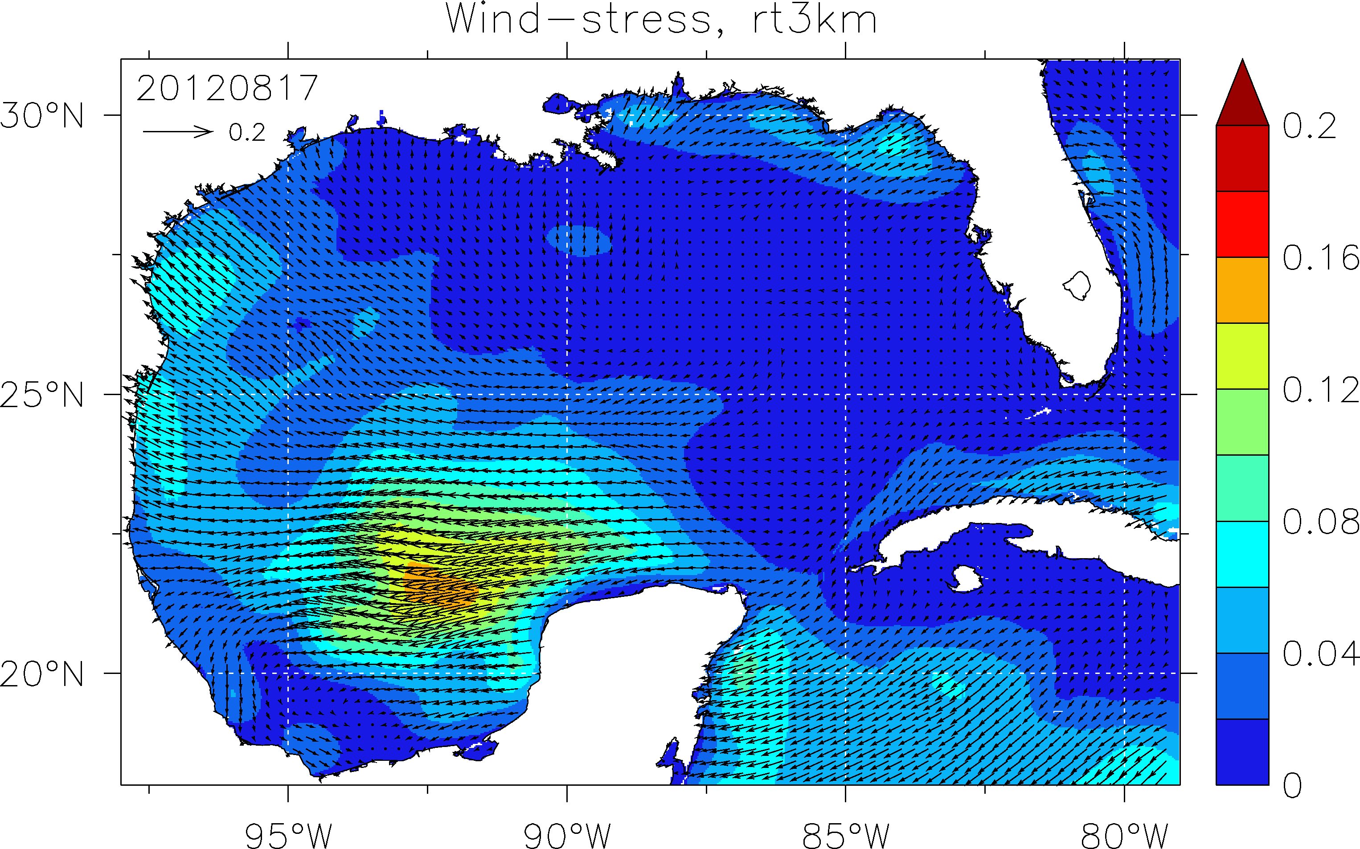
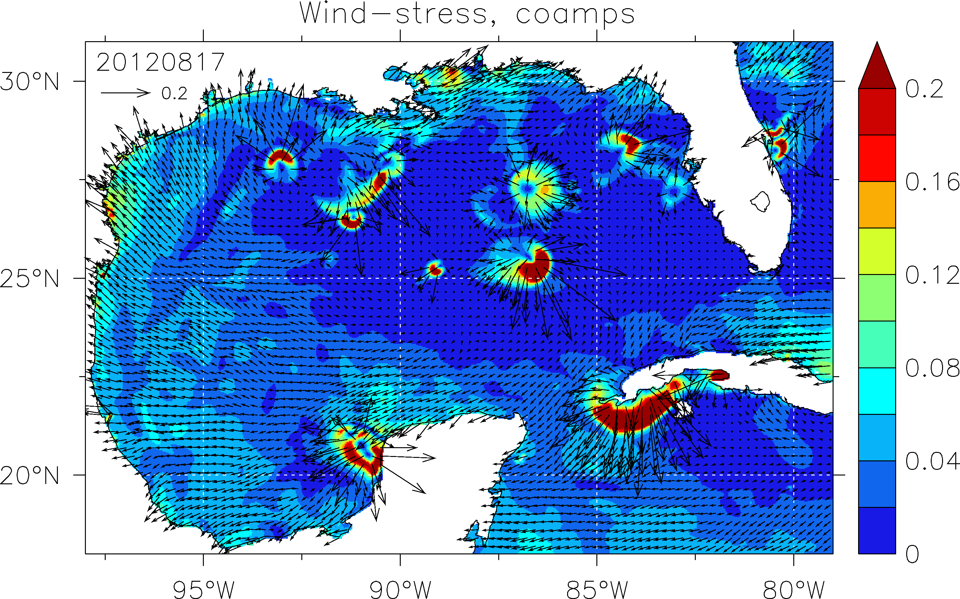
COAMPS Gulf of Mexico Model
(NRL)
Major Findings:
High-resolution atmospheric forcing resolves finer scale features (e.g. convective systems) and results in increased oceanic surface dispersion
Optimizations to the NCODA data assimilation system results in more accurate oceanic forecasts
27-km COAMPS
6-km COAMPS

Slide 9
Gulf of Mexico Ecosystem Modeling
(NRL)
Goals:
Integrate a marine ecosystem modeling component into the Earth System Model for the Gulf of Mexico
Provide nowcast/forecast biogeochemical fields
Provide initial and boundary conditions for regional/coastal biogeochemical modeling components

Slide 10
Gulf of Mexico Ecosystem Modeling
(NRL)
Tasks Accomplished:
The Gulf of Mexico NCOM (Navy Coastal Ocean Model) has been coupled to the COSINE-13 ecosystem model.
The system has been tested by providing near-real-time runs to support Deep-C cruises.
A data-assimilative hindcast from 2000-2010 has been run to assess model skill.

Slide 11
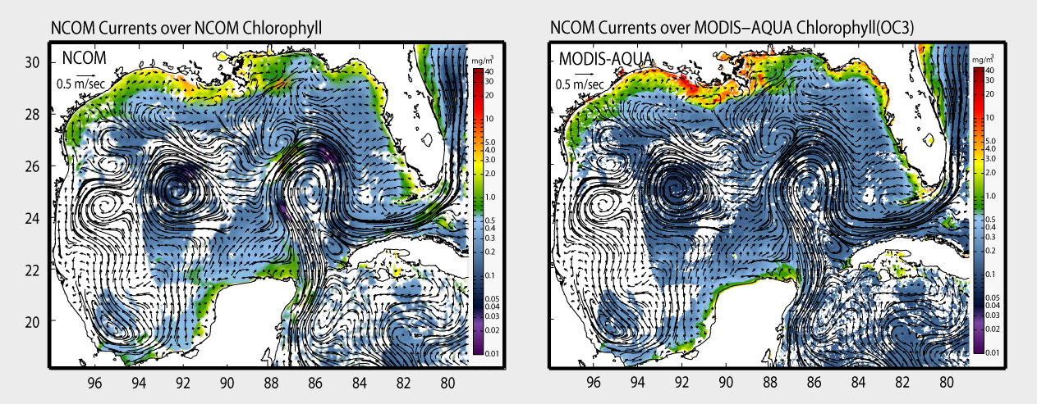
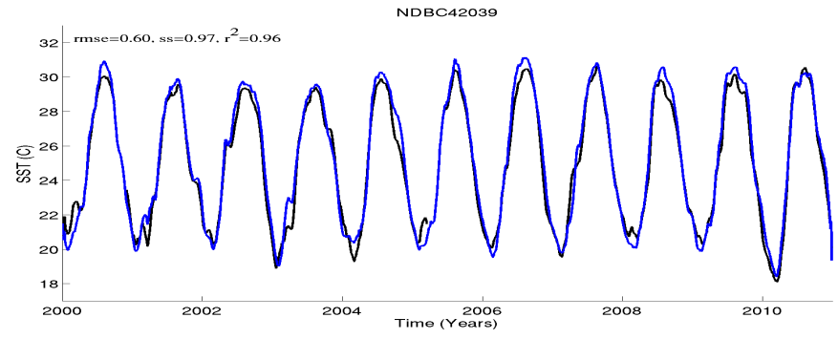
Gulf of Mexico Ecosystem Modeling
(NRL)
Major Findings:
Physical and biological fields have been validated against in situ and remotely sensed observations.
NOAA8729840
SS=0.71, r² = 0.83
SSH@PENSACOLA
2009
An 8-day composite (May 25-June 1, 2009) of the Gulf of Mexico region is used as a general qualitative comparison of the model computed chlorophyll (left) to the imagery derived from satellite (MODIS-AQUA) via the OC3 algorithm (right). In order to provide a better visual comparison, the model data was interpolated to the satellite grid and cloud-masked, and the model currents were overlaid on both plots.
SST@PENSACOLA
SS=0.97, r² = 0.96
Model (blue) evaluation in the “De Soto Canyon” region: SSH (top) real-time simulation (2009), and SST (bottom) long-term simulation (2000-2010), compared to NOAA tide-gauge and NDBC buoy observations (black); respectively.

Slide 12
ESM for the Gulf of Mexico (GoM-CRMS)
(Florida State Univ.)
Goals:
Develop a coupled Ocean – Atmosphere – Wave – Sediment transport modeling system (GoM-CRMS, based on COAWST) to:
  Aid coastal and offshore engineering applications.
  Provide quality, high resolution boundary and initial conditions to finer resolution regional models.
  Identify processes leading to transport between the deep ocean and the coastal environment.
  Be used for model inter-comparisons.

Slide 13
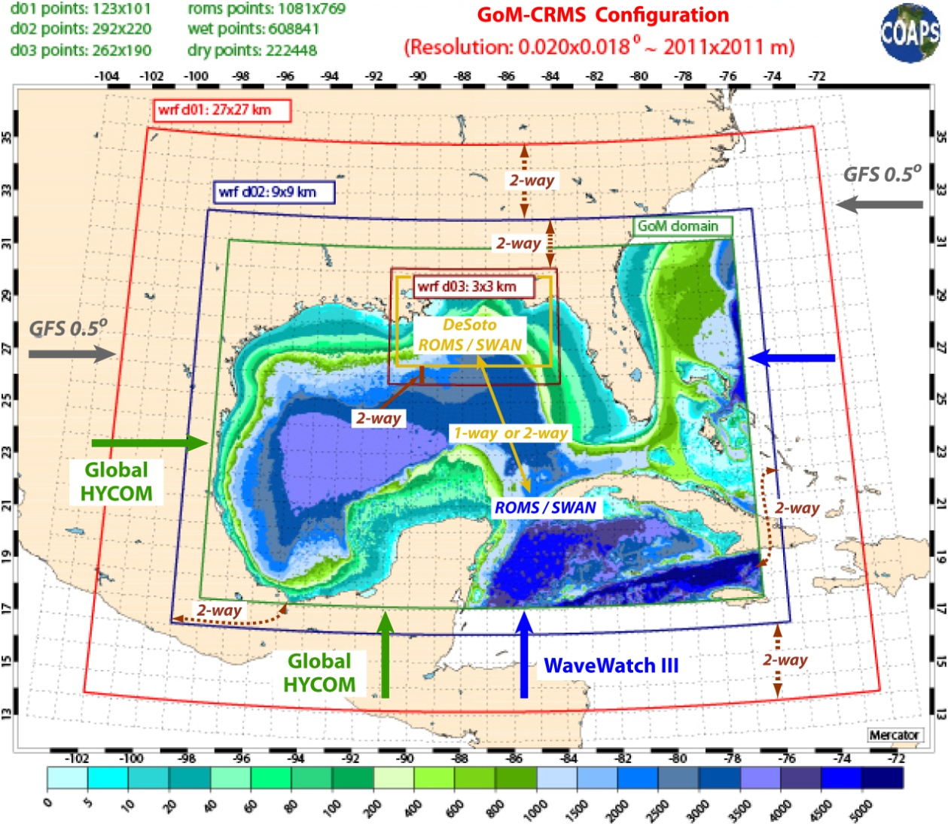
ESM for the Gulf of Mexico (GoM-CRMS)
(Florida State Univ.)
System Configuration:
ROMS and SWAN resolution: 0.02 x 0.02º.
WRF resolution: 27 x 27 km.
Multiple high resolution nests for all models.
Two-way coupling between models.
Two-way communication between nests (except SWAN).
Atm. BCs by GFS 0.5 x 0.5º.
Ocean BCs by global HYCOM.
Wave BCs by WWIII.

Slide 14
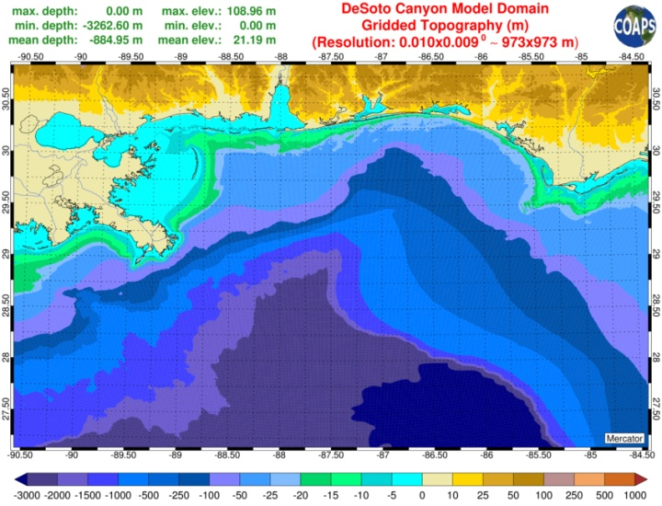
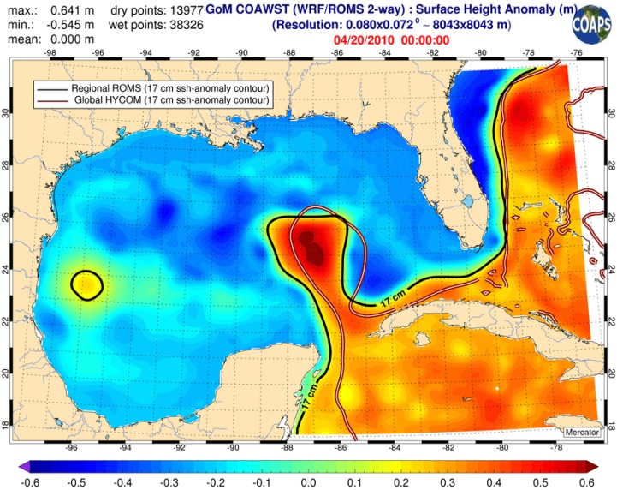
ESM for the Gulf of Mexico (GoM-CRMS)
(Florida State Univ.)
Tasks Accomplished:
Developed improved 1-km/2-km resolution gridded topo-bathymetries with edited coastline for use by the modeling community.
Established GoM-CRMS as hindcast/nowcast prediction system.
Incorporated WRF, ROMS and SWAN modeling components.
Evaluation:
WRF is being evaluated on 1993 Super-storm simulations.
ROMS and SWAN are evaluated on 2010 simulations.

Slide 15
ESM for the Gulf of Mexico (GoM-CRMS)
(Florida State Univ.)
Deliverables and Future Tasks:
Deliver atmospheric (winds, air temp, etc), ocean (currents, salinity, etc) and wave (spectra, heights, etc) of high spatial and temporal resolution products by December 2013.
Configure the sedimentary environment (bottom and shoreline sediment classes and fractions) of the Gulf of Mexico region. Develop gridded sediment distribution databases (for modeling tasks).
Incorporate and evaluate the sediment model in GoM-CRMS.

Slide 16
ESM for the DeSoto Canyon Region
(Florida State Univ.)
Goals:
Apply a coupled Ocean – Atmosphere – Wave – Sediment transport modeling system (COAWST) to understand dynamics responsible for fate and distribution of hydrocarbons in the DeSoto Canyon region, and characterize processes leading to transport between the deep ocean and coast
Provide modularity and enhancements to the coupled modeling system.

Slide 17
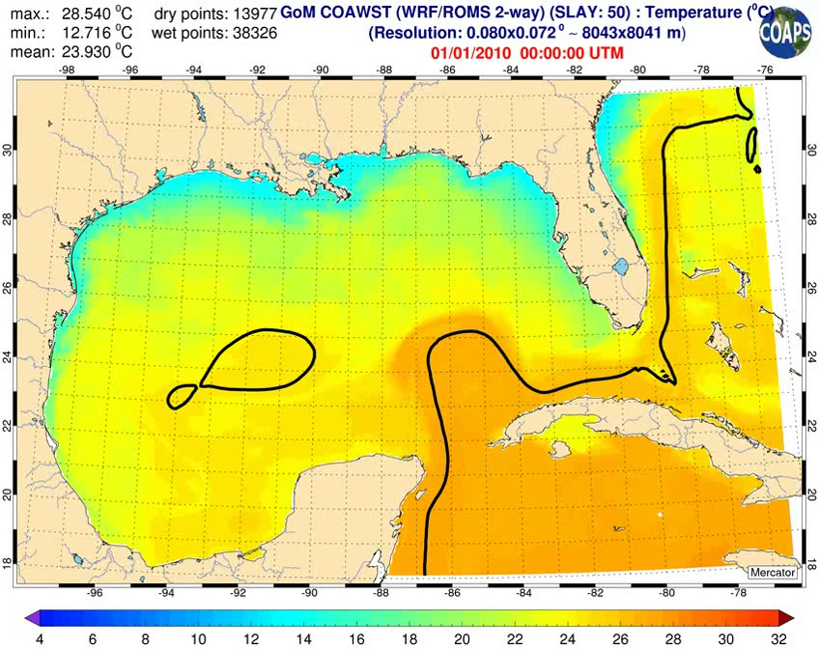
ESM for the DeSoto Canyon Region
(Florida State Univ.)
Tasks Accomplished:
COAWST has been implemented for the Gulf of Mexico region for testing, model intercomparison, and provision of boundary conditions to regional models.
An improved 1-km resolution bathymetry for the Gulf of Mexico has been developed with edited coastline for use by the modeling community.

Slide 18
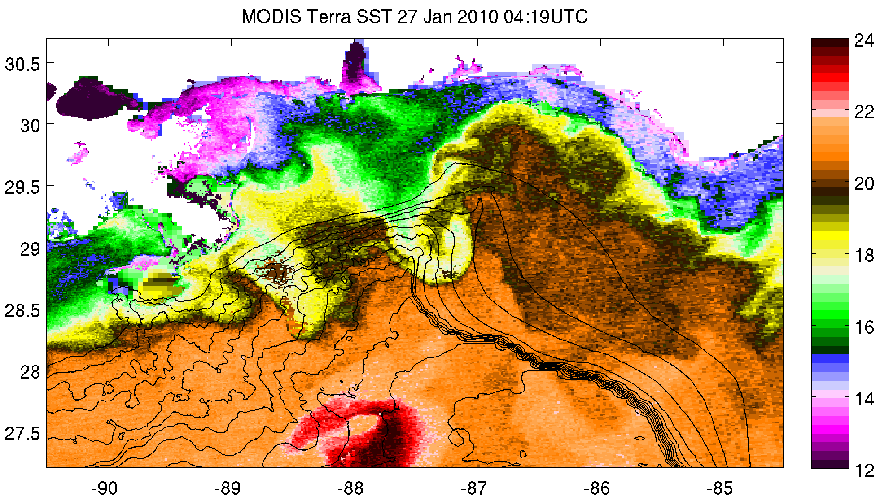
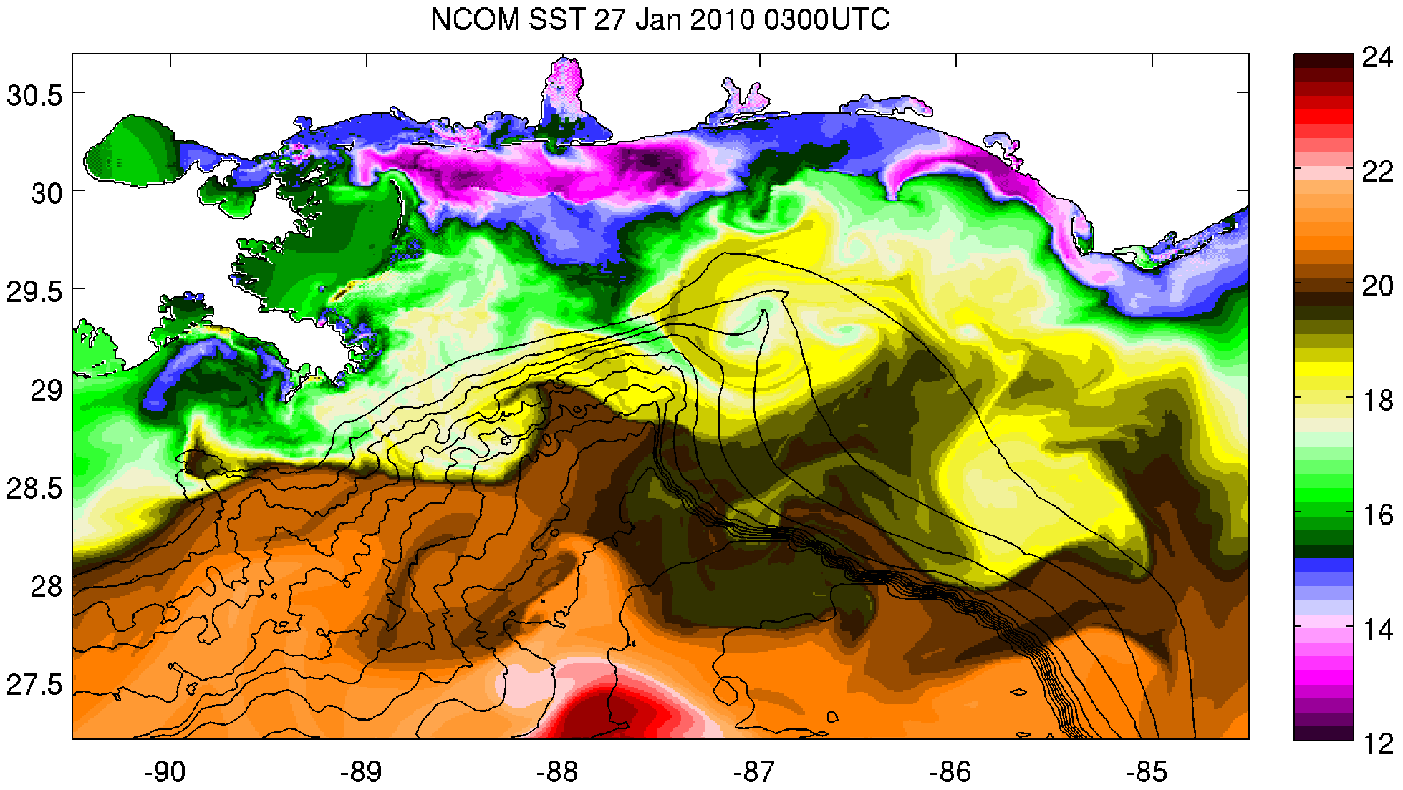
ESM for the DeSoto Canyon Region
(Florida State Univ.)
MODIS Satellite SST: 27 January 2010
Tasks Accomplished:
Multiple ocean simulations have been configured for the DeSoto Canyon region (NCOM, ROMS, HYCOM)
  High (1-km) horizontal and varying vertical (up to 80 layers) resolution
  Hand-edited bathymetry/coastline
  Daily discharge from all gauged rivers and streams
  Hourly atmospheric forcing
  Nested within the data assimilative Gulf of Mexico HYCOM
NCOM Simulated SST: 27 January 2010

Slide 19
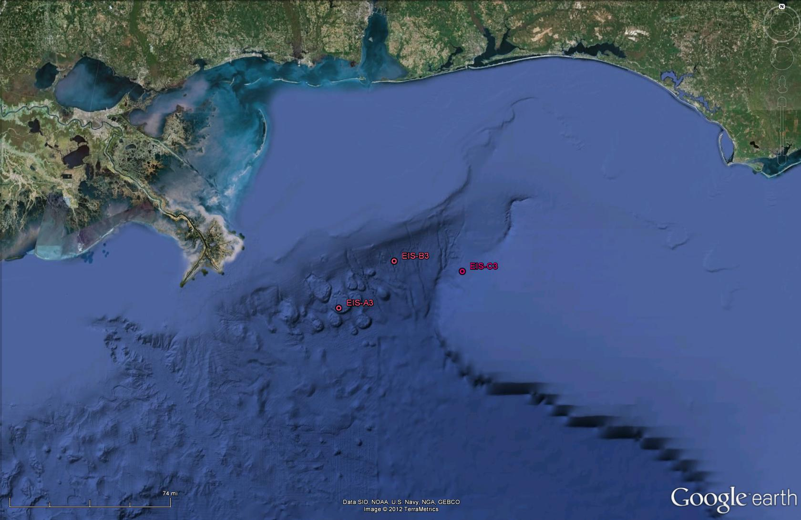
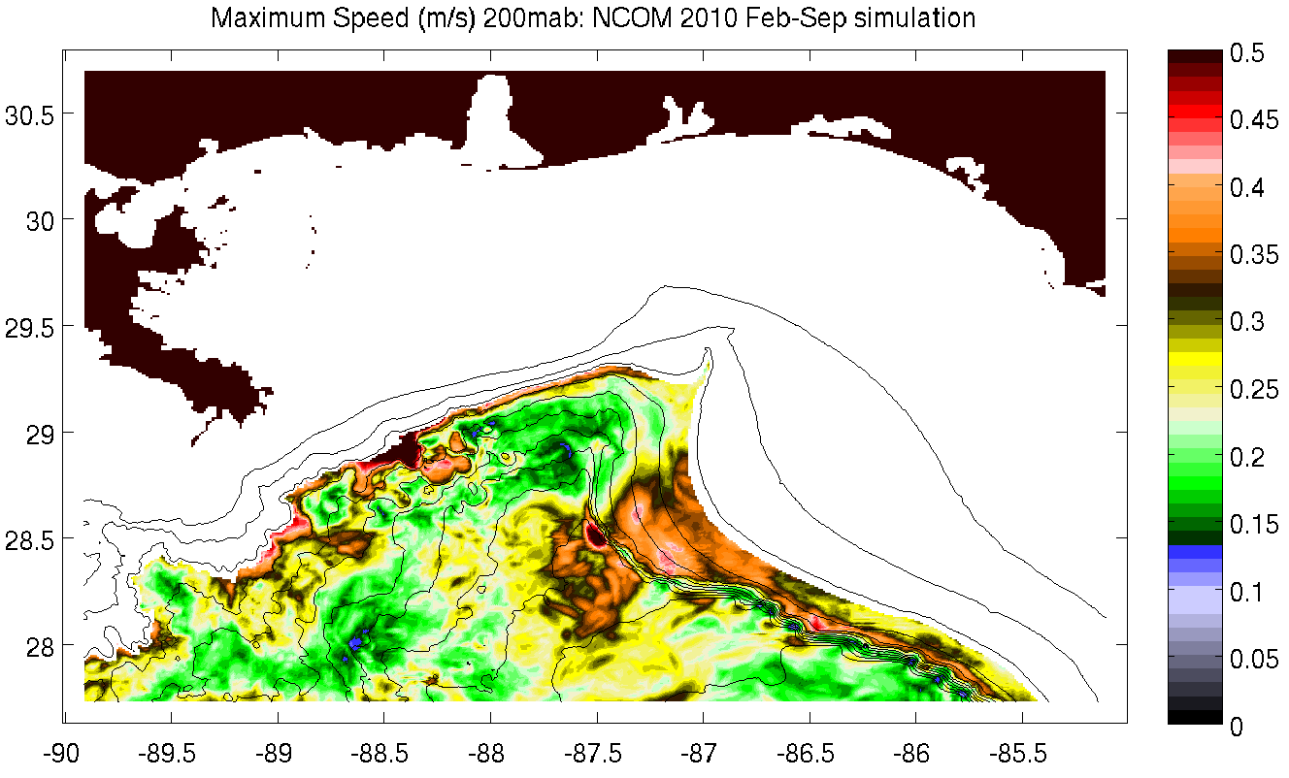
ESM for the DeSoto Canyon Region
(Florida State Univ.)
MMS-SAIC DeSoto Canyon Eddy Intrusion Study (1997-1999)
Major Findings:
The NCOM simulation has been developed to allow accurate simulation of deep flows and their interaction with steep bathymetric features.
Inspection of historic observations shows times of enhanced near-bottom speed at depths typified by less energetic currents.
NCOM simulations show evidence of trapping of strong currents to the Florida Escarpment that may be linked with interaction with deep circulation features
1997-1999 Mean Speeds (~1300m)
1997-1999 Maximum Speeds (~1300m)
4.6 cm/s
5.3 cm/s
27.7 cm/s
48.6 cm/s
4.0 cm/s
29.3 cm/s

Slide 20
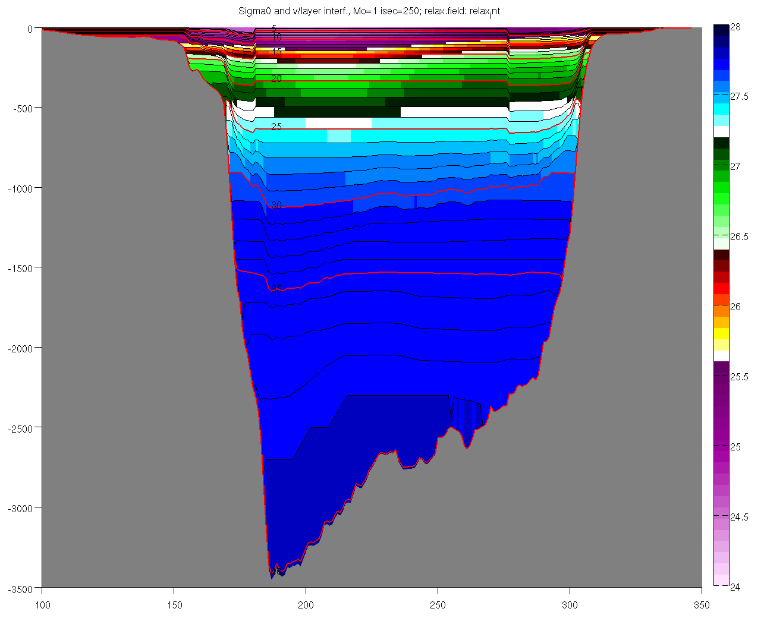
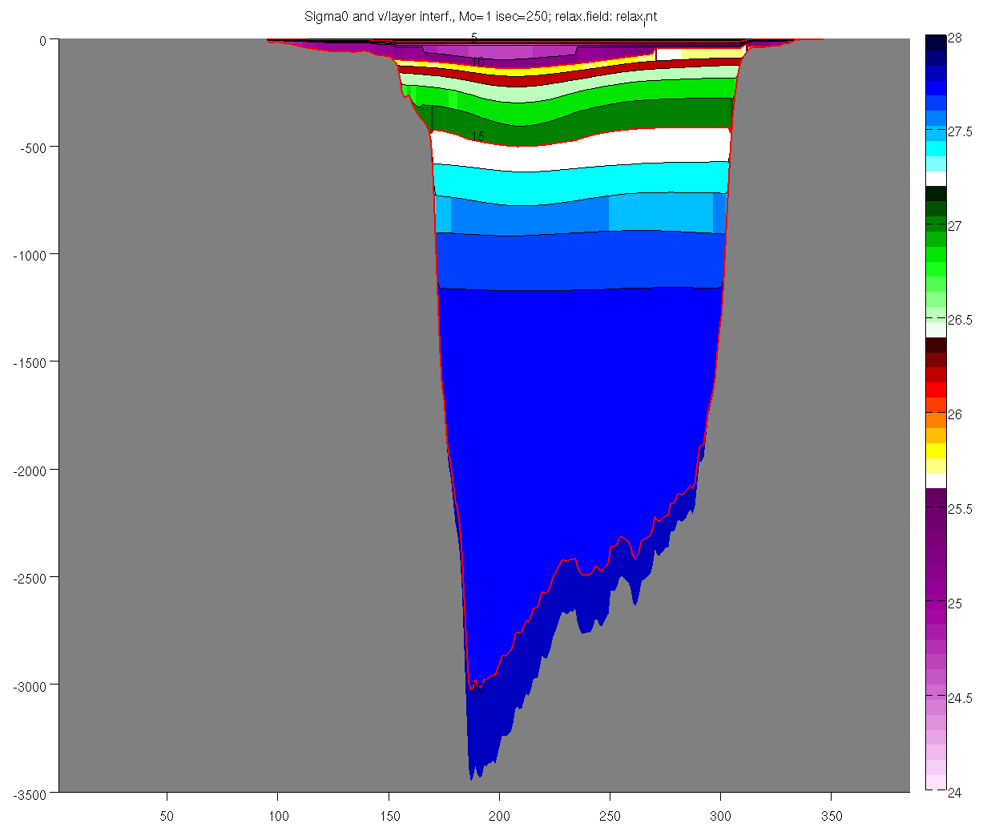
ESM for the DeSoto Canyon Region
(Florida State Univ.)
Tasks Accomplished:
A new higher vertical resolution HYCOM Gulf of Mexico simulation has been developed and run for comparison to the current model and to understand deep currents in the GoM
Vertical Grid in GOMl0.04 with 40 (left) and 20 (right) layers
The new vertical grid with 40 layers (left) provides notably higher resolution of the deep ocean compared to the 20-layer grid (left). Higher vertical resolution may be crucial for accurate simulation of deep ocean dynamics over steep topography, such as in the De Soto Canyon.

Slide 21
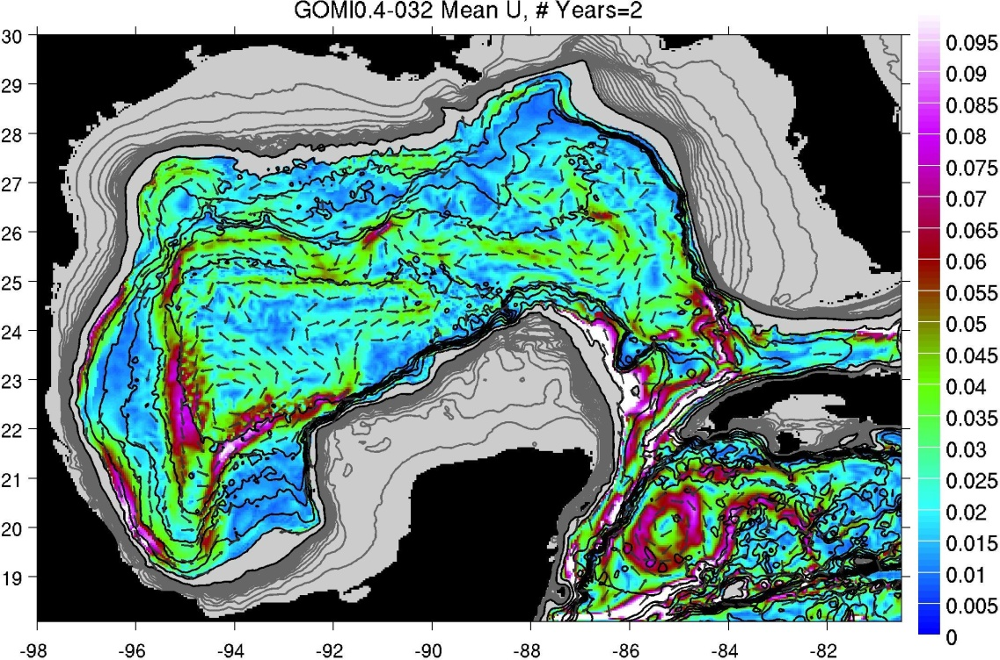
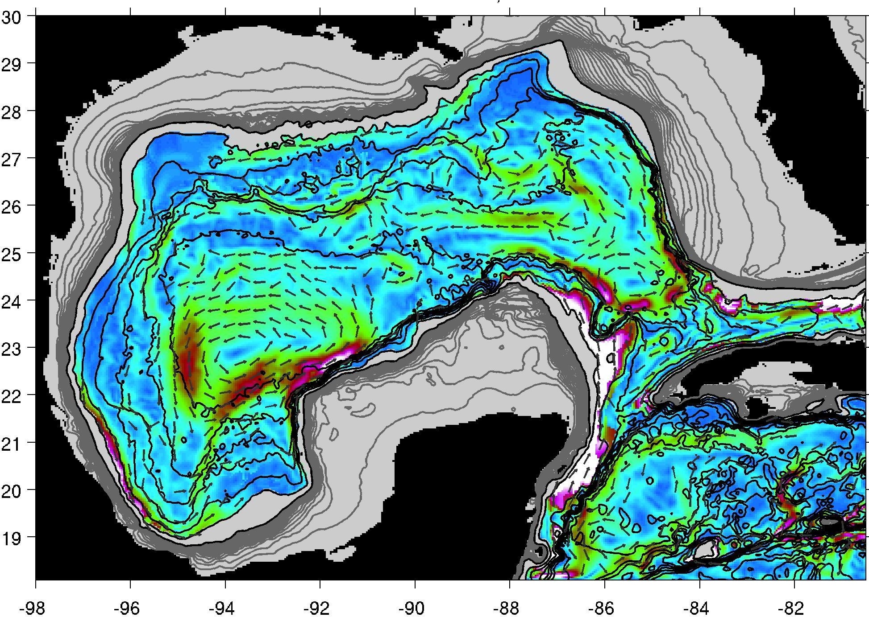
ESM for the DeSoto Canyon Region
(Florida State Univ.)
Major Findings:
Analysis of a 50-year free-running HYCOM simulation shows interaction between upper ocean and deep flows that may impact the DeSoto Canyon region.
Enhanced vertical resolution of the HYCOM leads to more energetic deep currents.
Mean Near-Bottom Currents from HYCOM with 40 (Left) and 20 (right) Vertical Layers

Slide 22
Coastal and Estuarine Modeling
(Univ. South Florida)
Goals:
Develop a coastal ocean model to downscale from the deep ocean, across the continental shelf and into the estuaries.
Gauge performance through quantitative comparisons against in situ observations.
Establish a daily, automated nowcast/forecast system for circulation and waves publically available on the internet.

Slide 23
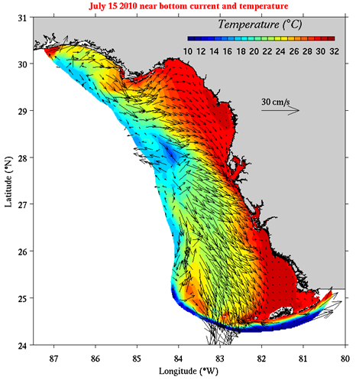
Coastal and Estuarine Modeling
(Univ. South Florida)
Major Findings:
A hindcast of 2010 using an FVCOM simulation embedded in HYCOM shows that year had anomalous upwelling from May (LC eddy shed) through December.
No K. brevis red tide occurred in 2010
  Zheng and Weisberg, 2012, Ocean Modelling
  Weisberg et al, 2013, Harmful Algae, in press
Bottom V superimposed on temperature for 7/15/10. Upwelling was driven primarily by LC interaction with the shelf slope near the Dry Tortugas

Slide 24
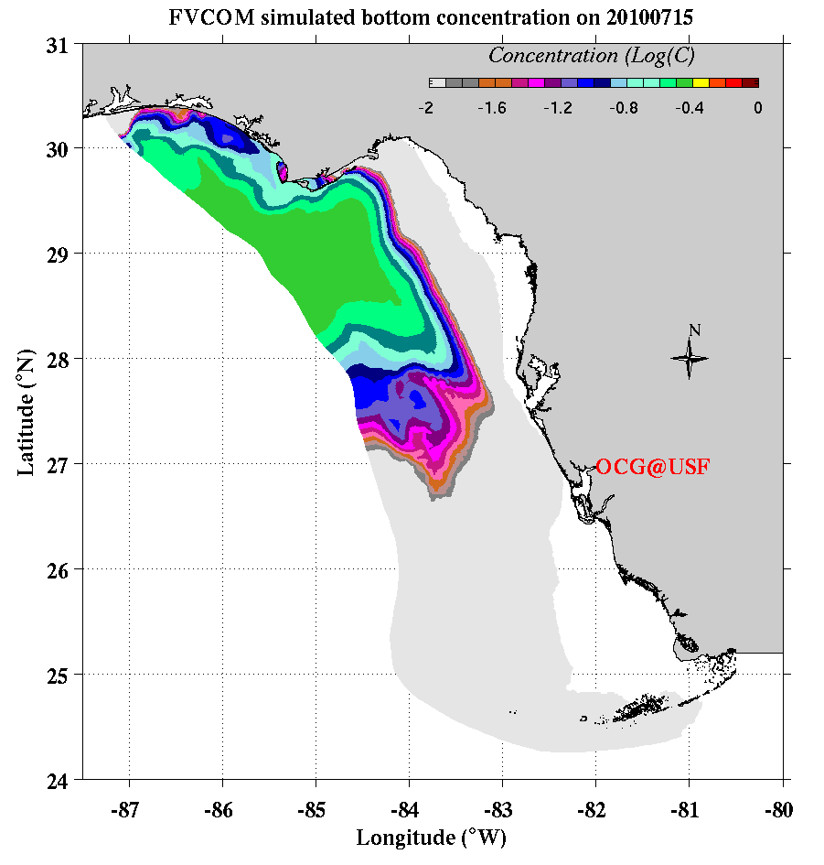
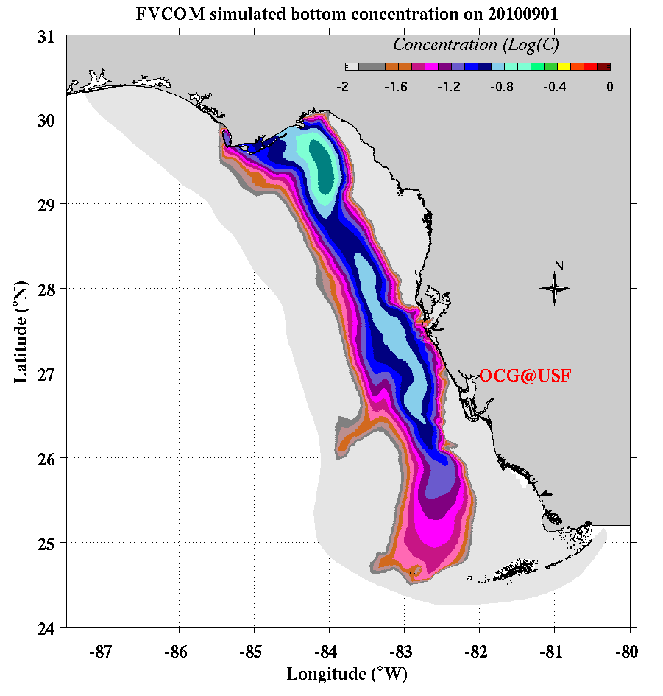
Coastal and Estuarine Modeling
(Univ. South Florida)
Major Findings:
The intense and prolonged upwelling in 2010 would have transported material properties (including hydrocarbons) from the north Florida shelf to the WFS.
Normalized tracer concentration on 7/15/10 and 9/1/10 given an initialization off the north Florida coast on 6/19/10. Blue represents a 90% reduction from the initial concentration.

Slide 25
River Plume Dynamics for the ESM and Oil Drift Model
(Univ. of Miami)
Goals:
Develop, implement and test improved parameterization of river plume dynamics in the Earth System Model
Simulate influence of river plumes on surface oil drift

Slide 26
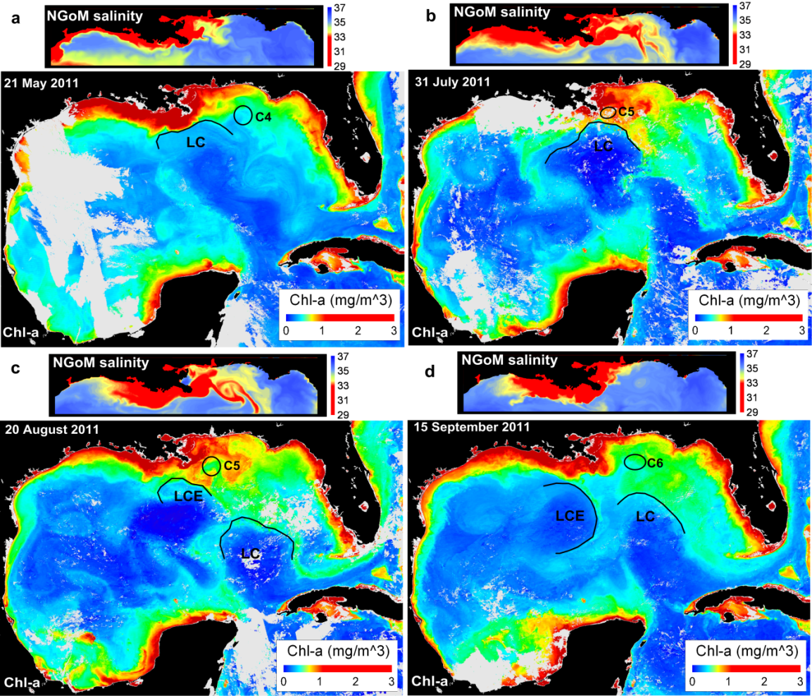
River Plume Dynamics for the ESM and Oil Drift Model
(Univ. of Miami)
Major Findings:
Interaction of the Mississippi River plume with the DeSoto canyon and Northeastern GoM under flood conditions depends on the status of the Loop Current system intrusions
(Androulidakis and Kourafalou, 2013, Ocean Dynamics)

Slide 27
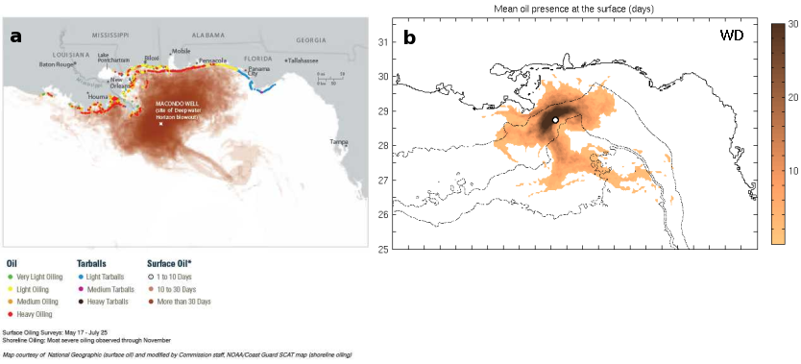
River Plume Dynamics for the ESM and Oil Drift Model
(Univ. of Miami)
Major Findings:
Modeling the transport of the DwH surface oil requires adding wind drift in hydrodynamic fields employed by a fully 3D oil spill model
Oil presence (number of days observed), from observations (left, NOAA), and model outputs (CMS oil model + NRL GoM HYCOM)
(Le Henaff, Kourafalou, Paris, Helgers, Hogan, Srinivasan, 2012, Environ. Sci. Technol.)

Slide 28
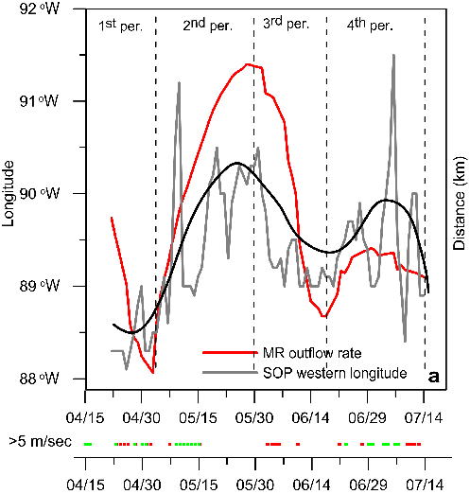
River Plume Dynamics for the ESM and Oil Drift Model
(Univ. of Miami)
Major Findings:
Transport of the DwH surface oil patch was influenced by the variability in the Mississippi River plume.
Black line: western longitude reached by the Surface Oil Patch
Red line: Mississippi River discharge
(Kourafalou and Androulidakis, 2013, JGR, In Review)

Slide 29
3-D Oil Spill Modeling and Uncertainty Quantification
(Univ. of Miami, Tendral)
Goals:
Develop a fully open source oil spill model integrated with an ocean forecast system that includes undertainty quantification suitable for operational oil spill monitoring and decision support
Collaborate with CARTHE and Norgegian Met office to validate the components of the oil spill model

Slide 30
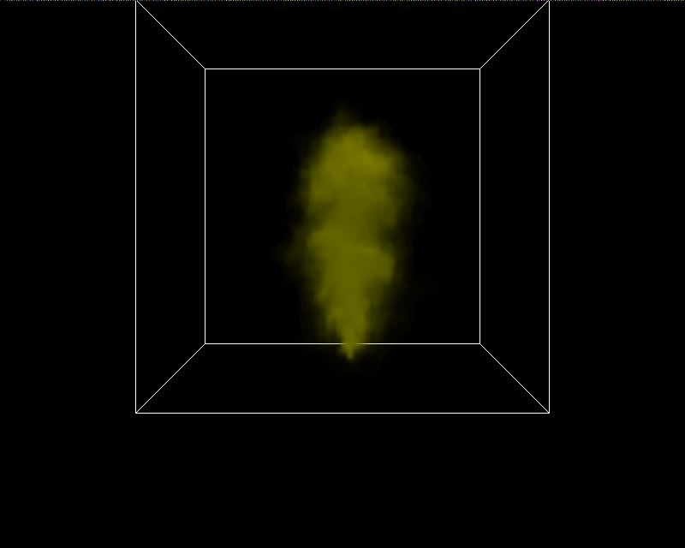
3-D Oil Spill Modeling and Uncertainty Quantification
(Univ. of Miami, Tendral)
Major Findings:
A non-hydrostatic 3D Fast Plume Model has been developed that simulates plume dynamics in the case of a subsea blowout
  Example of an idealized plume simulated by the
  Fast Plume Model. Unlike other CFD based approaches
  this model is very fast, light and suitable for real-time
  operations. The algorithms used in the development have
  been chosen so that this model can be efficiently
  integrated into the larger scale oil spill model.

Slide 31
Oil Drift and Weathering Model
(Norwegian Met. Inst.)
Goals:
Perform oil drift simulations for the DWH 2010 spill.
Develop an open source oil drift code (with Srinivasan) to be an integral component of the ESM.
Create web services for operational oil drift modeling.
Perform Lagrangian field studies

Slide 32
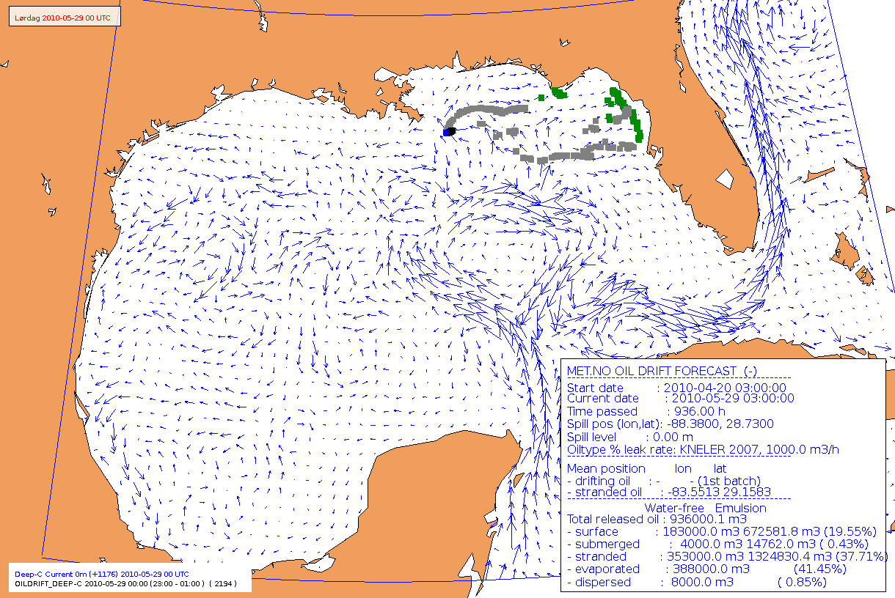
Oil Drift and Weathering Model
(Norwegian Met. Inst.)
Major Findings:
The first test simulations of the DWH spill have been run
Two peer-reviewed papers have been published on oil drift modeling

Slide 34
Earth System Modeling
Year 2 Planned Tasks
Task Members
FSU: E. Chassignet (Task Lead), M. Bourassa, D. Dukhovskoy, S. Morey, H. Hiester, W. Sturges, P. Velissariou
NRL: S. deRada, P. Hogan
RSMAS: M. Iskandarani, V. Kourafalou, A. Srinivasan (Tendral)
USF: R. Weisberg
NMI: L. Hole, C. Wettre

Slide 35
COAMPS Gulf of Mexico Model
(NRL)
Year 2 Plans:
Investigate linkage between deep and shallow circulation in DeSoto Canyon region; emphasis on upwelling and vertical mixing
Process studies: different atmospheric conditions (hurricane, etc.) and river flow conditions
Investigate impact of high resolution coupled atmosphere/ocean in littoral regions
Continue to run in real time, increase forecast length
Implement 12/24 atmosphere/ocean update cycle
Port to the new DSRC computers this fall
Implement improvements in nowcast/forecast system
  Real-time river forcing
  Global HYCOM boundary conditions
  Implement wave coupling

Slide 36
Gulf of Mexico Ecosystem Modeling
(NRL)
Year 2 Plans:
Continue the Gulf of Mexico model 2000-2010 simulation to the present and into near-real time and fully automate real-time system and product production
Construct a Northern Gulf of Mexico climatology (data and figures) of validated model and ocean color products
Compare model to observational data collected during the Deep-C cruises. Validate meso-scale processes in the De Soto Canyon area as compared to other collaborator’s research. Publish pertinent results.
Start modularizing the ecosystem code to become an independent “callable” component that can be incorporated into the COAMPS coupled system
Setup a De Soto Canyon COAMPS nest to start test runs of the COAMPS system with the newly coupled ecosystem

Slide 37
ESM for the DeSoto Canyon Region
(Florida State Univ.)
Year 2 Plans:
Run coupled ocean-atmosphere-wave hindcasts for 2010 over the Gulf of Mexico and DeSoto Canyon domains
Perform model intercomparison and validation – extend simulations for comparison with Deep-C observations
Continue ocean process studies
  Deep flows in the Gulf of Mexico
  Slope circulation in DeSoto Canyon

Slide 38
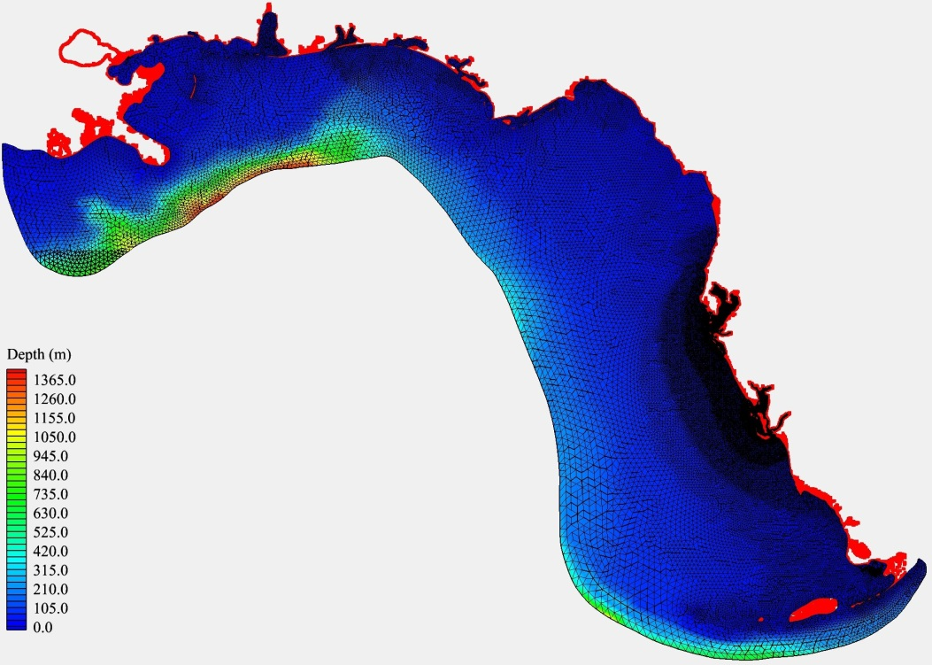
Coastal and Estuarine Modeling
(Univ. South Florida)
Year 2 Plans:
Complete tracer work and examine linkages with evidence from fish lesions and sediments
Complete testing of new model grid (with flooding/drying) to allow forecasts of impacts of spills on all major estuaries in the eastern GoM
Continue data assimilation work
Expand ecology collaboration.
Expanded model domain: FVCOM nested in HYCOM.

Slide 39
River Plume Dynamics for the ESM and Oil Drift Model
(Univ. of Miami)
Year 2 Plans:
Evaluate river plume dynamics in the ESM
Analyze select test cases under different shelf and offshore conditions
Perform comparisons to satellite and in situ observations

Slide 40
3-D Oil Spill Modeling and Uncertainty Quantification
(Univ. of Miami, Tendral)
Year 2 Plans:
Release a beta/demonstration version of the oil spill model on the Deep-C website
Collaborate with NMI and CARTHE to further develop and validate the open source model, including simulation results from the new open source model with existing models and other high-fidelity simulations
Implement Polynomial Chaos-based uncertainty quantification methods.

Slide 41
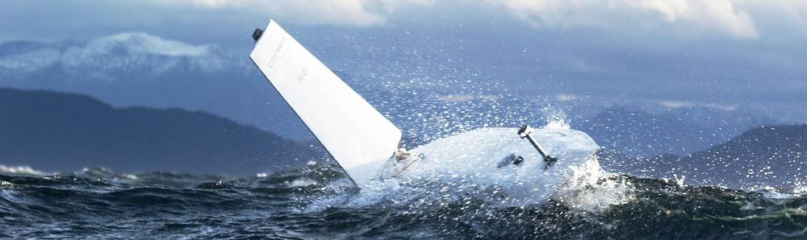
Oil Drift and Weathering Model
(Norwegian Met. Inst.)
Year 2 Plans:
Carry out CMR sail buoy experiment in March-May 2013 (T,S and Oxygen measurements during spring bloom). See www.sailbuoy.no.
Carry out full DWH simulations with full ocean, atmosphere and wave forcing.
Compare with observations and publish.
Present first version of open source oil drift code.

Slide 42
Discussion Points
What data/products/results do other groups want from the numerical models?
What is the preferred mechanism for sharing the data/products/results with other groups?
  Downloadable from the data server?
  Customized extracted/delivered data?
What model simulation/experiments are of interest to the Deep-C community?
What data/products/results do modelers need from the other groups?
What are data needs common to other modelers (surface forcing, rivers, etc.) that could be aided by the Deep-C data management group?

