Slide 1
A System Dynamics Approach for
Municipal Water Resources Management with
Water Quality and Energy Consumption Incorporation
Qiong (Jane) Zhang, PhD
Associate Professor, Civil and Environmental Engineering, University of South Florida

Slide 2
Why System Approach?
Traditional Thinking | System Thinking
Linear | With feedback
Overlook other impacts | Holistic consideration
VS

Slide 3
65 Water System Dynamics Models
Model Formulation
Model Testing
Problem Articulation
Scenario Evaluation
Our Model
Water Supply
Alternative Water Supply
Water Demand in Energy Sector
Energy Consumption
Water Quality
Research Gaps
Water Quality
Energy Consumption associated with Water Supply
Supply-Demand Interaction
Formal Model Validation

Slide 4
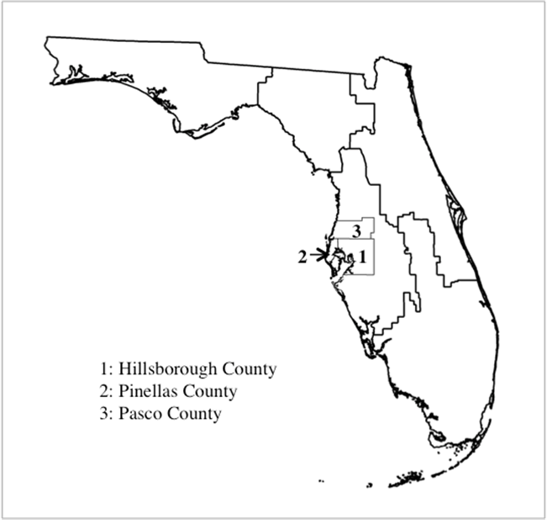
Spatial Boundary
Temporal Boundary
Model Testing
Pasco County
1980
2010
2080
Scenario
Evaluation
Pinellas County
Hillsborough County
Notes:
The study area is Tampa Bay region, included Hillsborough county, Pinellas county, and Pasco county
Previous studies 10~100. The system boundary also includes temporal boundary. This study considers a 100 year time span with a monthly step. The first 30 years are used for model testing and the next 70 years are used for scenario evaluation

Slide 5
Causal-loop Diagram of Water Demand
Notes:
The positive sign represents the reinforcing causality and the negative sign represents the balancing causality. The two-line bar in the middle of the link represents time delay. Orange variables are the water demand options and red variable is the system output .

Slide 6
Causal-loop Diagram of Water Supply
Notes:
Green variables are the water supply options, red variable are system output, pink variables are related to water quality.

Slide 7
Model Testing
Variable | Average |  | RMSE¹ | Inequality Statistics
 | Observed | Simulated |  | U^{M} | U^{S} | U^{C}
Surface Water Level (Feet) | 21.6 | 21.7 | 0.2% | 0.02 | 0.47 | 0.28
Municipal Water Withdrawal (MDG) | 135.0 | 132.7 | 1.4% | 0.02 | 0.00 | 0.53
Agricultural Water Withdrawal (MGD) | 79.0 | 82.7 | 5.3% | 0.04 | 0.21 | 0.40
Energy Supply (Trillion Btu/Year) | 39.9 | 31.8 | 4.1% | 0.88 | 0.10 | 0.01
Surface Water Level (Feet) | 21.6 | 21.7 | 0.2% | 0.02 | 0.47 | 0.28
¹ Root mean square error

Slide 8
Model Testing
Variable | Average |  | RMSE¹ | Inequality Statistics
 | Observed | Simulated |  | U^{M} | U^{S} | U^{C}
Surface Water Level (Feet) | 21.6 | 21.7 | 0.2% | 0.02 | 0.47 | 0.28
Municipal Water Withdrawal (MDG) | 135.0 | 132.7 | 1.4% | 0.02 | 0.00 | 0.53
Agricultural Water Withdrawal (MGD) | 79.0 | 82.7 | 5.3% | 0.04 | 0.21 | 0.40
Energy Supply (Trillion Btu/Year) | 39.9 | 31.8 | 4.1% | 0.88 | 0.10 | 0.01
¹ Root mean square error

Slide 9
Features of Current Model
Incorporate alternative water supplies
Consider sectoral water demand including water demand in energy sector
Incorporate water quality and energy consumption associated with different water supply options
Can investigate different demand and supply options
Facilitate stakeholder engagement via graphical output and user interaction

Slide 10
Model Improvement in CNH Proposal
Employing a more accurate representation of precipitation
Considering water allocation between different users under shortages
Investigating the water use and supply under climate change
Test the hypotheses regarding water source switching through scenario analysis

