Slide 1
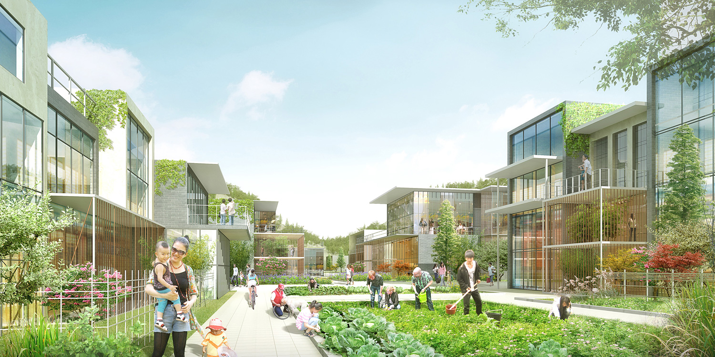
Human System
Are there built environment typologies that correlate with population characteristics?
Built environment: Housing density, percent green space, commercial and residential land use mixture…
Demographics: Race/ethnicity, age, income, education…
Knowing this allows us to project how demographic shifts might be accompanied by changes in built environment forms

Slide 2
Human System
How does demand for water vary by population characteristics?
Knowing this allows us to project how demographic shifts might be accompanied by changing demands

Slide 3
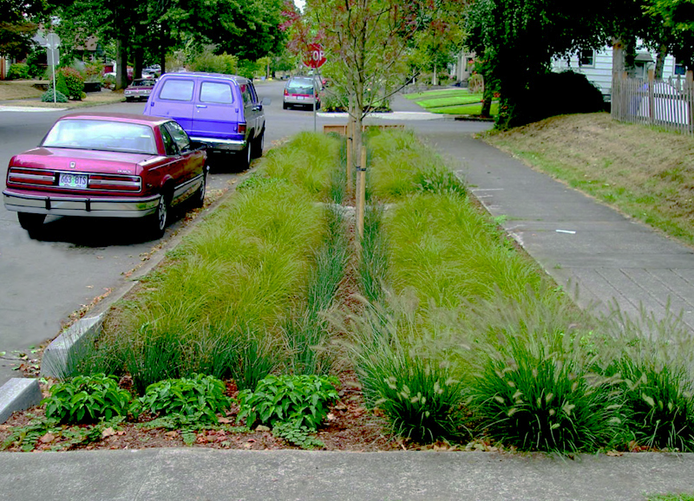
Human System on Natural System
How do characteristics of the built environment influence water quality and quantity?
Built environment: % area impermeable surface, ratio of impermeable surface per resident…
Impermeable surfaces increase runoff/decrease permeation and groundwater recharge, increase the toxicity of runoff…
One remedy are built environment forms that conserve land cover and include green infrastructure

