Slide 1
Whither are the thresholds of the Florida Urban Water System in a Future World

Slide 2
Overarching hypothesis
In a changing and varying climate, the Florida urban water supply and demand system is accelerating to reach thresholds of demand exceeding supply if the supply system remains unchanged under rapidly increasing population and changing demography.
Ancillary hypothesis: At the aggregate level (management district level) climate variability and change may be the drivers for reaching thresholds faster. But at finer scales (Public water utility level) demography may be the drivers for reaching the thresholds faster. So in ignoring the changing climate at the WMD level, the urban water supply and demand system is being put in further strain.

Slide 3
FUTURE world (SLR, wet season length decrease, Temperature warming, variance?) ➔ alternative sources, water pricing
Natural System in CURRENT world (Surface and ground water hydrology)
Seasonality
Variance of weather and climate (droughts, flooding, landfalling TCs)
SLR
Human System (Water supply and demand system)
Demography and water use (indoor and outdoor use; water pricing)
Water demand for in-stream water use (tourism)
Coastal development [built environment and population]-more vulnerable
Water suppliers’ perspective: investment in alternative water supply sources
Built environment changes➔ water quality, runoff, Meteorology

Slide 4
Temperature is affected by land cover and land use

Slide 5
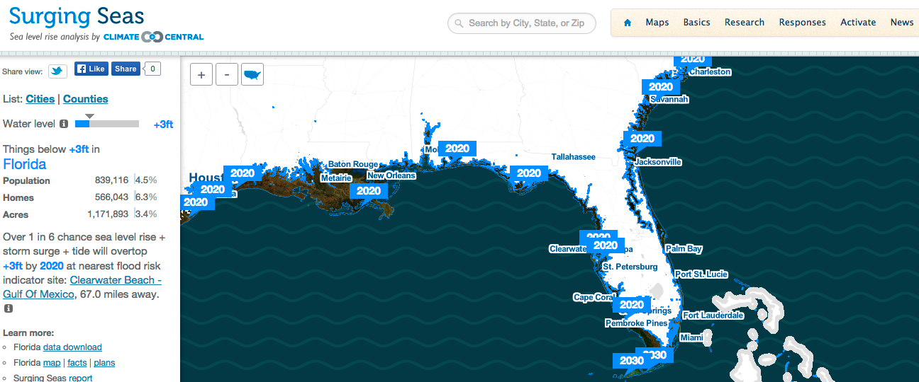
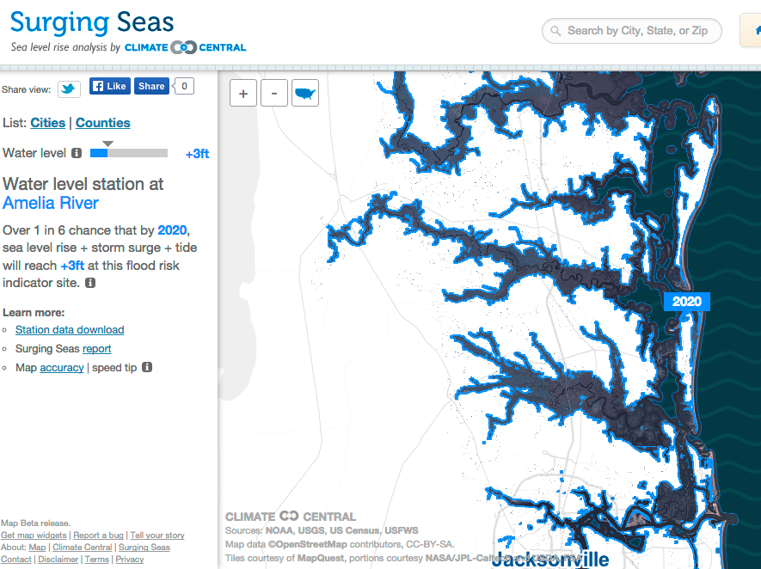
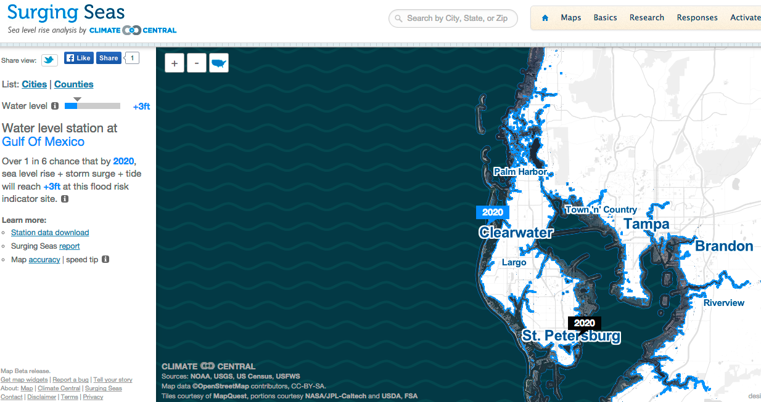
The impact of 3ft sea level rise

Slide 6
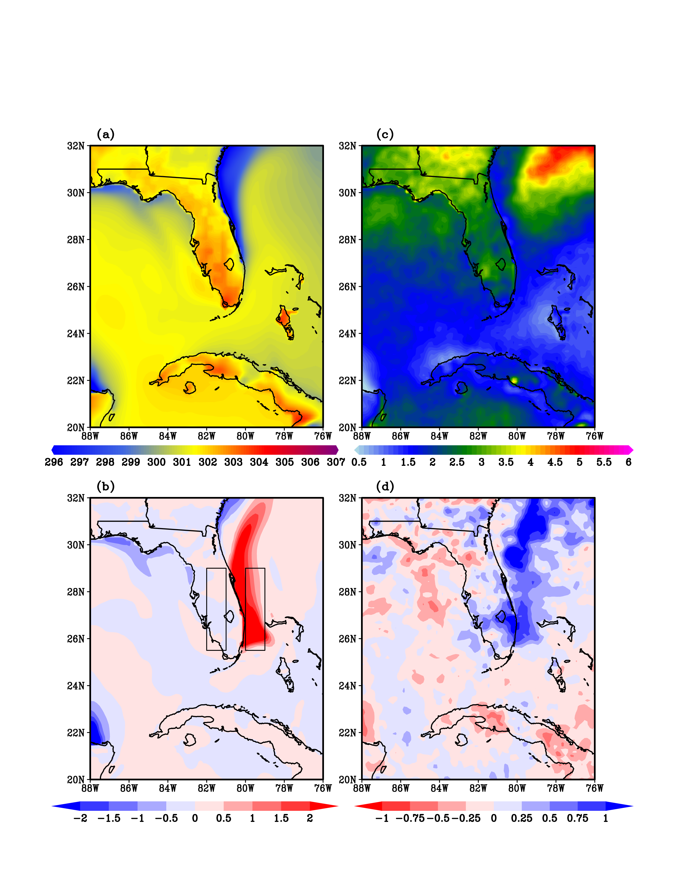
Sea surface temp.
Rainfall
The impact of strength and position of Gulf Stream: When Gulf Stream stronger and closer to coast, there is more rain in peninsular Florida.

Slide 7
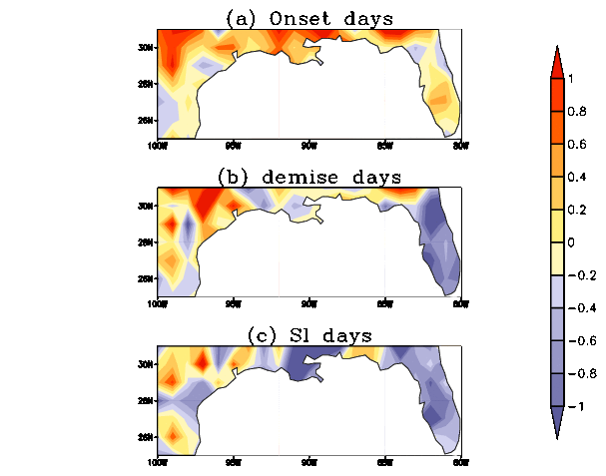
Length of the wet season on an average is reducing by about 0.25 days/year in the last 60 years of data.

Slide 8
Climate Drivers

Slide 9
Investigations
What does “business as usual practice” in water supply and demand at utility and WMD level do in current climate with growing and static population?
Same as above but in a future climate?
Where are the uncertainties buried in drawing conclusions –Natural system, Human system, feedback loops?

