Slide 1


Impact of Power Extraction on the Florida Current/Gulf Stream System:
New Results
Alexandra Bozec¹, Eric Chassignet¹, Howard P. Hanson²
1 Center for Ocean-Atmospheric Prediction Studies, Tallahassee, FL
2 Center for Ocean Energy Technology, Florida Atlantic University, Dania Beach, FL, USA

Slide 2
Objectives of the Project
to assess the power availability in the Florida Current in the Fort Lauderdale region.
to assess the impact of turbines on the Florida Current/Gulf Stream system

Slide 3
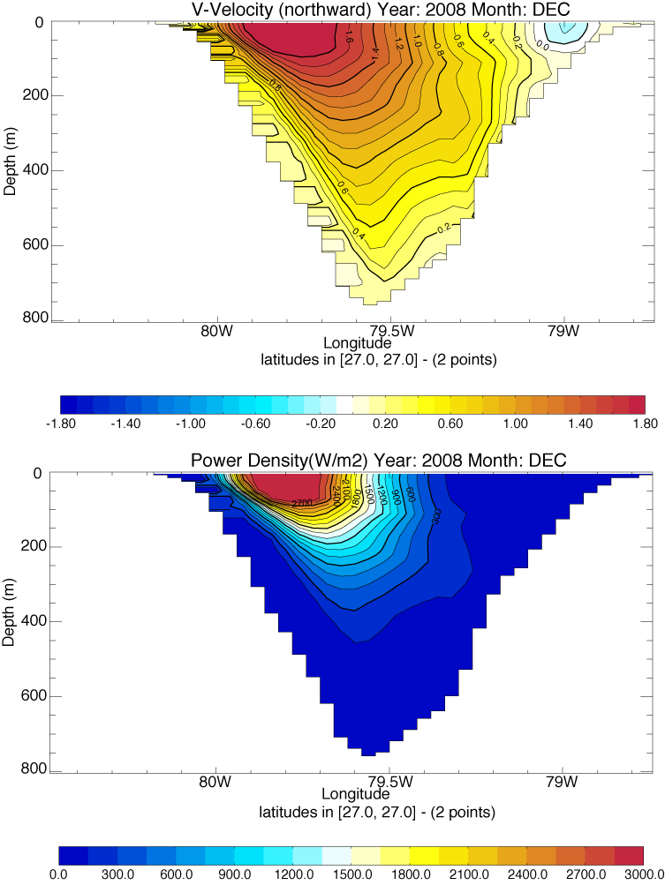
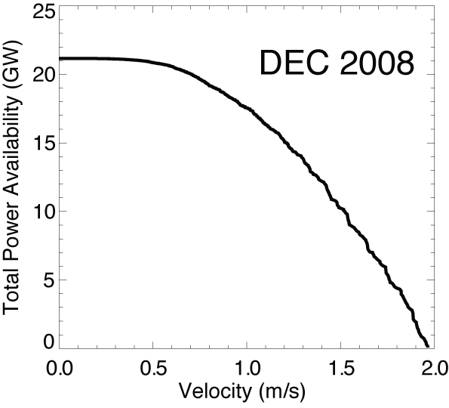
Total Power Availability (GW)
Power Density (W/m²):
Total Power Availability (GW):
10.8 GW
available
18 GW
available
6 GW
available
10 GW
available
Best efficiency :
Only ~ 60% of the energy can be captured
1GW = 10⁹ W ≈ 1 Nuclear Power Plant
or
Rotor minimum Operating Speed

Slide 4
Tools
to assess the power availability in the Florida Current
  Global 1/12º resolution (~8 km) assimilated simulations of the HYbrid Coordinates Ocean Model (HYCOM)
  (Hanson et al., 2011, EOS Trans. AGU, 92(4), 29-30.)
to assess the impact of turbines on the Florida Current/Gulf Stream system (circulation, transport, power and energy)
  Atlantic Ocean 1/12º resolution HYCOM simulations (no assimilation)

Slide 5
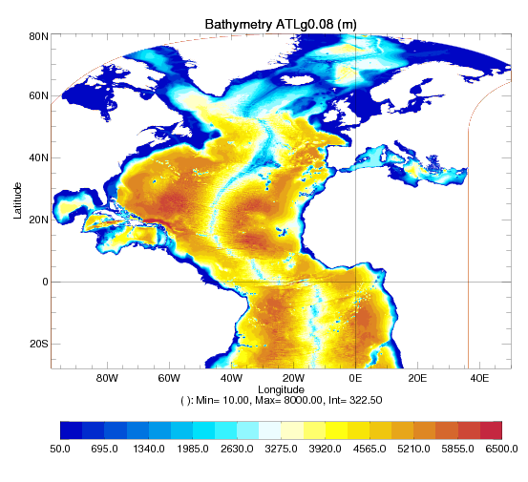
Atlantic Ocean Configuration
Atlantic configuration of HYCOM (ATLg0.08):
1/12º horizontal resolution (~7-8km)
32 hybrid layers
Climatological initial conditions
(T,S) from GDEM3
Climatological atmospheric forcing
from ERA40
Start from a 10 year spin-up
(Courtesy of X. Xu)

Slide 6
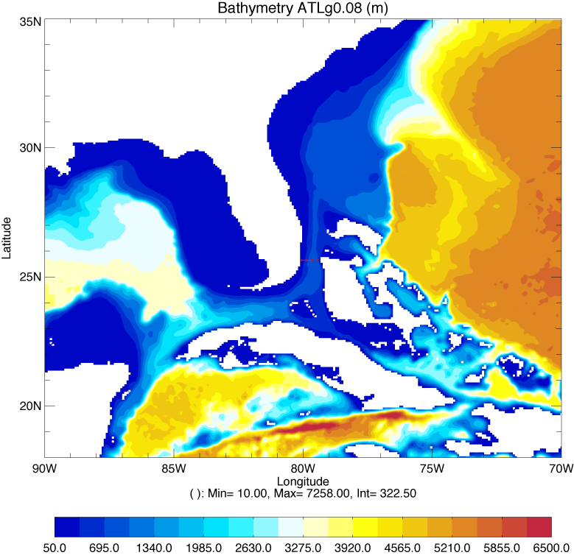
Experimental Set-up
  Turbine parameterized as a drag :
  with C_{T}=0.1
4 Simulations of 3 years :
  control simulation (CONTROL)
  4 turbines at 25.7ºN (TURB_C_{T}=0.1)
  12 turbines across the 25.7ºN section (TURB_C_{T}=0.1_WALL1)
  wall of turbines across the 25.7ºN section over 12 layers (TURB_C_{T}=0.1_WALL12)

Slide 7
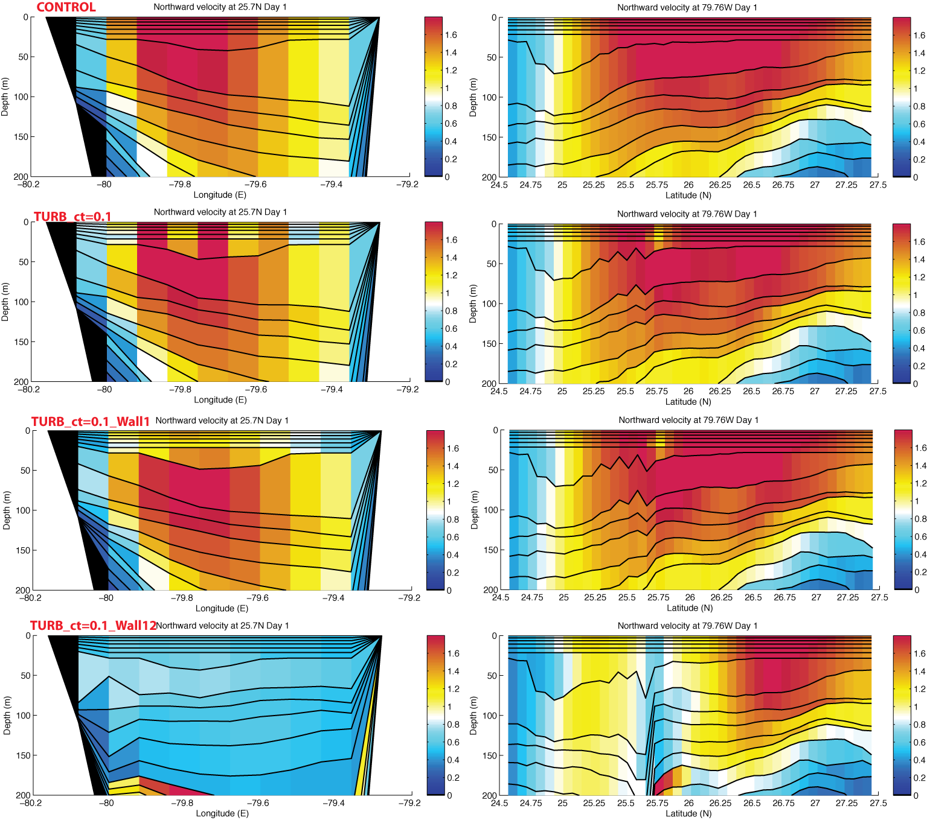
Impact of the turbines at 25.7ºN
W
E
S
N
W
E
S
N
W
E
S
N
W
E
S
N

Slide 8
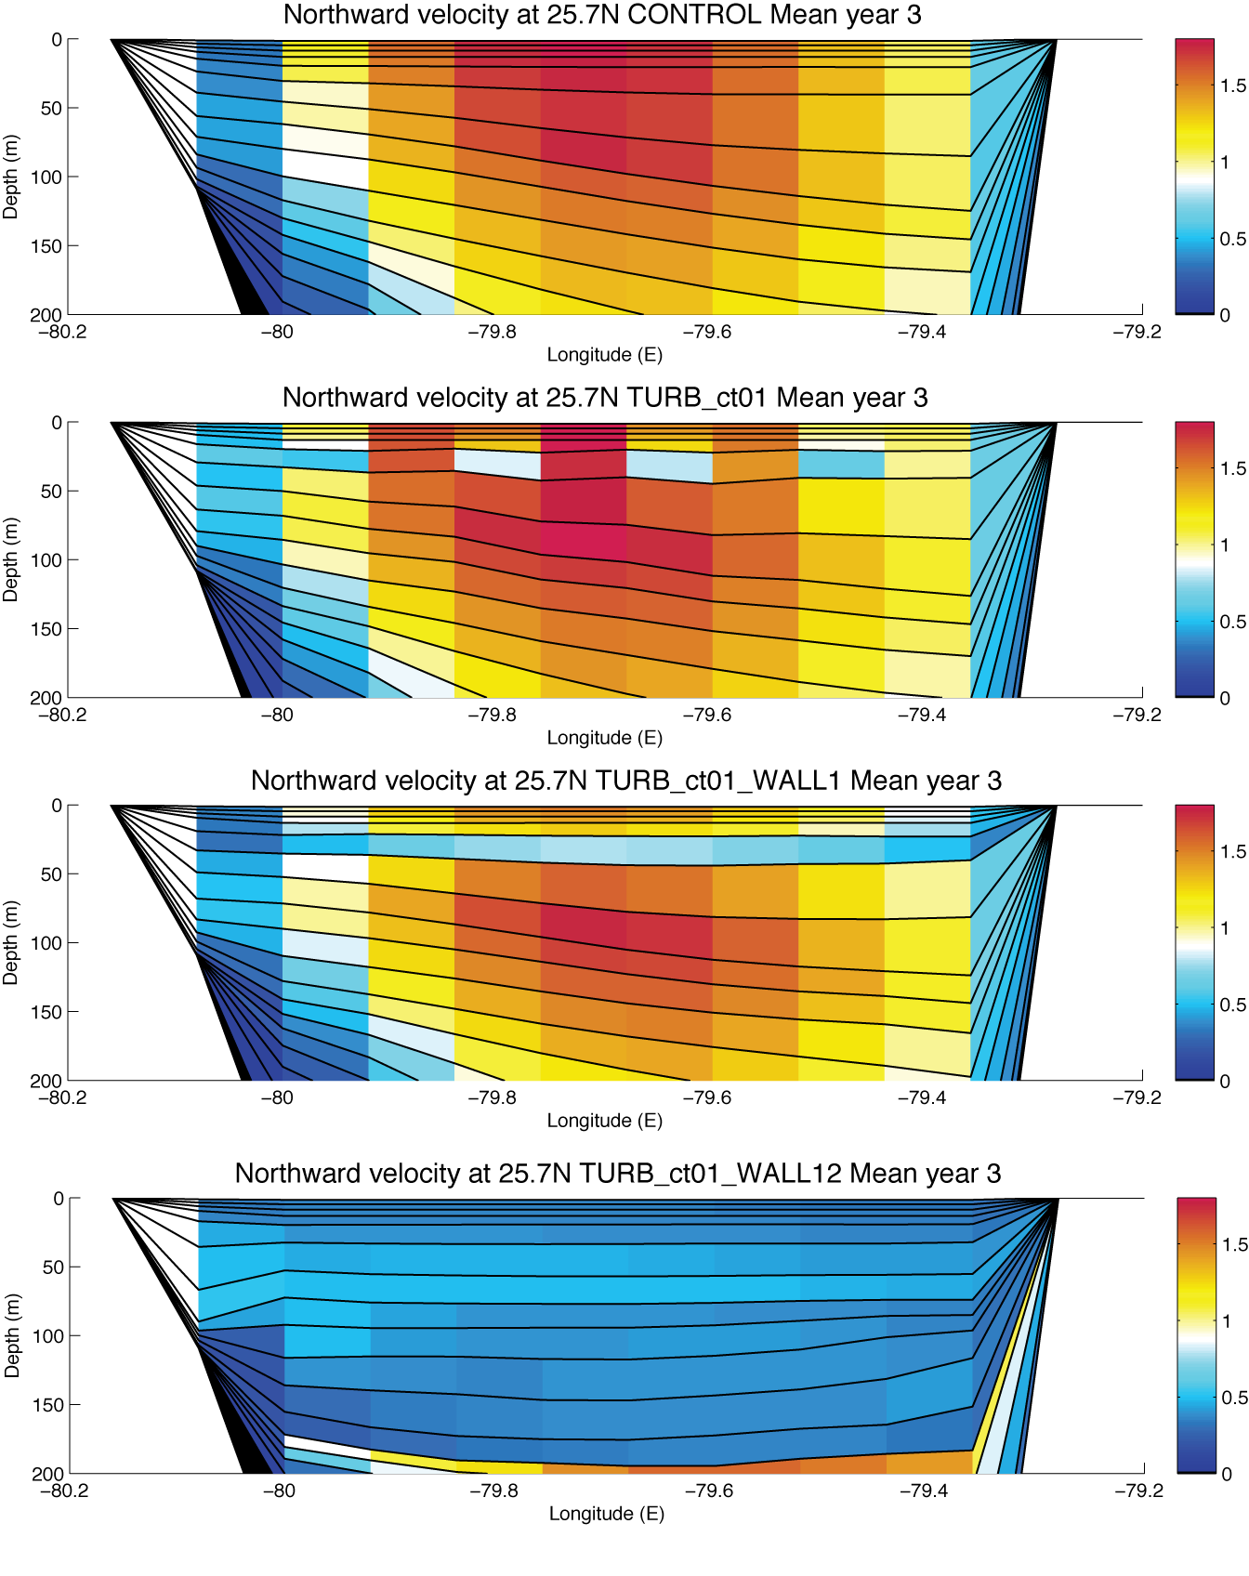
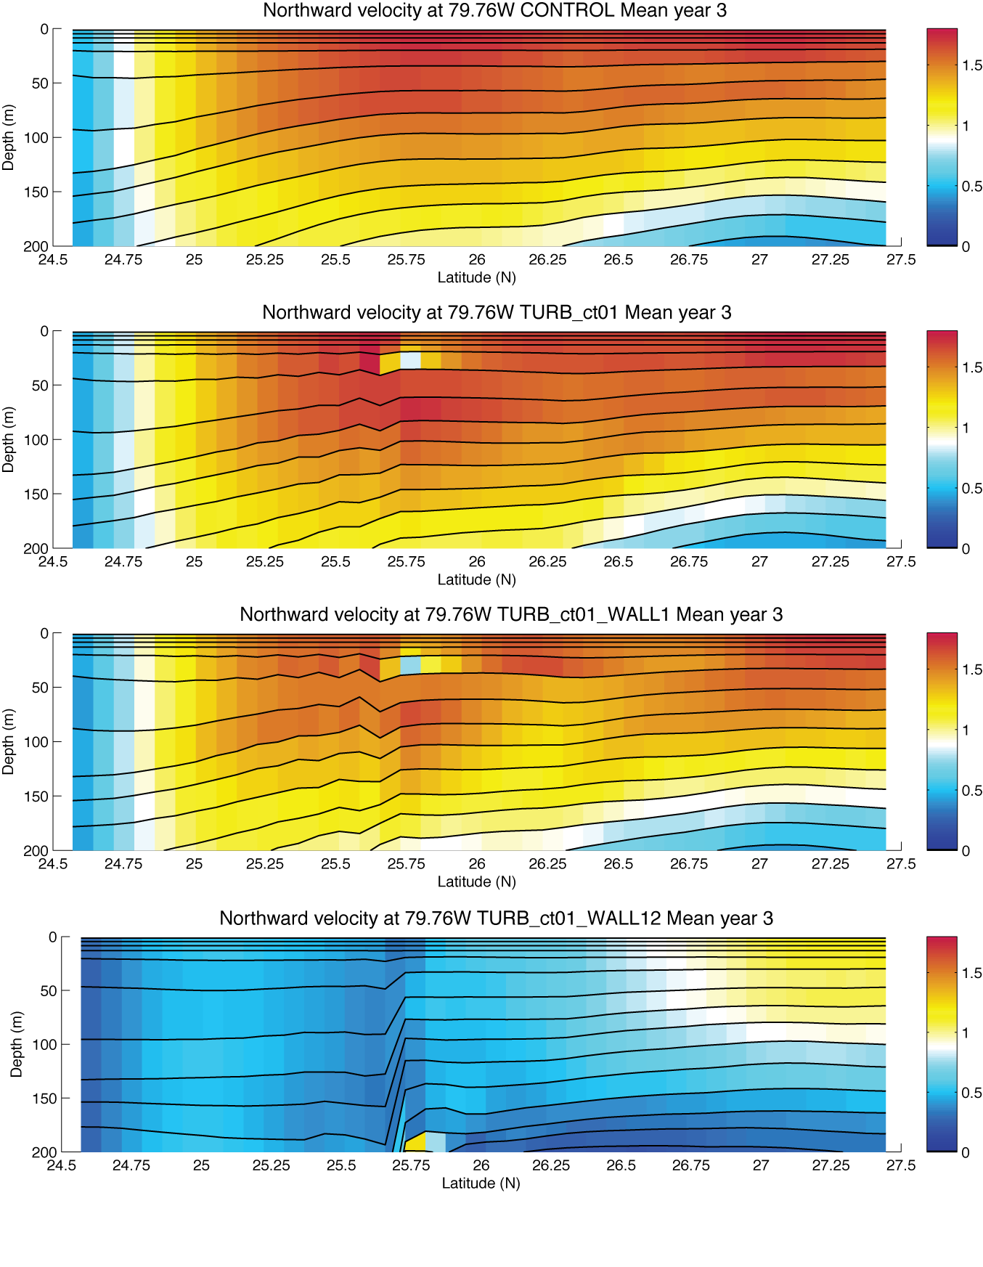
Impact of the turbines at 25.7ºN
W
E
S
N
Mean Northward Velocity year 3
W
E
S
N
W
E
S
N
W
E
S
N

Slide 9
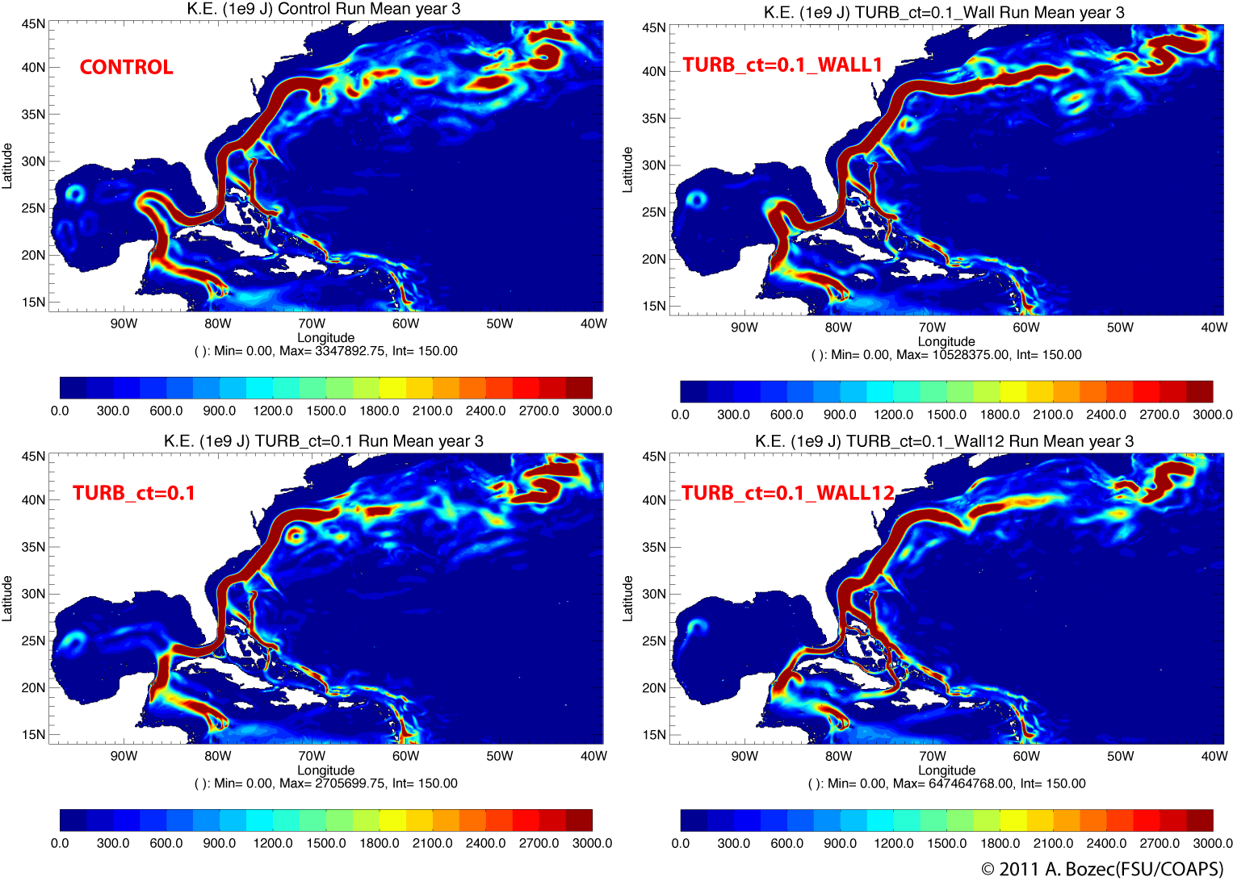
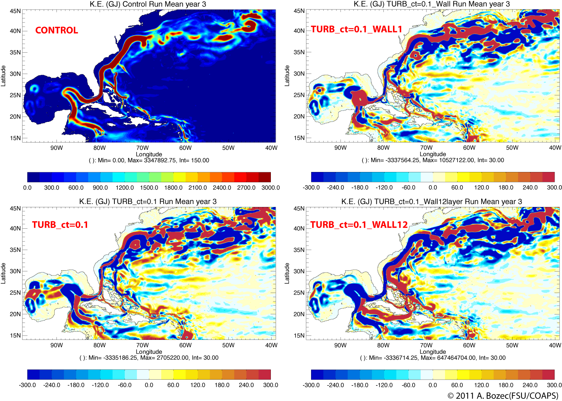
Impact on the Circulation

Slide 10

Impact on Transports
29ºN
Yucatan
25.7ºN
Haiti
80.9ºW
78.6ºW

Slide 11
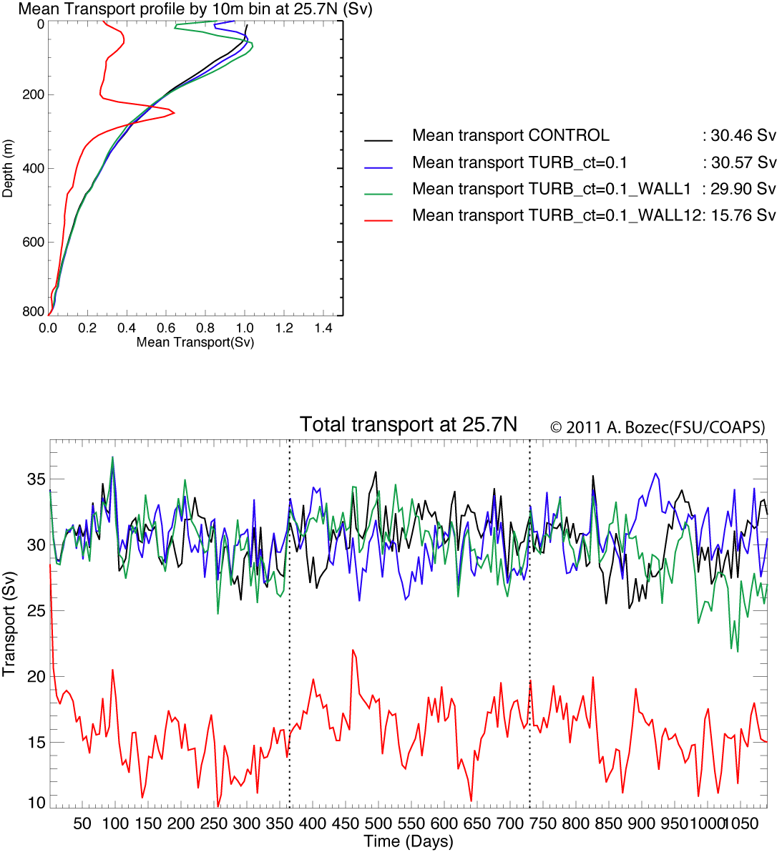
Transport at 25.7ºN
The total mean transport is roughly the same between CONTROL and TURB_C_{T}=0.1/TURB_C_{T}=0.1_WALL1
  Compensation between the surface and the deeper transport
TURB_C_{T}=0.1_WALL12 transport is half the CONTROL one

Slide 12
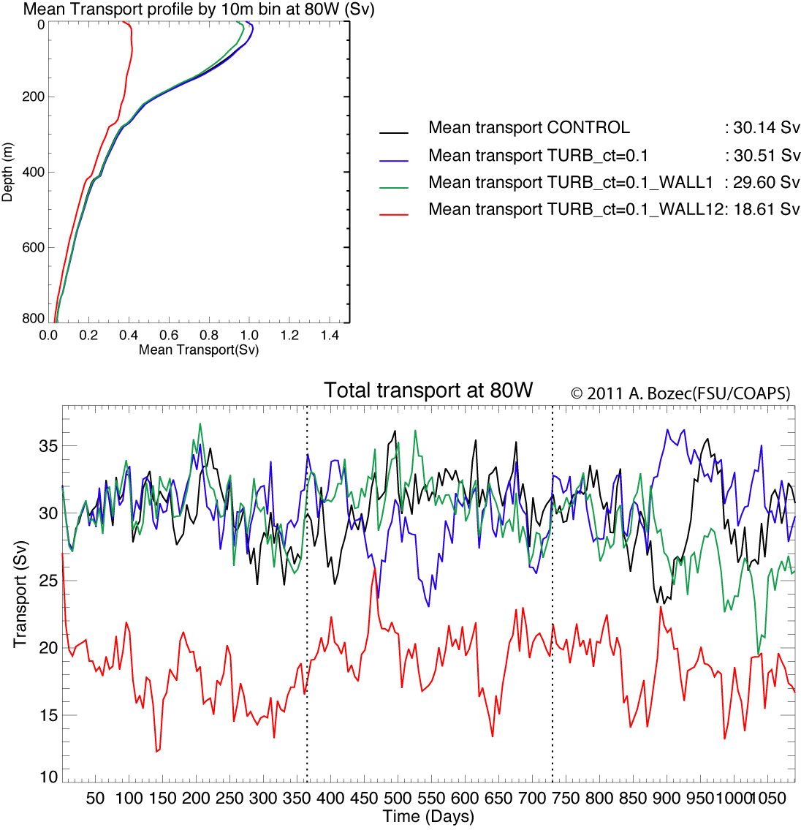
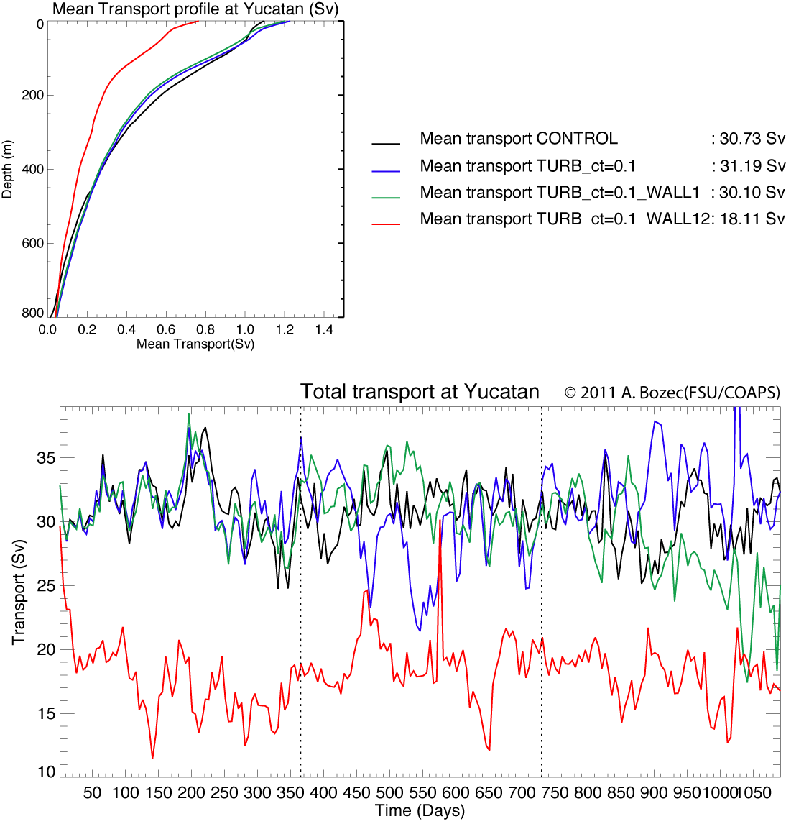
Upstream Transports
The total mean transport is roughly the same between CONTROL and TURB_C_{T}=0.1/TURB_C_{T}=0.1_WALL1
TURB_C_{T}=0.1_WALL12 transport is MORE than a half the CONTROL one

Slide 13
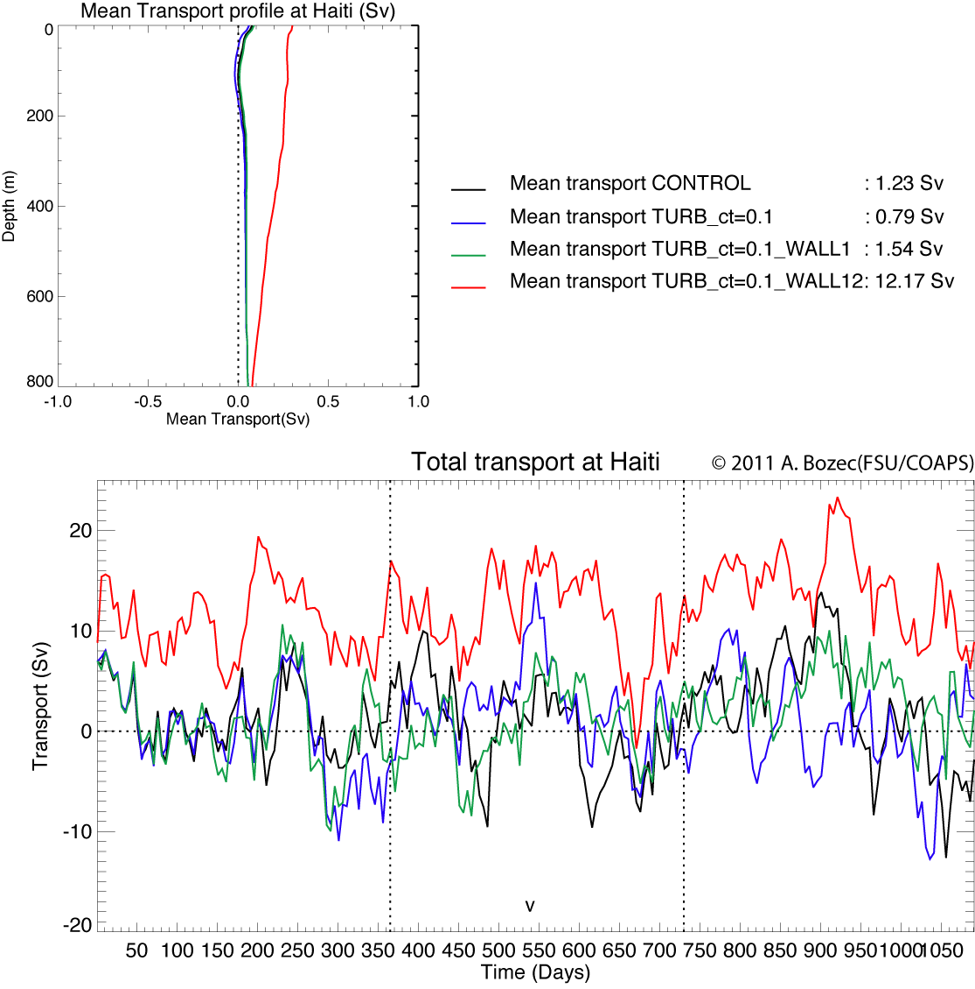
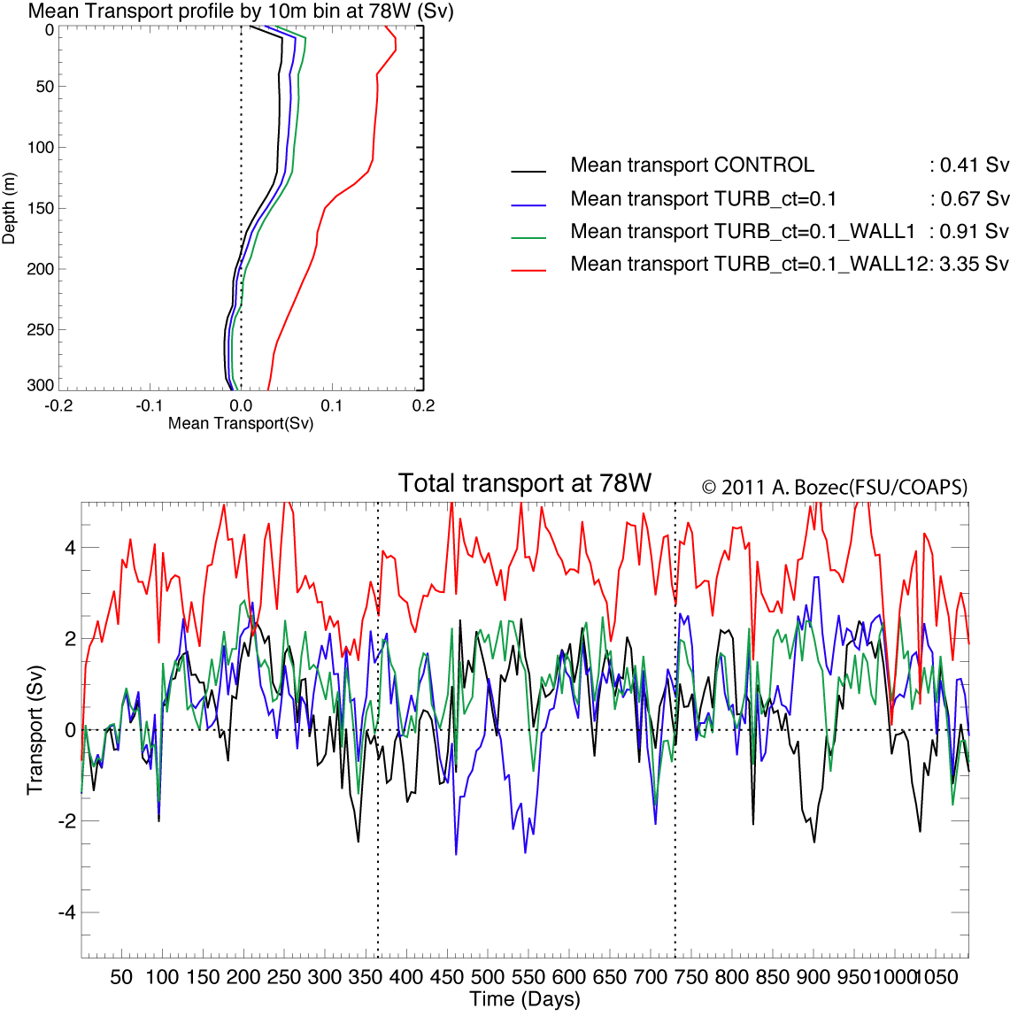
Detoured Transports
A transport of ~3 Sv detoured at 78W and ~12Sv between Haiti and Cuba.

Slide 14
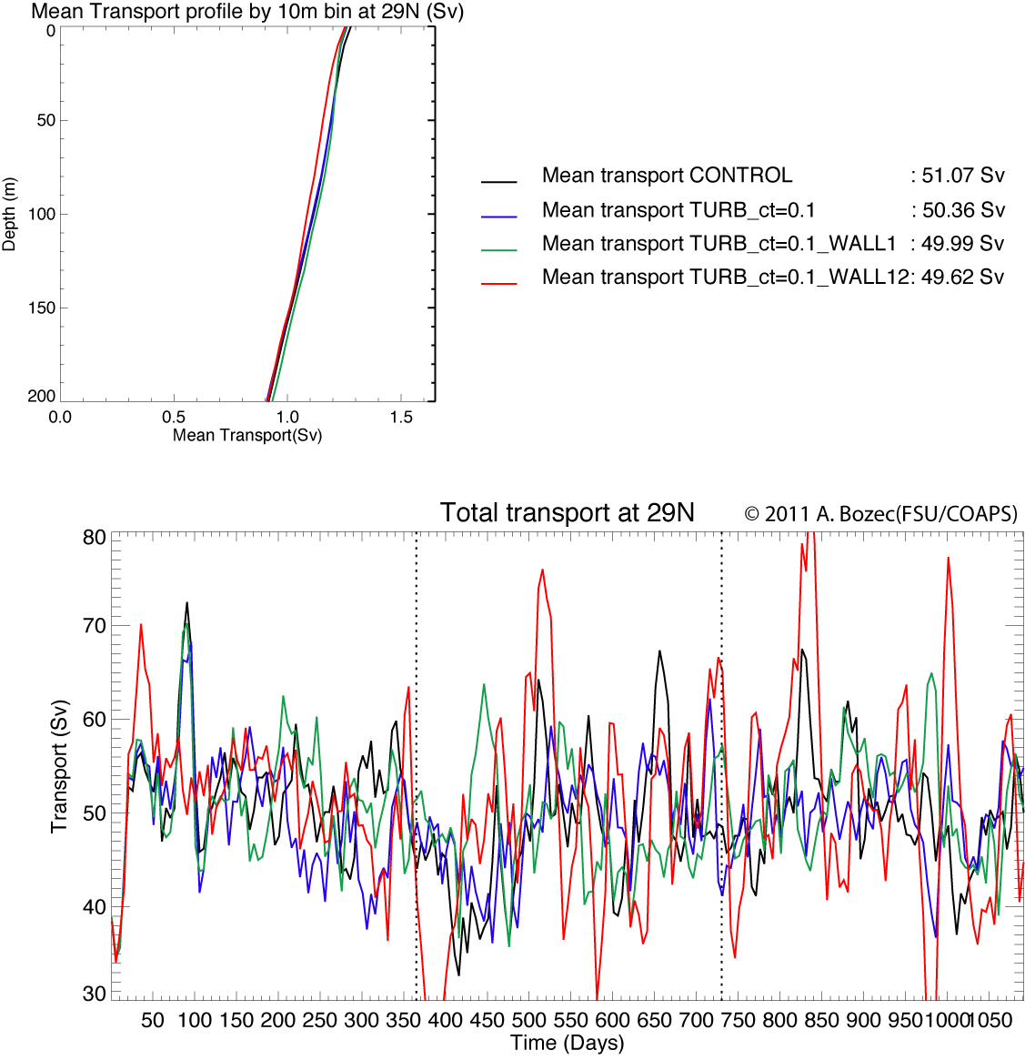
Downstream Transport
The total mean transport is roughly the same between CONTROL and ALL turbines simulations

Slide 15
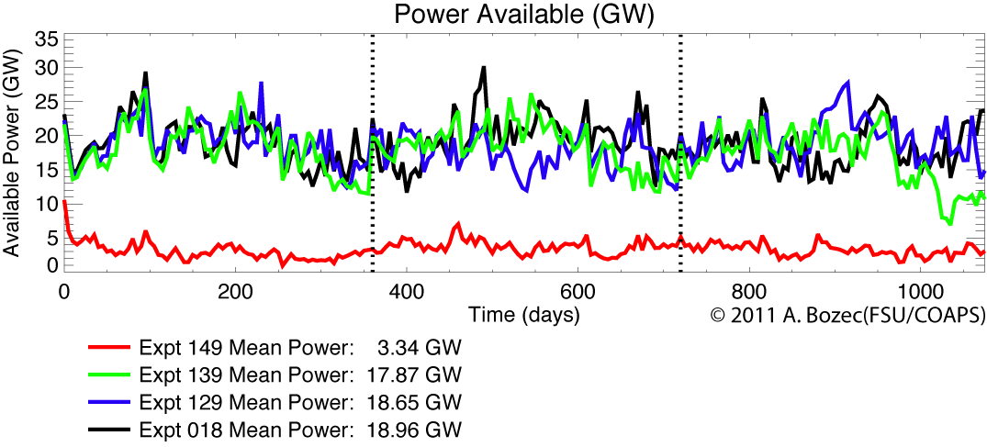
Impact on Power Availability
Power Availability:
TURB_C_{T}=0.1_WALL12
TURB_C_{T}=0.1_WALL1
TURB_C_{T}=0.1
CONTROL

Slide 16
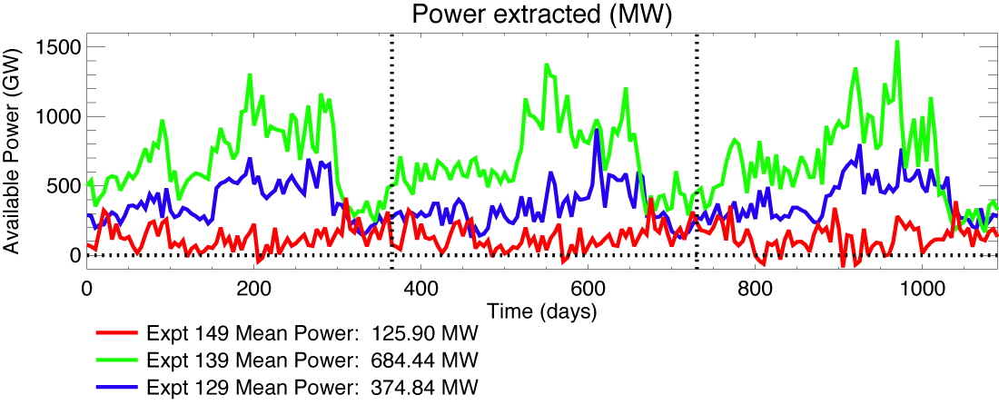
Power Extraction Estimate
Power Estimate : Sum of the difference of Kinetic Energy Fluxes between the point before and after the turbines
Grid Cells
Grid Cells
TURB_C_{T}=0.1_WALL12
TURB_C_{T}=0.1_WALL1
TURB_C_{T}=0.1

Slide 17
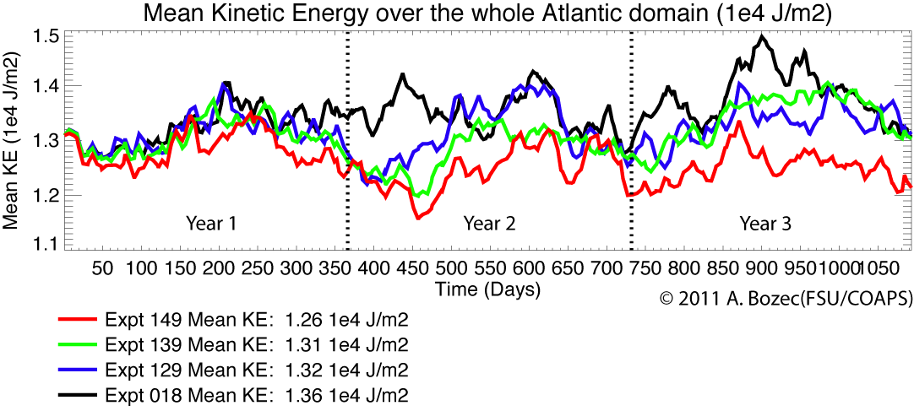
Mean Kinetic Energy
TURB_C_{T}=0.1_WALL12
TURB_C_{T}=0.1_WALL1
TURB_C_{T}=0.1
CONTROL

Slide 18
Summary
3 cases with different distribution of “turbines” in the Florida Current:
  2 “reasonable” cases with 4 “turbines” and 12 “turbines”
    Flow decelerated at the surface but compensated at depth
    Circulation and transports remain similar to observations
    Kinetic Energy over the basin is slightly decreased
    350-700 MW of power extracted for a power availability of ~20GW as in the observations
  1 “extreme” case with turbines over the first 180m of the 25.7ºN section
    Flow strongly decelerated without compensation at depth
    Transports at half the observations at 25.7ºN and upstream
    Detour of the flow of about 3Sv at 78W and 12Sv between Cuba and Haiti
    No change of the transport at 29ºN
    Kinetic Energy over the basin is decreased
    160MW of power extracted for a power availability of ~3.4GW
Future Work:
=> Focus on the Gulf Stream region
=> Focus on the Gulf of Mexico

